Slide 1
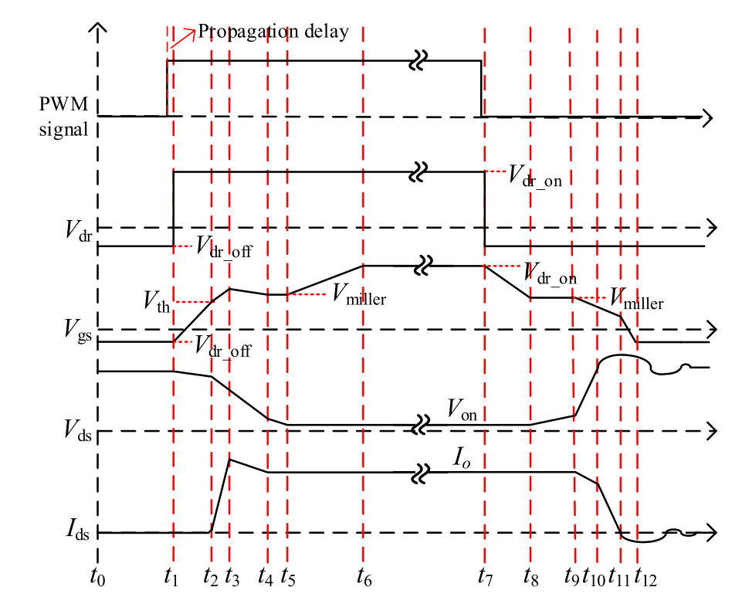
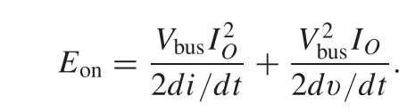
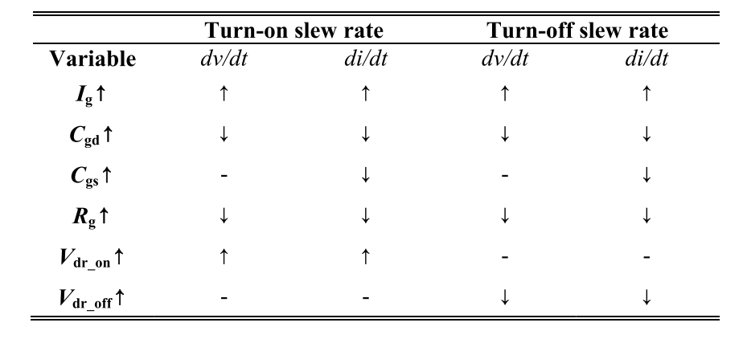
The switching energy loss can be roughly evaluated with the following equation (without zero current component):
A Review of Switching Slew Rate Control for Silicon Carbide Devices Using Active Gate Drivers.
Analytical Loss Model for Three-Phase 1200V SiC MOSFET Inverter Drive System Utilizing Miller Capacitor-Based dv/dt-Limitation

Slide 2
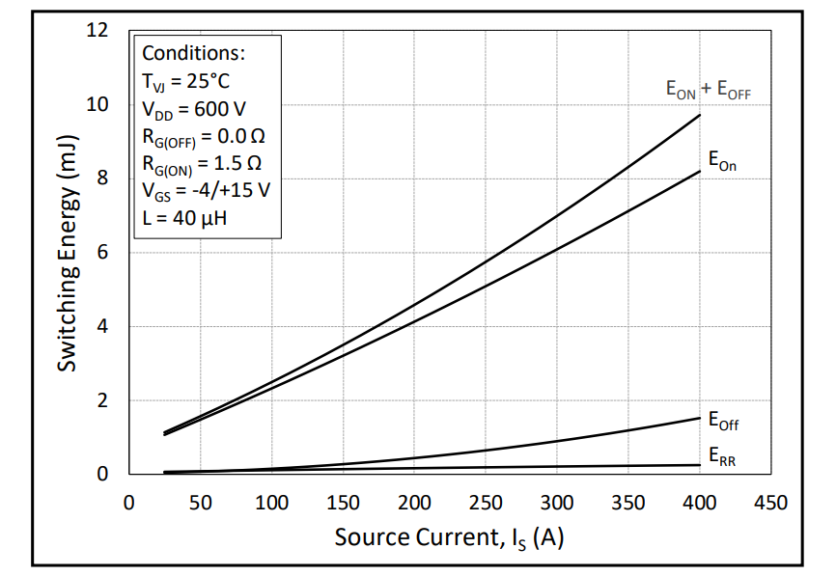
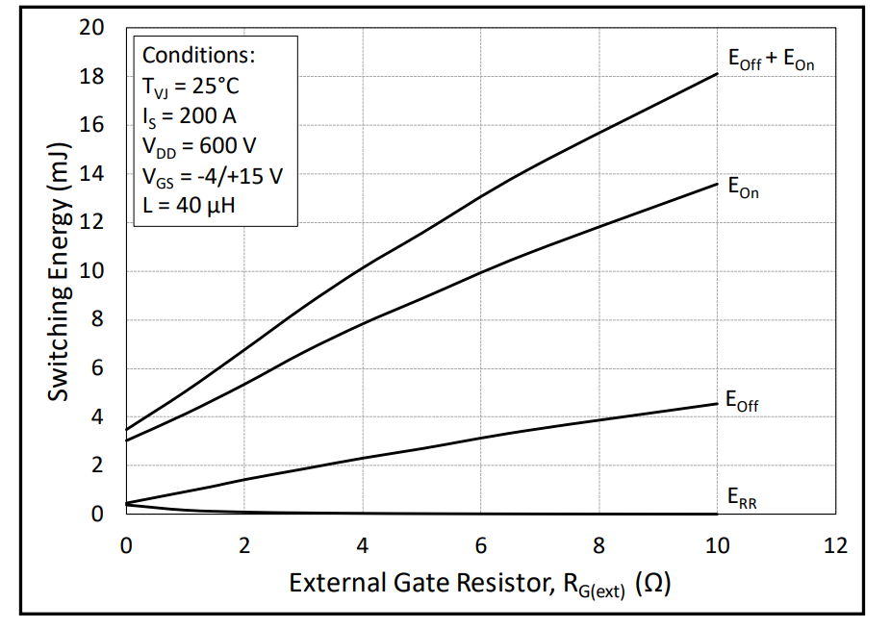
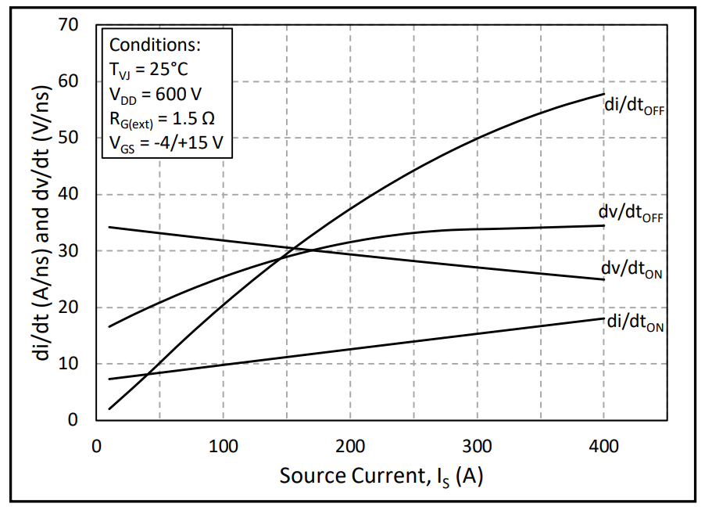
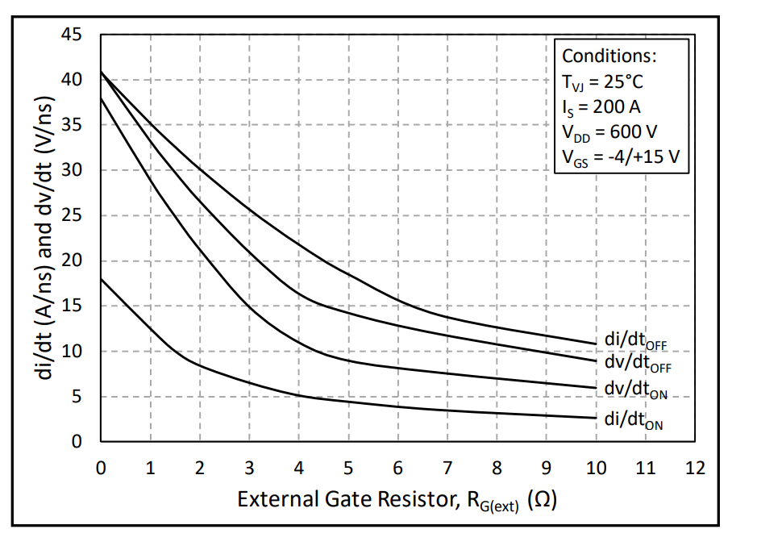
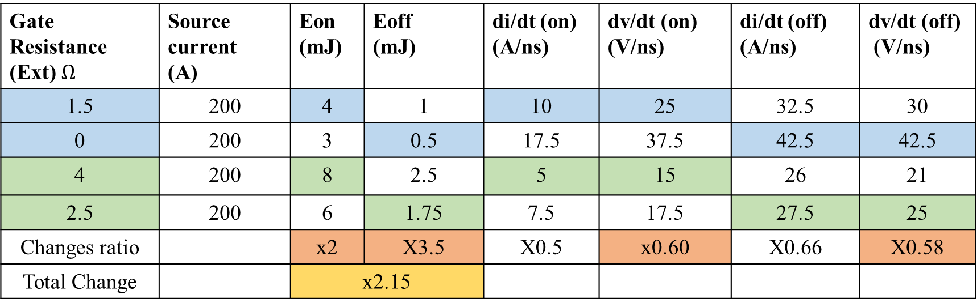
Effect of dv/dt
https://eu.mouser.com/datasheet/2/90/CAB006A12GM3-2886938.pdf
Gate Resistance (Ext) $Ω$ | Source current (A) | Eon (mJ) | Eoff (mJ) | di/dt (on) (A/ns) | dv/dt (on) (V/ns) | di/dt (off) (A/ns) | dv/dt (off) (V/ns)
1.5 | 200 | 4 | 1 | 10 | 25 | 32.5 | 30
0 | 200 | 3 | 0.5 | 17.5 | 37.5 | 42.5 | 42.5
4 | 200 | 8 | 2.5 | 5 | 15 | 26 | 21
2.5 | 200 | 6 | 1.75 | 7.5 | 17.5 | 27.5 | 25
Changes ratio |  | x2 | X3.5 | X0.5 | x0.60 | X0.66 | X0.58
Total Change |  | x2.15

Slide 3
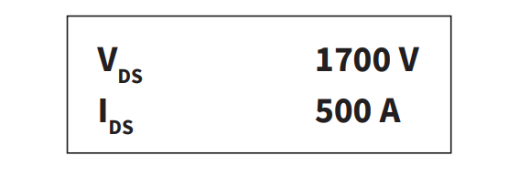
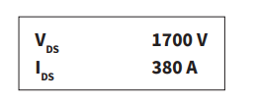
CAB500M17HM3-3ph
CAS380M17HM3-3ph

Slide 4
CAS380M17HM3-3ph
CAS380M17HM3-6ph

Slide 5
