Slide 1
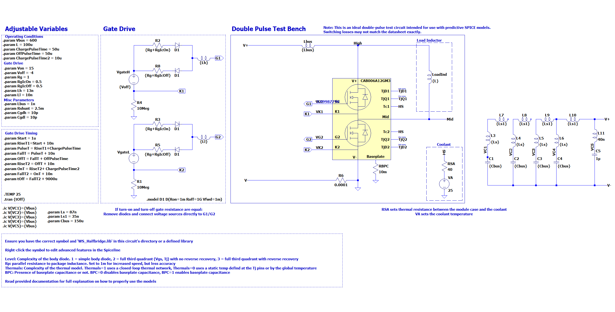

Slide 2
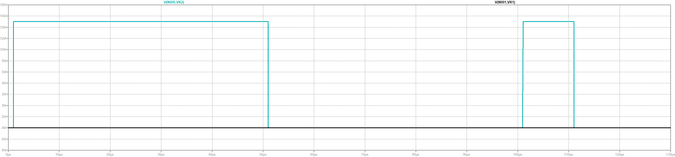
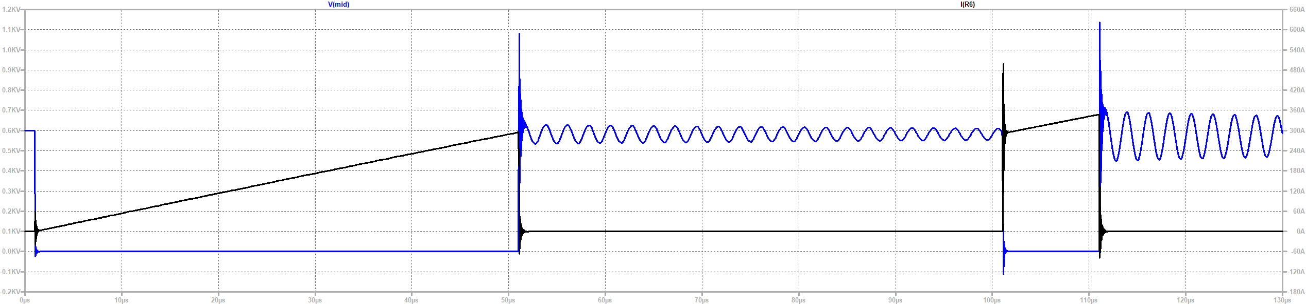

Slide 3
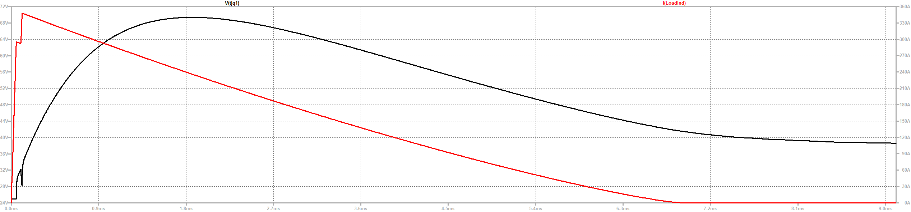

Slide 4
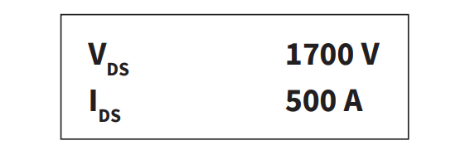
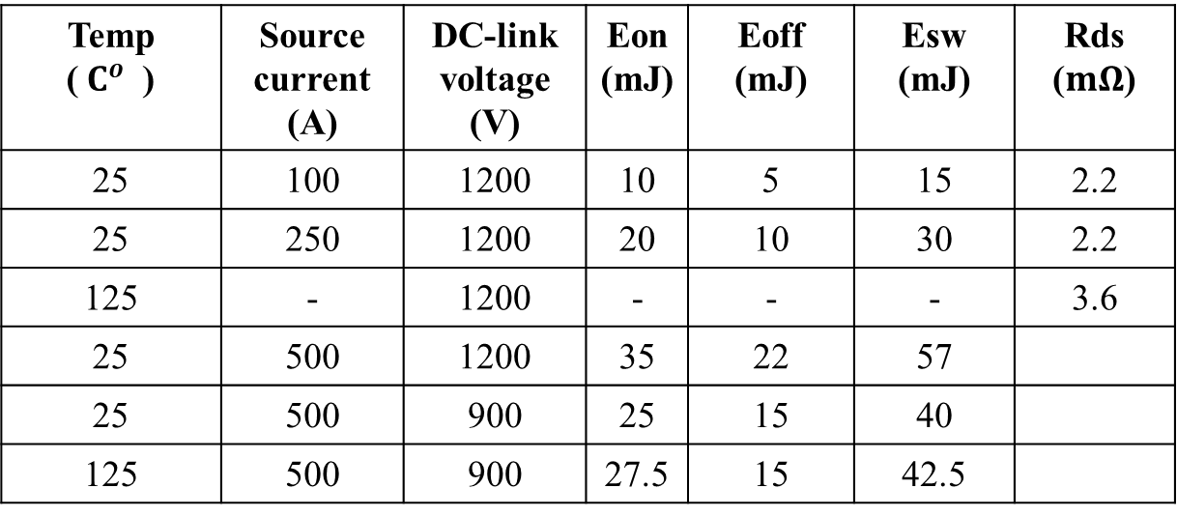
CAB500M17HM3
Temp ($C^{o}$) | Source current (A) | DC-link voltage (V) | Eon (mJ) | Eoff (mJ) | Esw (mJ) | Rds ($mΩ$)
25 | 100 | 1200 | 10 | 5 | 15 | 2.2
25 | 250 | 1200 | 20 | 10 | 30 | 2.2
125 | - | 1200 | - | - | - | 3.6
25 | 500 | 1200 | 35 | 22 | 57
25 | 500 | 900 | 25 | 15 | 40
125 | 500 | 900 | 27.5 | 15 | 42.5

Slide 5
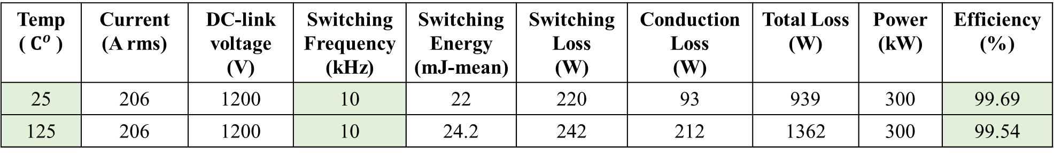
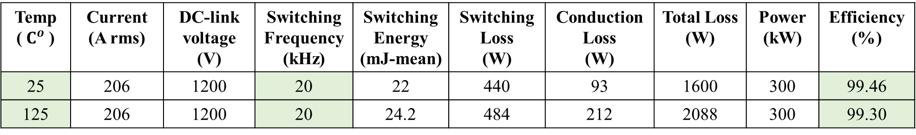
Basic Calculations
m=1.27 and p.f=0.9
Temp ($C^{o}$) | Current (A rms) | DC-link voltage (V) | Switching Frequency (kHz) | Switching Energy (mJ-mean) | Switching Loss (W) | Conduction Loss (W) | Total Loss (W) | Power (kW) | Efficiency (%)
25 | 206 | 1200 | 10 | 22 | 220 | 93 | 939 | 300 | 99.69
125 | 206 | 1200 | 10 | 24.2 | 242 | 212 | 1362 | 300 | 99.54
Temp ($C^{o}$) | Current (A rms) | DC-link voltage (V) | Switching Frequency (kHz) | Switching Energy (mJ-mean) | Switching Loss (W) | Conduction Loss (W) | Total Loss (W) | Power (kW) | Efficiency (%)
25 | 206 | 1200 | 20 | 22 | 440 | 93 | 1600 | 300 | 99.46
125 | 206 | 1200 | 20 | 24.2 | 484 | 212 | 2088 | 300 | 99.30

Slide 6
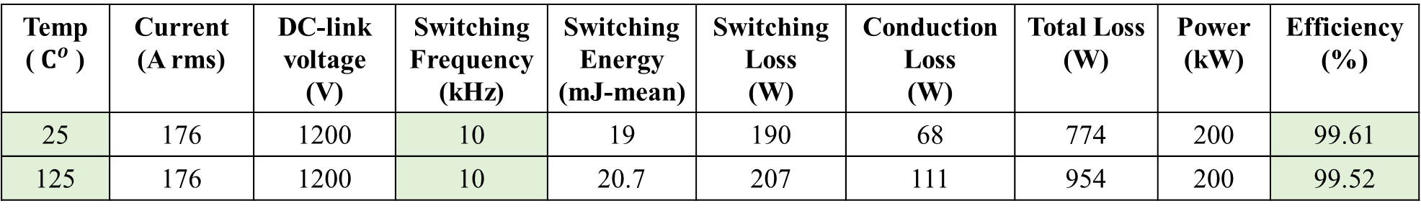
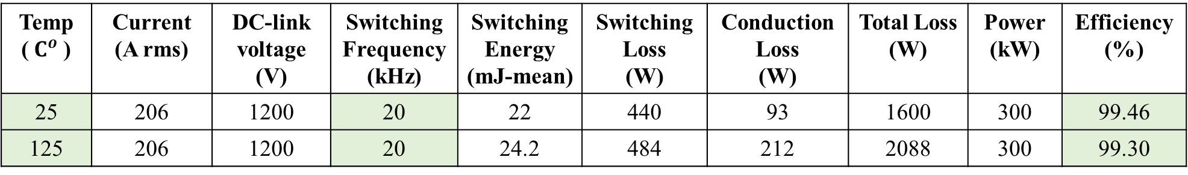

Basic Calculations
m=1 and p.f=0.9
Temp ($C^{o}$) | Current (A rms) | DC-link voltage (V) | Switching Frequency (kHz) | Switching Energy (mJ-mean) | Switching Loss (W) | Conduction Loss (W) | Total Loss (W) | Power (kW) | Efficiency (%)
25 | 176 | 1200 | 10 | 19 | 190 | 68 | 774 | 200 | 99.61
125 | 176 | 1200 | 10 | 20.7 | 207 | 111 | 954 | 200 | 99.52
m=1.27 and p.f=0.9
Temp ($C^{o}$) | Current (A rms) | DC-link voltage (V) | Switching Frequency (kHz) | Switching Energy (mJ-mean) | Switching Loss (W) | Conduction Loss (W) | Total Loss (W) | Power (kW) | Efficiency (%)
25 | 206 | 1200 | 10 | 22 | 220 | 93 | 939 | 300 | 99.69
125 | 206 | 1200 | 10 | 24.2 | 242 | 212 | 1362 | 300 | 99.54
Temp ($C^{o}$) | Current (A rms) | DC-link voltage (V) | Switching Frequency (kHz) | Switching Energy (mJ-mean) | Switching Loss (W) | Conduction Loss (W) | Total Loss (W) | Power (kW) | Efficiency (%)
25 | 206 | 1200 | 20 | 22 | 440 | 93 | 1600 | 300 | 99.46
125 | 206 | 1200 | 20 | 24.2 | 484 | 212 | 2088 | 300 | 99.30

Slide 7
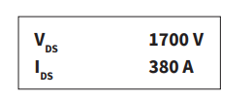
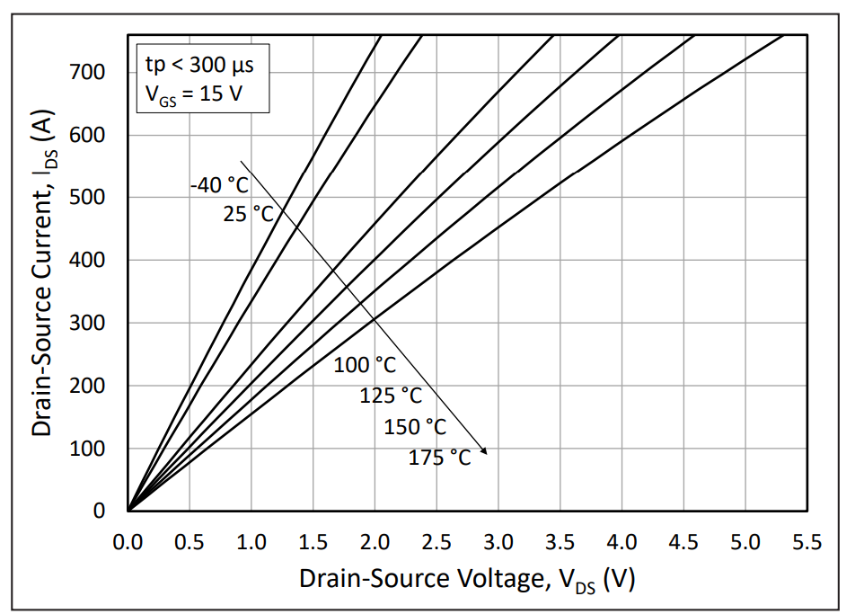
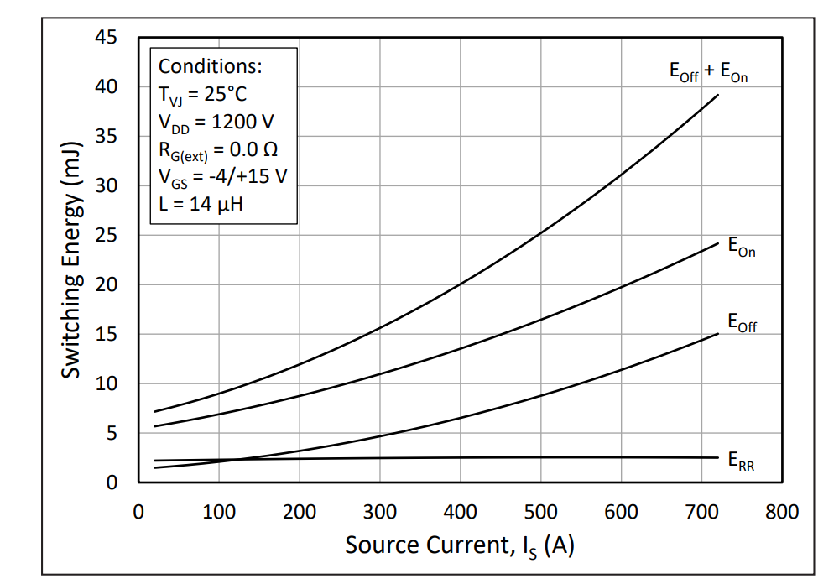
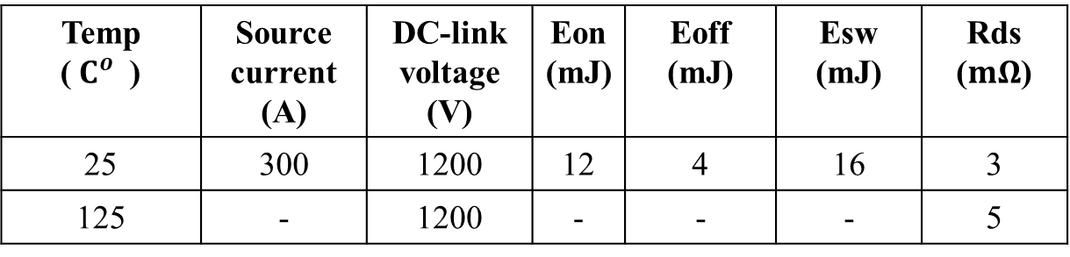
CAS380M17HM3
Temp ($C^{o}$) | Source current (A) | DC-link voltage (V) | Eon (mJ) | Eoff (mJ) | Esw (mJ) | Rds ($mΩ$)
25 | 300 | 1200 | 12 | 4 | 16 | 3
125 | - | 1200 | - | - | - | 5

Slide 8



Basic Calculations
m=1.27 and p.f=0.9
Temp ($C^{o}$) | Current (A rms) | DC-link voltage (V) | Switching Frequency (kHz) | Switching Energy (mJ-mean) | Switching Loss (W) | Conduction Loss (W) | Total Loss (W) | Power (kW) | Efficiency (%)
25 | 206 | 1200 | 10 | 10.2 | 102 | 127 | 687 | 300 | 99.77
125 | 206 | 1200 | 10 | 11.2 | 112 | 211 | 969 | 300 | 99.68
Temp ($C^{o}$) | Current (A rms) | DC-link voltage (V) | Switching Frequency (kHz) | Switching Energy (mJ-mean) | Switching Loss (W) | Conduction Loss (W) | Total Loss (W) | Power (kW) | Efficiency (%)
25 | 206 | 1200 | 20 | 10.2 | 204 | 127 | 993 | 300 | 99.67
125 | 206 | 1200 | 20 | 11.2 | 224 | 211 | 1305 | 300 | 99.56
Temp ($C^{o}$) | Current (A rms) | DC-link voltage (V) | Switching Frequency (kHz) | Switching Energy (mJ-mean) | Switching Loss (W) | Conduction Loss (W) | Total Loss (W) | Power (kW) | Efficiency (%)
25 | 206 | 1200 | 30 | 10.2 | 306 | 127 | 1299 | 300 | 99.56
125 | 206 | 1200 | 30 | 11.2 | 336 | 211 | 1641 | 300 | 99.45

Slide 9
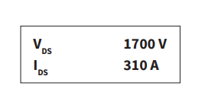
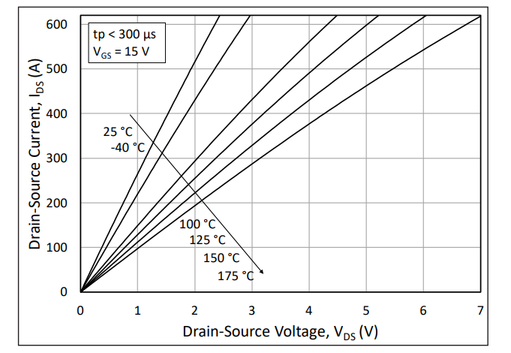
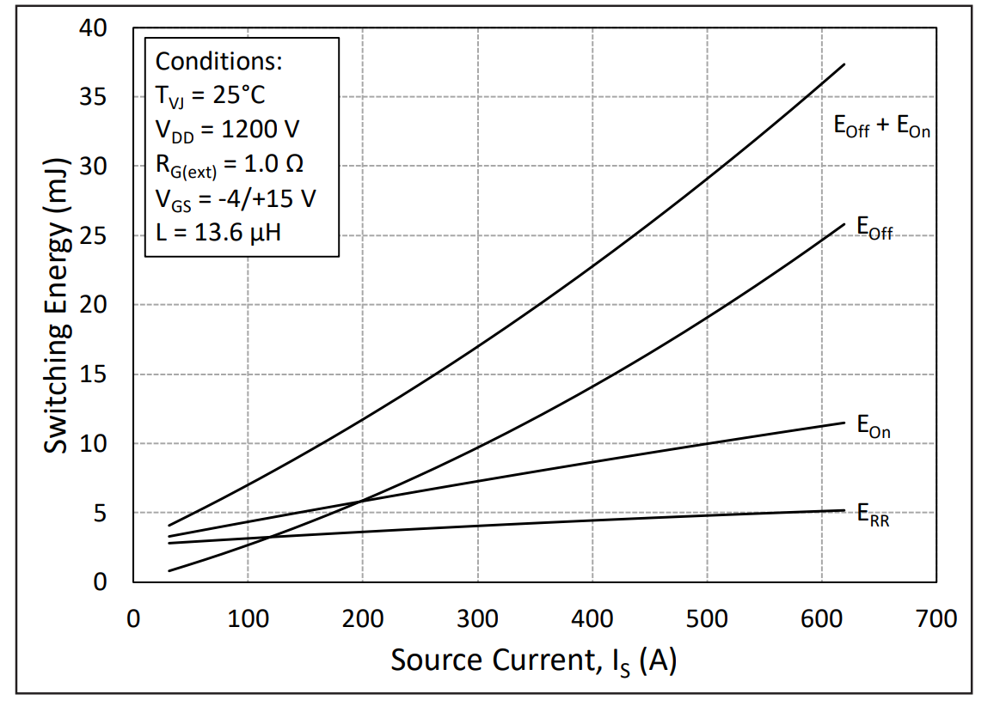
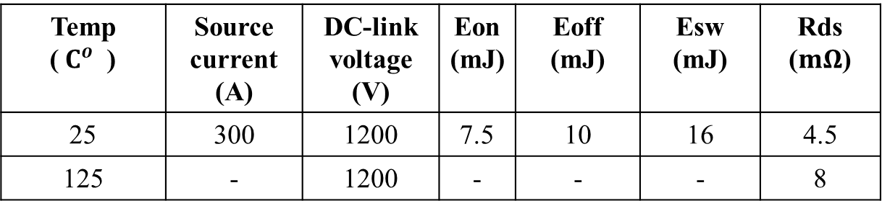
WAS310M17BM3
Temp ($C^{o}$) | Source current (A) | DC-link voltage (V) | Eon (mJ) | Eoff (mJ) | Esw (mJ) | Rds ($mΩ$)
25 | 300 | 1200 | 7.5 | 10 | 16 | 4.5
125 | - | 1200 | - | - | - | 8

Slide 10


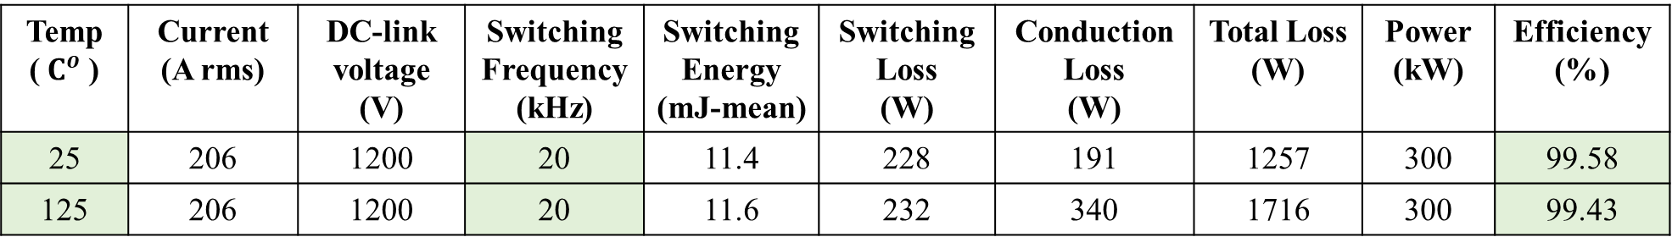
Basic Calculations
m=1.27 and p.f=0.9
Temp ($C^{o}$) | Current (A rms) | DC-link voltage (V) | Switching Frequency (kHz) | Switching Energy (mJ-mean) | Switching Loss (W) | Conduction Loss (W) | Total Loss (W) | Power (kW) | Efficiency (%)
25 | 206 | 1200 | 10 | 11.4 | 114 | 191 | 915 | 300 | 99.69
125 | 206 | 1200 | 10 | 11.6 | 116 | 340 | 1368 | 300 | 99.54
Temp ($C^{o}$) | Current (A rms) | DC-link voltage (V) | Switching Frequency (kHz) | Switching Energy (mJ-mean) | Switching Loss (W) | Conduction Loss (W) | Total Loss (W) | Power (kW) | Efficiency (%)
25 | 206 | 1200 | 20 | 11.4 | 228 | 191 | 1257 | 300 | 99.58
125 | 206 | 1200 | 20 | 11.6 | 232 | 340 | 1716 | 300 | 99.43
Temp ($C^{o}$) | Current (A rms) | DC-link voltage (V) | Switching Frequency (kHz) | Switching Energy (mJ-mean) | Switching Loss (W) | Conduction Loss (W) | Total Loss (W) | Power (kW) | Efficiency (%)
25 | 206 | 1200 | 30 | 11.4 | 342 | 191 | 1599 | 300 | 99.47
125 | 206 | 1200 | 30 | 11.6 | 348 | 340 | 2064 | 300 | 99.31

Slide 11
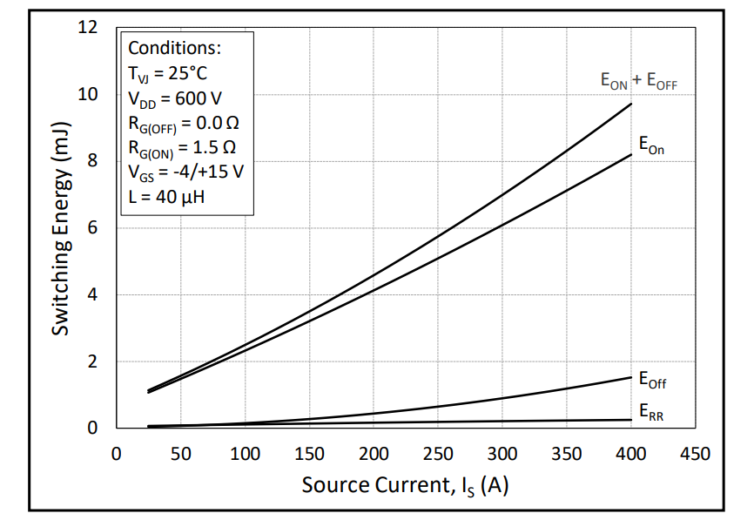
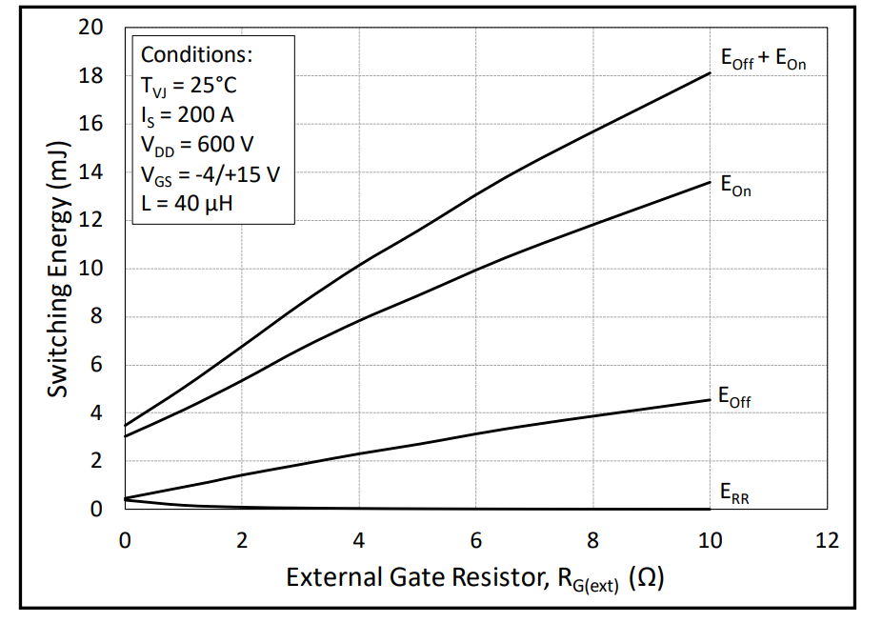
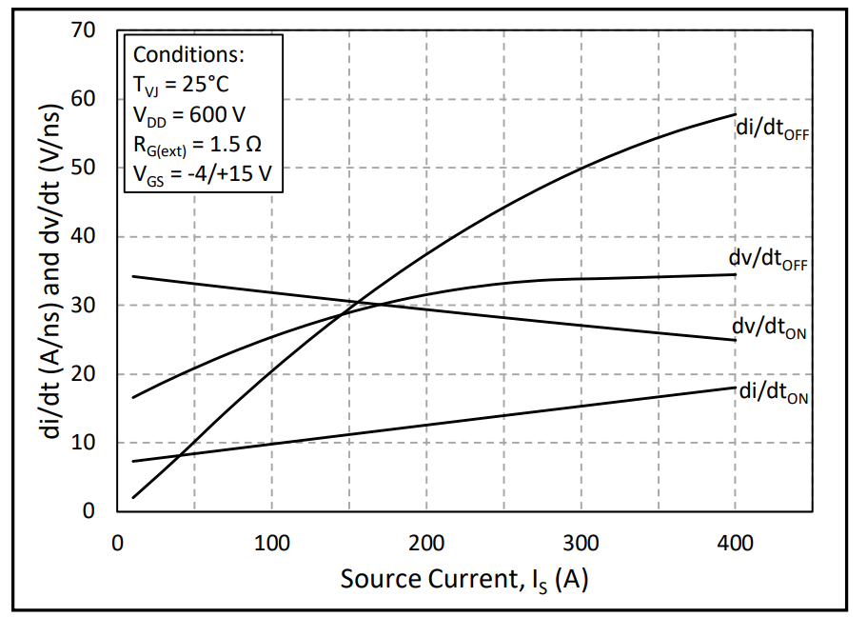
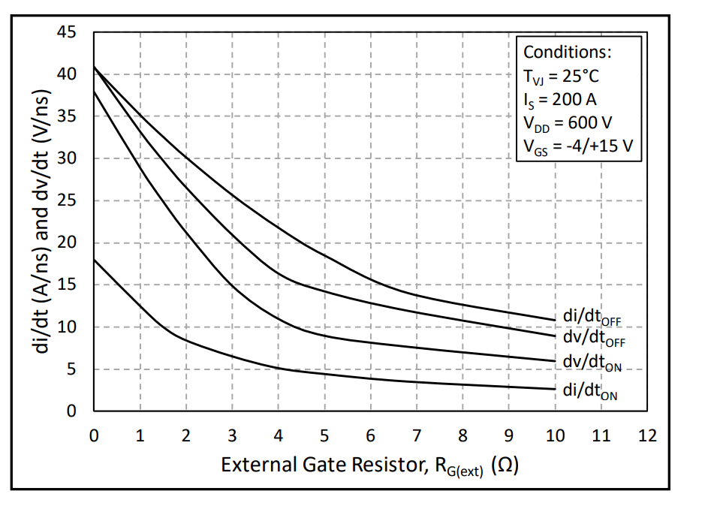
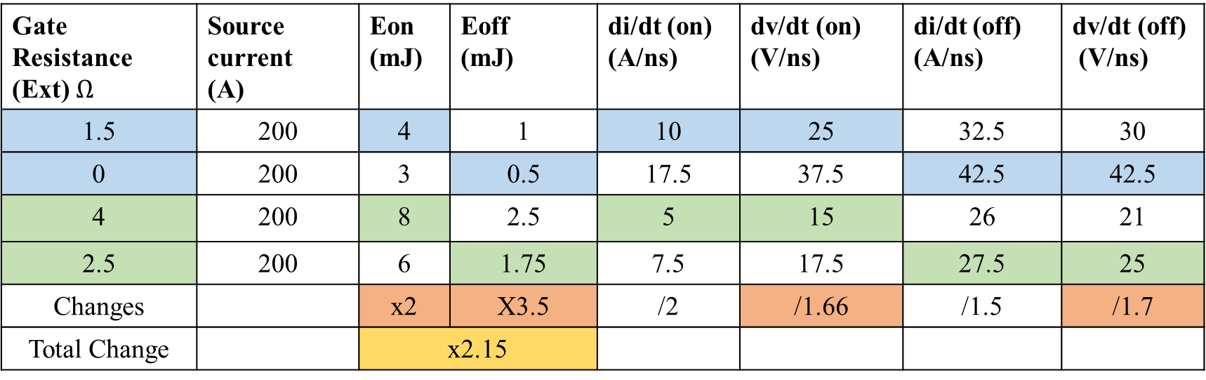
Effect of dv/dt
https://eu.mouser.com/datasheet/2/90/CAB006A12GM3-2886938.pdf
Gate Resistance (Ext) $Ω$ | Source current (A) | Eon (mJ) | Eoff (mJ) | di/dt (on) (A/ns) | dv/dt (on) (V/ns) | di/dt (off) (A/ns) | dv/dt (off) (V/ns)
1.5 | 200 | 4 | 1 | 10 | 25 | 32.5 | 30
0 | 200 | 3 | 0.5 | 17.5 | 37.5 | 42.5 | 42.5
4 | 200 | 8 | 2.5 | 5 | 15 | 26 | 21
2.5 | 200 | 6 | 1.75 | 7.5 | 17.5 | 27.5 | 25
Changes |  | x2 | X3.5 | /2 | /1.66 | /1.5 | /1.7
Total Change |  | x2.15

