Slide 1
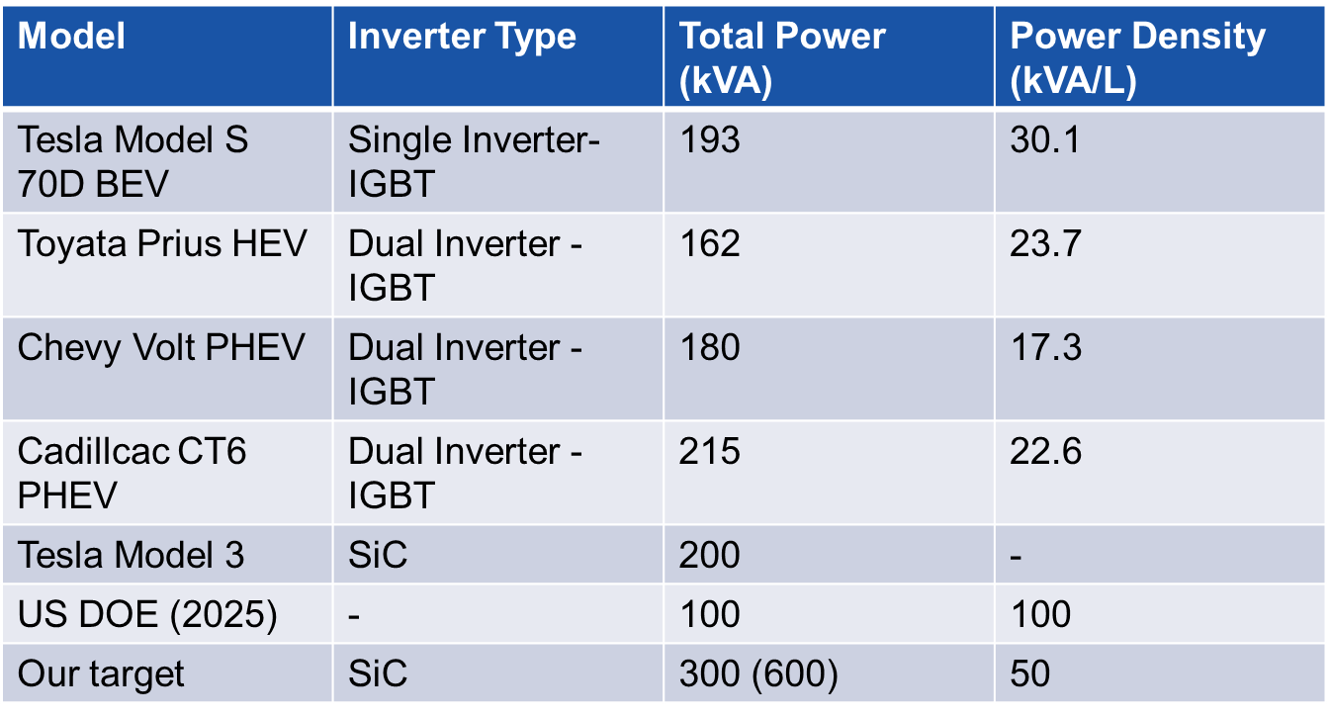
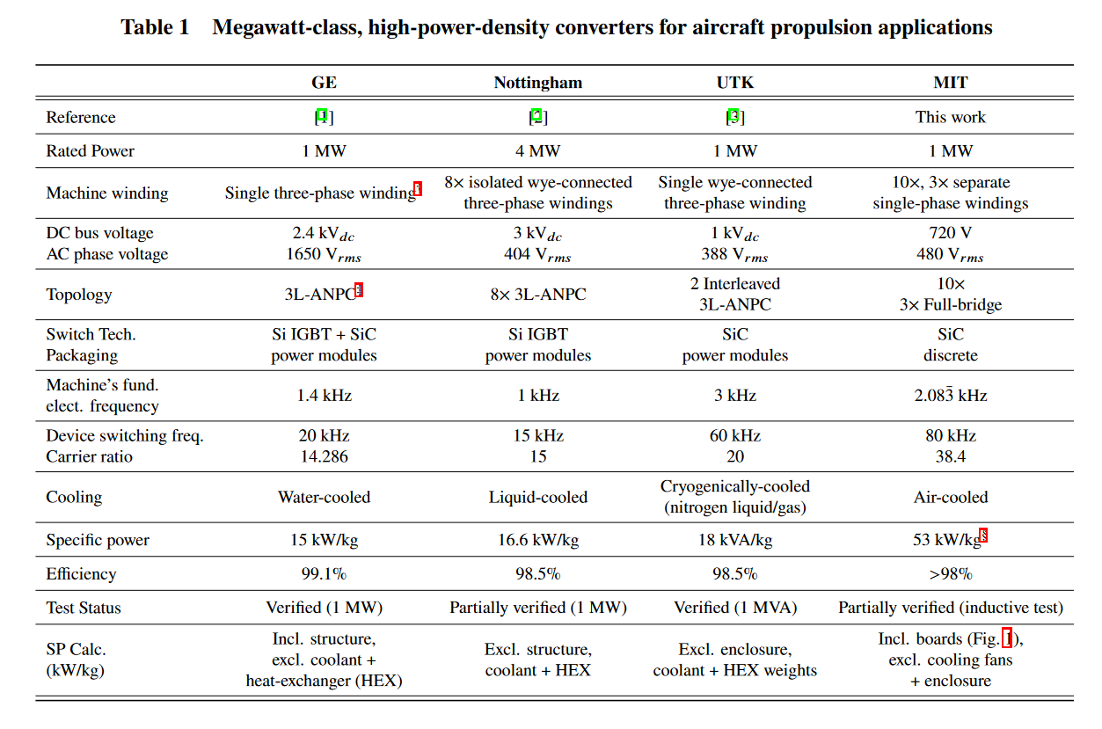
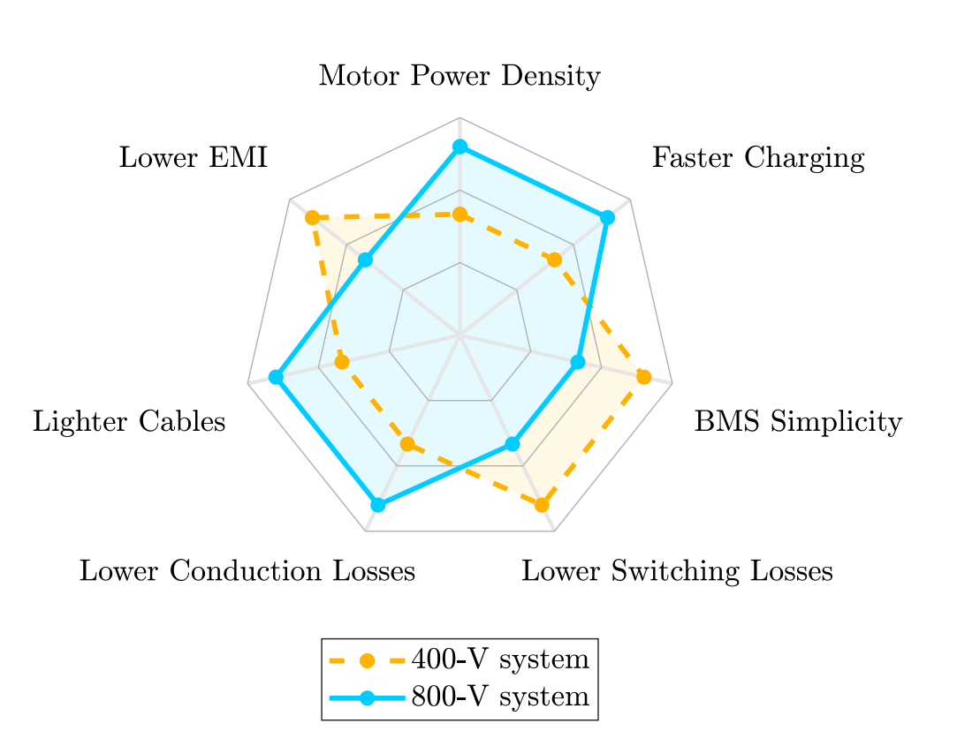

Outline: Evaluation (or Overview) of Traction Inverter Topologies for High-Duty Electric Truck
Literature Review:
  Traction Inverters:
      Automotive,
      Aerospace because of ratings
  Key Requirements for High-Duty Electric Trucks:
      Power requirements
      High voltage, fast charge
  Existing Traction Inverter Topologies

Slide 2
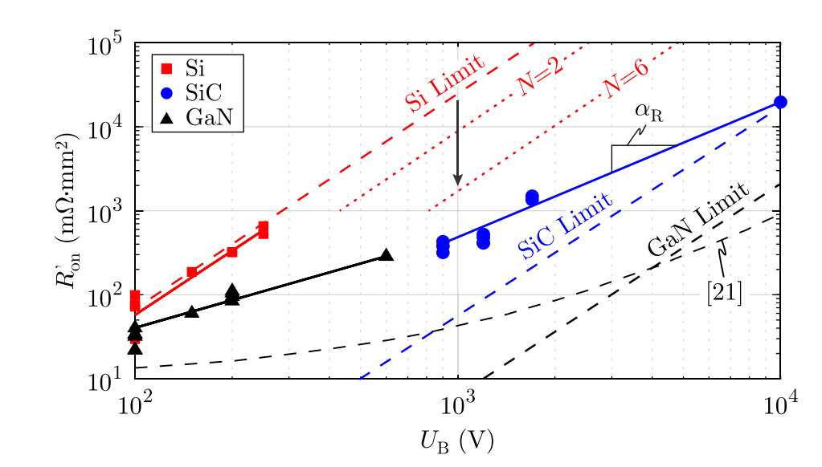
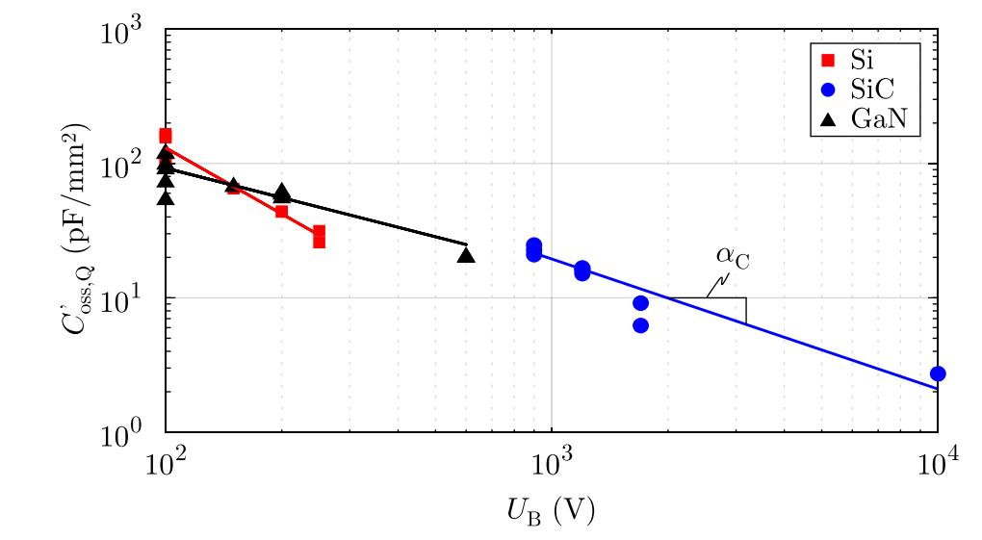
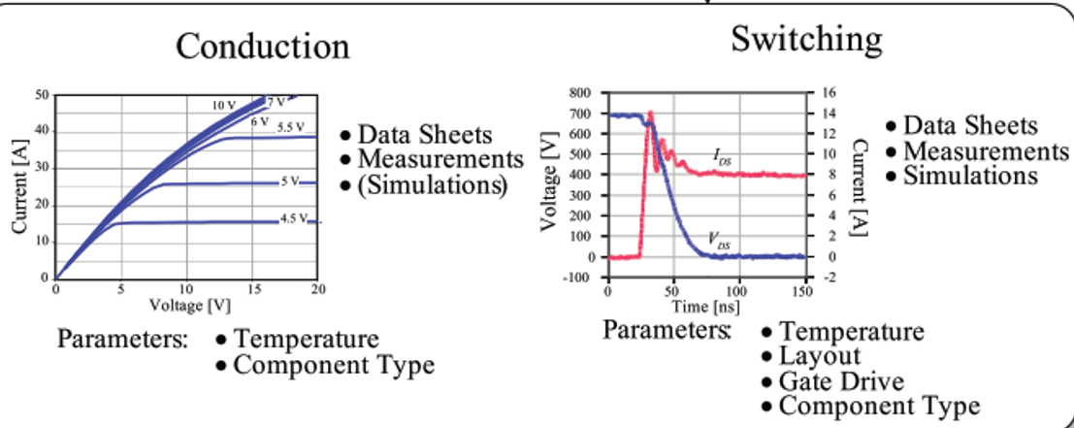
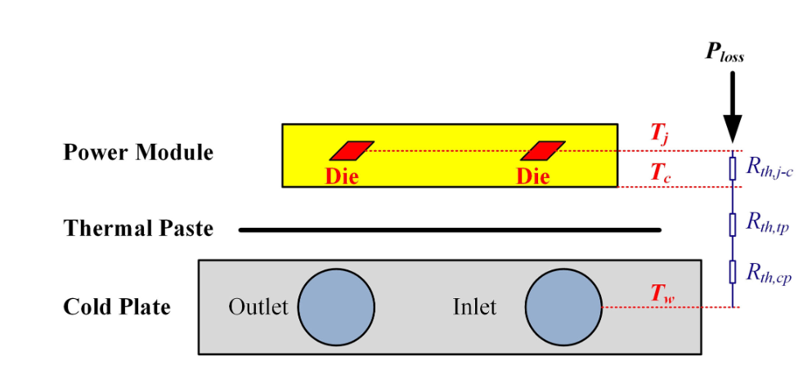
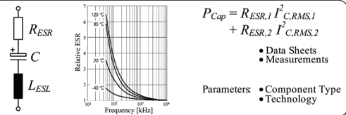

Virtual Prototyping and Modelling:
Figure-of-Merit SiC devices:
      rds
      switching loss
Probable Topology Selection and Current-Voltage Waveforms:
      2-level 3-phase
      3-level 3-phase
      2-level 6-phase
Loss Modelling
      Semiconductor Loss
      Thermal Model
      Capacitor Modelling

Slide 3
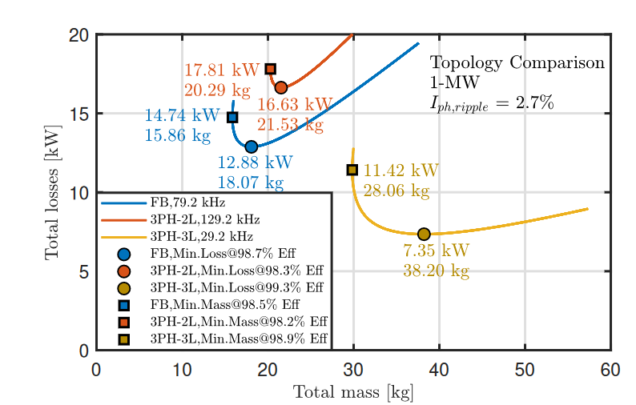
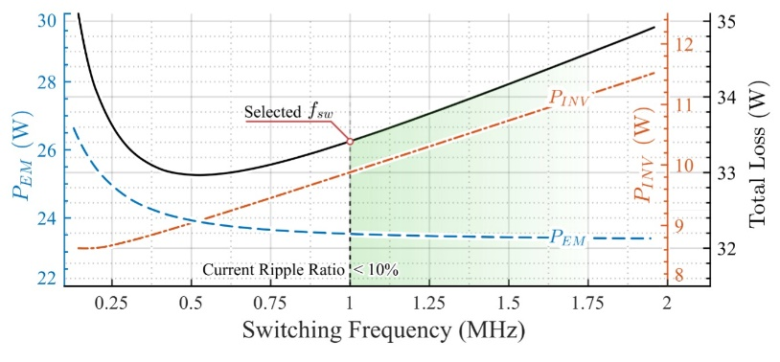
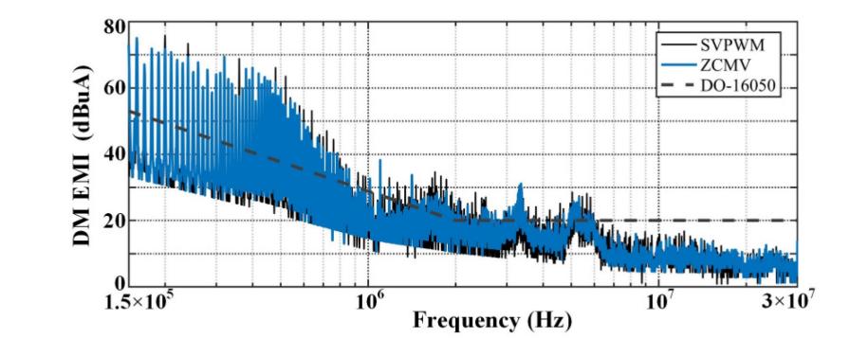
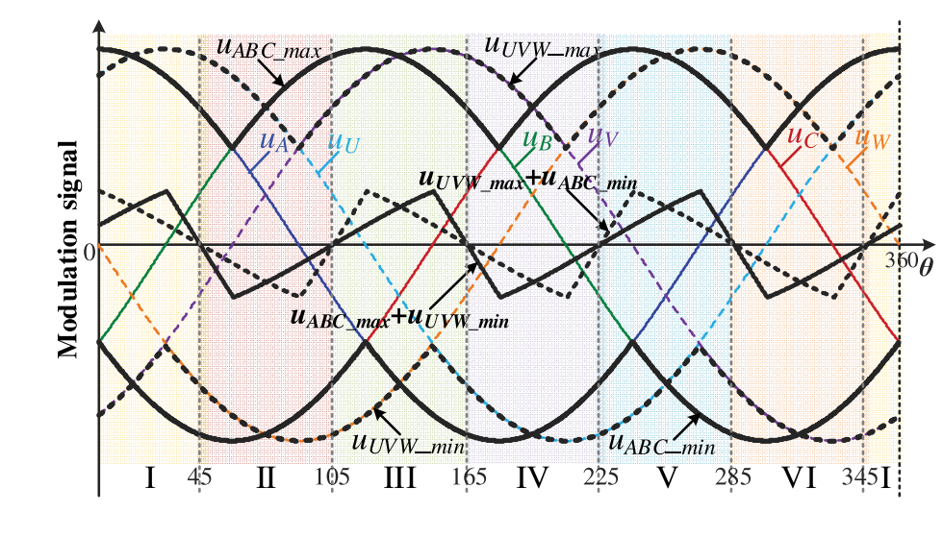
Performance Evaluation:
Loss and Size Comparison
Reliablity and Lifetime?
Output Harmonics and Possible Motor Losses
C. Common Mode Voltage and Bearing Current
  PWM methodologies

Slide 4
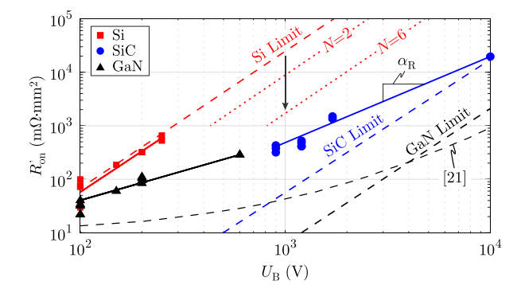

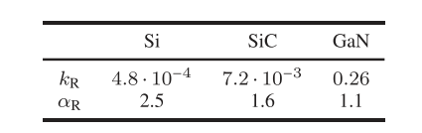
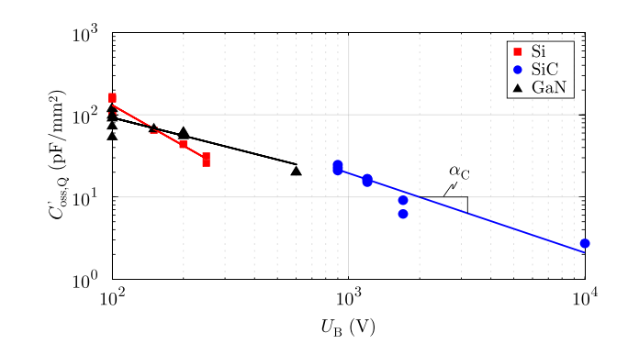

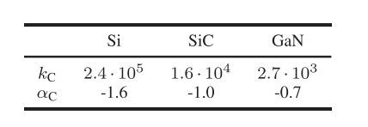
Virtual Prototyping
Conduction Loss
Zero Current Switching Loss

Slide 5
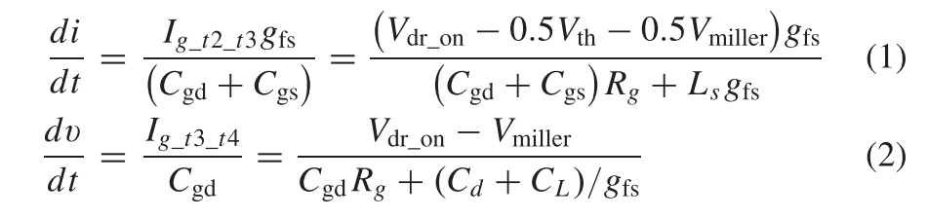
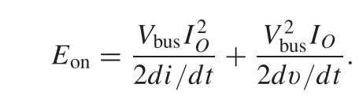
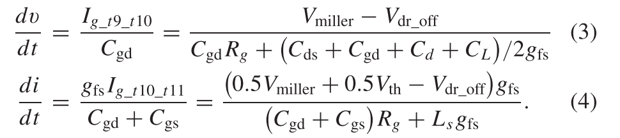
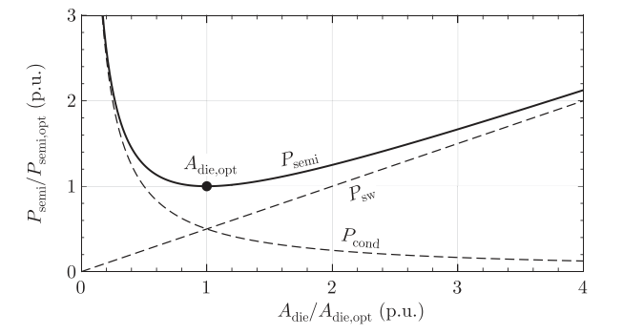
Virtual Prototyping
Switching Loss – dv/dt and di/dt
2-level loss-minimized
optimal semiconductor die area

