Slide 1
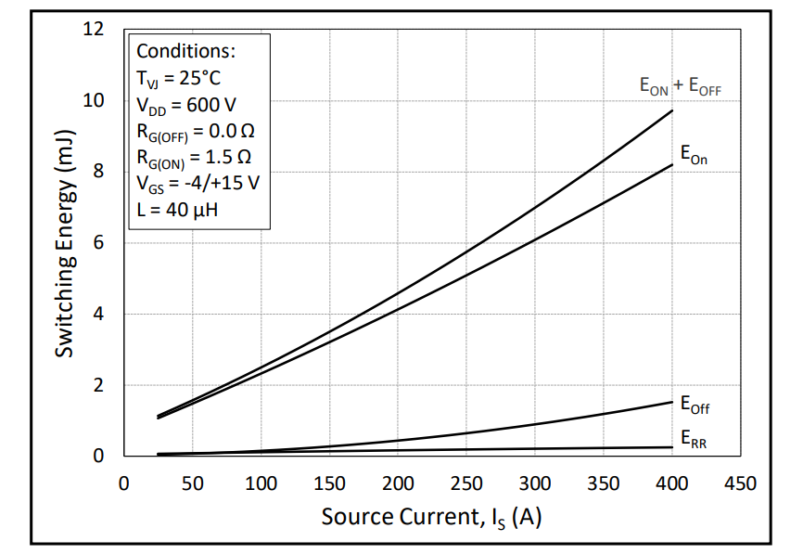
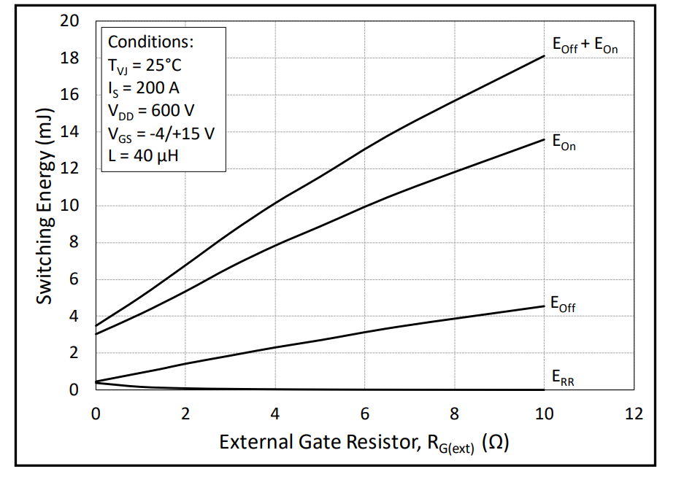
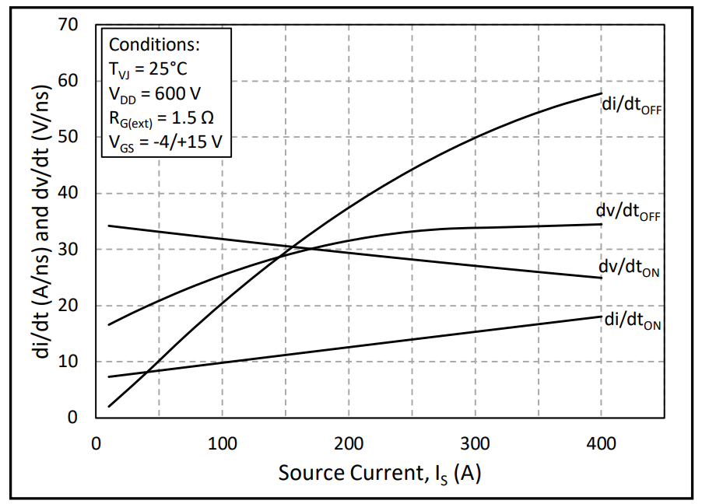
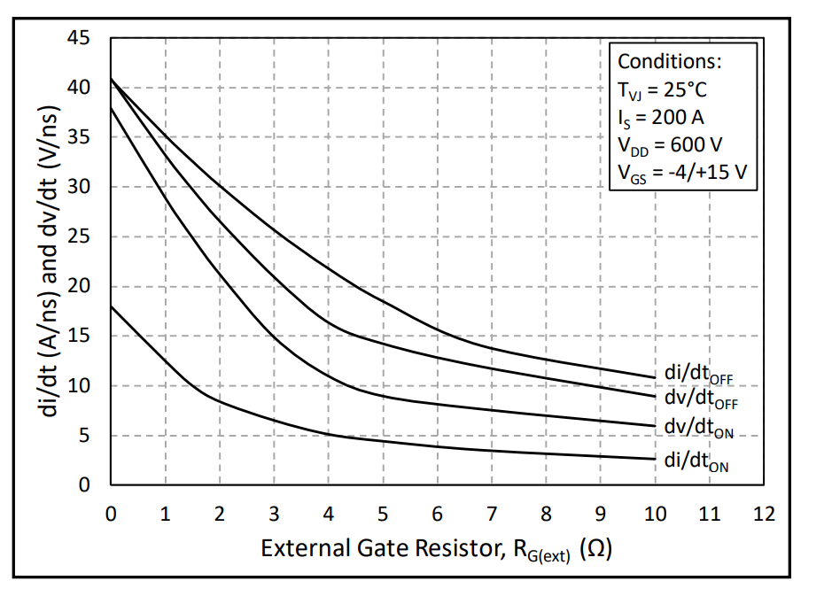
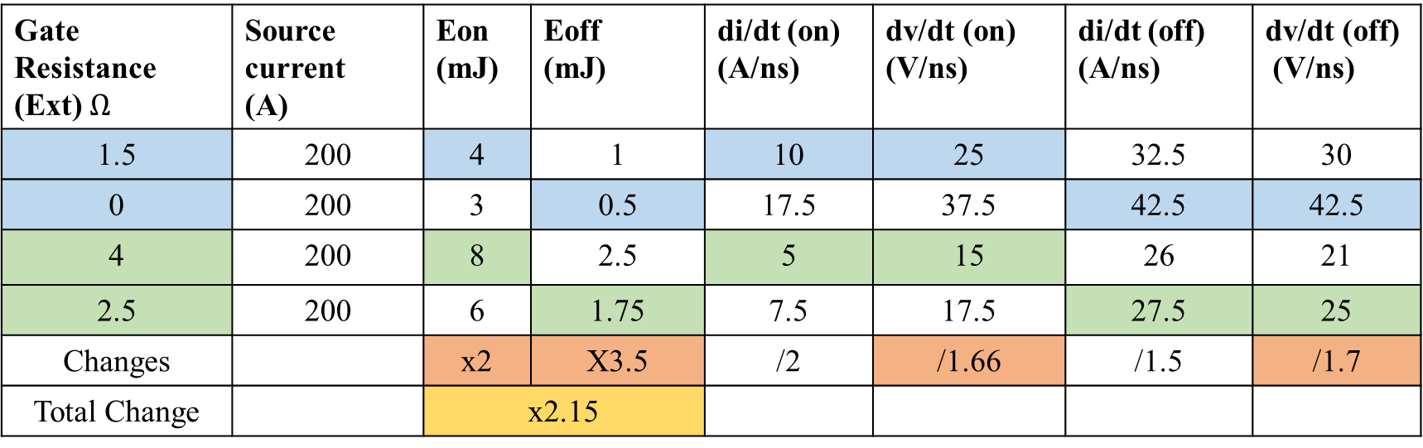
Effect of dv/dt
https://eu.mouser.com/datasheet/2/90/CAB006A12GM3-2886938.pdf
Gate Resistance (Ext) $Ω$ | Source current (A) | Eon (mJ) | Eoff (mJ) | di/dt (on) (A/ns) | dv/dt (on) (V/ns) | di/dt (off) (A/ns) | dv/dt (off) (V/ns)
1.5 | 200 | 4 | 1 | 10 | 25 | 32.5 | 30
0 | 200 | 3 | 0.5 | 17.5 | 37.5 | 42.5 | 42.5
4 | 200 | 8 | 2.5 | 5 | 15 | 26 | 21
2.5 | 200 | 6 | 1.75 | 7.5 | 17.5 | 27.5 | 25
Changes |  | x2 | X3.5 | /2 | /1.66 | /1.5 | /1.7
Total Change |  | x2.15

Slide 2
Topology
Semiconductor Voltage/ Current Rating
Topology Voltage and Current Rating
Switching Losses per frequency (W/hz)
Conduction Losses (W)

