Slide 1

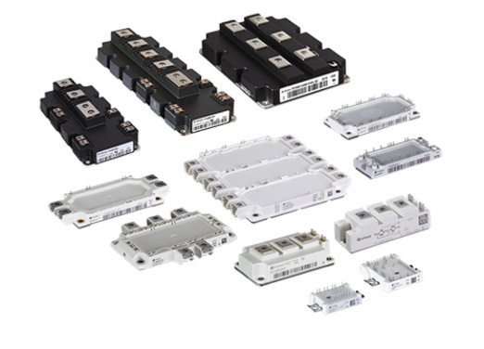
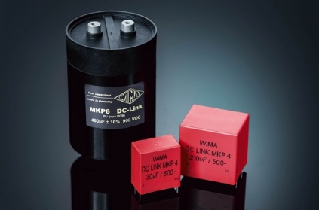
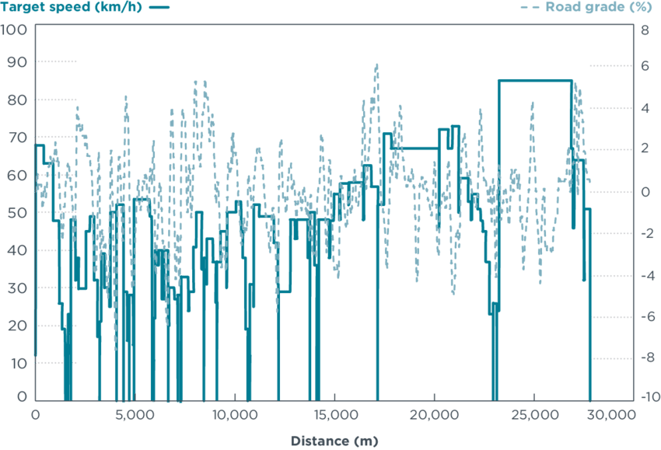
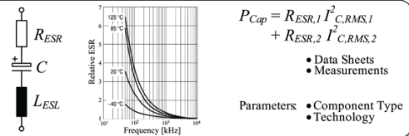
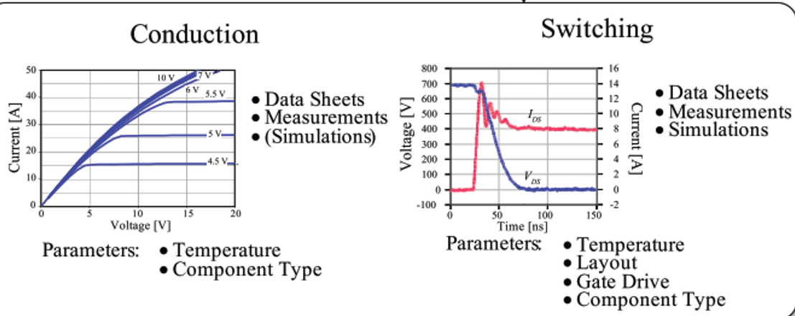

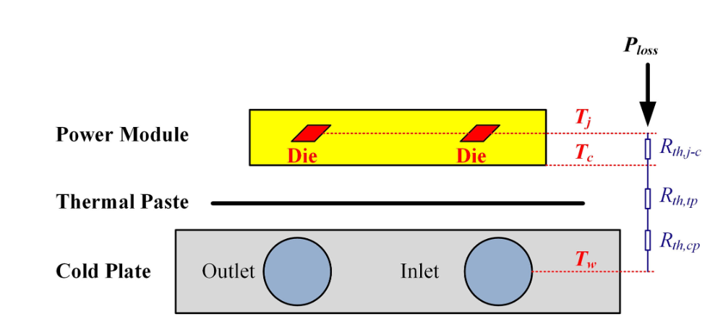
Topology Selection
V/I Ratings
Semiconductor and CapacitorSelection
Drive Cycle
Operating Points
V/I (t)
Capacitor Loss Calulation
Tc
Tj
Semiconductor Loss Calculation
W
W
Thermal Model
Thermal Model
Tc
Tj
No
No
|Tc (k)-Tc(k-1)|< ϵ
|Tj (k)-Tj(k-1)|< ϵ
Yes
Yes
Tc (t)
Tj (t)

