Slide 1
Loss Modelling of the Traction Inverter and Validation by Double Pulse Test

Slide 2
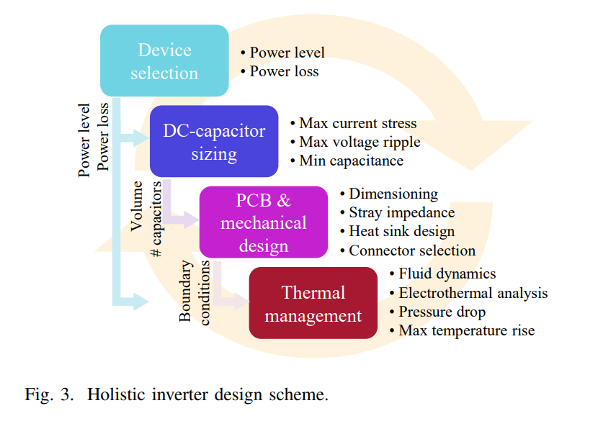
Semiconductor Losses
Losses
Power semiconductors (90 %) (eff 99.5%)
  Conduction Losses
  Switching Losses
  Driving losses
  Leakage Losses
Additional Losses ( 10%)
  Filters losses
Losses
Cooling system
Volume

Slide 3

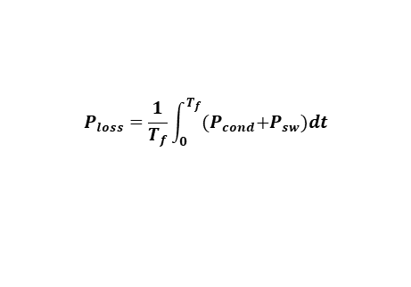
Loss Modelling
The average module power loss during one fundamental cycle consists of two parts: the conduction loss $P_{cond}$ and the switching loss $P_{sw}$. i.e.,
$$P_{loss}=\frac{1}{T_{f}}\int_{0}^{T_{f}}{{(P}_{cond}+P_{sw})dt}$$
The module conduction loss can be calculated as:
$$P_{cond}\left( T_{j}\right)=I_{out }^{2}{[R}_{ds }\left(T_{j}\right)]\frac{1}{F_{sw}}$$
The junction temperature can affect the device ON-state resistance, i.e., $R_{ds }$ is a function of $T_{j}.$
The module switching loss can be written as:
$$P_{sw}\left(I_{out}, T_{j}, V_{SW}\right)=2 F_{sw} [E_{on}\left(I_{out}, T_{j}, V_{SW}\right)+E_{off}\left(I_{out}, T_{j}, V_{SW}\right)]$$
Similarly, the switching energies are also affected by the junction temperature, module output current, and the switching voltage.

Slide 4
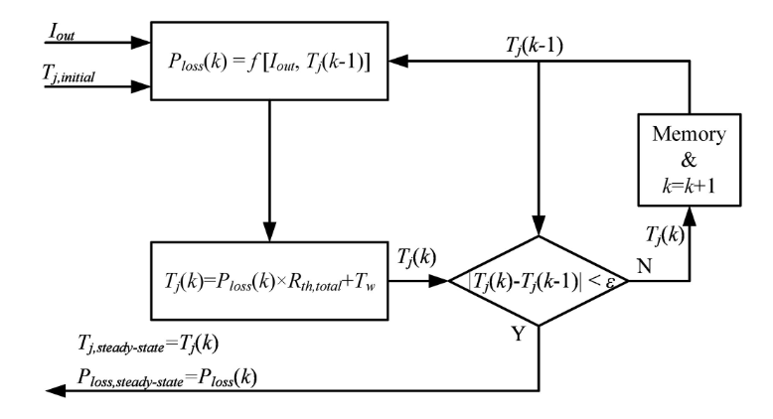
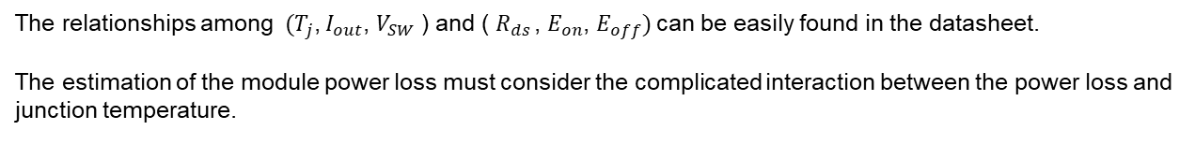
Loss Modelling
The relationships among${ (T}_{j}$, $I_{out}$, $V_{SW}$ ) and ( $R_{ds }$, $E_{on}$, $E_{off})$can be easily found in the datasheet.
The estimation of the module power loss must consider the complicated interaction between the power loss and junction temperature.
At a fixed output current, the module power loss leads to a fixed junction temperature rise, and the junction temperature rise affects the module power loss in turn, resulting in the need for iteration to solve for steady-state behavior.

Slide 5
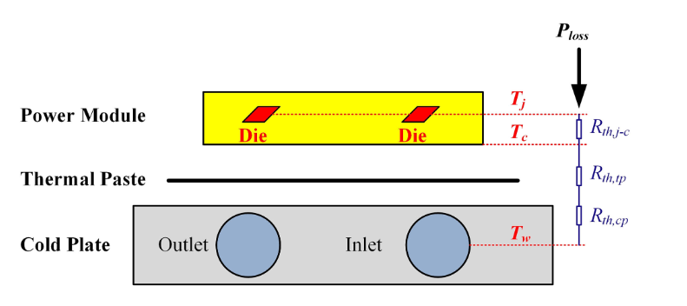
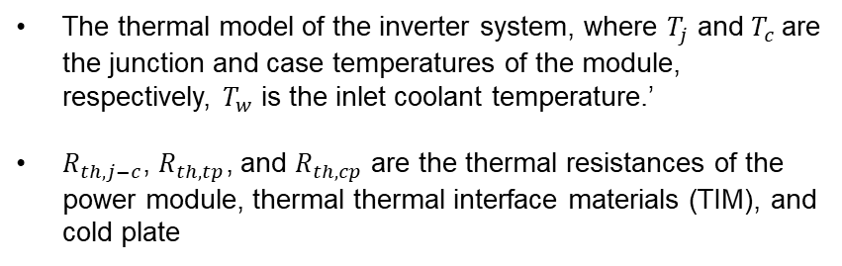


Thermal Model
The thermal model of the inverter system, where $T_{j}$ and $T_{c}$are the junction and case temperatures of the module, respectively, $T_{w}$ is the inlet coolant temperature.’
$R_{th,j−c}$, $R_{th,tp}$, and $R_{th,cp}$ are the thermal resistances of the power module, thermal thermal interface materials (TIM), and cold plate
The case and junction temperature of the module can be written as:
$$T_{j}=T_{c}+R_{th,j−c}{ P}_{loss}$$
$$T_{c}=T_{w}+(R_{th,tp}+R_{th,cp}{ )P}_{loss}$$
The junction temperature is a function of coolant temperature, module power loss, and thermal resistances.

Slide 6
Loss Calculation Assumptions
SiC MOSFETs, which are capable of forward and reverse current conduction through the channel, are used as switching devices. It is assumed that the reverse current flows completely through the MOSFET channel. This is a worse assumption than current sharing between the channel and the body diode. It partly compensates the neglection of losses in the body diode during interlock (dead) times.
The reverse recovery energy of the body diode is also not considered, since measuring it is problematic and it is comparably small so that it is not included in the datasheet of the module.
When the MOSFET is in reverse conduction mode the current commutates from and to its own body diode under zero voltage switching (ZVS) condition, and therefore switching losses are only taken into account during forward conduction mode of the MOSFET.
For the NPC inverter, another type of semiconductor is used for the clamping diodes. Here, SiC Schottky diodes are considered which have negligible switching losses, and thus only the conduction losses are accounted for.

Slide 7
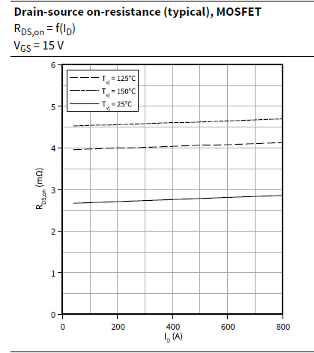
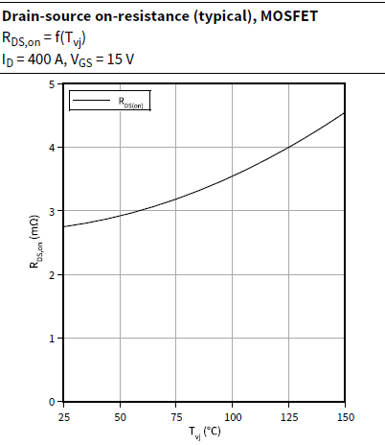
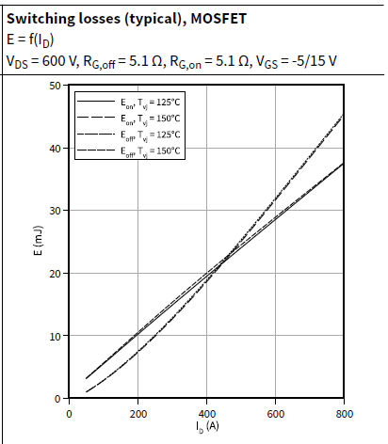
Datasheet Parameters

Slide 8
Grabit and Digital Data

Slide 9
Modulation
Selection of Input Parameters
Switching frequency, DC link voltage, Power,
Power factor
Topology and Modulation Selection
2 level : SPWM THIPWM SVPWM
3 level NPC: SPWM THIPWM SVPWM
Creating voltage and current waveforms

Slide 10
Conduction and Switching Events
Voltage and current waveforms
Finding the conduction and commutation times

Slide 11
Loss Calculations
The conduction and commutation times
Conduction Loss Calculation
Switching Loss Calculation

Slide 12
Iterative Solution

Slide 13





Summary
1. The $R_{ds}$ is proportional to $T_{j}$
$$f_{c_{Tj}}\left(T_{j}\right)= (1+p T_{j})$$
2. The switching energy is proportional to $U^{x}$
$$f_{{sw}_{U_{DC}}}\left(U_{sw}\right)= {\left(\frac{U_{sw}}{U_{DC}}\right)}^{x}$$
3. The switching energy is supposed to be proportional to the load current.
$$f_{{sw}_{DC}}\left(I_{L}\right)= (1+p I_{L})$$
4. The function for the temperature effect fits with a first-degree polynomial.
$$f_{{sw}_{T_{j}}}\left(T_{j}\right)= (1+pT_{j})$$

Slide 14
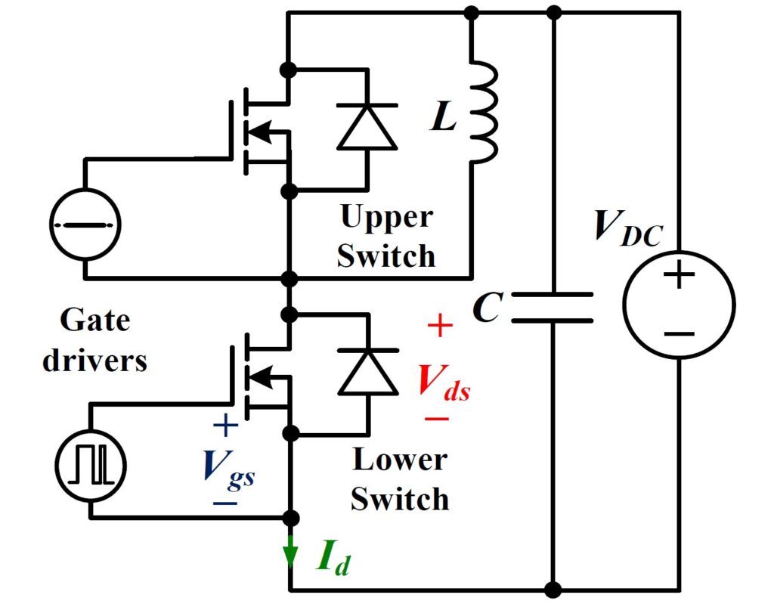
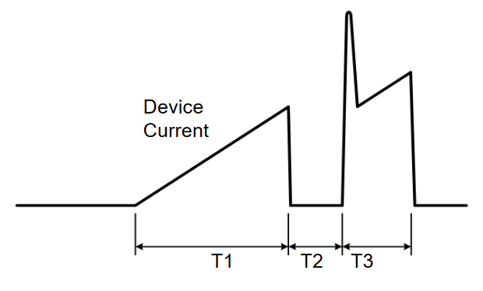
Validation by Double Pulse Test
Objective: The primary objective of the double pulse test is to measure the switching behavior and compare/validate the theoretical calculation.
Setup: To perform a double pulse test, we need a half-bridge module, a gate driver, a pulse generator, DC-link capacitance, and load inductance.
First Pulse (Turn-Off): turn-off time, voltage fall time, and any voltage spikes or ringing.
Second Pulse (Turn-On) : to switch from off to on (turn-on time), the voltage rise time, and any overshoot or ringing in the voltage waveform

Slide 15
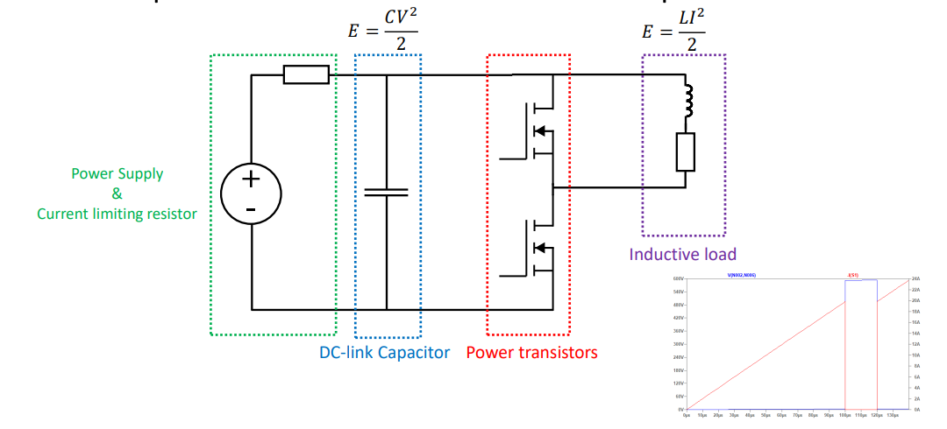
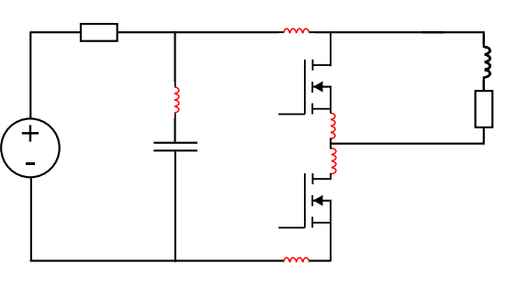
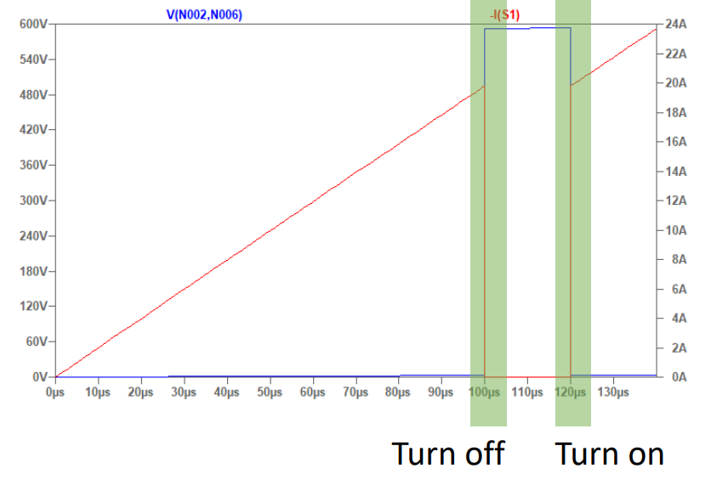
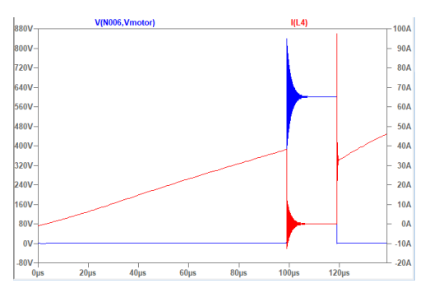
Double Pulse Test
Ideal parts and waveforms
Parasitics and affects

Slide 16
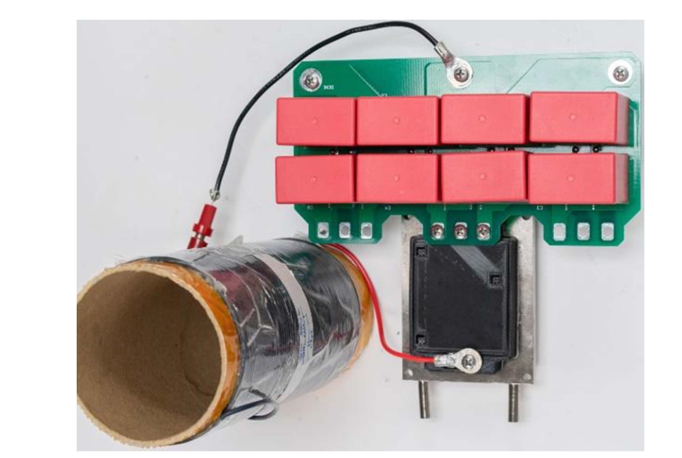
Inductor Selection
The key considerations for the selection of this inductor include:
It should not saturate at the peak test currents. (Air core inductors)
It should limit the di/dt so that the switching times (T1, T2 and T3) are not less than 10 μs, to ensure the devices have fully turned on or off.
The di/dt should not be so low that the switching times are longer than 200 μS so as not to cause the DC bus voltage to dip by more than ≈5 percent, and so change the switching performance. In addition, if the current pulse is long, then the chip temperature can increase by more than a few °C, again affecting the switching performance.
The inductor should be mounted well away from the test setup to prevent EMI interference or magnetic field coupling into any gate drive circuits or instrumentation

Slide 17
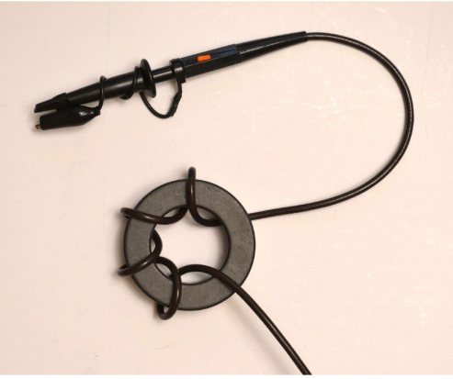
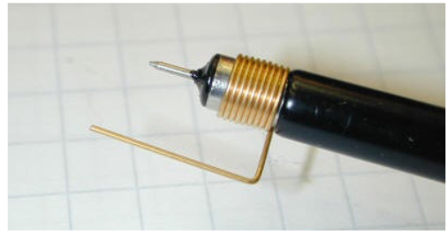
Instrumentation
We need some techniques to reduce loop inductance and coupling in the measurement path and how some turns around a ferrite core can add common mode impedance to the measurement signal.
To measure voltages at nonground reference potentials, differential probes are required and should be selected with a high common mode rejection ratio, as the DUT can be moving at very high dv/dt levels with respect to the scope ground.
Voltage probe tip to reduce inductance in measurement loop
Voltage probe with some added common mode impedance

Slide 18
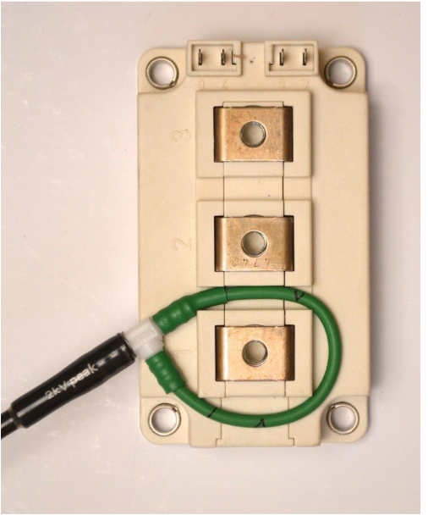
Instrumentation
To measure the actual device switching current, a current sensor must be inserted into the source/drain of the DUT.
Rogowski coils: These have a bandwidth of between 15-30 Mhz which is enough for many applications and any delay skew can be compensated for with an oscilloscope.

Slide 19
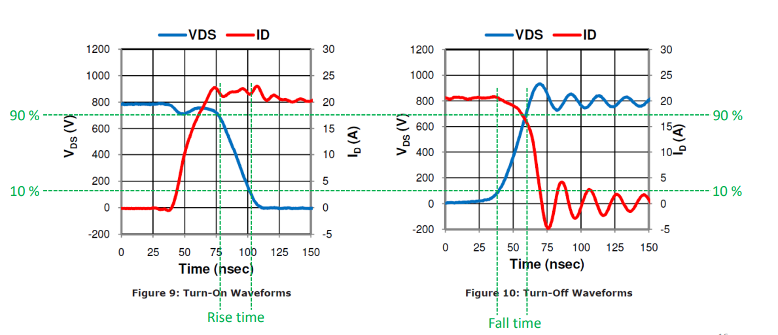
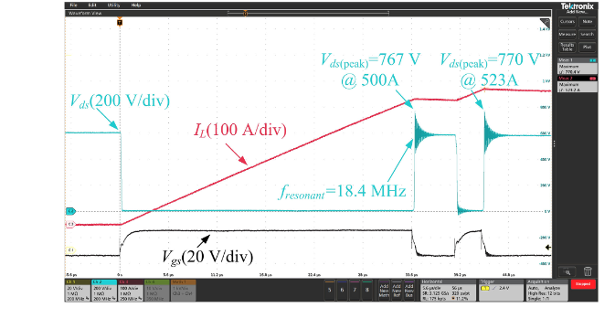
What testing should be included in a DPT and expected results
DUT can be switched at different voltages.
  We can change the DC link voltage.
DUT can be switched at different currents.
  We can change the pulse widths or inductor values.
DUT can be switched at different temperatures.
  This can be adjusted by mounting the DUT on a heatsink, which can be heated or cooled

Slide 20
References
Loss Calculation
A Compact 250 kW Silicon Carbide MOSFET based Three-Level Traction Inverter for Heavy Equipment Applications, 2018 IEEE Transportation Electrification Conference and Expo (ITEC),
Electrothermal-Control Co-Design of an All Silicon Carbide 2×250 kW Dual Inverter for Heavy-Duty Traction Applications, in IEEE Transactions on Industry Applications
Potentials and Comparison of Inverter Topologies for Future All-Electric Aircraft Propulsion, in IEEE Journal of Emerging and Selected Topics in Power Electronics
Double Pulse Test
A Low Inductance, High Power Density 3L-TNPC Power Module for More-Electric Aircraft Applications, in IEEE Transactions on Transportation Electrification
Design and Evaluation of a 1200-V/200-A SiC Three-Level NPC Power Module," in IEEE Transactions on Industry Applications
Double Pulse Testing: The How, What and Why by David Levett, Ziqing Zheng and Tim Frank, Infineon Technologies
Double pulse testing by Philip Abrahamssont

