Slide 1
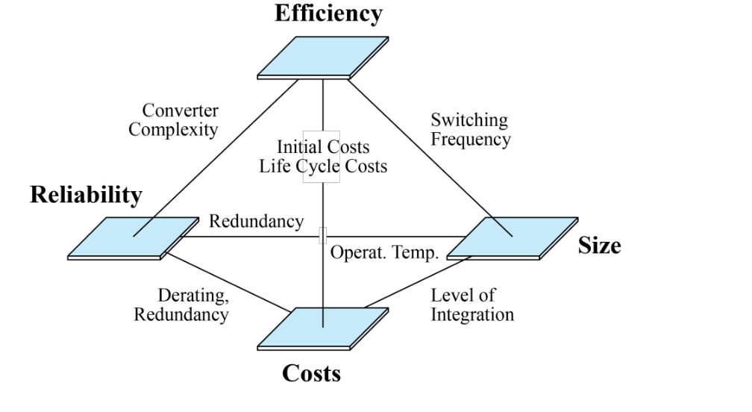
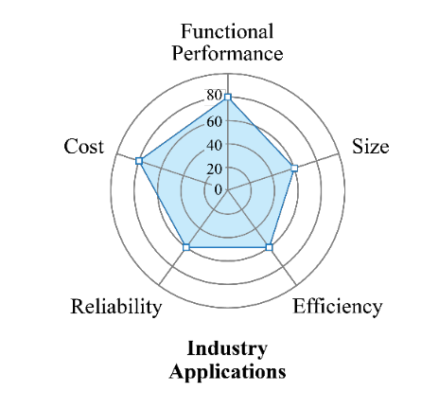
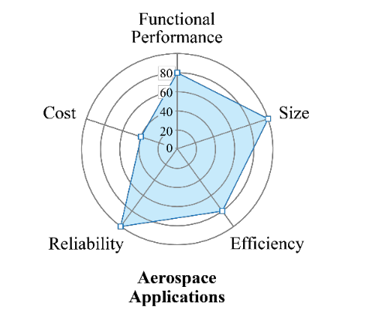
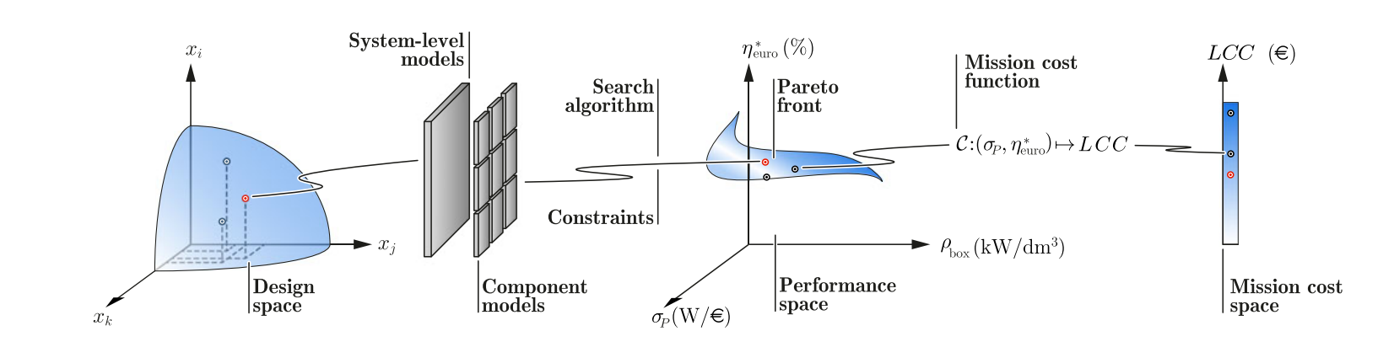
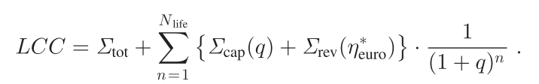
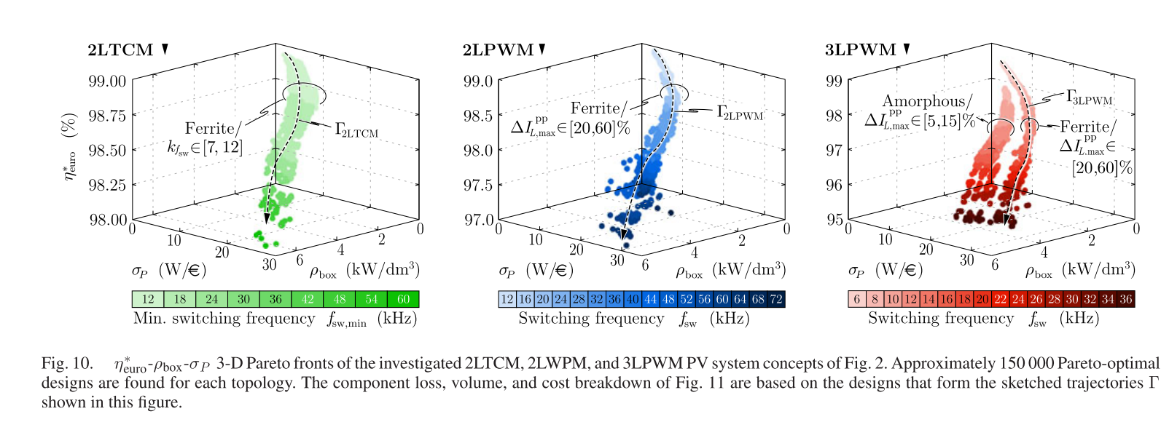
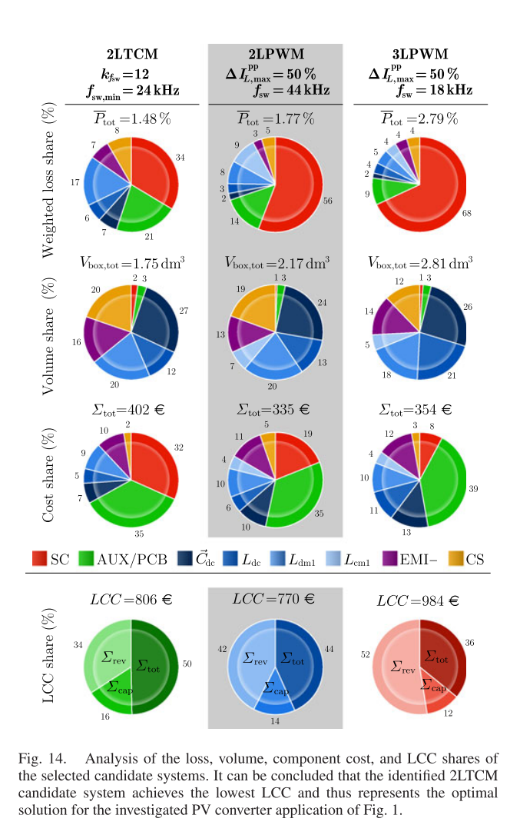
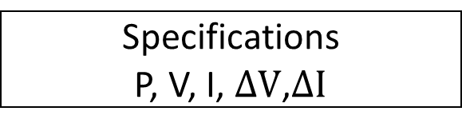
Holistic Life Cycle Cost Optimization - W.P.6
Development of models and tools:
Models regarding dimensioning, power losses, and cooling are compiled and integrated into software.
To carry out comprehensive calculations regarding total power losses as well as life cycle costs.
Project deliverable:
Lev. 6.2. Software and documentation for holistic life cycle cost optimization.
Performance Indices:
─ Power Density [kW/L]
─ Power per Unit Weight [kW/kg]
─ Relative Costs [kW/$]
─ Relative Losses [%]
─ Failure Rate [h-1]
Sofware-Flow Chart - Virtual prototyping routine
Specifications
P, V, I, $ΔV$,$ΔI$
Converter Topology
Modulation Scheme
Generating Voltage and Current Waveforms for Leg
Time Domain
Frequency Domain
Power Circuit Model
Switching frequency increase
Reliability
Capacitor:
Type
Value
Semiconductor:
Type
Voltage Rating
dv/dt limitations
Motor Losses
Drive Cycle
Model
Estimation:
Sizing
Cost
Loss
Update
Die Area Selection
Harmonic Loss Modelling
Capacitor
Volume
Junction Temp
Loss Model
Junction Temp
Loss Model
Capacitor
Cost
Thermal Model
Thermal Model
Estimation:
Heatsink size/cost
Power module size/cost
Aux size (e.g. gate driver) size/cost
Semiconductor Loss
Motor Harmonic Loss
Failure rate model
Capacitor
Loss
Size
Heatsink
Module
Aux
Cost
Heatsink
Module
Aux
Failure in rate
Volume/Cost/Loss
Total Converter
Loss
Volume
Cost
Trade-off of Performance (Cost/Volume/Loss) and Life-cycle-cost analysis
System-Level Loop Models :
  Topology
  Modulation,
  Waveform
Semiconductor Loss:
  Conduction Loss
  Switching Loss
  Motor Harmonic Loss
Cooling System:
  Cooling system performance index (CSPI)
  Thermal resistance network
Capacitors:
  Size
  Cost
Aux PCB:
  Size
  Cost

Slide 2
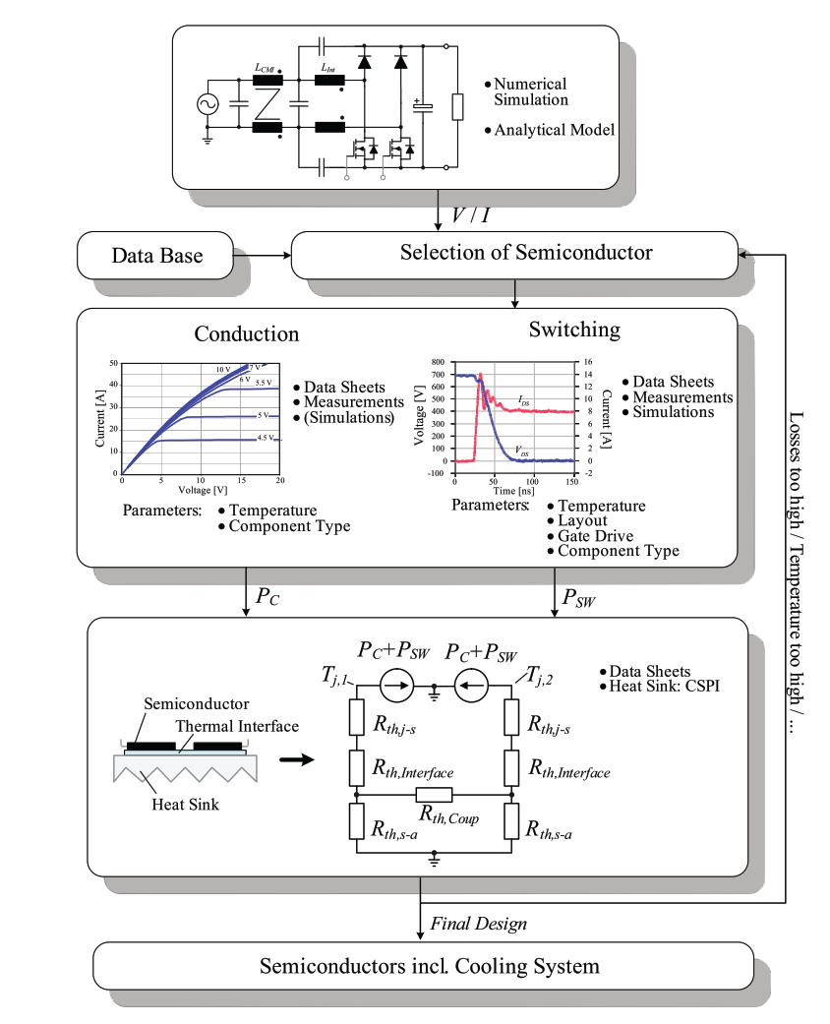
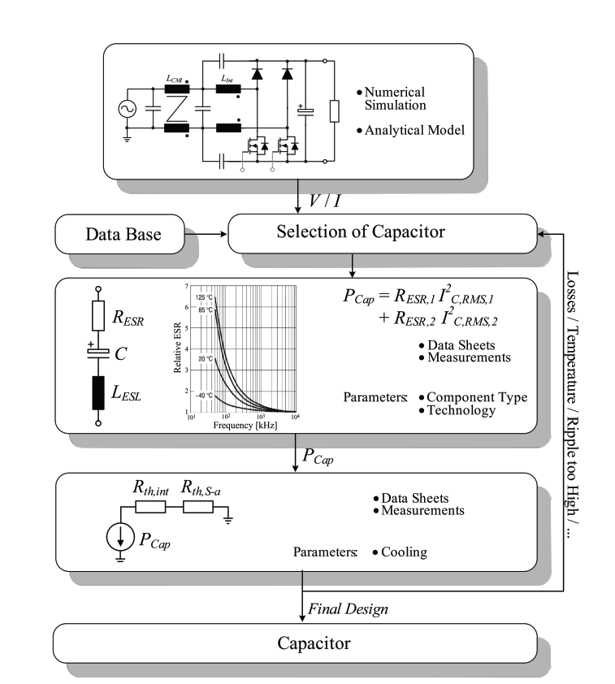

Slide 3
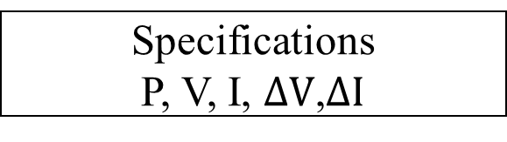
Specifications
P, V, I, $ΔV$,$ΔI$
Converter Topology
Modulation Scheme
Generating Voltage and Current Waveforms for Leg
Time Domain
Frequency Domain
Power Circuit Model
Switching frequency increase
Reliability
Capacitor:
Type
Value
Semiconductor:
Type
Voltage Rating
dv/dt limitations
Motor Losses
Drive Cycle
Model
Estimation:
Sizing
Cost
Loss
Update
Die Area Selection
Harmonic Loss Modelling
Capacitor
Volume
Junction Temp
Loss Model
Junction Temp
Loss Model
Capacitor
Cost
Thermal Model
Thermal Model
Estimation:
Heatsink size/cost
Power module size/cost
Aux size (e.g. gate driver) size/cost
Semiconductor Loss
Motor Harmonic Loss
Failure rate model
Capacitor
Loss
Size
Heatsink
Module
Aux
Cost
Heatsink
Module
Aux
Failure in rate
Volume/Cost/Loss/Carbon Emission
Total Converter
Loss
Volume
Cost (capital + running)
Carbon Emission (capital + running)

