Slide 1
2L Inverter Busbar Design

Slide 2
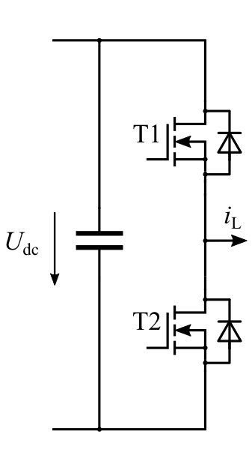
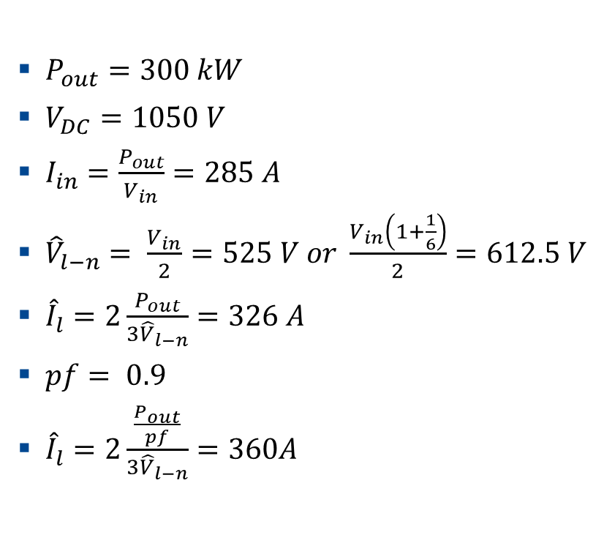

2-Level Inverter Power Ratings
$P_{out}=300 kW$
$V_{DC}=1050 V$
$I_{in}=\frac{P_{out}}{V_{in}}=285 A$
${\hat{V}}_{l−n}= \frac{V_{in}}{2}=525 V or \frac{V_{in}\left(1+\frac{1}{6}\right)}{2}=612.5 V$
${\hat{I}}_{l}=2\frac{P_{out}}{{3\hat{V}}_{l−n}}=326 A$
$pf= 0.9$
${\hat{I}}_{l}=2\frac{\frac{P_{out}}{pf}}{{3\hat{V}}_{l−n}}=360A$
Efficiency (99.5%)
Semiconductor Losses (6 switches): 1500 $W$
Switching Frequency: Up to 18.5 kHz
  (Holistic Design for minimizing total loss : 14 kHz)
Continuous Power: 300 kW
Short-term Power: 360 kW
Power factor: 0.9-1

Slide 3
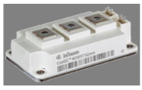
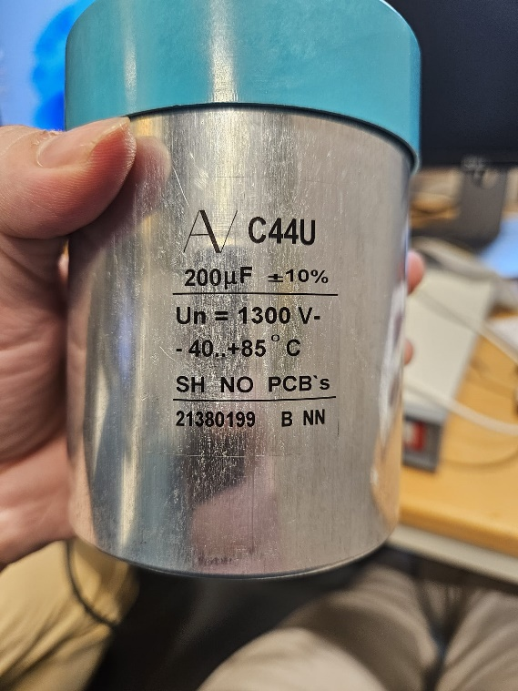
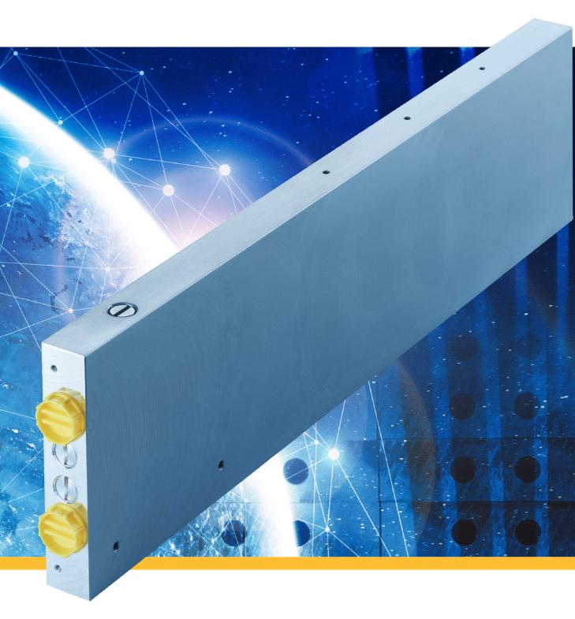
Main Components
62mm Power Modules
Film capacitor with cylindrical can-type
Coldplate

Slide 4
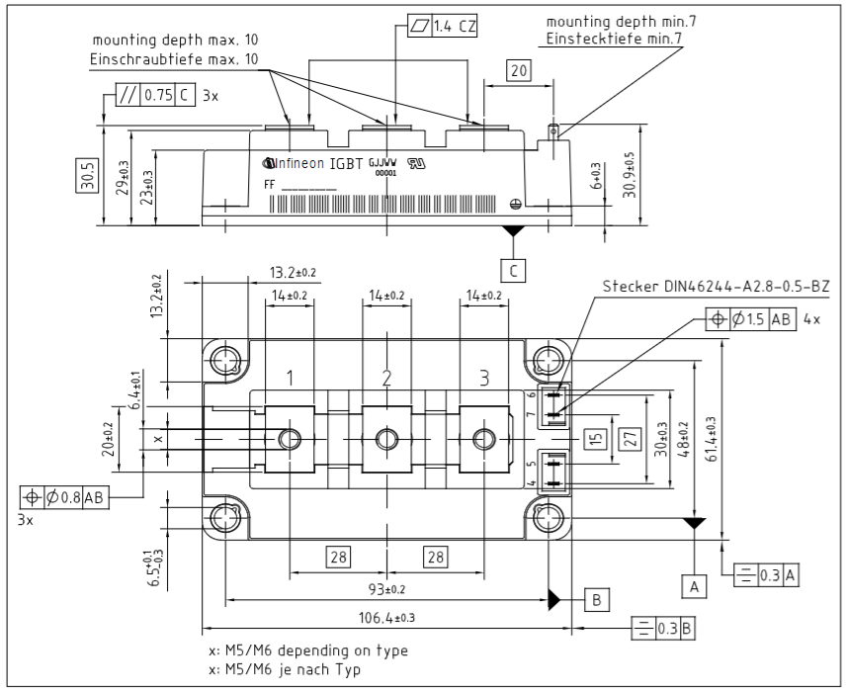
Dimensions - FF3MR20KM1H Power Module
*Datasheet

Slide 5
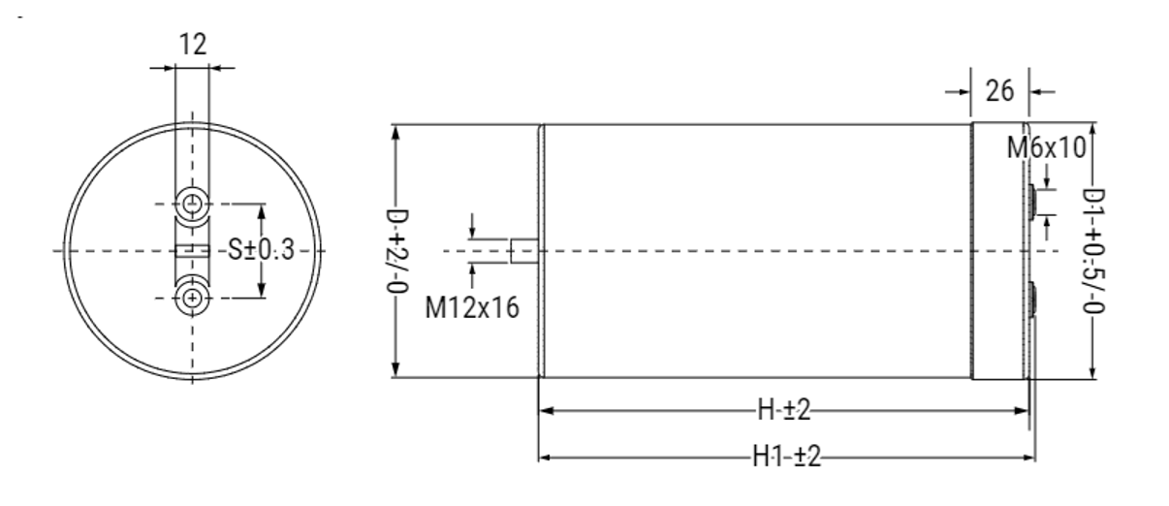
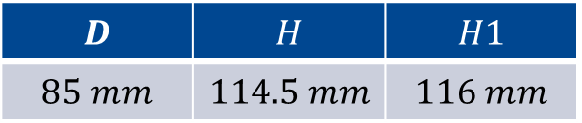
Dimensions - C44U 1300 V 200$μ$F
$$D$$ | $$H$$ | $$H1$$
$$85 mm$$ | $$114.5 mm$$ | $$116 mm$$
*Datasheet

Slide 6
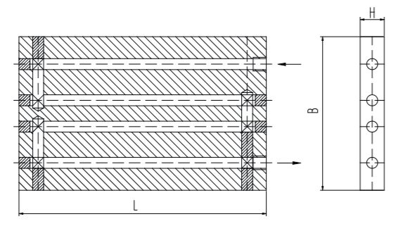
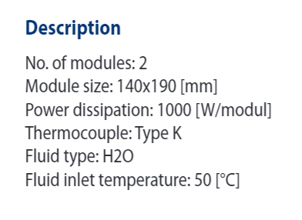
Dimensions - LIQUID COOLING
*Datasheet

Slide 7
Layout Example : Sideview
DC -
DC +
AC
Power Module
Capacitor
Capacitor
Cold Plate
13.2mm
106.4mm
140mm
85mm
85mm

Slide 8
Layout Example : Topview
Capacitor
Capacitor
Power Module
Power Module
Capacitor
Capacitor
Power Module
Cold Plate

Slide 9
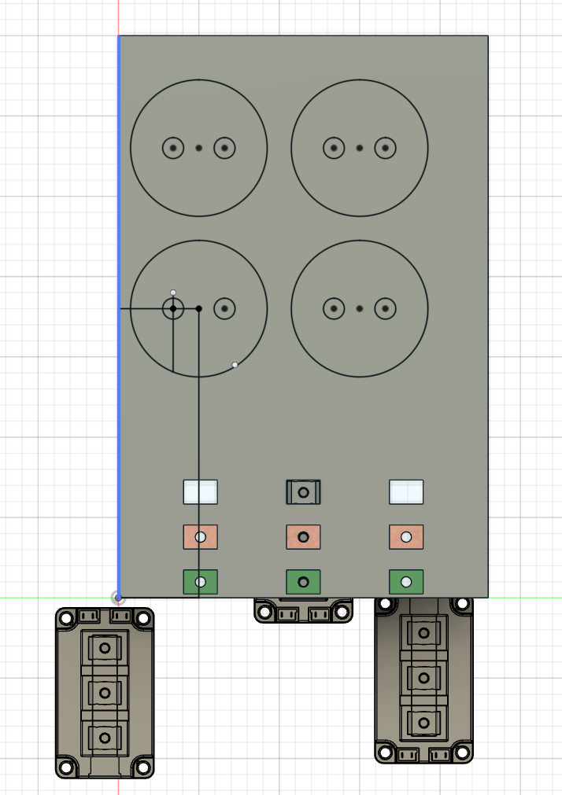
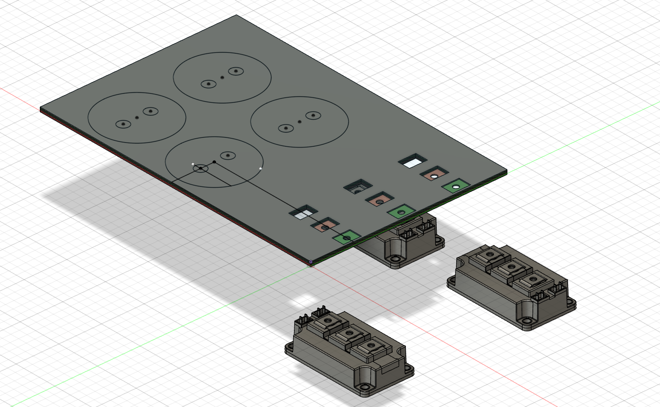
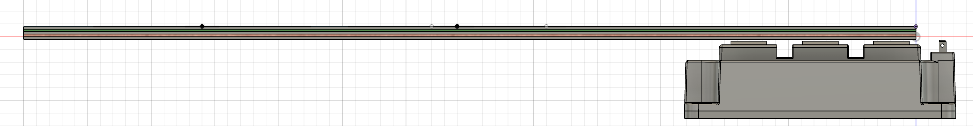
Starting with CAD Drawings

