Slide 1
Holistic Life Cycle Optimization
Development of models and tools:
Models regarding
  Power losses
  Cooling
  Dimensioning
  Cost
  Carbon emission
are needed to be compiled and integrated into software to carry out comprehensive calculations regarding life cycle costs.

Slide 2
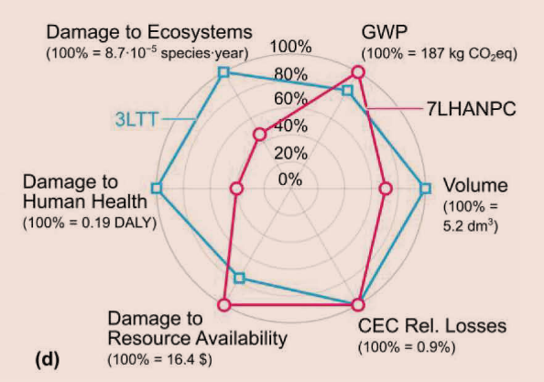
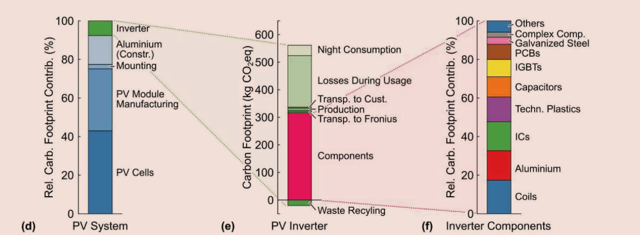
Holistic Life Cycle Optimization
Performance Indices:
─ Power Density [kW/L]
─ Power per Unit Weight [kW/kg]
─ Relative Costs [kW/$]
─ Relative Losses [%]
─ Failure Rate [h-1]
─ Carbon footprint [Co2eq]

Slide 3
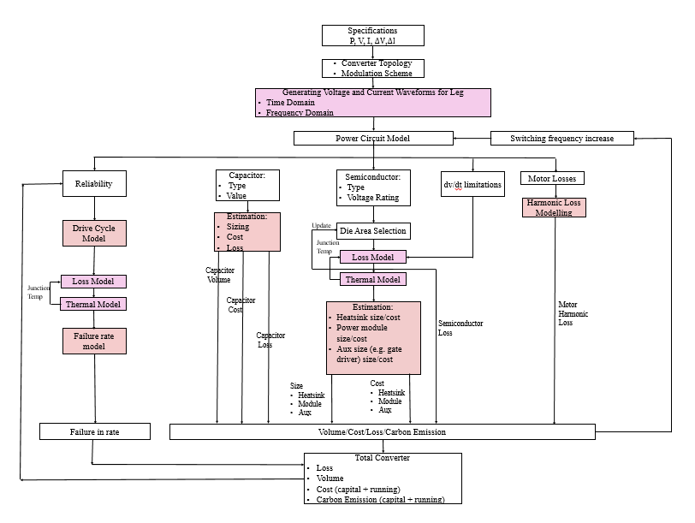
Holistic Life Cycle Optimization

Slide 4
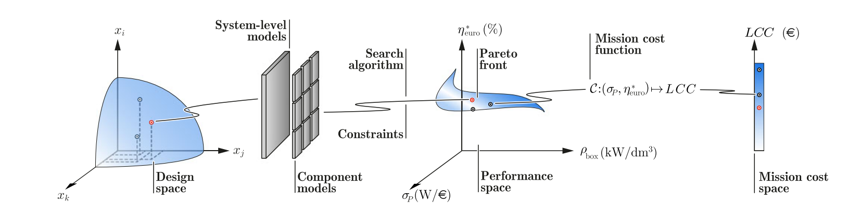
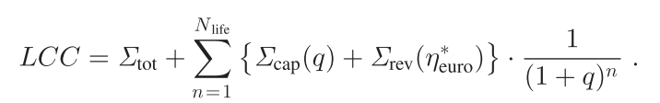
Trade-off of Performance (Cost/Volume/Loss) and Life-cycle-cost analysis
Optimization cost function should be generated.

