Slide 1
2-Level Inverter Loss Analysis: 1700 V SiC Module
Enes Ayaz, KTH

Slide 2
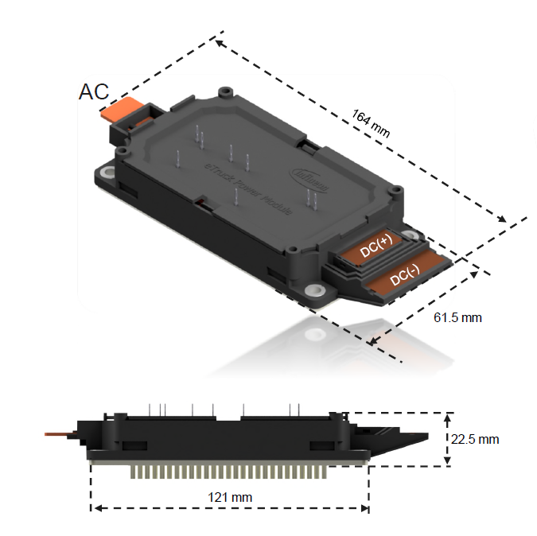
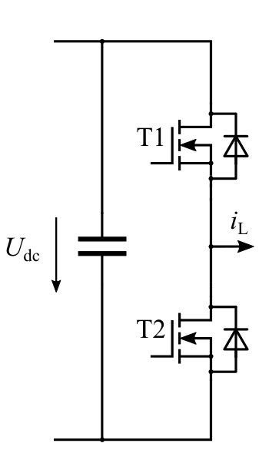
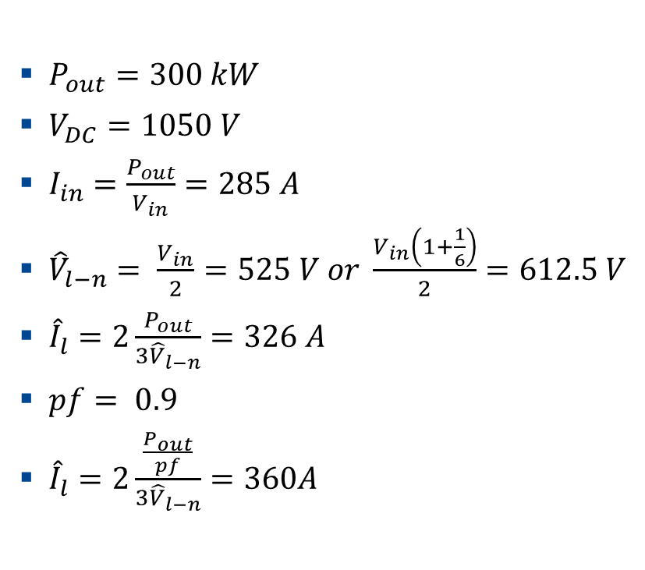
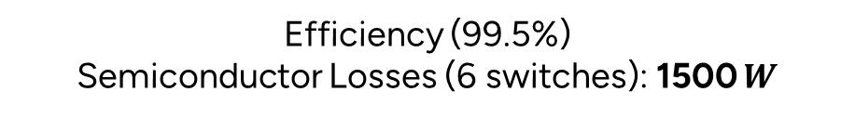
2-Level Inverter Power Ratings
$P_{out}=300 kW$
$V_{DC}=1050 V$
$I_{in}=\frac{P_{out}}{V_{in}}=285 A$
${\hat{V}}_{l−n}= \frac{V_{in}}{2}=525 V or \frac{V_{in}\left(1+\frac{1}{6}\right)}{2}=612.5 V$
${\hat{I}}_{l}=2\frac{P_{out}}{{3\hat{V}}_{l−n}}=326 A$
$pf= 0.9$
${\hat{I}}_{l}=2\frac{\frac{P_{out}}{pf}}{{3\hat{V}}_{l−n}}=360A$
Efficiency (99.5%)
Semiconductor Losses (6 switches): 1500 $W$

Slide 3
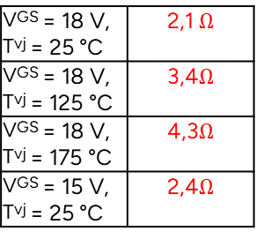

Given Parameters from Infineon
A. Basic Parameters:
Current rating @25°C (in Amperes) $700 A$
On-state resistance @25°C (in Ohms)
Internal gate resistance (in Ohms) ~ $2,1 Ω$
Die Size (mm) $20mm^{2}$ (12 chips)
Thermal resistance (Junction to Fluid) $56\text{°}\text{C}\text{/}\text{kW}$
VGS = 18 V, Tvj = 25 °C | 2,1 $Ω$
VGS = 18 V, Tvj = 125 °C | 3,4$Ω$
VGS = 18 V, Tvj = 175 °C | 4,3$Ω$
VGS = 15 V, Tvj = 25 °C | 2,4$Ω$
per MOSFET, Tf = 60 °C, ΔV/Δt = 10 dm³/min,
50% water / 50% ethylenglycol 56

Slide 4
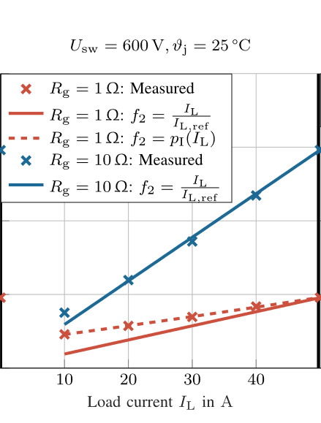

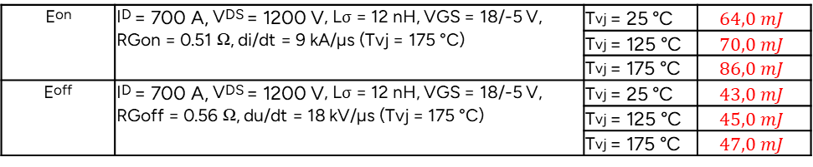
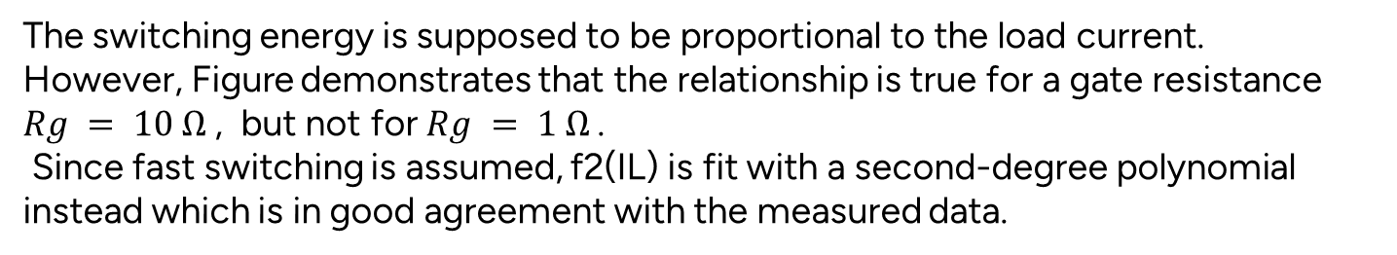
Datasheet-driven Loss Calculation
Voltage rating: 1700V
Current rating: 700A
Eon | ID = 700 A, VDS = 1200 V, Lσ = 12 nH, VGS = 18/-5 V, RGon = 0.51 Ω, di/dt = 9 kA/µs (Tvj = 175 °C) | Tvj = 25 °C | $$64,0 mJ$$
 |  | Tvj = 125 °C | $$70,0 mJ$$
 |  | Tvj = 175 °C | $$86,0 mJ$$
Eoff | ID = 700 A, VDS = 1200 V, Lσ = 12 nH, VGS = 18/-5 V, RGoff = 0.56 Ω, du/dt = 18 kV/µs (Tvj = 175 °C) | Tvj = 25 °C | $$43,0 mJ$$
 |  | Tvj = 125 °C | $$45,0 mJ$$
 |  | Tvj = 175 °C | $$47,0 mJ$$
Fast Switching
The switching energy is supposed to be proportional to the load current.
However, Figure demonstrates that the relationship is true for a gate resistance $Rg = 10 Ω$, but not for $Rg = 1 Ω$.
Since fast switching is assumed, f2(IL) is fit with a second-degree polynomial instead which is in good agreement with the measured data.
Retrieved from Potentials and Comparison of Inverter Topologies for Future All-Electric Aircraft Propulsion

Slide 5
Datasheet-driven Loss Calculation
Linear assumption
Polynomial assumption 1
Polynomial assumption 2
Eon ➔ p1,1=0.007 p1,2=0.5 p1,3=0
Eon ➔ p1,1=0.0107 p1,2=0.25 p1,3=0
Eoff ➔ p1,1=0.011 p1,2=0.5 p1,3=0
Eoff ➔ p1,1=0.0165 p1,2=0.25 p1,3=0
Linear assumption might be the worst-case scenario.

Slide 6
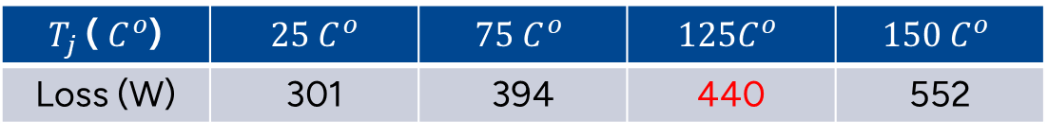
Datasheet-driven Loss Calculation (Conduction)
$T_{j}$ ( $C^{o}$) | $$25 C^{o}$$ | $$75 C^{o}$$ | $$125C^{o}$$ | $$150 C^{o}$$
Loss (W) | 301 | 394 | 440 | 552
Switching energies should be lower than 1060 W.

Slide 7


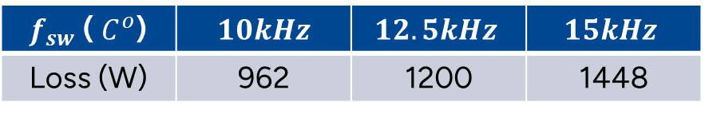
Datasheet-driven Loss Calculation (Switching)
$$10kHz$$
$$10kHz$$
$f_{sw}$ ( $C^{o}$) | $$10kHz$$ | $$12.5kHz$$ | $$15kHz$$
Loss (W) | 962 | 1200 | 1448

Slide 8

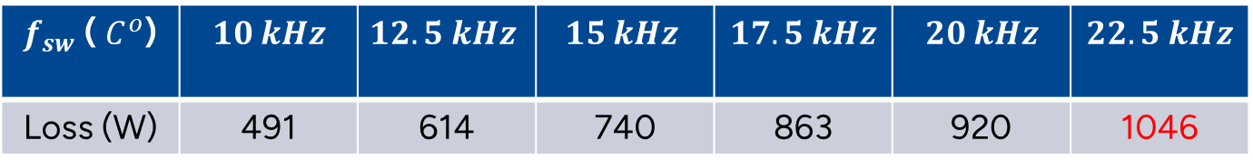

Datasheet-driven Loss Calculation (Switching)
$$10 kHz$$
$$10 kHz$$
Polynomial assumption 2
$f_{sw}$ ( $C^{o}$) | $$10 kHz$$ | $$12.5 kHz$$ | $$15 kHz$$ | $$17.5 kHz$$ | $$20 kHz$$ | $$22.5 kHz$$
Loss (W) | 491 | 614 | 740 | 863 | 920 | 1046

