Slide 1
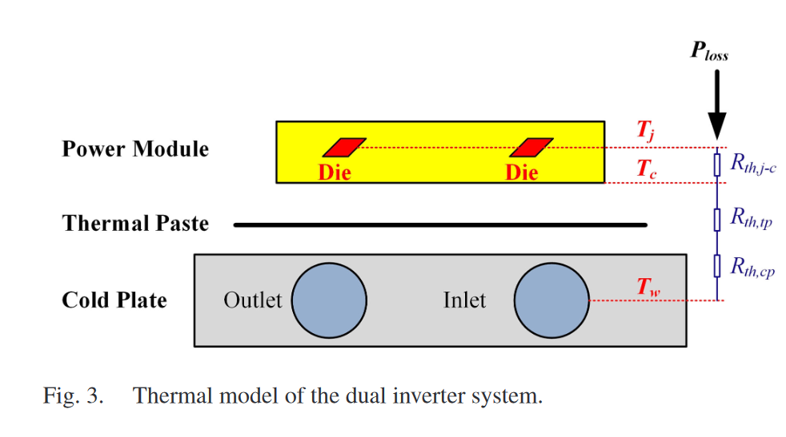
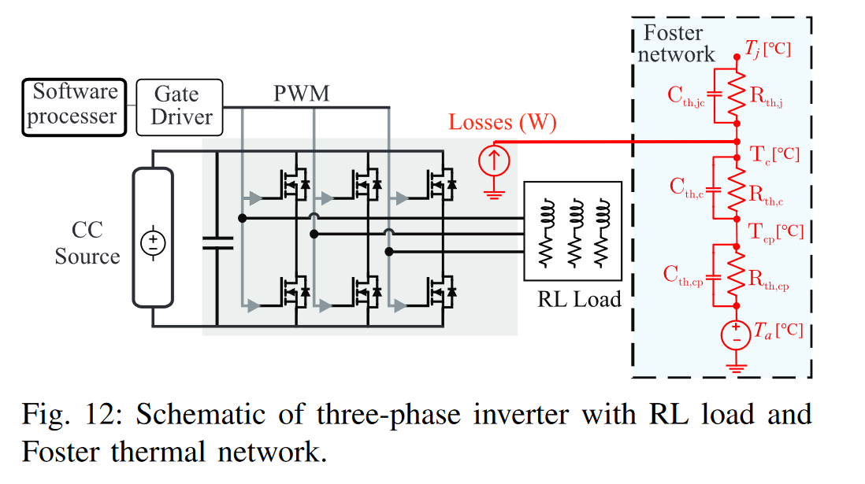

Thermal Modelling
[1] Electrothermal-Control Co-Design of an All Silicon Carbide 2×250 kW Dual Inverter for Heavy-Duty Traction Applications
[2] ANALYSIS AND MODELING OF A LIQUID COOLED HEAT SINK FOR EV TRACTION INVERTER SYSTEMS
The thermal model, including just thermal resistance, is enough to calculate steady-state junction temperature and losses for continuous power operation.
A Foster network is required to consider peak power operation for a finite time.
Continuous rating​
600 kW ​
Short term rating​
20% above the continous rating​
10 s
[3] A SiC-Based Liquid-Cooled Electric Vehicle Traction Inverter Operating at High Ambient Temperature

Slide 2
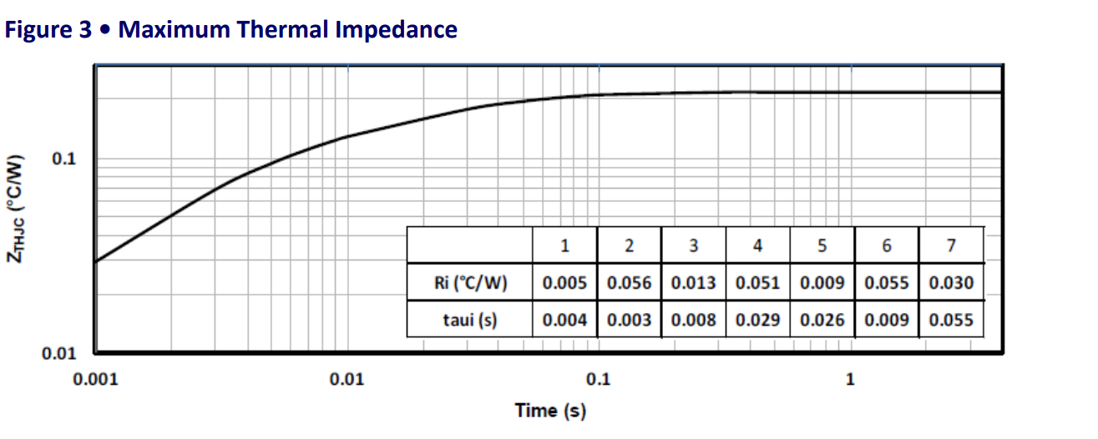
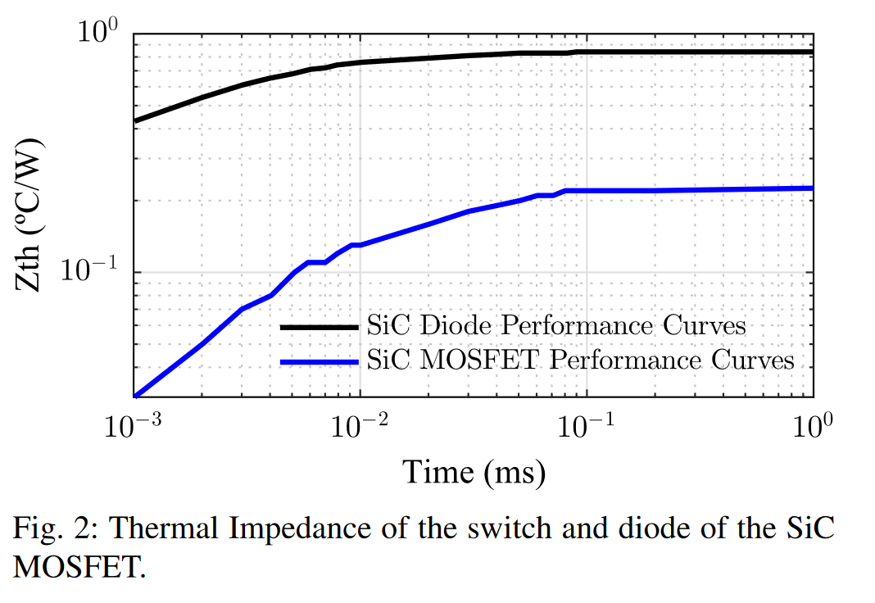
Thermal Modelling
Time constant
Time constant
[4] MSCSM70AM10CT3AG Datasheet Phase Leg SiC MOSFET Power Module https://www.microchip.com/content/dam/mchp/documents/PPM/ProductDocuments/DataSheets/Microsemi_MSCSM70AM10CT3AG_Phase_Leg_SiC_MOSFET_Power_Module_Datasheet_1.0.pdf
[2] ANALYSIS AND MODELING OF A LIQUID
COOLED HEAT SINK FOR EV TRACTION INVERTER SYSTEMS

Slide 3

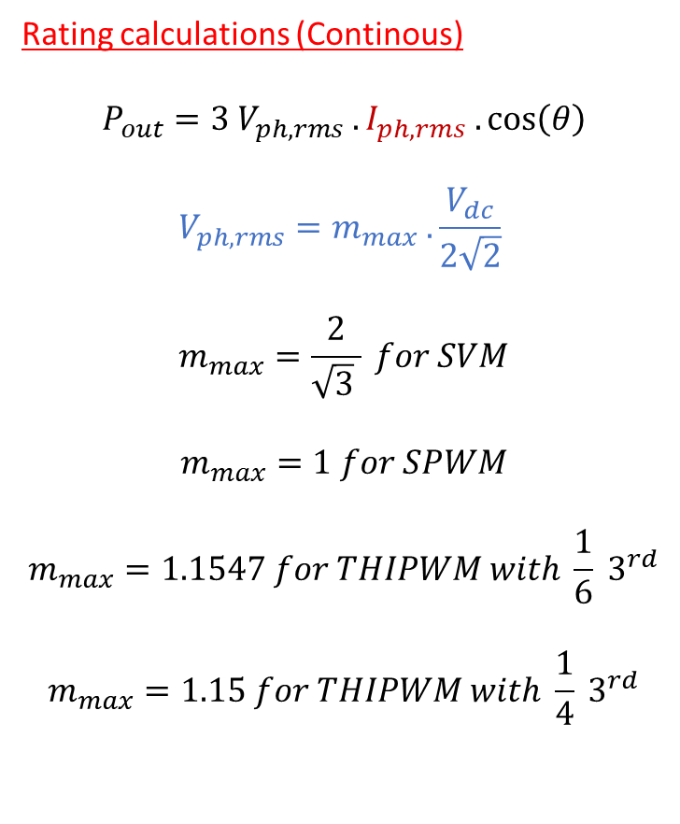
Overall Modelling
Modulations
SPWM
THIPWM
  1/6 THIPWM
  ¼ THIPWM
SVM
DPWM
  ${120}^{o} DPWM$
  ${60}^{o} DPWM$
  ${30}^{o} DPWM$
Rating calculations (Continous)
$$P_{out}=3 V_{ph,rms} . I_{ph,rms} .\cos\left(θ\right)$$
$$V_{ph,rms}=m_{max} .\frac{V_{dc}}{2\sqrt{2}}$$
$$m_{max}=\frac{2}{\sqrt{3} } for SVM$$
$$m_{max}=1 for SPWM$$
$$m_{max}=1.1547 for THIPWM with {\frac{1}{6} 3}^{rd}$$
$$m_{max}=1.15 for THIPWM with {\frac{1}{4} 3}^{rd}$$

Slide 4
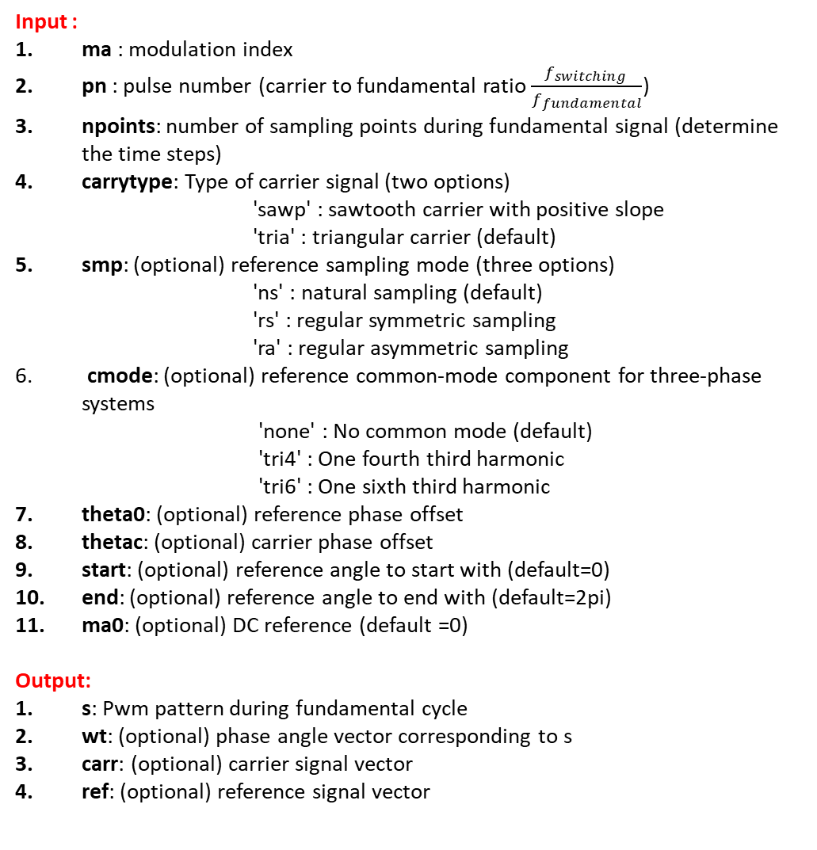
Input :
ma : modulation index
pn : pulse number (carrier to fundamental ratio $\frac{f_{switching }}{f_{fundamental}}$)
npoints: number of sampling points during fundamental signal (determine the time steps)
carrytype: Type of carrier signal (two options)
        'sawp' : sawtooth carrier with positive slope
        'tria' : triangular carrier (default)
smp: (optional) reference sampling mode (three options)
        'ns' : natural sampling (default)
        'rs' : regular symmetric sampling
        'ra' : regular asymmetric sampling
cmode: (optional) reference common-mode component for three-phase systems
        'none' : No common mode (default)
        'tri4' : One fourth third harmonic
        'tri6' : One sixth third harmonic
theta0: (optional) reference phase offset
thetac: (optional) carrier phase offset
start: (optional) reference angle to start with (default=0)
end: (optional) reference angle to end with (default=2pi)
ma0: (optional) DC reference (default =0)
Output:
s: Pwm pattern during fundamental cycle
wt: (optional) phase angle vector corresponding to s
carr: (optional) carrier signal vector
ref: (optional) reference signal vector
ma
Modulation
Function
pn
npoints
s
carrytype
smp
wt
cmode
theta0
carr
thetac
ref
start
end
ma0

Slide 5
SCPAR (Semicondcutor and Thermal Parameters)
SCPAR.SW.TOF.T
SCPAR.SW.TOF.I
SCPAR.SW.TOF.E
SCPAR.SW.TOF.U
SCPAR.SW.TOF.model
SCPAR.SW.TON.T
SCPAR.SW.TON.I
SCPAR.SW.TON.E
SCPAR.SW.TON.U
SCPAR.SW.TON.model
SCPAR.SW.ON.T
SCPAR.SW.ON.I
SCPAR.SW.ON.V
SCPAR.SW.ON.model
SCPAR.SW.NAME
SCPAR.SW.Manuf
SCPAR.SW.RATG.Irat
SCPAR.SW.BV
SCPAR.SW.TH.Rthjc
SCPAR.SW.TH.Rthch
SCPAR.SW.TH.model
SCPAR.SW.NPKG
SCPAR.SW.Package
SCPAR.DI.TOF.T
SCPAR.DI.TOF.I
SCPAR.DI.TOF.E
SCPAR.DI.TOF.U
SCPAR.DI.TOF.model
SCPAR.DI.ON.T
SCPAR.DI.ON.I
SCPAR.DI.ON.V
SCPAR.DI.ON.model
SCPAR.DI.NAME
SCPAR.DI.Manuf
SCPAR.DI.RATG.Irat
SCPAR.DI.BV
SCPAR.DI.TH.Rthjc
SCPAR.DI.TH.Rthch
SCPAR.DI.TH.model
SCPAR.DI.NPKG
SCPAR.DI.Package
SCPAR.HSSW.NAME
SCPAR.HSSW.L
SCPAR.HSSW.Rthha
SCPAR.HSSW.model
SCPAR.HSDI.NAME
SCPAR.HSDI.L
SCPAR.HSDI.Rthha
SCPAR.HSDI.model
SCPAR.igbtareascale
SCPAR.diodeareascale

Slide 6
PC and OP
PC.SC.diodepackincr
PC.SC.Igbtpackincr
PC.SC.Igbtcoolincr
PC.SC.diodecoolincr
PC.SC.seriesautoselect
PC.SC.Nseries
PC.SC.diodefile
PC. SCTHERM.Tjtol
PC. SCTHERM.model
PC. SCTHERM.maxiter
PC.npar
PC.nop
PC.TOPOLOGY
OP.Ta
OP.Ud
PC.SC.seriesmargin

Slide 7
Loss Calculation
Function for 2L
ip
PC.TOPOLOGY
(switch case)
Input
Modulation
Function
f1
scloss2l
vp
Loss Calculation
Function
1
case for 2l
SCLOSS
case for 3l NPC
scloss
2
Dataset
(Semiconductor and Heatsink)
SCPAR
3
case for 3l ANPC
4
case for MMC
5
case for MMC
Parameters for calculations
PC
OP

Slide 8
1. Calculating the number of series IGBTs and Diodes
PC.SC.seriesautoselect
PC.SC.seriesmargin
PC.SC.Nseries
SCPAR.DI.NPKG
SCPAR.SW.NPKG
If PC.SC.seriesautoselect =0
determine # of series IGBTs (N) by PC.SC.Nseries
Then # of series diodes (Nd) N * SCPAR.DI.NPKG / SCPAR.SW.NPKG
If PC.SC.seriesautoselect =1
determine PC.SC.seriesmargin
and # of series IGBTs (N) by PC.SC.seriesmargin *2*max(OP.Ud)/SCPAR.SW.BV
Then # of series diodes (Nd) N * SCPAR.DI.NPKG / SCPAR.SW.NPKG
if isfield(PC.SC,'seriesautoselct')
if PC.SC.seriesautoselct,
N = round(PC.SC.seriesmargin * 2*max(OP.Ud)/SCPAR.SW.BV);
else
N=PC.SC.Nseries;
end;
end
Nd = N*SCPAR.DI.NPKG/SCPAR.SW.NPKG; % no of diodes
Why do we multiply by 2 ?
if we select margin as 1.5, we have a DC link 1250 Voltage and semiconductor with 1200V blocking voltage, our series devices become 3.
Using 3 series device seem not logical?

Slide 9
1. Temperature Tolerance and SCLOSS struct
T0=1/f0; % Fundamental cycle time
thiterate = PC.SCTHERM.model > 1; % Iterate to find proper junction temperatures?
if thiterate, PC.SCTHERM.Tjtol=0.5; end; %tolerance in temperature;
npts=length(Up); % No of time points
PC. SCTHERM.model
PC. SCTHERM.Tjtol
PC. SCTHERM.maxiter
% Reserve space
SCLOSS.SW.Tj = plstruc('Switch junction temperature',zeros(PC.npar,PC.nop),'C',1);
SCLOSS.SW.Pc = plstruc('Switch conduction losses',zeros(PC.npar,PC.nop),'W',1);
SCLOSS.SW.Pton = plstruc('Switch turn on losses',zeros(PC.npar,PC.nop),'W',1);
SCLOSS.SW.Ptof = plstruc('Switch turn off losses',zeros(PC.npar,PC.nop),'W',1);
SCLOSS.SW.Ptot = plstruc('Switch total losses',zeros(PC.npar,PC.nop),'W',1);
SCLOSS.DI.Tj = plstruc('Diode junction temperature',zeros(PC.npar,PC.nop),'C',1);
SCLOSS.DI.Pc = plstruc('Diode conduction losses',zeros(PC.npar,PC.nop),'W',1);
SCLOSS.DI.Ptof = plstruc('Diode turn off losses',zeros(PC.npar,PC.nop),'W',1);
SCLOSS.DI.Ptot = plstruc('Diode total losses',zeros(PC.npar,PC.nop),'W',1);
SCLOSS.Ptot= plstruc('Total semiconductor losses',zeros(PC.npar,PC.nop),'W',1);

Slide 10
Creating Loop for different operation point and area scales
% Check dimension of voltage and current vectors
if size(Up,1) == PC.npar*PC.nop
varsizeopt =1; % option 1
elseif size(Up,1) == PC.npar
varsizeopt =2; % option 2
elseif size(Up,1) == 1
varsizeopt =3; % option 3
else
error('Wrong dimension of ')
end
% Extract vectors with phase current and voltage for this point
switch varsizeopt
case 1
varindex = kop+(kpar-1)*PC.nop;
case 2
varindex = kpar;
case 3
varindex = 1;
end
Ipk = Ip(varindex,:);
Upk = Up(varindex,:);
PC.npar is related to the selection of igbtareascale/diodearescale SCPAR.igbtareascale SCPAR.diodeareascale
PC.nop is related to the selection of operating condition OP.Ta OP.Ud
We should update the plot script as well
PC.npar=length(SCPAR.diodeareascale);
PC.nop=length(OP.Ud);

Slide 11
Finding devices currents and commutations
sw = (Ipk>=0&Upk>0) | (Ipk<0&Upk<=0); % =1 when current passes through switch
di = ~sw; % =1 when current passes through diode
Isw = abs(Ipk.*sw); % current through switch
Idi = abs(Ipk.*di); % current through diode
comm = sw - [sw(end) sw(1:end-1)]; % Nonzero at commutations (NOTE includes natural as well as forced commutations)
s2d=find(comm < -eps); % Find the instants (samples) when current commutates from switch to diode
d2s=find(comm > eps); % Find the instants (samples) when current commutates from diode to switch
is2d = abs(Ipk(s2d)); % Current at commutations switch to diode
id2s = abs(Ipk(d2s)); % Current at commutations diode to switch
Tjdi = OP.Ta(kop); % Inital junction temp value for iteration
Tjsw = OP.Ta(kop); % Inital junction temp value for iteration
niter=0;
go=1;

Slide 12
Thermal iteration-Loss Calculation
Pcsw = Isw*Von(SCPAR.SW.ON,Tjsw,Isw/SCPAR.igbtareascale(kpar))/npts/2; % '/2' -> Loss in one of two devices in a phase leg
Pcdi = Idi*Von(SCPAR.DI.ON,Tjdi,Idi/SCPAR.diodeareascale(kpar))/npts/2;
Ptonsw = SCPAR.igbtareascale(kpar)*sum(swloss_calc(SCPAR.SW.TON , Tjsw , 2*OP.Ud(kop)/N , id2s/SCPAR.igbtareascale(kpar))) / T0 / 2;
Ptofsw = SCPAR.igbtareascale(kpar)*sum(swloss_calc(SCPAR.SW.TOF , Tjsw , 2*OP.Ud(kop)/N , is2d/SCPAR.igbtareascale(kpar))) / T0 / 2;
Ptofdi = SCPAR.diodeareascale(kpar)*sum(swloss_calc(SCPAR.DI.TOF , Tjdi ,2*OP.Ud(kop)/Nd , id2s/SCPAR.diodeareascale(kpar))) / T0 / 2;
Ptotsw = Pcsw + Ptonsw + Ptofsw;
Ptotdi = Pcdi + Ptofdi;

Slide 14
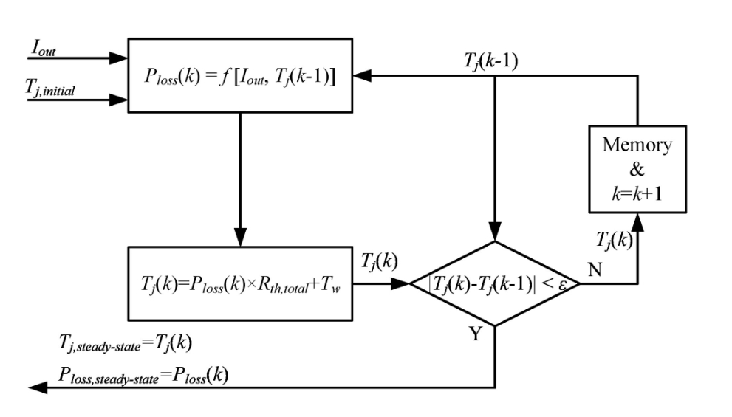
Thermal Modelling

