Slide 1
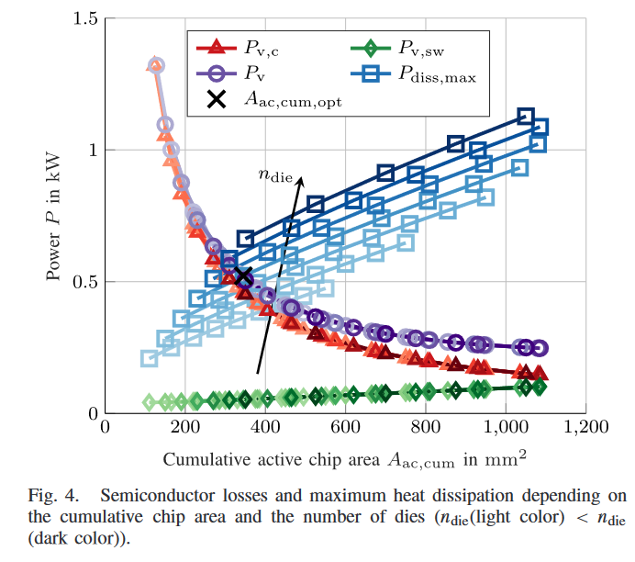

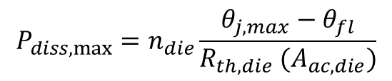
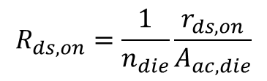
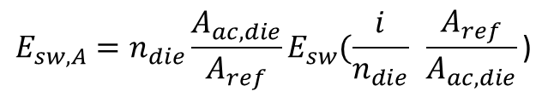
The intersection of the total losses $P_{v} = P_{v,c} +P_{v,sw}$ with the maximum heat dissipation $P_{diss,max}$where both the cumulative chip area and the losses are minimal, marks the design point of the semiconductor under consideration.
$$R_{ds,on}=\frac{1}{n_{die}}\frac{r_{ds,on}}{A_{ac,die}}$$
$P_{v,c}$and decreases with increasing chip area.
$$E_{sw,A}=n_{die}\frac{A_{ac,die}}{A_{ref}}E_{sw}(\frac{i}{n_{die}} \frac{A_{ref}}{A_{ac,die}}\text{)}$$
The switching energy occurs in each die and grows with increasing chip areas
$$P_{diss,max}=n_{die}\frac{θ_{j,max}−θ_{fl}}{R_{th,die} (A_{ac,die})}$$
The thermal resistance is decreasing with increasing chip areas leading to a growth in the total maximum heat dissipation

Slide 4
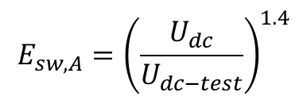
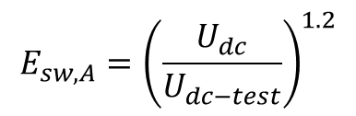
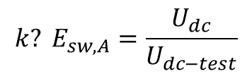
$${k? E}_{sw,A}=\frac{U_{dc}}{U_{dc−test}}$$
$$E_{sw,A}={\left(\frac{U_{dc}}{U_{dc−test}}\right)}^{1.2}$$
$$E_{sw,A}={\left(\frac{U_{dc}}{U_{dc−test}}\right)}^{1.4}$$
We have two datasheet values as $U_{dc−test}=900$ and $U_{dc−test}=1200$
which also means that we have local loss minimal for higher switching frequencies

Slide 5

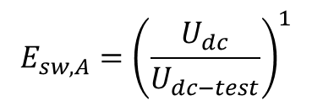
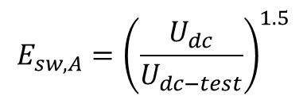
While only using $U_{dc−test}=1200$
$$E_{sw,A}={\left(\frac{U_{dc}}{U_{dc−test}}\right)}^{1}$$
$$E_{sw,A}={\left(\frac{U_{dc}}{U_{dc−test}}\right)}^{1.5}$$

Slide 6





Switching Losses
For examining the SiC MOSFET switching losses, the parameters $k_{sw,dss}$, $I_{L}$, $θ_{j}$, and $U_{dss}$ are analyzed individually, while the others are assumed to be constant.
1. The switching energy is proportional to $U^{1.5}$
2. The switching energy is supposed to be proportional to the load current. Since fast switching is assumed, f2(IL) is fit with a second-degree polynomial instead which is in good agreement with the measured data
3. The function for the temperature effect fits with a first-degree polynomial
4. If the voltage slew rate is not limited and the voltage utilization factor is constant (ksw,dss = (Usw/Udss) = const.), the charge Qoss and consequently the switching time tsw are constant. Therefore, the switching energy is proportional to the rated voltage.

Slide 7
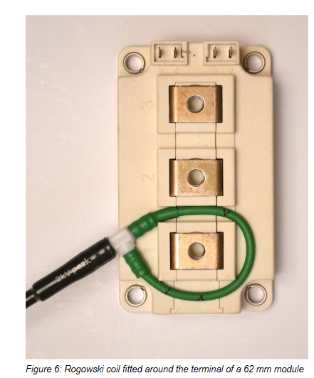
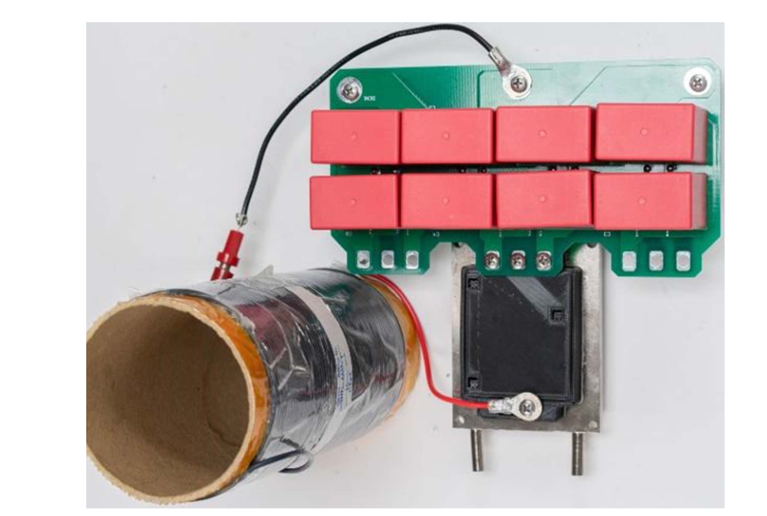
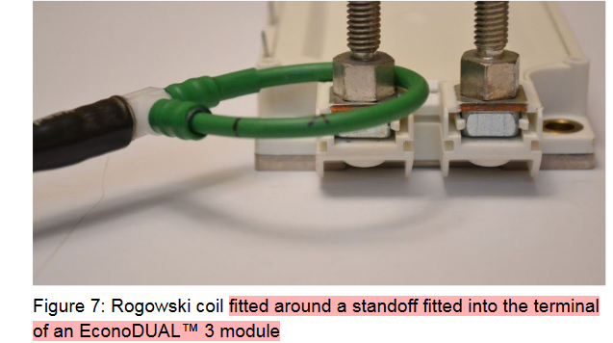
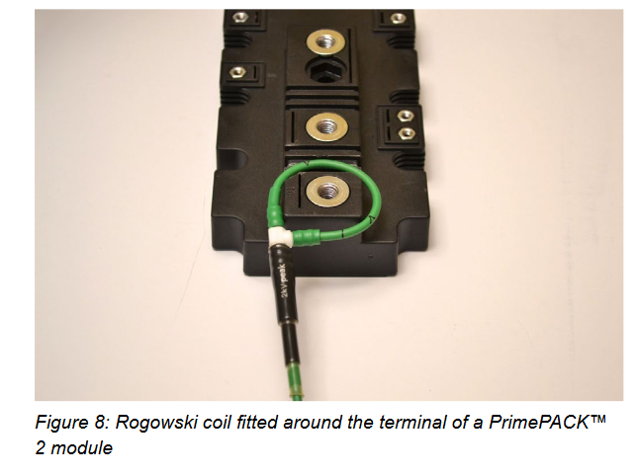
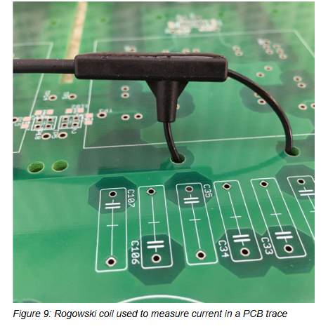
1. A Low Inductance, High Power Density 3L-TNPC Power Module for More-Electric Aircraft Applications
2. Double Pulse Testing: The How, What and Why

Slide 8
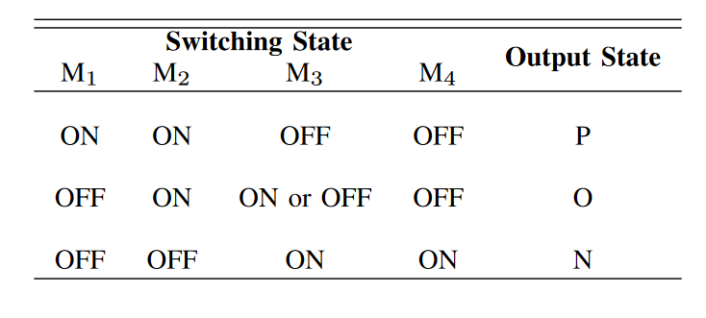
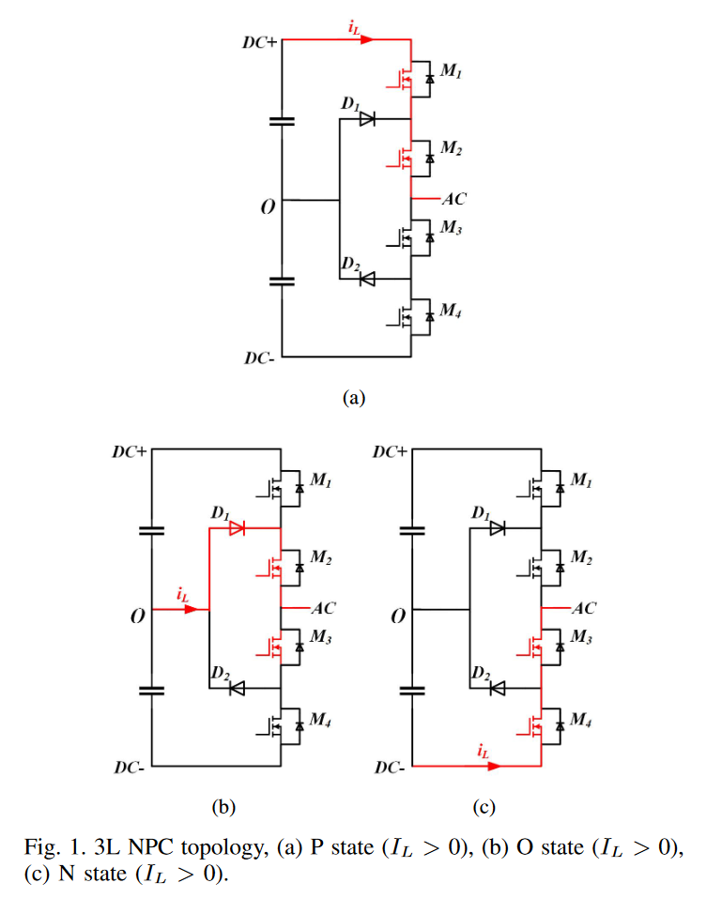
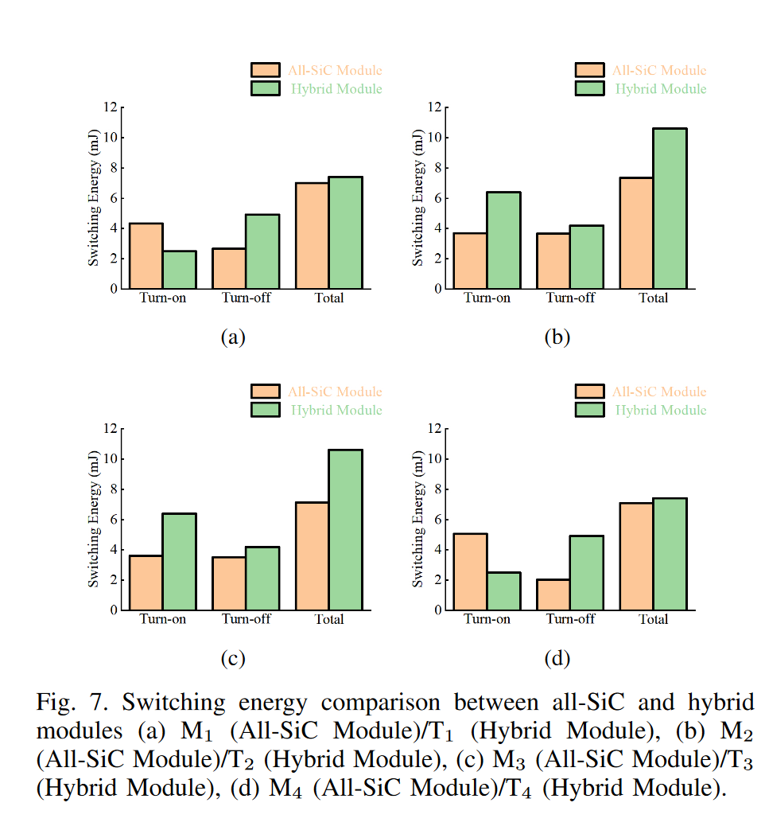

Slide 9
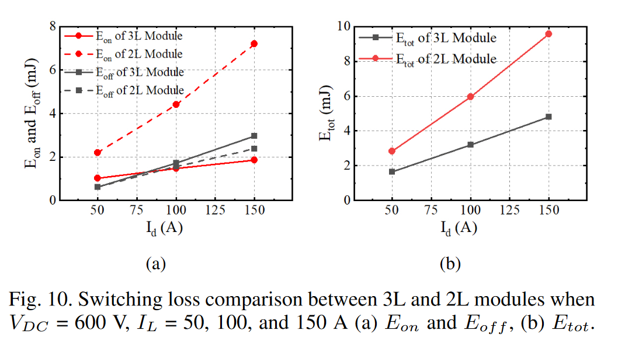
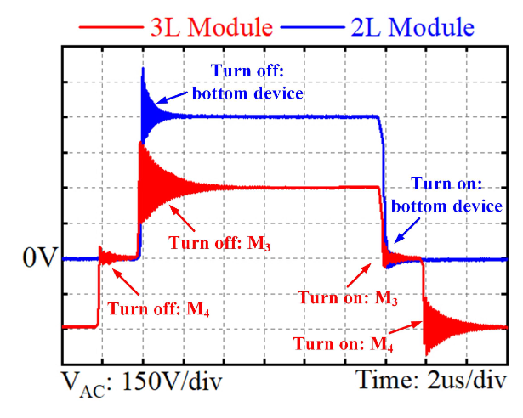
3L NPC topology including two hard-switches in a complete switching period, and the voltage stress on each device has been halved. Compared with its 2L counterpart, there is a nearly 50% reduction of the total switching loss can be achieved with the 3L module

Slide 10

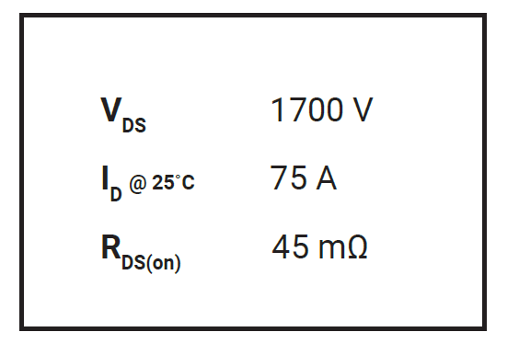
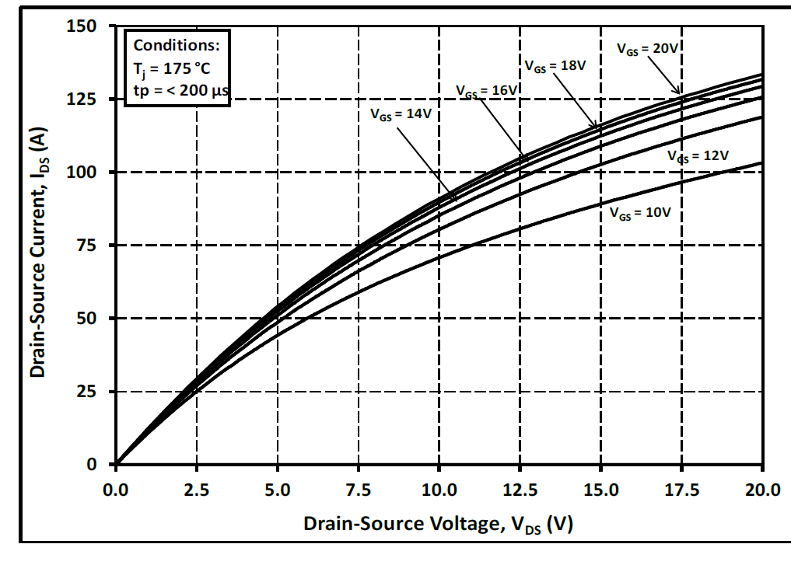
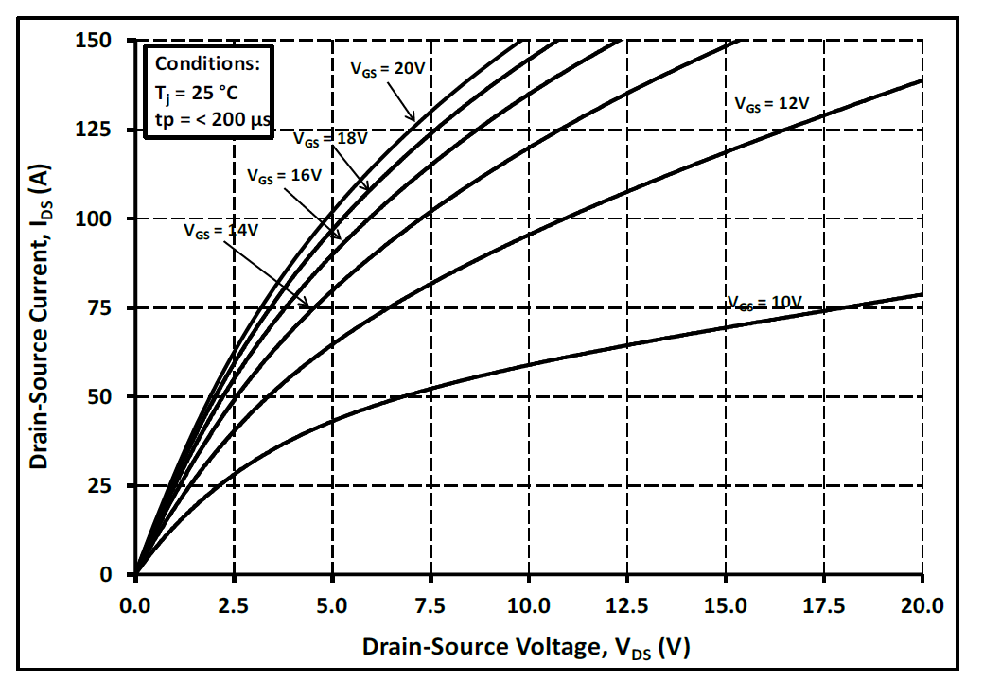
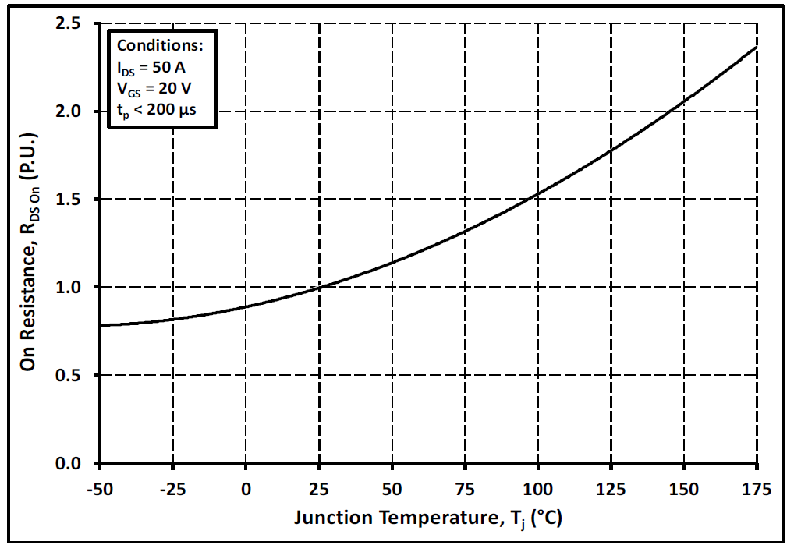
Bare Die Datasheet
Only we have conduction loss parameters changing with different switch current and junction temperature.

