Slide 1
Evaluation of Possible Traction Inverter Topologies for Heavy-Duty Electric Vehicles
Enes Ayaz

Slide 2

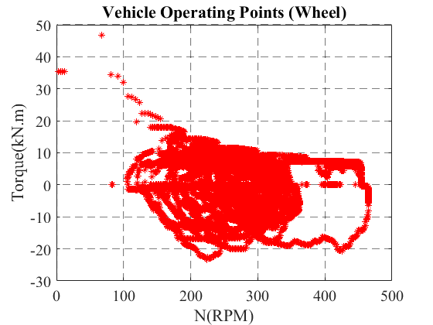
Introduction
The shift towards electrifying heavy-duty vehicles is driven by the increasing need for sustainable transportation solutions to address environmental challenges and reduce emissions.
Main Differences Between Electric Trucks and Passenger Electric Vehicles:
Power Ratings: Electric trucks require high power ratings, typically exceeding 300 kW, to handle heavy loads.
Megawatt charging systems (MCS) are essential to support rapid charging, aligning with the operational demands of electric trucks.
European Union's regulation on driving times
  Drivers may drive for a maximum of 4.5 hours continuously.
  After 4.5 hours, a driver must take a minimum 45-minute rest.
.

Slide 3
Design Chapters on Traction Inverters
Topology:
  2-level three-phase VSI for low-cost and simple control.
  Multi-level inverters enable higher DC-link voltages with lower voltage-rated switches.
  Multiphase inverters handle high currents effectively.
Power Switches:
  IGBTs were favored for their affordability, maturity of technology, and reliability.
  SiC and GaN devices improve power density and efficiency.
DC-Link Voltage:
  400 V was standard, and 800 V was emerging with SiC technology.
  High voltages (above 1kV) support megawatt charging.
DC-Link Capacitance:
  The polymer film is used as the dc-link capacitor for electric drive applications because of its reliability, high-current conduction capability, high-frequency operation, and lower losses compared with aluminum electrolytic capacitors.
Thermal Management:
  Cold plates with liquid-cooling-based systems are common.

Slide 4

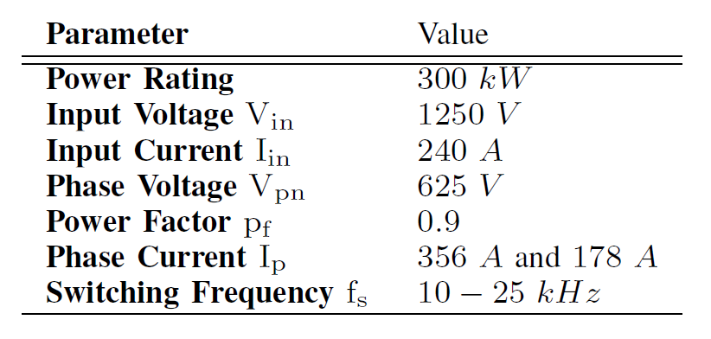
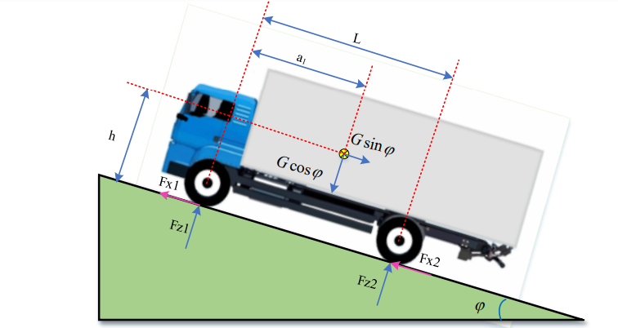
System Specifications
DC-Link Voltage:
1250 V was chosen for efficient and reliable megawatt charging.
Power Rating:
Determined by vehicle dynamics and heavy-duty vehicle load.

Slide 5
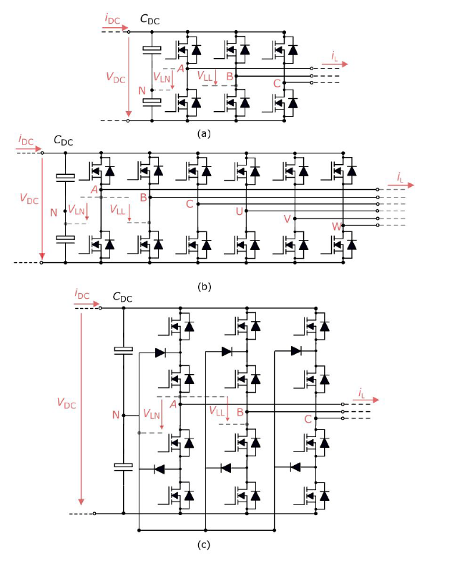
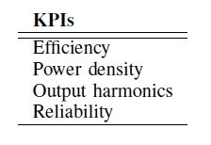
Evaluated Topologies and KPIs
Evaluated Traction Inverters:
a) 2-Level 3-phase voltage source inverters.
b) 2-level 6-phase voltage source inverters.
c) 3-level neutral point clamped inverters.
Traction Machines:
Two options: 3-phase and 6-phase.
Both maintain the same phase voltage.
In order to compare the evaluated topologies, there are several key performance indices (KPIs).

Slide 6
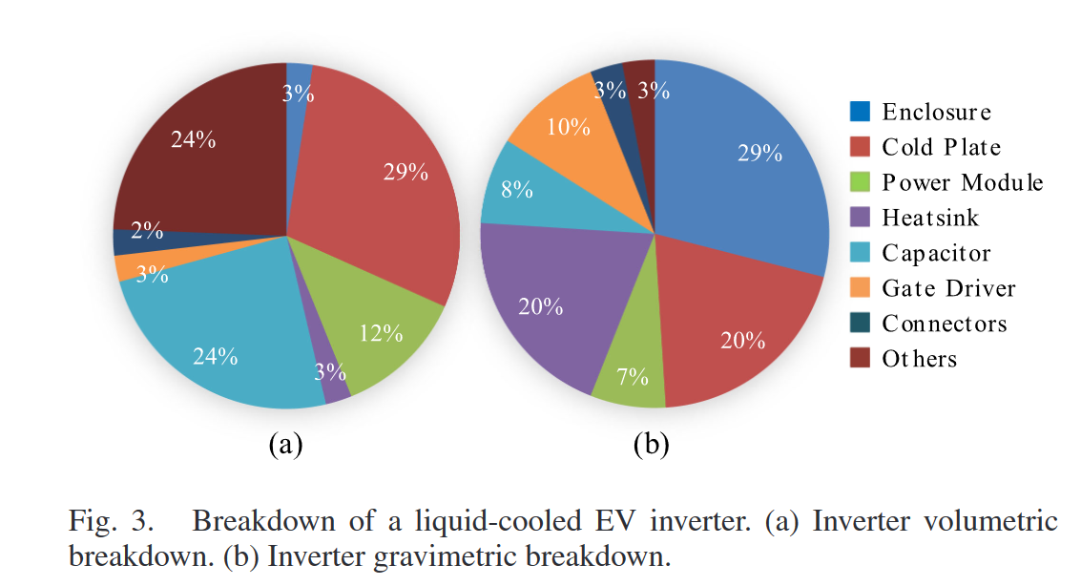
Methodology and Modelling
The Virtual Prototyping Method:
This methodology utilizes Figure-of-Merit (FOM) parameters without specific off-the-shelf components.
This approach offers a system-level understanding of the performance characteristics and technological limits.
The modeling includes:
  Semiconductor loss calculation,
  Cooling system size estimation,
  DC-link capacitance requirement estimation,
  Output harmonics calculation.
Volumetric Breakdown of an EV inverter.
68% of overall inverter volume and the majority of overall inverter losses.
Effect on the traction machine harmonic losses.

Slide 7
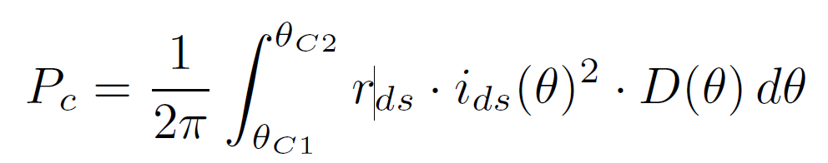
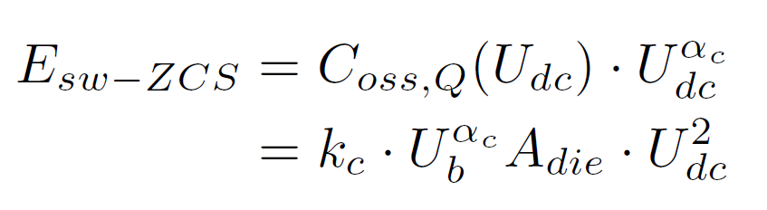
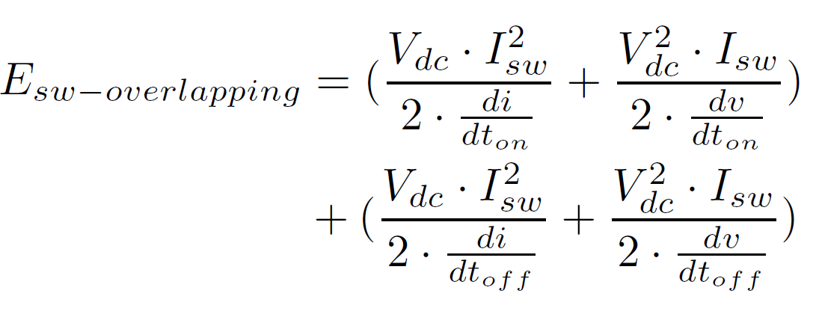
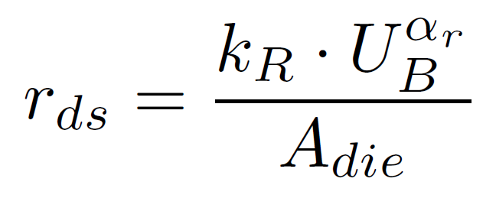
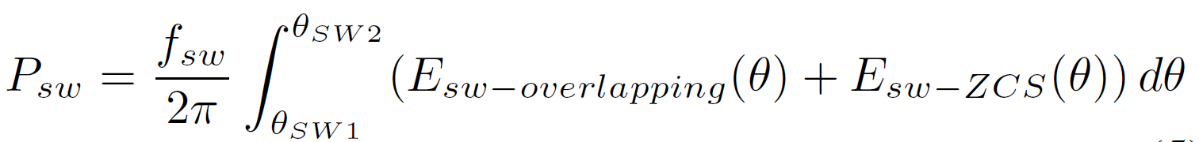
Semiconductor Loss Calculations
The semiconductor losses are divided into two main parts: conduction and switching losses.
Conduction Loss
Switching Losses
The zero current switching energy is reliant on the output capacitance (Coss,Q) and switching voltage (Udc).
where duty cycles (D(θ)), switch current (ids(θ)), conduction angles (θC1 to θC2), and on-state resistance (rds) are required.
dV/dt and di/dt should be selected regarding layout parasitics, gate driver and isolation requirements of the motor.
The on-state resistance depends on the voltage rating (UB) and die area (Adie) that can be roughly calculated:
θSW1 and θSW2 are switching angles.
where kr and αr are technology-dependent coefficients.

Slide 8
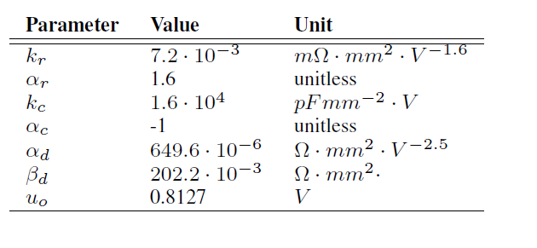
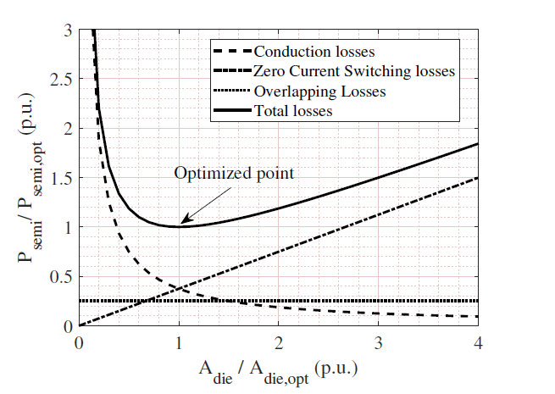
Switching Ratings Selection and FOM Parameters
Voltage rating:
It is often selected higher than the blocking voltage with a safety factor to account for voltage overshoots caused by high-switching speeds and layout parasitics and the effect of cosmic rays on reliability.
In our system, the safety factor of 1.36 is selected, leading to the switches’ voltage ratings of 1700 V for 2-level topologies and 850 V for 3-level topologies.
The die area will be chosen in the next slide by
comparing the switching frequency and dv/dt .
Current rating:
The optimal die area or current rating of the switch plays a critical role in the efficiency performance of the inverter. The appropriate die area depends on the switching frequency and the voltage change rate (dV/dt).
FOM parameters for SiC MOSFETS:

Slide 9
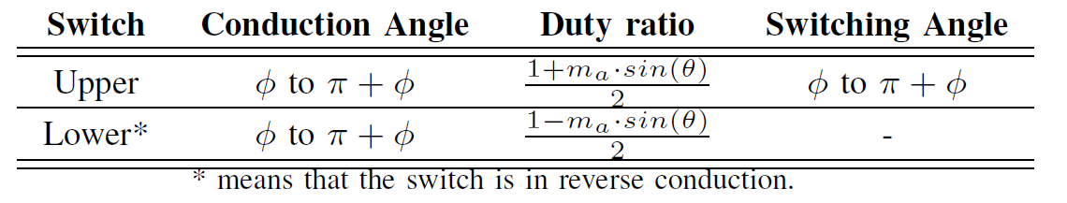
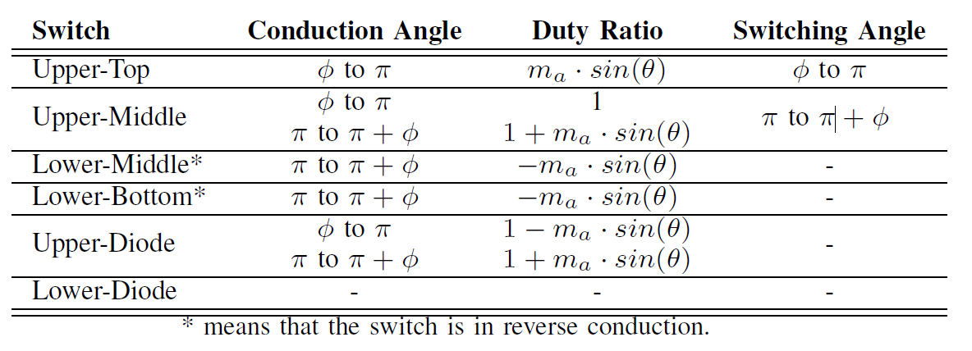
Implementation of the Loss Modelling in Different Topologies
The conduction and switching angles are employed in calculating the semiconductor losses.
However, these angles vary based on different topologies.
2-level inverters
3-level NPC inverter

Slide 10
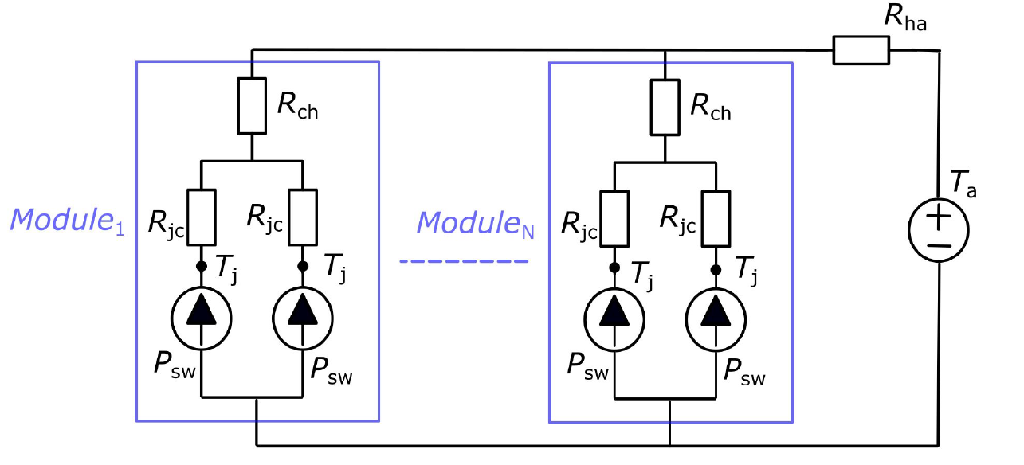
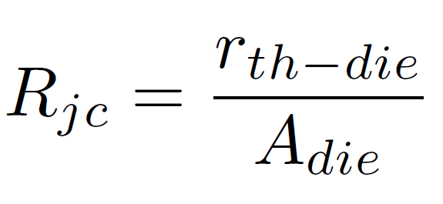
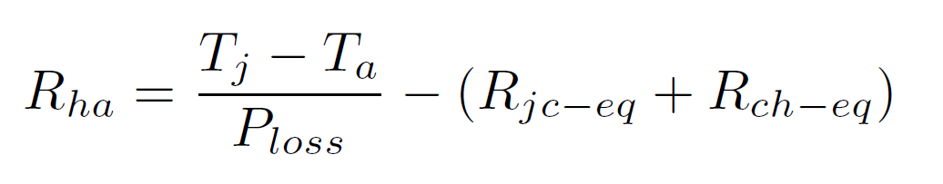
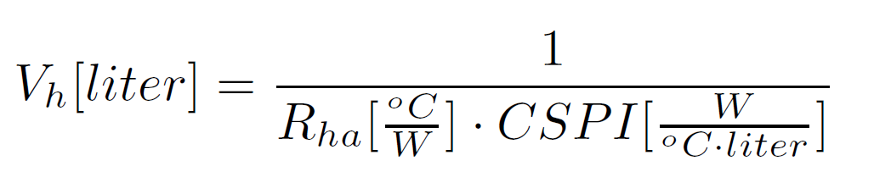
Cooling System Size Estimation
An Example Of A Thermal Circuit For Inverter
The thermal resistance from the junction to case decreases as the chip area increases.
Even if the total losses are the same for different topologies, the loss distribution and total die area lead to different heatsink sizes while keeping the junction temperature constant. For a simplified calculation, the thermal resistance for the heatsink can be determined as given by
where Rjc is junction-to-case thermal resistance, Rch is case-to-heatsink thermal resistance, Rha is heatsink-to-ambient thermal resistance, Tj is junction temperature, and Ta is ambient temperature.
The heatsink volume can be estimated by utilizing the cooling system performance index (CSPI).

Slide 11
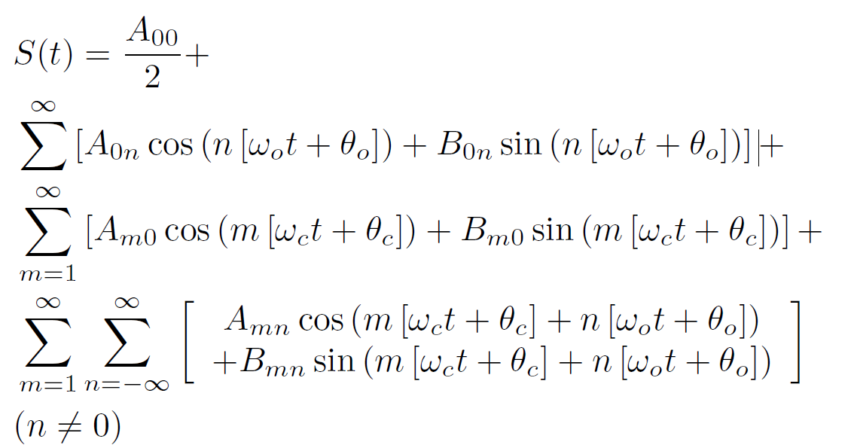
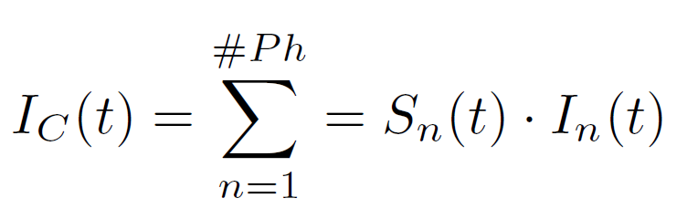
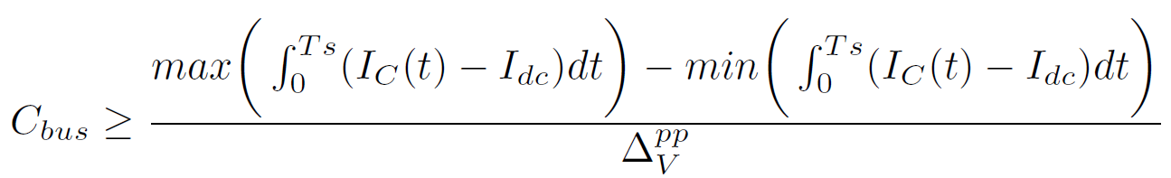
DC-link Capacitance Requirements
The selection of DC link capacitance relies on various factors such as switching frequency, voltage ripple requirements, line current, modulation technique, etc.
The switching functions (Sn(t)) are different in 2-level and 3-level inverters, and they can be calculated by using double Fourier series expansions as given by
Certain assumptions have been made:
The chosen modulation technique is carrier-based sinusoidal pulse width modulation (SPWM).
The line current is considered pure sinusoidal.
All harmonics are considered to be provided by the DC-link capacitors, whereas DC current comes from the battery.
The capacitor current in the time domain (IC(t)) can be calculated as given by
Given the switching functions, the capacitance requirement is numerically calculated as given by
where Sn(t) is the switching function of the top switches of the nth phase and In(t) is the current of the nth phase.
where ΔV pp is a specific peak-to-peak voltage ripple.

Slide 12
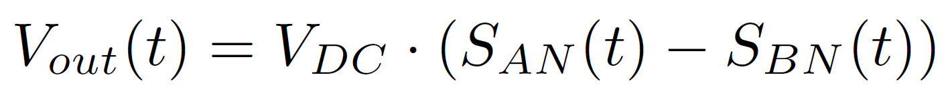
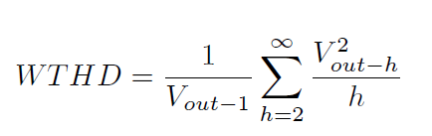
Output Harmonics
The switching functions are used to calculate the differential output harmonics as given by
Since the load of the inverter is inductive, the harmonic component’s impact decreases while increasing the harmonic numbers. Therefore, weighted total harmonic distortion, as given by
which can be used as an indicator for the harmonic quality of the output.

Slide 13
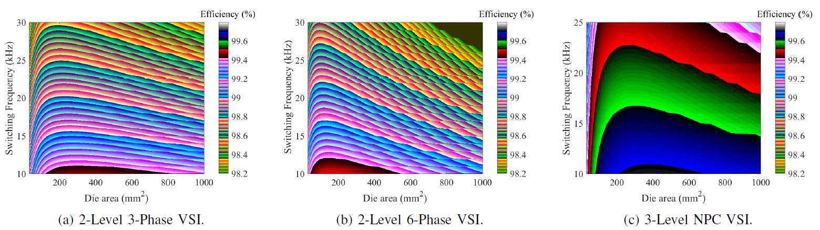
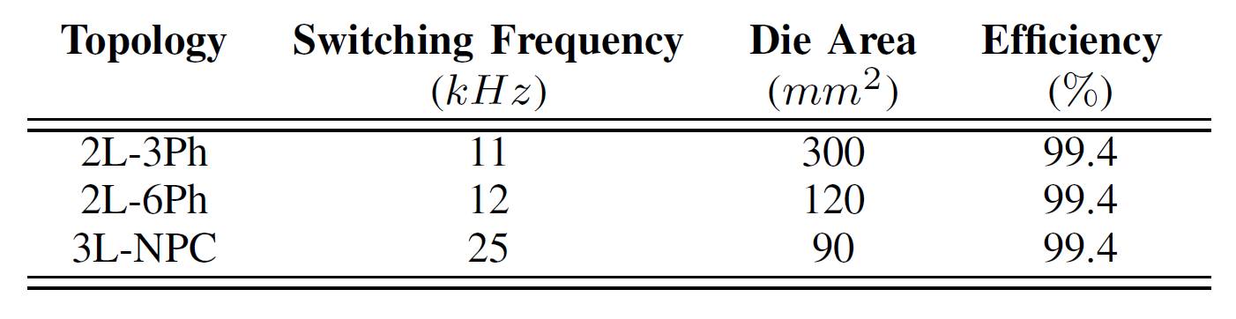
Results – Die Area and Switching Frequency Selection
The efficiency assessment of various topologies has been carried out through a sweep of die area and switching frequency to identify an optimal operation point that minimizes inverter losses.
An operation point is selected for all topologies at 99.4 percent efficiency. Each topology’s switching frequency and die area information for these operation points are given below.

Slide 14
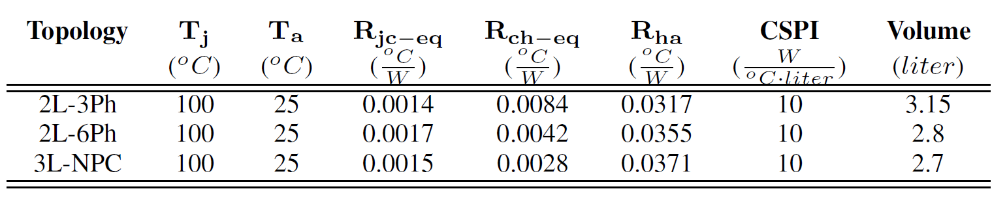
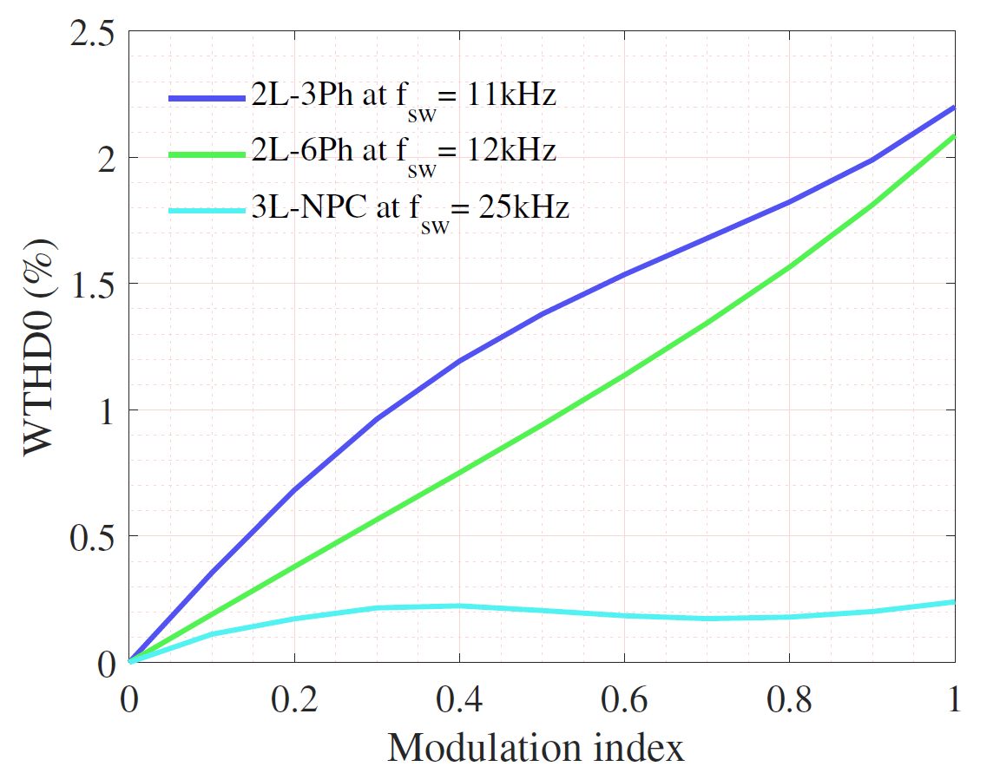
Results – Cooling System Size and Output Harmonics
The topologies’ thermal parameters and the required heatsink’s thermal resistance are calculated, and CSPI is taken as 10 for a water-cooling system, ignoring the heat-exchanger volume.
WTHD is a useful metric to account for motor harmonic losses without exact calculation. WTHDs of three topologies with given switching frequencies are computed.
The output harmonic quality of 3L-NPC VSI surpasses the other topologies, as expected, since it enables higher switching frequency and a 5-step voltage level at the output.

Slide 15
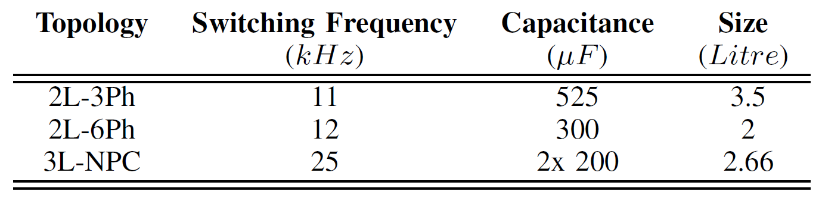
Results – DC-link Capacitance and Reliability
The capacitance requirements are computed and the volume estimation is carried out with the aid of [1].
It is observed that the lowest capacitance demand is in the 2L-6Ph inverter, even though the applied switching frequency is lower than that of the 3L-NPC inverter.
2L-3Ph VSIs would offer higher reliability than other topologies due to fewer switch and gate drive failure points. However, the switches in these inverters pose higher thermal stress resulting from higher semiconductor losses, which can lead to fatigue failures.
2L-6Ph VSIs possess built-in redundancy that can operate in 3 phases, allowing them to function with reduced power in case of a failure and enhancing system reliability.
DC-link capacitors are often the root cause of failures in traction inverters. Accordingly, 3L-NPC VSIs pose less stress on the DC-link capacitors, improving reliability.
[1] Y. Wu, M. J. Hoque, M. H. Mahmud, E. M. Allee, A. A. Lad, Y. Zhao, H. A. Mantooth, and N. Miljkovic, “Electrothermal-control co-design of an all silicon carbide 2×250 kw dual inverter for heavy-duty traction applications,” IEEE Transactions on Industry Applications, vol. 58, no. 1, pp. 505–516, 2022.

Slide 16
Summary
Topology Comparison:
  3-Level NPC VSI outperforms 2-Level 3-Phase VSI and 2-Level 6-Phase VSI in key performance indices.
  The evaluation was conducted using virtual prototyping and figure-of-merit parameters for a fair comparison.
Advantages of 3L-NPC VSI:
  Utilizes lower voltage-rated MOSFETs, reducing switching losses.
  Higher switching frequency improves output harmonic quality.
  Reduced need for passive components due to an additional output voltage level.
Key Findings:
  3L-NPC VSIs are a viable solution for heavy-duty EVs, meeting specifications for high DC-link voltages and power ratings.

Slide 17

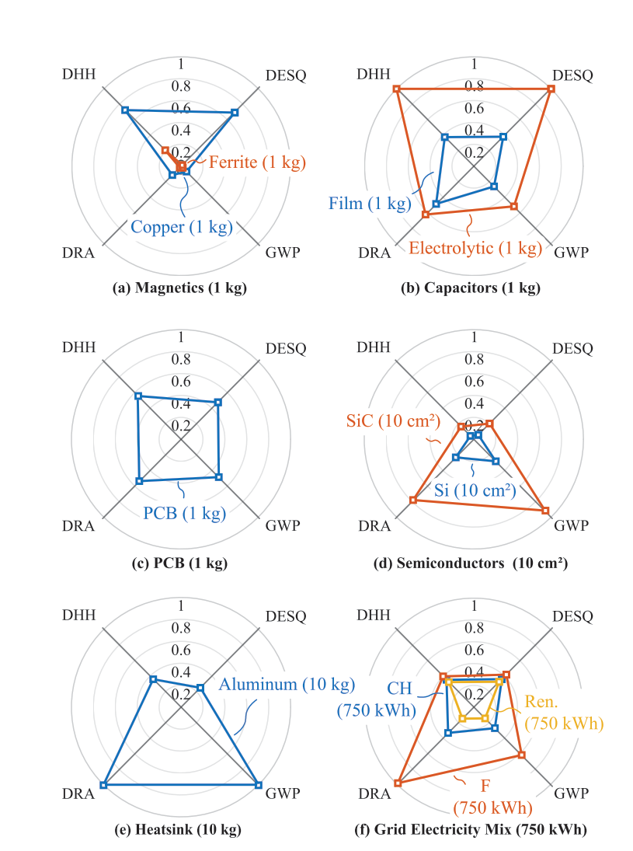
Future Work
Energy Efficiency and Beyond:
Traditional power converter optimization focuses on efficiency and power density.
Environmental impacts across the inverter's lifecycle and reliability are often overlooked but crucial for sustainability.
How can we integrate life-cycle environmental impacts with traditional performance metrics (efficiency, power density, reliability)?
The need for multi-objective optimization frameworks that include:
  Global Warming Potential (GWP)
  Damage to Eco-System Quality (DESQ)
  Damage to Resource Availability (DRA),
  Damage to Human Health (DHH)

Slide 18
Thank you !!!
Research leading to these results has received funding from the EU CHIPSJoint Undertaking under grant agreement no 101007326 (project PowerizeD) and from the (Swedish) partner national funding authority Vinnova. Funding for this research has also been received from the Swedish Energy Agency through the HEMIZERO project.

