Slide 1
UC 1.4 / 2-Level Voltage Source Traction Inverter Design using 2kV Infineon SiC Power Modules
Enes Ayaz, KTH

Slide 2
Agenda
  Power Ratings of 2-Level Inverter
  Power Modules (Infineon 2kV) Parameters
  Inverter Loss Estimation with Datasheet Values
  Harmonic Losses on the Motor
  Die area and Switching Frequency Selection (Total Losses)

Slide 3
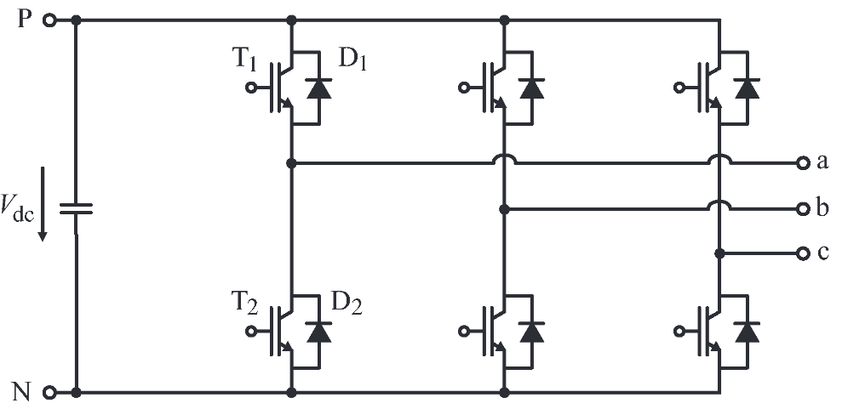
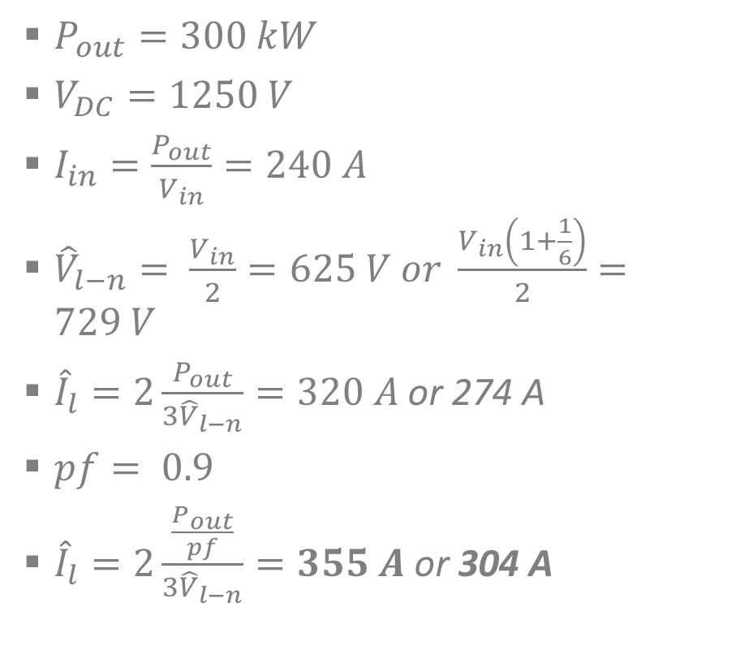

2-Level Inverter Power Ratings
$P_{out}=300 kW$
$V_{DC}=1250 V$
$I_{in}=\frac{P_{out}}{V_{in}}=240 A$
${\hat{V}}_{l−n}= \frac{V_{in}}{2}=625 V or \frac{V_{in}\left(1+\frac{1}{6}\right)}{2}=729 V$
${\hat{I}}_{l}=2\frac{P_{out}}{{3\hat{V}}_{l−n}}=320 A$ or 274 A
$pf= 0.9$
${\hat{I}}_{l}=2\frac{\frac{P_{out}}{pf}}{{3\hat{V}}_{l−n}}=355 A$ or 304 A
Efficiency (99.5%)
Semiconductor Losses (6 switches): 1500 $W$

Slide 4

Parameters of Infineon 2kV Bare die
Basic Parameters of Bare die:
Current rating @25°C (in Amperes) $40A$
On-state resistance @25°C (in Ohms) $26 mΩ$
Internal gate resistance (in Ohms) ~ $7,2 Ω$
Die Size (mm x mm) 5,71 x 5,24 mm
Thermal resistance (Junction to Case) (in °C/W) 0.0880 K/W per Mosfet (8 or 10 dies )
Case to heat sink: 0.0330 K/W
Zero Current Loss (Output Capacitance Loss) ~ $1.25 mJ. f_{sw}, 1 mJ. f_{sw}$

Slide 5

Datasheet-Driven Loss Estimation
Voltage rating: 2kV
Current rating: 400A
FF3MR20KM1H using 10 dies in parallel
58 mJ at 304 A
17 mJ at 304 A
$$\frac{26}{10}=2.6mΩ$$

Slide 6
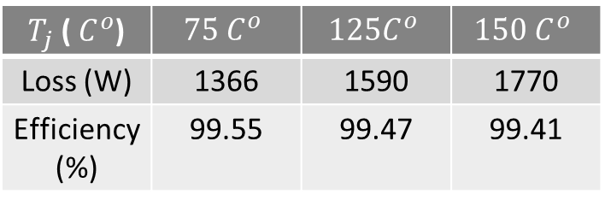
Datasheet-driven Loss Calculation
Switching frequency = 5kHz, ma=1.15, pf=0.9 2-level 3-phase, P=300kW
The maximum switching frequency is 5kHz since we have slow switching speed (dv/dt) test data in the datasheet.
The current is sinusoidal.
$T_{j}$ ( $C^{o}$) | $$75 C^{o}$$ | $$125C^{o}$$ | $$150 C^{o}$$
Loss (W) | 1366 | 1590 | 1770
Efficiency (%) | 99.55 | 99.47 | 99.41
Assume only conduction loss is changed with temperature.
We do not use a thermal model here; we just find the losses for different junction temperatures.

Slide 7

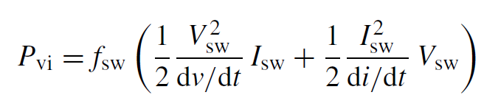
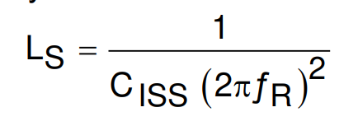
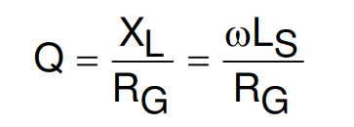
Updating Switching Losses for Fast dv/dt
58 mJ at 304 A
17 mJ at 304 A
10mJ
Output capacitance loss
Overlapping loss
Linearly increasing by the number of dies in parallel
Depends on dv/dt and di/dt

Slide 8
Updating Switching Loss for Fast dv/dt
Same output capacitance loss Updated overlapping loss

Slide 9
Updating Switching Losses for Fast dv/dt
Number of Dies area selected as minimized the losses regarding the switching frequency.
Junction temperature is taken at $75 C^{o}$.

Slide 10

Other Cases
If junction temperature is taken at $100 C^{o}$
If we lower dv/dt 2.5 times

Slide 11
Harmonic Losses on the Motor
We have trade-off between motor harmonic losses and inverter losses.
Optimum point
Decreasing trend
Increasing trend

Slide 12
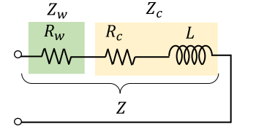
Harmonic Losses Estimation- Impedance Model

Slide 13
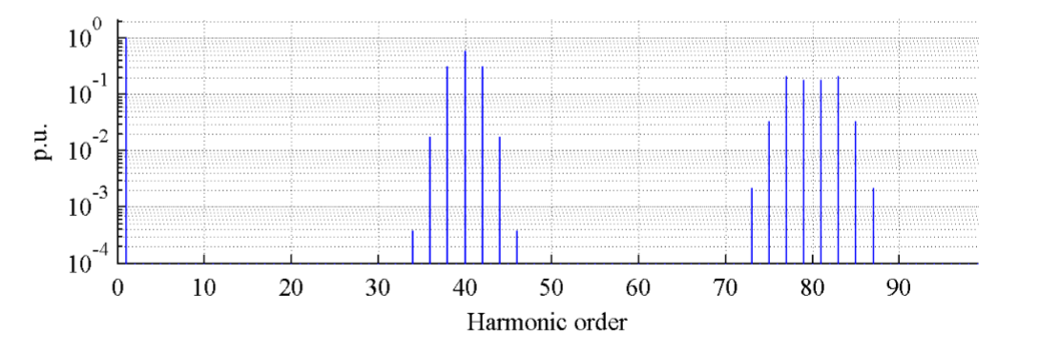
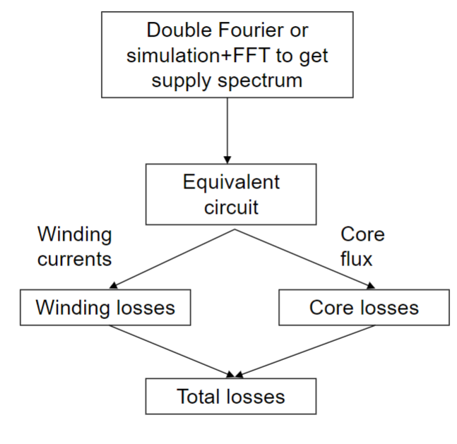
Harmonic Losses Estimation- Impedance Model
Harmonic distribution changes regarding inverter operation
Loss Factor

Slide 14
Total Losses Calculation
Optimum switching frequency
Voltage rating: 2kV
Current rating: 440A
11 dies in parallel
Desired one for fast dv/dt, 14 kHz
Voltage rating: 2kV
Current rating: 400A
FF3MR20KM1H
10 dies in parallel

