Slide 1
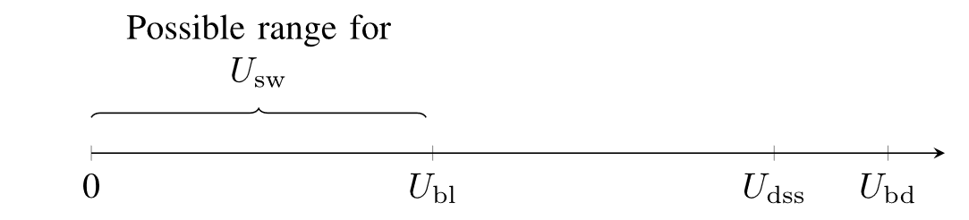
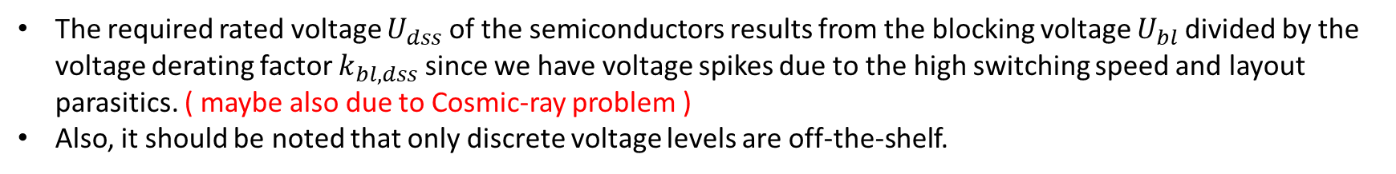
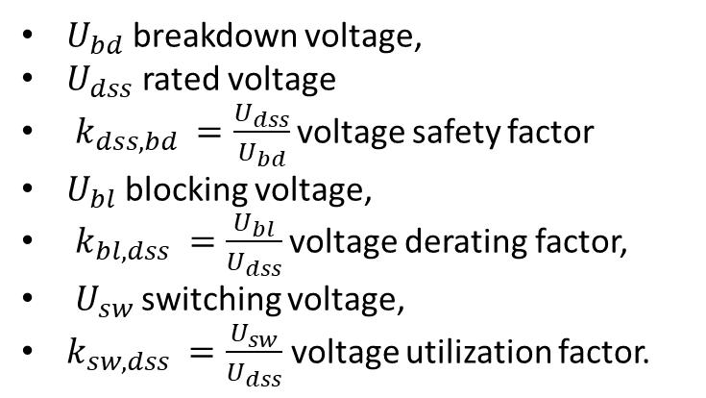
Selection of Voltage Ratings of Semiconductors
The required rated voltage $U_{dss}$of the semiconductors results from the blocking voltage $U_{bl}$divided by the voltage derating factor $k_{bl,dss}$ since we have voltage spikes due to the high switching speed and layout parasitics. ( maybe also due to Cosmic-ray problem )
Also, it should be noted that only discrete voltage levels are off-the-shelf.
$U_{bd}$ breakdown voltage,
$U_{dss}$ rated voltage
$k_{dss,bd} =\frac{U_{dss}}{U_{bd}}$ voltage safety factor
$U_{bl}$ blocking voltage,
$k_{bl,dss} =\frac{U_{bl}}{U_{dss}}$ voltage derating factor,
$U_{sw}$ switching voltage,
$k_{sw,dss} =\frac{U_{sw}}{U_{dss}}$ voltage utilization factor.

Slide 2
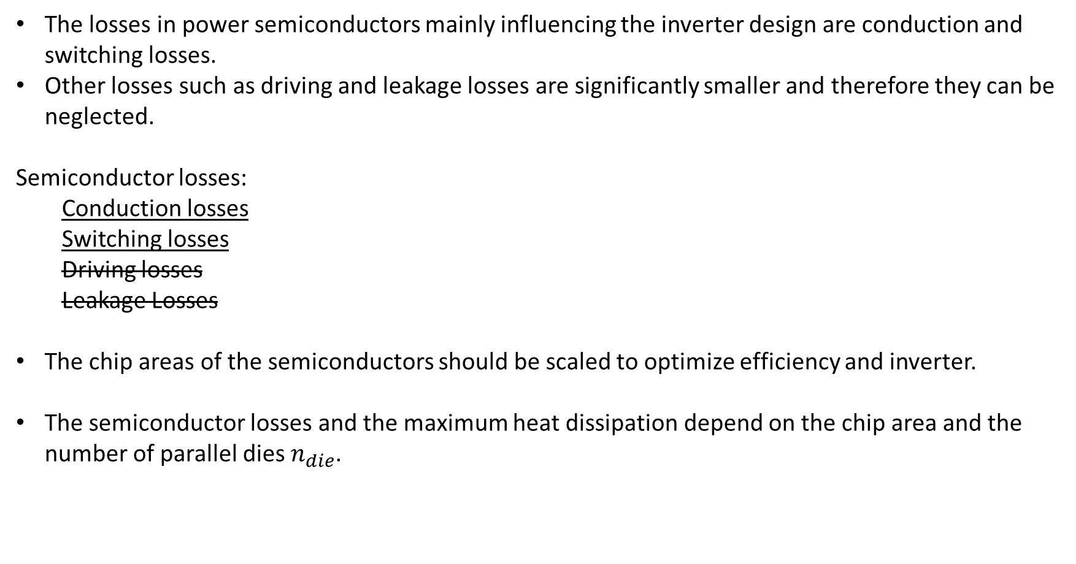
Selection of Chip Area (Current Ratings)
The losses in power semiconductors mainly influencing the inverter design are conduction and switching losses.
Other losses such as driving and leakage losses are significantly smaller and therefore they can be neglected.
Semiconductor losses:
  Conduction losses
  Switching losses
  Driving losses
  Leakage Losses
The chip areas of the semiconductors should be scaled to optimize efficiency and inverter.
The semiconductor losses and the maximum heat dissipation depend on the chip area and the number of parallel dies $n_{die}$.

Slide 3
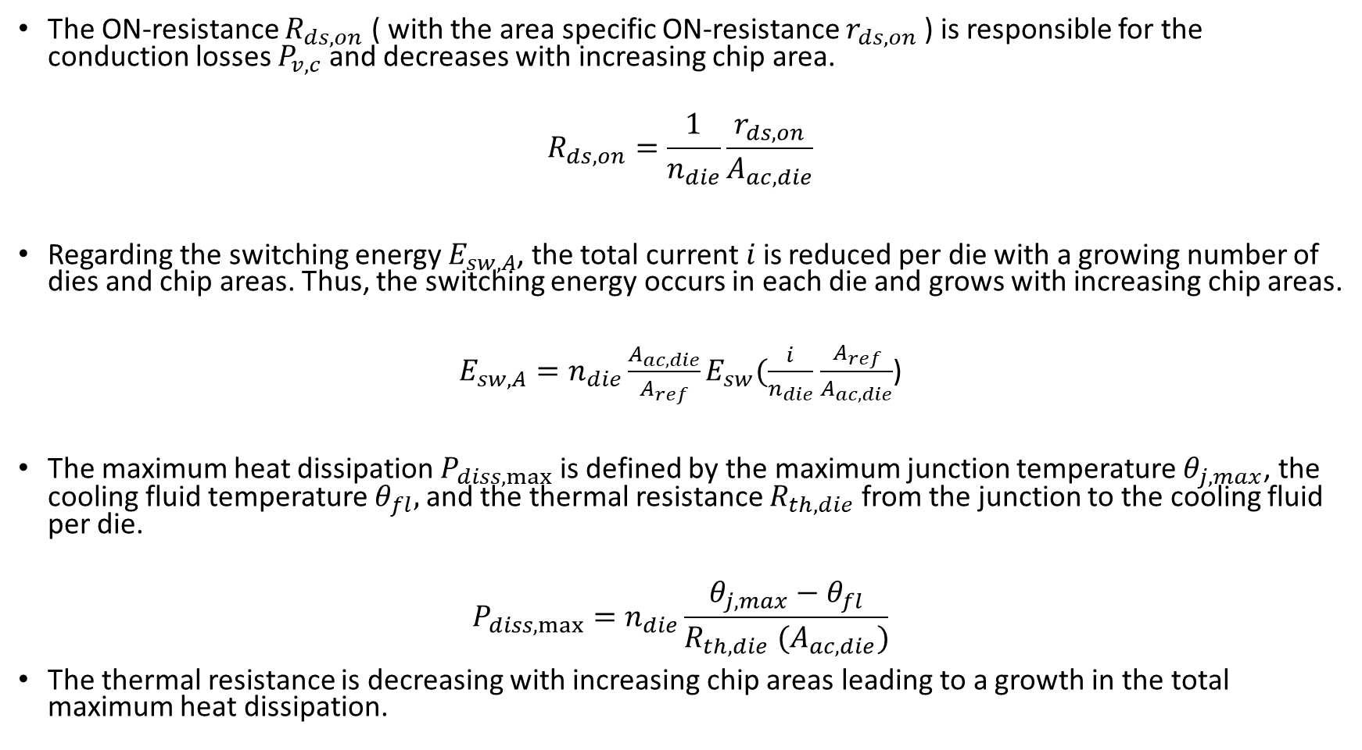
The ON-resistance $R_{ds,on}$ ( with the area specific ON-resistance $r_{ds,on}$ ) is responsible for the conduction losses $P_{v,c}$and decreases with increasing chip area.
$$R_{ds,on}=\frac{1}{n_{die}}\frac{r_{ds,on}}{A_{ac,die}}$$
Regarding the switching energy $E_{sw,A}$, the total current$i$is reduced per die with a growing number of dies and chip areas. Thus, the switching energy occurs in each die and grows with increasing chip areas.
$E_{sw,A}=n_{die}\frac{A_{ac,die}}{A_{ref}}E_{sw}(\frac{i}{n_{die}}$ $\frac{A_{ref}}{A_{ac,die}}$)
The maximum heat dissipation $P_{diss,max}$ is defined by the maximum junction temperature $θ_{j,max}$, the cooling fluid temperature $θ_{fl},$and the thermal resistance $R_{th,die}$ from the junction to the cooling fluid per die.
$$P_{diss,max}=n_{die}\frac{θ_{j,max}−θ_{fl}}{R_{th,die} (A_{ac,die})}$$
The thermal resistance is decreasing with increasing chip areas leading to a growth in the total maximum heat dissipation.

Slide 4
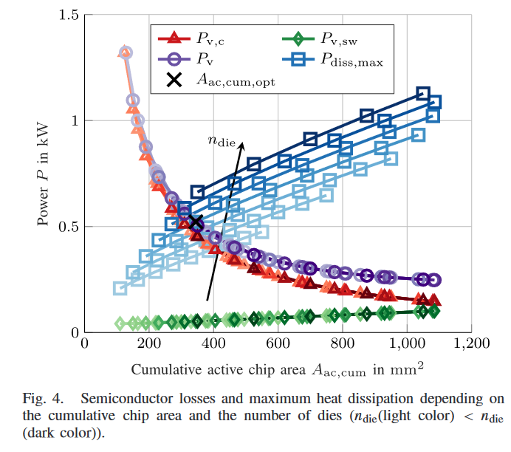

A higher number of dies allow for a larger amount of maximum heat dissipation for the same total chip area due to heat spreading.
The intersection of the total losses $P_{v} = P_{v,c} +P_{v,sw}$ with the maximum heat dissipation $P_{diss,max}$where both the cumulative chip area and the losses are minimal, marks the design point of the semiconductor under consideration.

Slide 5

Considered Topologies
Two-level (2L)
Inverter
Three-level
T-Type (3L-TT)
Inverter
Three-level
Neutral Point Clamped (3L-NPC)
Inverter
Three-level
Active Neutral Point Clamped
(3L-ANPC)
Inverter
Modular multilevel converters
(MMC)
*The topologies, indicated by bold font, may be preferred for a pre-study.

Slide 6
Loss Calculation Assumptions
SiC MOSFETs, which are capable of forward and reverse current conduction through the channel, are used as switching devices. It is assumed that the reverse current flows completely through the MOSFET channel. This is a worse assumption than current sharing between the channel and the body diode. It partly compensates the neglection of losses in the body diode during interlock (dead) times.
The reverse recovery energy of the body diode is also not considered, since measuring it is problematic and it is comparably small so that it is not included in the datasheet of the module.
When the MOSFET is in reverse conduction mode (referred to as rev after), the current commutates from and to its own body diode under zero voltage switching (ZVS) condition, and therefore switching losses are only taken into account during forward conduction mode of the MOSFET.
For the NPC inverter, another type of semiconductor is used for the clamping diodes. Here, SiC Schottky diodes are considered which have negligible switching losses, and thus only the conduction losses are accounted for.

Slide 7
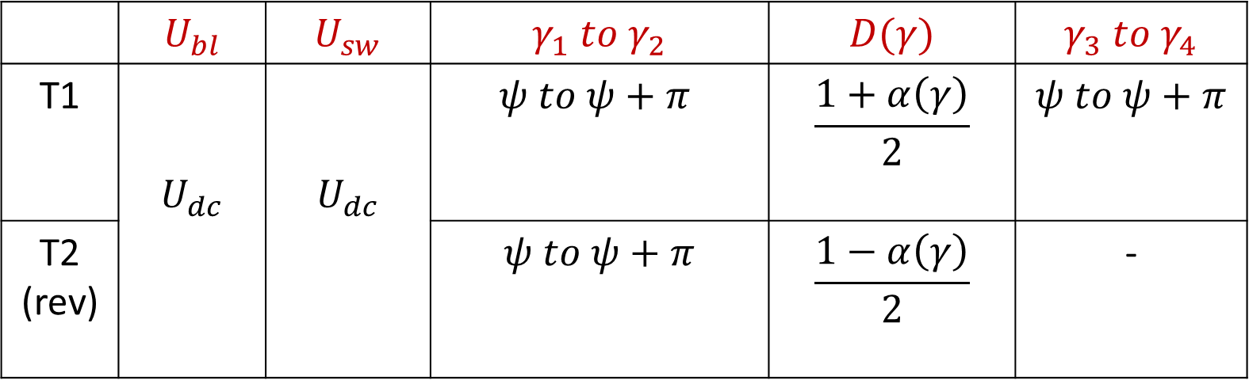
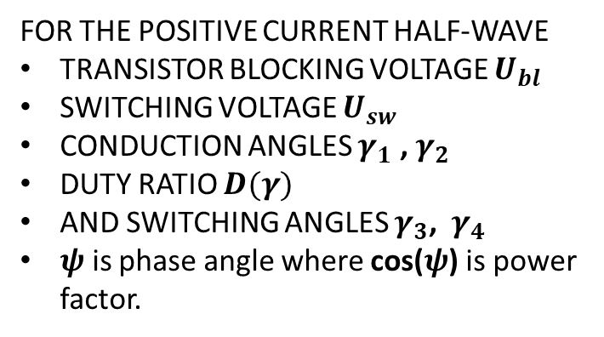
2L-Inverter
 | $$U_{bl}$$ | $$U_{sw}$$ | $$γ_{1} to{ γ}_{2}$$ | $$D(γ)$$ | $$γ_{3} to{ γ}_{4}$$
T1 | $$U_{dc}$$ | $$U_{dc}$$ | $$ψ to ψ+π$$ | $$\frac{1+α\left(γ\right)}{2}$$ | $$ψ to ψ+π$$
T2 (rev) |  |  | $$ψ to ψ+π$$ | $$\frac{1−α\left(γ\right)}{2}$$ | -
FOR THE POSITIVE CURRENT HALF-WAVE
TRANSISTOR BLOCKING VOLTAGE $U_{bl}$
SWITCHING VOLTAGE $U_{sw}$
CONDUCTION ANGLES $γ_{1}$ , $γ_{2}$
DUTY RATIO $D(γ)$
AND SWITCHING ANGLES $γ_{3}$, ${ γ}_{4}$
$ψ$ is phase angle where cos($ψ$) is power factor.
A phase (leg) of a conventional 2L inverter consists of two transistors (T1/T2) that block and switch the full dc-link voltage.

Slide 8
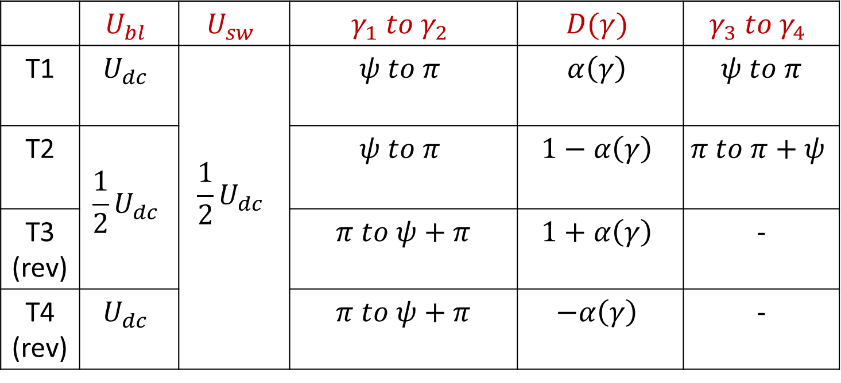
3L-TT
 | $$U_{bl}$$ | $$U_{sw}$$ | $$γ_{1} to{ γ}_{2}$$ | $$D(γ)$$ | $$γ_{3} to{ γ}_{4}$$
T1 | $$U_{dc}$$ | $${\frac{1}{2}U}_{dc}$$ | $$ψ to π$$ | $$α\left(γ\right)$$ | $$ψ to π$$
T2 | $${\frac{1}{2}U}_{dc}$$ |  | $$ψ to π$$ | $$1−α\left(γ\right)$$ | $$π to π+ψ$$
T3 (rev) |  |  | $$π to ψ+π$$ | $$1+α\left(γ\right)$$ | -
T4 (rev) | $$U_{dc}$$ |  | $$π to ψ+π$$ | $$−α\left(γ\right)$$ | -
The neutral point of the three-level T-type inverter is connected via an active bidirectional switch (T2/T3) which blocks and switches half of the dc-link voltage.
However, the outer transistors (T1/T4) block the full dc-link voltage, whereas half of the dc-link voltage is applied during the switching process.

Slide 9
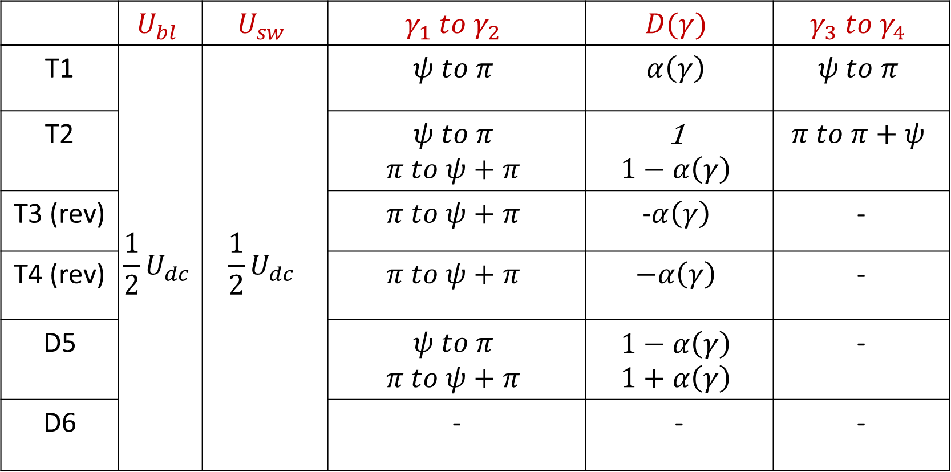
3L-NPC
 | $$U_{bl}$$ | $$U_{sw}$$ | $$γ_{1} to{ γ}_{2}$$ | $$D(γ)$$ | $$γ_{3} to{ γ}_{4}$$
T1 | $${\frac{1}{2}U}_{dc}$$ | $${\frac{1}{2}U}_{dc}$$ | $$ψ to π$$ | $$α\left(γ\right)$$ | $$ψ to π$$
T2 |  |  | $$ψ to π$$ $$π to ψ+π$$ | 1 $$1−α\left(γ\right)$$ | $$π to π+ψ$$
T3 (rev) |  |  | $$π to ψ+π$$ | $$−α\left(γ\right)$$ | -
T4 (rev) |  |  | $$π to ψ+π$$ | $$−α\left(γ\right)$$ | -
D5 |  |  | $$ψ to π$$ $$π to ψ+π$$ | $$1−α\left(γ\right)$$ $$1+α\left(γ\right)$$ | -
D6 |  |  | - | - | -
The neutral point is clamped via diodes (D5/D6).
The transistors/diodes of the NPC switch and block half of the dc-link voltage.

Slide 10

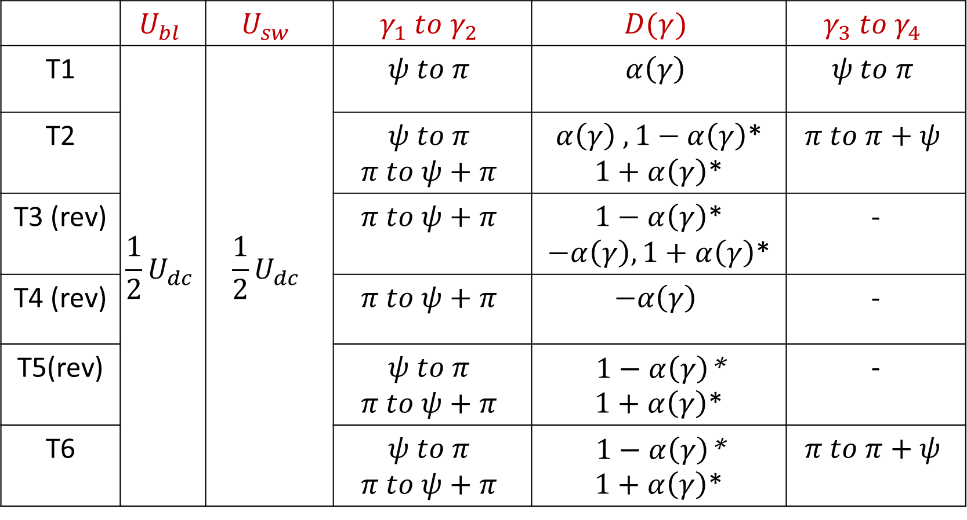
3L-ANPC
 | $$U_{bl}$$ | $$U_{sw}$$ | $$γ_{1} to{ γ}_{2}$$ | $$D(γ)$$ | $$γ_{3} to{ γ}_{4}$$
T1 | $${\frac{1}{2}U}_{dc}$$ | $${\frac{1}{2}U}_{dc}$$ | $$ψ to π$$ | $$α\left(γ\right)$$ | $$ψ to π$$
T2 |  |  | $$ψ to π$$ $$π to ψ+π$$ | $α\left(γ\right) , 1−α\left(γ\right)$* $1+α\left(γ\right)$* | $$π to π+ψ$$
T3 (rev) |  |  | $$π to ψ+π$$ | $1−α\left(γ\right)$* $−α\left(γ\right), 1+α\left(γ\right)$* | -
T4 (rev) |  |  | $$π to ψ+π$$ | $$−α\left(γ\right)$$ | -
T5(rev) |  |  | $$ψ to π$$ $$π to ψ+π$$ | $1−α\left(γ\right)$* $1+α\left(γ\right)$* | -
T6 |  |  | $$ψ to π$$ $$π to ψ+π$$ | $1−α\left(γ\right)$* $1+α\left(γ\right)$* | $$π to π+ψ$$
By replacing the diodes of the NPC inverter with active switches, the ANPC inverter offers more degrees of freedom.

Slide 11

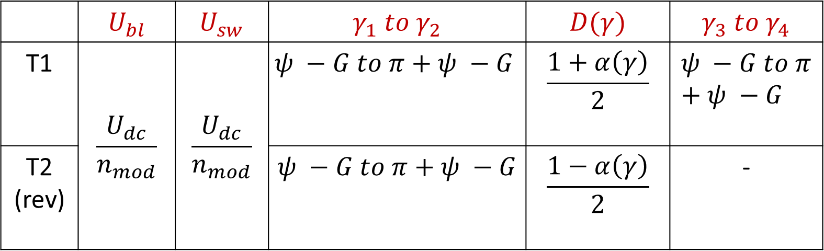
MMC
 | $$U_{bl}$$ | $$U_{sw}$$ | $$γ_{1} to{ γ}_{2}$$ | $$D(γ)$$ | $$γ_{3} to{ γ}_{4}$$
T1 | $$\frac{U_{dc}}{n_{mod}}$$ | $$\frac{U_{dc}}{n_{mod}}$$ | $$ψ −G to π+ψ −G$$ | $$\frac{1+α\left(γ\right)}{2}$$ | $$ψ −G to π+ψ −G$$
T2 (rev) |  |  | $$ψ −G to π+ψ −G$$ | $$\frac{1−α\left(γ\right)}{2}$$ | -
The blocking and switching voltages of the semiconductors (T1/T2) are reduced to the voltage of a single module capacitor $C_{mod}$.

Slide 12
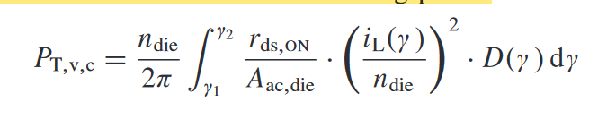
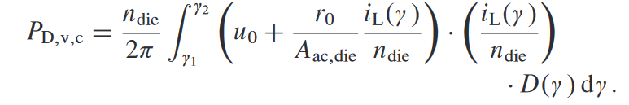

Semiconductor Losses
The loss calculations are shown for one phase with the reference signal a(γ ) and the modulation index M.
$$α\left(γ\right)=M\sin\left(γ\right) , γ=2πf_{L}t$$
The output current $i_{L}\left(γ\right)={\hat{I}}_{L}\sin\left(γ−ψ\right)$which depends on the connected machine’s power factor $cos\left(ψ\right).$
Based on these parameters, the average conduction losses of the transistor $P_{T,v,c}$ and the diode $P_{D,v,c}$ are calculated in dependence on the conduction angles $γ_{1}$ and $γ_{2}$ and the duty ratio $D\left(γ\right)$ which indicates the ratio between the conduction time and the switching period.

Slide 13
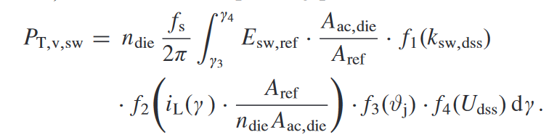
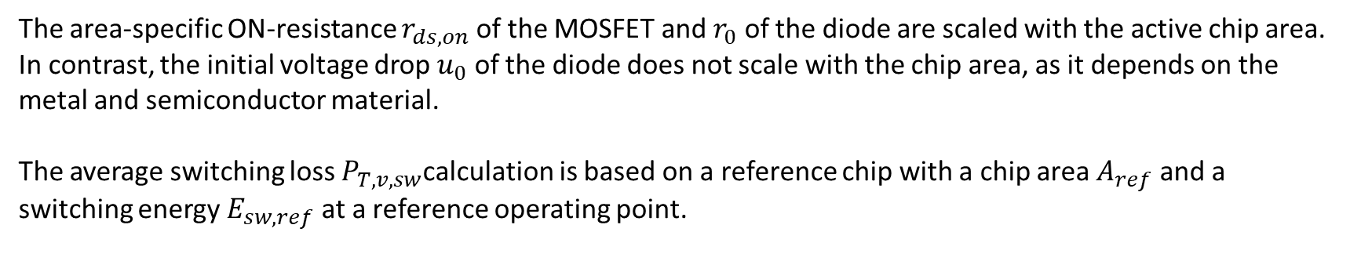
The area-specific ON-resistance $r_{ds,on}$ of the MOSFET and $r_{0}$ of the diode are scaled with the active chip area.
In contrast, the initial voltage drop $u_{0}$ of the diode does not scale with the chip area, as it depends on the metal and semiconductor material.
The average switching loss $P_{T,v,sw}$calculation is based on a reference chip with a chip area $A_{ref}$ and a switching energy $E_{sw,ref}$ at a reference operating point.
It depends on the voltage utilization factor $k_{sw,dss} =\frac{U_{sw}}{U_{dss}}$ (with the switched voltage $U_{sw}$), the current $i_{L}$, the junction temperature $θ_{j}$, and the rated voltage $U_{dss}$.
The angles $γ_{3}$ and $γ_{4}$ indicate the range in which the semiconductor causes switching losses and are equal to the conduction angles $γ_{1}$ and $γ_{2}$ in most of the cases in forward conduction mode.

Slide 14
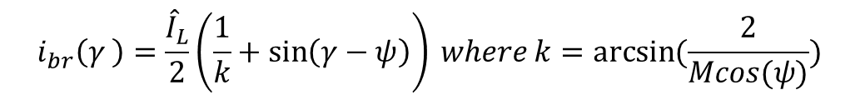
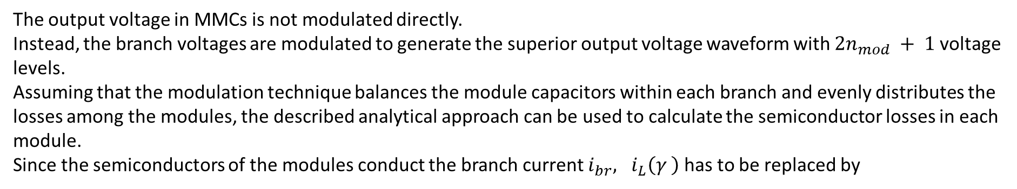
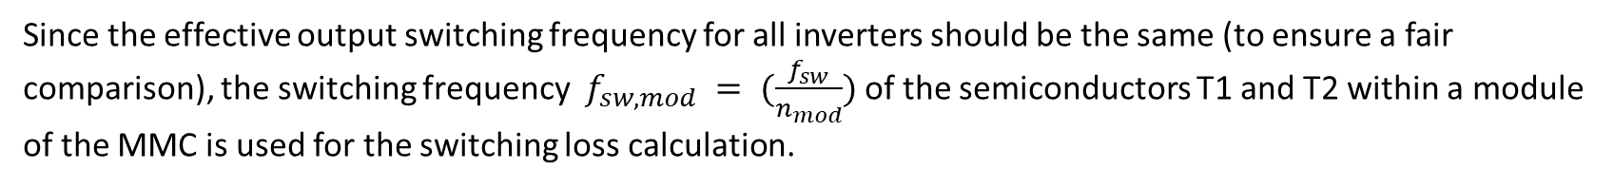
The output voltage in MMCs is not modulated directly.
Instead, the branch voltages are modulated to generate the superior output voltage waveform with $2n_{mod} + 1$voltage levels.
Assuming that the modulation technique balances the module capacitors within each branch and evenly distributes the losses among the modules, the described analytical approach can be used to calculate the semiconductor losses in each module.
Since the semiconductors of the modules conduct the branch current $i_{br}, i_{L}\left(γ \right)$has to be replaced by
$$i_{br}\left(γ \right)=\frac{{\hat{I}}_{L}}{2}\left(\frac{1}{k}+\sin\left(γ−ψ\right)\right) where k=arcsin⁡(\frac{2}{Mcos(ψ)})$$
Since the effective output switching frequency for all inverters should be the same (to ensure a fair comparison), the switching frequency $f_{sw,mod} = (\frac{f_{sw}}{n_{mod}})$of the semiconductors T1 and T2 within a module of the MMC is used for the switching loss calculation.
It should be noted here that the inverter output waveforms, as well as the switching frequencies, are also related to losses in the electric machine.
But compared with the two-level inverter, the three-level inverters cause less losses in the machine at the same (resulting) switching frequency due to their lower voltage distortion.
For the MMC, the same consideration applies because the number of levels is even higher.

Slide 15
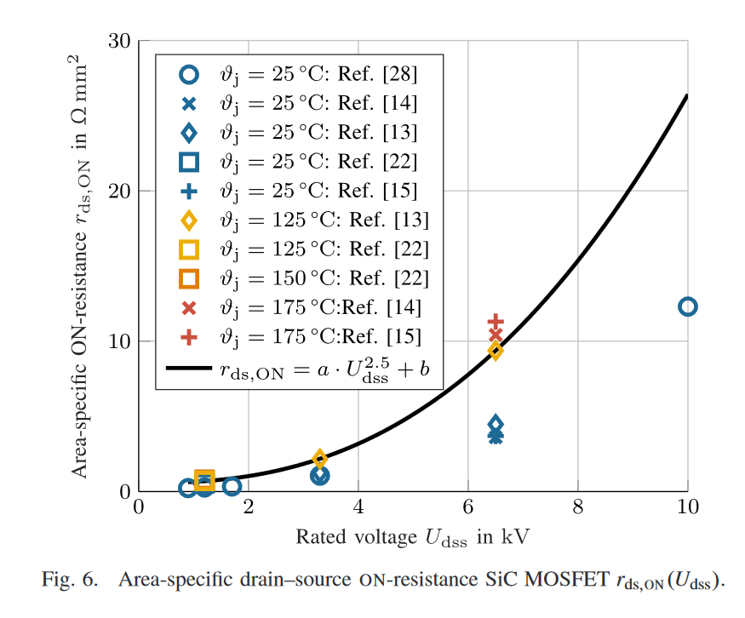
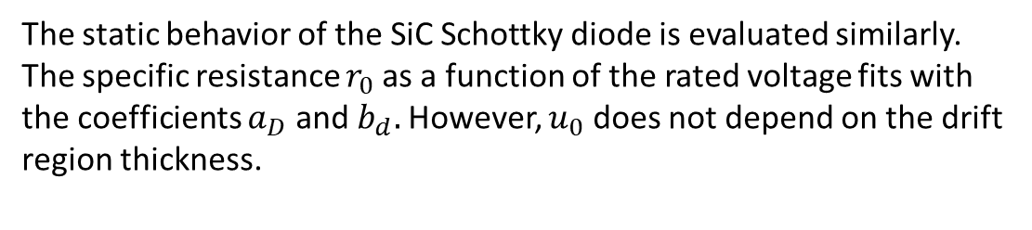
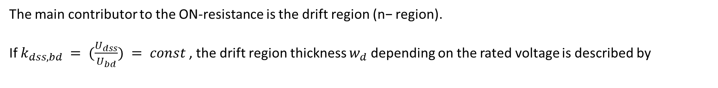

Conduction Losses
The main contributor to the ON-resistance is the drift region (n− region).
If $k_{dss,bd} = (\frac{U_{dss}}{U_{bd}}) = const$, the drift region thickness $w_{d}$ depending on the rated voltage is described by
$w_{d}=2\frac{U_{dss}}{k_{dss,bd} E_{c}}$ where $E_{c}$ is the critical field strength of the material
As a higher blocking capability requires an enlargement of the drift region, the ON-resistance is increased in the process and it is proportional to $U_{dss}^{2.5}$.
$r=a_{T}U_{dss}^{2.5}+b_{T}$
The static behavior of the SiC Schottky diode is evaluated similarly. The specific resistance $r_{0}$as a function of the rated voltage fits with the coefficients $a_{D}$ and $b_{d}.$However, $u_{0}$ does not depend on the drift region thickness.

Slide 16





Switching Losses
For examining the SiC MOSFET switching losses, the parameters $k_{sw,dss}$, $I_{L}$, $θ_{j}$, and $U_{dss}$ are analyzed individually, while the others are assumed to be constant.
1. The switching energy is proportional to $U^{1.5}$
2. The switching energy is supposed to be proportional to the load current. Since fast switching is assumed, f2(IL) is fit with a second-degree polynomial instead which is in good agreement with the measured data
3. The function for the temperature effect fits with a first-degree polynomial
4. If the voltage slew rate is not limited and the voltage utilization factor is constant (ksw,dss = (Usw/Udss) = const.), the charge Qoss and consequently the switching time tsw are constant. Therefore, the switching energy is proportional to the rated voltage.

Slide 17
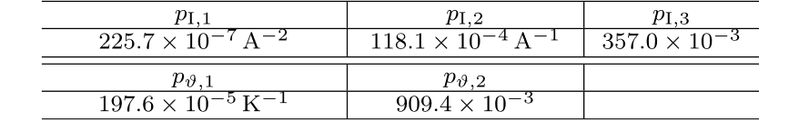
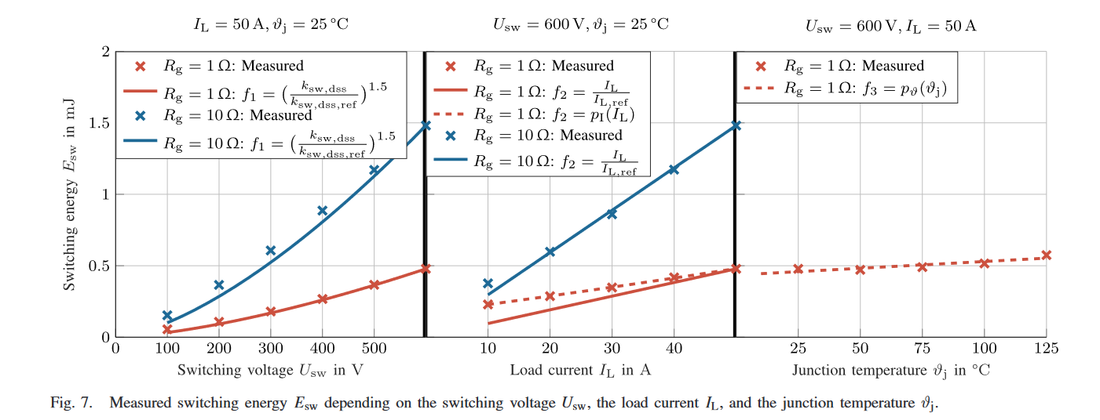
Switching Losses

Slide 18
Thermal Management
The size of the SiC device is smaller than the Si counterpart, and its power loss caused by high switching frequency makes it a high-heat-flux scenario.
Overheating is typically a main cause that can lead to device failure, system malfunction, or even the vehicle break down.
Especially when modern automotive industry continuously drives for higher system performance and smaller packing size, proper thermal management is critically required to achieve better heat dissipation, avoid local heat concentration, improve reliability, and reduce packaging size.
Different cooling technologies for power electronics are based on
  The heat transfer mechanism
  Coolant agent
  Heat sink (Aluminum is the cheapest and simplest)
  Advanced thermal interface materials (TIM) such as silicone based greases, aluminum-filled polyesters, and epoxy adhesives with silver particles

Slide 19
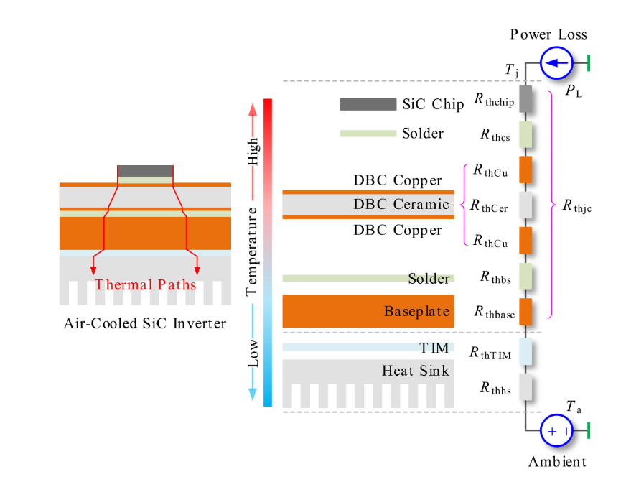
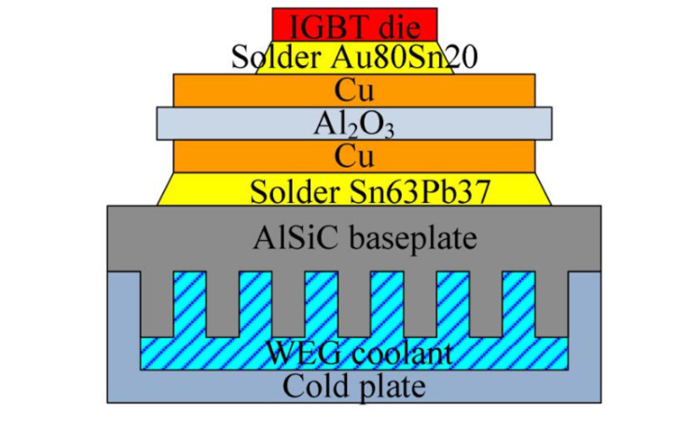
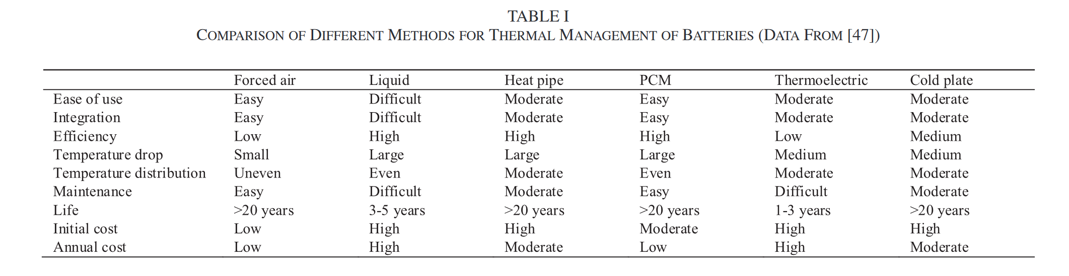
Air cooling technologies
  The simplest one
  Increasing the surface area of heat transfer with added fins
Liquid cooling technologies
  Higher device power density, microchannel heat sink can achieve around 1000 W/cm2 heat flux (State-of-the-art)
  However, liquid cooling also brings in extra weight, complexity, and cost to the system.

