Slide 1
Holistic Design of 300kW (600kW) Traction Inverter

Slide 2
Agenda
Key Parameter Indicators
Commercial Traction Drives
Trends
Design Chapters and Methodology
  Topologies
    Two-level VSI
    Three-level NPC and T-type Inverters
    Modular Multi-level Inverters
    Cascaded H-bridges
    Stacked Poly-phase Bridges
    Integrated Modular Motor Drives
    Multiphase Drives
  Cooling System
  DC-link Capacitance Investigation
  Busbar Design

Slide 3
Key parameter indicators (KPIs)
Higher power density and Lower Losses
Holistic optimization methods
Utilizing new thermal management
KPIs
Volume (50kW/L)
Losses/Efficiency (99.5%)
Cost
Reliability
Life cycle cost (LCC) (energy-wise favorable)
New materials and optimization technologies will also be required to reduce volume, while new thermal management techniques will be applied to take the heat out more efficiently.
To achieve higher power density and reduced weight, the trend is toward higher switching frequency, higher battery voltage, the use of WBG semiconductor devices, and tightly integrated packaging with advanced thermal management systems and materials.
[1] I. Husain, B. Ozpineci, M. S. Islam, E. Gurpinar, G.-J. Su, W. Yu, S. Chowdhury, L. Xue, D. Rahman, and R. Sahu, “Electric drive technology trends, challenges, and opportunities for future electric vehicles,” Proceedings of the IEEE, vol. 109, no. 6, pp. 1039–1059, 202

Slide 4
Commercial Traction Drives
Topology:
Traction inverters used in BEVs/HEVs are dominated by the 2-level three-phase voltage-source inverter (VSI) topology because of its high efficiency (for lower switching frequency), low cost, and simple control requirements.
Power Switches:
IGBTs have been the predominant choice for traction inverters compared to other switching devices. This is due to the maturity of the technology, its wide availability, low cost, decent efficiency, and good short circuit capability of around 10μs and sufficient power capability.
Almost all traction inverters are built with modules.
Recent advances in WBG devices, particularly SiC and GaN devices, promise
significant power density and efficiency increases in traction inverter drives.
DC-link Voltage:
Although the nominal dc-link voltage of 400 V is used BEVs and PHEVs, With the advent of SiC
technology, 800-V nominal dc-link voltage is being considered for passenger vehicles to provide system-level benefits to the EV powertrain.
[1] I. Husain, B. Ozpineci, M. S. Islam, E. Gurpinar, G.-J. Su, W. Yu, S. Chowdhury, L. Xue, D. Rahman, and R. Sahu, “Electric drive technology trends, challenges, and opportunities for future electric vehicles,” Proceedings of the IEEE, vol. 109, no. 6, pp. 1039–1059, 202
[2] J. Reimers, L. Dorn-Gomba, C. Mak, and A. Emadi, “Automotive traction inverters: Current status and future trends,” IEEE Transactions on Vehicular Technology, vol. 68, no. 4, pp. 3337–3350, 2019

Slide 5
Commercial Traction Drives
Thermal Management:
Traditionally, fin-based heat sinks, such as straight-fin and pinfin, have been used to cool the power electronic system with air- and liquid-cooling-based systems.
Advanced cooling concepts, such as microchannel cooling, jet impingement, two-phase cold plates, double-sided packaging, and direct substrate cooling, are also being implemented for such high-power density power electronic applications.
DC-link Capacitance:
Capacitors are one of the essential passive components used in a traction inverter to keep the dc-link voltage constant, and suppress high-frequency current components.
Although the electrolytic capacitors are the most popular choice for conventional motor drive applications, their short lifespan, limited current conduction capability, and low-frequency operation make them untenable for use as DC-link capacitors in EV inverters.
Polymer film is used as the dc-link capacitor for electric drive applications because of its reliability, high-current conduction capability, high-frequency operation, and lower losses compared with aluminum electrolytic capacitors.
Busbar :
The dc bussing is a multiphysical design problem in the electrical, thermal, and mechanical domains. Electrically, the dc bus needs to be a low equivalent series resistance (ESR) and low equivalent series inductance (ESL).
The laminated busbar is widely used in high-power and integrated converters for its low parasitic inductance advantage to restrain voltage overshoot, EMI, and switching losses.
[1] I. Husain, B. Ozpineci, M. S. Islam, E. Gurpinar, G.-J. Su, W. Yu, S. Chowdhury, L. Xue, D. Rahman, and R. Sahu, “Electric drive technology trends, challenges, and opportunities for future electric vehicles,” Proceedings of the IEEE, vol. 109, no. 6, pp. 1039–1059, 202
[2] J. Reimers, L. Dorn-Gomba, C. Mak, and A. Emadi, “Automotive traction inverters: Current status and future trends,” IEEE Transactions on Vehicular Technology, vol. 68, no. 4, pp. 3337–3350, 2019

Slide 6
Commercial Traction Drives and Targets
The U.S. Department of Energy (DOE) expects to design the inverter power module composed of an inverter and, if applicable, a DC/DC boost converter 100 kW integrated design with 100 kW/L at $2.7/kW.
Model | Inverter Type | Total Power (kVA) | Power Density (kVA/L)
Tesla Model S 70D BEV | Single Inverter- IGBT | 193 | 30.1
Toyata Prius HEV | Dual Inverter - IGBT | 162 | 23.7
Chevy Volt PHEV | Dual Inverter -IGBT | 180 | 17.3
Cadillcac CT6 PHEV | Dual Inverter - IGBT | 215 | 22.6
Tesla Model 3 | SiC | 200 | -
US DOE (2025) | - | 100 | 100
Our target | SiC | 300 (600) | 50
[1] “U.s. drive electrical and electronics technical team roadmap,” U.S. Department of Energy, 2017
[2] J. Reimers, L. Dorn-Gomba, C. Mak, and A. Emadi, “Automotive traction inverters: Current status and future trends,” IEEE Transactions on Vehicular Technology, vol. 68, no. 4, pp. 3337–3350, 2019

Slide 7

Trends
The question of the most promising inverter topology and DC supply voltage level is yet to be answered.
When voltage is a limiting factor, multilevel inverters (MLIs) constitute a viable solution. MLIs are able to utilize switching devices with lower voltage ratings for the same or higher DC-link voltages when compared to two-level inverters
When current is a limiting factor for the semiconductor devices, discrete device paralleling is the industry-accepted solution; multiple devices are connected in parallel to withstand the output current of the inverter. Alternatively, multiphase drives (MPDs), beyond three phases, thrive in delivering high power, owing to their improved per-phase current handling.
Using such high voltages for power supply provides megawatt charging aims at a reduction in cable weight, while at the same time, the requirements for insulation become more challenging.
Wide bandgap semiconductors are key enablers in the electrification, which
are commercially available up to 1.7 kV. On the one hand, the semiconductors’ losses are influenced by the rated voltage, thus calling for prediction models to calculate inverter losses and efficiency depending on the semiconductor-rated voltage. On the other hand, failures due to cosmic radiation have to be considered, which result in a failure in time (FIT) rate of the semi-conductors which is strongly voltage-dependent.
[1] J. Ebersberger, M. Hagedorn, M. Lorenz, and A. Mertens, “Potentials and comparison of inverter topologies for future all-electric aircraft propulsion,” IEEE Journal of Emerging and Selected Topics in Power Electronics, vol. 10, no. 5, pp. 5264–5279, 2022
[2] Q. Mohammad, “Design and optimization of an inverter for a one- megawatt ultra-light motor drive,” AIAA Aviation Forum 2023, 2023
[3] A. Poorfakhraei, M. Narimani and A. Emadi, "A Review of Multilevel Inverter Topologies in Electric Vehicles: Current Status and Future Trends," in IEEE Open Journal of Power Electronics, vol. 2, pp. 155-170, 2021, doi: 10.1109/OJPEL.2021.3063550.

Slide 8
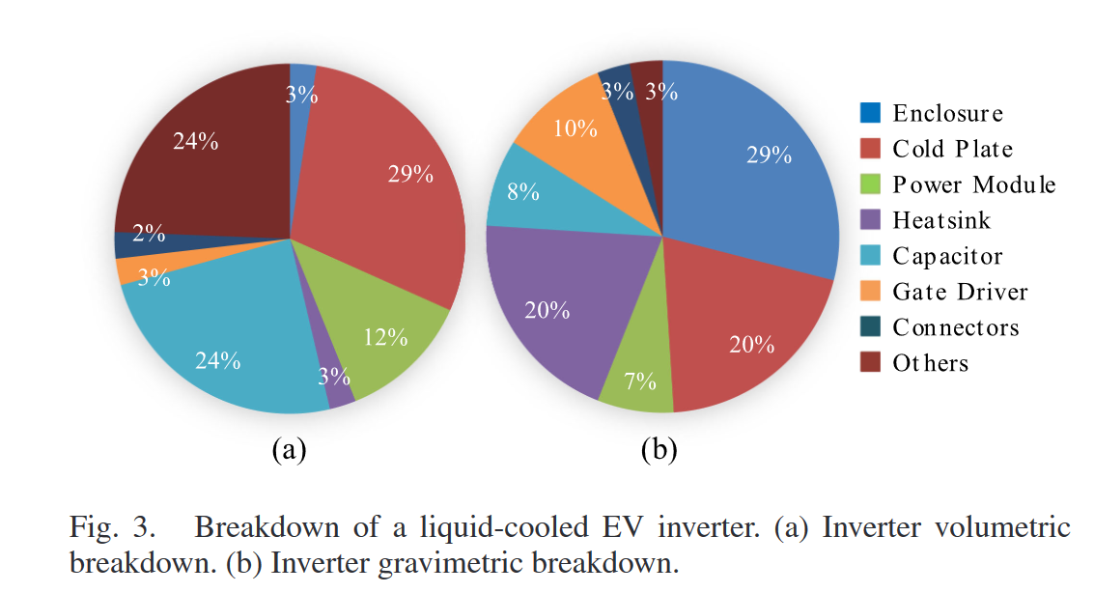
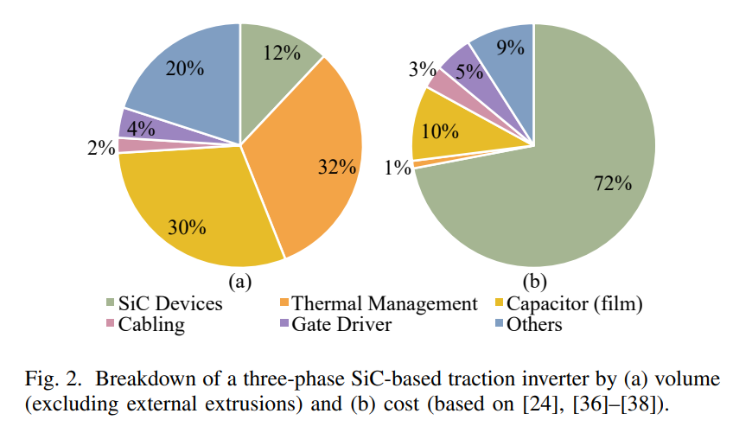
Design Chapters for Holistic Design
Selection of topology and power modules
Heat sink and cooling system
Capacitor bank for DC-link
Bus bar design
Auxiliary circuits:
Connectors and Filters :
Additionally, the life-time cost modeling, reliability and common mode voltage and EMI issues should be considered.
[1] W. Taha et al., "Holistic Design and Development of a 100 kW SiC-Based Six-Phase Traction Inverter for an Electric Vehicle Application," in IEEE Transactions on Transportation Electrification, doi: 10.1109/TTE.2023.3313511.
[2] Z. Zeng, X. Zhang, F. Blaabjerg, H. Chen and T. Sun, "Stepwise Design Methodology and Heterogeneous Integration Routine of Air-Cooled SiC Inverter for Electric Vehicle," in IEEE Transactions on Power Electronics, vol. 35, no. 4, pp. 3973-3988, April 2020, doi: 10.1109/TPEL.2019.2937135.

Slide 9
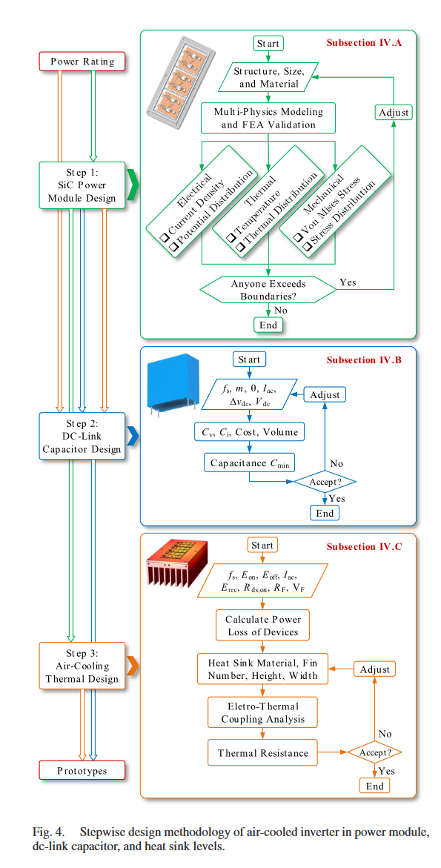
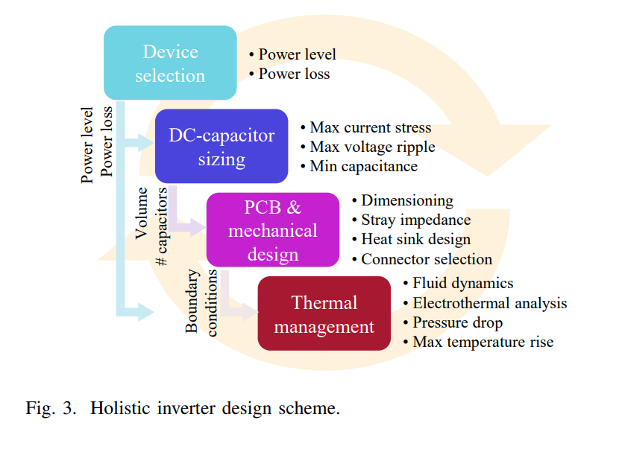
Stepwise Design Methodologies
Losses
Power semiconductors (90 %) (eff 99.5%)
  Conduction Losses
  Switching Losses
  Driving losses
  Leakage Losses
Additional Losses ( 10%)
  Filters losses
Cooling system
Losses
Volume
[1] W. Taha et al., "Holistic Design and Development of a 100 kW SiC-Based Six-Phase Traction Inverter for an Electric Vehicle Application," in IEEE Transactions on Transportation Electrification, doi: 10.1109/TTE.2023.3313511.
[2] Z. Zeng, X. Zhang, F. Blaabjerg, H. Chen and T. Sun, "Stepwise Design Methodology and Heterogeneous Integration Routine of Air-Cooled SiC Inverter for Electric Vehicle," in IEEE Transactions on Power Electronics, vol. 35, no. 4, pp. 3973-3988, April 2020, doi: 10.1109/TPEL.2019.2937135.
9

Slide 10
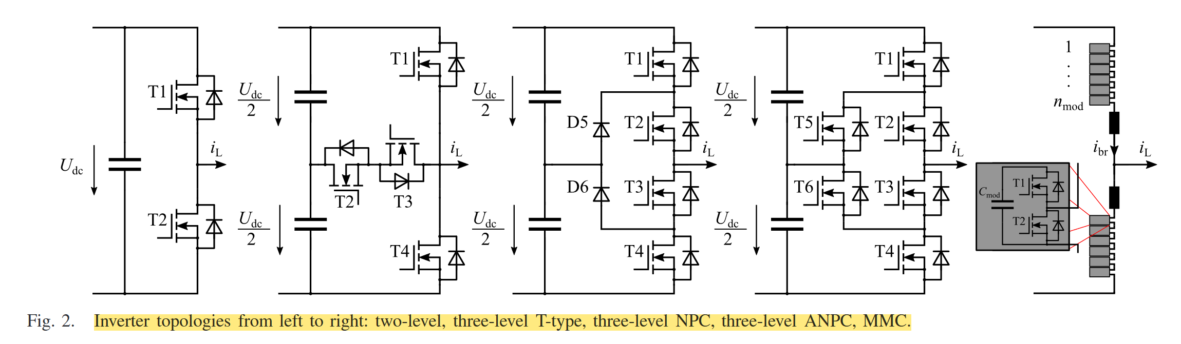
Traction Drives Topologies
Three-level
T-Type (3L-TT)
Inverter
Three-level
Neutral Point Clamped (3L-NPC)
Inverter
Three-level
Active Neutral Point Clamped
(3L-ANPC)
Inverter
Two-level (2L)
Inverter
Modular multilevel converters
(MMC)
[1] J. Ebersberger, M. Hagedorn, M. Lorenz, and A. Mertens, “Potentials and comparison of inverter topologies for future all-electric aircraft propulsion,” IEEE Journal of Emerging and Selected Topics in Power Electronics, vol. 10, no. 5, pp. 5264–5279, 2022

Slide 12
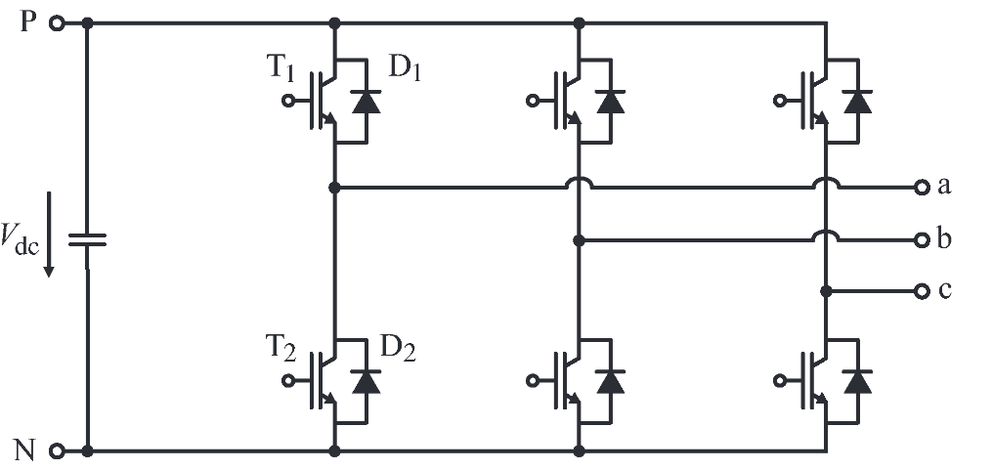
Two-level Conventional Inverters
A phase leg of a conventional two-level inverter
consists of two transistors that block and switch
the full dc-link voltage.
Two-level inverters are less complex than the
other topologies and have the least control effort.
On the other hand, the connected machine suffers
from higher harmonic losses and the steep
voltage slopes can damage it by causing bearing
currents or overstressing the winding insulation.
Two-level inverters have a bad efficiency for higher switching frequency.

Slide 13
1. **Simple and Robust Structure**
- Uses only two switches per phase leg, making the circuit straightforward and easy to implement.
- Fewer components reduce failure points and simplify maintenance.
2. **Low Control Complexity**
- Well-established PWM techniques (e.g., sinusoidal PWM, space vector PWM) are easy to implement.
- Requires minimal computational effort compared to more advanced topologies.
3. **Lower Cost**
- Fewer semiconductor devices and passive components reduce manufacturing costs.
- Economical for low- and medium-power applications.
4. **Compact Design**
- Smaller footprint due to fewer components, making it suitable for space-constrained applications.
5. **Mature Technology**
- Widely used in industry, with proven reliability in motor drives, UPS systems, and renewable energy applications.
---
### **Cons of Two-Level Voltage Source Inverters (VSIs)**
1. **High Voltage Stress on Switches**
- Each transistor must block the full DC-link voltage, requiring higher-rated (and more expensive) semiconductor devices.
2. **High dv/dt and EMI Issues**
- Fast switching generates steep voltage slopes, leading to electromagnetic interference (EMI) and requiring additional filters.
- Can cause insulation degradation in motors and transformers over time.
3. **Harmonic Distortion and Machine Stress**
- Produces higher total harmonic distortion (THD), increasing losses in connected machines (motors, generators).
- May cause bearing currents and winding insulation stress, reducing equipment lifespan.
4. **Poor Efficiency at High Switching Frequencies**
- Increased switching losses at higher frequencies reduce overall efficiency.
- Not ideal for applications requiring high-frequency operation.
5. **Limited Voltage and Power Range**
- Not suitable for very high-voltage applications without complex series connections of switches.
- Higher power levels lead to increased losses and thermal challenges.
---
### **Summary**
Two-level inverters are **simple, cost-effective, and easy to control**, making them ideal for many industrial applications. However, they suffer from **high harmonic distortion, voltage stress, and efficiency issues at high frequencies**, which can limit their use in demanding or high-power systems.
Would you like details on mitigation techniques (e.g., filters, soft-switching) to address some of these drawbacks?

Slide 14
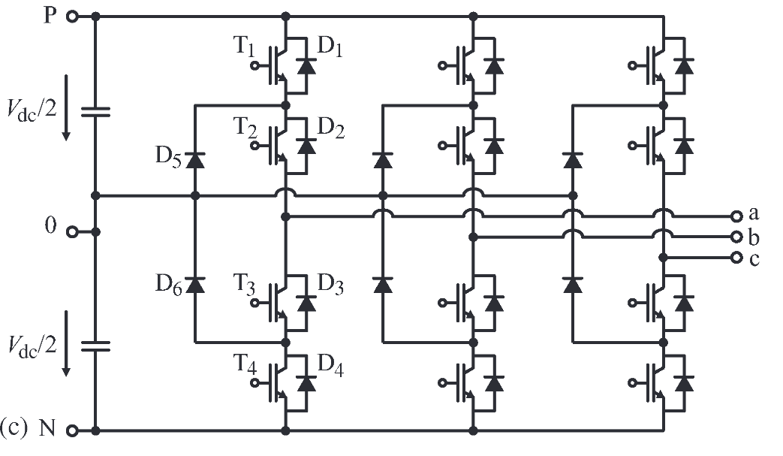
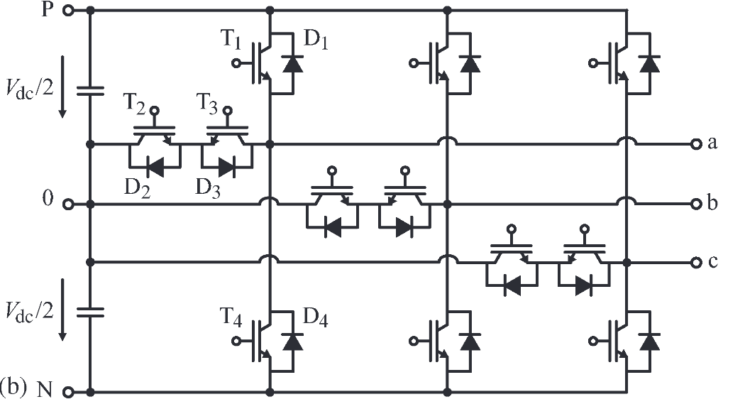
Three-level Inverters
3L-NPC
By adding another voltage level, harmonic losses
and voltage slopes can be reduced with a slightly
higher control effort.
Regarding the three-level NPC inverter, the neutral point is clamped via diodes. The transistors/diodes of the NPC switch block half of the DC-link voltage.
The neutral point of the three-level T-type inverter is connected via an active bidirectional
switch which blocks and switches half of the
dc-link voltage. However, the outer transistors
block the full dc-link voltage, whereas half of the dc-link voltage is applied during the switching process.
By replacing the diodes of the NPC inverter with
active switches, the ANPC inverter offers more
degrees of freedom
But, unequal loss in switches.
3L-T-type

Slide 15
Three-level Inverters - Comparison
3L-NPC
The conduction losses can increase for the switches if two devices with half of the blocking voltage are connected in series compared to one device providing the full blocking voltage.
Increased amount of semiconductors (2 diodes and four MOSFETs per bridge leg)
Increased amount of isolated gate drive voltage supplies (6 additional ones per inverter)
3L-T-type
Reduced both conduction and switching losses.
Increased amount of semiconductors (4 MOSFETs per bridge leg)
Increased amount of isolated gate drive voltage supplies (3 addition ones per inverter) if midpoint is configured in common collector.
Results show that the efficiency of the VSI is higher only for low frequencies but drops significantly above 10 kHz. On the other hand, the TNPC is more efficient for medium frequencies between 10 kHz to 30 kHz, while the NPC becomes slightly more efficient for frequencies above 30 kHz.
[1] J. Reimers, L. Dorn-Gomba, C. Mak, and A. Emadi, “Automotive traction inverters: Current status and future trends,” IEEE Transactions on Vehicular Technology, vol. 68, no. 4, pp. 3337–3350, 2019

Slide 16
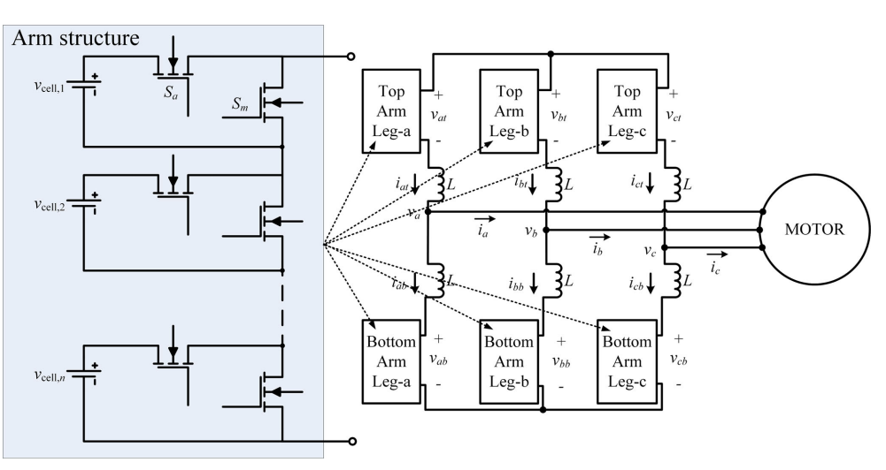
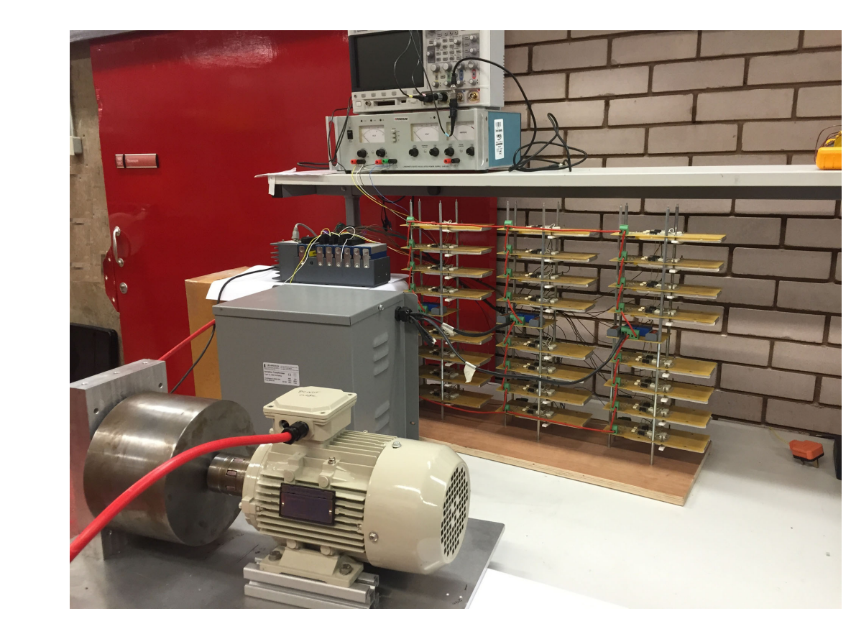
Modular multi-level converters (MMC)
MMCs are considered which provide even smaller
voltage steps at the inverter output terminals; thus, reducing the EMI and ripples.
Disadvantageous are their higher weight due to
their passive components (module capacitors
and branch inductors) and the high complexity
of the control system.
In comparison to the other topologies, MMCs
consist of a series connection of n half-bridge
modules in the upper and lower branches. In this
topology, the blocking and switching voltages
of the semiconductors are reduced to the voltage
of a single-module capacitor.
Although MMC inverters have significantly lower power densities, they have the best efficiencies.
They could be integrated with battery cells.
[1] J. Ebersberger, M. Hagedorn, M. Lorenz, and A. Mertens, “Potentials and comparison of inverter topologies for future all-electric aircraft propulsion,” IEEE Journal of Emerging and Selected Topics in Power Electronics, vol. 10, no. 5, pp. 5264–5279, 2022
[2] M. Quraan, P. Tricoli, S. D’Arco and L. Piegari, "Efficiency Assessment of Modular Multilevel Converters for Battery Electric Vehicles," in IEEE Transactions on Power Electronics, vol. 32, no. 3, pp. 2041-2051, March 2017, doi: 10.1109/TPEL.2016.2557579.

Slide 17
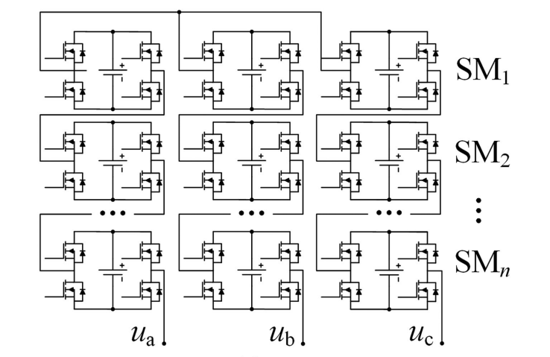
Cascaded H-Bridge (CHB)
CHBs are considered which provide even smaller
voltage steps at the inverter output terminals.
Provides high reliability and simple control.
Isolated DC sources are needed, and smaller battery packs could be implemented.
We can use GaN or Si-based devices with lower blocking voltage.
Increased inverter power density due to the smaller cooling system.
[1] F. Chang, O. Ilina, M. Lienkamp and L. Voss, "Improving the Overall Efficiency of Automotive Inverters Using a Multilevel Converter Composed of Low Voltage Si mosfets," in IEEE Transactions on Power Electronics, vol. 34, no. 4, pp. 3586-3602, April 2019, doi: 10.1109/TPEL.2018.2854756.
[2] A. Poorfakhraei, M. Narimani and A. Emadi, "A Review of Multilevel Inverter Topologies in Electric Vehicles: Current Status and Future Trends," in IEEE Open Journal of Power Electronics, vol. 2, pp. 155-170, 2021, doi: 10.1109/OJPEL.2021.3063550.

Slide 18
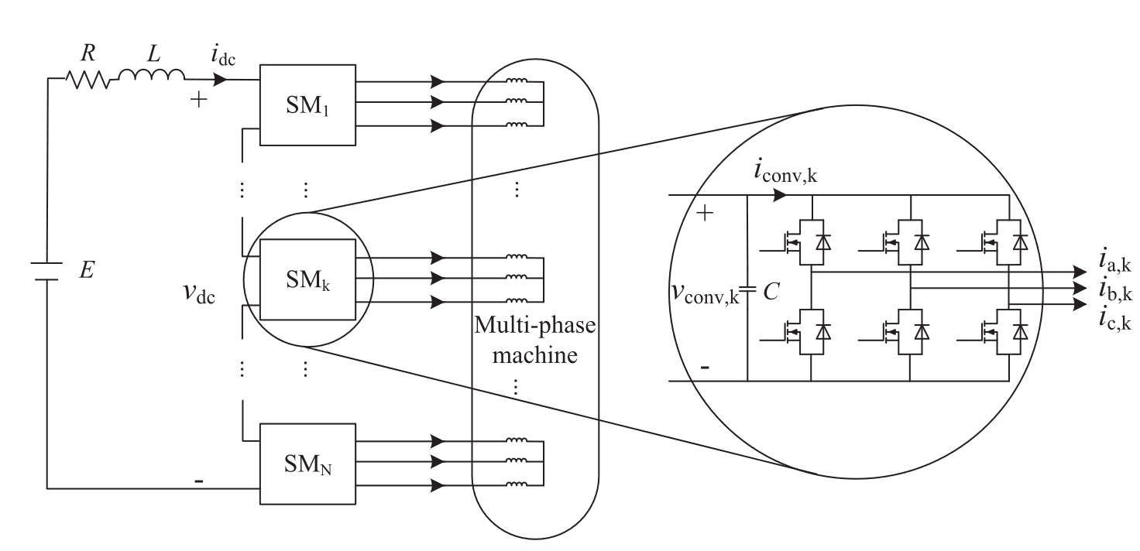
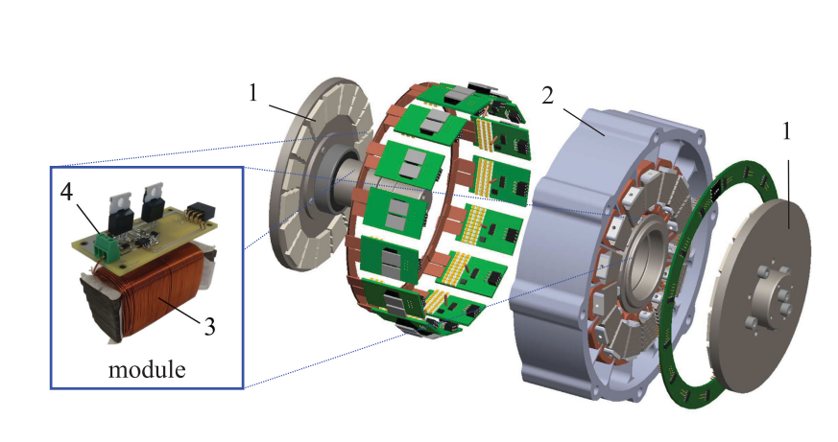
Stacked Polyphase Bridge (SPB) Converter
Trends in power semiconductor technology indicate a tradeoff in the selection of devices in terms of voltage-blocking capability and switching frequency. By lowering the voltage level of each submodule, modular converters can utilize a large variety of semiconductor devices.
The SPB converter provides the possibility to use a relatively high switching frequency (¿100 kHz), avoiding un-optimized component sizing, which could restrain the compactness of a drive system.
Can drive multi-phase or multi-3-phase machines.
Reduces capacitor size in submodules, allowing for high switching frequencies and interleaving.
Possesses an inherent fault-tolerant capability.
Gives manufacturing flexibility of integration and scalability.
Since the series-connected submodules share the dc voltage, the submodule capacitor voltage balance should be maintained under both normal and fault conditions.
[1] L. Jin, S. Norrga, O. Wallmark and N. Apostolopoulos, "Modulation and Power Losses of a Stacked Polyphase Bridge Converter," in IEEE Journal of Emerging and Selected Topics in Power Electronics, vol. 5, no. 1, pp. 409-418, March 2017, doi: 10.1109/JESTPE.2016.2621349.
[2] L. Verkroost, J. Van Damme, D. V. Bozalakov, F. De Belie, P. Sergeant and H. Vansompel, "Simultaneous DC-Link and Stator Current Ripple Reduction With Interleaved Carriers in Multiphase Controlled Integrated Modular Motor Drives," in IEEE Transactions on Industrial Electronics, vol. 68, no. 7, pp. 5616-5625, July 2021, doi: 10.1109/TIE.2020.2992965.

Slide 19
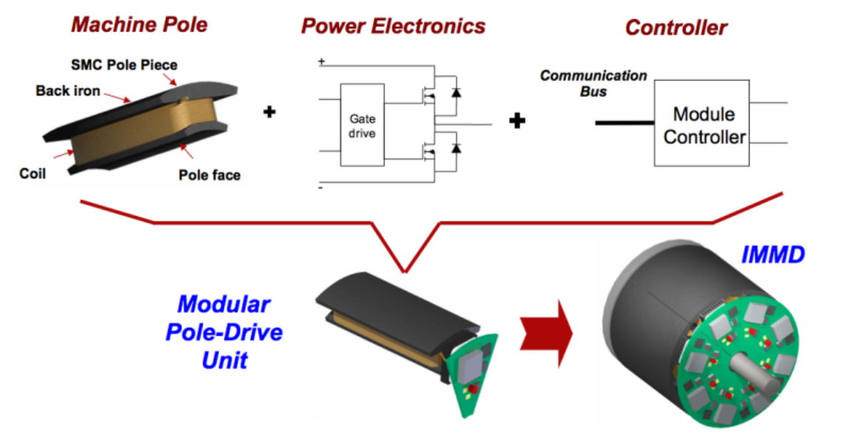
Integrated modular motor drives (IMMD)
All the components of the motor drive system can be integrated onto the motor including power electronics, control electronics, passive components and heat sink. By doing so, the power density of the system can be enhanced significantly which is very critical in aerospace and electric traction applications
With modularization, the overall system is segmented with modules sharing the total power equally. By this way, the fault tolerance of the system is increased.
The current and voltage stress on the power semiconductor devices can also be decreased by modularization.
The manufacturing, installation and maintenance costs decrease thanks to the modular structure.
[1] In the case of the Toyota Prius, inverter peak power density increased roughly from 4.5 kW/L to 11.5 kW/L as this technology evolved from 2004 to 2017.
[1] B. Sarlioglu, “Automotive power electronics: Current status and future trends,” in 2019 International Aegean Conference on Electrical Machines and Power Electronics (ACEMP) 2019 International Conference on Optimization of Electrical and Electronic Equipment (OPTIM), 2019, pp. 1–2

Slide 20
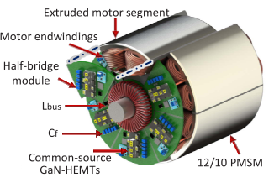
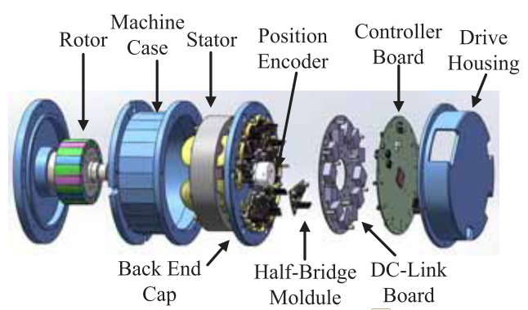
IMMD
A cost reduction up to 20% is possible thanks to the elimination of enclosures and connection equipment.
The components which produce heat due to power loss are distributed in a wider surface area which makes the thermal design more convenient as well as decreases the chance of hot spots.
The absence of connection cables yields less leakage current on the winding insulation which will extend the lifespan of the motor as well as minimize electromagnetic interference (EMI) problems.
It is challenging that fitting all the drive components to the available space requires size optimization and careful layout design.
It is difficult to cool the motor and drive simultaneously since they both produce heat.
All the electronic components are subjected to a higher ambient temperature and continuous vibration.
[1] Hang Dai, Thomas M. Jahns, Renato A. Torres, Mingda Liu, Bulent Sarlioglu, Steven Chang ,2018, Development of High-Frequency WBG Power Modules with Reverse-Voltage-Blocking Capability for an Integrated Motor Drive using a Current-Source Inverter
[2] Zihan Gao, Dong Jiang, Wubin Kong, Cai Chen, Haiyang Fang, Cong Wang, Dawei Li, Yi Zhang, Ronghai Qu 2018, A GaN-Based Integrated Modular Motor Drive for Open-Winding Permanent Magnet Synchronous Motor Application

Slide 21
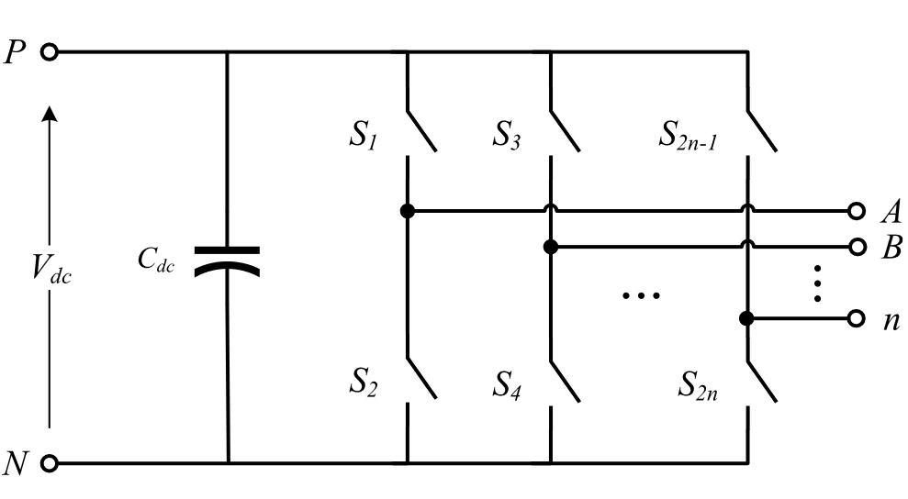
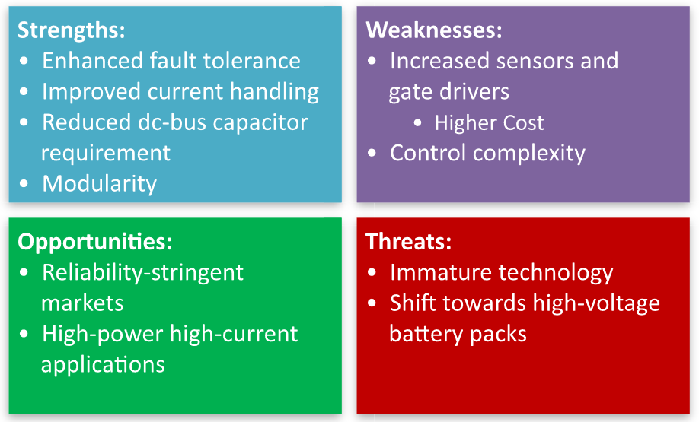
Multi Phase
Multiphase drives (MPDs), beyond three phases, thrive in delivering high power, owing to their improved per-phase current handling.
With more phases to share the required output power, device paralleling issues are alleviated, or eliminated altogether.
From another perspective, MPDs leverage reliability as they have superior fault-tolerance capabilities.
Conventional three-phase inverters are extendable to MPIs by simply adding
additional switching legs to the existing ones. Another reason is the modularity of six-phase machines with two isolated neutrals, which can be treated as two three-phase sets, commonly known as dual three-phase machines.
In principle, for n-phase machine with n multiples of three, the system can be decomposed into n/3 three phase systems.
The dc-bus capacitor is generally bulky and has a limited operating temperature range. In fact, it is the bottleneck in the face of achieving higher power densities as it occupies up to two-thirds of the total volume of the inverter. With increasing number of phases, it was shown that the required DC-link capacitance decreases with increasing phase number. A 50% capacitance reduction can be achieved in a six-phase VSI.
[1] W. Taha, P. Azer, A. D. Callegaro, and A. Emadi, “Multiphase traction inverters: State-of-the-art review and future trends,” IEEE Access,vol. 10, pp. 4580–4599, 2022.

Slide 22
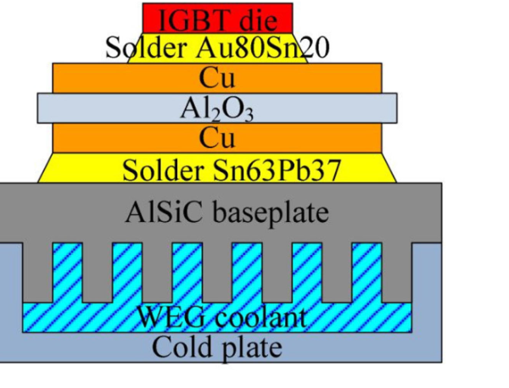
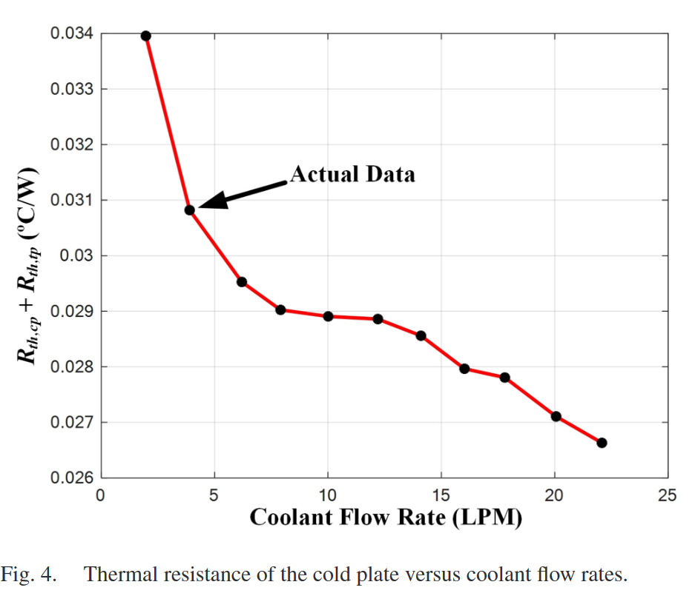
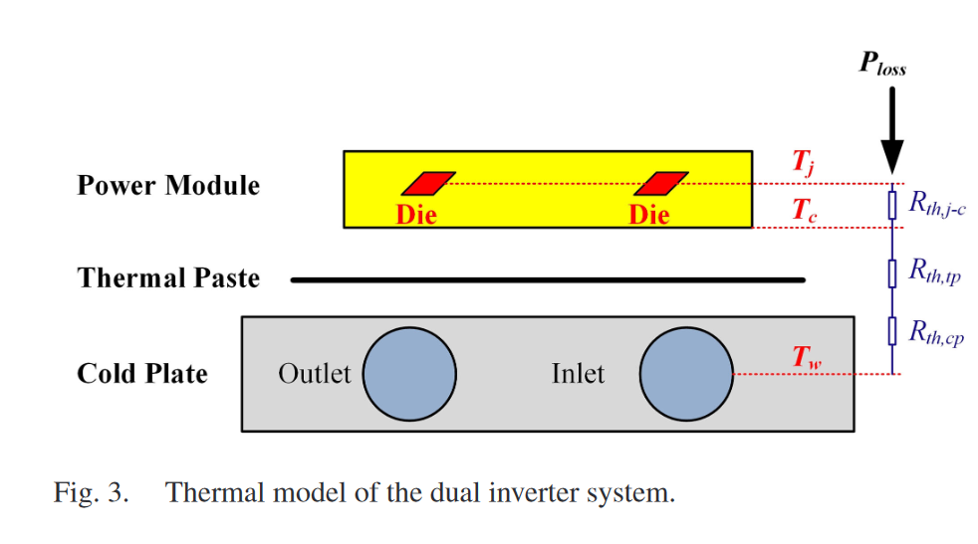
Thermal Management (Liquid-Cooling System)
The thermal resistance of the cold plate depends on:
Coolant type
Coolant temp
Flow rate
The thermal model, including just thermal resistance, is enough to calculate steady-state junction temperature and losses for continuous power operation.
Dominant thermal resistance is junction-to-case resistance.
[1] Y. Wu et al., "Electrothermal-Control Co-Design of an All Silicon Carbide 2×250 kW Dual Inverter for Heavy-Duty Traction Applications," in IEEE Transactions on Industry Applications, vol. 58, no. 1, pp. 505-516, Jan.-Feb. 2022, doi: 10.1109/TIA.2021.3127144.

Slide 23

DC-link Capacitor Selection
To meet the light and compact design target, the capacitance and volume of the dc-link capacitor should be optimized.
Due to the ripple voltage and ripple current caused by the switching behavior of SiC MOSFET, the DC-link capacitor is one of the weakest elements in the inverter.
Constraints:
  Ripple voltage
  Ripple current
  Cost
  Size
  Weight
  Materials:
    Ceramic can endure high temperatures, but its capacitance is small and sensitive to humidity. Power density is about 2$μF/cm^{3}$. It is much more expensive than others.
    Electrolytic has a large capacitance, it cannot endure high temperature. The hot operation condition dries the electrolytic out and damages the capacitor. Higher power density, which is greater than $4 μF/cm^{3}$
    Film are between the ceramic and electrolytic capacitors. Power density is about 1$μF/cm^{3}$

Slide 24
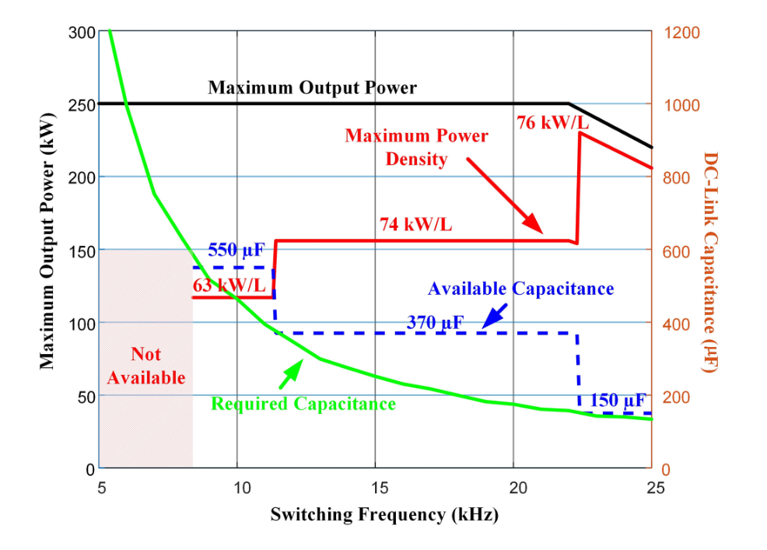
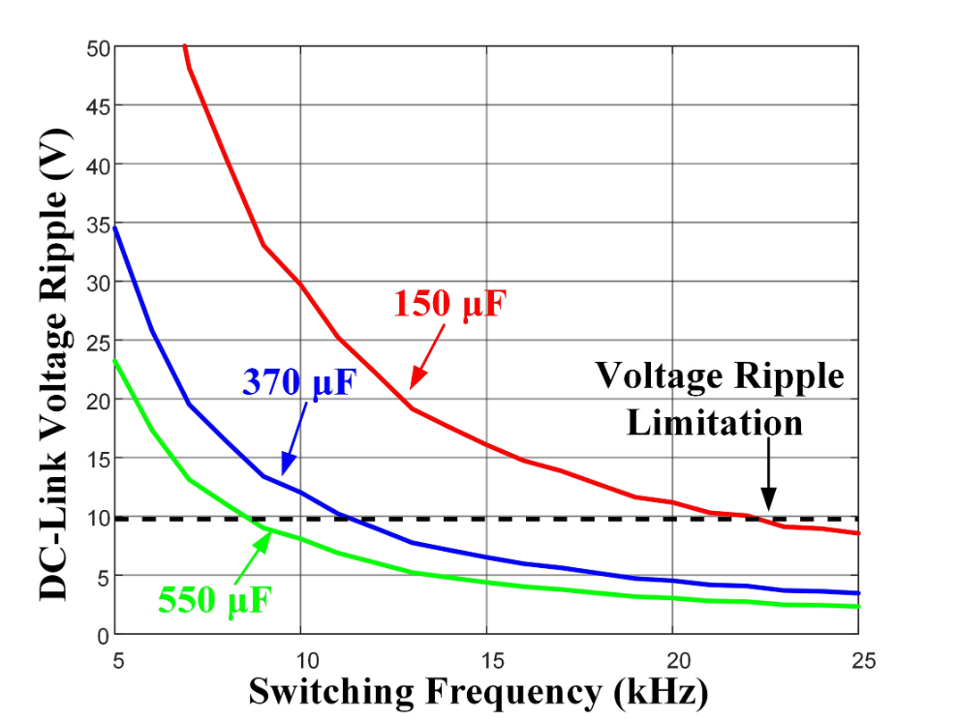
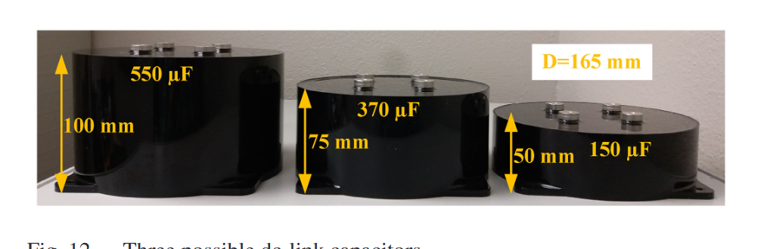
Minimization of the DC-link capacitance
    Considering the ripple voltage of the inverter, the minimum capacitance can be found respecting topology.
    Considering the ripple current, the minimum capacitance can be found respecting topology.
    Multi-level or multi-module decreases the capacitance requirement.
    Switching frequency affects the capacitance requirement.
[1] Y. Wu et al., "Electrothermal-Control Co-Design of an All Silicon Carbide 2×250 kW Dual Inverter for Heavy-Duty Traction Applications," in IEEE Transactions on Industry Applications, vol. 58, no. 1, pp. 505-516, Jan.-Feb. 2022, doi: 10.1109/TIA.2021.3127144.

Slide 25
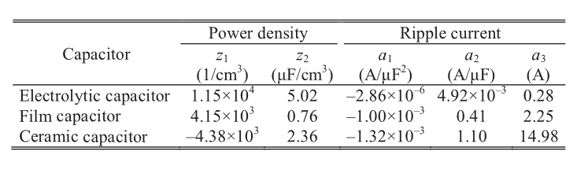
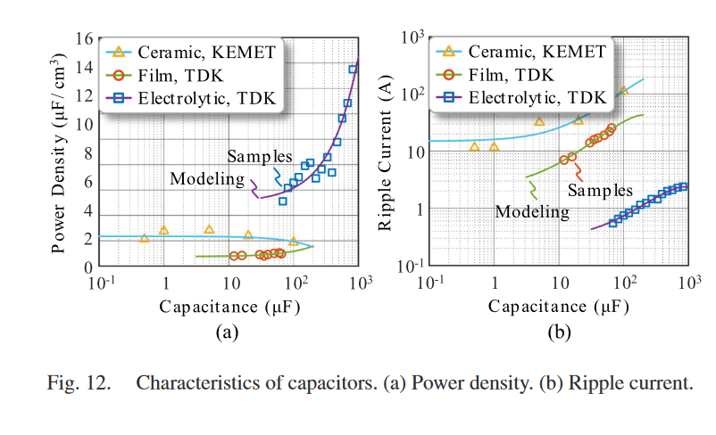
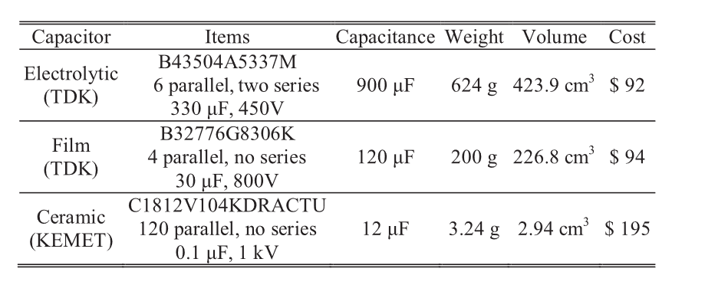
Prices and Power Densities
[1] Z. Zeng, X. Zhang, F. Blaabjerg, H. Chen and T. Sun, "Stepwise Design Methodology and Heterogeneous Integration Routine of Air-Cooled SiC Inverter for Electric Vehicle," in IEEE Transactions on Power Electronics, vol. 35, no. 4, pp. 3973-3988, April 2020, doi: 10.1109/TPEL.2019.2937135.

Slide 26
Busbar Design
High switching speed of SiC may potentially cause:
  Excessive voltage overshoot
  Ringing
The overshoot voltage during turn-OFF transient is a common issue. It stems from:
  high di/dt (5-10 times higher than Si)
  the total stray inductance in the current commutation loops (CCLs)
    the parasitic inductance of the dc-link capacitors
    the stray inductance of the semiconductor devices or power modules
    the stray inductance on the bus bars connecting the capacitors and the power devices.

Slide 27
Busbar Design
The laminated bus bar structure, which consists of multiple copper sheets, separated from each other by a dielectric material, is commonly used since it can effectively reduce the stray inductance. A proper busbar decrease:
  voltage overshoot
  electromagnetic interference (EMI) emission
  switching losses
  thermal stress

Slide 28
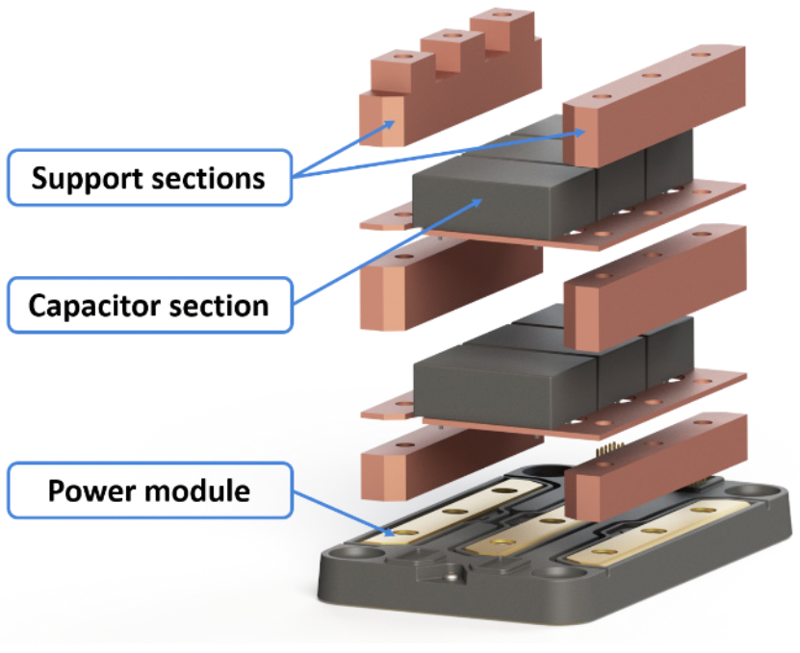
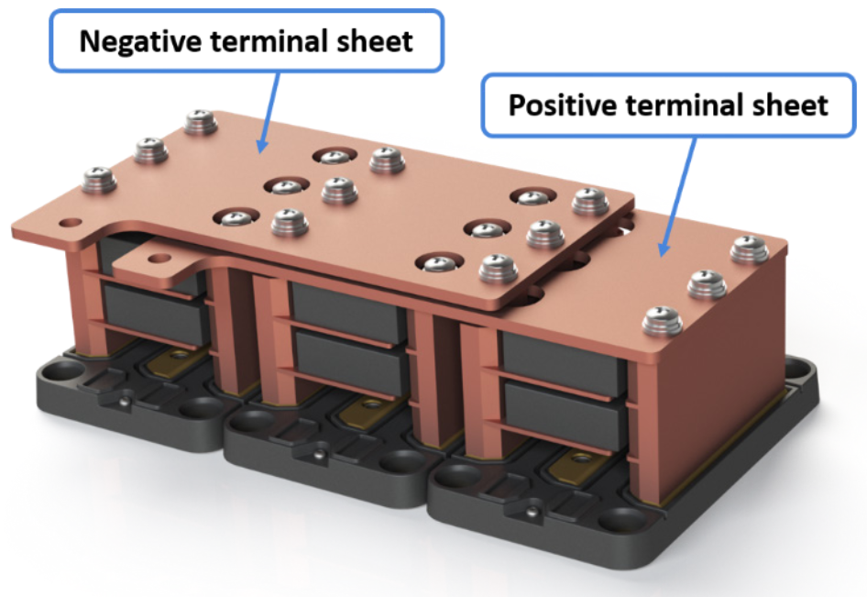
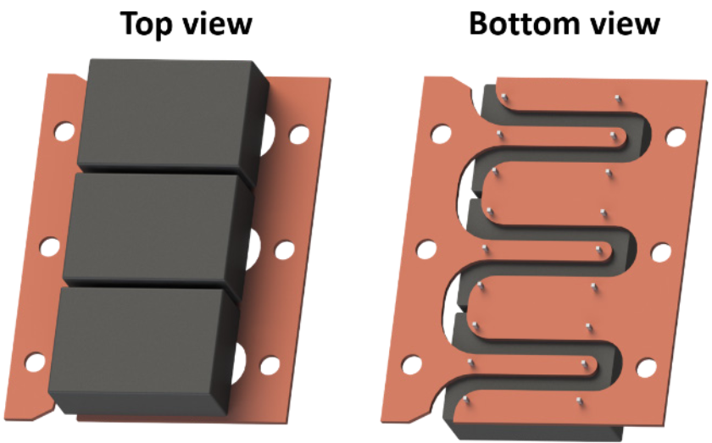
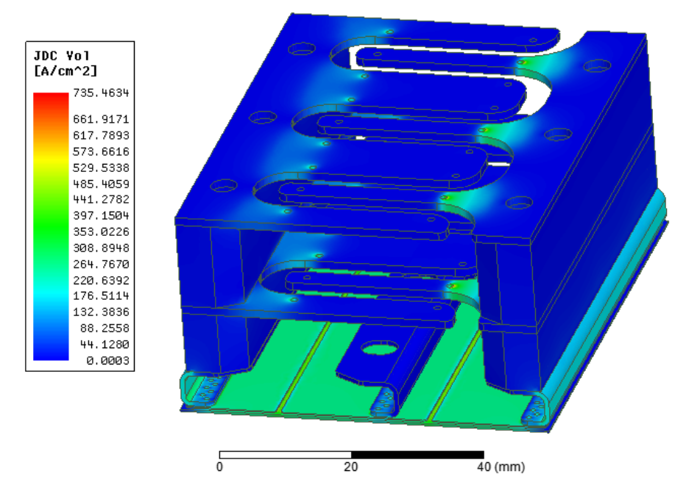
Busbar Design
High-frequency current flow paths should be considered.
The layout of the busbar should be symmetric.
Current distribution should be homogenized.
Analytical calculations or FEA can be used to calculate stray inductances.
The stray inductances in current commutation loops should be minimized. (Typically order of 10nH)

