Slide 1
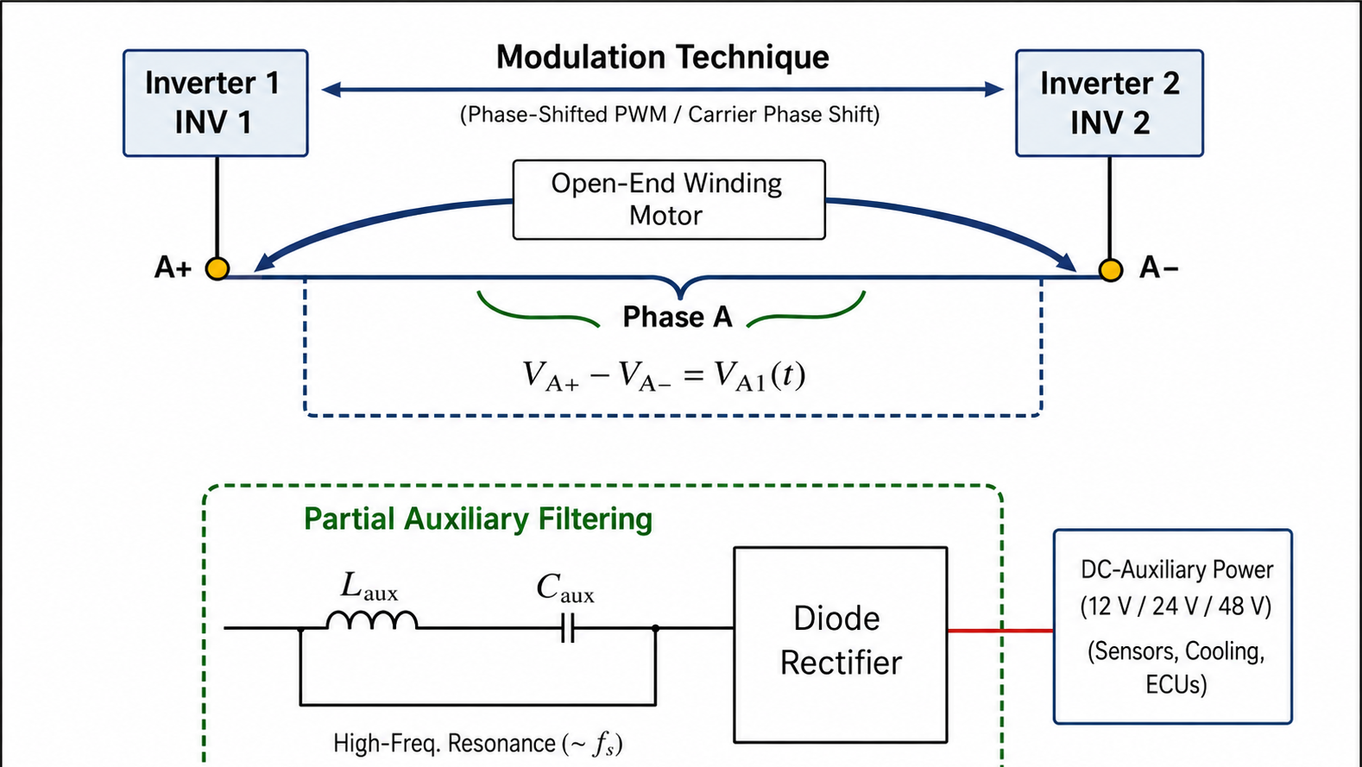

Slide 2
Inverter 1
Inverter 2
Modulation Techniques
PWM-based HF Voltage Reshaping
A+
Open-End Winding
Motor
A-
B+
B-
C+
C-
Auxiliary Power Supply
A+
LC Filter
A-
DC Auxiliary Power
12/24/48 V
(Control, Cooling, ECUs)
Rectifier & Load

Slide 3
Inverter 1
Inverter 2
Modulation Techniques
PWM-based HF Voltage Reshaping
A+
Open-End Winding
Motor
A-
B+
B-
C+
C-
Auxiliary Power Supply
A+
LC Filter
A-
DC Auxiliary Power
12/24/48 V
(Control, Cooling, ECUs)
Rectifier & Load

