Slide 1
2-Level Inverter Integration with 62mm Power Module
KTH

Slide 2
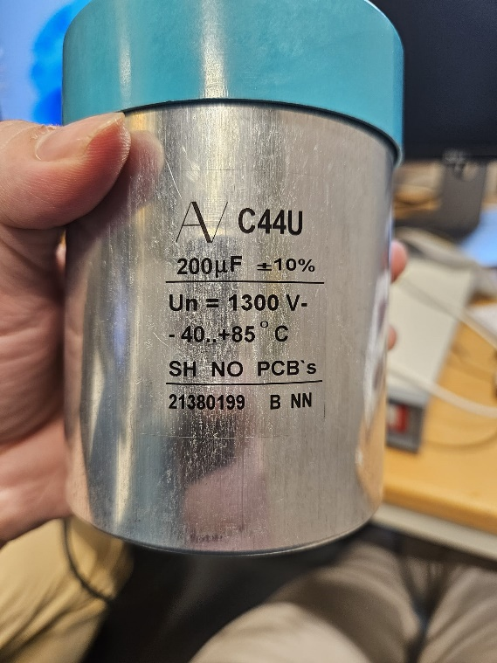

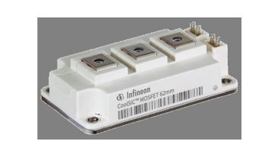
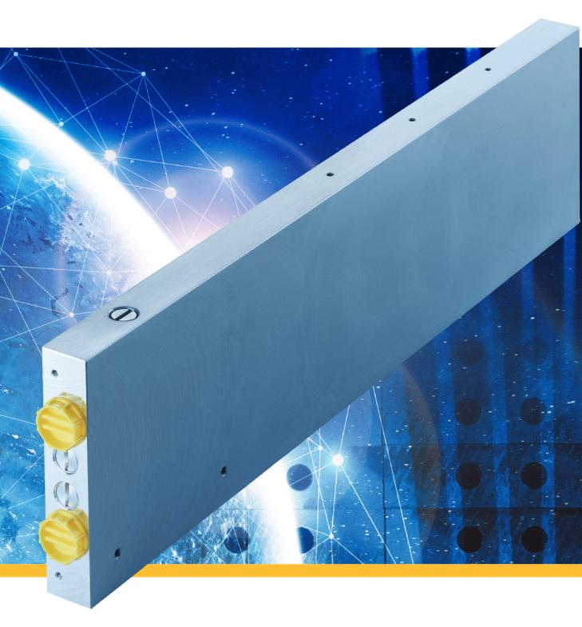
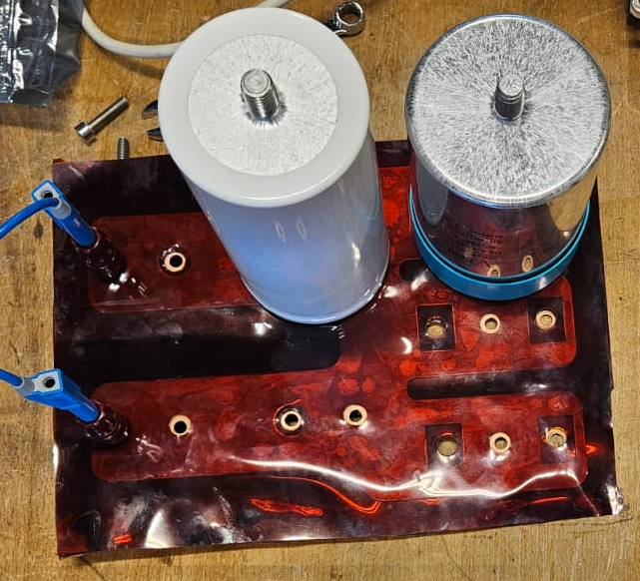
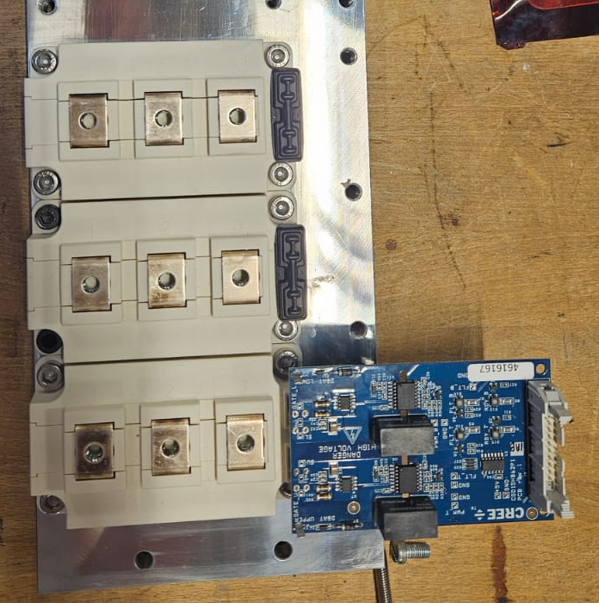
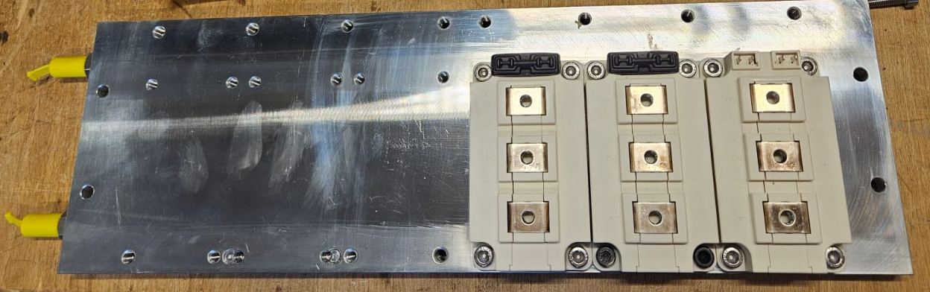
Busbar Desing
Capacitor : KEMET C44U 1300V 200uH
DC- Nodes
Power Modules : Infineon 2kV CoolSic 62mm
DC+ Nodes
Coldplate
Coldplate
Power Modules
Laminated
Busbar
Capacitor
Gate Driver

Slide 3
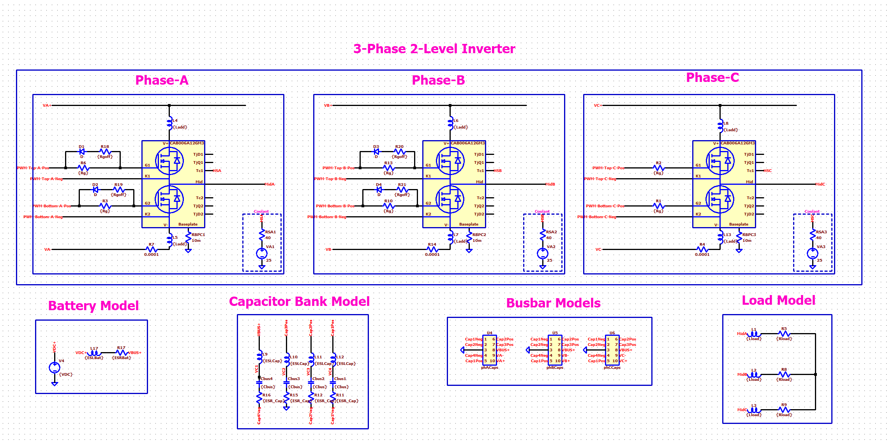
Parasitic Inductances (Switching Speed Limitation)
Parasitic Sources | Inductance
Power module | 50 nH
Capacitor ESL | 50nH
Busbar | Overall <20nH

Slide 4
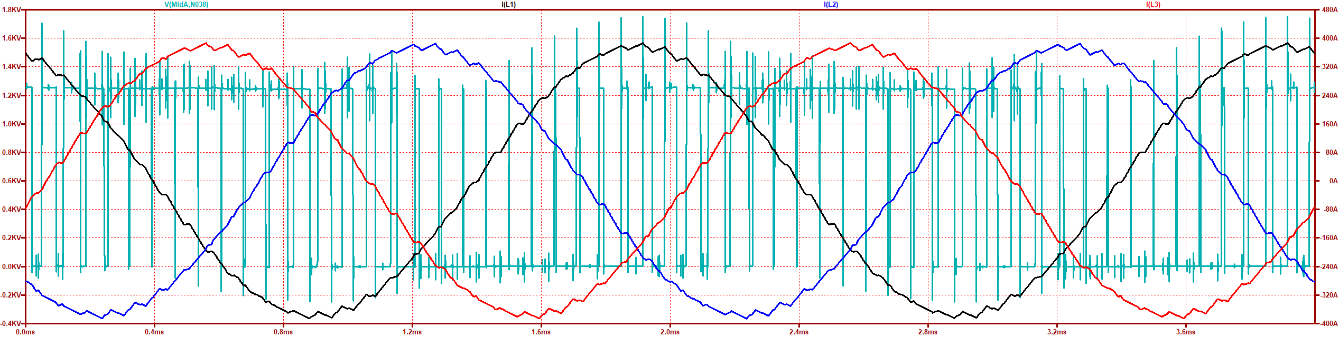
Parasitic Inductances (Switching Speed Limitation)
Maximum Current (MaxA) (inA) | dv/dt (in V/nS) @ MaxA | Overshoot (in %) @ MaxA
380 A | 35 V/ns | 40 %
Phase-A Current
Phase-B Current
Phase-C Current
Drain-source Voltage
Leg-A
Bottom Switch

Slide 5
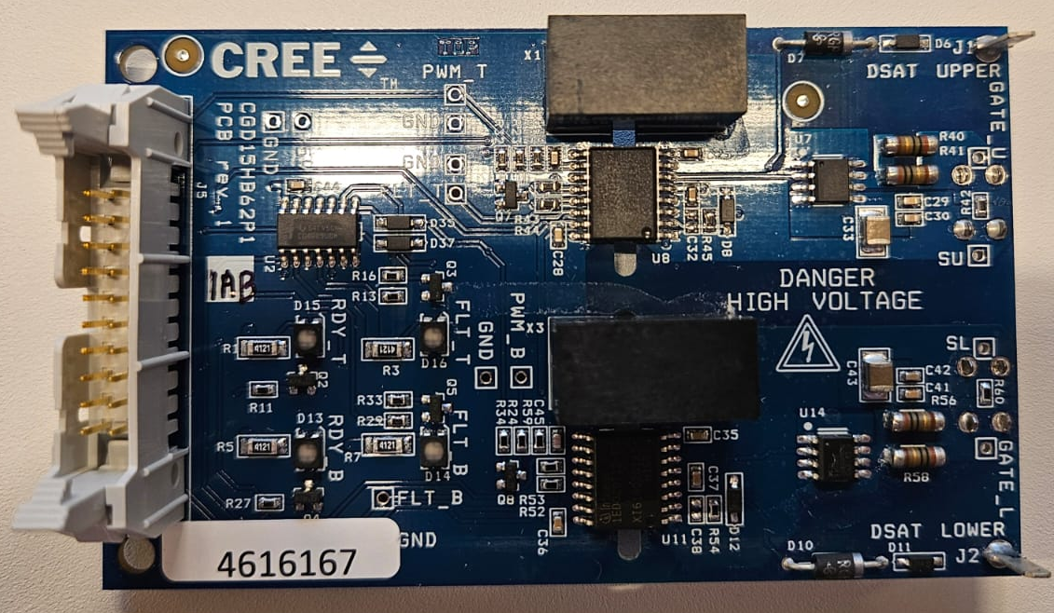
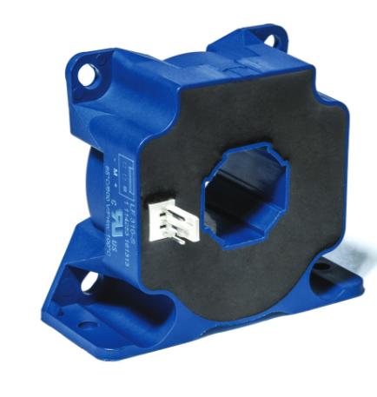
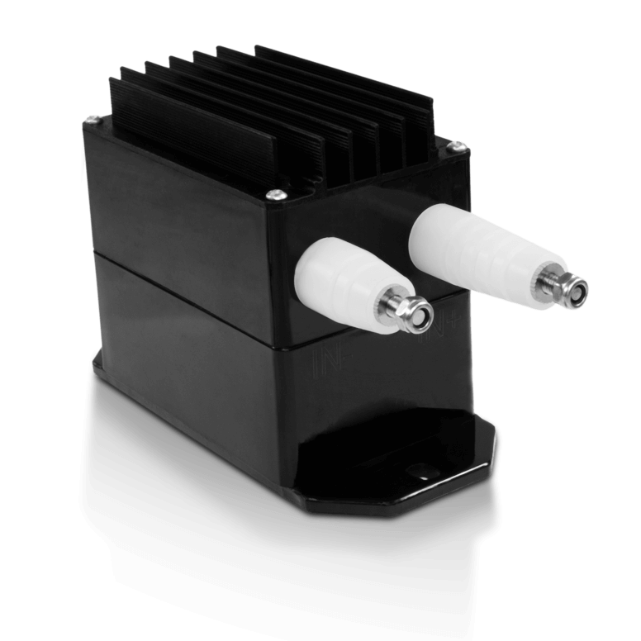
Gate Driver and Sensors (that we consider to use)
Gate Driver: Evaluation Board Cree
CGD1200HB2P
20V -5V
Current Transducer LF 310-S
300A (RMS)
100kHz Bandwith
Accuenergy HV2-1500
1500V
DC
Scania's suggestions? The sensors that Scania uses?

Slide 6
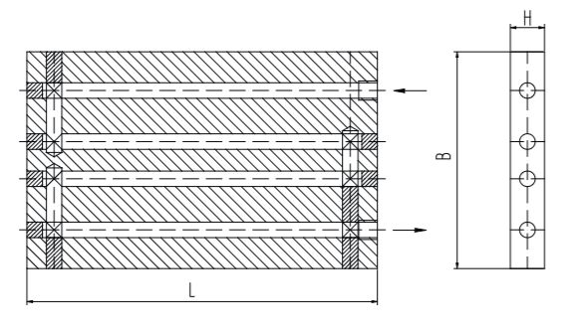
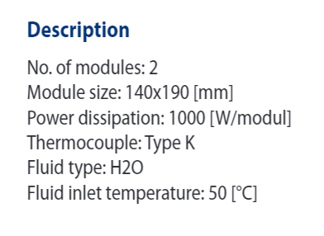
Cooling : Six 62mm Power Modules (in a row)
LIQUID COOLING
Series KS

Slide 7
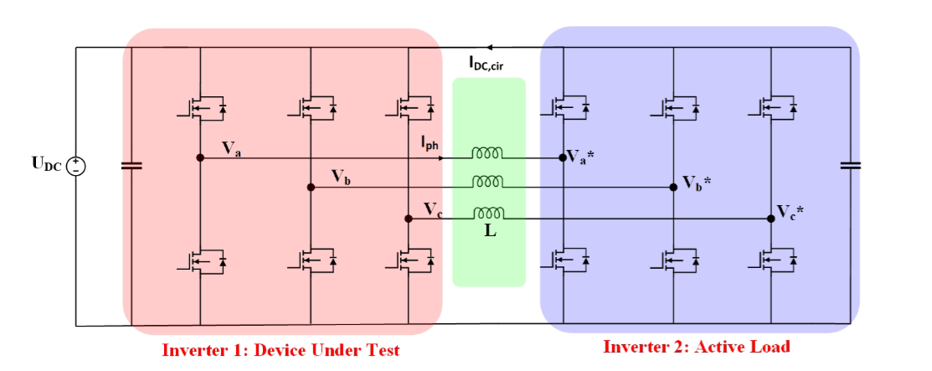
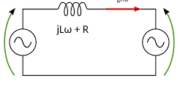


Control: Back-to-Back Inverter
Iph
Q$=\frac{V_{ph1}^{2} − V_{ph1}V_{ph2}\cos\left(δ\right)}{jωL}$
$$P=\frac{V_{ph1}V_{ph2}\sin\left(δ\right)}{jωL}$$
Vph1
Vph2
When two AC voltage sources are connected through an inductance, the power flow between them depends on the phase difference between the voltages of the two sources and the reactance of the connecting inductance.

Slide 8

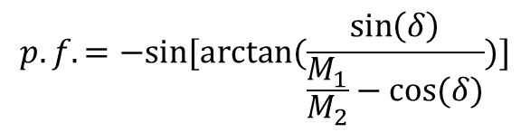
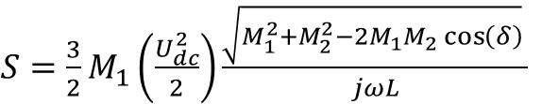


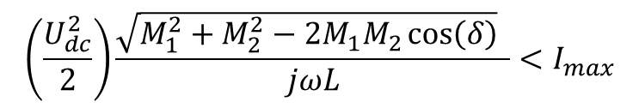

Control: Back-to-Back Inverter
Independent control of the power and power factor might be achieved by controlling ${ M}_{1}$, ${ M}_{2}$, and $δ$.
$$P=\frac{V_{ph1}V_{ph2}\sin\left(δ\right)}{jωL}$$
Q$=\frac{V_{ph1}^{2} − V_{ph1}V_{ph2}\cos\left(δ\right)}{jωL}$
$V_{ph1}=\frac{1}{\sqrt{2}}U_{dc}\frac{{ M}_{1}}{2}$
$V_{ph2}=\frac{1}{\sqrt{2}}U_{dc}\frac{{ M}_{2}}{2}$
$S=\frac{3}{2}M_{1}\left(\frac{U_{dc}^{2}}{2}\right)\frac{\sqrt{M_{1}^{2}+M_{2}^{2}−2M_{1}M_{2}\cos\left(δ\right)} }{jωL}$
$$p.f.=−sin⁡[arctan⁡(\frac{\sin\left(δ\right)}{\frac{M_{1}}{M_{2}}−cos⁡(δ)})]$$
However, maximum current is limited by
$$\left(\frac{U_{dc}^{2}}{2}\right)\frac{\sqrt{M_{1}^{2}+M_{2}^{2}−2M_{1}M_{2}\cos\left(δ\right)} }{jωL}<I_{max}$$

Slide 9
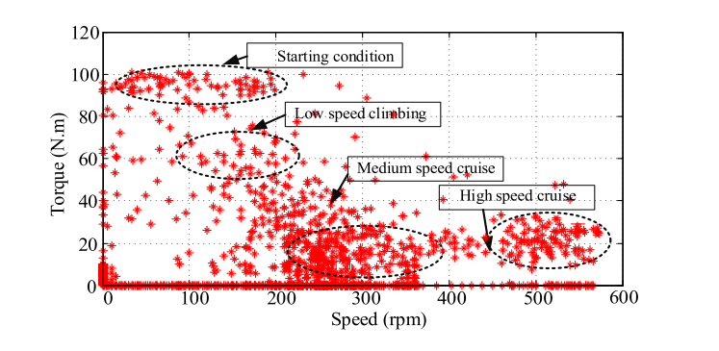
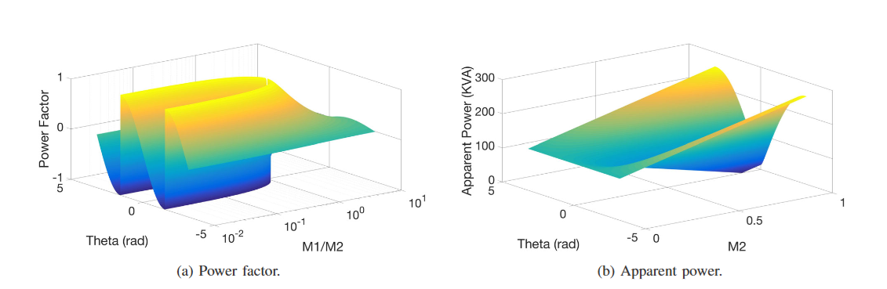
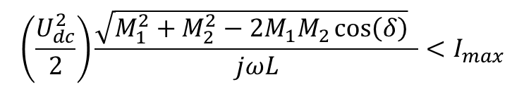
Control: Back-to-Back Inverter
Mimicking EV Drive Cycles: Drive cycles involve a wide range of operating conditions, from low-speed to high-speed driving.
Low-Speed Operation: High inductance is needed to achive the nominmal current at low modulation indexes.
High-Speed Operation: Increasing utilization of DC-link is needed, i.e. SVM, THIPWM. This common mode voltages creates common mode circulating current, which effects the efficiency.
$$\left(\frac{U_{dc}^{2}}{2}\right)\frac{\sqrt{M_{1}^{2}+M_{2}^{2}−2M_{1}M_{2}\cos\left(δ\right)} }{jωL}<I_{max}$$

Slide 10
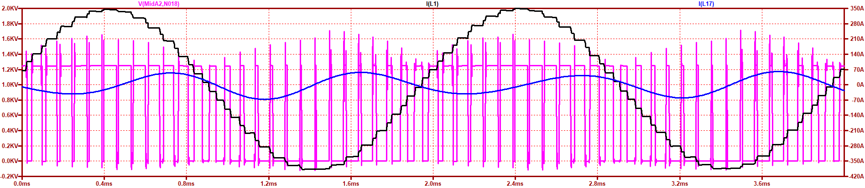
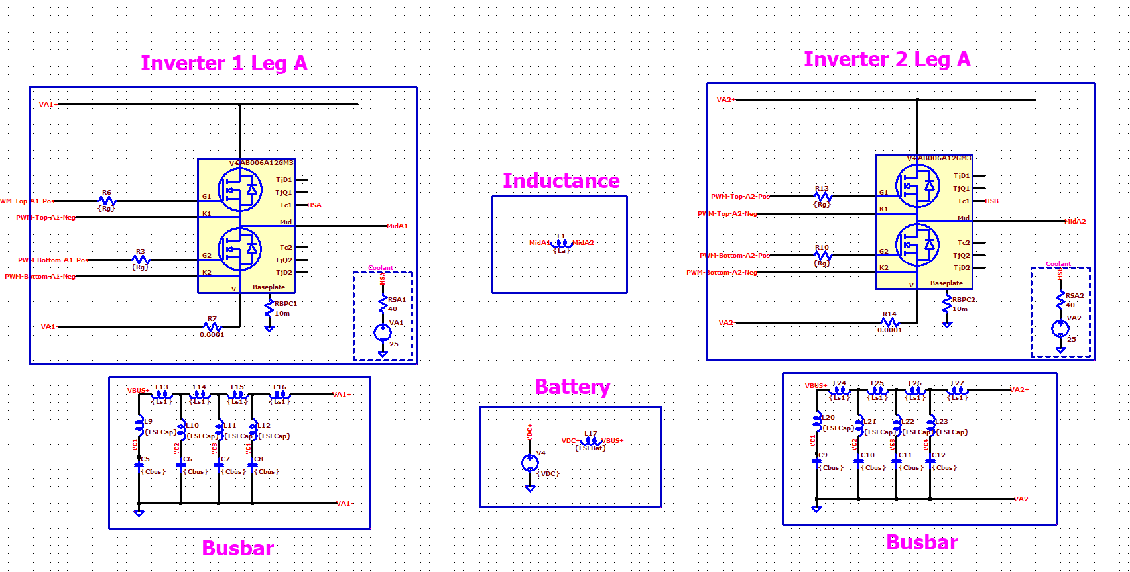
Control: Back-to-Back Inverter

