Slide 1
2-Level Voltage Source Traction Inverter
Enes Ayaz

Slide 2
Agenda
  Power Ratings of 2-Level Inverter
  Power Modules (Infineon 2kV) Parameters
  Inverter Loss Estimation with Datasheet Values
    Updating Loss for Different Switching Speed (dv/dt)
  Harmonic Losses on the Motor
  Die area and Switching Frequency Selection (Total Losses)

Slide 3


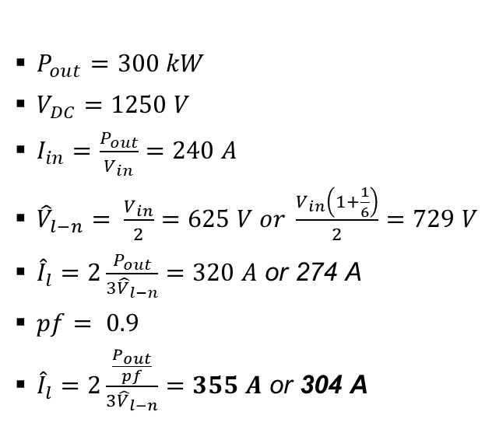
2-Level Inverter Power Ratings
$P_{out}=300 kW$
$V_{DC}=1250 V$
$I_{in}=\frac{P_{out}}{V_{in}}=240 A$
${\hat{V}}_{l−n}= \frac{V_{in}}{2}=625 V or \frac{V_{in}\left(1+\frac{1}{6}\right)}{2}=729 V$
${\hat{I}}_{l}=2\frac{P_{out}}{{3\hat{V}}_{l−n}}=320 A$ or 274 A
$pf= 0.9$
${\hat{I}}_{l}=2\frac{\frac{P_{out}}{pf}}{{3\hat{V}}_{l−n}}=355 A$ or 304 A
Efficiency (99.5%)
Semiconductor Losses (6 switches): 1500 $W$
A phase leg of a conventional two-level inverter
consists of two transistors that block and switch
the full dc-link voltage.
Two-level inverters are less complex than the
other topologies and have the least control effort.
On the other hand, the connected machine suffers from higher harmonic losses and the steep voltage slopes can damage it by causing bearing currents or overstressing the winding insulation.
Two-level inverters have a bad efficiency for higher switching frequency.

Slide 4
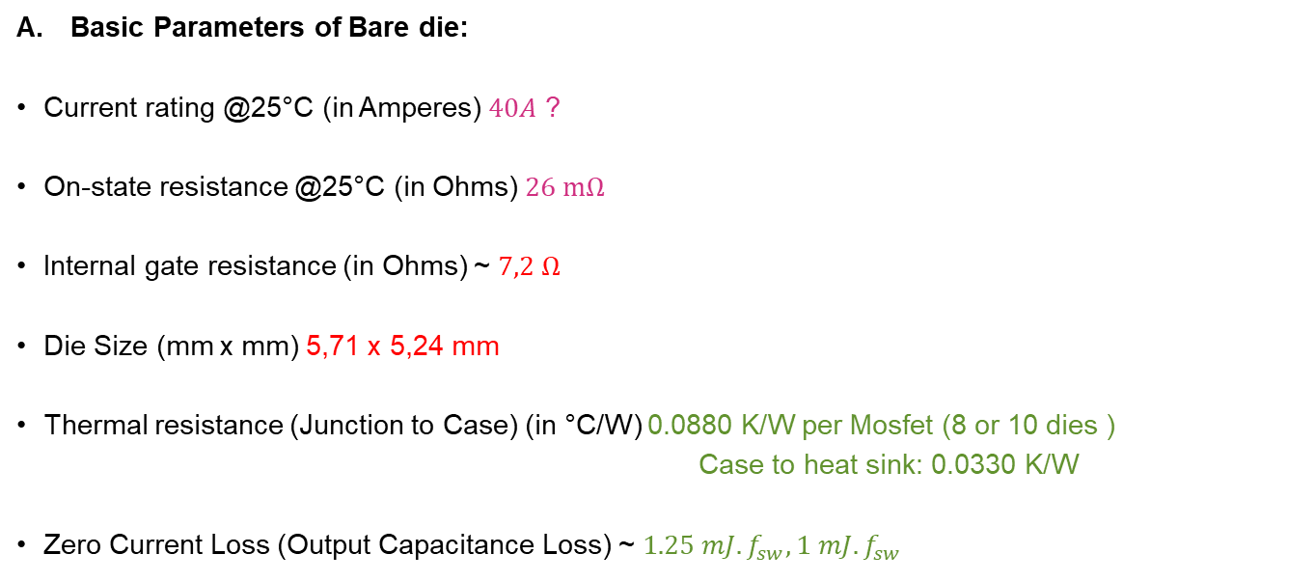
Parameters of Infineon 2kV Bare die
Basic Parameters of Bare die:
Current rating @25°C (in Amperes) $40A$ ?
On-state resistance @25°C (in Ohms) $26 mΩ$
Internal gate resistance (in Ohms) ~ $7,2 Ω$
Die Size (mm x mm) 5,71 x 5,24 mm
Thermal resistance (Junction to Case) (in °C/W) 0.0880 K/W per Mosfet (8 or 10 dies )
Case to heat sink: 0.0330 K/W
Zero Current Loss (Output Capacitance Loss) ~ $1.25 mJ. f_{sw}, 1 mJ. f_{sw}$
Considering this current rating of a single die, it seems we have around 8-16 dies in parallel.

Slide 5

Datasheet-Driven Loss Estimation
Voltage rating: 2kV
Current rating: 400A
FF3MR20KM1H using 10 dies in parallel
58 mJ at 304 A
17 mJ at 304 A
$$\frac{26}{10}=2.6mΩ$$

Slide 6
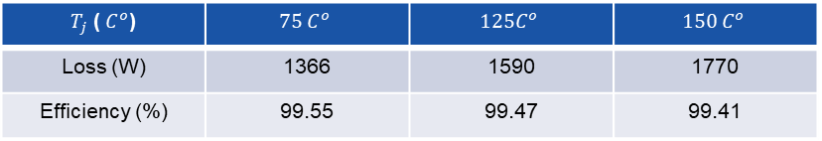
Datasheet-driven Loss Calculation
Switching frequency = 5kHz, ma=1.15, pf=0.9 2-level 3-phase, P=300kW
The maximum switching frequency is 5kHz since we have slow switching speed (dv/dt) test data in the datasheet.
The current is sinusoidal.
$T_{j}$ ( $C^{o}$) | $$75 C^{o}$$ | $$125C^{o}$$ | $$150 C^{o}$$
Loss (W) | 1366 | 1590 | 1770
Efficiency (%) | 99.55 | 99.47 | 99.41
Assume only conduction loss is changed with temperature.
We do not use a thermal model here; we just find the losses for different junction temperatures.

Slide 7
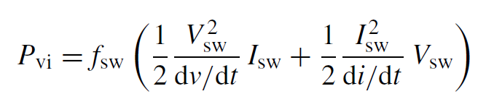

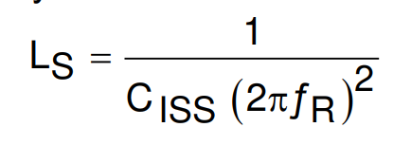
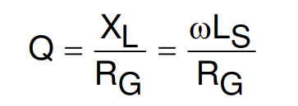
Updating Switching Losses for Fast dv/dt
58 mJ at 304 A
17 mJ at 304 A
10mJ
Overlapping loss
Output capacitance loss
Depends on dv/dt and di/dt
Linearly increasing by the number of dies in parallel

Slide 8
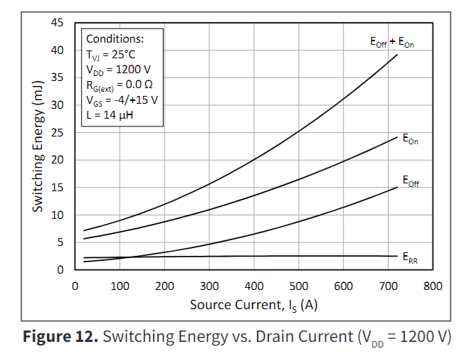
Updating Switching Loss for Fast dv/dt
Scaled by considering 1.7 kV Wolf-Speed power modules which have test data with higher dv/dt

Slide 9
Updating Switching Losses for Fast dv/dt
Number of Dies area selected as minimized the losses regarding the switching frequency.
Junction temperature is taken at $75 C^{o}$.

Slide 10
Updating Switching Losses for Fast dv/dt

Slide 11

Other Cases
If junction temperature is taken at $100 C^{o}$
If we lower dv/dt 2.5 times

Slide 12
Other Cases
If we lower dv/dt 2.5 times

Slide 13
Harmonic Losses on the Motor
We have trade-off between motor harmonic losses and inverter losses.
Optimum point
Decreasing trend
Increasing trend

Slide 14
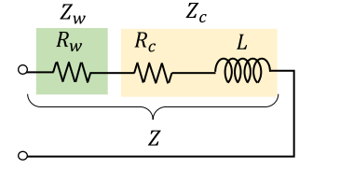
Harmonic Losses Estimation- Impedance Model

Slide 15
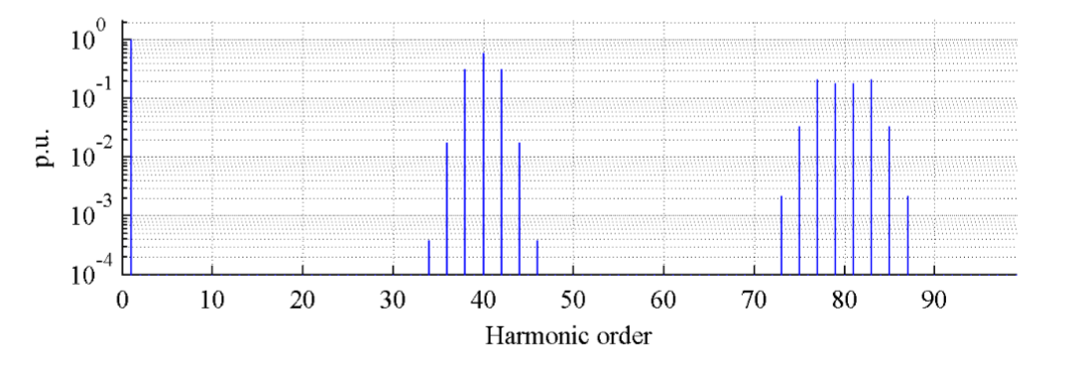
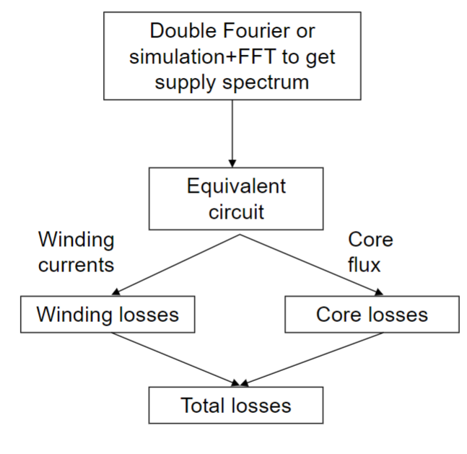
Harmonic Losses Estimation-Impedance Model
Harmonic distribution changes regarding inverter operation
Loss Factor

Slide 16
Total Losses Calculation
Optimum switching frequency

Slide 17
Total Losses Calculation

Slide 18
Power Modules
Voltage rating: 2kV
Current rating: 400A
FF3MR20KM1H
10 dies in parallel
Can we use an off-the-shelf power module ?
Voltage rating: 2kV
Current rating: 440A
11 dies in parallel
Desired one for fast dv/dt, 14 kHz
Voltage rating: 2kV
Current rating: 600A
15 dies in parallel
Desired one for slow dv/dt, 9 kHz
Voltage rating: 1.7kV
Current rating: 360 - 440 A ?
Can we acquire 1.7 kV power modules ?

Slide 19
Thanks !!!

