Slide 1
2-Level Voltage Source Traction Inverter
Enes Ayaz

Slide 2
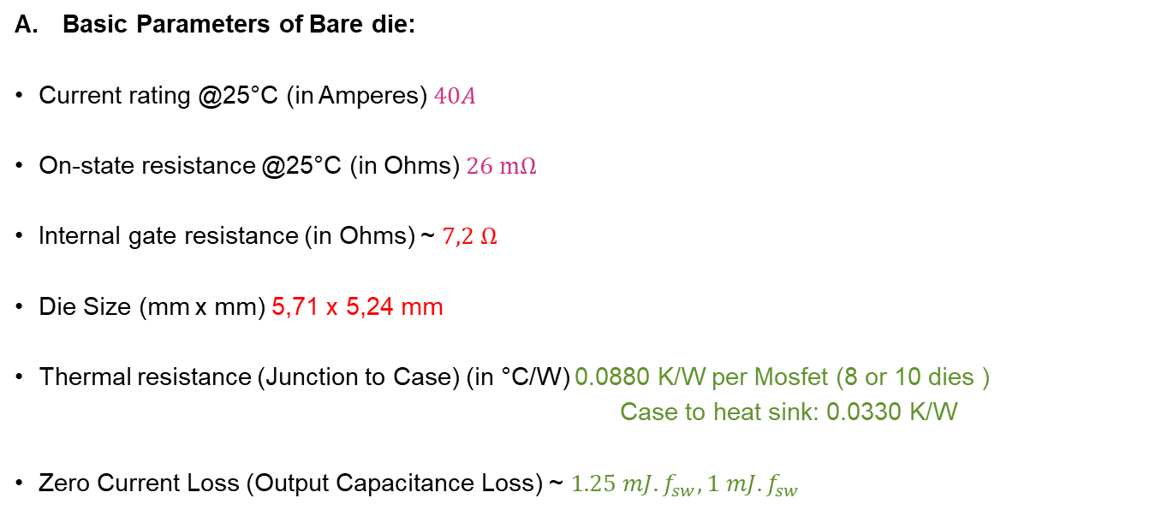
Parameters of Infineon 2kV Bare die
Basic Parameters of Bare die:
Current rating @25°C (in Amperes) $40A$
On-state resistance @25°C (in Ohms) $26 mΩ$
Internal gate resistance (in Ohms) ~ $7,2 Ω$
Die Size (mm x mm) 5,71 x 5,24 mm
Thermal resistance (Junction to Case) (in °C/W) 0.0880 K/W per Mosfet (8 or 10 dies )
Case to heat sink: 0.0330 K/W
Zero Current Loss (Output Capacitance Loss) ~ $1.25 mJ. f_{sw}, 1 mJ. f_{sw}$
Considering this current rating of a single die, it seems we have around 8-16 dies in parallel.

Slide 3
Loss Analysis
Number of Dies area selected as minimized the losses regarding the switching frequency.
Junction temperature is taken at $75 C^{o}$.

Slide 4
Die Area Optimization

Slide 5
Total Losses Calculation
Voltage rating: 2kV
Current rating: 440A
11 dies in parallel
Desired one for fast dv/dt, 14 kHz
Voltage rating: 2kV
Current rating: 400A
FF3MR20KM1H
10 dies in parallel

Slide 6
Thanks !!!

