Slide 1
SPB Leg Building Block: Design Flow
Four EPC2361 per switch: DPT and load-test boards, 1200 V / 300 kW SPB inverter
Enes Ayaz, KTH Royal Institute of Technology, October 2026

Slide 2
Design flow
 | Step | Question → decision
1 | Design inputs | 1200 V, 300 kW, M ≤ 1.15, PMSM cos φ = 0.9 → 228 A_{rms} per leg
2 | Device | 100–650 V GaN survey, absolute and per volt → 100 V GaN, EPC2361 (Kelvin pad)
3 | Submodule voltage | V_{m} + L·di/dt ≤ 90 V for 0.5 / 1 nH, even N → 75 V, N = 16
4 | One device, one driver | loop of one cell + LTspice at 0.5 / 1 nH → ≤ 80 A per device
5 | n in parallel | loss, T_{j}, V_{DS} vs n → 4 EPC2361 per switch
6 | f_{sw}, DC link | ≥ 50 kHz; 3 % ripple → 20 × 22 µF 2220 + 10 × 1 µF bypass per cell
7 | Gate drive → block | one 2EDF7275K per pair (star, Kelvin) → building block of two cells
8 | Four on one board | two pairs, one DC pair, one AC output → DPT board and load-test board
9 | Supplies, measurement | two isolated supplies + Zener bias, UFCS per cell (DPT), U.FL V_{GS}, MMCX V_{DS}, HO 250-S
10 | Three-phase DC bus | legs share the 75 V bus → laminated PCB busbar; 3D level and 16-level stack
11–12 | Verification, boards | fast Q3D set on the final boards and the busbar; fab files

Slide 3
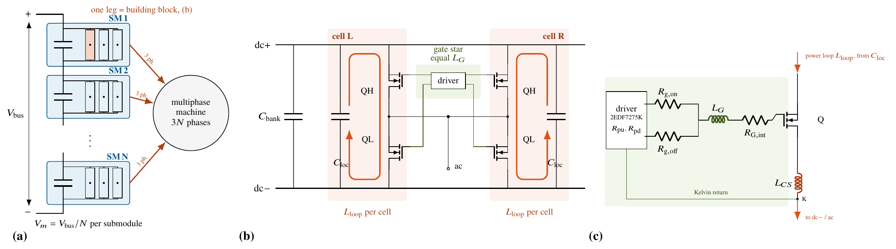
Design inputs
Quantity | Value
DC bus | 1200 V nominal
Output power | 300 kW
Modulation index | M ≤ 1.15 (SVM)
Machine | PMSM, cos φ assumed 0.9
Switching frequency | ≥ 50 kHz (step 6)
Cooling / T_{j} | load test: air 25–40 °C / ≤ 125 °C
Device stress | V_{DS} ≤ 90 V at nominal bus (100 V part)
SPB: N three-phase submodules in series on the DC side, each feeding one winding set of the machine
V_{m} = 1200 V / N per submodule; each submodule = 3 legs on one DC link

Slide 4
Phase current follows from the inputs
Each of the 3N legs delivers P/3N at V_{ph} = M·V_{m}/(2√2):
I_{rms} = P / (3 · M·V_{bus}/(2√2) · cos φ)
  N·V_{m} = V_{bus}: the phase current does not depend on N
  V_{ph} = 1.15 · 75 V / 2√2 = 30.5 V; 6.25 kW per leg
  228 Arms per leg, 322 A peak (cos φ = 0.9)
  DC current per leg 83 A; series DC chain 250 A
Losses in this deck are for cos φ = 0.9; the PMSM operating point is confirmed with the machine design
cos φ | I_{rms} per leg
1.0 | 205 A
0.95 | 216 A
0.9 | 228 A
0.85 | 241 A

Slide 5
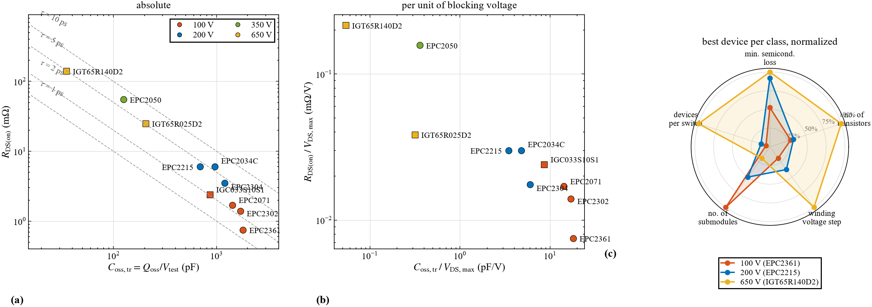
Voltage class: why 100 V GaN
(a) At fixed bus voltage and phase current the minimum semiconductor loss scales with √(R_{DS(on)}·C_{oss,tr}): the 100 V GaN parts have the lowest product
(b) Per volt of blocking capability: 100 V GaN has the lowest R_{DS(on)}/V_{DS,max} (EPC2361 7.5 µΩ/V, 3–30× below 200–650 V) at a higher C_{oss}/V; conduction dominates here (12.4 W vs 4–5 W switching per leg, step 5)
(c) Best device per class: 100 V needs more submodules but the fewest devices per switch and the smallest voltage step → EPC2361, 100 V, 0.75 mΩ typ, 3 × 5 mm, top-side cooling

Slide 6
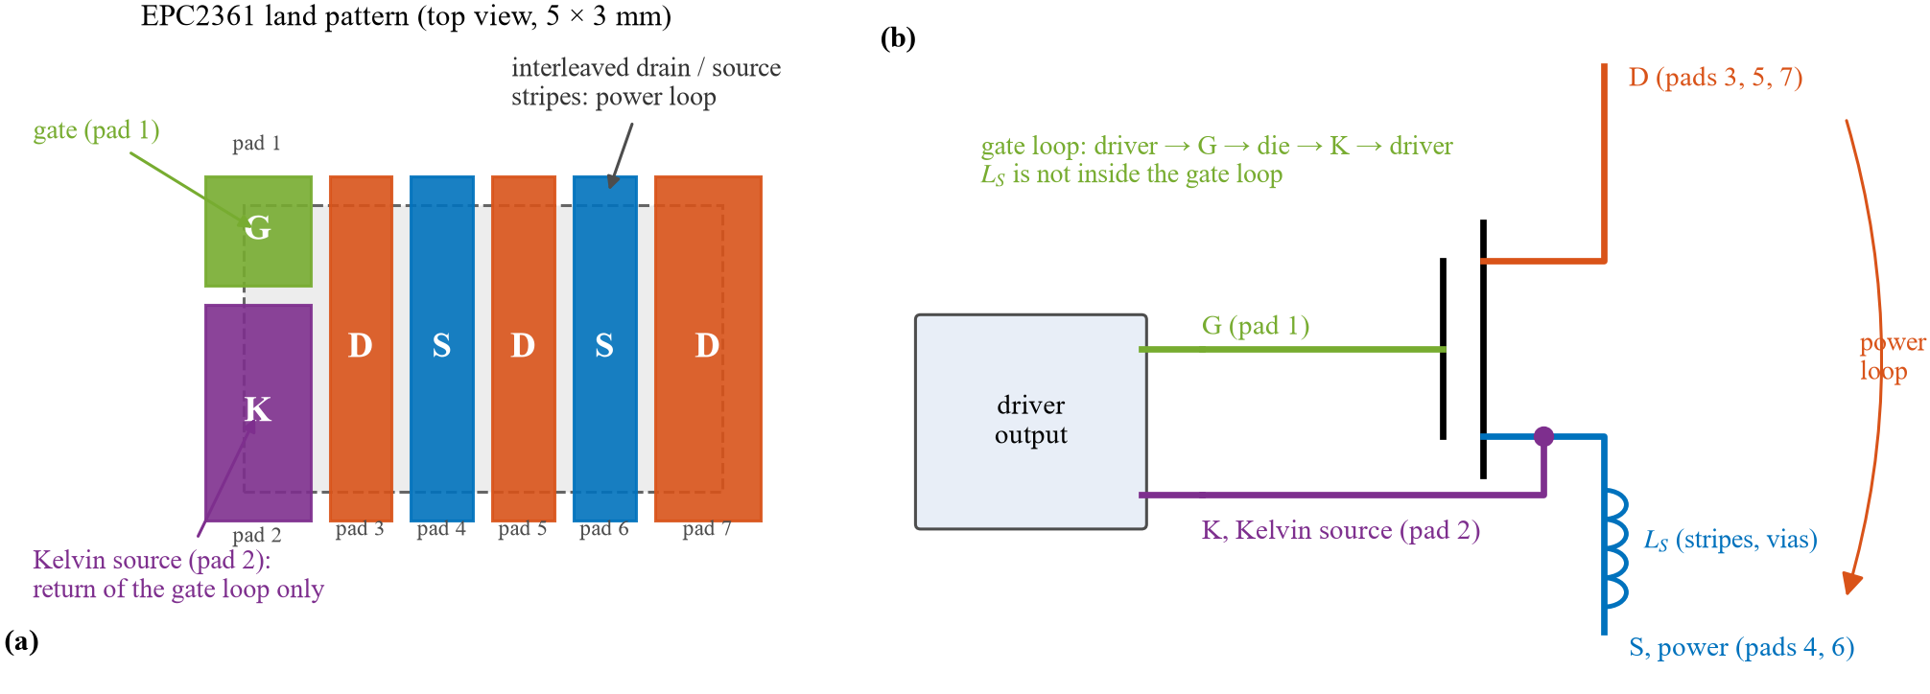
EPC2361: key data and the Kelvin source
Parameter | Value
V_{DS} / transient | 100 / 120 V
R_{DS(on)} | 0.75 mΩ typ (1.0 max)
V_{GS} range / V_{GS(th)} | −4 … +6 V / 0.8 – 2.5 V
C_{iss} / C_{oss} / C_{rss} | 3599 / 1019 / 13 pF
Q_{G} / Q_{GD} / Q_{OSS} | 28 / 3.8 / 90 nC
Kelvin pad 2 next to the gate: the gate loop returns at the die, the source stripes and vias (L_{S}) stay in the power loop only ⇒ no L_{S}·di/dt feedback into v_{GS}
Low threshold and −4 V limit: gate bump and negative bias need care (step 7)
Top of the package at source potential: the thermal interface must insulate

Slide 7
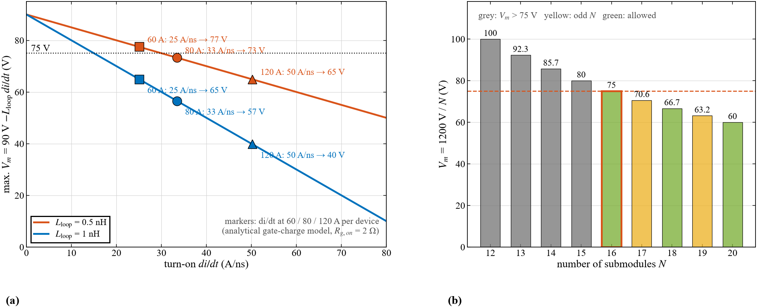
Submodule voltage from L·di/dt
Peak stress v̂_{DS} = V_{m} + L_{loop}·di/dt ≤ 90 V; turn-on di/dt (gate-charge model, R_{g,on} 2 Ω): 25 / 33 / 50 A/ns at 60 / 80 / 120 A per device
At 80 A per device: V_{m} ≤ 73 V with 0.5 nH, only 57 V with 1 nH ⇒ the loop must stay near 0.5 nH (or the turn-on is slowed); N even (symmetric winding sets): 16 → 75 V
Decision: V_{m} = 75 V, N = 16; layout target 0.5 nH per cell

Slide 8
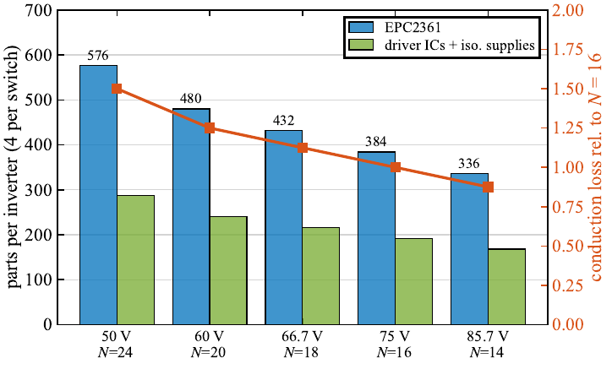
Why not lower: every submodule costs parts and loss
Phase current is fixed by P, V_{bus}, M, cos φ, not by N
Each submodule carries the full phase current ⇒ conduction loss, transistors, drivers and supplies scale with N
60 V (N = 20): +25 % parts and conduction loss
Overshoot margin rechecked on the final boards (Q3D, step 11)

Slide 9
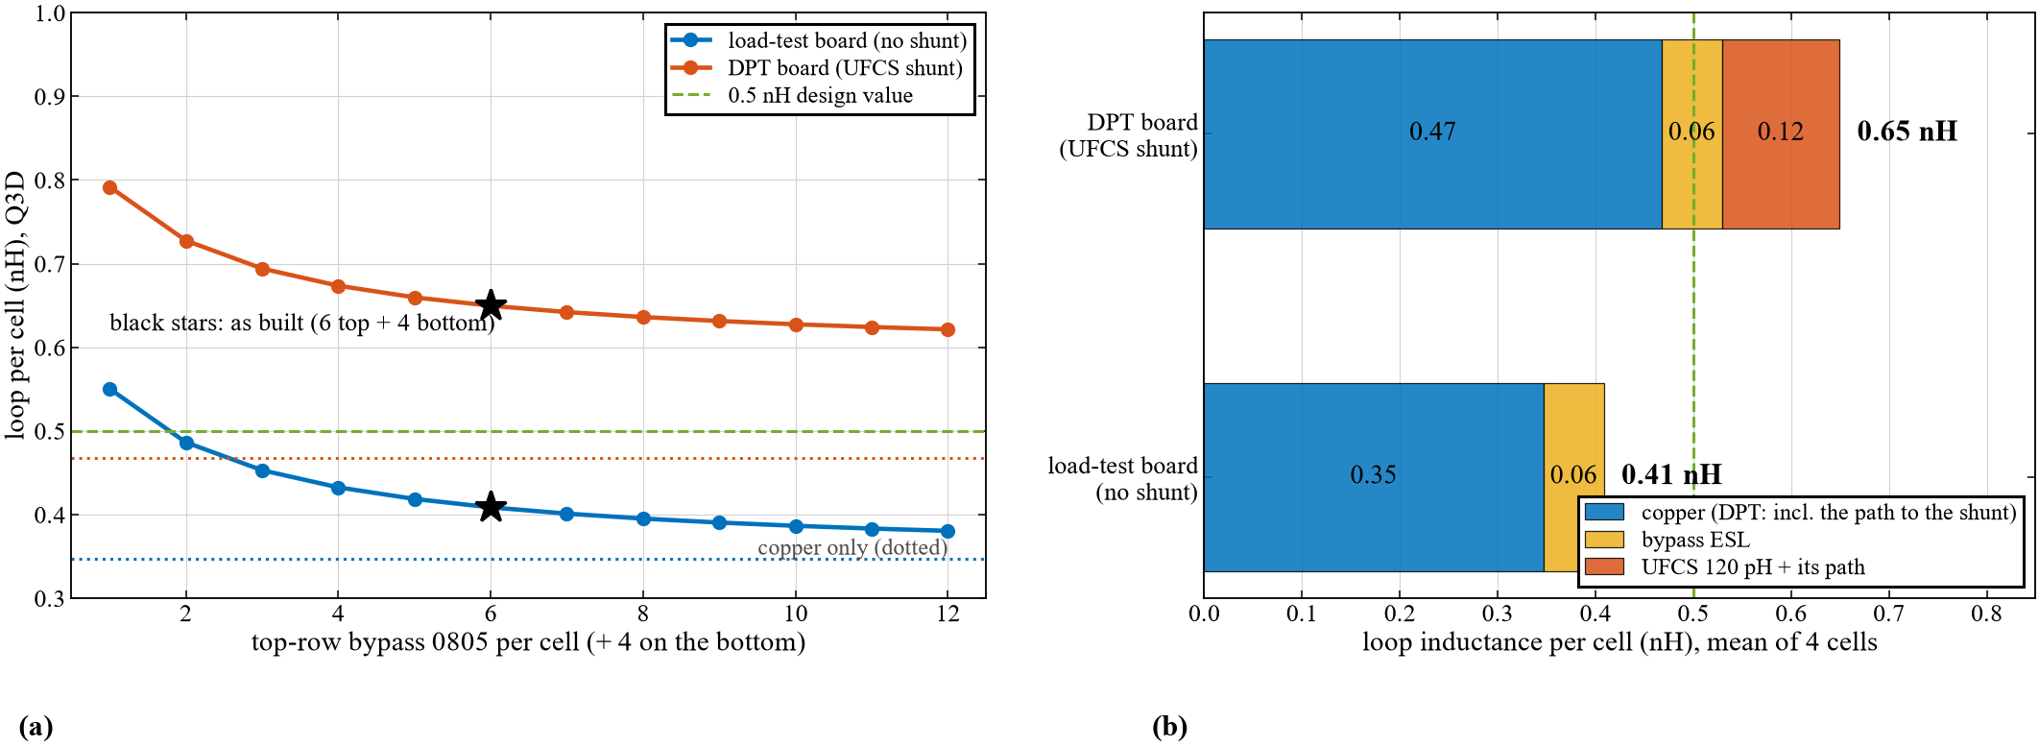
Power loop of one cell: copper, bypass ESL and shunt
Q3D of the final boards (cell band): loop = copper of the vertical loop over 0.1 mm (vias, pads) + bypass ESL/n (+ UFCS 120 pH on the DPT board)
Copper alone: 0.35 nH (load) / 0.47 nH (DPT, shunt path); with 6 + 4 bypass 0805 per cell: 0.41 / 0.65 nH
Beyond ≈ 4 bypass parts per cell the number hardly matters; part: 1 µF 100 V X7S 0805 next to the drains
Decision: Design value L_{loop} = 0.5 nH per cell; 1 nH as the pessimistic bound

Slide 10
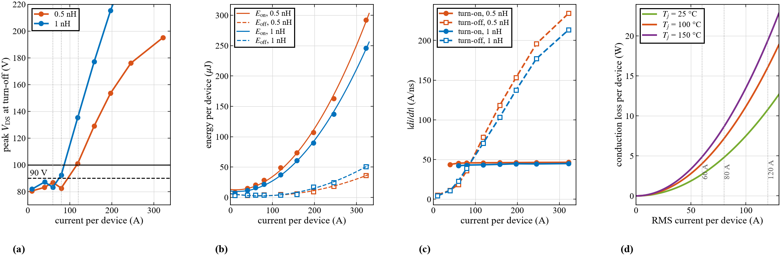
One EPC2361 per switch: how fast and how much overshoot
LTspice half bridge at 75 V, lumped loop 0.5 / 1 nH, 1.7 nH gate loop, 2 Ω on / 0 Ω off, 4 A / 8 A driver
(a) Peak V_{DS} at 60 / 80 / 120 A: 87 / 83 / 102 V (0.5 nH), 83 / 93 / 137 V (1 nH)
(b, c) A larger loop lowers E_{on} (the loop takes L·di/dt of the voltage while the current rises) but raises E_{off} and the overshoot; turn-on di/dt is set by the driver (≈ 45 A/ns)
(d) Conduction per device at 100 °C: 4.0 / 7.2 / 16.1 W at 60 / 80 / 120 A_{rms}; one device would carry 322 A peak ⇒ current per device ≤ 80 A

Slide 11
Thermal path per device: load-test board
Path (LAM 4 K 50 12 in air, per device) | K/W
R_{θJC} (top), datasheet | 0.20
gap pad 0.4 mm, 5 W/mK, over the 15 mm² package top | 5.3
Al spreader, outer cell → tube (8 mm in 12.8 × 3 mm, 2 devices) | 2.1
Junction → heatsink, per device | 7.6
Heatsink → air, whole leg (Fischer LAM 4 K 50 12) | 0.65
T_{j} = T_{amb} + 0.65 K/W · P_{leg} + 7.6 K/W · P_{device}
The gap pad dominates (insulation is needed: the package top is at source potential)
n = 4 at full load: 69 °C (40 °C ambient), 52 °C (25 °C), 78 °C with a 3 W/mK pad
R_{DS(on)}(T_{j}): ×1.49 at 100 °C, ×1.80 at 150 °C
Spreader and pad values are hand estimates from the dimensions; for n ≠ 4 the same per-device path is assumed.

Slide 12
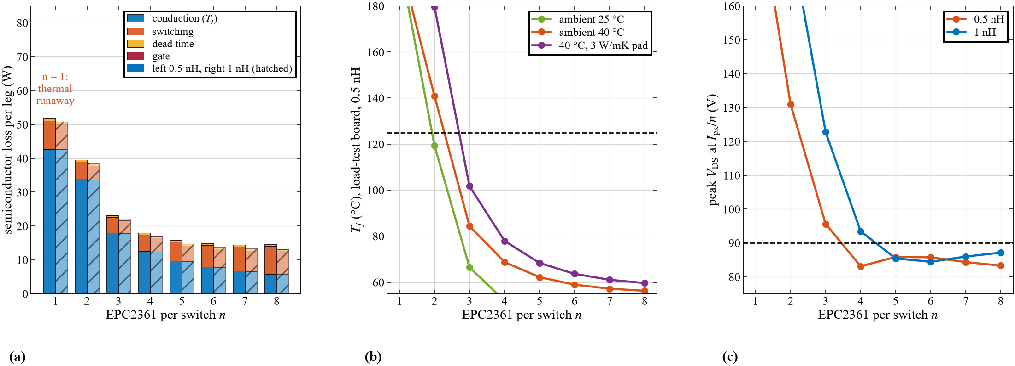
n identical cells per switch (one device and one driver each)
228 A_{rms} per leg, 50 kHz, T_{j} and R_{DS(on)} solved together (load-test board in air, previous slide); LTspice energies at 0.5 nH (left bars) and 1 nH (hatched)
n = 4: 18.0 W (0.5 nH) / 17.0 W (1 nH) per leg, T_{j} 69 °C; peak V_{DS} at 80 A: 83 V (0.5 nH), 93 V (1 nH)
Decision: 4 EPC2361 per switch (T_{j} < 80 °C in all three cases; ≤ 90 V needs ≈ 0.5 nH; two equal pairs)

Slide 13
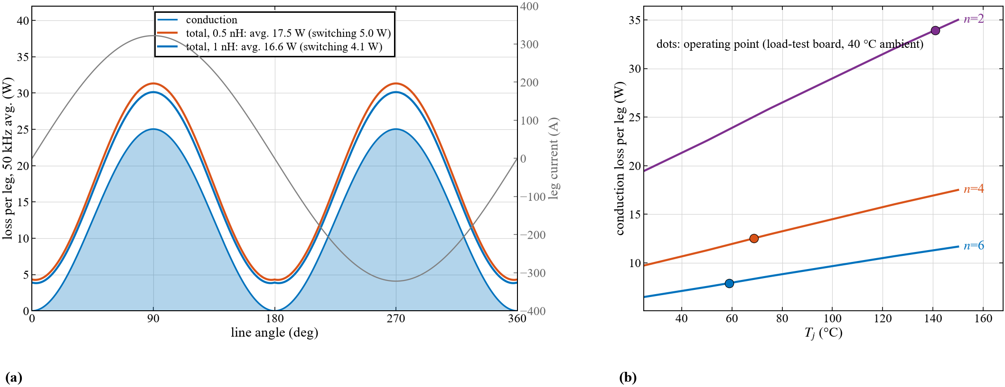
Where the loss comes from: line period and junction temperature
n = 4, 50 kHz: switching loss follows |i| (plus a constant E_{oss} part), conduction loss follows i²
Conduction 12.5 W per leg (at the load-test T_{j}); switching 5.0 W at 0.5 nH, 4.1 W at 1 nH (lower E_{on}, higher E_{off} and overshoot)

Slide 14
Losses vs number in parallel
n per switch | 1 | 2 | 3 | 4 | 5 | 6 | 7 | 8
Loss per leg, 0.5 nH (W) | runaway | 39.5 | 23.2 | 18.0 | 15.8 | 14.8 | 14.5 | 14.6
Loss per leg, 1 nH (W) | runaway | 38.4 | 22.2 | 17.0 | 14.8 | 13.7 | 13.3 | 13.3
conduction at T_{j} (W) | runaway | 33.9 | 18.0 | 12.5 | 9.7 | 7.9 | 6.7 | 5.8
switching 0.5 / 1 nH (W) | – | 5.0 / 4.2 | 4.6 / 3.8 | 5.0 / 4.1 | 5.6 / 4.6 | 6.4 / 5.3 | 7.3 / 6.1 | 8.2 / 6.9
Efficiency, 0.5 nH (%) | – | 99.37 | 99.63 | 99.71 | 99.75 | 99.76 | 99.77 | 99.77
Loss per device (W) | runaway | 9.9 | 3.9 | 2.2 | 1.6 | 1.2 | 1.0 | 0.9
T_{j} (°C) | runaway | 141 | 84 | 69 | 62 | 59 | 57 | 56
Peak V_{DS} 0.5 / 1 nH (V) | 195 / 292 | 131 / 180 | 96 / 123 | 83 / 93 | 86 / 85 | 86 / 84 | 84 / 86 | 83 / 87
Driver channels per leg | 2 | 4 | 6 | 8 | 10 | 12 | 14 | 16
Semiconductor losses only; leg loss / (2 n) = loss per device; T_j on the load-test board at 40 °C ambient, 50 kHz; efficiency relative to 6.25 kW per leg.

Slide 15
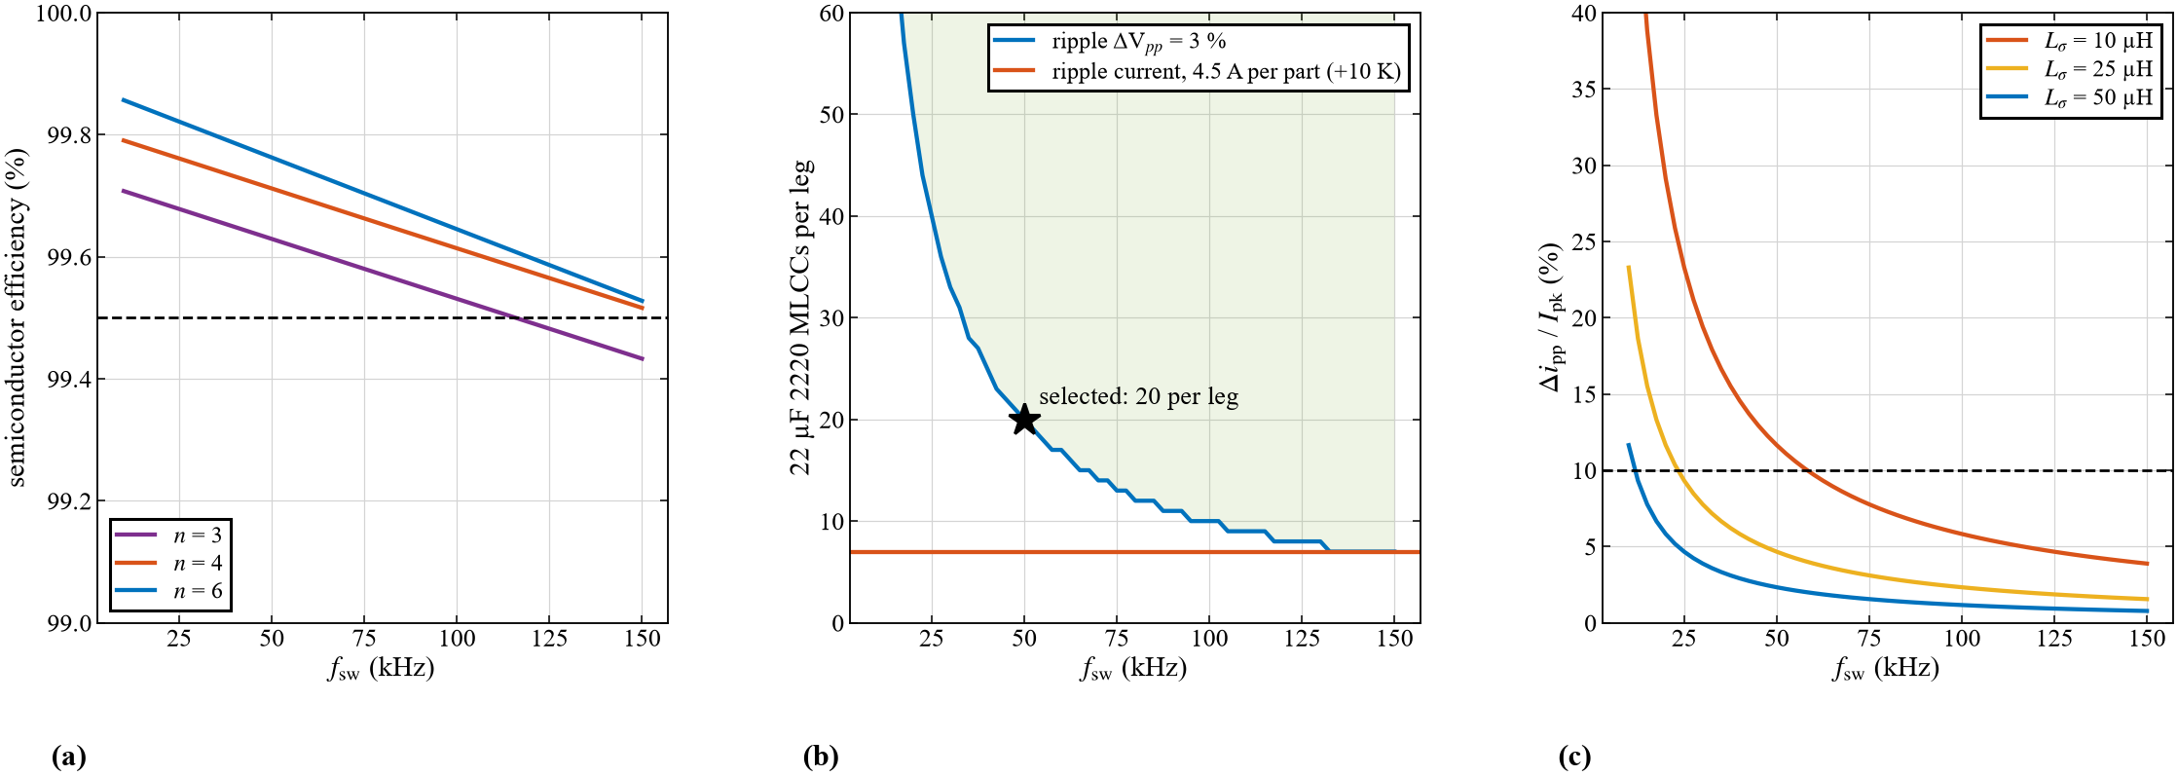
Switching frequency: losses, DC-link capacitors, current ripple
(a) n = 4: 99.77 / 99.71 / 99.61 % at 20 / 50 / 100 kHz; (b) the voltage ripple sets the 2220 count (20 per leg at 50 kHz), ripple current needs only 7; (c) winding ripple Δi_{pp} = V_{m}/(4 L_{σ} f_{sw}) depends on the machine
Decision: f_{sw} ≥ 50 kHz (higher allowed by the machine); the DC link is sized for 50 kHz

Slide 16
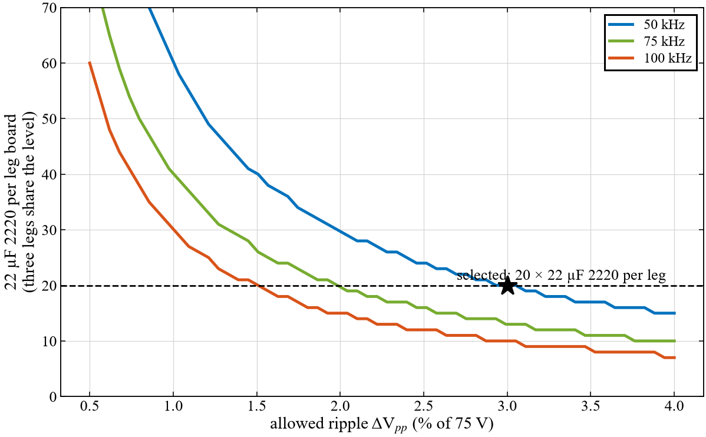
DC-link sizing for a three-phase level
f_{sw} | ΔV_{pp} | C_{eff} level | per leg
50 kHz | 2 % | 573 µF | 191 µF
50 kHz | 3 % | 382 µF | 127 µF
100 kHz | 2 % | 287 µF | 96 µF
100 kHz | 3 % | 191 µF | 64 µF
One 75 V level = three legs on one bus (SVPWM, M = 1.15, cos φ = 0.9)
Balanced three-phase: no 2f ripple; capacitor RMS current 85 A per level (≈ 28 A per leg)
Per switching period the bank supplies the difference between the cell current and its average: ΔV_{pp} = ΔQ / C
Decision: ΔV_{pp} ≤ 3 % (2.25 V) at 50 kHz ⇒ 127 µF effective per leg board ⇒ 20 × 22 µF 2220

Slide 17
Capacitor selection: effective capacitance at 75 V
Part (100 V X7S) | Size | C_{nom} → C at 75 V | Kept | ESR 50 kHz | Parts / leg (3 %)
Murata GRM32EC72A106KE05 | 1210 | 10.0 → 1.50 µF | 15 % | – | 83
TDK C3225X7S2A475K200AB | 1210 | 4.7 → 0.92 µF | 19 % | 12.3 mΩ | 135
TDK C4532X7S2A475K230KB | 1812 | 4.7 → 1.10 µF | 23 % | 13.1 mΩ | 112
TDK C5750X7S2A106K230KB | 2220 | 10.0 → 2.45 µF | 24 % | 6.4 mΩ | 51
TDK C5750X7S2A156M250KB | 2220 | 15.0 → 3.80 µF | 25 % | 3.6 mΩ | 33
TDK C5750X7S2A226M280KB | 2220 | 22.0 → 6.35 µF | 29 % | 2.8 mΩ | 20
DC bias at 75 V from the manufacturers' characteristic data (TDK, Murata): 100 V class-II MLCCs keep only 15–29 %
TDK C5750X7S2A226M280KB (2220, 22 µF): highest C per part and per area (0.22 µF/mm²), 2.8 mΩ, 4.5 A for +10 K
Checks: 2.8 mm height under the heatsink spreader; 2220 flex cracking ⇒ away from the board edge and holes
Decision: Bank: 20 × TDK C5750X7S2A226M280KB per leg (2 rows), 127 µF effective, 1.4 A ripple per part

Slide 18
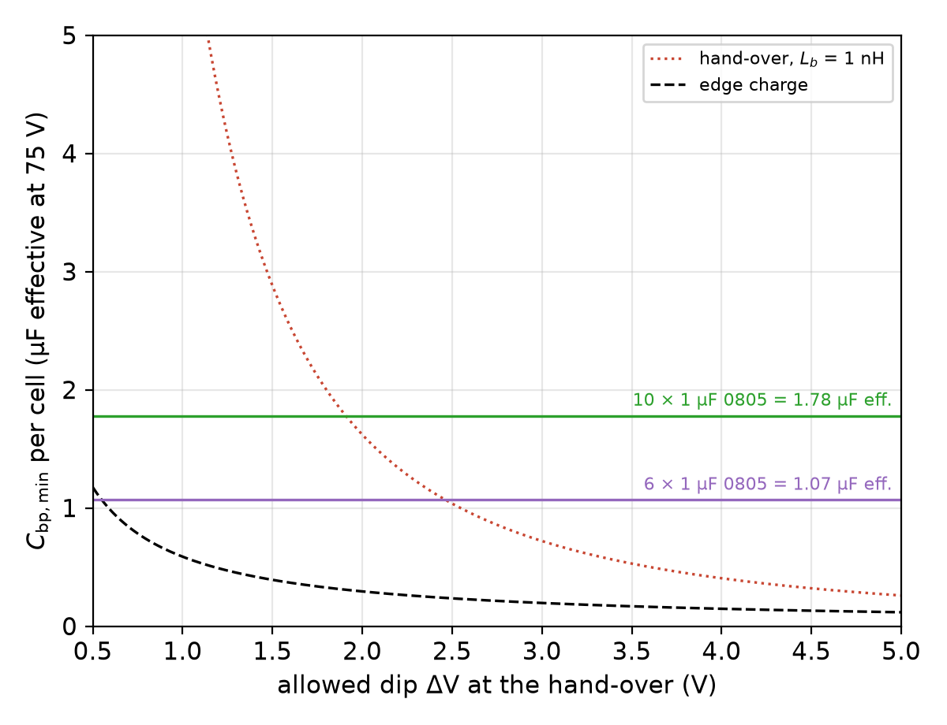
Bypass capacitors: how many and how large
Bypass (1 µF 0805 at the drains) supplies the edge, bank the f_{sw} ripple; per cell 81 A:
  di/dt → number: L_{Cu} + ESL/n ≈ 0.5 nH ⇒ n ≥ 4
  Hand-over to the bank through L_{b}: C_{bp} ≥ L_{b}(ΔI/ΔV)² sets the value
  L_{b} from Q3D: (pending)
  0805 1 µF 100 V X7S keeps only 18 % at 75 V (TDK data): 0.18 µF per part
  dip for 6 / 10 per cell: (pending bank model)
Decision: 10 × 1 µF 0805 per cell: 6 on top at the drains + 4 on the bottom, identical in all cells

Slide 19
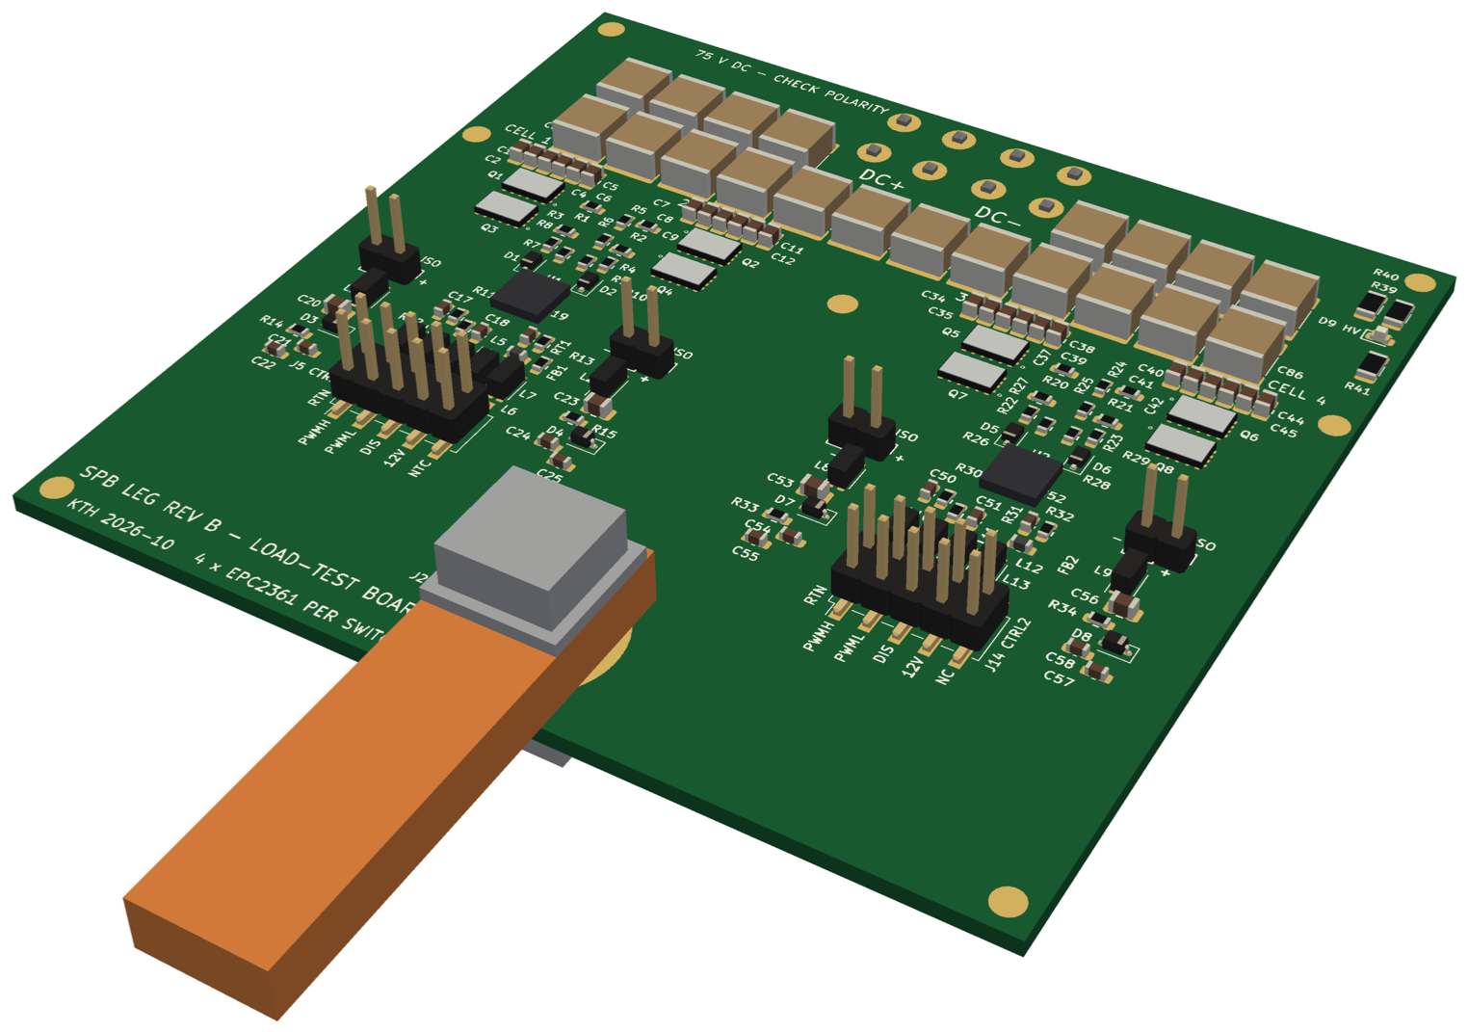
DC link of one leg board
Per leg board | Parts | Nominal | At 75 V
Bypass, 10 per cell × 4 | 40 × 1 µF 0805 | 40 µF | 7 µF
Bank, rows A (8) + B (12) | 20 × 22 µF 2220 | 440 µF | 127 µF
Total | 60 | 480 µF | 134 µF
Ripple at 50 kHz with the three legs of a level sharing: 2.1 V (2.9 %)
Leg alone (DPT, back-to-back test without the busbar): ≈ 2× higher, acceptable for the lab tests
Bank ≥ 10 × bypass (127 vs 7 µF eff.): fulfilled
Row A leaves the board centre free for the DC terminal pins
Decision: Same DC link on the DPT and load-test boards

Slide 20
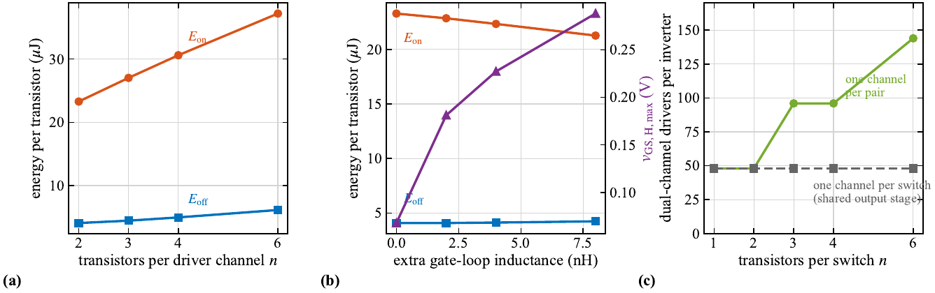
Can one driver drive all four?
Why E_{on} per transistor rises with n per channel: the n gate capacitances (n × 3.6 nF C_{iss}) charge through one driver output (4 A source, 0.85 Ω) and a longer shared gate trace ⇒ v_{GS} rises n× slower ⇒ lower di/dt and dv/dt at turn-on ⇒ longer V–I overlap: +16 / +31 / +60 % E_{on} for 3 / 4 / 6
(b) Extra gate-loop inductance of the longer tree raises the gate bump; (a) peak sink current 12–14 A for 4–6 devices exceeds the 8 A rating
(c) One channel per device is symmetric but needs 4 channels and supplies per switch

Slide 21
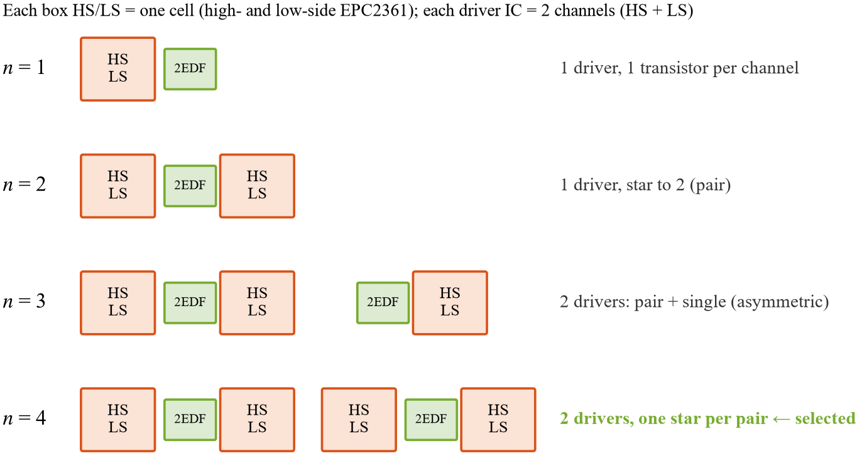
Driver arrangement for 1 … 4 EPC2361 per switch
One dual-channel driver (HS + LS) between two cells: both gate loops equal and with their own Kelvin return (design value ≈ 1.7 nH; extracted on the routed board: step 11)
n = 3 breaks the symmetry (pair + single)
n = 4: two pairs, two drivers, one star per pair ⇒ the building block of two point-symmetric cells
Decision: 2 × EPC2361 per driver channel; 4 per switch = two pairs = two drivers

Slide 22
Gate driver selection: why the 2EDF7275K
 | 2EDF7275K (Infineon) | 1EDF5673K (Infineon) | LMG1210 (TI)
Channels / isolation | 2, each output isolated (functional) | 1, isolated | half bridge, bootstrap HS
Peak source / sink | 4 A / 8 A | 0.85 Ω / 0.35 Ω output | 1.5 A / 3 A class
Prop. delay / mismatch | 37 ns / ≤ 3 ns ch-ch | 37 ns | ≤ 21 ns / ≤ 3.4 ns
CMTI | 150 V/ns | > 200 V/ns | 300 V/ns (HS dv/dt)
Off-voltage | external (Zener split) | built-in negative (RC) | 0 V only
ICs per switch (4 EPC2361) | 2 (one per pair) | 4 | 2 (weak for a pair)
A pair needs ≈ 2 × 3.6 nF: 4 A / 8 A drives it at the single-device speed; the 1.5 A / 3 A half-bridge driver does not
Two isolated outputs in one 5 × 5 mm LGA: HS and LS of the same pair from one IC, ≤ 3 ns channel mismatch
Floating outputs: each output gets its own supply split (5.1 V Zener on, −1.9 V off) for the bump margin (next)
Data: Infineon / TI product pages and datasheets (2EDF7275K, 1EDF5673K, LMG1210); check the current revision.

Slide 23
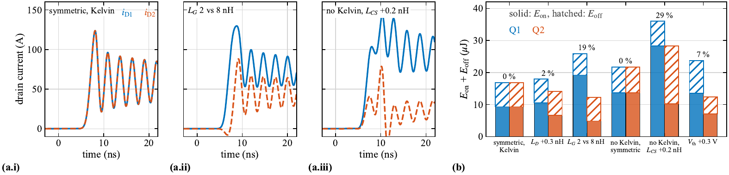
Why symmetry: what sets the current sharing
Asymmetry (LTspice, two EPC2361 in parallel) | Case | E_{on}+E_{off} imbalance | Layout measure
Power-loop inductance mismatch | L_{D} +0.3 nH | 2 % | symmetric cells, identical via sets
Gate-loop inductance mismatch | L_{G} 2 vs 8 nH | 19 % (E_{on} 4 : 1) | star network, equal gate traces
Common-source inductance, no Kelvin | symmetric | 0 %, both +47 % E_{on} | Kelvin pad per device
Common-source mismatch, no Kelvin | L_{CS} +0.2 nH | 29 % | Kelvin return per device
Threshold spread | V_{th} +0.3 V | 7 % | same driver channel per pair
Static (conduction): copper / R_{DS(on)} | – | self-limiting (positive TC) | symmetric copper (Q3D, step 11)
Decision: Star gate network with Kelvin returns, one driver channel per pair, point-symmetric cells

Slide 24
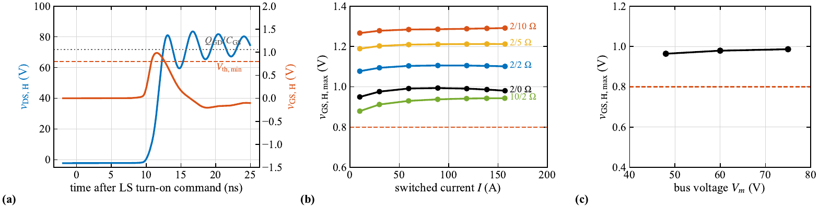
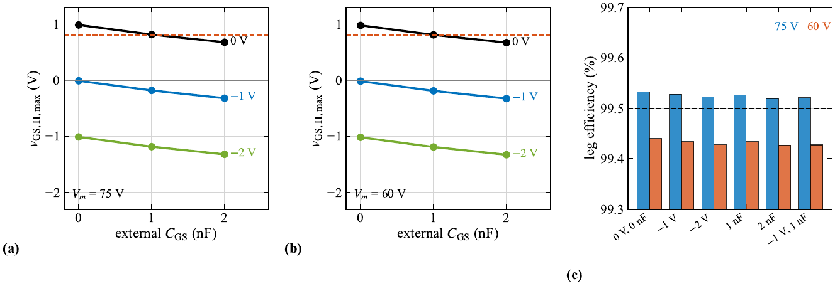
Gate bump and negative off-voltage
Bump: when the other device of the leg turns on, the off device sees dv/dt; C_{GD}·dv/dt flows through its gate loop and lifts v_{GS} by ≈ Q_{GD}/C_{GS} ≈ 1.06 V
Independent of load current and bus voltage (top b, c); close to the 0.8 V minimum threshold ⇒ shoot-through risk
Negative off-voltage shifts the whole bump down: −1 V ⇒ peak ≈ 0 V; extra C_{GS} divides it further (bottom)
Cost: reverse conduction in the dead time at V_{SD} + |V_{off}|; off-state ringing must stay above the −4 V limit
Implemented: V_{GS,off} = −(V_{ISO} − 5.1 V) = −1.9 V (V_{ISO} = 7 V), set with the extracted gate loop (step 11): bump ≤ −0.5 V, ringing ≈ −3.4 V

Slide 25
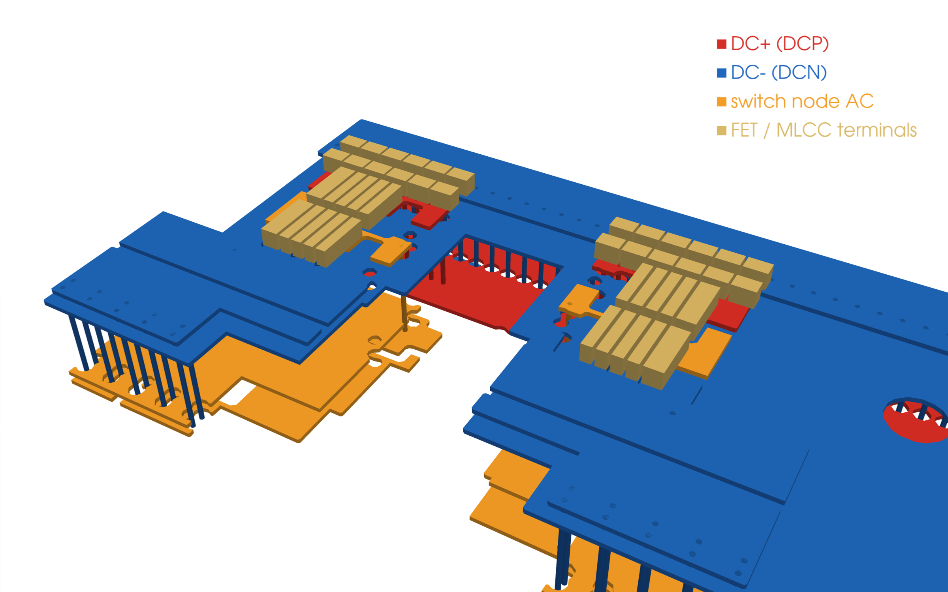
Building block: two point-symmetric cells, one centre driver
Q3D model of the final board (cell band): copper per net, vias, FET pads and bypass terminals
Two cells rotated by 180° about the driver (point symmetry): identical gate loops and Kelvin returns
One 2EDF7275K channel drives a pair (star network, R_{G} 0.5 Ω per transistor)
Each cell keeps its own commutation loop (step 11: 0.41 nH load board, 0.65 nH DPT board)
Decision: 2 × EPC2361 per channel; 4 per switch = two pairs, two drivers, one leg board

Slide 26
Rev B: four cells per switch, two drivers, one leg
One leg: 4 EPC2361 per switch, two 2EDF7275K, each drives one pair (HS + LS channel) through a star
Why one driver per pair: the driver sits between its two cells ⇒ short, identical gate loops; one HS + one LS isolated supply, split per driver
One DC+ / DC− pair at the centre: laminated terminal row (L1/L3 +, L2/L4 −) feeds one continuous bank
One AC output: all four switch nodes joined, one M6 bolt pad, Cu bar through the HO 250-S
Built as two boards from the same generator: DPT (UFCS shunt per cell) and load test (no shunt)
Rev B leg board, 89.5 × 85.2 mm, 4 layers
laminated terminal row + one bank
DC+
DC−
cell 1
HS + LS
EPC2361
cell 2
HS + LS
EPC2361
cell 3
HS + LS
EPC2361
cell 4
HS + LS
EPC2361
UFCS (DPT only)
UFCS (DPT only)
UFCS (DPT only)
UFCS (DPT only)
2EDF7275K #1
HS + LS, star
2EDF7275K #2
HS + LS, star
AC joined in copper (all layers)
ONE M6 AC bolt pad → Cu bar
→ LEM HO 250-S → load

Slide 27
Two boards from one design: double-pulse test and load test
 | DPT board (spb-bb-revb-dpt) | Load-test board (spb-bb-revb-load)
Purpose | switching energies, per-cell current, overshoot | back-to-back / three-phase load test
LS source path | PMK UFCS-R001 per cell (1 mΩ, 120 pH) | source stripes via-in-pad (blind L1–L2) to DC−
UFCS land | IN land shortened to 1.2 mm: blade 1.45 mm from the source | –
Cooling | none (pulsed test) | Fischer LAM 4 K 50 12 on an Al spreader
Loop per cell (Q3D) | 0.65 nH (mean) | 0.41 nH (mean)
v̂_{DS} at 30 A/ns | 94 V | 87 V
Parts / DRC / schematic | 200 footprints, DRC 0 / 0 / 0, schematic = PCB | 200 footprints, DRC 0 / 0 / 0, schematic = PCB
Decision: Same copper, drivers, bank and terminals; only the LS source path and the cooling differ

Slide 28
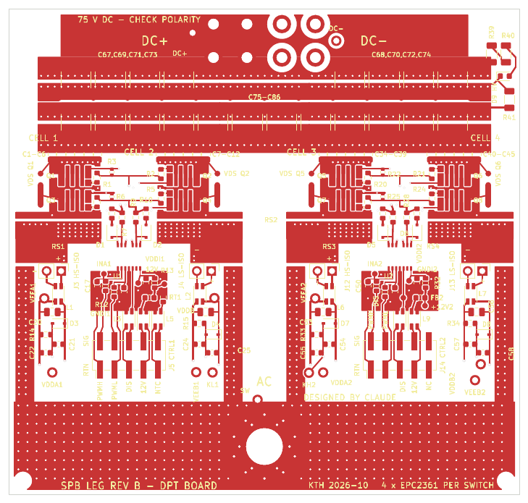
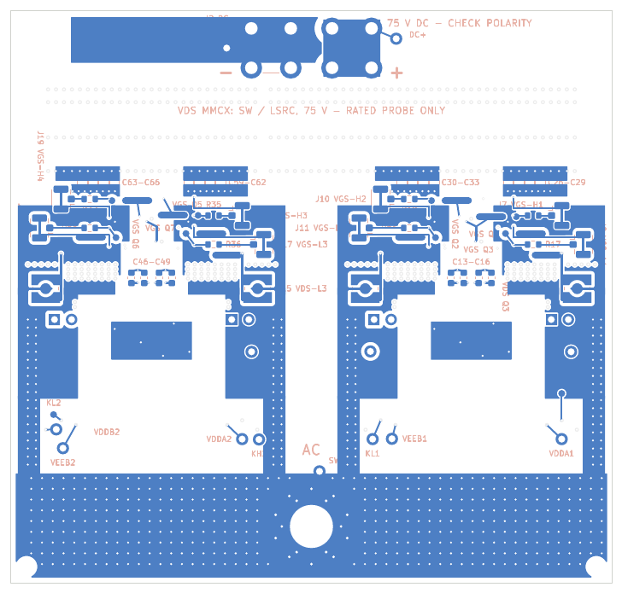
DPT board layout (UFCS shunts, no heatsink)
89.5 × 85.2 mm, 4 layers
UFCS-R001 per cell, IN land 1.2 mm (blade at the source edge), return vias in the SHLD pad
No heatsink, no spreader holes
DRC 0 / 0 / 0, schematic = PCB

Slide 29
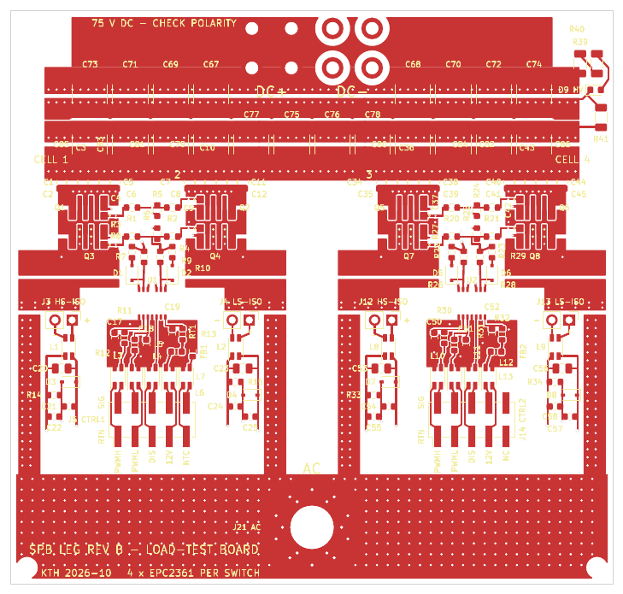
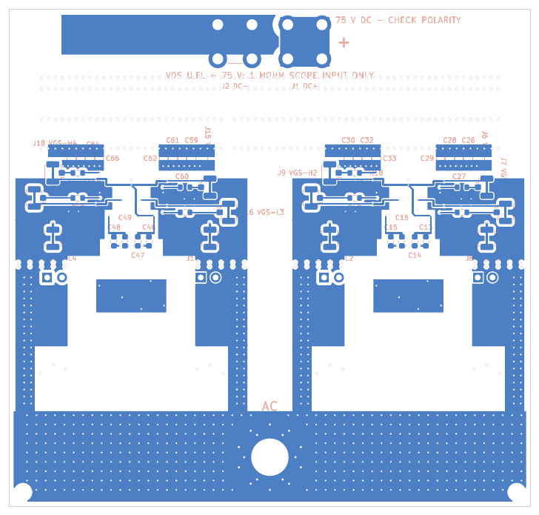
Load-test board layout (no shunt, heatsink)
89.5 × 85.2 mm, 4 layers
LS source stripes: 3 blind L1–L2 vias each (filled, capped) into the DC− plane
LAM 4 K 50 12 over the cells, 3 spreader holes (H5–H7)
DRC 0 / 0 / 0, schematic = PCB

Slide 30
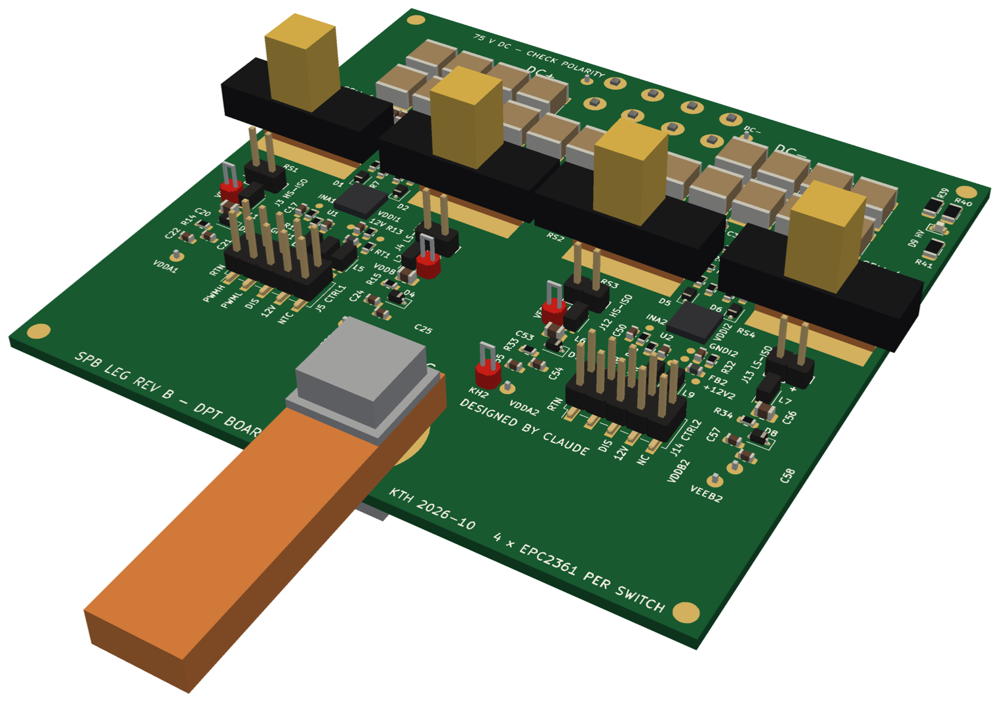
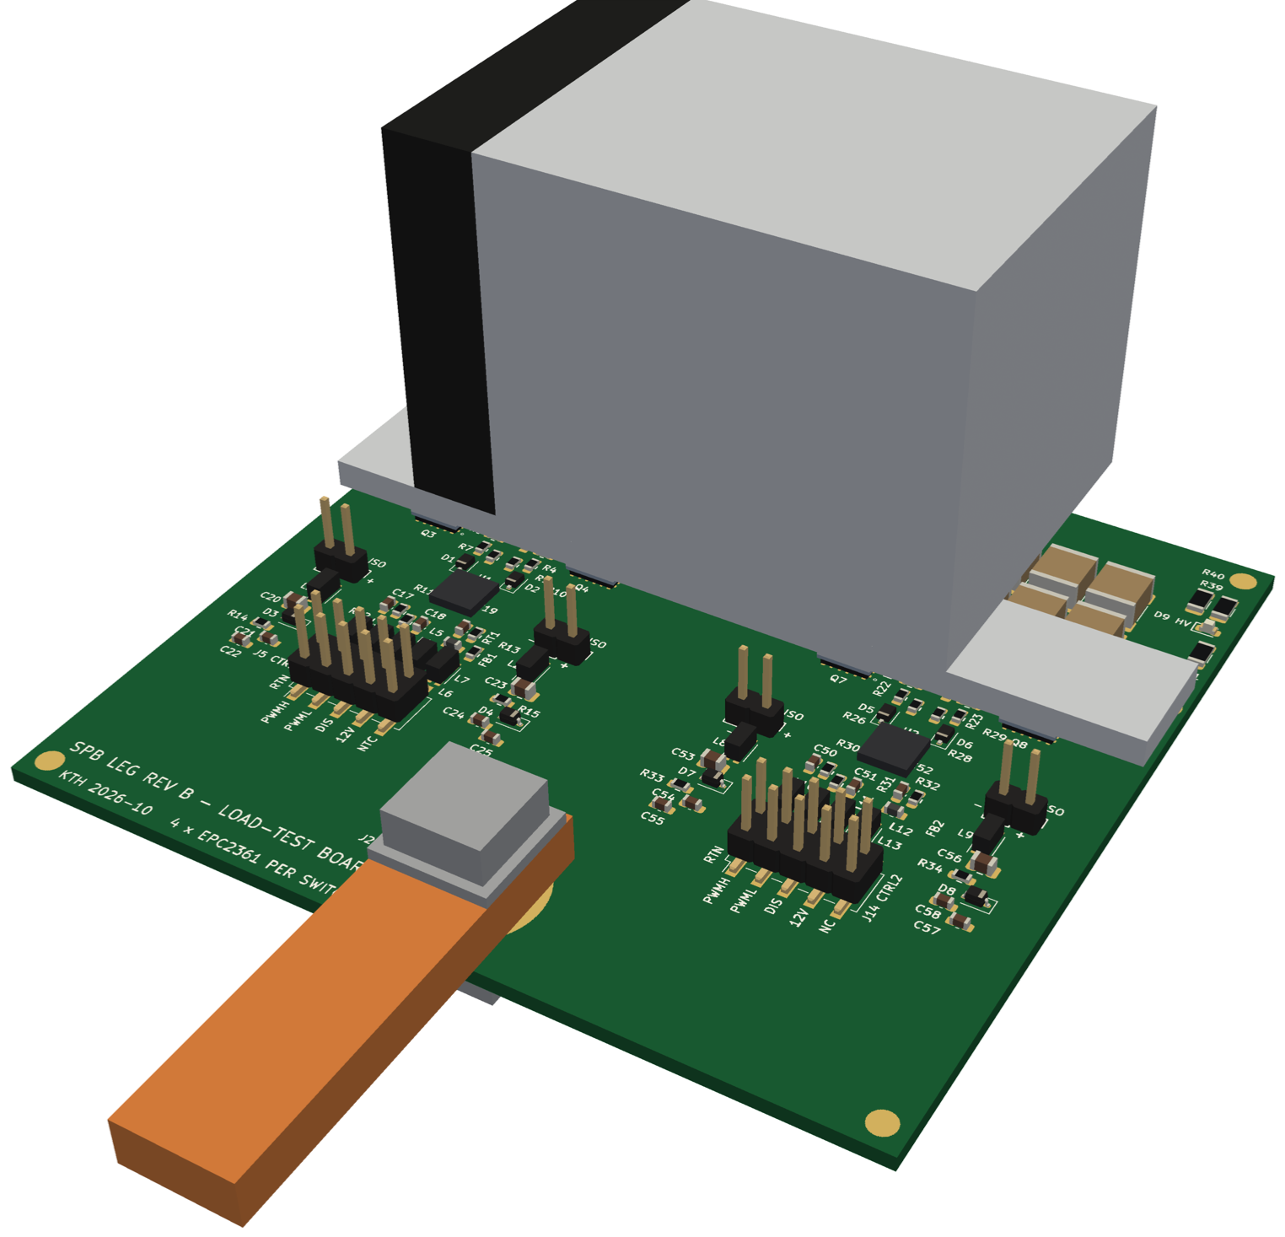
The two boards in 3D (KiCad models)
DPT board: UFCS shunts over the LS FETs, M6 AC bolt + Cu bar
Load-test board: LAM 4 K 50 12 + Al spreader
Every footprint has a 3D model (KiCad library + box models: EPC2361, 2EDF7275K, UFCS, TDK 2220, WE-CNSW, M6 bolt + bar, heatsink); board STEPs in hardware/spb-bb-revb-*/fab; rendered with pyvista (scripts/render_3d.py)
Box models are dimensioned envelopes, not manufacturer CAD (UFCS SMA jack position approximate).

Slide 31
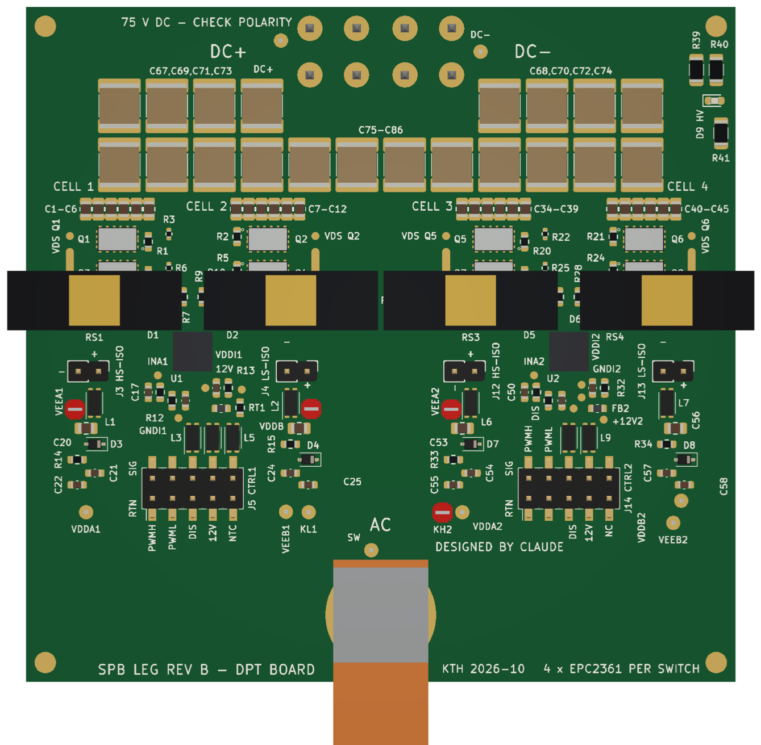
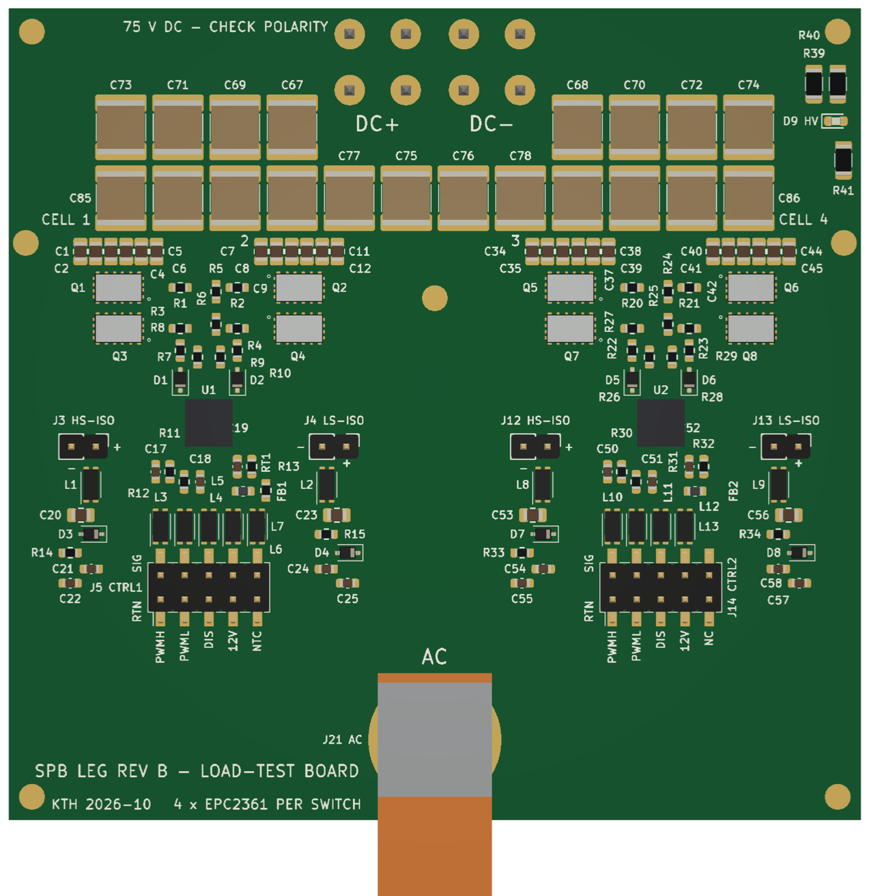
Top view with the silkscreen: DPT and load-test boards
DPT board (UFCS shunts over the LS FETs)
load-test board (heatsink removed for the view)

Slide 32
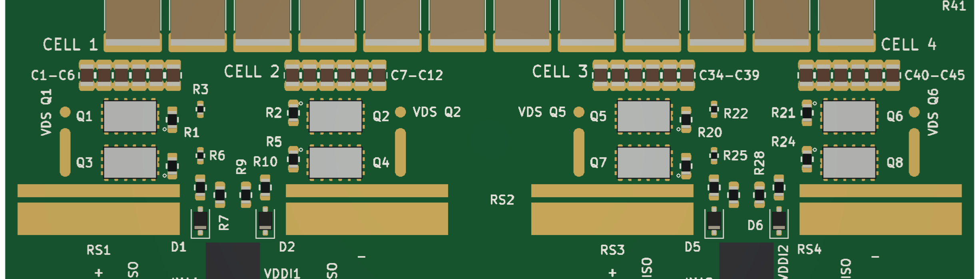
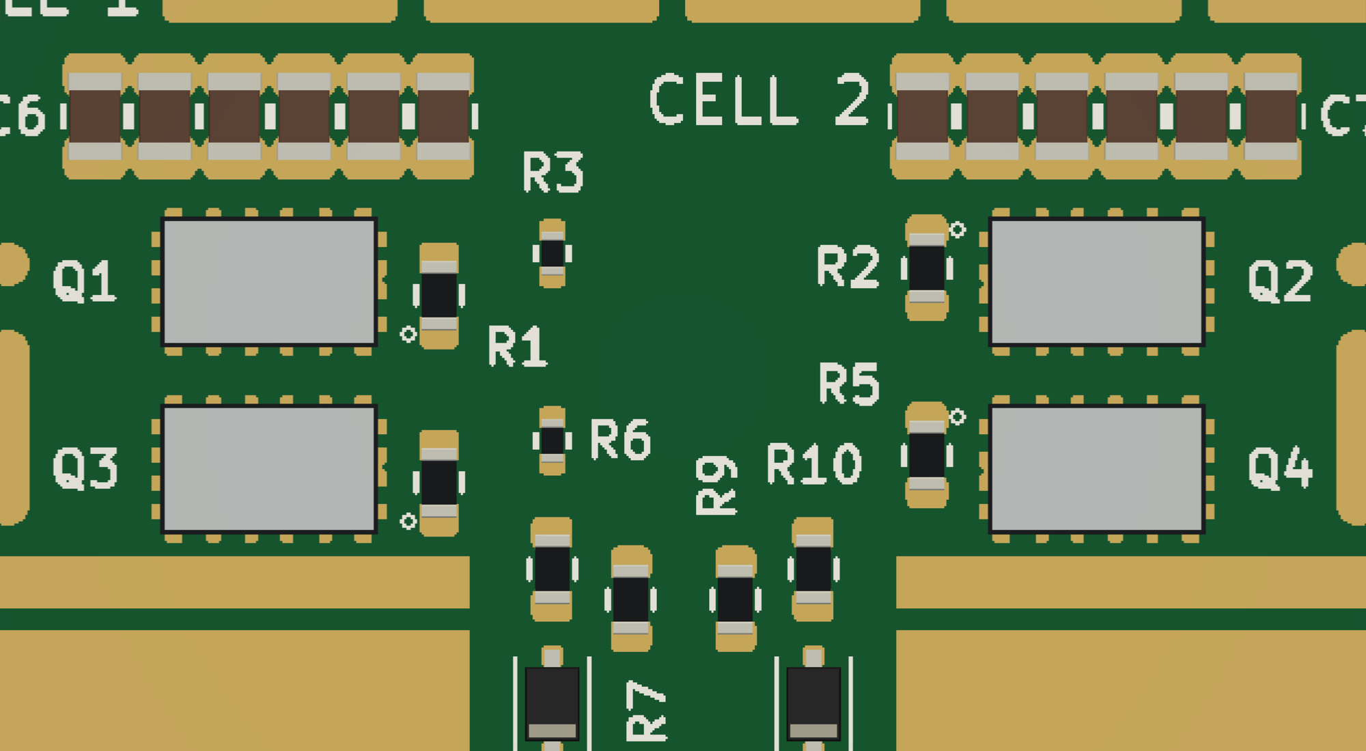
DPT board: the eight EPC2361 from above
Heatsink and UFCS shunt bodies hidden; straight top view (parallel projection)
Land pattern = EPC2361 recommended copper drawing (datasheet p. 12): copper 0.3 mm beyond the 3.0 × 5.0 mm body on the long sides, 0.4 mm at the ends, solder-mask defined; pin-1 circle at the gate pad
Cells of a driver block face each other with R_{G} between them (left: block 1, Q1–Q4)

Slide 33
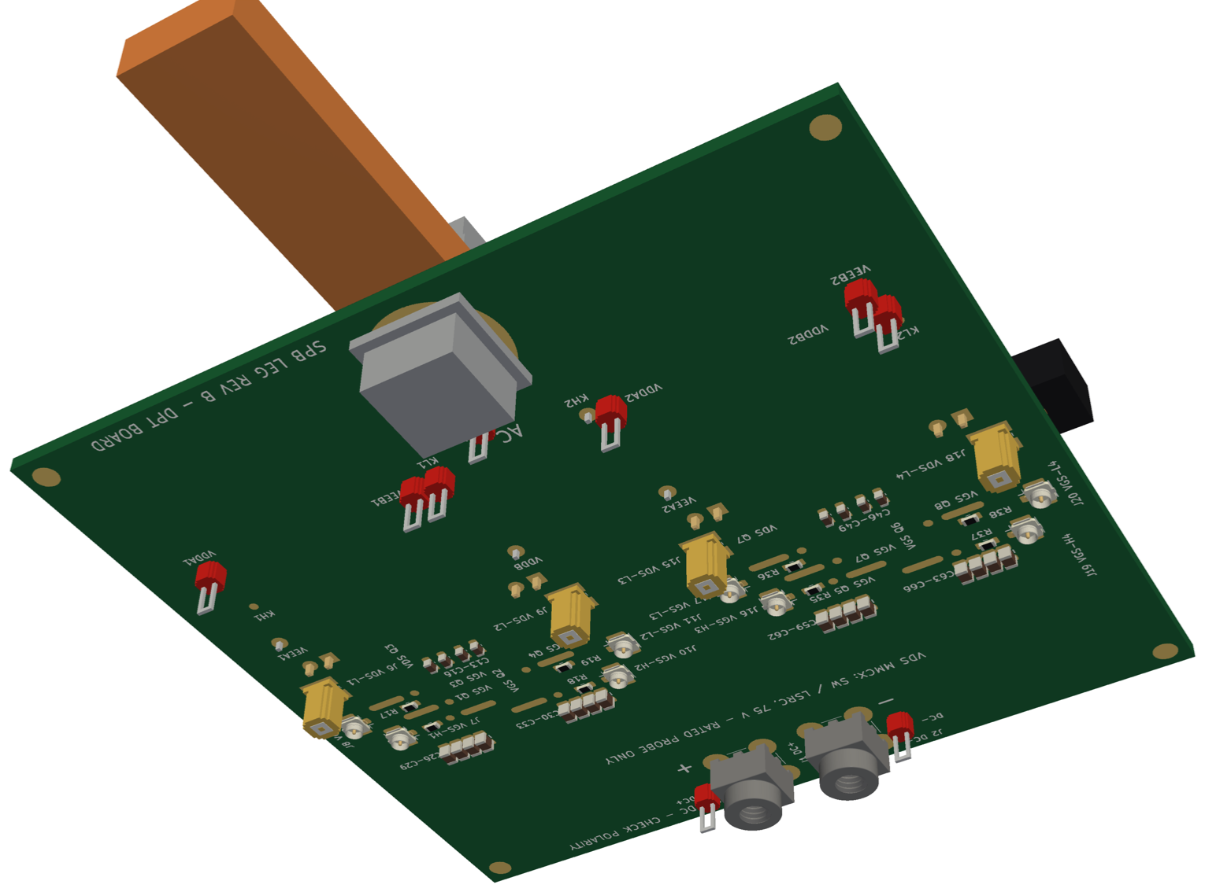
Bottom side and the load board without heatsink
Bottom: REDCUBE M4 DC terminals (the leg stands on the busbar), 4 bypass 0805 per cell, U.FL V_{GS} and MMCX V_{DS} ports, M6 AC nut
Top without heatsink: 20 × 2220 bank in two rows, 8 EPC2361 under the spreader pedestals, 2 drivers

Slide 34
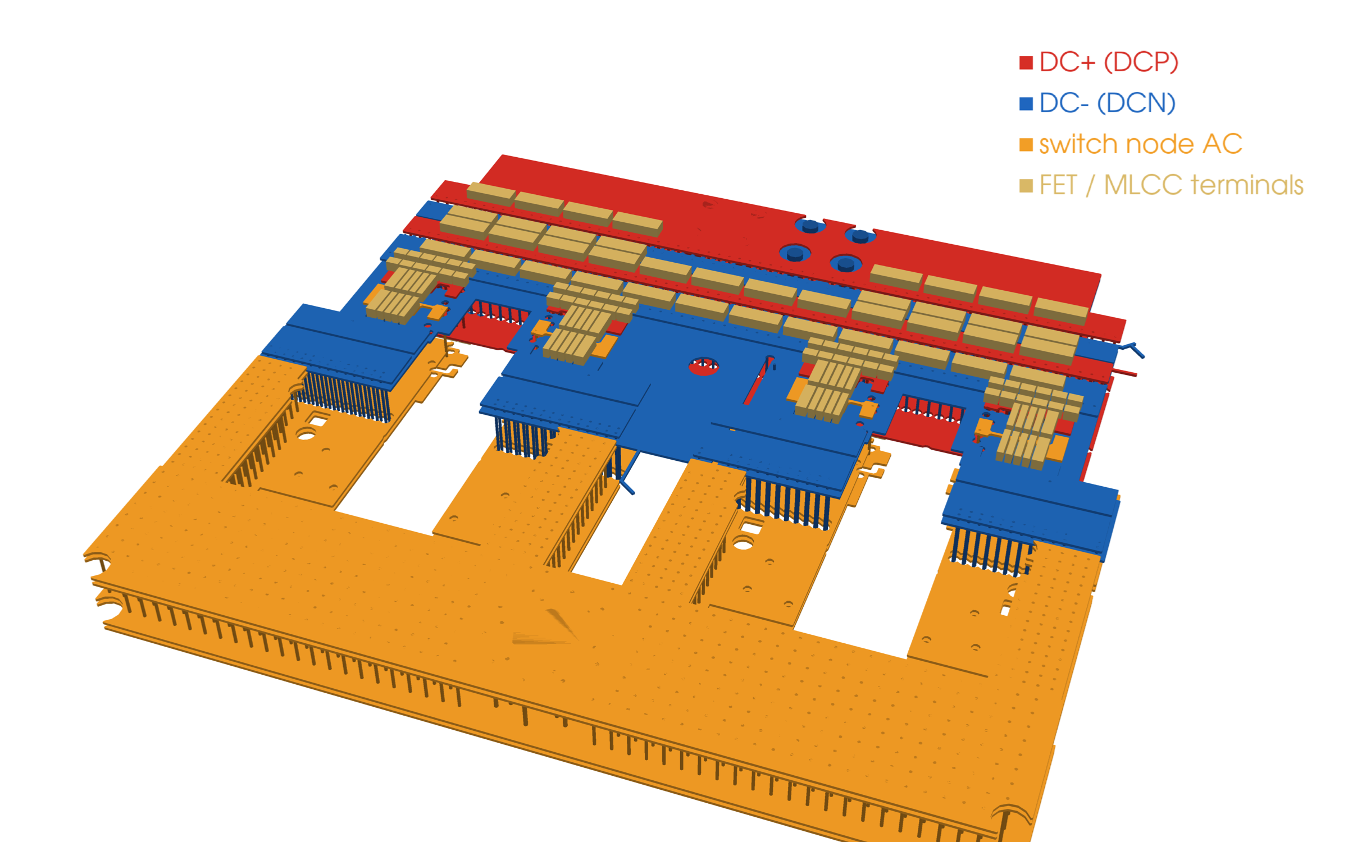
Two driver pairs on one switch node: driver skew
The four switch nodes are joined in copper; L_{x} = inductance between the switch nodes of the two driver pairs
If driver 2 switches Δt later, pair 1 takes ΔI ≈ V_{m}·Δt / L_{x} until pair 2 follows
Q3D (fast lx model, final boards): L_{x} = 6.77 nH (HS on) / 5.44 nH (LS on) on the load board, 4.91 / 2.68 nH on the DPT board
⇒ ≈ 14 A per ns of skew (load board)
Measure | Rev B
One PWM source | C2000 drives both headers
Matched traces | same PCB, same CMC per block
Driver skew | 2EDF7275K part-to-part: check datasheet
Verify | U.FL V_{GS} of both blocks, UFCS per cell (DPT)
Decision: Measure the per-cell current (UFCS) with both drivers switching; delay trim in the C2000 if needed

Slide 35
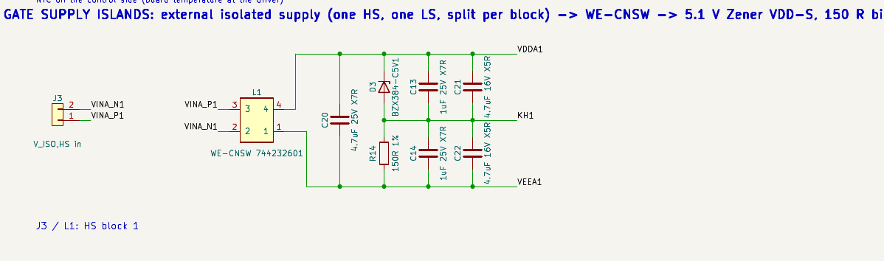
Gate supplies: two isolated supplies, Zener split
One external isolated supply for all HS drivers and one for all LS drivers; each splits per driver through a WE-CNSW common-mode choke
5.1 V Zener VDD–S and 150 Ω bias resistor S–VEE (Karakaya, METU 2020, Fig. 4.1): V_{GS,on} = +5.1 V, V_{GS,off} = −(V_{ISO} − 5.1 V)
V_{ISO} = 7.0 V ⇒ −1.9 V off (bump mitigation, inside the −4 V limit); island decoupling 1 µF + 4.7 µF per rail

Slide 36
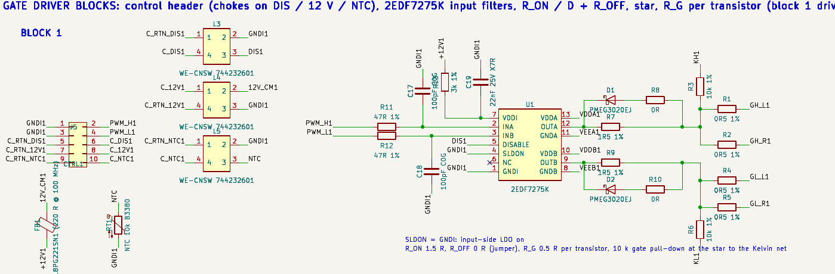
Driver block: input filters, turn-on / turn-off paths, star
Per block a 2×5 control header (each signal next to its return); common-mode chokes on 12 V, DIS and NTC, none on PWM_H / PWM_L (no extra delay or LC ringing with the 100 pF input filter; removed after the PWM review)
47 Ω / 100 pF input filters, 10 k pull-downs, R_{ON} 1.5 Ω (shared by the pair), R_{OFF} 0 Ω + Schottky, R_{G} 0.5 Ω per transistor ⇒ R_{g,on} = 3.5 Ω per device

Slide 37
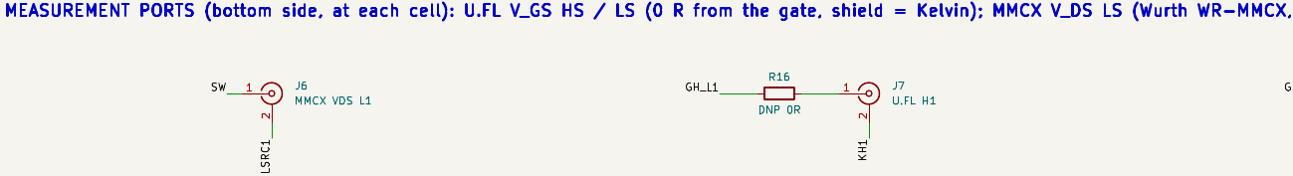
Measurement and control
Quantity | How | Where
Cell current (DPT) | PMK UFCS-R001, 1 mΩ, 120 pH | LS source of each cell, DPT board
Phase current (control) | LEM HO 250-S, ±625 A, 3.2 mV/A | Cu bar on the M6 AC pad
V_{GS} HS / LS | U.FL, 0 Ω, shield = Kelvin | bottom, at each cell (both boards)
V_{DS} LS (DPT) | MMCX (WR-MMCX, 170 V rms): SW / LSRC, rated isolated probe (e.g. IsoVu TIVPMX50X) | bottom, next to each LS FET
Bring-up | test points + spring-tip pads (V_{GS}, V_{DS}), list in fab/testpoints.csv | both sides
Board temperature | NTC 10 k at the driver | control side (GNDI)
Back-to-back load test, closed loop on a TI TMS320F28379D
Load board: no shunt ⇒ phase current from the HO 250-S, cell sharing from the DPT board
No short-circuit protection on the boards

Slide 38
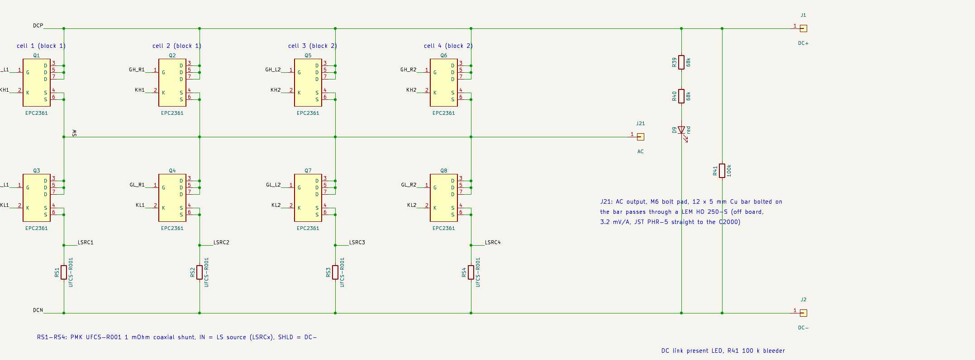
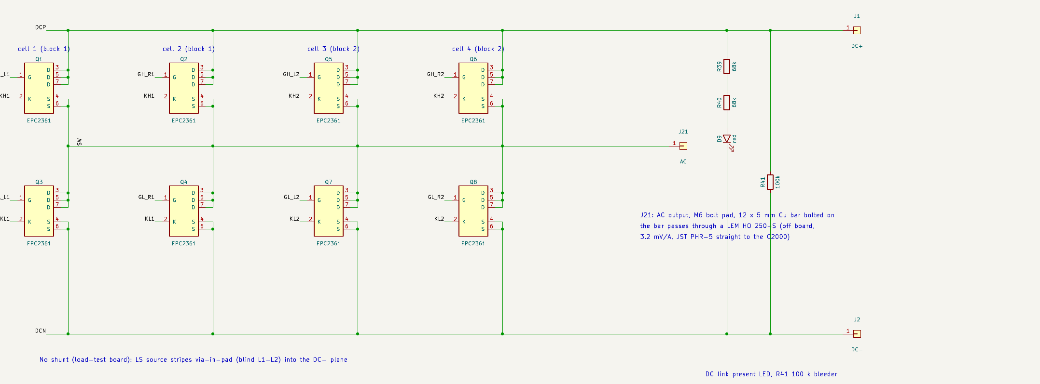
Power stage schematics (generated, identical to the PCBs)
Top: DPT board (UFCS in each LS source). Bottom: load-test board (LS source to DC−). make_kicad_sch_revb.py; check_sch_vs_pcb.py: 0 problems on both

Slide 39
Three legs on one 75 V bus: what the bus must do
The switching edge closes on each board (bypass + bank); the bus only carries the f_{sw} ripple between the leg banks
Sharing needs ωL_{bus} ≪ 1/(ωC): at 50 kHz and ≈ 127 µF eff. per leg L ≪ 80 nH ⇒ target ≤ 5 nH leg to leg
DC: 250 A stack current enters the level, 83 A per leg
All-MLCC banks joined by nH copper form a high-Q resonator ⇒ damping footprints
leg a
(phase a)
load board
leg b
(phase b)
load board
leg c
(phase c)
load board
laminated PCB busbar (L1 + / L2 − / L3 + / L4 −)
stack lugs at the centre leg
to the levels above / below

Slide 40
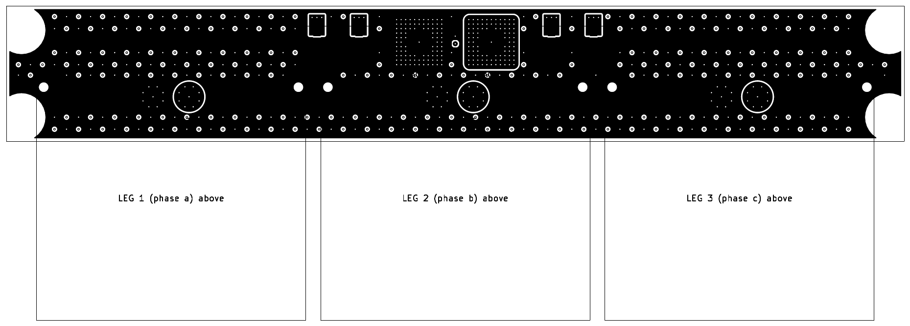
PCB busbar: easy to manufacture
Item | Value
Size | 298.5 × 45 mm, 1.6 mm, 4 layers
Copper | 2 oz all layers (JLCPCB JLC3313); 3–4 oz option
Stack-up | L1 DC+ / ≤ 0.2 mm / L2 DC− / core / L3 DC+ / ≤ 0.2 mm / L4 DC−
Leg contact | 6 × M4: one DC pair per leg (REDCUBE, 6.5 mm)
Stack contact | 2 × M6 lug pads at the centre leg
Insulation | frame holes with 8 mm Cu keep-out (1200 V)
Q3D (step 11): leg-to-leg loop 1.46 nH at 1 MHz (a–b), DC busbar loss (pending) W
Damping caps (100 V hybrid polymer) as DNP footprints; nylon standoffs at the leg corner holes
Generated: scripts/make_kicad_busbar.py, DRC clean; fab files in hardware/spb-busbar/fab

Slide 41
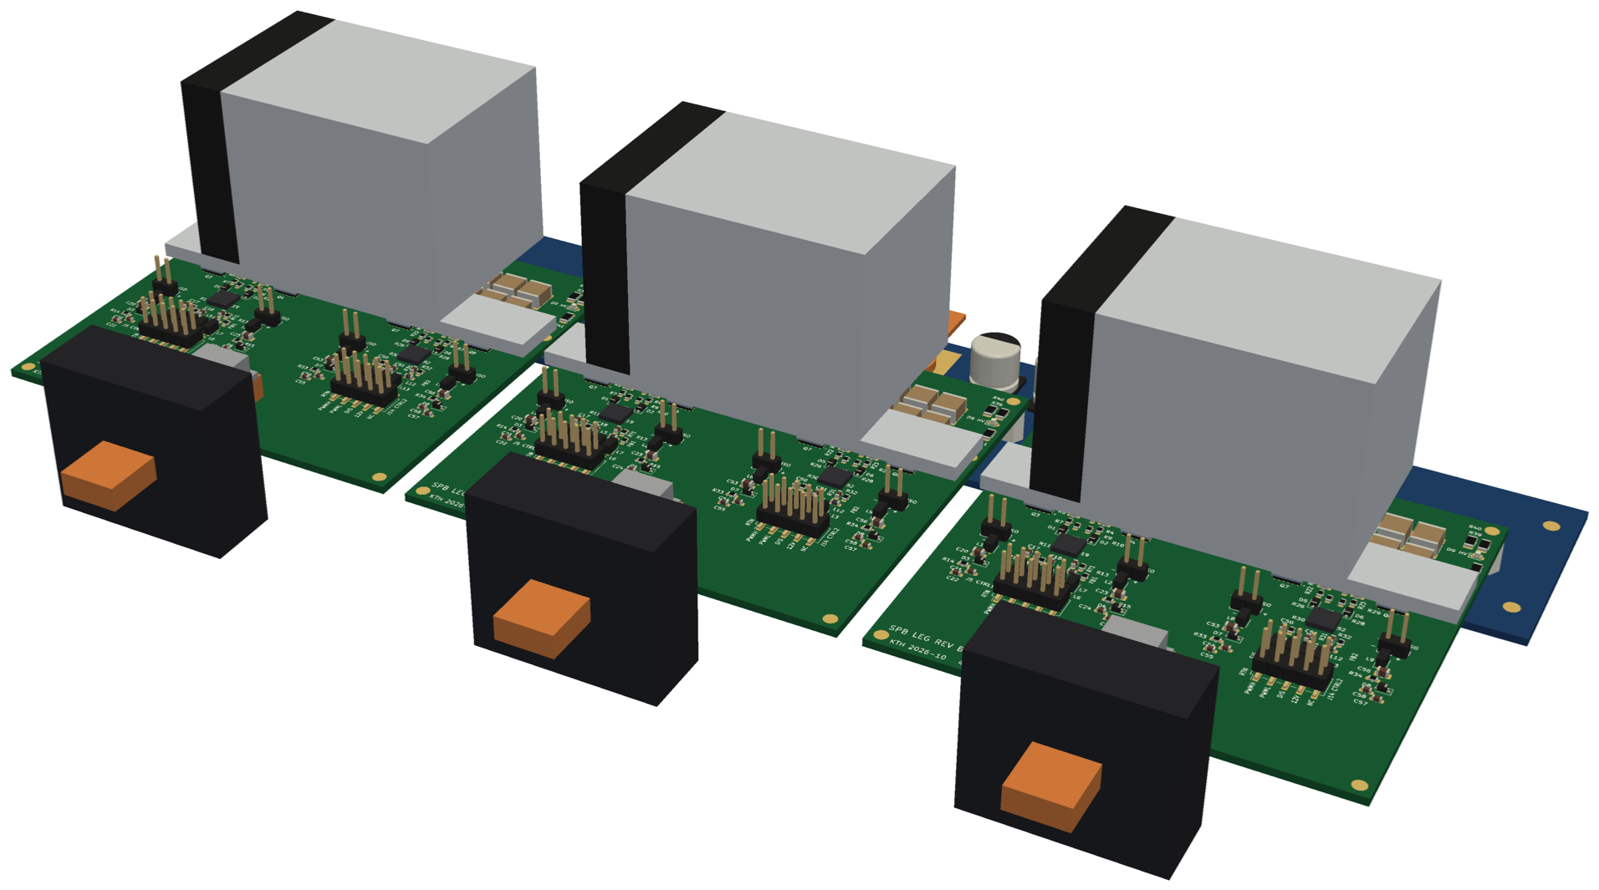
One 75 V level in 3D: busbar + three load-test legs
Legs a, b, c (pitch 94.5 mm, 5 mm gaps) stand on their REDCUBE DC terminals (6.5 mm) on the PCB busbar; M4 × 8 screws from below; AC bar of each leg through its LEM HO 250-S; heatsinks stay inside each board outline

Slide 42
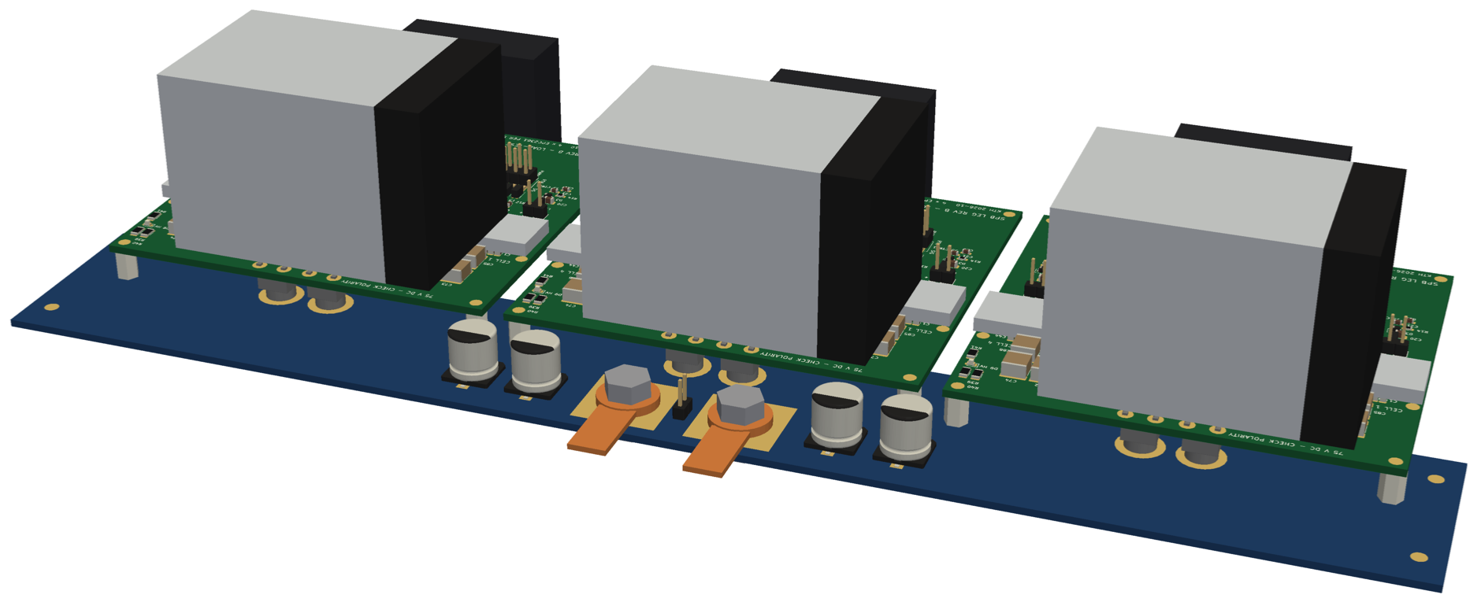
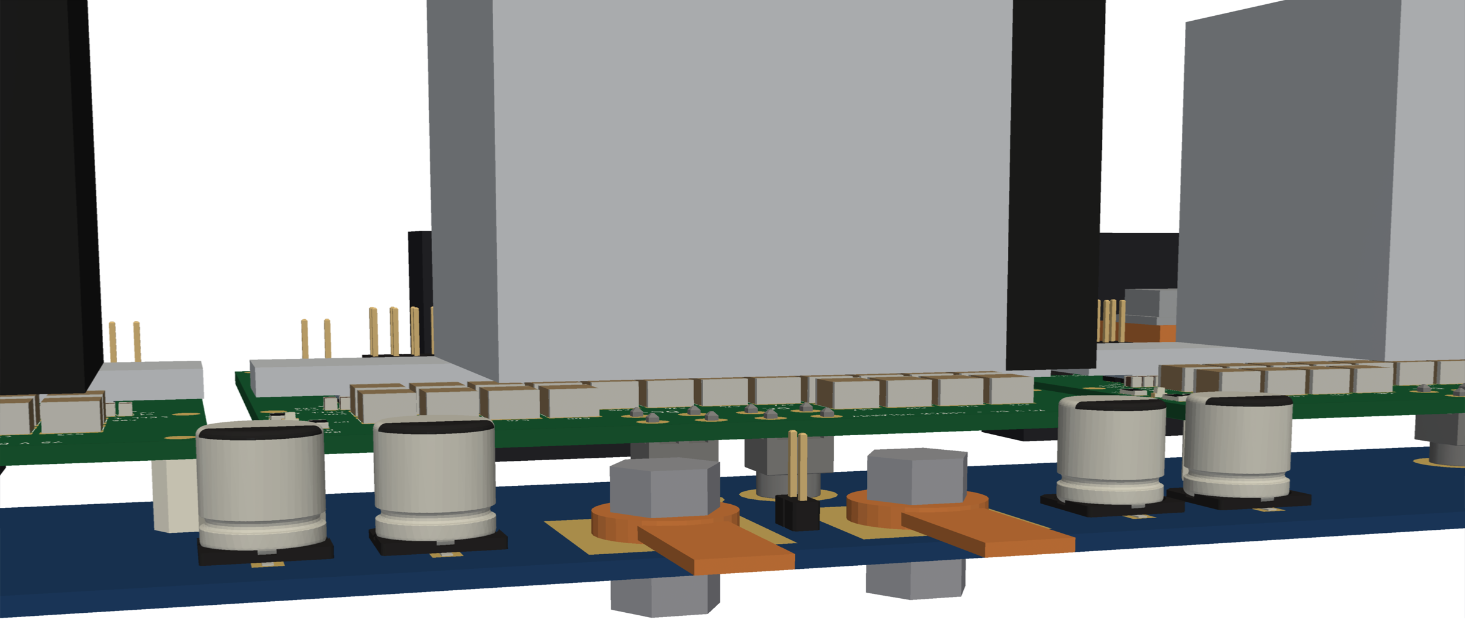
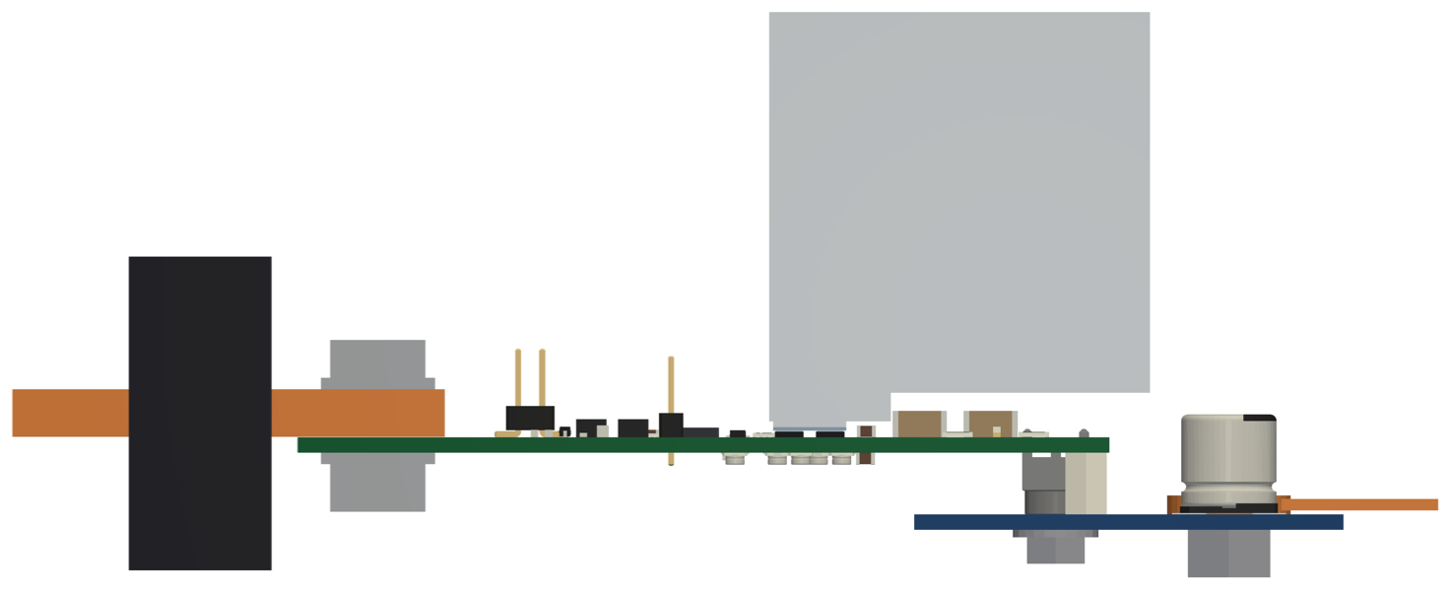
Level assembly: busbar side and DC connection
Right: middle leg on the bus: REDCUBE + M4, nylon standoffs, M6 stack lugs, DNP damping caps, level header
Left bottom: side view (z stack): busbar top z = 0, leg bottom 6.5 mm, heatsink top 52.8 mm

Slide 43
Mechanics: heatsink length fixed by the leg pitch
LAM 4 (100 mm) + fan = 110 mm: wider than the 89.5 mm board ⇒ with 5 mm gaps the heatsinks of neighbouring legs would overlap by ≈ 15 mm
LAM 4 K 50 12 (Farnell 4708974, 0.65 K/W): 50 mm tube + fan centred over the cells (x −35 … 25 mm), inside the board outline
Al spreader 89.5 × 12.8 × 3 mm carries the outer cells (x ±33 mm) to the tube; ≈ 18 W FET loss per leg ⇒ ≈ 12 K heatsink rise
Spreader underside 1.68 mm, top 4.68 mm: clears the 2.8 mm bank and all bypass parts
Decision: Load board heatsink: LAM 4 K 50 12, centred; leg pitch stays 94.5 mm (busbar unchanged)

Slide 44
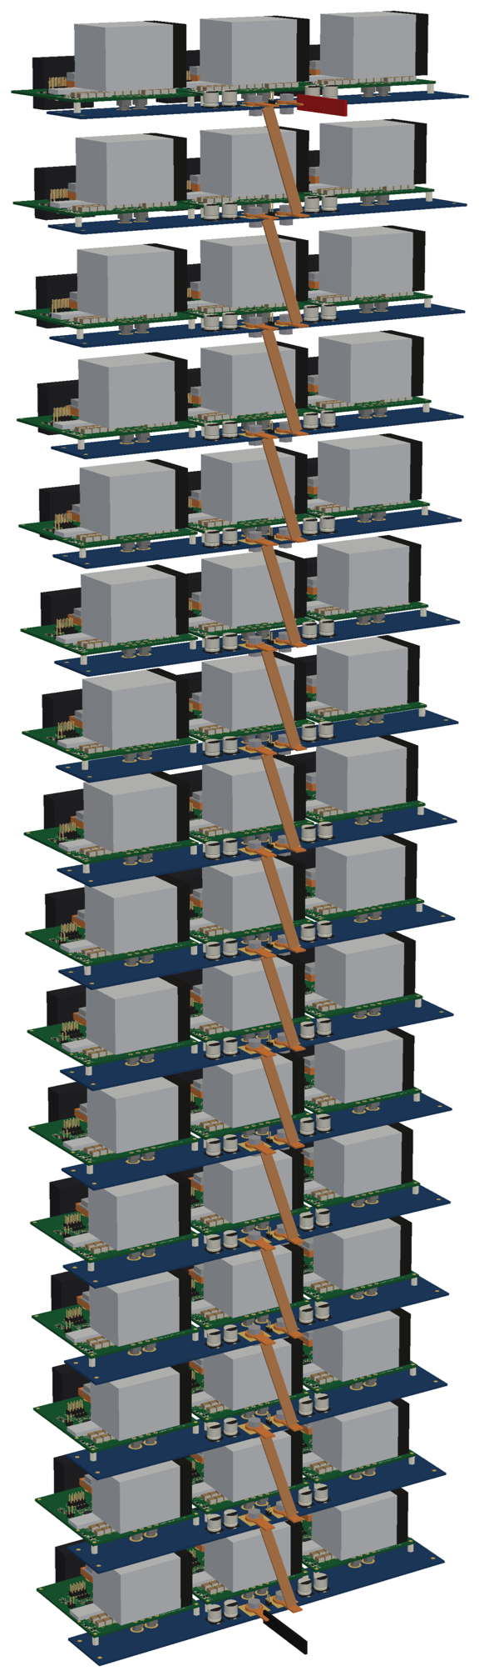
Full inverter: 16 levels on one 1200 V stack
16 identical levels (75 V each) stacked in z, pitch 72 mm ⇒ ≈ 1.15 m
DC+ lug of level k ↔ DC− lug of level k + 1 by a Cu braid (8 × 1.5 mm in the model); stack ends = 1200 V DC+ / DC−
Each level: 3 legs = one three-phase winding set; AC bars + HO 250-S per leg
Every level floats up to 1200 V above the frame: insulating standoffs with 8 mm Cu keep-out on the busbar
Assembly STEP: hardware/assembly/spb-level-assembly.step (1 level), spb-stack-assembly.step (16 levels), scripts/make_assembly_step.py (OpenCascade)
Stack direction and frame are illustrative: the machine-side layout (winding terminals) sets the final arrangement.

Slide 45
Fast Q3D set on the final boards
Model | Region | Solve | Gives | Run time
loop (per board) | cell band y −4.6 … 20.6 mm, AC split per cell | AC 100 MHz | commutation loop per cell | 787 / 30 min
full board | whole board, all terminals | DC R only | current sharing, copper loss | 26 / 22 min
bank | DC terminals + bank + bypass (y −25 … 4.3 mm) | AC 1 MHz | leg DC-link port, L_{b} bypass → bank | 6 min
lx | cells + AC columns + AC bus, no bank / terminals | AC 100 MHz | L_{x} between the driver pairs | 138 / 113 min
busbar | PCB busbar, stitching vias every 2nd | DC + AC 1 MHz, 2 % | leg-to-leg loop, DC distribution | 43 min
three-phase level | 3 × bank model + busbar matrices | network (MNA) | ripple sharing, |Z|, terminal currents | seconds
Instead of one large model (> 3 h, not converged): small models, each solved only for what it is used for; DC is solved for R only (the DC-inductance solve alone ran > 19 h on the first attempt)
Run: simulation/bb_q3d/run_bb_q3d_final.cmd (KTH licence) → final_post.py → reports/slides/data/final_numbers.json
Run times: DPT / load board

Slide 46
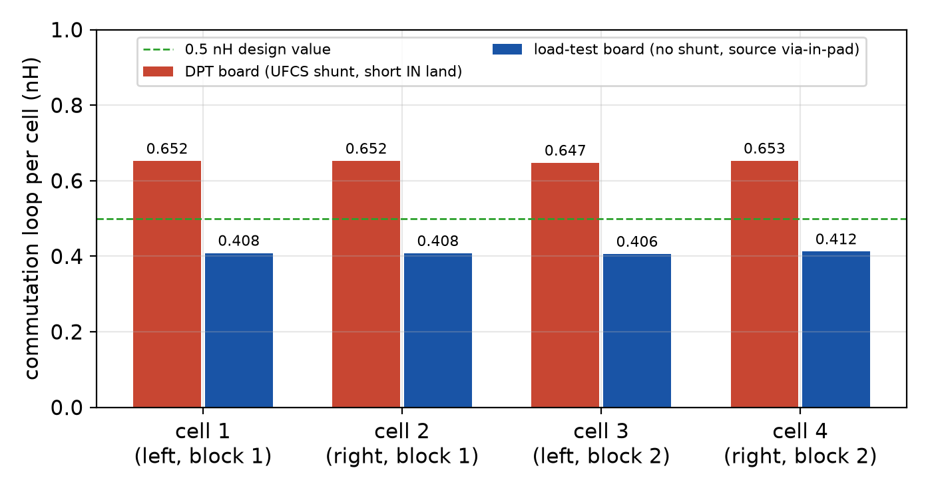
Q3D: commutation loop per cell, final boards
Loop per cell (nH) | DPT | load test
cell 1 / 2 | 0.652 / 0.652 | 0.408 / 0.408
cell 3 / 4 | 0.647 / 0.653 | 0.406 / 0.412
mean | 0.65 | 0.41
v̂_{DS} at 30 A/ns | 94 V | 87 V
All four LS switching together; HS shorted, bypass as its ESL, UFCS 120 pH
Cells within 1 % (DPT) and 2 % (load): left/right symmetric by layout (power vias pruned in mirror pairs)
DPT ≤ 90 V: turn-on ≤ 23 A/ns

Slide 47
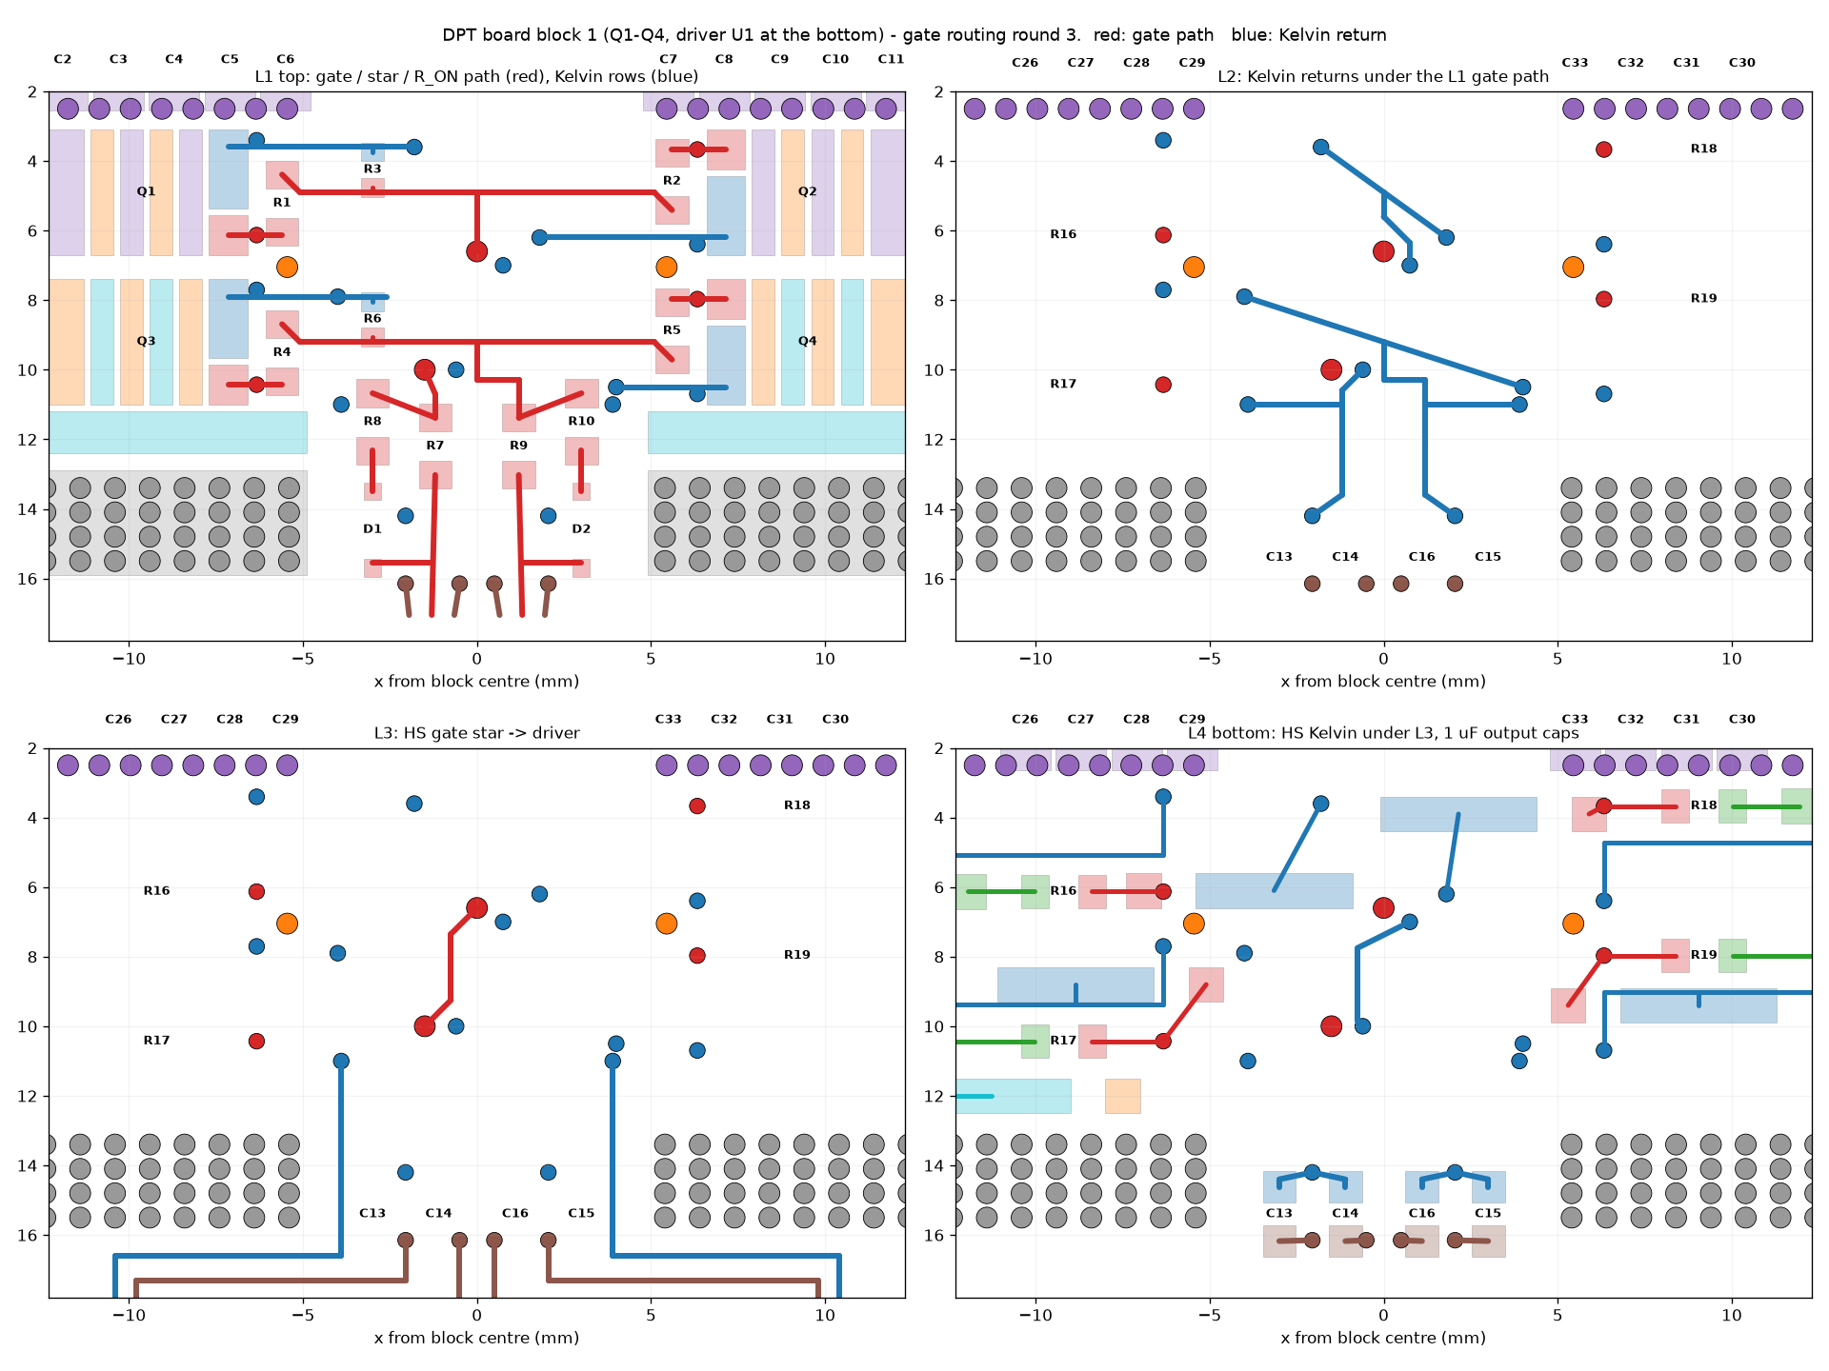
Q3D: coupling between the cells and the gate loops (DPT board)
M (pH), k | cell 2 | cell 3 | cell 4
cell 1 | 7, 0.011 | 1, 0.002 | 0, 0.001
cell 2 |  | 21, 0.034 | 1, 0.002
cell 3 |  |  | 7, 0.011
Gate loop (nH, copper) | HS Q1 / Q2 | LS Q3 / Q4
one device driven | 12.53 / 12.56 | 7.61 / 7.62
pair driven (operation) | 20.6 / 20.6 | 12.3 / 12.3
branch / shared star-driver | 4.5 / 8.0 | 2.9 / 4.7
gate-power coupling, both cells | max 9 pH | max 0.26 V at 30 A/ns
Cells: at most 21 pH between neighbours (k ≤ 0.034) ⇒ each cell commutates through its own loop
Gate: Kelvin return on the adjacent layer from every gate pad to the driver caps; Q1 = Q2, Q3 = Q4 within 0.3 %, block 2 an identical copy ⇒ all four paralleled devices equal; but ≈ 10× the 1.7 nH design value (driver behind the barrier)

Slide 48
Gate drive from the extracted gate network (SPICE, DPT board, 75 V, 322 A)
Case | R_{g,on} | off | v̂_{DS} HS | E_{on} / E_{off} (4 cells) | di/dt on | bump, held-off gate
lumped 1.7 nH gate, R_{ON} 1.5 Ω | 3.5 Ω | −1.9 V | 89.8 V | 136 / 17 µJ | 31 A/ns | -1.04 … -1.00 V
extracted, R_{ON} 1.0 Ω | 2.5 Ω | −1.9 V | 105.3 V | 97 / 20 µJ | 49 A/ns | -0.72 … -0.46 V
extracted, RON 1.5 Ω (board) | 3.5 Ω | −1.9 V | 92.9 V | 125 / 20 µJ | 36 A/ns | -0.76 … -0.50 V
Extracted gate network: Q3D copper + 0.4 nH per 0603 resistor body + 1 nH D_{OFF}; UFCS 120 pH as its own inductor
The larger gate loop speeds up the turn-on ⇒ HS overshoot ≈ 75 V + 0.65 nH × di/dt: R_{ON} 1.0 Ω gives 105 V
−1.9 V off: bump of the held-off gate ≤ −0.5 V (≥ 1.3 V below V_{th,min} 0.8 V); with 0 V off it was +1.2 … +1.4 V
Off-state ringing ≈ −3.4 V against the −4 V limit (EPC2361) ⇒ no larger negative bias
Turn-on of the four cells within 0.2 %; turn-off current inner vs outer cells ±1.5 % (power side)
Decision: DPT: R_{ON} 1.5 Ω (R_{g,on} 3.5 Ω), V_{ISO} 7 V (−1.9 / +5.1 V); next revision: driver stage next to each pair

Slide 49
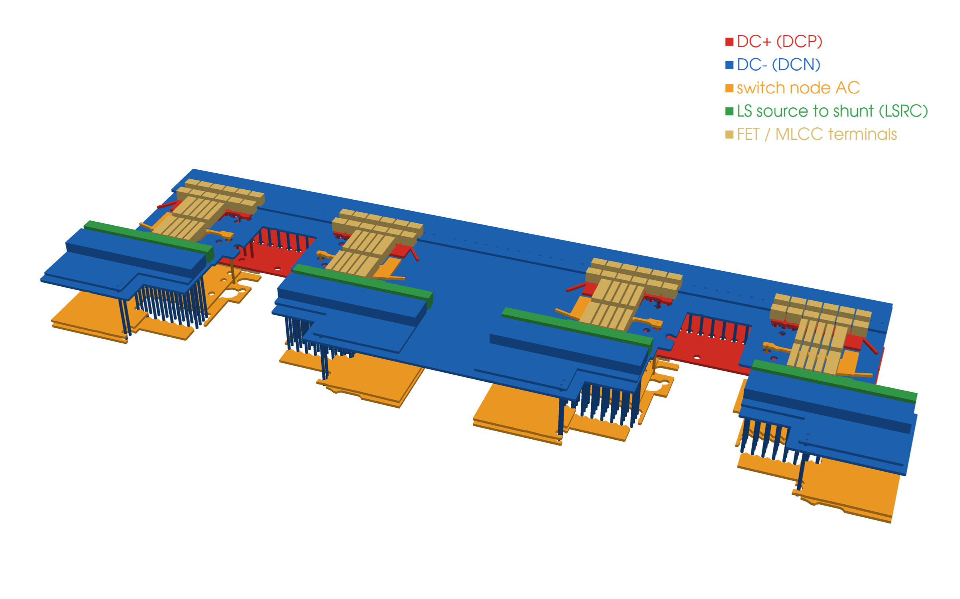
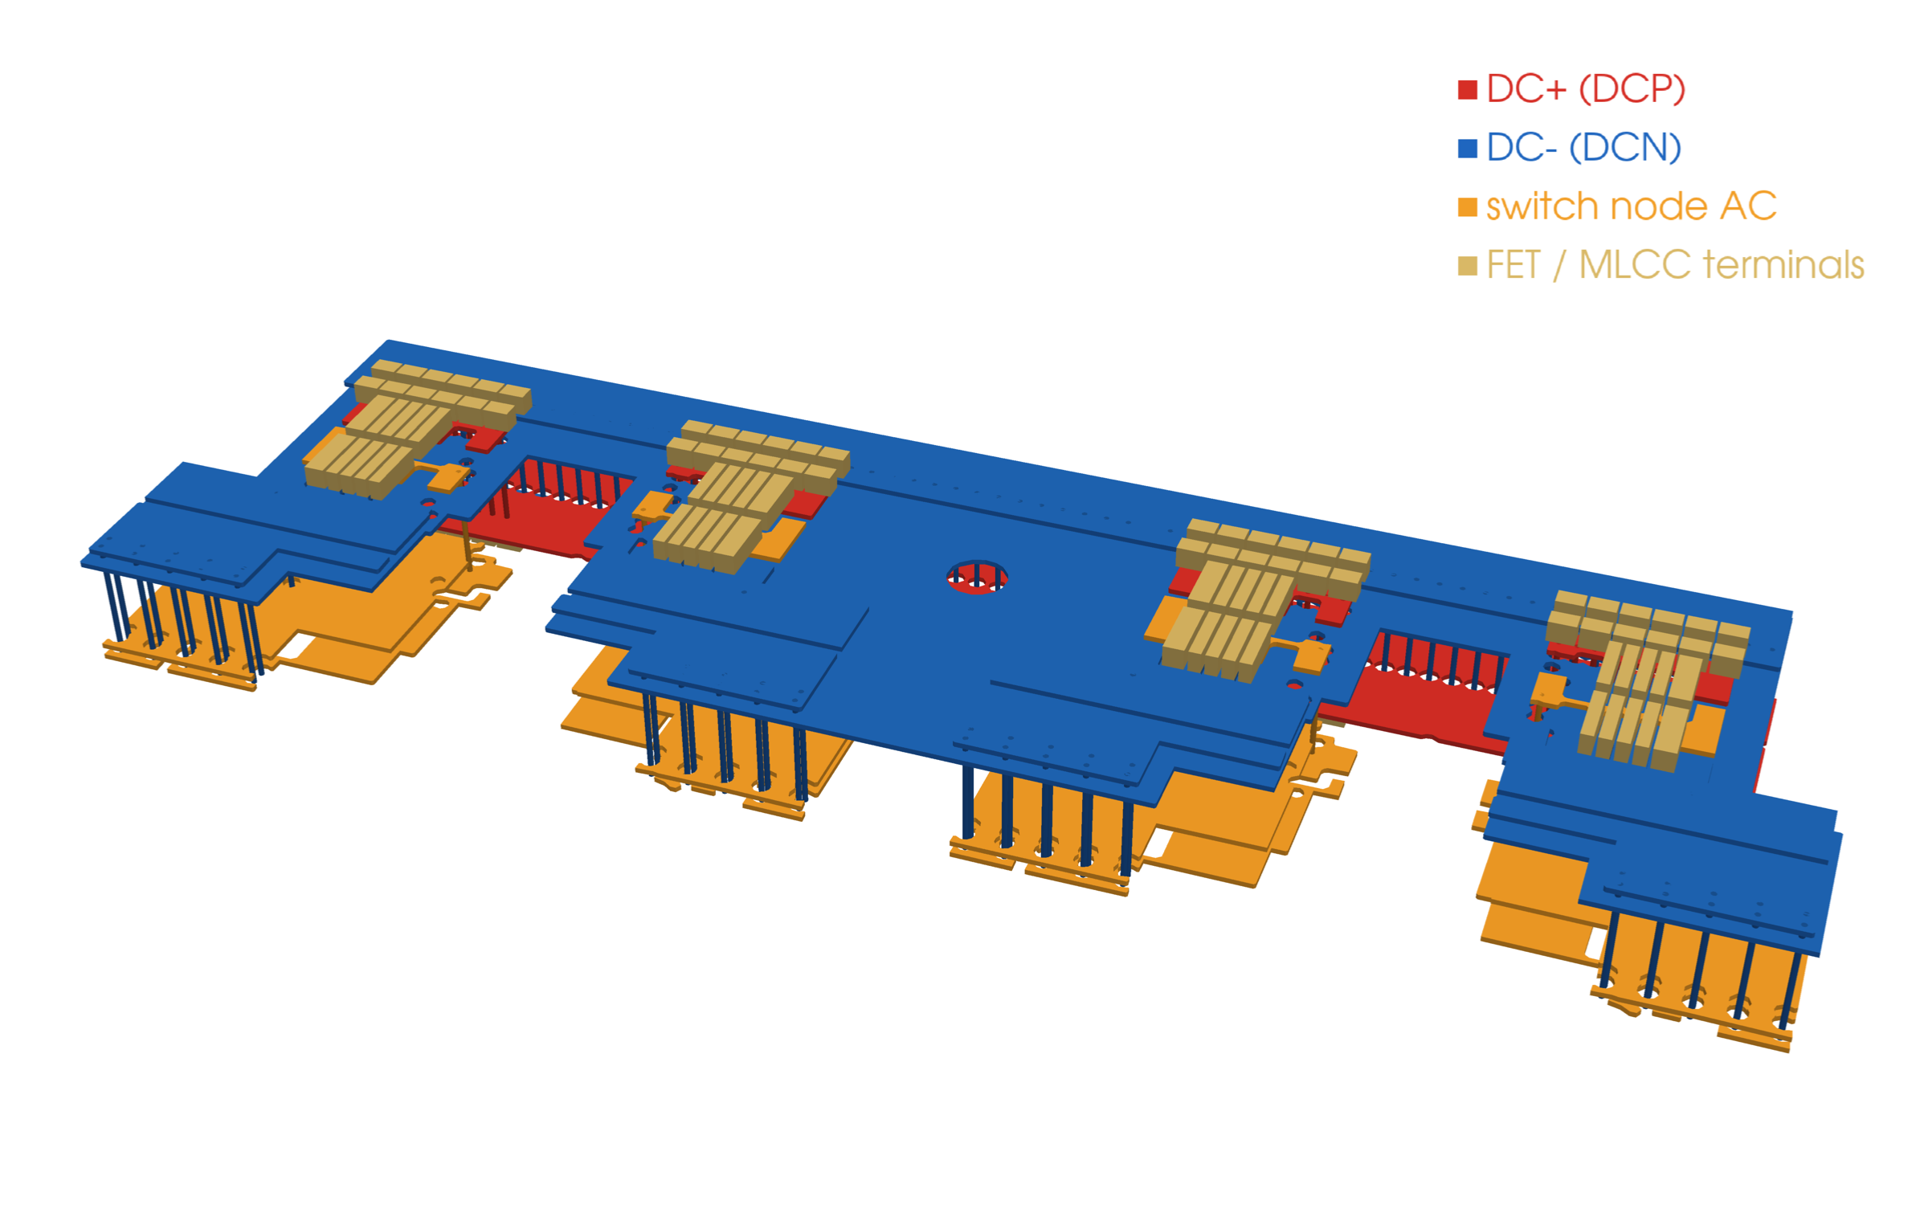
Q3D model of the cell band (fast loop model)
DPT board: LS source (green) to the UFCS land
load-test board: LS source straight to DC−
Geometry exported from the routed KiCad boards (revb_export.py): copper per net and layer with clearance holes, vias with their layer span (blind L1–L2 on the load board), FET and bypass terminal pads; z stretched 4×

Slide 50
Q3D: static current sharing and copper loss
Board, path (DC) | R total (mΩ) | R copper (mΩ) | share cell 1 / 2 / 3 / 4 | max/min
DPT: DC+ → HS FETs → AC | – | – | – | –
DPT: AC → LS FETs → shunts → DC− | – | – | – | –
load: DC+ → HS FETs → AC | – | – | – | –
load: AC → LS FETs → DC− | – | – | – | –
Static sharing = how the conduction (DC) current splits between the four parallel cells: set by each cell's copper path (DC terminals → cell → AC pad) plus R_{DS(on)}; dynamic sharing during the edges is set by the gate loops (step 7)
Full-board DC model; FET 0.75 mΩ × 1.49 (100 °C), UFCS 1 mΩ; DC terminals as one pair, AC at the M6 bolt pad
Board copper loss at 228 A_{rms}: (pending) W (DPT, + (pending) W in the shunts) / (pending) W (load board)
Hand-over inductance bypass → bank L_{b} = (pending) (bank model, 1 MHz) ⇒ used for the bypass sizing (step 6)

Slide 51
Q3D: three load-test legs on the PCB busbar
Quantity | Value
Leg-to-leg loop a–b / a–c, 1 MHz | 1.46 / 1.98 nH
Leg-to-leg loop a–b / a–c, DC | 7.41 / 10.01 nH
Ripple of leg a at 50 kHz from banks a / b / c | (pending)
Busbar DC loss (250 A in, 3 × 83 A) | (pending) W
Highest REDCUBE terminal current | (pending) A
Network: Q3D bank-model matrices of three load-test legs (cells draw at their bypass; MLCCs with ESR/ESL, C at 75 V) + busbar (DC below 1 MHz, AC above); peaks in |Z| = inter-leg resonance
Target ≤ 5 nH leg to leg (step 10)

Slide 52
Main findings on the final boards
Quantity | DPT board | Load-test board | Consequence
Loop per cell | 0.65 nH | 0.41 nH | DPT: limit di/dt; load: 30 A/ns ok
Static sharing, max/min (HS / LS) | (pending) / (pending) | (pending) / (pending) | verify with the UFCS per cell
Board copper loss at 228 A_{rms} | (pending) W | (pending) W | heats the board, not the FETs
L_{x} between driver pairs (HS / LS) | 4.91 / 2.68 nH | 6.77 / 5.44 nH | skew → ΔI = V_{m}Δt / L_{x}
Bus leg-to-leg loop (1 MHz) | – | 1.46 nH | target ≤ 5 nH
All values from the fast Q3D set on the final layouts (run_bb_q3d_final.cmd, final_post.py).

Slide 53
Fabrication files
Board | Fab set (hardware/<board>/fab) | Notes for the fab house
spb-bb-revb-dpt | Gerber zip, drill, pos, BOM, STEP, assembly + schematic PDF | 2 oz all layers, 0.1 mm prepreg, via-in-pad filled + capped
spb-bb-revb-load | same | + blind vias L1–L2 (0.25 mm) filled + capped
spb-busbar | Gerber zip, drill, pos, BOM, STEP | 2 oz all layers (JLC3313), bolt pads without mask
assembly | spb-level-assembly.step, spb-stack-assembly.step | mechanics / frame design
Generated: make_kicad_bb_revb.py (BOARD=dpt | load), make_kicad_sch_revb.py, make_kicad_busbar.py, make_3d_models_revb.py, make_fab_outputs_revb.py, make_assembly_step.py, render_3d.py
Mechanical items (screws, spreader, gap pads, heatsink, lugs) are listed at the end of each BOM

Slide 54
Status and next steps
Item | Status
DC link: 20 × 22 µF 2220 + 10 × 1 µF per cell | in both layouts
DPT board (UFCS, no heatsink) | DRC 0 / 0 / 0, schematic = PCB
Load-test board (no shunt, LAM 4 K 50) | DRC 0 / 0 / 0, schematic = PCB
PCB busbar | DRC clean, fab files
Fast Q3D: loop, DC, L_{x}, busbar, level | done (this deck)
3D models, board + assembly STEP | done
Fab outputs + BOMs | done
DPT and three-phase load test | after assembly
Order: DPT board first (switching energies, per-cell current, overshoot vs di/dt), then 3 load boards + busbar
Mechanics: spreader drawing, frame and stack insulation from the assembly STEP
Decide after measurement: bank depopulation, damping caps, busbar copper weight
Machine: L_{σ}, cos φ and the final f_{sw}

Slide 55
Thank you - questions?
Enes Ayaz, KTH Royal Institute of Technology

