Slide 1
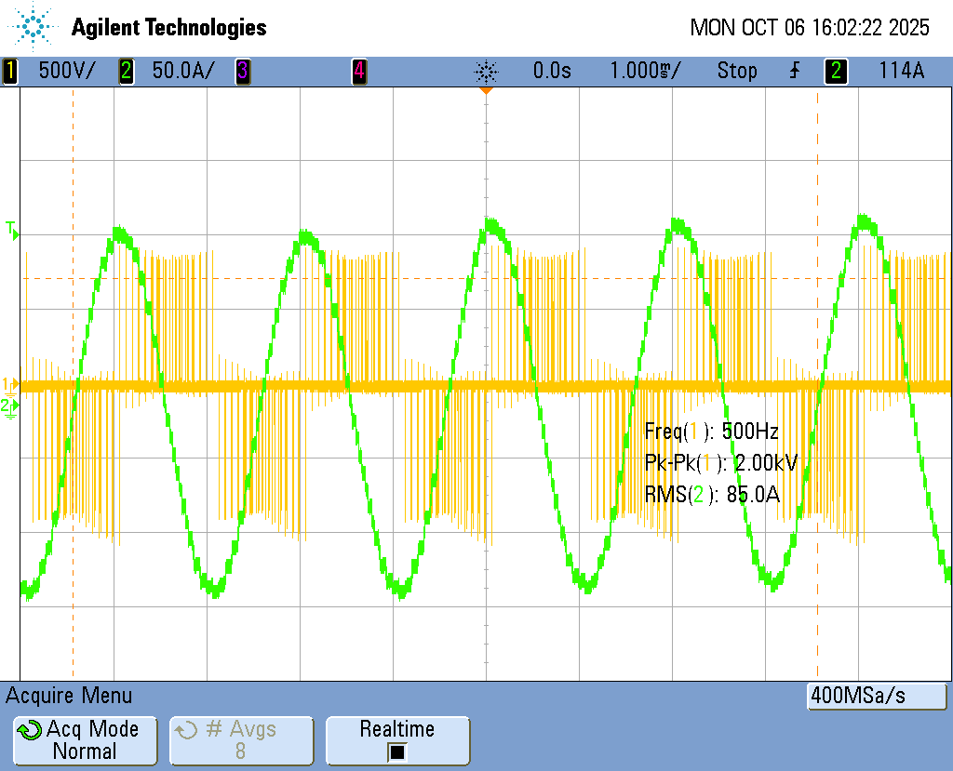
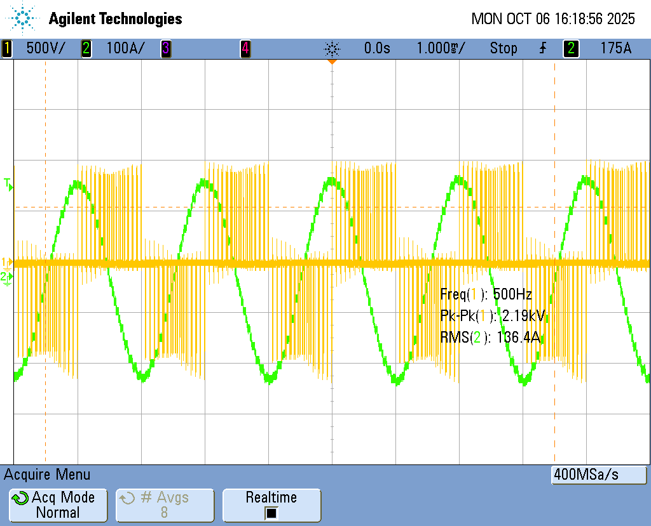
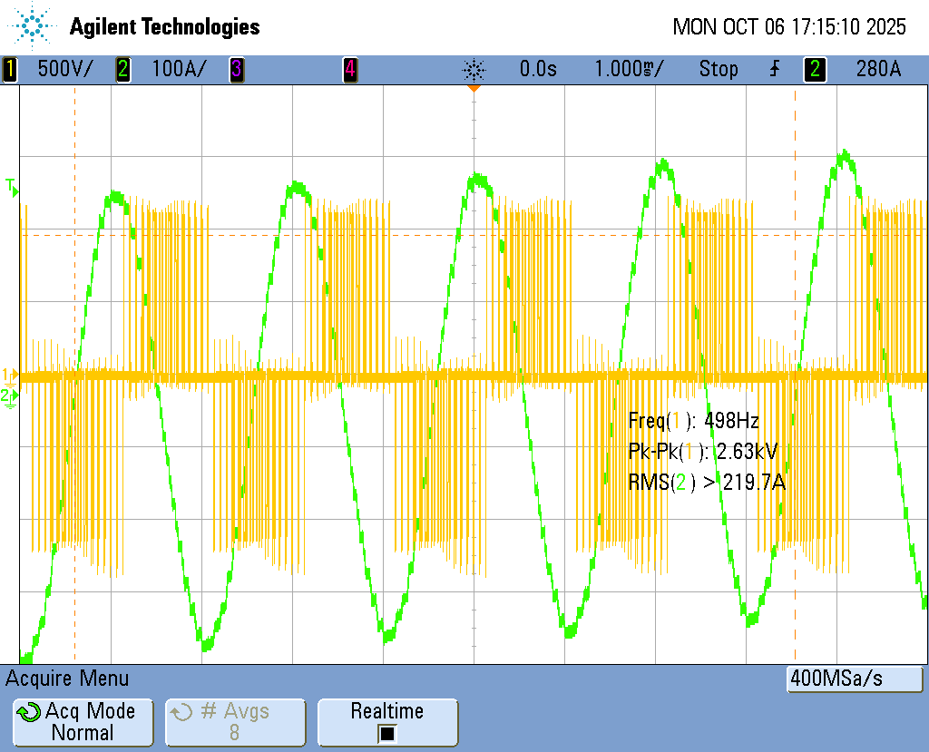
Experimental Waveforms - B2B Inverter: Single Phase
Vll – Iph
1070 V DC
800 V DC
1000 V DC

Slide 2
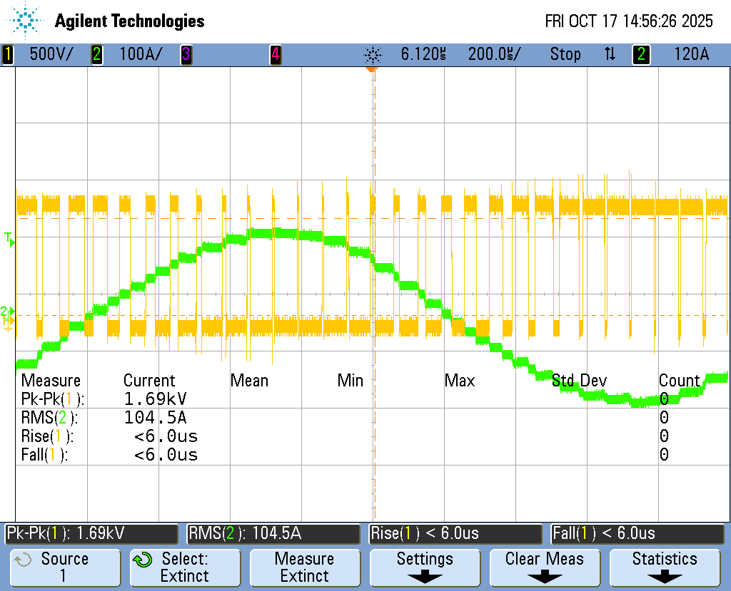
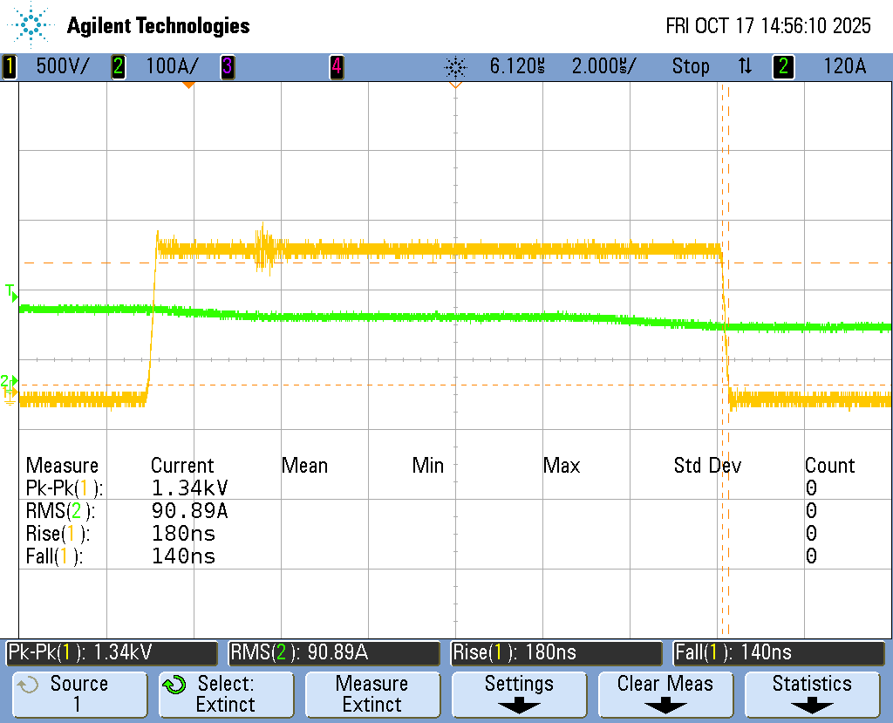


Experimental Waveforms - B2B Inverter: Single Phase
Vds – Iph
$$dv/dt \sim 6kV/μS$$
$$dv/dt \sim 7.6kV/μS$$

