Slide 1
PhD Works
Enes Ayaz

Slide 2
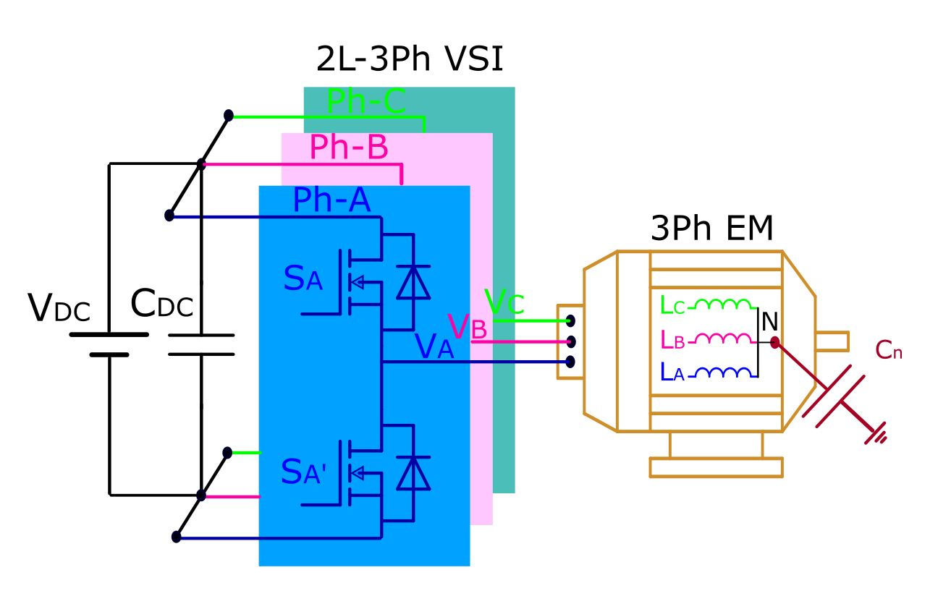
Overview of Three-Phase Two-Level VSIs
Still dominant in industrial motor drives, traction systems, and renewable energy applications owing to:
  Structural simplicity
  Minimal component requirements
  Simple to control
  Minimal cost
Reliability remains a critical concern for sustainable power conversion systems.
Extending the lifespan of the system is crucial at this point.

Slide 3
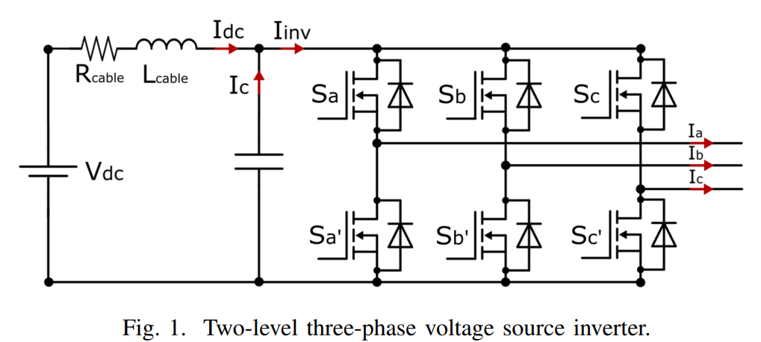
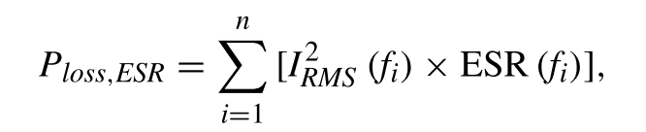

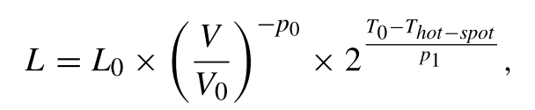
DC-Link Capacitor: Reliability Bottleneck
Functions:
  Stabilizes DC bus voltage
  Suppresses switching-induced fluctuations and parasitic oscillations
Accounts for ~20% of all VSI failures.
Degradation impacts system longevity.
DC-link current harmonics influence thermal stress, affecting capacitor lifespan.
Capacitor lifetime improves with lower hot-spot temperatures.
Hot-spot temperature depends on power losses, which decrease when the RMS value of the capacitor current is reduced.
Therefore, minimizing the capacitor's ripple current helps extend its lifespan.

Slide 4
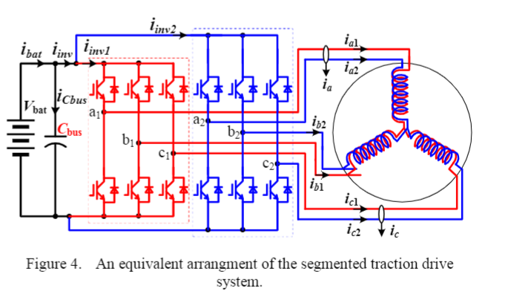
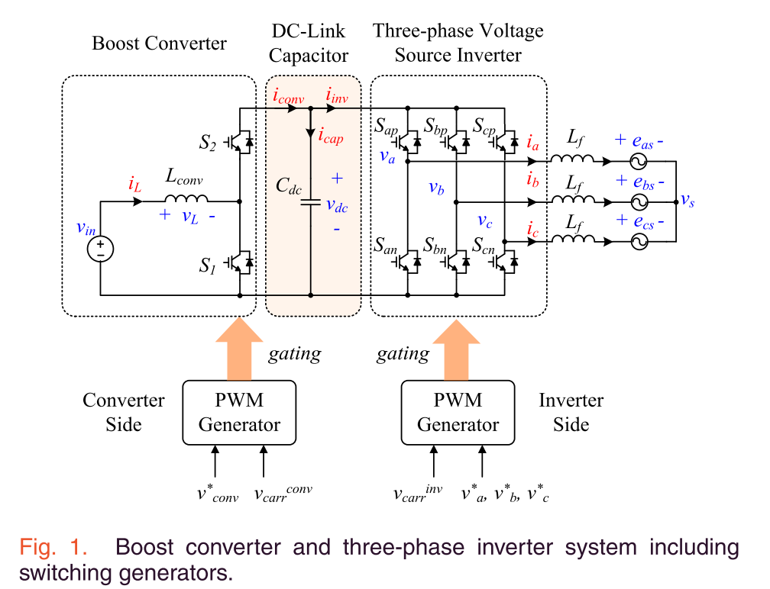
Reducing Current Ripple & Stress
Advanced modulation techniques aim to:
  Minimize inverter-induced current ripple
  Reduce DC-link current stress
  Maintain system performance & durability
Interleaving techniques modify carrier phase-shift relationships to reduce stress.
Primarily applied in multi-converter systems, such as:
  Dual-inverter architectures (e.g. Segmented motor drives)
  Systems with integrated front-end converters for DC-link regulation

Slide 5
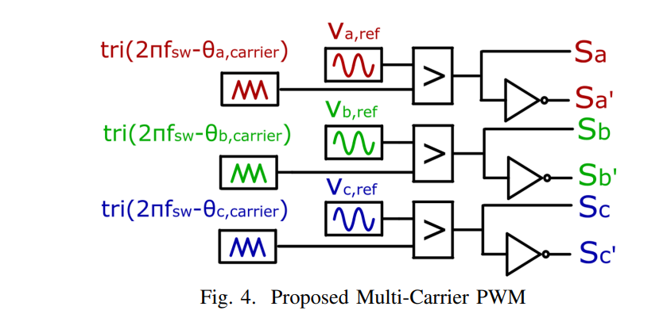
Interleaving for Single 2L-VSI
Existing Interleaving Approaches & Limitations
  Require additional switches (pre-converters, parallel inverters)
  Not applicable for several applications that aim to achieve a cost-effective solution.
We propose a novel interleaving between the phase legs of a single two-level VSI.
Challenges:
  Time-varying leg currents complicate implementation.
  Unlike parallel systems, it requires dynamic phase adjustment.

Slide 6
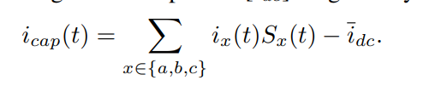

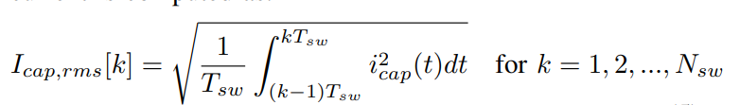
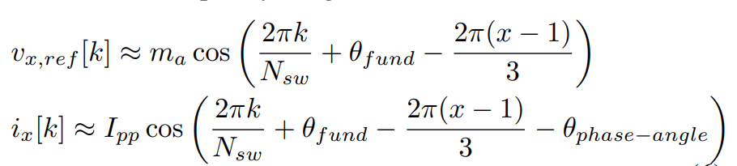
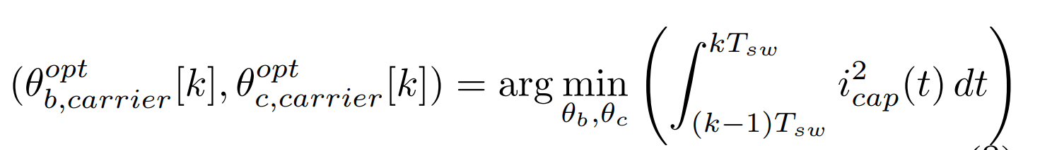







Dynamic Variable Carrier Phase-Shift Modulation
  Adaptively adjusts carrier phase shifts in real-time.
  Optimizes current stress reduction while maintaining performance
$OC_{1}$
$OC_{Nsw}$
Operating condition
…
$N_{sw}$ is the frequency ratio: $\frac{f_{sw}}{f_{fund}}$
Fundamental Phase
$0$
…
$2π$
Carrier phase shift
$[φ_{B−OC1},φ_{C−OC1},]$
…
$[φ_{B−OC_{mf}},φ_{C−OC_{mf}},]$

Slide 7
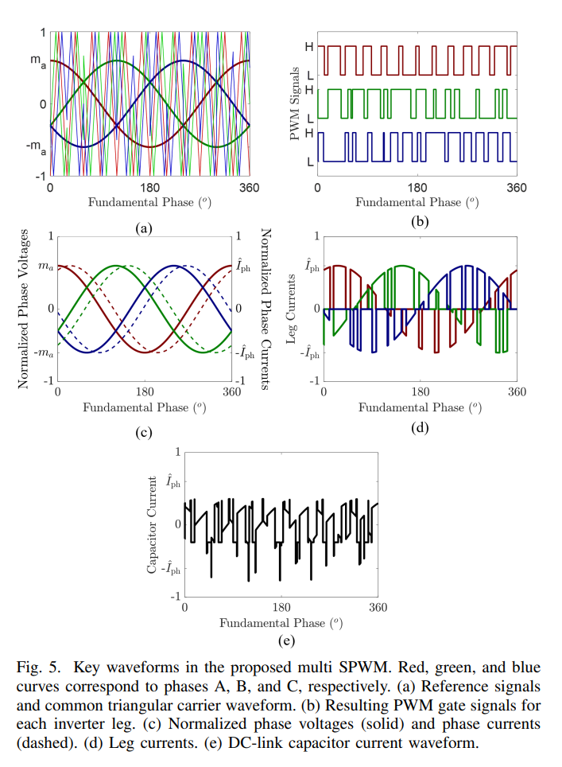
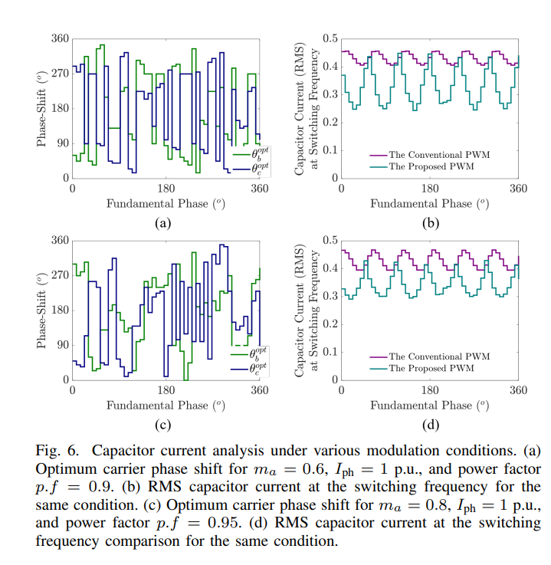
Dynamic Variable Carrier Phase-Shift Modulation

Slide 8
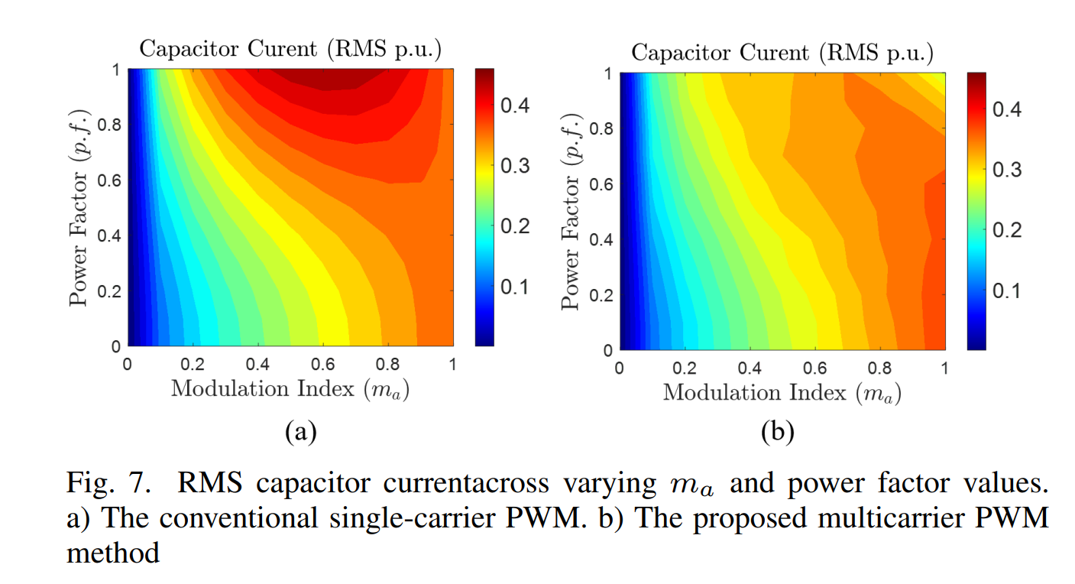
Dynamic Variable Carrier Phase-Shift Modulation

