Slide 1
PhD Works
Enes Ayaz

Slide 2
Outline
ECCE-Asia (IPEC-2026) Paper Digest
Initial Experimental Results of The Patent

Slide 3
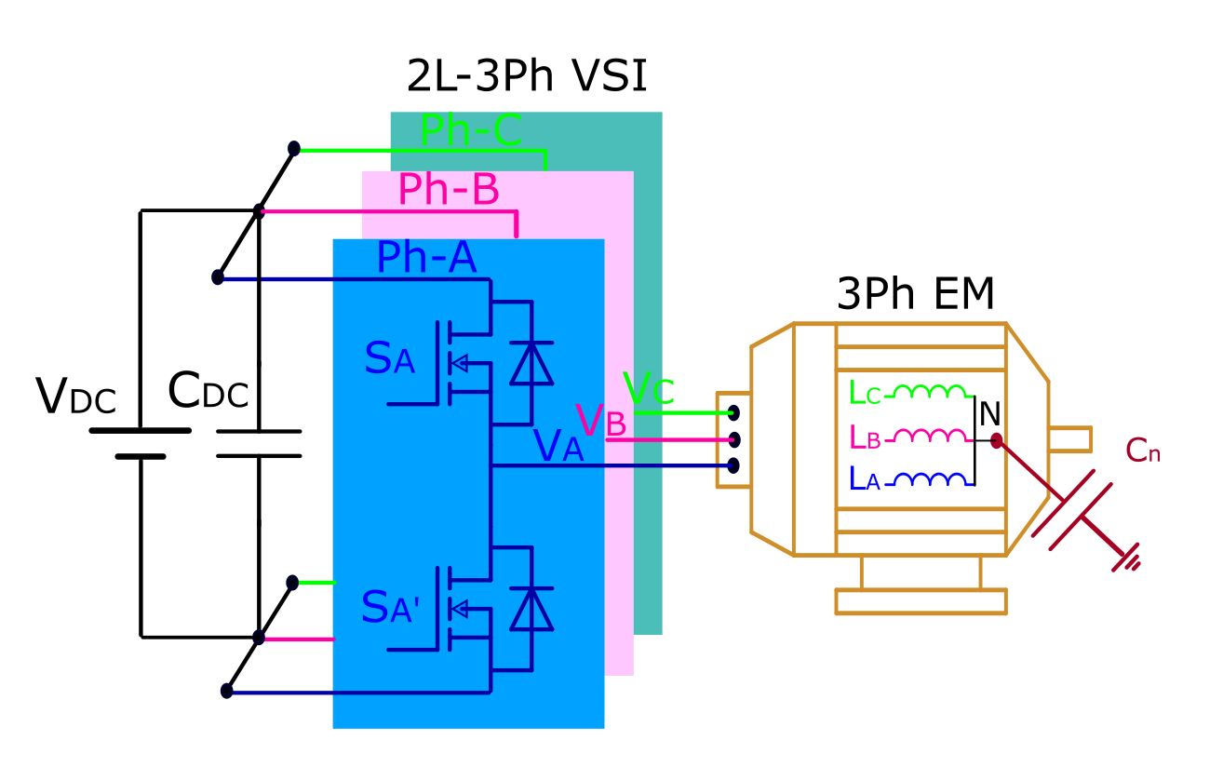
Overview of Three-Phase Two-Level VSIs
Still dominant in industrial motor drives, traction systems, and renewable energy applications owing to:
  Structural simplicity
  Minimal component requirements
  Simple to control
  Minimal cost
Reliability remains a critical concern for sustainable power conversion systems.
Extending the lifespan of the system is crucial at this point.

Slide 4
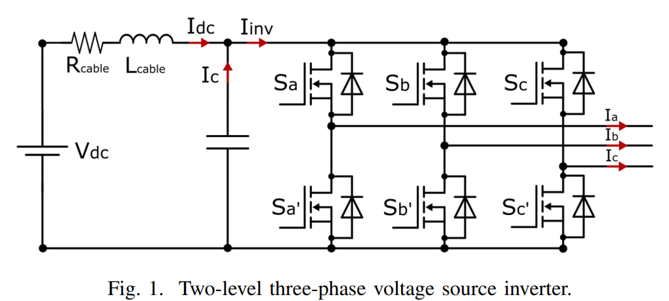
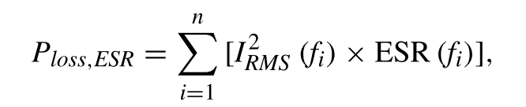

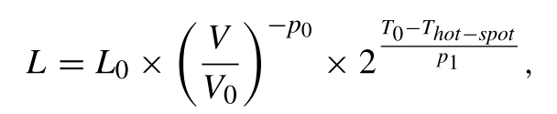
DC-Link Capacitor: Reliability Bottleneck
Functions:
  Stabilizes DC bus voltage
  Suppresses switching-induced fluctuations and parasitic oscillations
Accounts for ~20% of all VSI failures.
Degradation impacts system longevity.
DC-link current harmonics influence thermal stress, affecting capacitor lifespan.
Capacitor lifetime improves with lower hot-spot temperatures.
Hot-spot temperature depends on power losses, which decrease when the RMS value of the capacitor current is reduced.
Therefore, minimizing the capacitor's ripple current helps extend its lifespan.

Slide 5
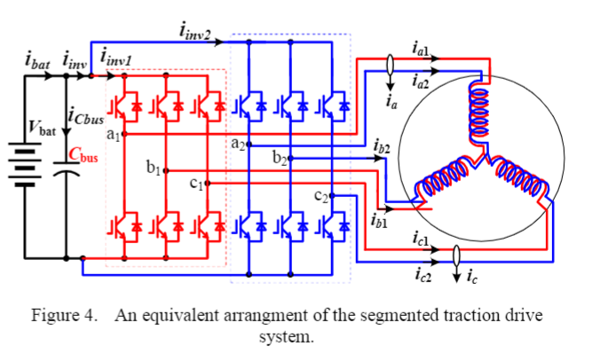
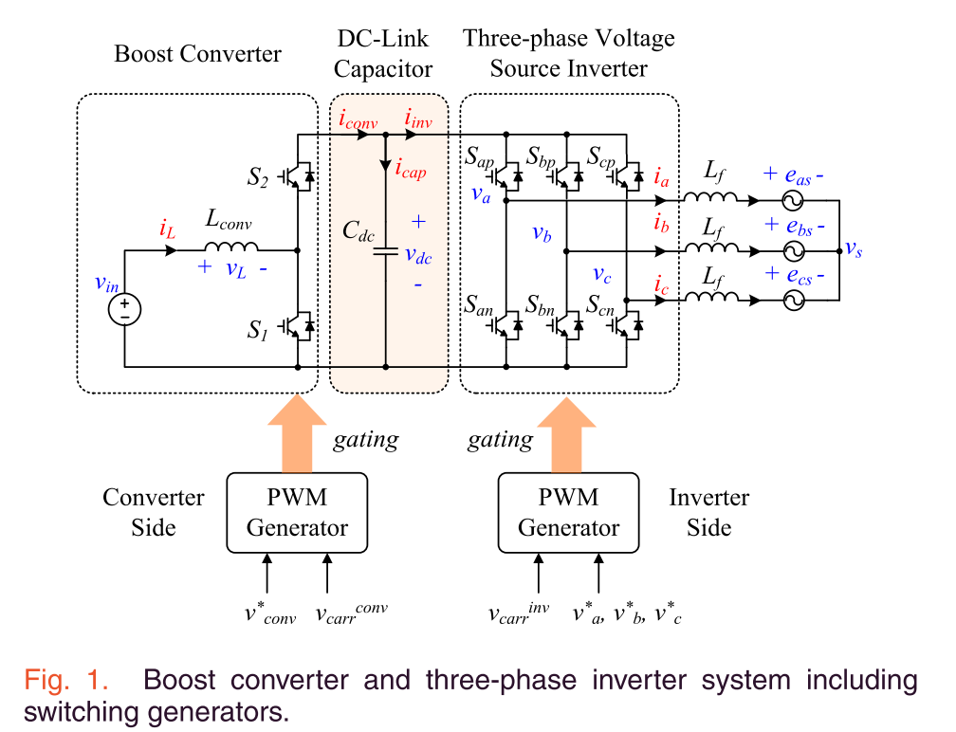
Reducing Current Ripple & Stress
Advanced modulation techniques aim to:
  Minimize inverter-induced current ripple
  Reduce DC-link current stress
  Maintain system performance & durability
Interleaving techniques modify carrier phase-shift relationships to reduce stress.
Primarily applied in multi-converter systems, such as:
  Dual-inverter architectures (e.g. Segmented motor drives)
  Systems with integrated front-end converters for DC-link regulation

Slide 6
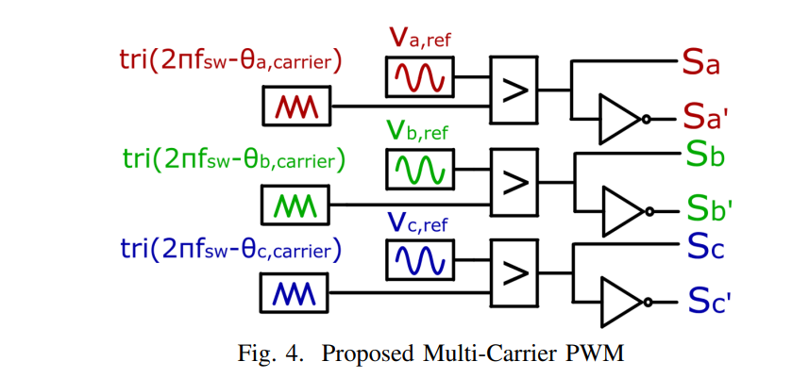
Interleaving for Single 2L-VSI
Existing Interleaving Approaches & Limitations
  Require additional switches (pre-converters, parallel inverters)
  Not applicable for several applications that aim to achieve a cost-effective solution.
We propose a novel interleaving between the phase legs of a single two-level VSI.
Challenges:
  Time-varying leg currents complicate implementation.
  Unlike parallel systems, it requires dynamic phase adjustment.

Slide 7
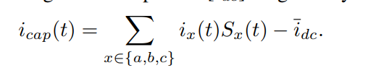

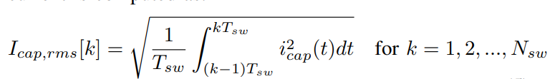
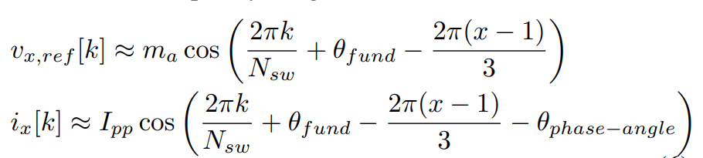
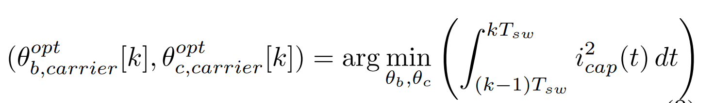







Dynamic Variable Carrier Phase-Shift Modulation
  Adaptively adjusts carrier phase shifts in real-time.
  Optimizes current stress reduction while maintaining performance
$OC_{1}$
$OC_{Nsw}$
Operating condition
…
$N_{sw}$ is the frequency ratio: $\frac{f_{sw}}{f_{fund}}$
Fundamental Phase
$0$
…
$2π$
Carrier phase shift
$[φ_{B−OC1},φ_{C−OC1},]$
…
$[φ_{B−OC_{mf}},φ_{C−OC_{mf}},]$

Slide 8
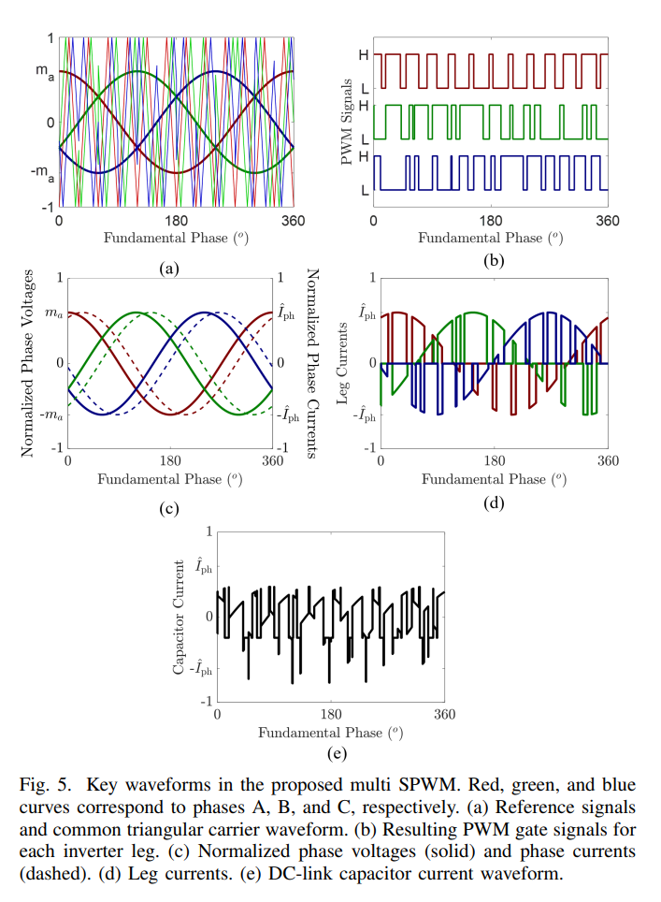
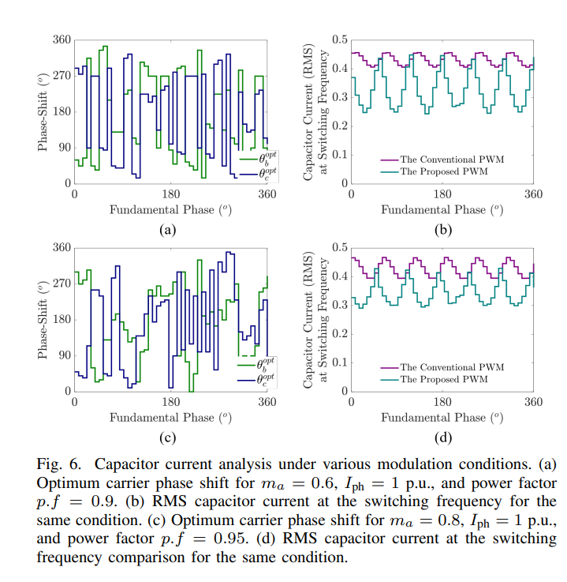
Dynamic Variable Carrier Phase-Shift Modulation

Slide 9
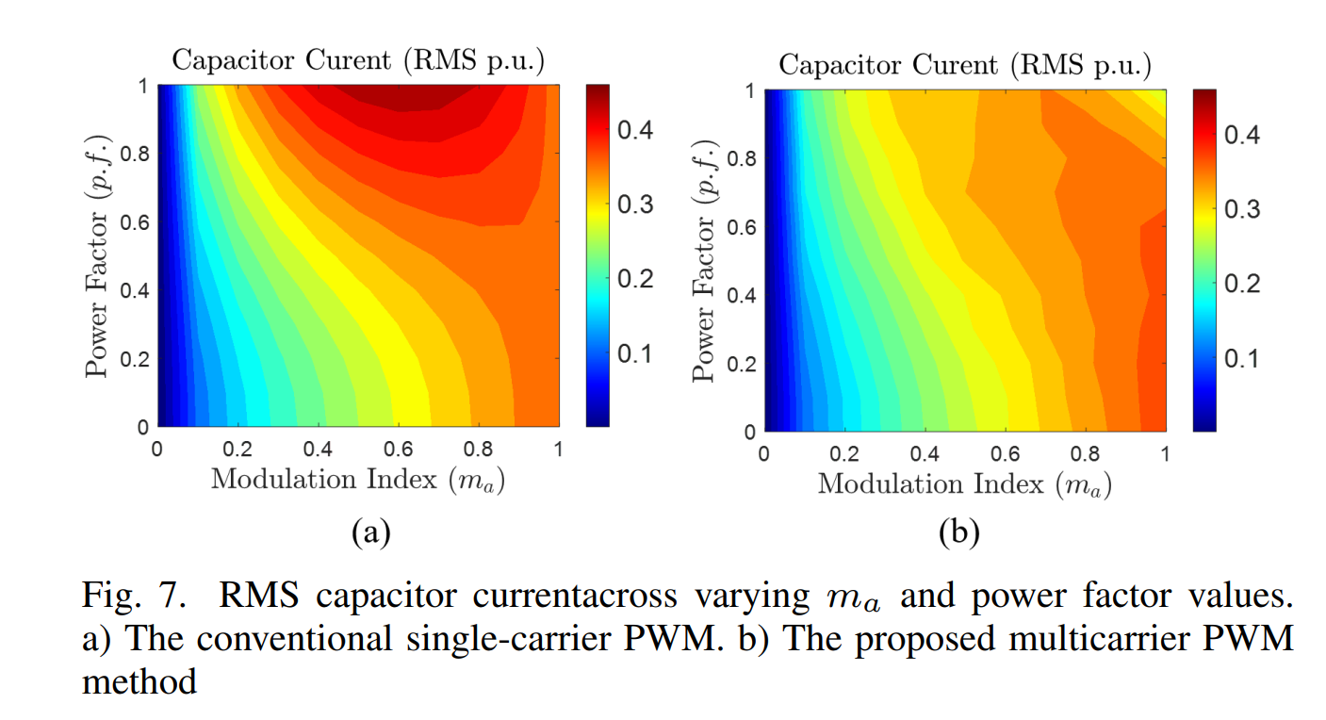
Dynamic Variable Carrier Phase-Shift Modulation

Slide 10
Outline
ECCE-Asia (IPEC-2026) Paper Digest
Initial Experimental Results of The Patent

Slide 11
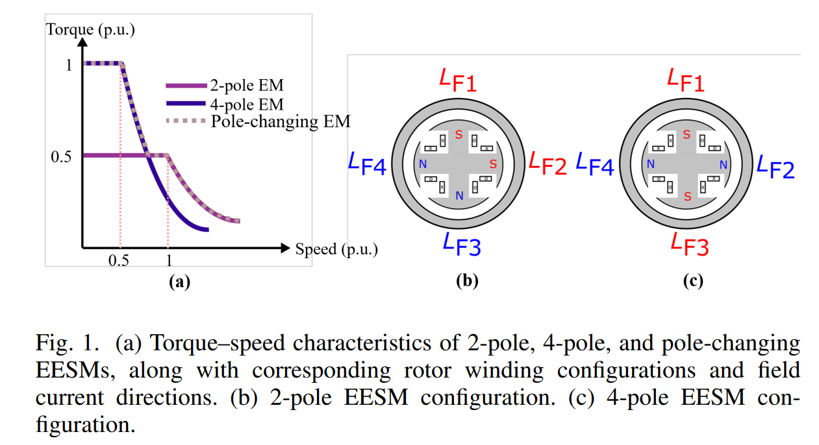
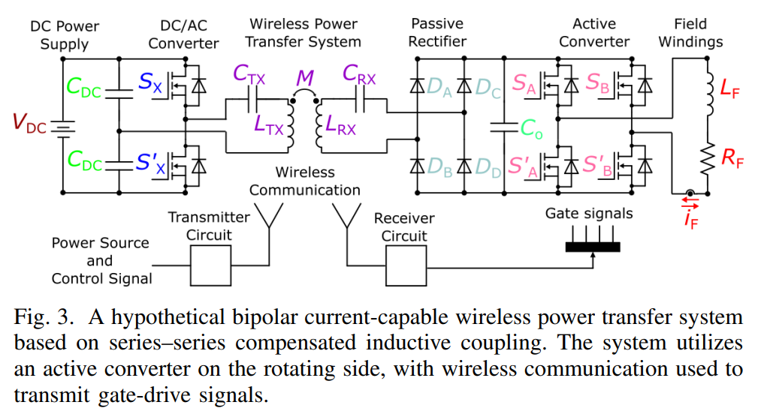
Variable Phase-Pole Machine
Hypothetically, if such a solution were to exist, it might involve utilizing rotating semiconductor components that necessitate active gate signals for control.
However, this approach introduces complexities, including the need for a wireless converter system to receive commands from the stationary side. This This would add layers of intricacy to the system, posing challenges to reliability and overall system robustness.
To achieve a variable pole (synchronous) machine, the rotor windings should be re-configurable, which means a controllable bi-directional current on the rotor side.
A 4-pole rotor structure can be transformed into a 2-pole structure by employing identical field windings and strategically altering the current direction in only two windings.

Slide 12
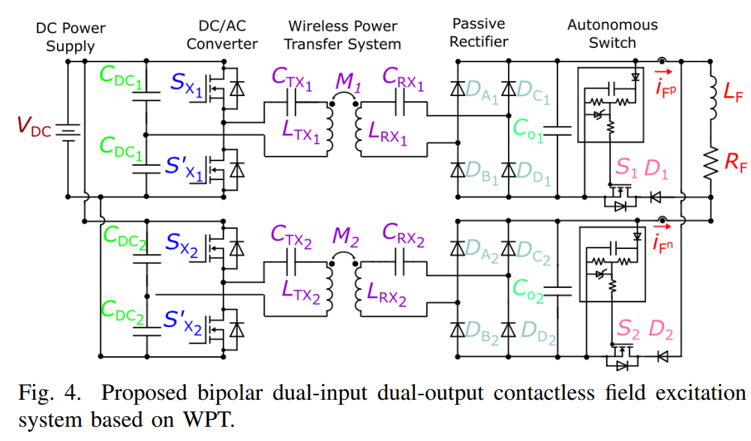
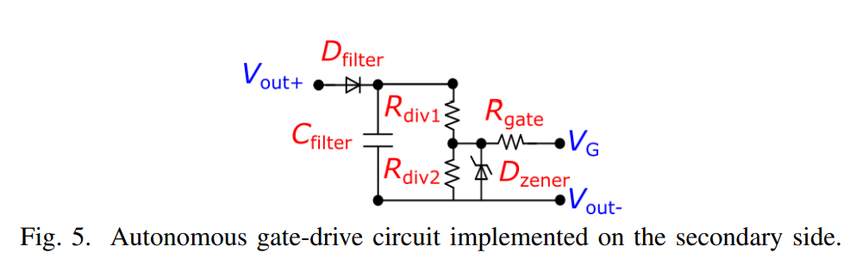
Self-Driven Field Excitation
The proposed dual-input, dual-output WPT system employs two resonant coil sets, each feeding a diode rectifier to supply unidirectional current.
The anti-parallel connection of the rectifier outputs enables bipolar excitation of the field winding.
To avoid reverse biasing of the rectifiers, bidirectional power switches—implemented using a MOSFET in anti-series with a diode—are placed between the rectifier ground and one terminal of the field winding.
These switches are self-driven using passive feedback network from their respective rectifier outputs, eliminating the need for external control signals.
Field-current reversal is achieved by altering excitation between the two coil sets: one set drives the positive direction, while the other drives the negative

Slide 13
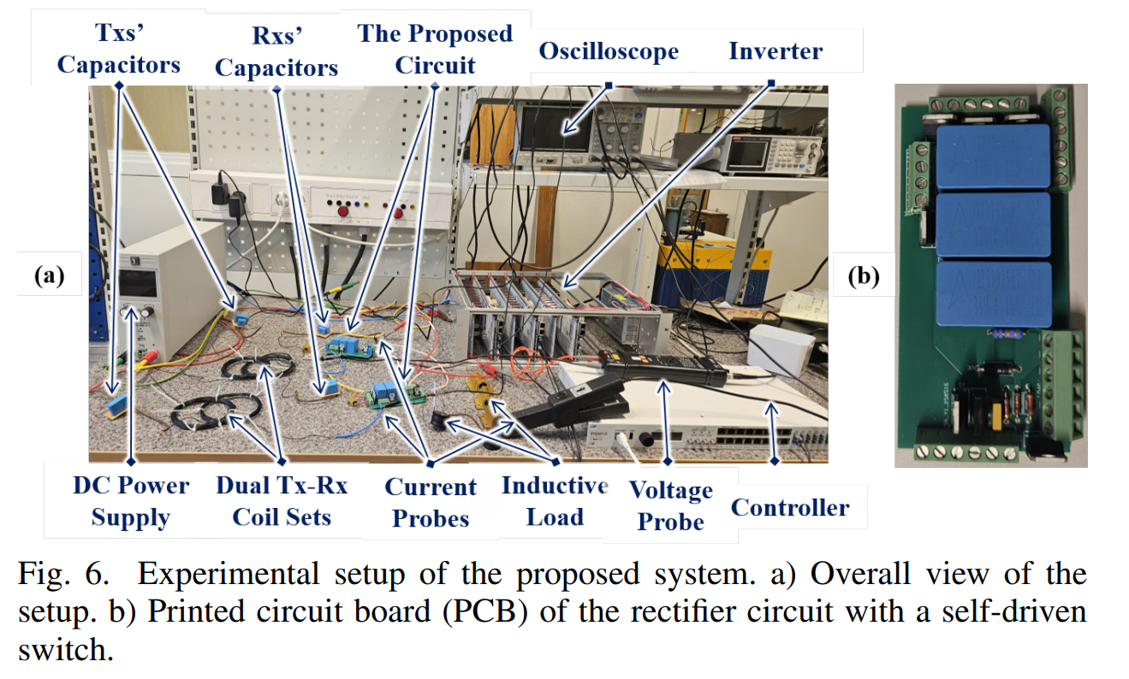
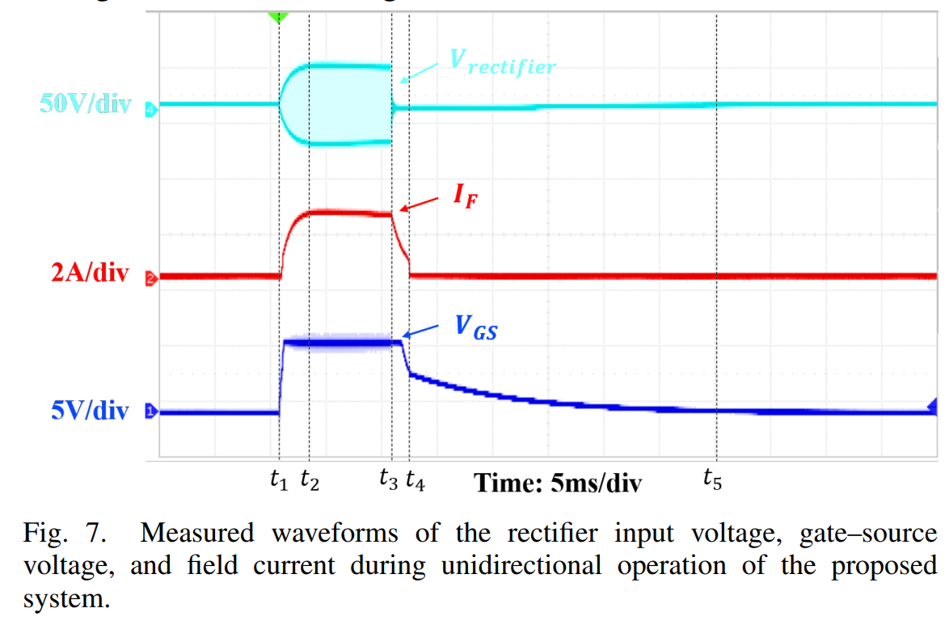
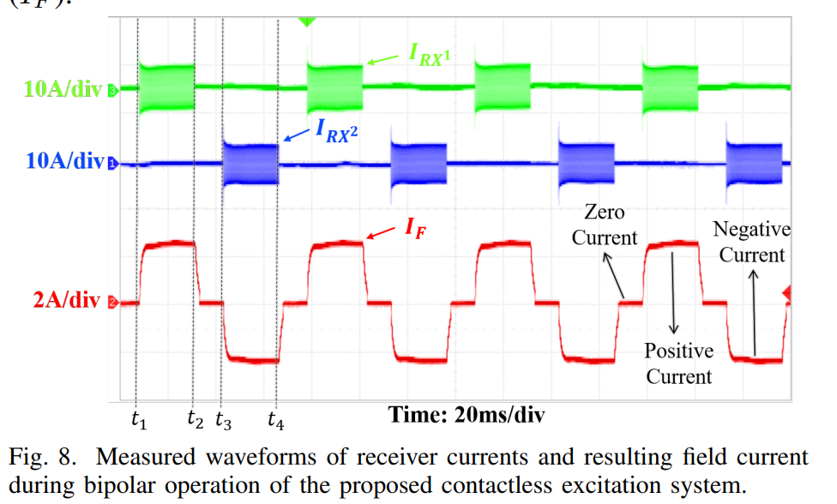
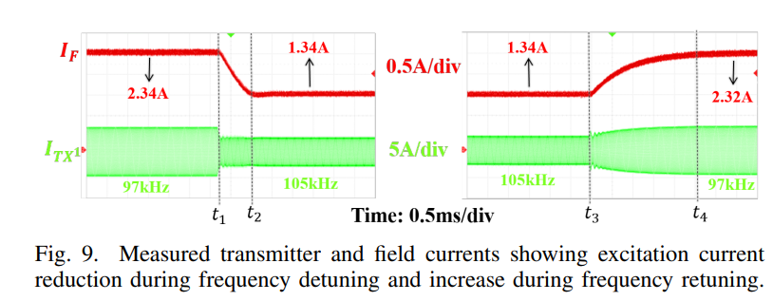
Experimental Validation

