Slide 1
Investigation of Conduction and Turn-off Losses Dynamics for Si and SiC-based Power Semiconductors
Enes Ayaz

Slide 2
AGENDA
Introduction
MOSFET Physical Structure
MOSFET Lumped Circuit Model with Parasitic Elements
Theory: Conduction and Turn-off Losses
Comparison of Si and SiC devices
Conclusion

Slide 3
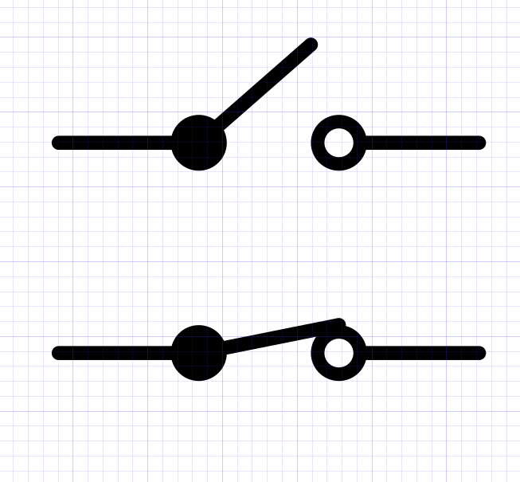
Introduction-Power Converters
Ideal Switch
Zero on-state voltage drop.
Infinite off-state resistance (Zero leakage current)
Zero rise and fall time.
Zero dissipating power.
No limit on voltage and current.
Utilized as step-down for DC to DC
Required active components:
  Power switches
  Power rectifier
Required passive components:
  Filter inductance
  Filter capacitance
Required control unit: Analog or digital controllers
I
Zero Forward
Voltage
Zero Reverse
Current
V

Slide 4
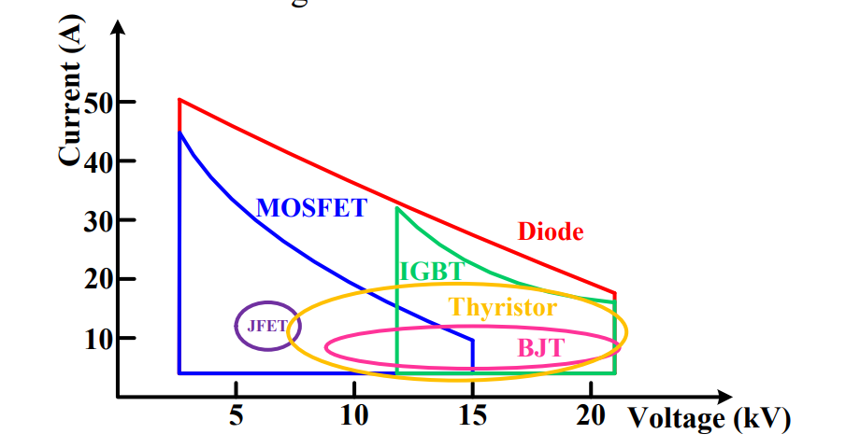
Background on Power Semiconductors
Power switches:
MOSFET
BJT
IGBT
Power rectifier :
Shottky Diodes
Pin Diodes
WHY MOSFETS?
Lower on-state resistance
Fast switching speeds
Simple driver circuitry.
Operate at high temperatures
Rated voltage and current of HV dies [1].
[1] Overview of High Voltage SiC Power Semiconductor Devices: Development and Application

Slide 5
MOSFET (Metal Oxide Semiconductor Field Effect Transistor) Physical Structure
V
metal
Metal- oxide-semiconductor (MOS) building block
oxide
p
qφm
Ef
-
-
-
-
-
-
-
-
-
-
-
-
-
-
Ec
-
-
-
-
-
Ei
V<0
Ef
Ef
V>0
+
V>0
+
Ef
+
+
+
+
+
+
+
+
+
+
+
+
+
+
+
+
+
+
+
Ef
Conduction bens down toward the fermi level
Accumulation of majority carrier.
The intrinsic energy gets closer Fermi level.
The intrinsic energy crosses the Fermi level.
Inversion of minority carrier.
All bands flat
in thermal equilibrium
[1] Retrived from”https://www.iue.tuwien.ac.at/phd/hehenberger/dissap2.html”

Slide 6
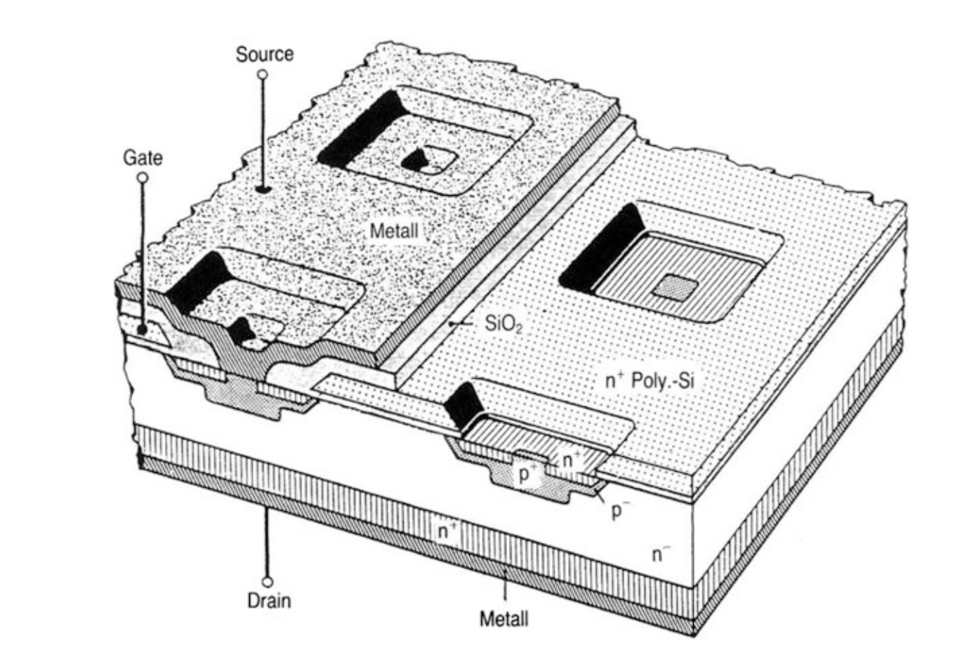
G
S
metal
D
oxide
Usually, MOSFETs of the enhancement type (. An n-channel only develops when VG > VT (normally off device)) are used in power electronics, because of the normally-off feature that is required in voltage source converters.
Almost always n-channel MOSFETs are used, being more advantageous since the mobility of the electrons is much higher than that of the holes.
The vertical MOSFET structure enables shorter channel length and higher blocking voltage. Therefore, If real “power” has to be controlled, vertical MOSFET is realized by arranging the area for the space charge vertically.
n
p
n
Basic lateral n-type MOSFET
G
S
metal
oxide
n+
p+
p
n-
n+
D
Basic vertical n-type MOSFET
[1] Semiconductor Power Devices Physics, Characteristics, Reliability

Slide 7
V> 0
G
S
metal
D
oxide
p+
p
n
Channel
n
Basic lateral n-type MOSFET
V> 0
G
S
metal
p+
oxide
n+
p+
p
n-
n+
D
Basic vertical n-type MOSFET

Slide 8
ID
ID
ID-sat
VG=0
VD
VG> VT
VD
Vs=0
G
VD=0
ID=0
Vs=0
G
VD = VD-sat
ID = ID-sat
S
metal
D
S
D
metal
oxide
oxide
n
p
n
-
-
-
-
+
+
+
-
-
-
-
n
-
-
-
-
+
+
+
+
+
-
-
-
-
-
-
-
-
-
-
-
-
n
-
-
-
-
+
+
+
+
+
+
+
+
-
-
-
-
p
-
-
-
-
+
+
+
+
+
+
+
+
+
+
+
+
+
+
+
+
depletion
+
+
+
+
depletion
+
+
+
+
+
+
+
+
+
+
+
+
+
+
+
+
+
+
+
+
+
+
+
+
+
+
+
+
+
+
+
+
+
+
+
+
+
+
+
+
+
+
+
+
+
+
+
+
+
+
+
+
ID
Pinch-off
ID
ID-sat
VG> VT
VD
Pinch-off
Vs=0
G
VD=small
ID >>
VG> VT
VD
S
metal
D
Vs=0
G
VD > VD-sat
ID = ID-sat
oxide
S
metal
D
n
p
-
-
-
-
-
-
-
-
-
-
-
-
-
-
-
-
-
-
-
-
-
-
-
-
n
oxide
-
-
-
-
-
-
-
-
n
-
-
-
-
+
+
+
+
+
+
+
+
-
-
-
-
-
-
-
-
n
depletion
depletion
-
-
-
-
p
-
-
-
-
+
+
+
+
+
+
+
+
+
+
+
+
+
+
+
+
+
+
+
+
+
+
+
+
+
+
+
+
+
+
+
+
depletion
+
+
+
depletion
+
+
+
+
+
+
+
+
+
+
+
+
+
+
+
+
+
+
+
+
+
+
+
+
+
+
+
+
+
+
+
+
+
[1] Retrieved from ”https://www.mks.com/n/mosfet-physics”

Slide 9
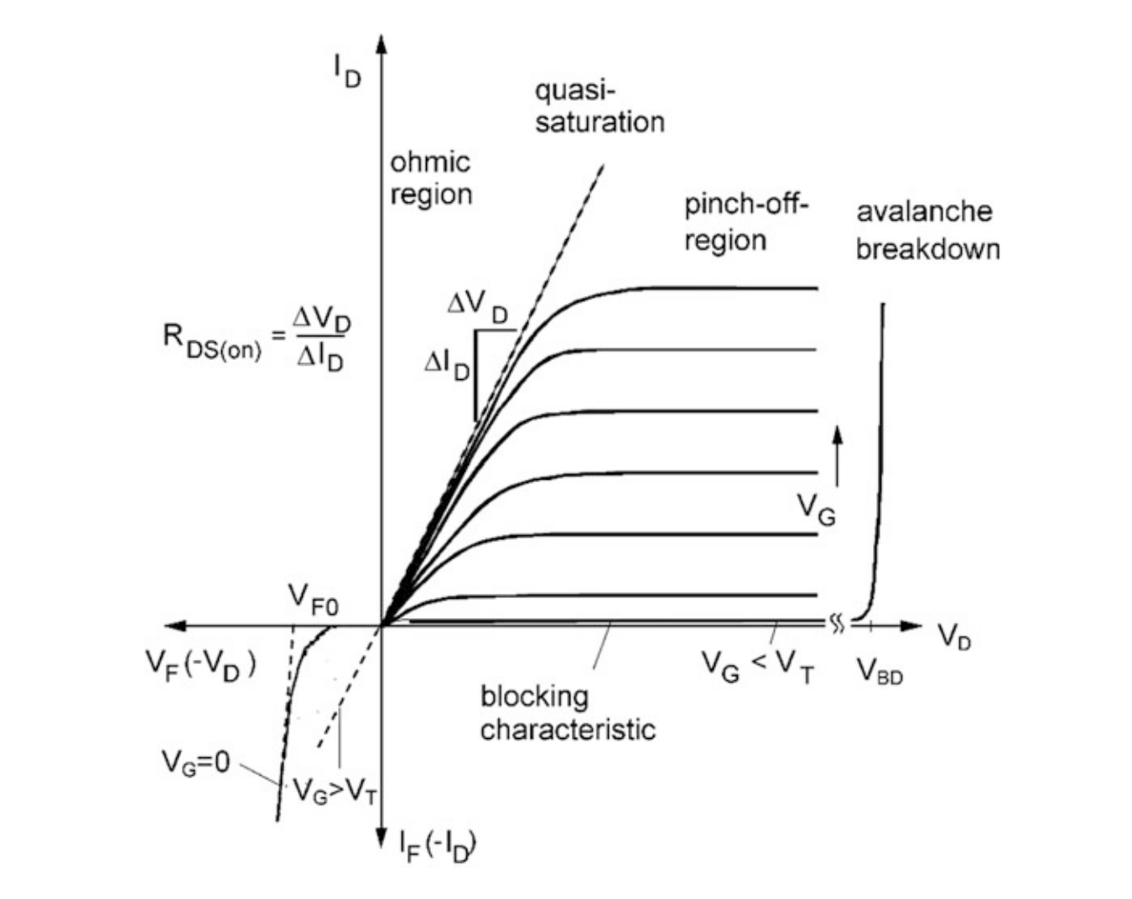
Region | VGS | VDS | ID
Cut-off | 0 | 0 | 0
Ohmic | > VT | << VGS-VT | < ID-sat
Quasi-saturation | > VT | =VGS-VT | = ID-sat
Saturation | > VT | >> VGS-VT | = ID-sat
Reverse Conduction | 0 | ~VT | = -ID
[1] Semiconductor Power Devices Physics, Characteristics, Reliability

Slide 10
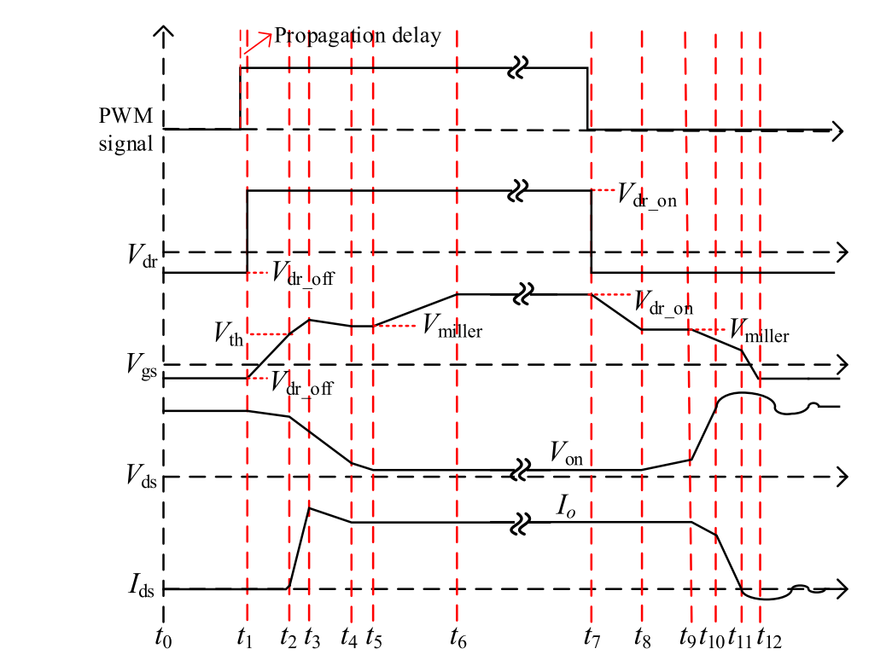
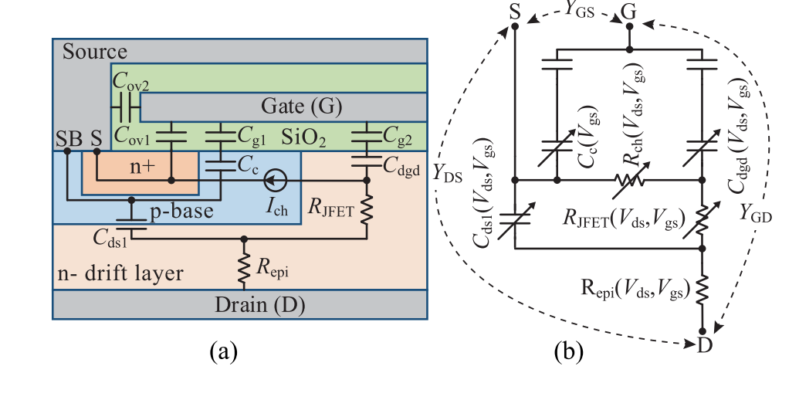
MOSFET Lumped Circuit Model with Parasitic Elements
Capacitances : Dynamic Losses
Resistances : Conduction Losses
[1] Accuracy of Three Interterminal Capacitance Models for SiC Power MOSFETs Under Fast Switching
[2] A Review of Switching Slew Rate Control for Silicon Carbide Devices Using Active Gate Drivers

Slide 11
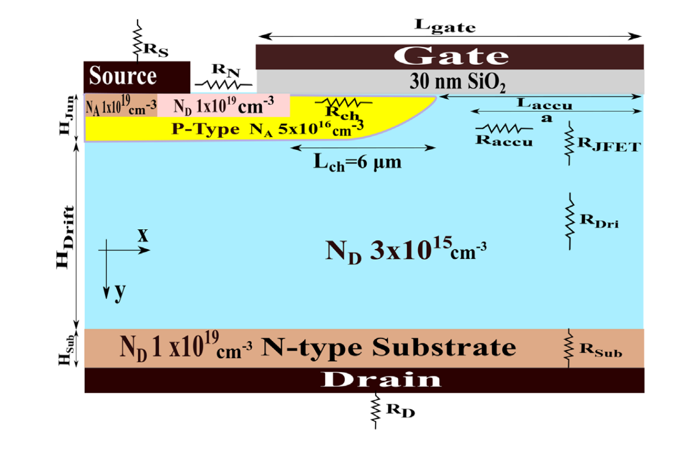
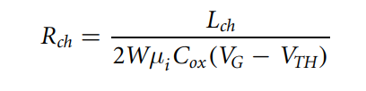
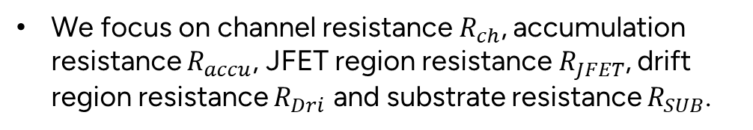
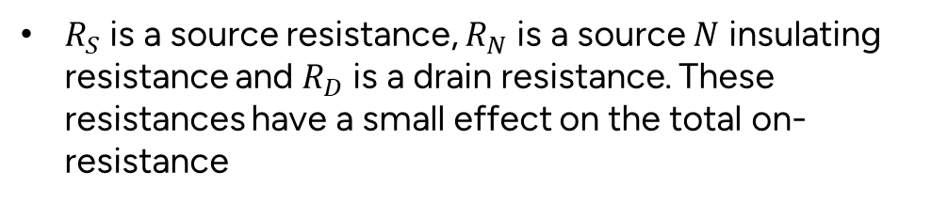
Theory : Conduction Losses
The on-resistance comprises the algebraic sum of all the relevant resistances as depicted in the figure.
$R_{S}$ is a source resistance, $R_{N}$ is a source $N$ insulating resistance and $R_{D}$ is a drain resistance. These resistances have a small effect on the total on-resistance
We focus on channel resistance $R_{ch}$, accumulation resistance $R_{accu}$, JFET region resistance $R_{JFET}$, drift region resistance $R_{Dri}$ and substrate resistance $R_{SUB}$.
$L_{ch}$ is a channel length and $W$ is a device width.
[1] Influence of temperature and dimension in a 4HSiC vertical power MOSFET

Slide 12
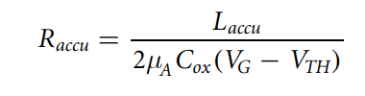
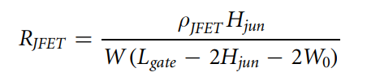
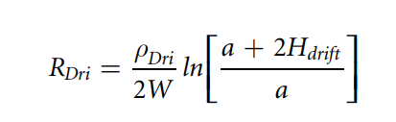

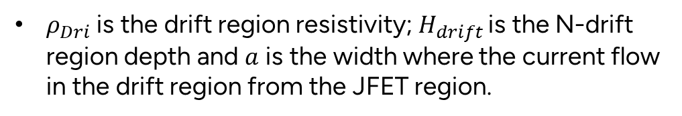
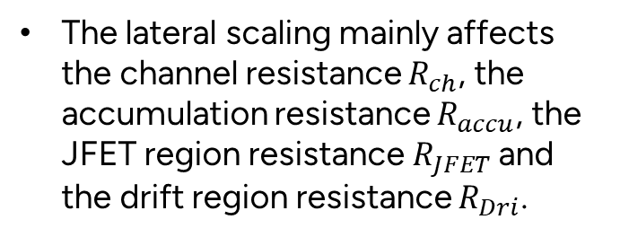
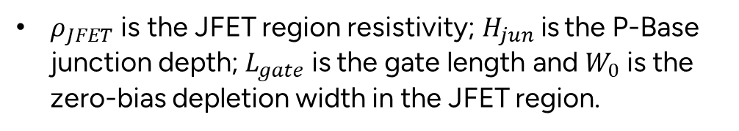
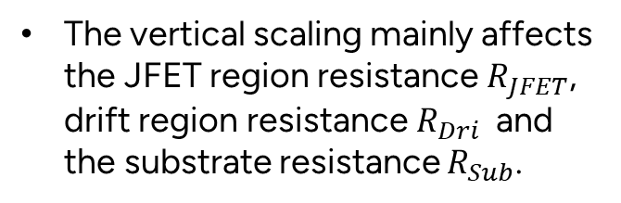

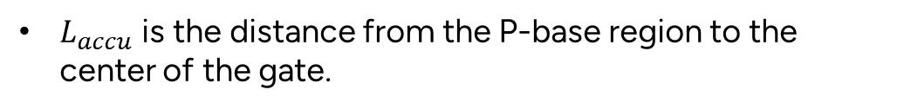
$L_{accu}$ is the distance from the P-base region to the center of the gate.
$ρ_{JFET}$ is the JFET region resistivity;$H_{jun}$is the P-Base junction depth;$L_{gate}$is the gate length and $W_{0}$ is the zero-bias depletion width in the JFET region.
The vertical scaling mainly affects the JFET region resistance $R_{JFET}$, drift region resistance $R_{Dri}$ and the substrate resistance $R_{Sub}$.
$ρ_{Dri}$ is the drift region resistivity; $H_{drift}$ is the N-drift region depth and $a$ is the width where the current flow in the drift region from the JFET region.
The lateral scaling mainly affects the channel resistance $R_{ch}$, the accumulation resistance $R_{accu}$, the JFET region resistance $R_{JFET}$ and the drift region resistance $R_{Dri}$.
$ρ_{Sub}$is the substrate resistivity and $H_{sub}$ is the substrate depth.

Slide 13
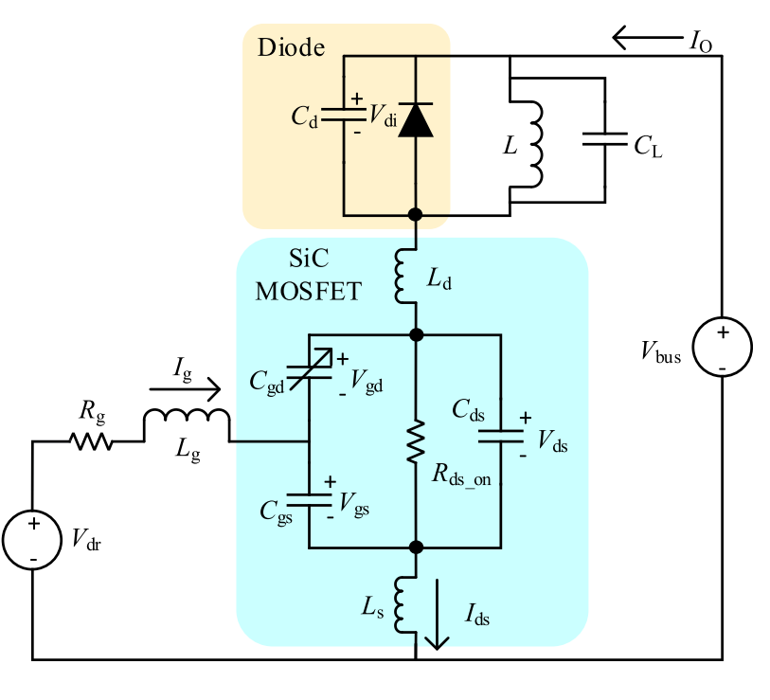
Theory : Turn-off Losses
[1] A Review of Switching Slew Rate Control for Silicon Carbide Devices Using Active Gate Drivers

Slide 14




$$t_{7}−t_{8}$$
$$t_{8}−t_{9}$$
G
G
S
metal
D
S
metal
D
oxide
oxide
n
p
-
-
-
-
-
-
-
-
-
-
-
-
-
-
-
-
-
-
-
-
-
-
-
-
n
n
-
-
-
-
-
-
-
-
-
-
-
-
-
-
-
-
n
-
-
-
-
-
-
-
-
p
-
-
-
-
depletion
+
+
+
+
+
+
+
+
depletion
+
+
+
+
+
+
+
+
+
+
+
+
depletion
+
+
+
+
+
+
+
+
depletion
+
+
+
+
+
+
+
+
+
+
+
+
+
+
+
+
+
+
+
+
+
+
+
+
+
+
+
+
+
+
+
+
+
+
+
+
+
+
+
+
+
+
+
+
+
+
+
+
+
+
+
+
Ohmic region
Quasi-saturation region
$$t_{9}−t_{11}$$
$$t_{11}−t_{12}$$
G
G
S
metal
D
S
D
oxide
metal
n
-
-
-
-
oxide
-
-
-
-
-
-
-
-
n
p
p
-
-
-
-
n
n
-
-
-
-
-
-
-
-
+
+
+
+
+
+
+
+
-
-
-
-
-
-
-
-
+
+
+
+
+
+
+
+
-
-
-
-
depletion
+
+
+
+
depletion
+
+
+
+
+
+
+
+
+
+
+
+
+
+
+
+
+
+
+
+
+
+
+
+
+
+
+
+
+
+
+
+
+
+
+
+
+
+
+
+
+
+
+
+
+
+
+
+
+
+
+
+
+
+
+
+
+
+
+
+
+
+
+
+
Saturation region
Cut-off region

Slide 15
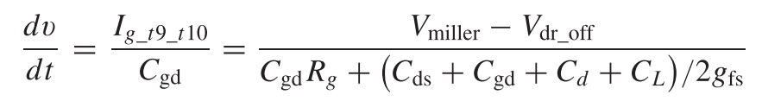
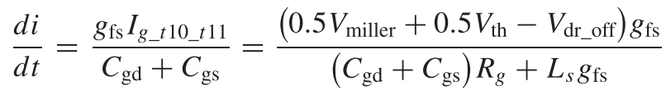
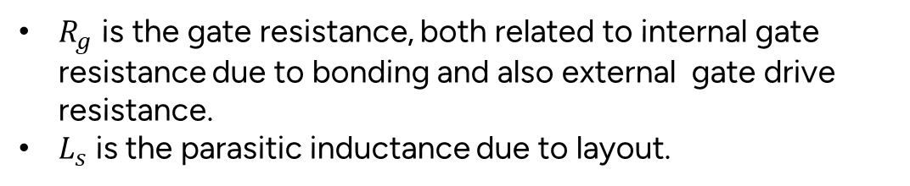

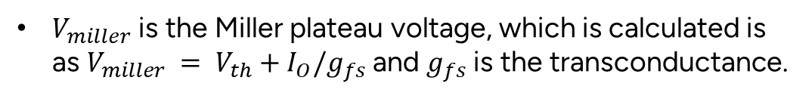
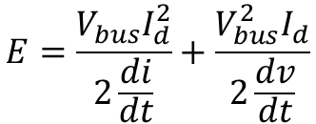

Saturation and
Quasi-saturation
Vds
Id
$$\frac{di}{dt}$$
$$\frac{dv}{dt}$$
$V_{miller}$ is the Miller plateau voltage, which is calculated is as $V_{miller} = V_{th}+I_{O}/g_{fs}$and $g_{fs}$ is the transconductance.
Ohmic
Region
Cut-off
region
$R_{g}$ is the gate resistance, both related to internal gate resistance due to bonding and also external gate drive resistance.
$L_{s}$is the parasitic inductance due to layout.
$$E=\frac{V_{bus}I_{d}^{2}}{2\frac{di}{dt}}+\frac{V_{bus}^{2}I_{d}}{2\frac{dv}{dt}}$$
[1] Analytical prediction of switching losses in MOSFETs for variable drain-source voltage and current applications
[2] A Review of Switching Slew Rate Control for Silicon Carbide Devices Using Active Gate Drivers

Slide 16
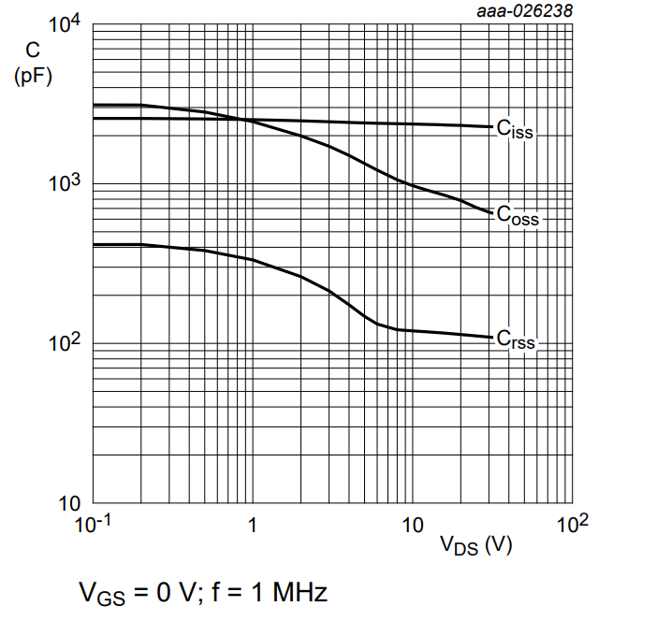
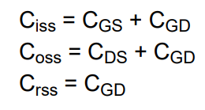
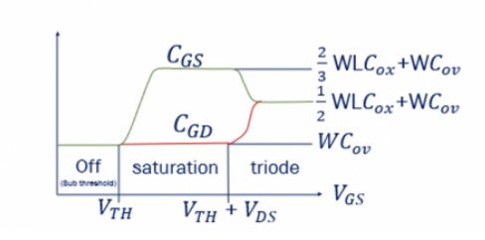
Gate-Source Capacitance (Cgs):
  Cgs is primarily influenced by Vgs, but also be minorly effected by Vds.
Gate-Drain Capacitance (Cgd):
  Cgd is predominantly dependent on the gate-source voltage (Vgs).
  However, at higher Vds, the effective Cgd can increase due to the reverse-biased pn-junction formed between the gate and drain regions.
  This increase in Cgd with Vds is often referred to as "Miller effect.“
Drain-Source Capacitance (Cds):
  The voltage-dependent capacitance arises due to the changing depletion region in the channel as a function of Vgs and Vds.
[1] AN11158 Understanding power MOSFET data sheet parameters
[2] Retrieved from ”https://rahsoft.com/2021/04/21/parasitic-capacitances-in-mos-transistor/”

Slide 17
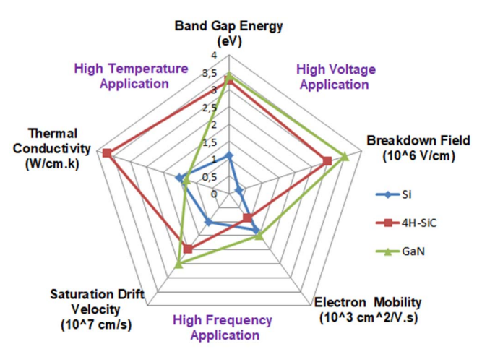
Si and SiC comparison
SiC diodes take up less space than Si for the same voltage rating
SiC has ~10x better dielectric breakdown field strength and, for a given blocking voltage, a thinner and a higher doped drift layer than silicon, giving it lower resistivity and better conduction performance.
This means a SiC die can be smaller than its silicon equivalent for the same voltage rating.
An extra benefit of having a smaller die size is lower device self-capacitance and lower associated charge for a given current and voltage rating.
This, combined with the higher electron saturation velocity of SiC, enables faster switching speeds with lower losses than Si.
[1] SIC power devices in power electronics: An overview
[2] Retrieved from ”https://efficiencywins.nexperia.com/efficient-products/8-reasons-why-silicon-carbide-diodes-outperform-their-silicon-peers#:~:text=SiC%20diodes%20take%20up%20less,resistivity%20and%20better%20conduction%20performance.”

Slide 18
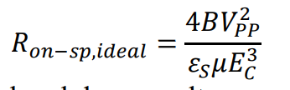
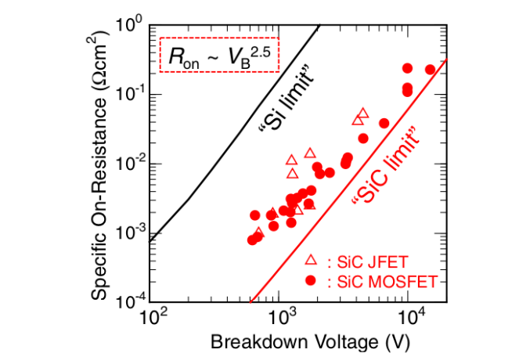
On-resistance comparison
The drift region resistance is called ideal on-resistance as can be calculated like below.
where$BV_{PP}$is the parallel-plane breakdown voltage, $ε_{S}$ is the dielectric constant for the semiconductor, $μ$ is the mobility, and $E_{c}$ is the critical electric field for breakdown.
[1] A Comparison between Si and SiC MOSFETs

Slide 19
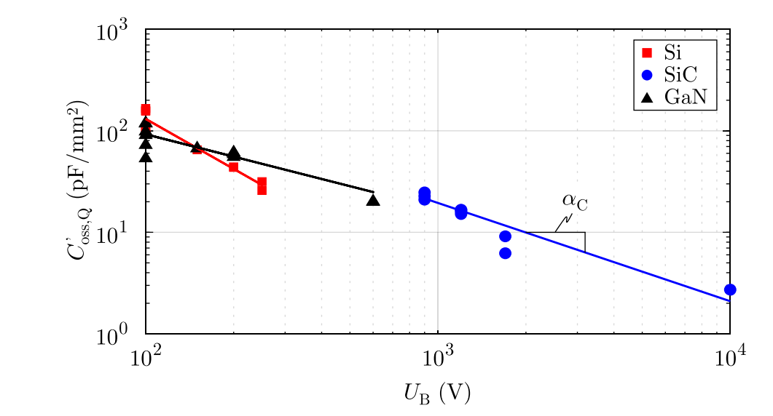
Switching Speed Comparison
Silicon Carbide (SiC) devices often have reduced parasitic capacitance because of their inherent material properties.
SiC has a wider bandgap and higher electron mobility compared to silicon (Si).
These properties result in a lower intrinsic capacitance in SiC devices, which reduces both gate-source and drain-source capacitance.
Lower capacitance leads to faster switching speeds and reduced capacitive switching losses, making SiC devices more suitable for high-frequency and high-power applications.
Specific charge-equivalent output capacitance
[1] Retrieved from ”https://www.infineon.com/dgdl/InfineonSilicon_Carbide_when_does_it_make_sense_to_switch_out_Si_for _SiC-Article-v01_00-EN.pdf?fileId=5546d462719b59230171a6dfb4a30ce0”

Slide 20
Thank you!
Question?

