Slide 2
Battery Pack
Motor
Gear Box
Battery
Modules
Battery
Modules
Traction
Inverter
Battery
Modules
Battery
Modules
Battery
Modules
Battery
Modules
On Board
Charger
Charging Plug

Slide 4
Energy Storage & Charging
Battery Pack
Battery
Modules
Battery
Modules
Power Electronics
Drivetrain
DC-Link
800V/1200V
3-Phase
AC
Shaft Power
To Drive Axle
Traction Inverter
(1.2kV / 2kV SiC)
Motor
Gear Box
Battery
Modules
Battery
Modules
DC-Link Capacitors
Liquid-Cooled Plates
On Board
Charger
Charging Plug

Slide 5
Energy Storage & Charging
Battery Pack
Battery
Modules
Battery
Modules
Power Electronics
Drivetrain
Dc-link
800V/1200V
3-Phase
AC
Shaft Power
Driven Axle
Traction Inverter
Motor
Gear Box
Battery
Modules
Battery
Modules
SiC MOSFETs
DC-Link Capacitors
Liquid-Cooled Plates
On Board
Charger
Charging Plug

Slide 6
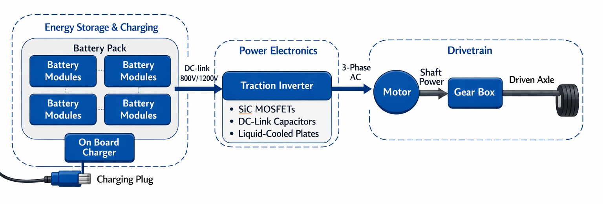
Energy Storage & Charging
Battery Pack
Power Electronics
Drivetrain
Battery
Modules
Battery
Modules
DC-link
800V/1200V
Traction Inverter
3-Phase
AC
Shaft
Power
Driven
Axle
SiC MOSFETs
DC-link Capacitors
Liquid-Cooled Plates
Motor
Gear Box
Battery
Modules
Battery
Modules
Wheels
On Board
Charger
Charging Plug

Slide 7
Energy Storage & Charging
Battery Pack
Power Electronics
Drivetrain
Battery
Modules
Battery
Modules
DC-link
800V/1200V
Traction Inverter
3-Phase
AC
Shaft
Power
Driven
Axle
SiC MOSFETs
DC-link Capacitors
Liquid-Cooled Plates
Motor
Gear Box
Battery
Modules
Battery
Modules
Wheels
On Board
Charger
Charging Plug

Slide 8
