Slide 1
PWM Losses on Motor Side
Enes Ayaz, KTH

Slide 2
Given Parameters
% Given parameters- For operating point 1
id = -224.33; % d-axis current value in A
iq = 325.97; % q-axis current value in A
vd = -138.8; % d-axis voltage value in V
vq = 94.9; % q-axis voltage value in V
Vdc= 625; % DC link voltage in V
Ld= 62.1e-6; % d-axis inductance value in H
Lq=101e-6; % q-axis inductance value in H
Torque= 600; % Torque of the motor in N.m
RPM = 3000; % Rotational speed in RPM
% Given parameters- For operating point 2
id = -118.36; % d-axis current value in A
iq = 222.25; % q-axis current value in A
vd = -198.3; % d-axis voltage value in V
vq = 175.4; % q-axis voltage value in V
Vdc= 625; % DC link voltage in V
Ld= 66e-6; % d-axis inductance value in H
Lq=146e-6; % q-axis inductance value in H
Torque= 370; % Torque of the motor in N.m
RPM = 5000; % Rotational speed in RPM

Slide 3
Modulation Parameter Calculation
d-q axis voltage waveforms
d-q axis voltage waveforms
Reverse Park and Clarke Transformation
Reverse Park and Clarke Transformation
Voltage (V)
Current (A)
Angle (rad)
Angle (rad)

Slide 4

Modulation Parameter Calculation
For operating point 1
Modulation index: 0.5381
Power factor: 0.9329
Electrical Frequency: 300.00 Hz
DC-link Voltage: 625.00 V
Peak phase current: 395.70 A
Current (A)
Voltage (V)
Time (sec)
Load calculation: 0.4143 $Ω$

Slide 5
Modulated Waveform
THPWM
SPWM
Reference Signal (p.u)
Reference Signal (p.u)
Current (A)
Time (sec)
Time (sec)
Time (sec)
Pulsated Phase Voltage (V)
Pulsated Phase Voltage (V)
Time (sec)
Time (sec)

Slide 6

Time Domain Inductance Calculation
La = Ld * sin(theta).^2 + Lq *cos(theta).^2;
Lb = Ld * sin(theta-2*pi/3).^2 + Lq *cos(theta-2*pi/3).^2;
Lc = Ld * sin(theta+2*pi/3).^2 + Lq *cos(theta+2*pi/3).^2;
Phase Inductance ($μH$)
Time (sec)

Slide 7
Phase Current Calculations- State Space
i_a= zeros(size(v_phase_a)); % phase-A time domain current vector
i_b= zeros(size(v_phase_b)); % phase-B time domain current vector
i_c= zeros(size(v_phase_c)); % phase-C time domain current vector
time=wt/2/pi/f1; % angle-to-time
sample_time=time(2)-time(1); % sample_time
for t=2:length(time)
dL_dt = (L_a(t) - L_a(t-1)) / sample_time; % Inductance change within sample time
i_a(t) = i_a(t-1) + sample_time * ((v_phase_a(t) - rs*i_a(t-1) - dL_dt * i_a(t-1)) / L_a(t)); % State-Space
dL_dt = (L_b(t) - L_b(t-1)) / sample_time; % Inductance change within sample time
i_b(t) = i_b(t-1) + sample_time * ((v_phase_b(t) - rs*i_b(t-1) - dL_dt * i_b(t-1)) / L_b(t)); % State-Space
dL_dt = (L_c(t) - L_c(t-1)) / sample_time; % Inductance change within sample time
i_c(t) = i_c(t-1) + sample_time * ((v_phase_c(t) - rs*i_c(t-1) - dL_dt * i_c(t-1)) / L_c(t)); % State-Space
end
Current (A)
Time (sec)
Including common mode current since it is solved in a single phase equivalent circuit

Slide 8
Differential mode current and reconstructing dq axis current
Park and Clarke Transformation
q-axis current
Current (A)
Current (A)
d-axis current
Time (sec)
Time (msec)

Slide 9





Different Switching Frequencies
$$30 kHz$$
$$25 kHz$$
$$20 kHz$$
$$15 kHz$$
$$10 kHz$$

Slide 10
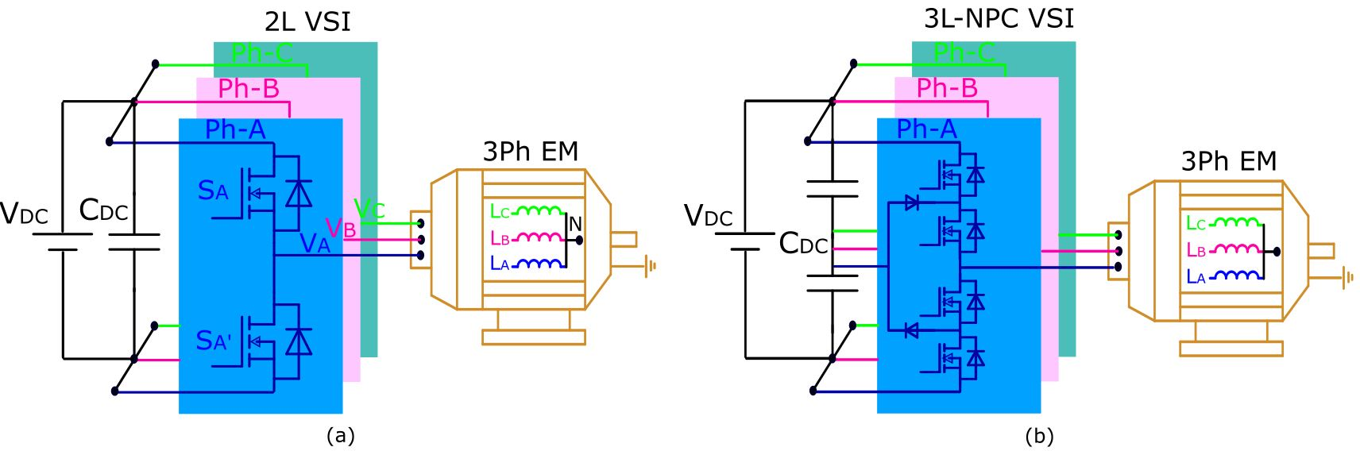
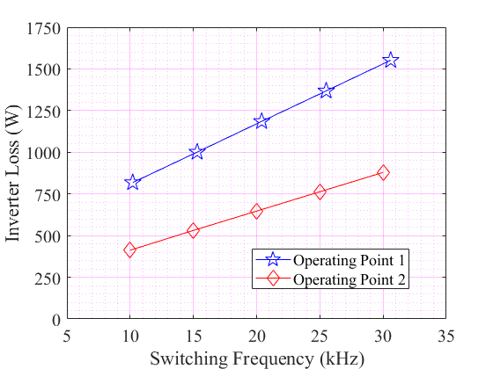
Inverter Losses

