Slide 1
Mitigation of CMV and Bearing Currents
Enes Ayaz
First Draft : 2023.06.01

Slide 2
CM Filter and Motor Shaft Grounding Ring
Paper title: Investigation and Mitigation of Premature Bearing Degradation in Motor Drive System, IEEE Electromagnetic Compatibility Magazine, 2019
Although there are several main mitigation methods for bearing degradation problem such as soft switching technology or advanced PWM techniques, CM filter, insulated motor bearing, shaft grounding ring and Faraday shield ; shaft grounding brush or CM filter are preferred, as they do not require major modifications to the machines and therefore they are more cost effective.

Slide 3
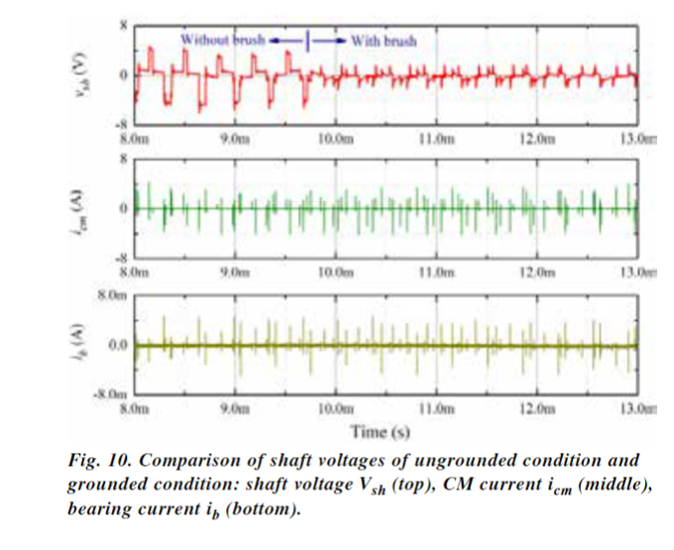
SHAFT GROUNDING BRUSH
The grounding brush provides a low impedance path in parallel with the bearing lubrication film.
Thus, peak-to-peak shaft voltage drops from more than 8 V to less than 2 V at the instant when the brush touches the rotating shaft.
Therefore, EDM process can be prevented.
The grounding brush helps to prevent bearing degradation caused by the EDM bearing current but has no impact on the CM current, which can be as high as tens of amperes in high power machines.
It is reported that in a 500-kW machine, the bearing current induced by CM current can reach as high as 5 A peak-to-peak.
(How much current flows in our motor????)

Slide 4
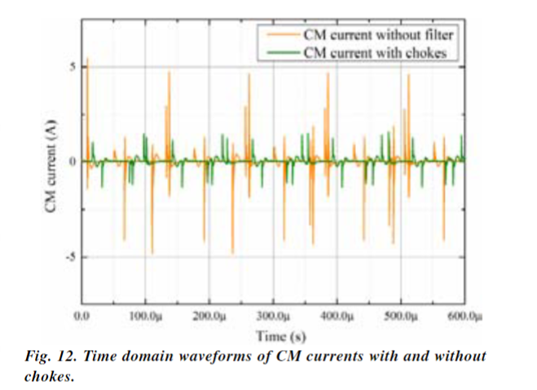
CM FILTER
Usually, several one-turn CM chokes are necessary to provide high inductance.
CM chokes with nanocrystalline core are selected because of their high permeability, high saturation flux density and low core loss.

Slide 5
Brushless Mitigation
Paper title: Brushless Mitigation of Bearing Currents in Electric Machines Via Capacitively Coupled Shunting, IEEE TRANSACTIONS ON INDUSTRY APPLICATIONS, , 2015
Although common solutions include insulating the bearings, installing common-mode filters, or using a brush to ground the rotor shaft, these solutions are not universally scalable and may require periodic maintenance.
Therefore, noncontact (brushless) capacitive coupling is proposed.
Generally speaking, smaller machines experience wear due to bearing currents of the electrostatic discharge currents (EDCs) , whereas larger machines experience the circulating bearing currents and rotor ground currents.

Slide 6
EXISTING BEARING CURRENT MITIGATION SOLUTION
1. Brushes:
A grounded brush forms a sliding contact on the rotor of the machine.
This contact possesses lower electrical impedance than the bearings, thus bearing cur-rents are shunted around the bearings safely and the bearing voltage is driven toward zero.
Brushes make physicalcontact with the rotor, and most experience mechani-cal wear that requires periodic maintenance.
2. Bearing Insulator:
Electrical insulation in the path that bearing currents flow are typically either in insulated bearing mounts or bearings with insulating balls and/or races.
a common approach for smaller machines is ceramic bearings.
The drawback of this system is the higher purchase price for ceramic bearings, and the retrofit of existing/deployed systems is difficult without significant effort
3. Line Filters
An electrical line filter may be placed on the terminals of the electric machine to filter common-mode voltages and reduce dv/dt at the terminals.
Line filters can be expensive and bulky, deterring their deployment in many application.

Slide 7
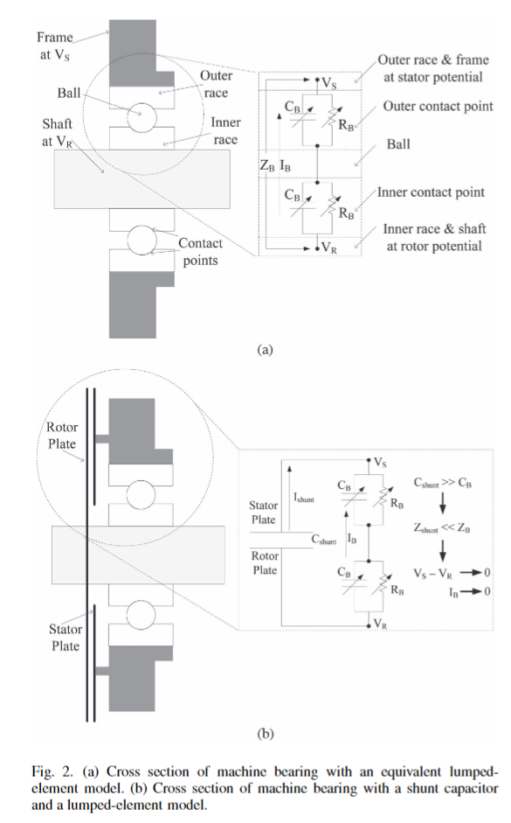
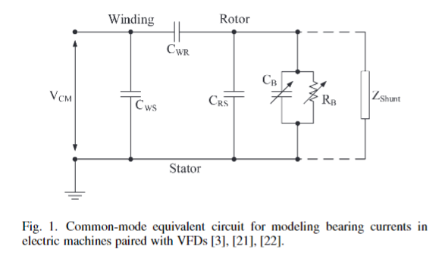
PROPOSED CAPACITIVE COUPLING APPROACH
To mitigate IB, the bearing voltage VB must be driven toward zero. A rotating capacitor placed in parallel with the bearing can accomplish this, i.e.,Zshunt is a capacitor.
A rotating capacitor may take one of two forms 1) a series of parallel plates/disks or 2) concentric hoops/cylinders. In both configurations, the surfaces must be close enough together and of sufficient surface area to provide significant capacitance.

Slide 8
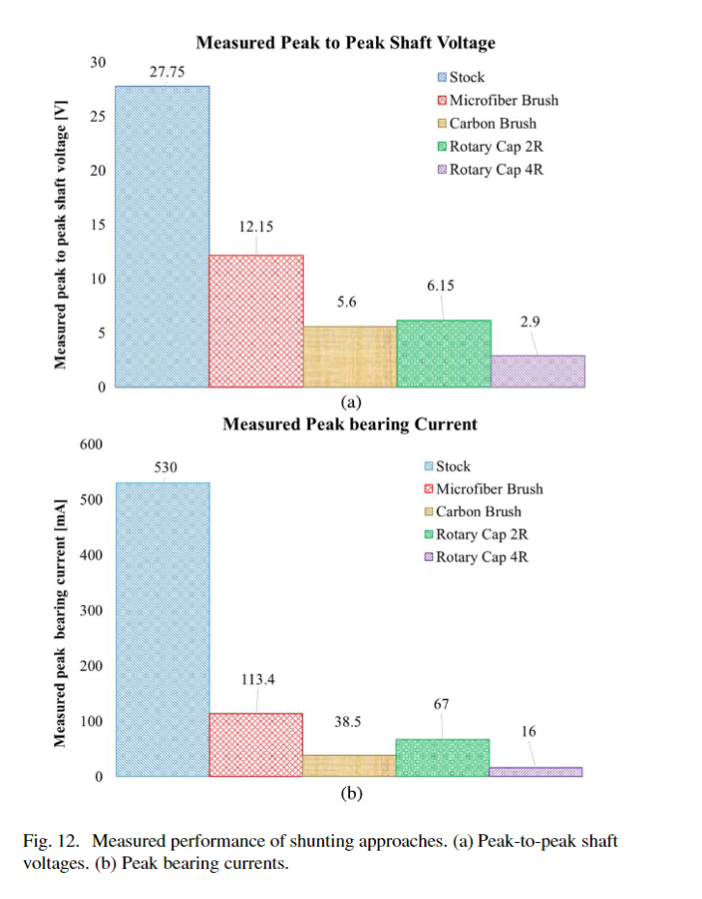
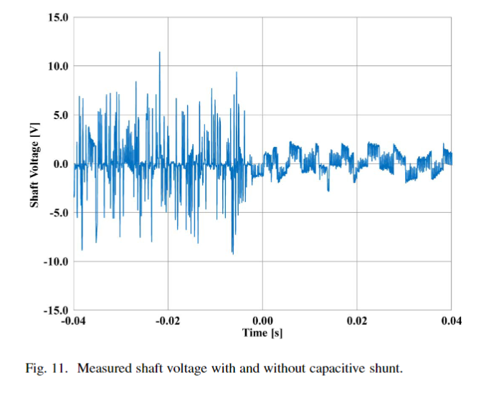
PROPOSED CAPACITIVE COUPLING APPROACH

Slide 9
Common-Mode Voltage and Vibration Mitigation
Paper title: Common-Mode Voltage and Vibration Mitigation ofa Five-Phase Three-Level NPC Inverter-FedInduction Motor Drive System, IEEE JOURNAL OF EMERGING AND SELECTED TOPICS IN POWER ELECTRONICS, 2015
The space vector pulse width modulation (SVPWM) technique is developed for the elimination of CM voltages. Only those switching states are selected which give zero CM voltage.
The same selected switching states also give the balanced dc link capacitor voltages.
The authors have shown that three-level inverter gives better performance (low stress to motor winding, less influence of noise to the adjacent equipment, low shaft voltage, and bearing current. etc.) when compared with its two-level counterpart.

Slide 10
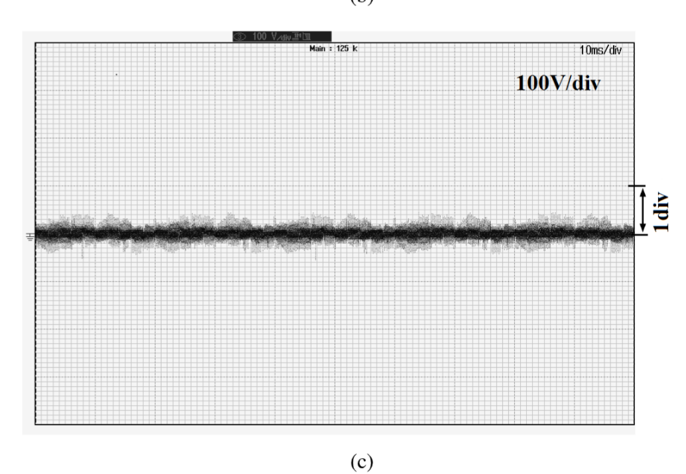
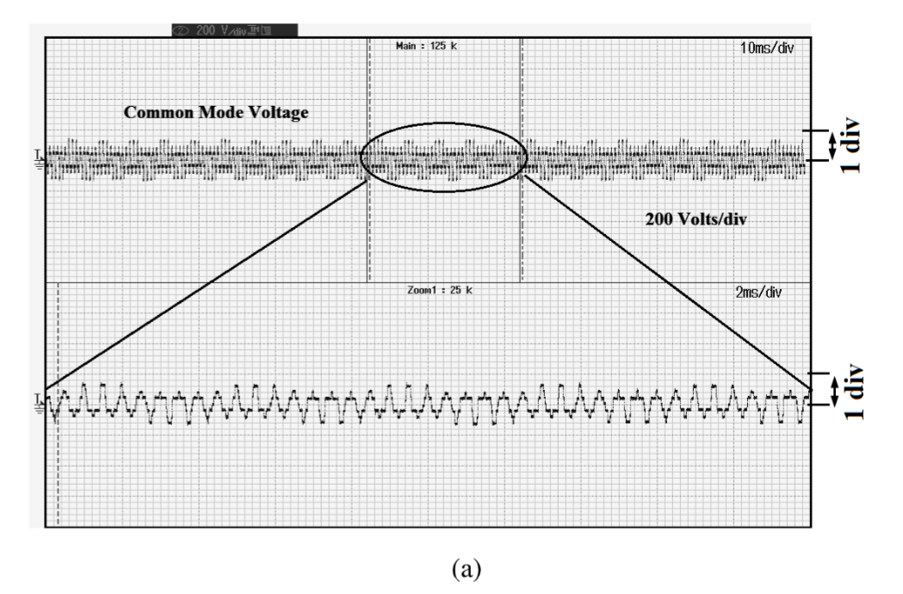
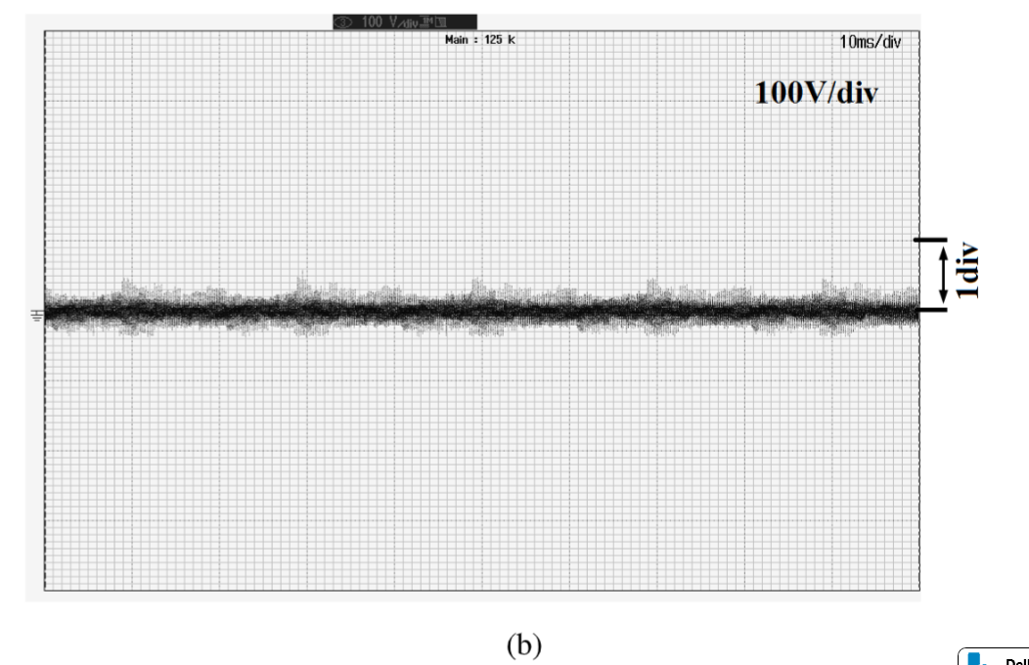
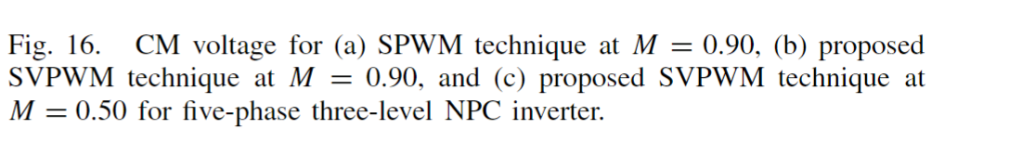
CM Voltage Elimination
The solution is to select only those switching states which give zero CM voltage.
For example, for a five-phase three-level inverter, out of 35(243) states, only 53 switching states give zero CM voltage.
Since, in the proposed SVPWM technique the voltage vectors with above two types of switching states are being used, the balanced dc link voltages are ensured for the entire switching cycle

Slide 11
Improved Topology
Paper title: Fourth-Arm Common-Mode Voltage Mitigation, IEEE TRANSACTIONS ON POWER ELECTRONICS, 2016
An active method for eliminating CMV in multilevel inverters which is independent on the inverter topology or its modulation scheme.
The proposed method does not restrict the modulation index range of the drive.
Special mechanical modifications have been suggested to mitigate the negative effect of CMV over motor bearing. Shaft ground brushes, conductive grease, and insulated bearings are one example of such an approach. While motor mechanical modifications are quite effective, they require high maintenance and impair motor standard.
Reduced CMV (RCMV) PWM schemes are another approach. These schemes attenuate CMV by avoiding zero-state space-vectors. The main advantage of RCMV-PWM methods is that they do not require additional hardware and/or motor structure modification. The disadvantages are reduced voltage utilization, increased over-voltages , low space-vector redundancy which could limit dc-link capacitor voltage balancing, and impracticability when dead-time is considered.
Passive methods are another approach. These methods generally involve common-mode (CM) inductors, CM transformers, and additional passive RLC elements. Passive CM filters involve large size and weight penalties.
Active and topological solutions are abundantly found.

Slide 12
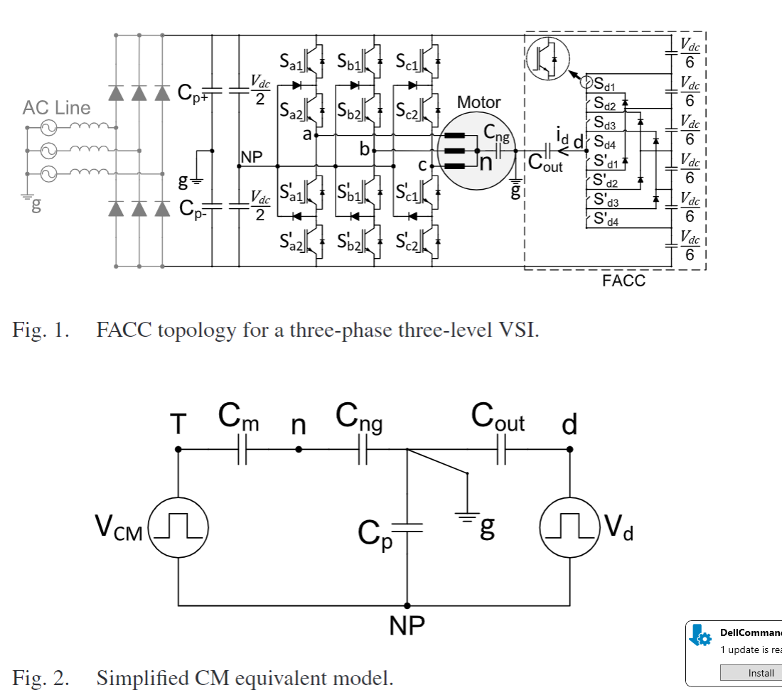
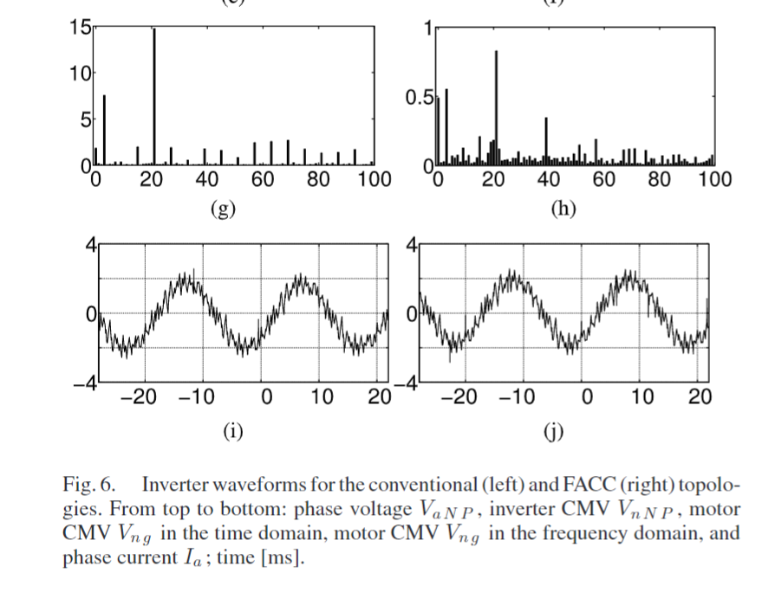
The Proposed Methodology
1)Small Cout will result in a small FACC output current,which will lead to low power ratings of the FACC
2) on the other hand, a large Cout will result in a voltage drop over the stray capacitor Cp nearly equal to Vd. As a result,a good mitigation of motor CMV will be provided.

Slide 13
Improved Topology
Paper title: Reduction of Common Mode Voltage and Conducted EMI Through Three-PhaseInverter Topology, IEEE TRANSACTIONS ON POWER ELECTRONICS-Letter, 2017
Instead of using filters, active or passive, or specific pulse width modulated (PWM) techniques to reduce the CM voltage, the pro-posed topology has inherently less CM voltage generation.
With the addition of two switches placed in series on the dc lines, this topology effectively reduces the CM voltage during zero switching states by “floating” the inverter from the dc source.
It can be implemented with any PWM method

Slide 14
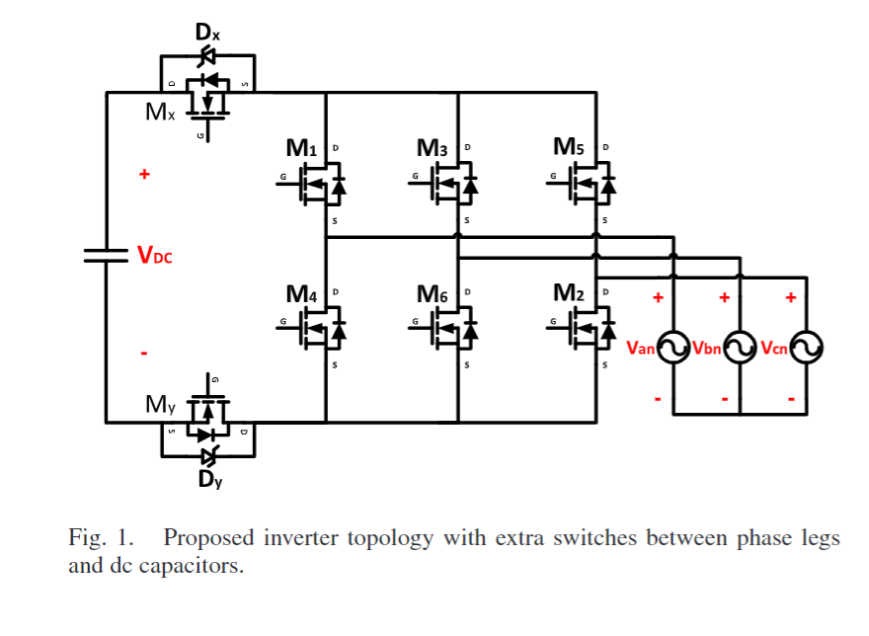
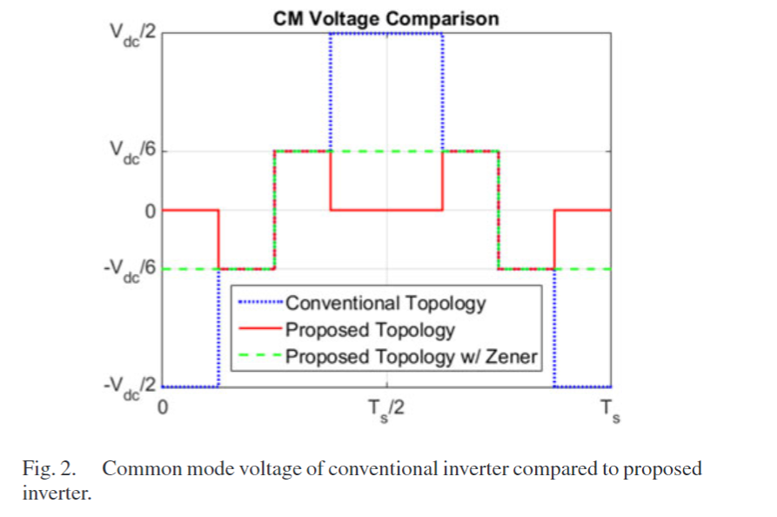
The Proposed Methodology
It is also important to understand the impact on efficiency that the introduction of the extra switches (series) has compared to the conventional inverter.

Slide 15
Motor Side Solution
Paper title: Mitigation Method of the Shaft Voltage According to Parasitic Capacitance of the PMSM, IEEE TRANSACTIONS ON INDUSTRY APPLICATIONS, 2017
The rotor-to-winding is determined as an appropriate parameter to mitigate the shaft voltage among the parasitic capacitances, because it affects the shaft voltage and does not affect the output torque.
In case of the ball bearing capacitance (Cb), it is a critical component for the shaft voltage. However, Cb is not considered as a mitigation parameter because standard of industrial bearings is fixed according to size.

Slide 16
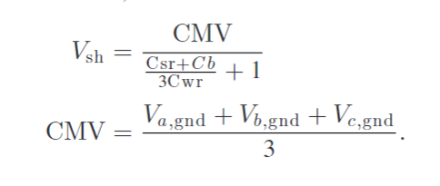
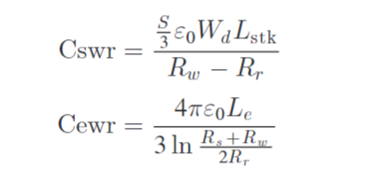
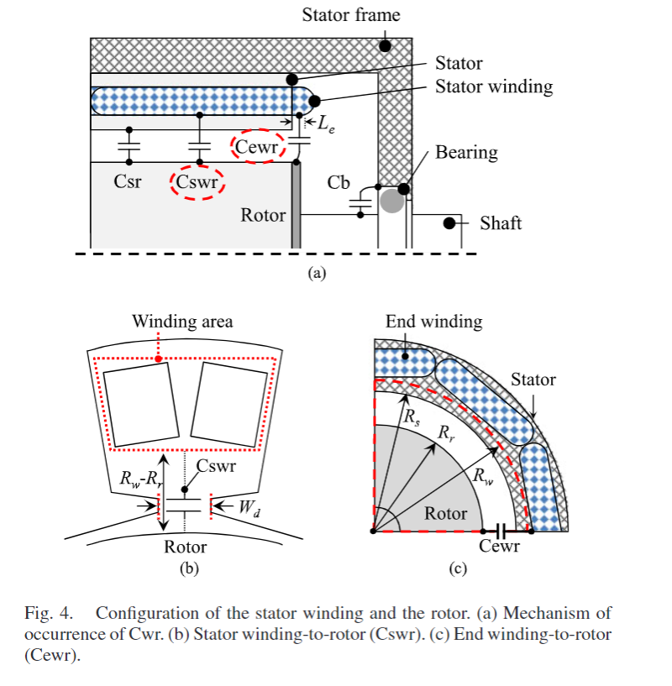
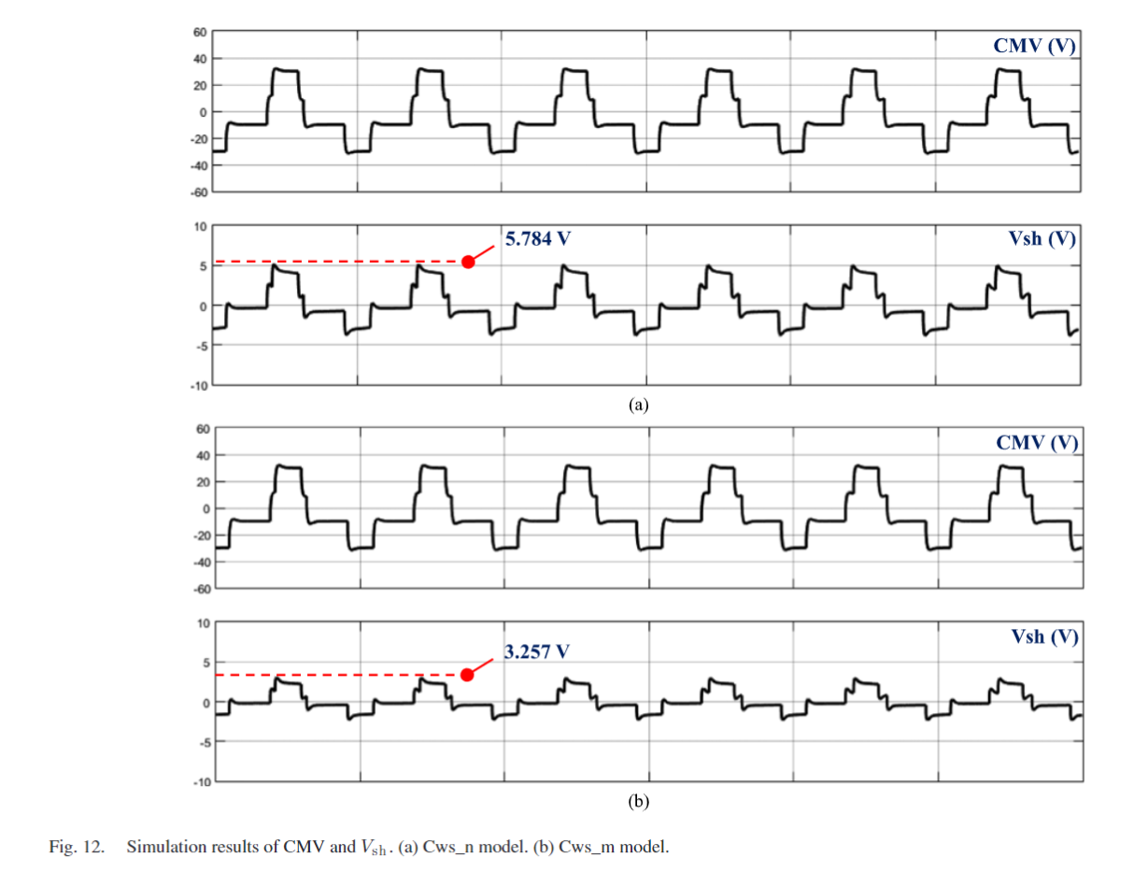
The Proposed Methodology

Slide 17
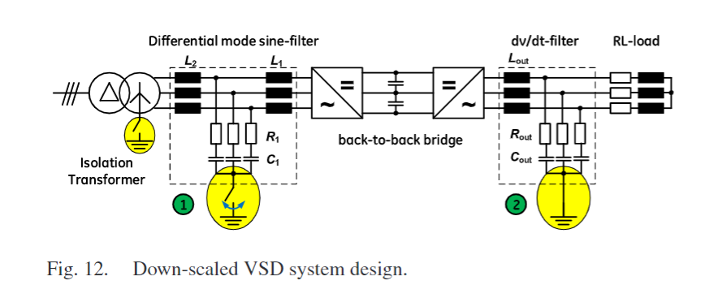
Grounding Concept and Common-Mode Filter
Paper title: Grounding Concept and Common-Mode Filter Design Methodology for Transformerless MV Drives to Prevent Bearing Current Issues, IEEE TRANSACTIONS ON INDUSTRY APPLICATIONS, 2017
Electric Discharge current
Induced Circulating Bearing Currents

Slide 18
Motor Side Solution
Paper title: Shaft-to-Frame Voltage Mitigation Method by Changing Winding-to-Rotor Parasitic Capacitance of IPMSM, IEEE TRANSACTIONS ON INDUSTRY APPLICATIONS, 2019
Among all parasitic capacitances, winding-to-rotor parasitic capacitance has the greatest effect on the shaft-to-frame voltage, which means the winding-to-rotor parasitic capacitance must be suppressed for noticeable mitigation of the shaft-to-frame voltage.
First, the modified windingshape is utilized for the suppression of stator winding-to-rotor ca-pacitance.
Second, a copper shield is applied to suppress the endwinding-to-rotor parasitic capacitance.

Slide 19
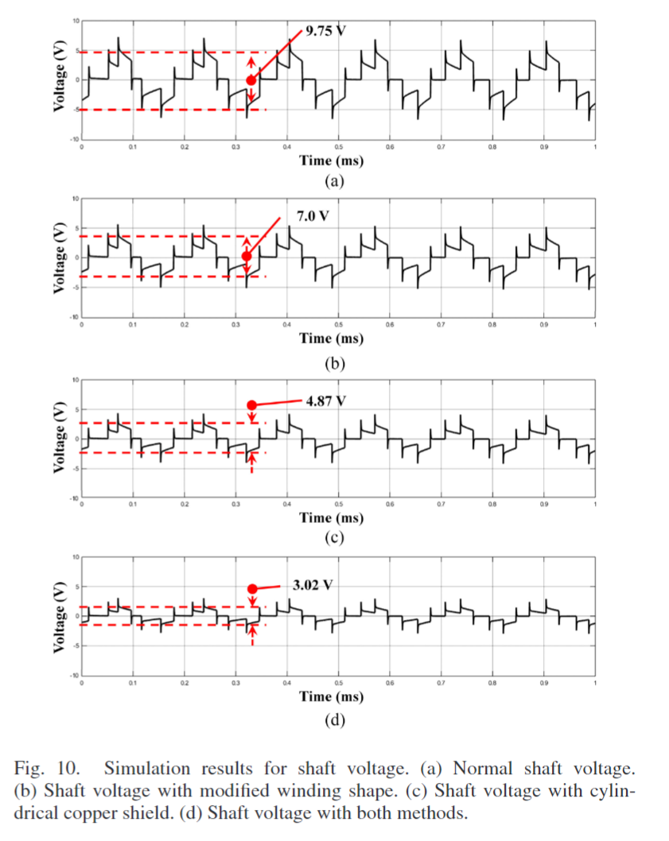
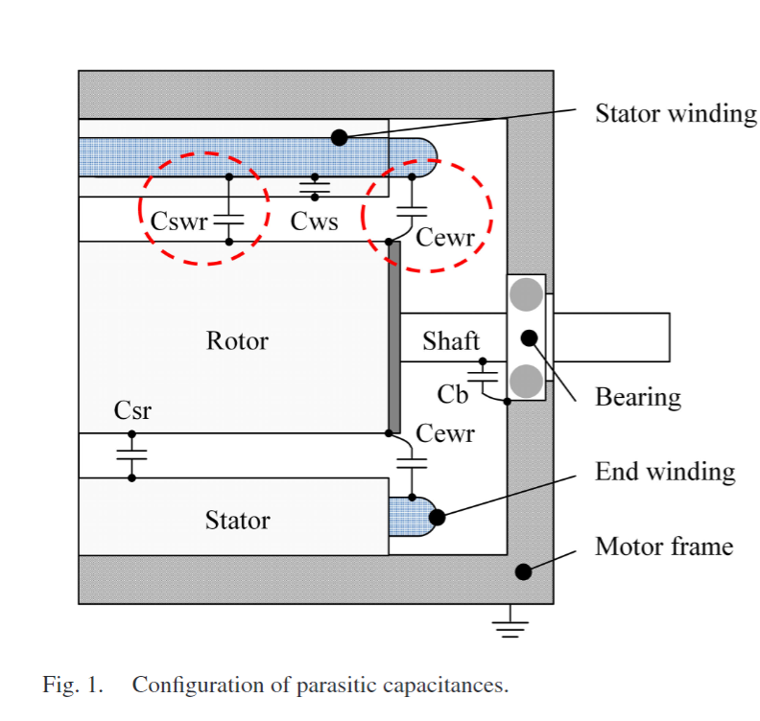
The Proposed Methodology

Slide 20
Dual Three-Phase VSI Inverter
Paper title: Common-Mode Voltage Mitigation of Dual Three-Phase Voltage Source Inverters in a Motor Drive Application, IEEE ACCESS, 2021

Slide 21
The Proposed Methodology

