Slide 1
Modulation Functions
(Carrier-based)
VSC/modlab
2L
3L-NPC
mod_2lcarr
mlspwm
Inputs | Outputs
ma | s
pn | wt (optional)
npoints | carr (optional)
carrtype (optional) | ref (optional)
smp (optional)
cmode (optional)
theta0 (optional)
thetac (optional)
start (optional)
end (optional)
ma0 (optional)
Inputs | Outputs
ma | s
p | wt (optional)
nlev | carr (optional)
theta0 | ref (optional)
npts | slev (optional)
type
opt
thetac (optional)
scale (optional)
offset (optional)

Slide 2
mod_2lcarr
ma : modulation index
pn : pulse number (carrier to fundamental ratio fc/f0)
npoints: number of sampling points during fundamental signal (determine the time steps)
carrytype: Type of carrier signal (two options)
        'sawp' : sawtooth carrier with positive slope
        'tria' : triangular carrier (default)
smp: (optional) reference sampling mode (three options)
        'ns' : natural sampling (default)
        'rs' : regular symmetric sampling
        'ra' : regular asymmetric sampling
cmode: (optional) reference common-mode component for three-phase systems
        'none' : No common mode (default)
        'tri4' : One fourth third harmonic
        'tri6' : One sixth third harmonic
theta0: (optional) reference phase offset
thetac: (optional) carrier phase offset
start: (optional) reference angle to start with (default=0)
end: (optional) reference angle to end with (default=2pi)
ma0: (optional) DC reference (default =0)

Slide 3
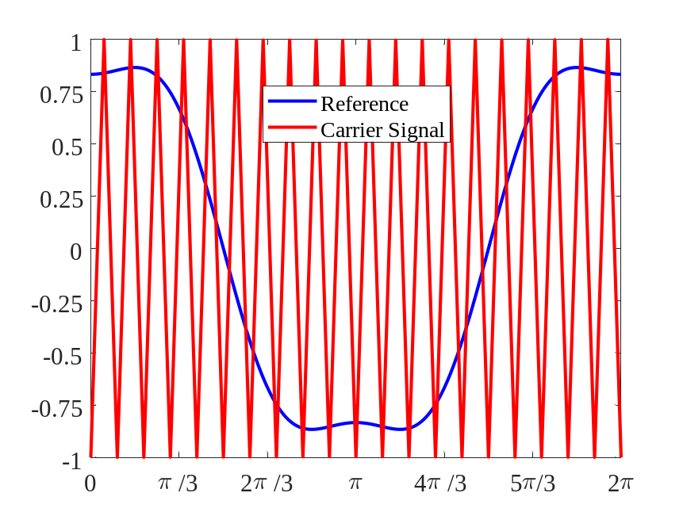
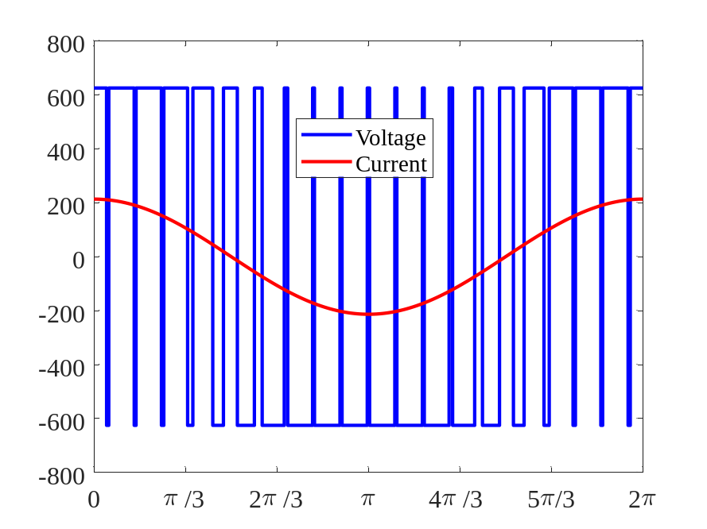
mod_2lcarr
s: Pwm pattern during fundamental cycle
wt: (optional) phase angle vector corresponding to s
carr: (optional) carrier signal vector
ref: (optional) reference signal vector

Slide 4
mlspwm
ma : modulation index
p : pulse number (carrier to fundamental ratio fc/f0)
nlev: number of levels
theta0: reference phase offset
npts: number of sampling points during fundamental signal (determine the time steps)
type: Type of modulation
        'pcs' -> Phase shifted carriers
        'pc2' -> M2LC phase shifted carriers
        'sc1' -> Stacked carriers with equal phase 'PD'
        'sc2' -> Stacked carriers with alternative phase opposition 'APOD'
        'sc3' -> Stacked carriers with phase opposition 'POD'
opt: (optional) reference common-mode component for three-phase systems
        'none' : No common mode (default)
        ’3rd1' : One sixth third harmonic
thetac: (optional) carrier phase offset
scale: (optional)
offset: (optional)
carrmod: (optional)

Slide 5
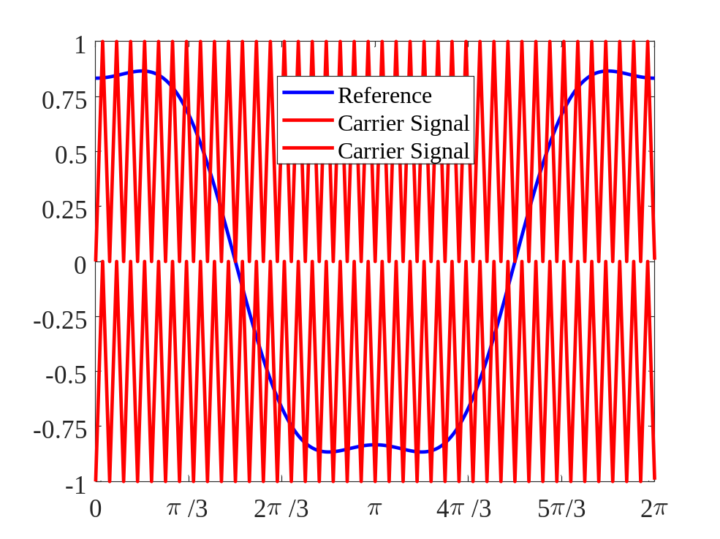
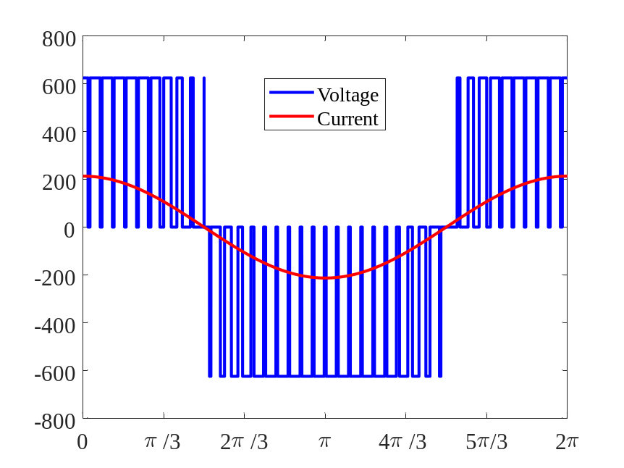
mlspwm
stot: Pwm pattern during fundamental cycle
wt: (optional) phase angle vector corresponding to s
carr: (optional) carrier signal vector
ref: (optional) reference signal vector

