Slide 1


STATE SPACE OF GaN

Slide 2
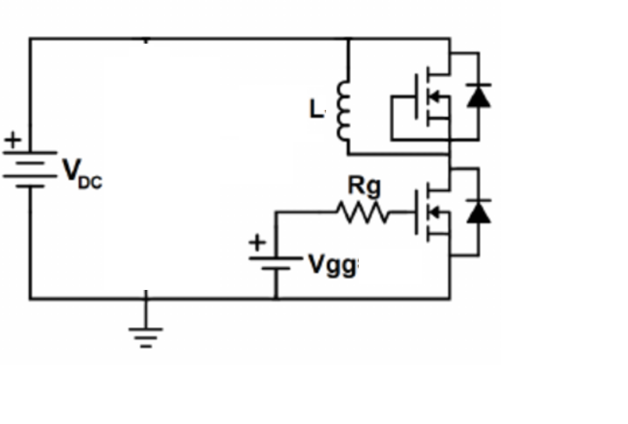
Double Pulse Test

Slide 3

Former Code and Results

Slide 4
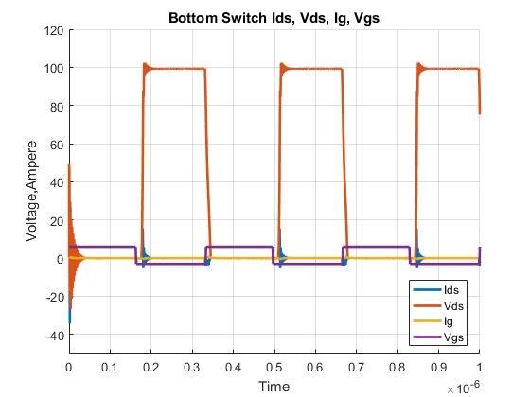
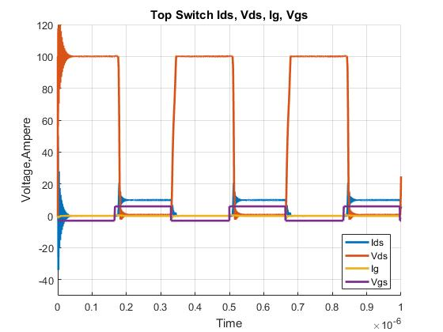
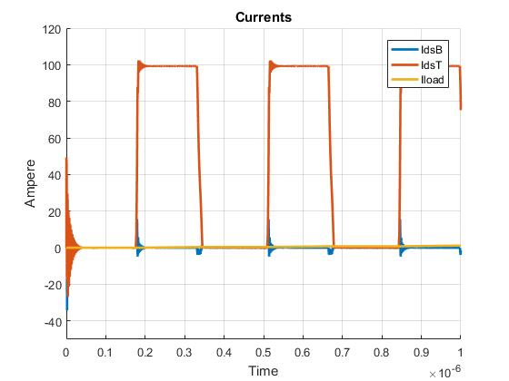

Slide 5

Now

Slide 6
