Slide 1
Three Level Boost Converter (Interleaved) Five Level Boost Converter (Phase-shifted switch)

Slide 2
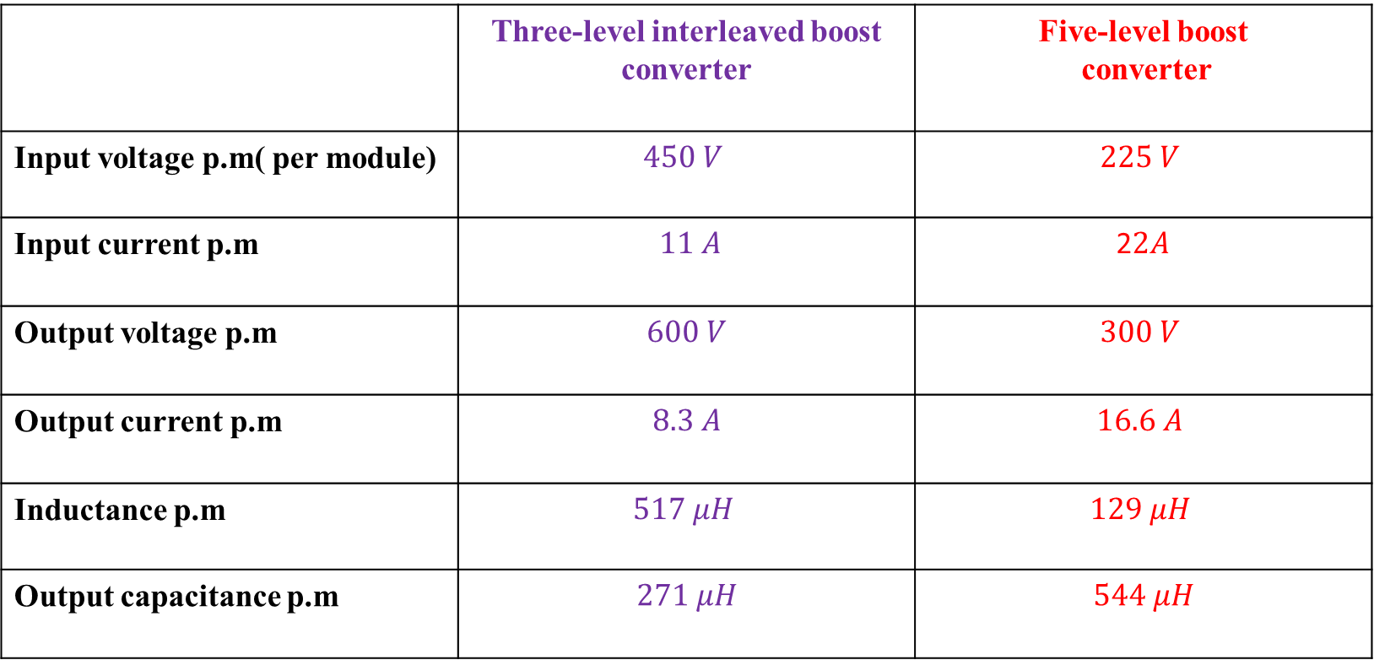
 | Three-level interleaved boost converter | Five-level boost converter
Input voltage p.m( per module) | $$450 V$$ | $$225 V$$
Input current p.m | $11 A$ | 2$2A$
Output voltage p.m | $$600 V$$ | $$300 V$$
Output current p.m | $$8.3 A$$ | $$16.6 A$$
Inductance p.m | $$517 μH$$ | $$129 μH$$
Output capacitance p.m | $$271 μH$$ | $$544 μH$$

Slide 3
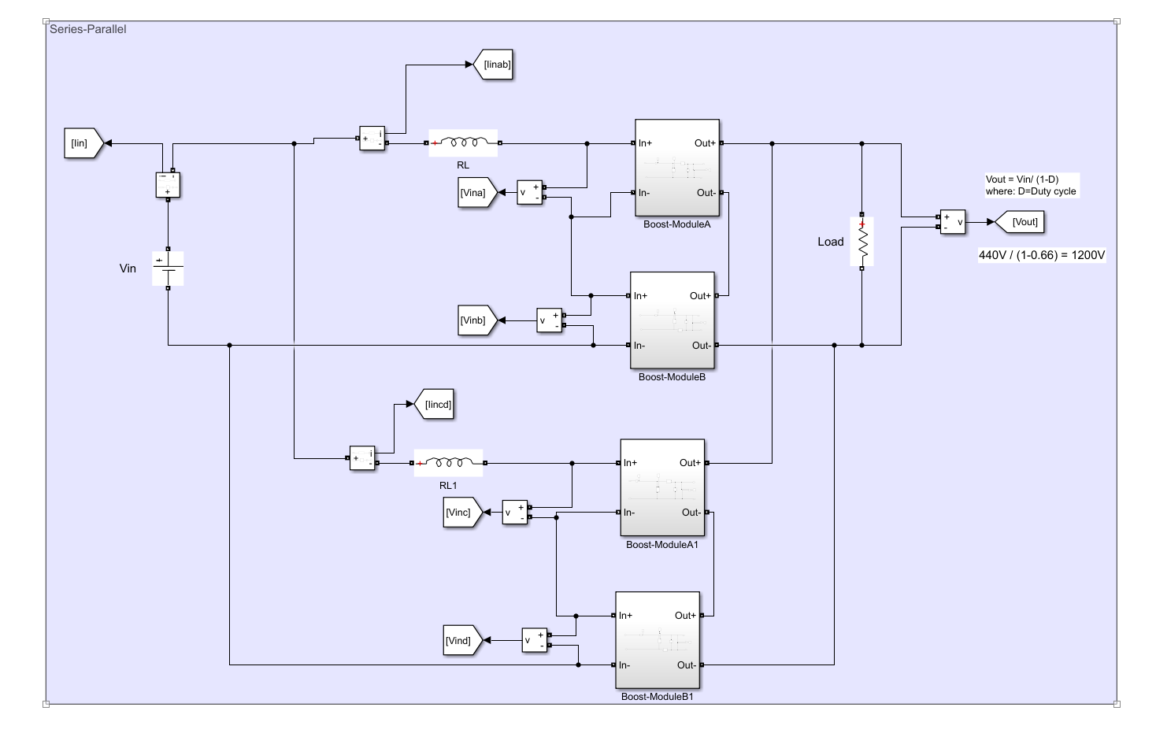

Slide 4
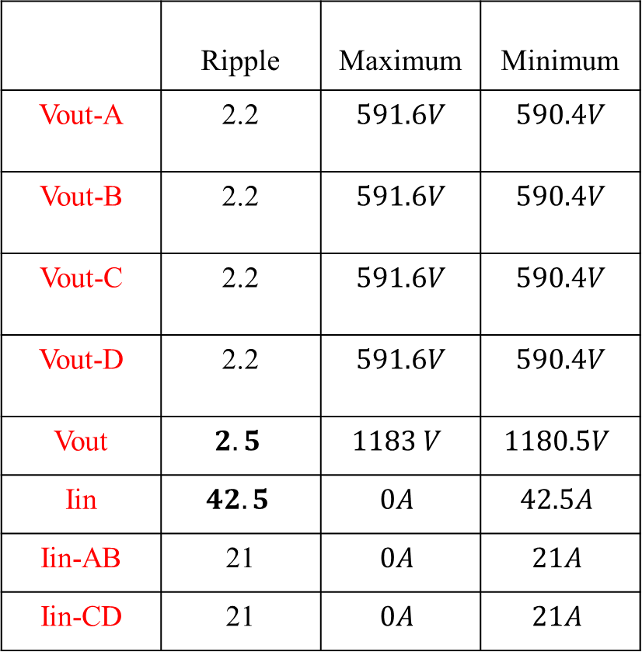
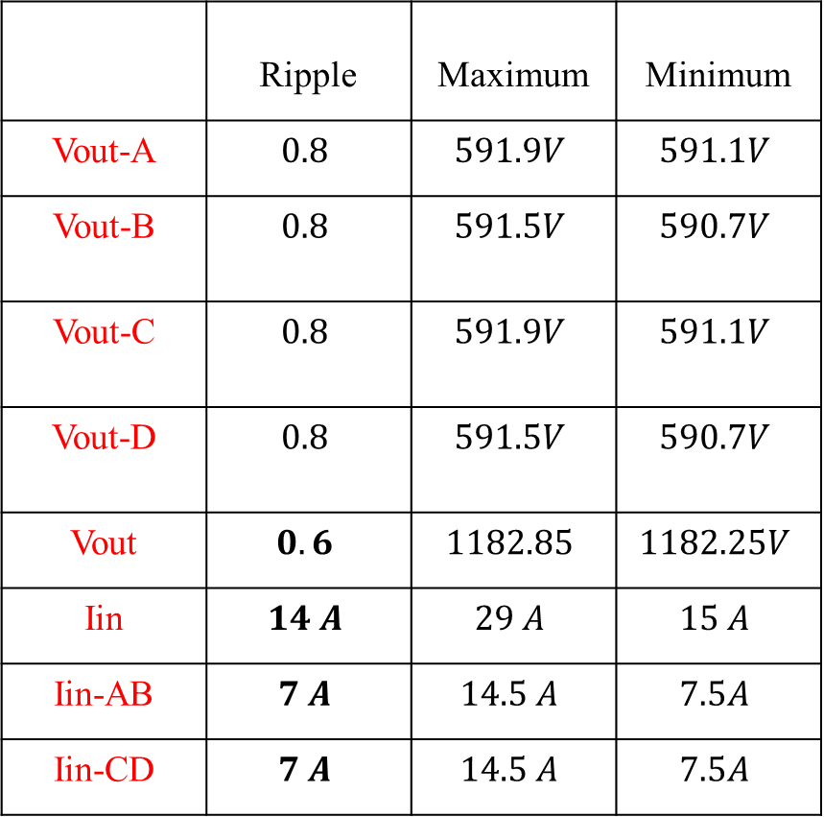
Three-level interleaved boost converter
W/O phase-shift (0-0-0-0)
W phase-shift (0-180-0-180)
 | Ripple | Maximum | Minimum
Vout-A | 2.2 | $$591.6V$$ | $$590.4V$$
Vout-B | 2.2 | $$591.6V$$ | $$590.4V$$
Vout-C | 2.2 | $$591.6V$$ | $$590.4V$$
Vout-D | 2.2 | $$591.6V$$ | $$590.4V$$
Vout | $$2.5$$ | $$1183 V$$ | $$1180.5V$$
Iin | $$42.5$$ | $$0A$$ | $$42.5A$$
Iin-AB | 21 | $$0A$$ | $$21A$$
Iin-CD | 21 | $$0A$$ | $$21A$$
 | Ripple | Maximum | Minimum
Vout-A | $$0.8$$ | $$591.9V$$ | $$591.1V$$
Vout-B | $$0.8$$ | $$591.5V$$ | $$590.7V$$
Vout-C | $$0.8$$ | $$591.9V$$ | $$591.1V$$
Vout-D | $$0.8$$ | $$591.5V$$ | $$590.7V$$
Vout | $$0.6$$ | $$1182.85$$ | $$1182.25V$$
Iin | $$14 A$$ | $$29 A$$ | $$15 A$$
Iin-AB | $$7 A$$ | $$14.5 A$$ | $$7.5A$$
Iin-CD | $$7 A$$ | $$14.5 A$$ | $$7.5A$$

Slide 5
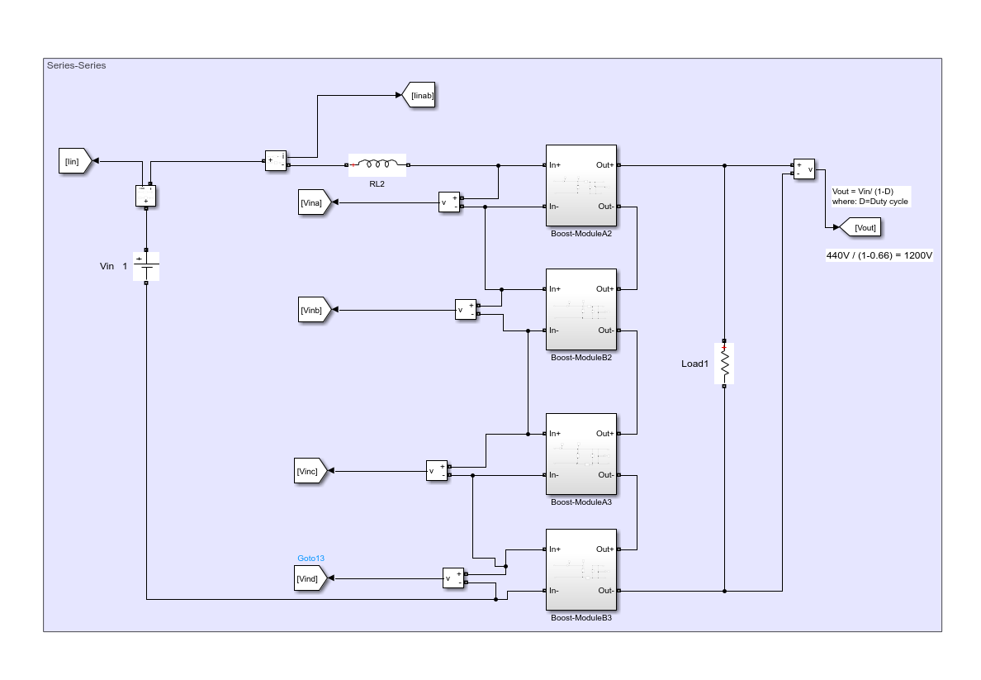

Slide 6
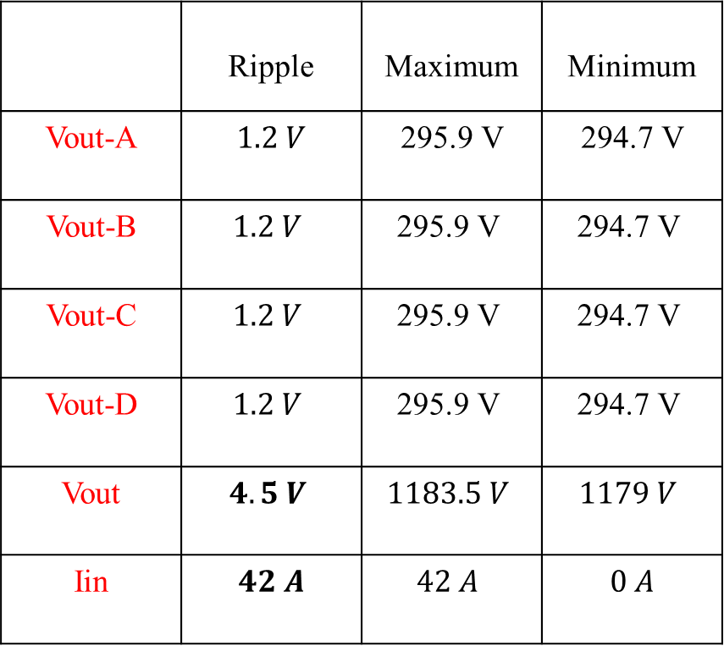
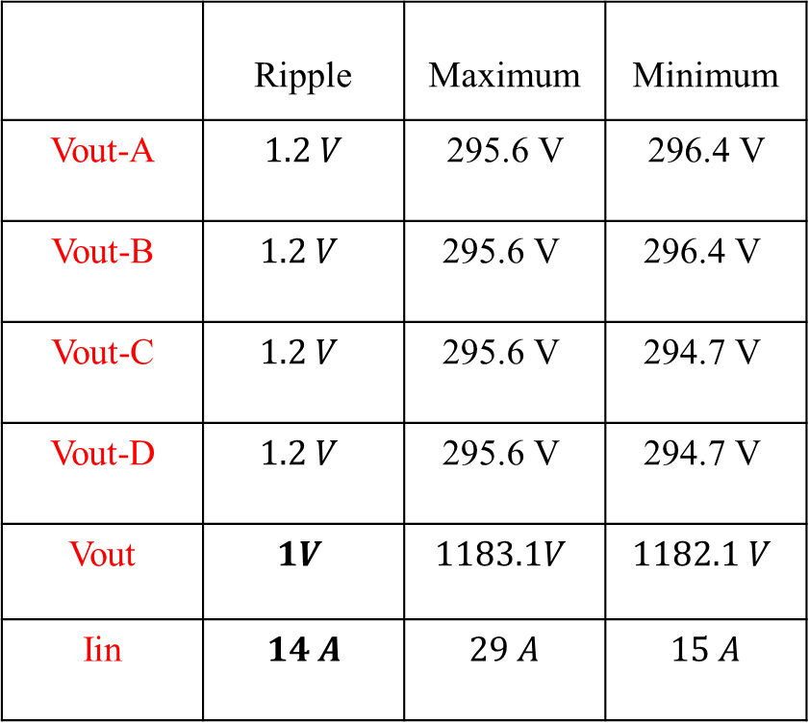
Five-level boost converter
W/O phase-shift (0-0-0-0)
W phase-shift (0-0-180-180)
 | Ripple | Maximum | Minimum
Vout-A | $$1.2 V$$ | $$\text{295.9} \text{V}$$ | $$\text{29}\text{4}\text{.}\text{7 }\text{V}$$
Vout-B | $$1.2 V$$ | $$\text{295.9} \text{V}$$ | $$\text{29}\text{4}\text{.}\text{7 }\text{V}$$
Vout-C | $$1.2 V$$ | $$\text{295.9} \text{V}$$ | $$\text{29}\text{4}\text{.}\text{7 }\text{V}$$
Vout-D | $$1.2 V$$ | $$\text{295.9} \text{V}$$ | $$\text{29}\text{4}\text{.}\text{7 }\text{V}$$
Vout | $$4.5 V$$ | $$1183.5 V$$ | $$1179 V$$
Iin | $$42 A$$ | $$42 A$$ | $$0 A$$
 | Ripple | Maximum | Minimum
Vout-A | $$1.2 V$$ | $$\text{295.}\text{6 }\text{V}$$ | $$\text{29}\text{6}\text{.}\text{4 }\text{V}$$
Vout-B | $$1.2 V$$ | $$\text{295.}\text{6 }\text{V}$$ | $$\text{29}\text{6}\text{.}\text{4 }\text{V}$$
Vout-C | $$1.2 V$$ | $$\text{29}\text{5}\text{.}\text{6 }\text{V}$$ | $$\text{29}\text{4}\text{.}\text{7 }\text{V}$$
Vout-D | $$1.2 V$$ | $$\text{295.}\text{6 }\text{V}$$ | $$\text{29}\text{4}\text{.}\text{7 }\text{V}$$
Vout | $$1V$$ | $$1183.1V$$ | $$1182.1 V$$
Iin | $$14 A$$ | $$29 A$$ | $$15 A$$

Slide 7


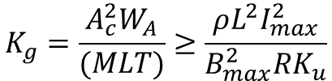


Inductor Size
$$K_{g}=\frac{A_{c}^{2}W_{A}}{(MLT)}≥\frac{ρL^{2}I_{max}^{2}}{B_{max}^{2}RK_{u}}$$
Core geometrical constant
TL-IBC > FL-BC
Conduction Losses
$4x{\frac{I}{4}}^{2}{2r}_{ds}={{2I}^{2}r}_{ds}$ ➔ TL-IBC
$$r_{ds}\left(TL−IBC\right)>r_{ds}(FL−BC)$$
$4xI^{2}r_{ds}={{4I}^{2}r}_{ds}$ ➔ FL-BC
Switching Losses
$8\frac{I}{2}\frac{V}{2}$ ➔ TL-IBC
$8I\frac{V}{4}$ ➔ FL-BC
Output capacitance smaller

