Slide 1
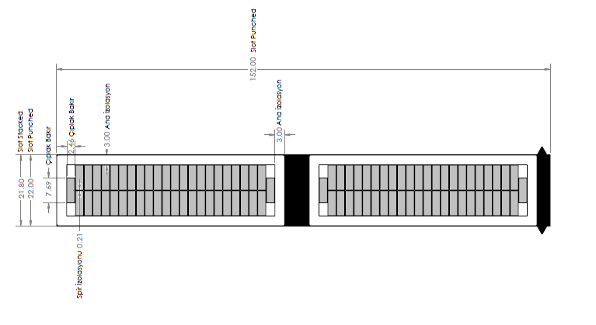
Selection of the Number of Strands

Slide 2
Conductor Width
The number of vertical strands= n
The number of horizontal strands= 2
The number of strands=2n
1
2n
2
2n-1
3
2n-2
Losses of Copper :
DC loss
Eddy (AC) loss
Circulation loss
Conductor Height
Increasing strand number
decreases the effective copper area due to insulation,
increases the DC resistance (loss)
decreases AC resistance (loss) due to the strand height being smaller than skin depth
n-1
n+2
n
n+1
Conductor Height = 61.4 mm
Conductor Width = 16 mm
Insulation between strands =0.21 mm
Skin depth = 9.22 mm

Slide 3
DC resistance increases 11%
if #strands raise from 20 to 80

Slide 4
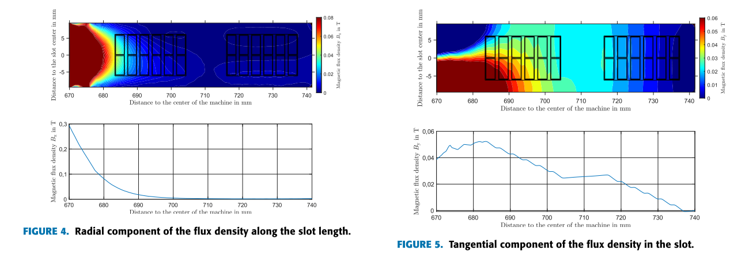
Circulation Current
The Impact of the Radial and Tangential Flux Components
Starting
first
winding
Ending
first
winding
Starting
first
winding
Ending
first
winding
M. W. Meiswinkel, A. Ebrahimi, C. Wohlers and T. Neschitsch, "Transient Roebel Bar Force Calculation in Large Salient-Pole Synchronous Machines," in IEEE Access, vol. 9, pp. 2266-2273, 2021, doi: 10.1109/ACCESS.2020.3046789.

Slide 5
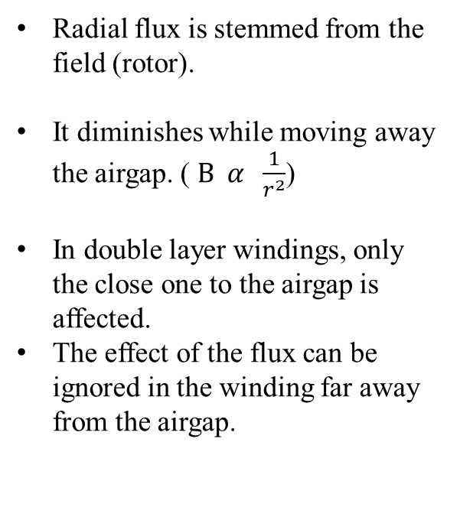
The Radial Flux Component
Radial flux is stemmed from the field (rotor).
It diminishes while moving away the airgap. ($B α \frac{1}{r^{2}}$)
In double layer windings, only the close one to the airgap is affected.
The effect of the flux can be ignored in the winding far away from the airgap.
Ending
first
winding
Starting
first
winding

Slide 6
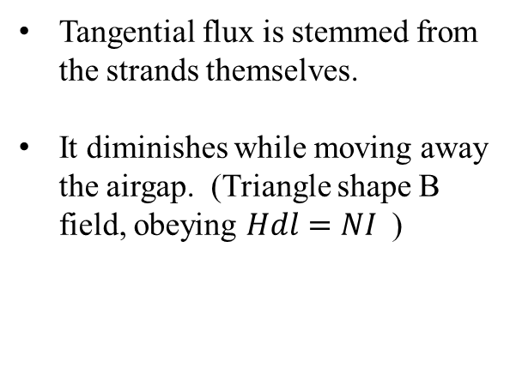
The Tangential Flux
Ending
second
winding
Starting
second
winding
Tangential flux is stemmed from the strands themselves.
It diminishes while moving away the airgap. (Triangle shape B field, obeying $Hdl=NI$)
Ending
first
winding
Starting
first
winding

Slide 7
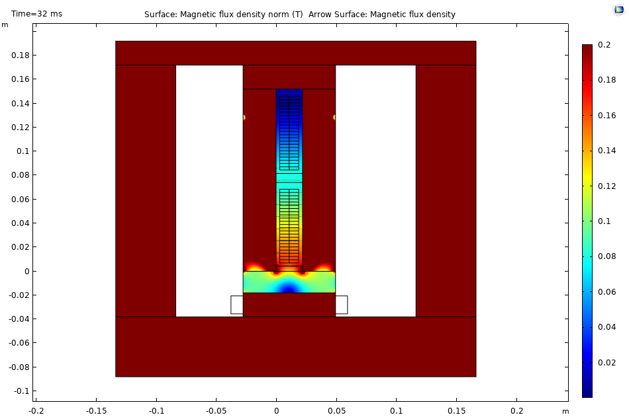
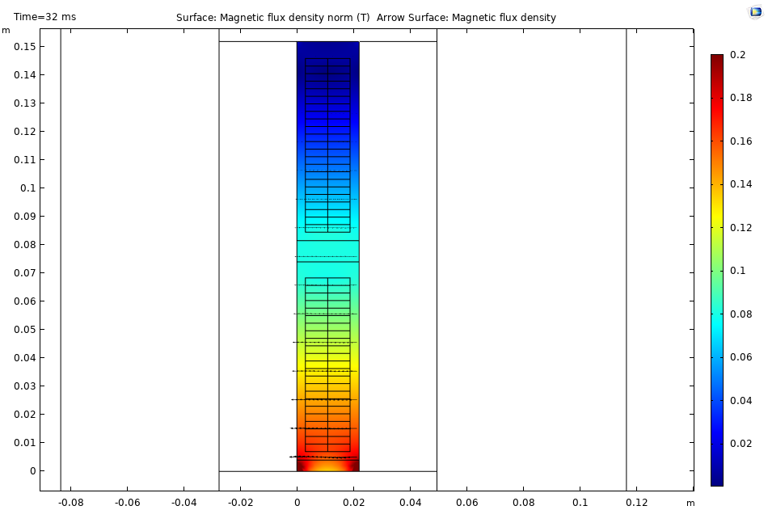
Tangential Flux on the Strands for Equal Current Distribution

Slide 8
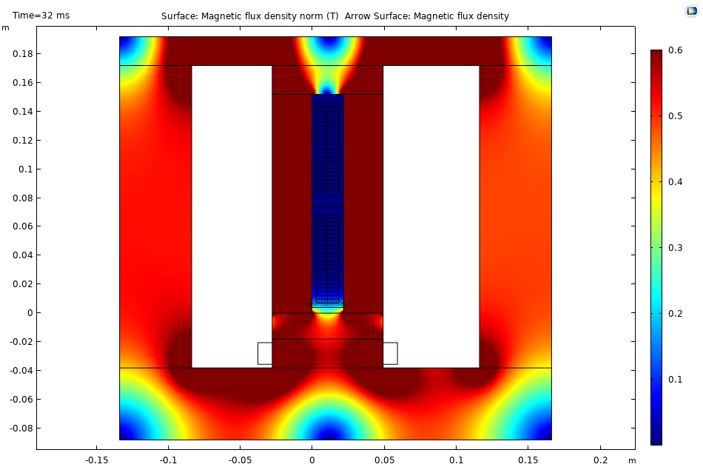
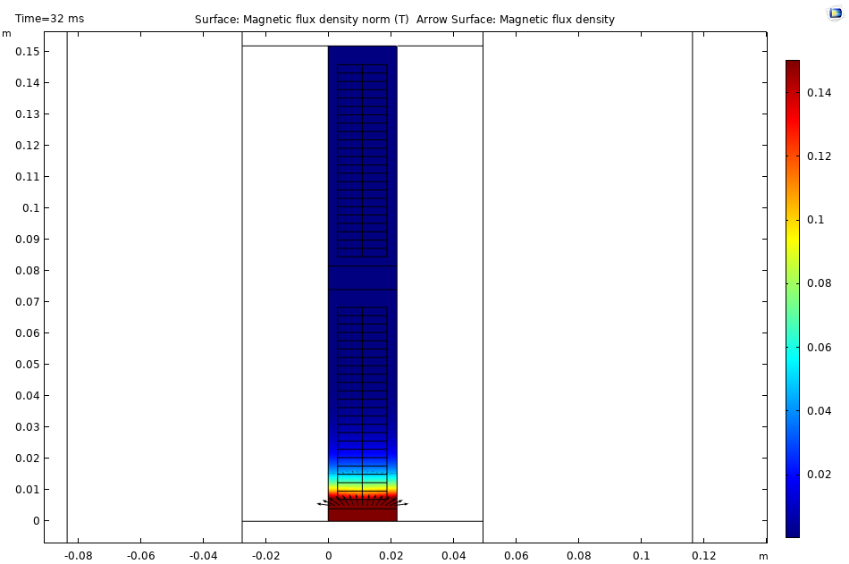
Radial Flux on the Strands

Slide 9
Top
Bottom
Induced voltage from tangential fluxes without Roebel

Slide 10
Top
Bottom
Induced voltage from tangential fluxes with ${180}^{o}$ roebel

Slide 11
Top
Bottom
Induced voltage from tangential fluxes with ${360}^{o}$ roebel

Slide 12
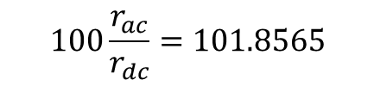
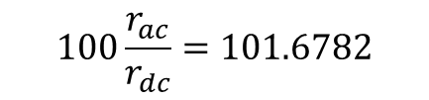
Circulating Currents (Tangential Flux)
$$100\frac{r_{ac}}{r_{dc}}=101.6782$$
$$100\frac{r_{ac}}{r_{dc}}=101.8565$$

Slide 13
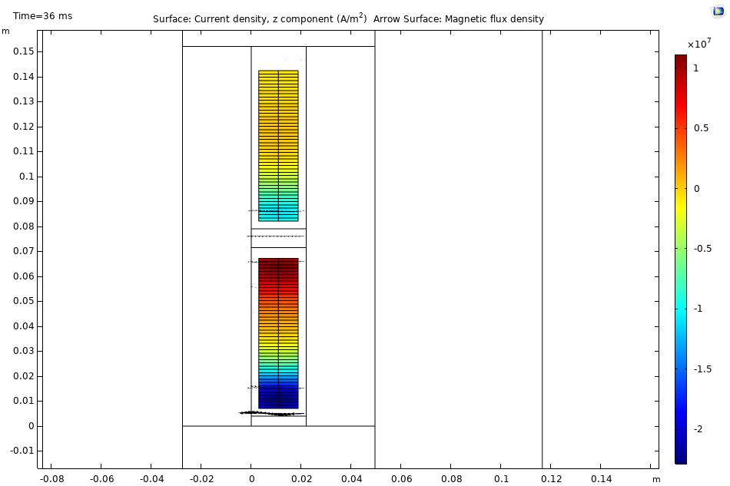
Straight wire Current Density Distribution
0
0
-I
-I/4
-3I/4
3I/4
I/4
-I
-I/2
-3I/2
DC Loss | Circulation (Airgap) | Circulation (Back Core)
$$123 W$$ | $$830 W$$ | $$215 W$$

Slide 14
Straight wire Current Density Distribution

Slide 15
Straight wire Current and Flux Density Distribution

Slide 16
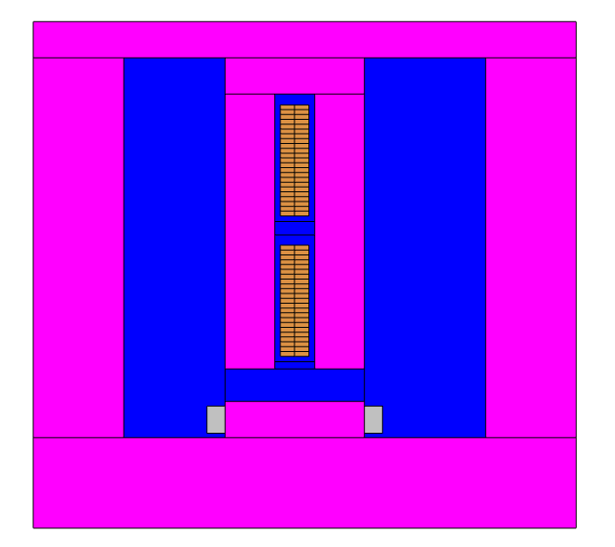
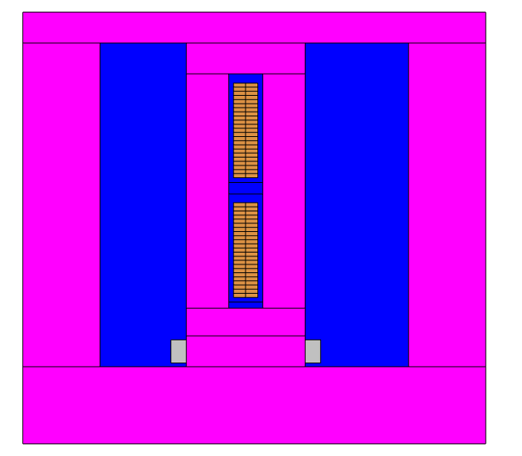
Infinitely permeable core
Copper strands
Bottom
Air
Excitation coil (Field)
We have two magnetic fields on the strands:
Radial Flux
Tangential Flux
Top

Slide 17
Max 1.2 mH
Max 2.4 mH
Slot Number
Top
Bottom
Inductance matrices without roebel

Slide 18

Max 0.9mH
Max 2.1 mH
Slot Number
Top
Bottom
Inductance matrices with ${180}^{o}$ roebel

Slide 19

Inductance Matrices
Max 0.7 mH
Max 1.9 mH
Slot Number
Top
Bottom
Inductance matrices with ${360}^{o}$ roebel

Slide 20
Top
Bottom
Induced voltage from tangential fluxes without roebel

Slide 21
Top
Bottom
Induced voltage from tangential fluxes with ${180}^{o}$ roebel

Slide 22
Top
Bottom
Induced voltage from tangential fluxes with ${360}^{o}$ roebel

Slide 23
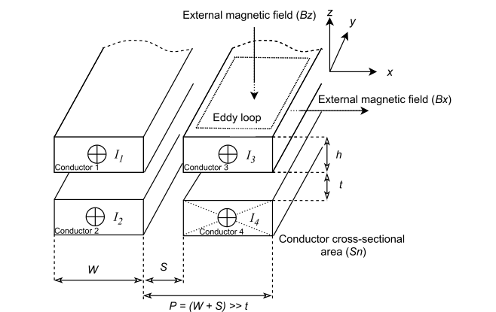
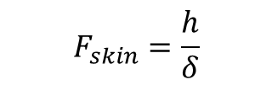
$$F_{skin}=\frac{h}{δ}$$

Slide 24
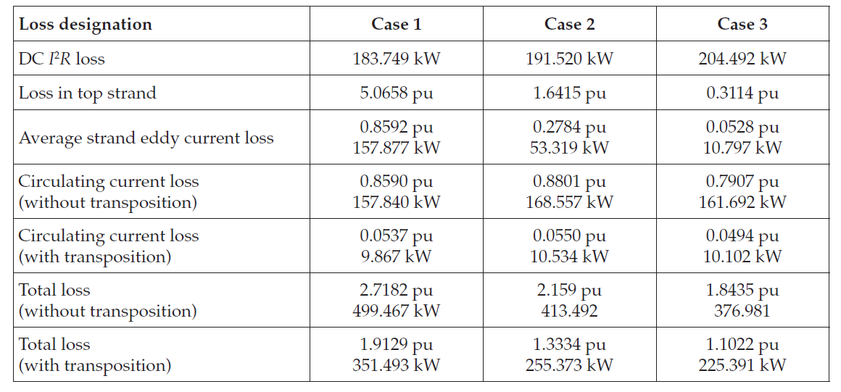

Slide 25
