Slide 1
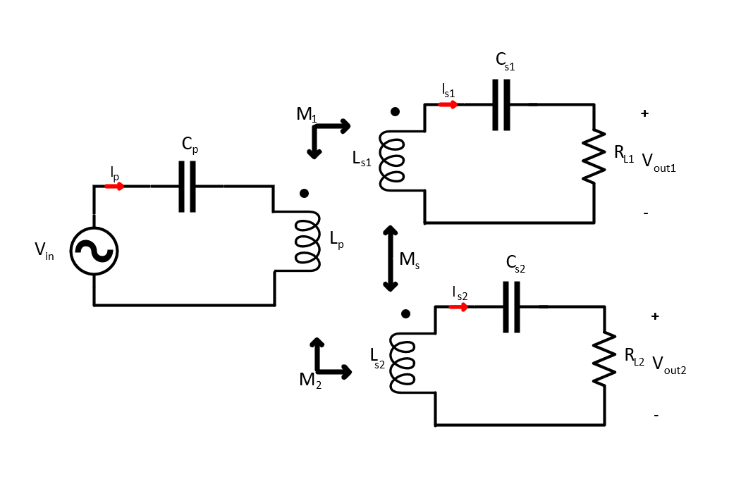
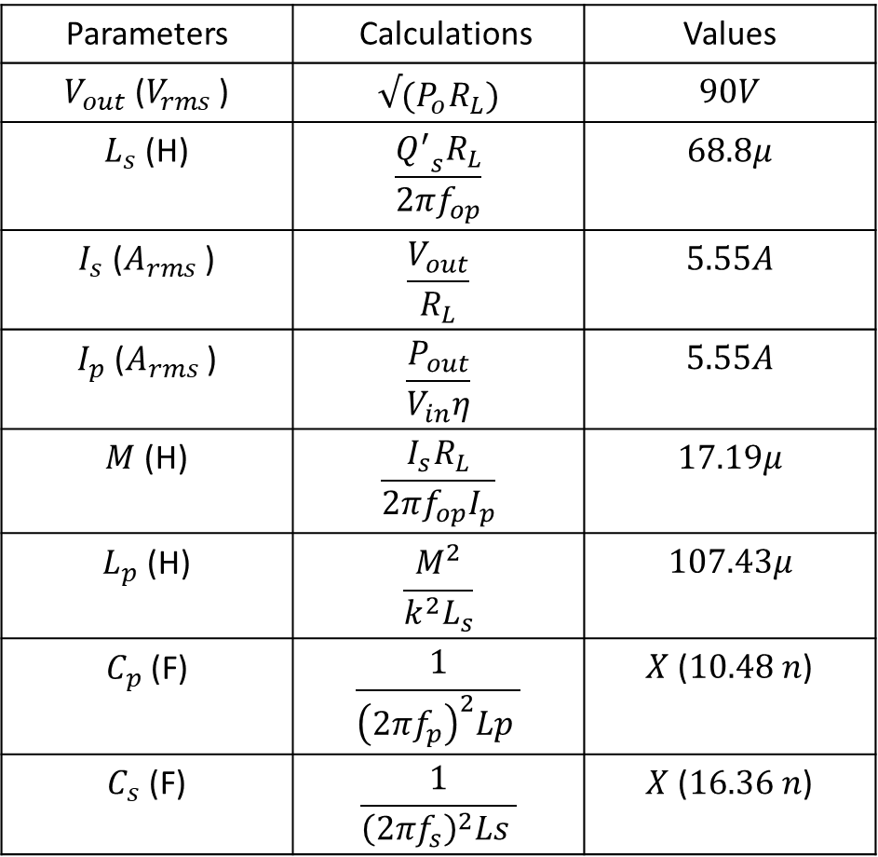
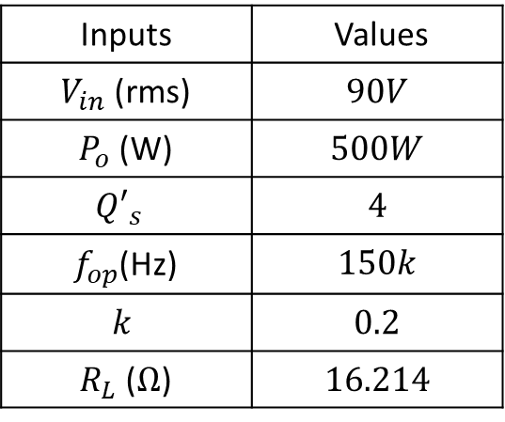
Parameters | Calculations | Values
$V_{out}$ ($V_{rms}$ ) | $$√(P_{o}R_{L})$$ | $$90V$$
$L_{s}$ (H) | $$\frac{{Q^{′}}_{s}R_{L}}{2πf_{op}}$$ | $$68.8μ$$
$I_{s}$ ($A_{rms}$ ) | $$\frac{V_{out}}{R_{L}}$$ | $$5.55A$$
$I_{p}$ ($A_{rms}$ ) | $$\frac{P_{out}}{V_{in}η}$$ | $$5.55A$$
$M$ (H) | $$\frac{I_{s}R_{L}}{2πf_{op}I_{p}}$$ | $$17.19μ$$
$L_{p}$ (H) | $$\frac{M^{2}}{k^{2}L_{s}}$$ | $$107.43μ$$
$C_{p}$ (F) | $$\frac{1}{{\left(2πf_{p}\right)}^{2}Lp }$$ | $X$ ($10.48 n$)
$C_{s}$ (F) | $$\frac{1}{{\left(2πf_{s}\right)}^{2}Ls }$$ | $X$ ($16.36 n$)
Inputs | Values
$V_{in}$ (rms) | $$90V$$
$P_{o}$ (W) | $$500W$$
$${Q′}_{s}$$ | $$4$$
$f_{op}$(Hz) | $$150k$$
$$k$$ | $$0.2$$
$R_{L}$ ($Ω$) | $$16.214$$
Previosuly, operation frequency is chosen as the frequency of
resonant tank of the secondaries and primary.

Slide 2
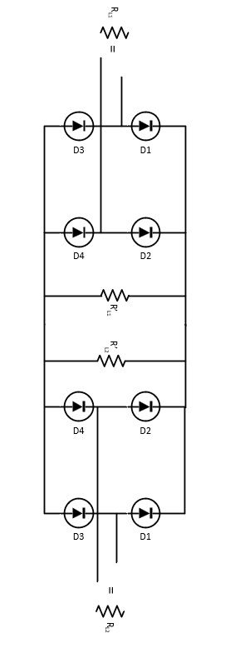
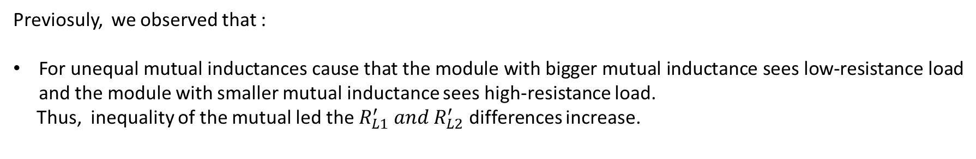
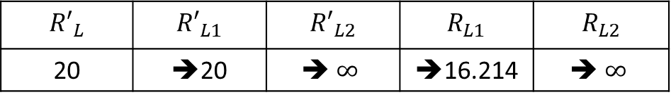
Previosuly, we observed that :
For unequal mutual inductances cause that the module with bigger mutual inductance sees low-resistance load and the module with smaller mutual inductance sees high-resistance load.
Thus, inequality of the mutual led the $R_{L1}^{′} and R_{L2}^{′}$ differences increase.
$${R′}_{L}$$ | $${R′}_{L1}$$ | $${R′}_{L2}$$ | $$R_{L1}$$ | $$R_{L2}$$
20 | ➔20 | ➔ $∞$ | ➔16.214 | ➔ $∞$
Thus , the power is transferred by one seconder module

Slide 3
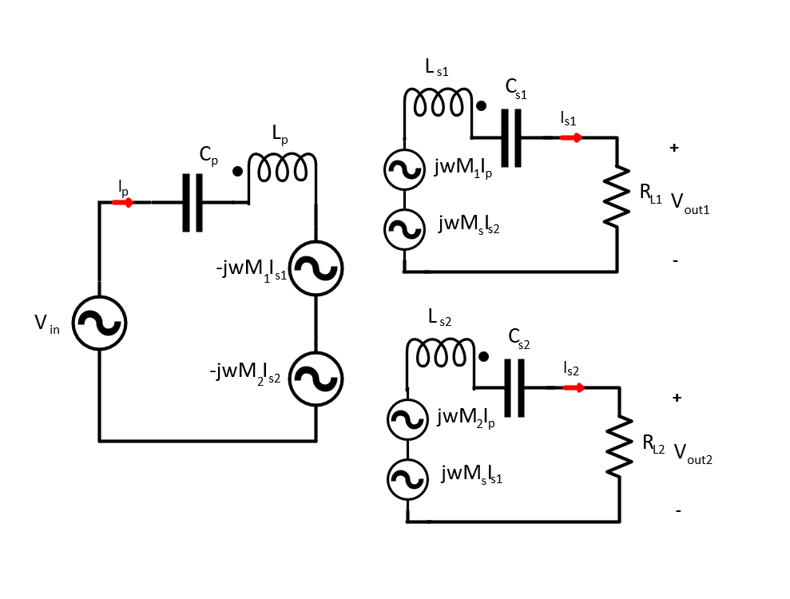
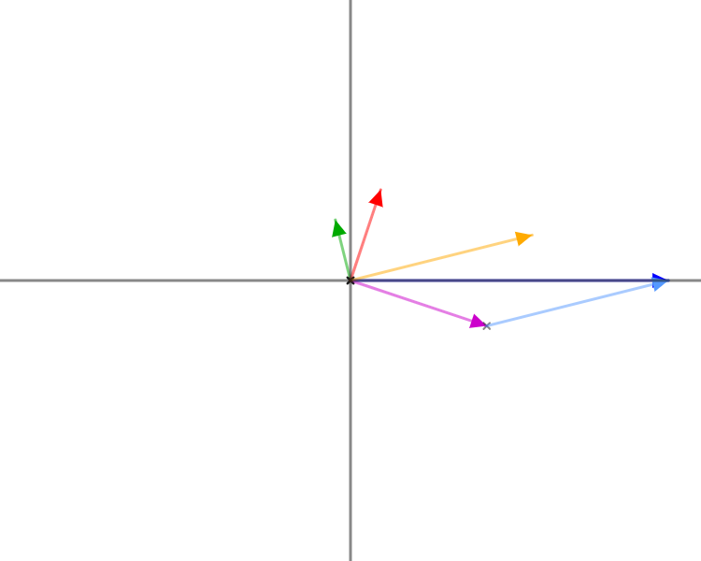
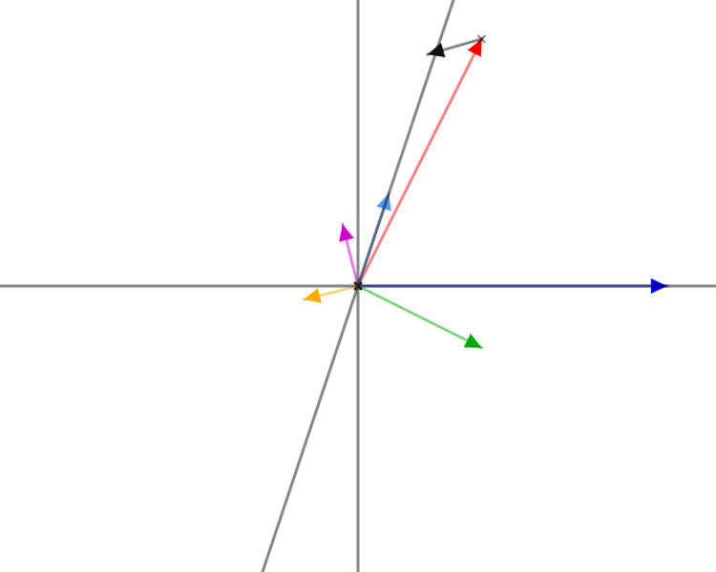
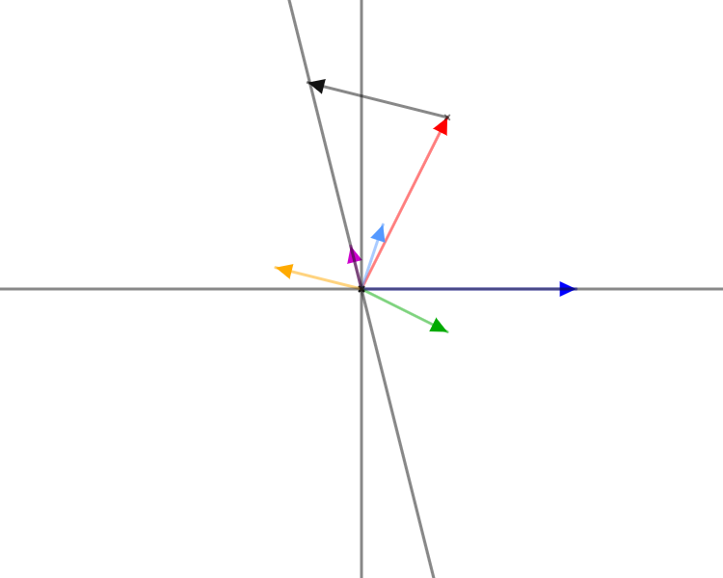


















Also, we discovered that cross-coupling can be used to feedback mechanism to keep balance of the load.
Phasor Voltage and Current Representation of the 1Tx-2Rx WPT
$$V_{out}$$
$$wM_{s }I_{s2}$$
$$wM_{1 }I_{p}$$
$$V_{out}$$
$$wM_{2 }I_{p}$$
$$I_{s1}$$
$$wM_{s }I_{s1}$$
$$I_{s2}$$
$$wM_{2 }I_{p}$$
$$I_{s1}$$
$$V_{in}$$
$$I_{s2}$$
$$V_{in}$$
$$I_{s1}$$
$$V_{in}$$
$$I_{s2}$$
$$wM_{s }I_{s1}$$
$$wM_{2 }I_{p}$$
$$wM_{s }I_{s2}$$
$$I_{p}$$
$$wM_{1 }I_{p}$$
$$I_{p}$$
Source Code
Source Code
Source Code

Slide 4



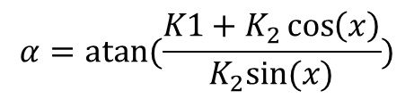


Step 1- Calculation of output voltage and real part of the input current
$$V_{out}=\left(I_{s1}+I_{s2}\right)R_{L}$$
${I_{pf}= I}_{p}.\cos\left(θ\right)=\frac{V_{out}\left(I_{s1}+I_{s2}\right)}{V_{in}}$
Step 2- Calculation of phases of the output currents
$$K_{1}=ωM_{1}I_{s1}$$
$$x=180−acos⁡((V_{in}^{2}−K_{1}^{2}−K_{2}^{2})/(−2K_{1}K_{2}))$$
$$K_{2}=ωM_{2}I_{s2}$$
$$α=atan⁡(\frac{K1+K_{2}\cos\left(x\right)}{K_{2}sin⁡(x)})$$
$$β=α+x$$

Slide 5


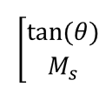










Step 3- Calculation of mutual inductance between secondary coils and phase of input currents (by using second secondary coil)
$$A_{1}=ωM_{2}I_{pf}$$
$$A_{2}=0$$
$$A_{3}=ωI_{s1}cos⁡(90+α)$$
$$A_{4}=ωI_{s1}sind(90+alpha )$$
$B_{1}=V_{out}sin⁡(β)$
$$B_{2}=V_{out}\sin\left(β\right)−ωM_{2}Ip_{f}$$
A =
$$\left[\begin{matrix}A_{1} & A_{3} \\ A_{2} & A_{4}\end{matrix}\right]$$
B =
x=
$$x=A^{−1}B$$
$$M_{s}=x(2)$$
$$θ=atan⁡(x\left(1\right))$$
The formulation can be applied to first seconder coils to find $M_{s}$ and $θ$

Slide 6
Now, we observed that:
Increasing operation frequency without cross-coupling also provide with keeping balance of secondaries.
Or,
Changing the frequency of the seconder resonant tank also provide with keeping balance of secondaries.
Firstly, we create a general closed form solution for 1Tx and 1Rx. In this point, we will investigate the effect of operation frequency and frequency of resonant tank. The primary current and secondary current will be compared previous design without cross-coupling.
Secondly, we create a general closed form solution for 1Tx-2Rx. In this point, we invesitagated the effect of operation frequency and frequency of resonant tank. For this analysis, we will compare only seconder current distribution and load balancing.

Slide 7


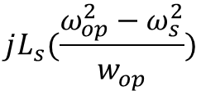

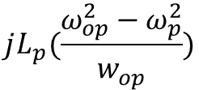

$$jL_{p}(\frac{{ω_{op}^{2}−ω}_{p}^{2}}{w_{op}^{}})$$
$$jL_{p}(Δw_{p})$$
=
$$jL_{s}(\frac{{ω_{op}^{2}−ω}_{s}^{2}}{w_{op}^{}})$$
$$jL_{p}(Δw_{s})$$
=
İnductance are same however capacitor values change with respect to frequency of resonant tank. Also, total impedance with respect to operation frequency is effective.
$$Z_{p}= jL_{p}(Δw_{p})$$
$$Z_{s}= jL_{p}\left(Δw_{s}\right)+R_{L}$$

Slide 8
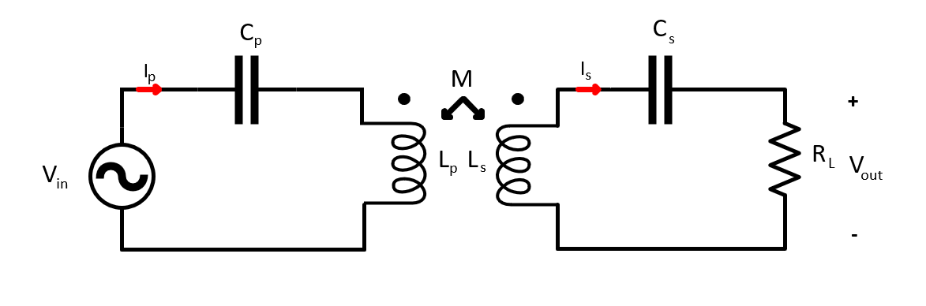
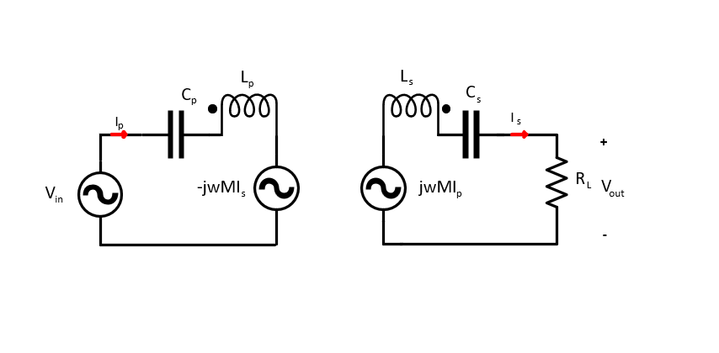
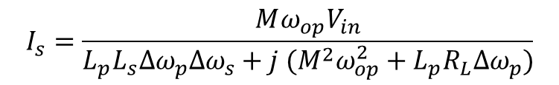
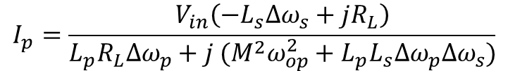

1Tx-1Rx Analysis
$$\left|\begin{matrix}Z_{p} & jωM \\ jωM & −Z_{S}\end{matrix}\right|\left|\begin{aligned}I_{p} \\ I_{s}\end{aligned}\right|=\left|\begin{aligned}V_{in} \\ 0\end{aligned}\right|$$
We can solve the equation:
$$I_{p}=\frac{V_{in}\left(−L_{s}Δω_{s}+jR_{L}\right)}{L_{p}R_{L}Δω_{p}+j (M^{2}ω_{op}^{2}+L_{p}L_{s}Δω_{p}Δω_{s})}$$
$$I_{s}=\frac{Mω_{op}V_{in}}{L_{p}L_{s}Δω_{p}Δω_{s}+j (M^{2}ω_{op}^{2}+L_{p}R_{L}Δω_{p})}$$

Slide 9

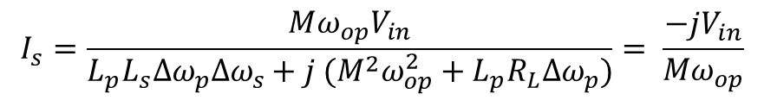

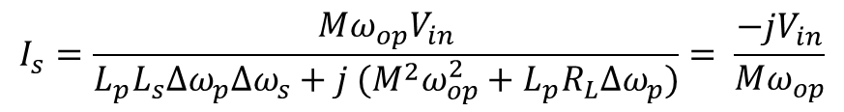
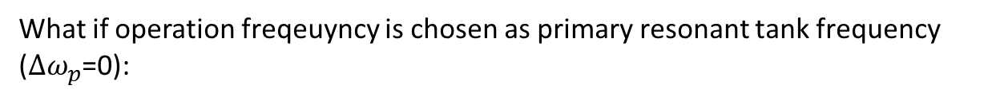
What if operation freqeuyncy is chosen as primary and seconder resonant tank frequency ($Δω_{p}$=0 and $Δω_{s}$=0):
$I_{p}=\frac{V_{in}\left(−L_{s}Δω_{s}+jR_{L}\right)}{L_{p}R_{L}Δω_{p}+j (M^{2}ω_{op}^{2}+L_{p}L_{s}Δω_{p}Δω_{s})}$= $\frac{V_{in}R_{L}}{ M^{2}ω_{op}^{2}}$
$$I_{s}=\frac{Mω_{op}V_{in}}{L_{p}L_{s}Δω_{p}Δω_{s}+j (M^{2}ω_{op}^{2}+L_{p}R_{L}Δω_{p})}= \frac{−jV_{in}}{Mω_{op}}$$
What if operation freqeuyncy is chosen as primary resonant tank frequency ($Δω_{p}$=0):
$I_{p}=\frac{V_{in}\left(−L_{s}Δω_{s}+jR_{L}\right)}{L_{p}R_{L}Δω_{p}+j (M^{2}ω_{op}^{2}+L_{p}L_{s}Δω_{p}Δω_{s})}$= $\frac{V_{in}R_{L}}{ M^{2}ω_{op}^{2}}+\frac{{jV}_{in}L_{s}Δω_{s}}{M^{2}ω_{op}^{2}}$
$$I_{s}=\frac{Mω_{op}V_{in}}{L_{p}L_{s}Δω_{p}Δω_{s}+j (M^{2}ω_{op}^{2}+L_{p}R_{L}Δω_{p})}= \frac{−jV_{in}}{Mω_{op}}$$

Slide 10
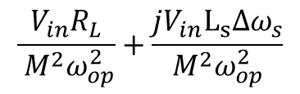
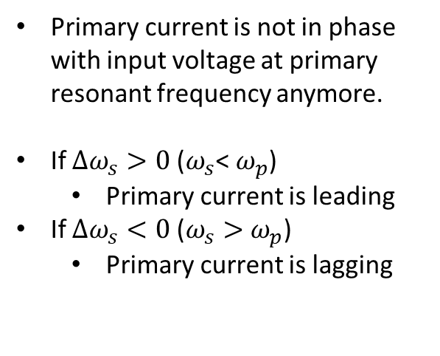
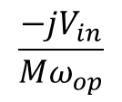
Primary current is not in phase with input voltage at primary resonant frequency anymore.
If $Δω_{s}>0$ ($ω_{s}$< $ω_{p}$)
Primary current is leading
If $Δω_{s}<0$ ($ω_{s}>$ $ω_{p}$)
Primary current is lagging
Secondary current is constant.Howeever, if the system resonance is changed.Thus, system gain increases.
$$\frac{V_{in}R_{L}}{ M^{2}ω_{op}^{2}}+\frac{{jV}_{in}L_{s}Δω_{s}}{M^{2}ω_{op}^{2}}$$
$$\frac{−jV_{in}}{Mω_{op}}$$
Previous term
Extra Term

Slide 11
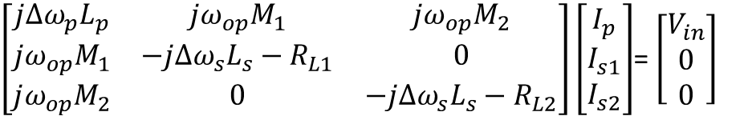
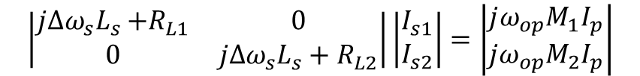
1Tx-2Rx Analysis
$\left[\begin{matrix}jΔω_{p}L_{p} & jω_{op}M_{1} & jω_{op}M_{2} \\ jω_{op}M_{1} & −jΔω_{s}L_{s}−R_{L1} & 0 \\ jω_{op}M_{2} & 0 & −jΔω_{s}L_{s}−R_{L2}\end{matrix}\right]\left[\begin{aligned}I_{p} \\ I_{s1} \\ I_{s2}\end{aligned}\right]$= $\left[\begin{aligned}V_{in} \\ 0 \\ 0\end{aligned}\right]$
$$\left|\begin{matrix}jΔω_{s}L_{s}{+R}_{L1} & 0 \\ 0 & jΔω_{s}L_{s}+R_{L2}\end{matrix}\right|\left|\begin{aligned}I_{s1} \\ I_{s2}\end{aligned}\right|=\left|\begin{aligned}jω_{op}M_{1}I_{p} \\ jω_{op}M_{2}I_{p}\end{aligned}\right|$$
We can solve the equation and find the secondary currents.

Slide 12
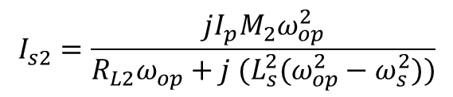
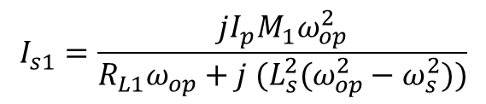
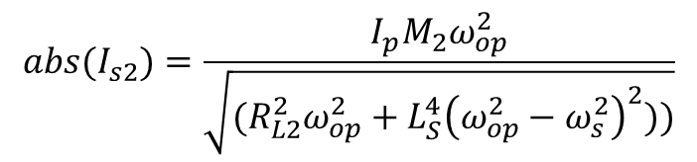
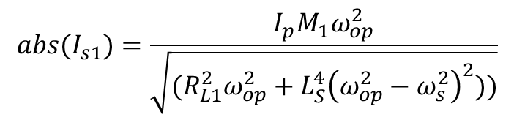

$$I_{s1}=\frac{jI_{p}M_{1}ω_{op}^{2}}{R_{L1}ω_{op}+j (L_{s}^{2}(ω_{op}^{2}−ω_{s}^{2}))}$$
We know that the magnitude of the output voltage of the secondaries are equal.
$$I_{s2}=\frac{jI_{p}M_{2}ω_{op}^{2}}{R_{L2}ω_{op}+j (L_{s}^{2}(ω_{op}^{2}−ω_{s}^{2}))}$$
$$R_{L1}abs\left(I_{S1}\right)=R_{L2}abs(I_{s2})$$
$${abs(I}_{s1})=\frac{I_{p}M_{1}ω_{op}^{2}}{\sqrt{(R_{L1}^{2}ω_{op}^{2}+L_{S}^{4}{\left(ω_{op}^{2}−ω_{s}^{2}\right)}^{2}))}}$$
$${abs(I}_{s2})=\frac{I_{p}M_{2}ω_{op}^{2}}{\sqrt{(R_{L2}^{2}ω_{op}^{2}+L_{S}^{4}{\left(ω_{op}^{2}−ω_{s}^{2}\right)}^{2}))}}$$

Slide 13

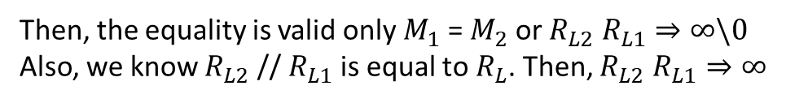
$$R_{L1}abs\left(I_{S1}\right)−R_{L2}abs\left(I_{s2}\right)=0$$
$I_{p}M_{1}ω_{op}^{2}R_{L1}$ $\sqrt{(R_{L2}^{2}ω_{op}^{2}+L_{S}^{4}{\left(ω_{op}^{2}−ω_{s}^{2}\right)}^{2}))}−I_{p}M_{2}ω_{op}^{2}R_{L2} \sqrt{(R_{L1}^{2}ω_{op}^{2}+L_{S}^{4}{\left(ω_{op}^{2}−ω_{s}^{2}\right)}^{2}))=}$0
What if $ω_{op}=ω_{s}$
$I_{p}M_{1}ω_{op}^{3}R_{L1}$ $R_{L2}−I_{p}M_{2}ω_{op}^{3}R_{L2} R_{L1}=$0
Then, the equality is valid only $M_{1}$ = $M_{2}$ or $R_{L2} R_{L1}⇒∞\backslash 0$
Also, we know $R_{L2} \text{// }R_{L1}$ is equal to $R_{L}$. Then, $R_{L2} R_{L1}⇒∞$

Slide 14

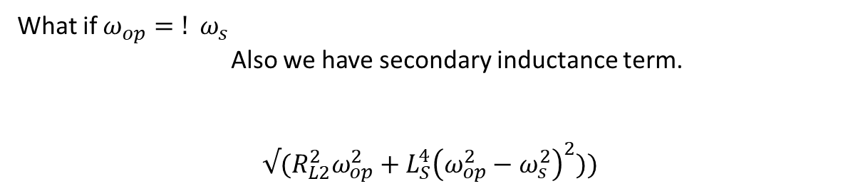
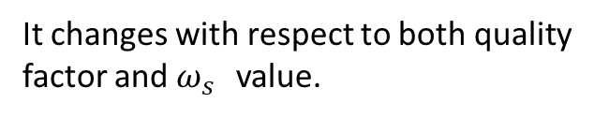
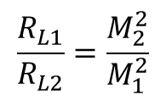
What if $ω_{op}=! ω_{s }$
Also we have secondary inductance term.
$$√(R_{L2}^{2}ω_{op}^{2}+L_{S}^{4}{\left(ω_{op}^{2}−ω_{s}^{2}\right)}^{2}))$$
It changes with respect to both quality factor and $ω_{s }$ value.
What if $ω_{op}≫ω_{s }$ or $ω_{op}≪ω_{s }$
$I_{p}M_{1}ω_{op}^{3}R_{L1}L_{s}^{2}(ω_{op}^{2}−ω_{S}^{2})−I_{p}M_{2}ω_{op}^{3}R_{L2}L_{s}^{2}(ω_{op}^{2}−ω_{S}^{2})=$0
$$\frac{R_{L1}}{R_{L2}}=\frac{M_{2}^{2}}{M_{1}^{2}}$$
It is ultimate result, but not practical.

Slide 15
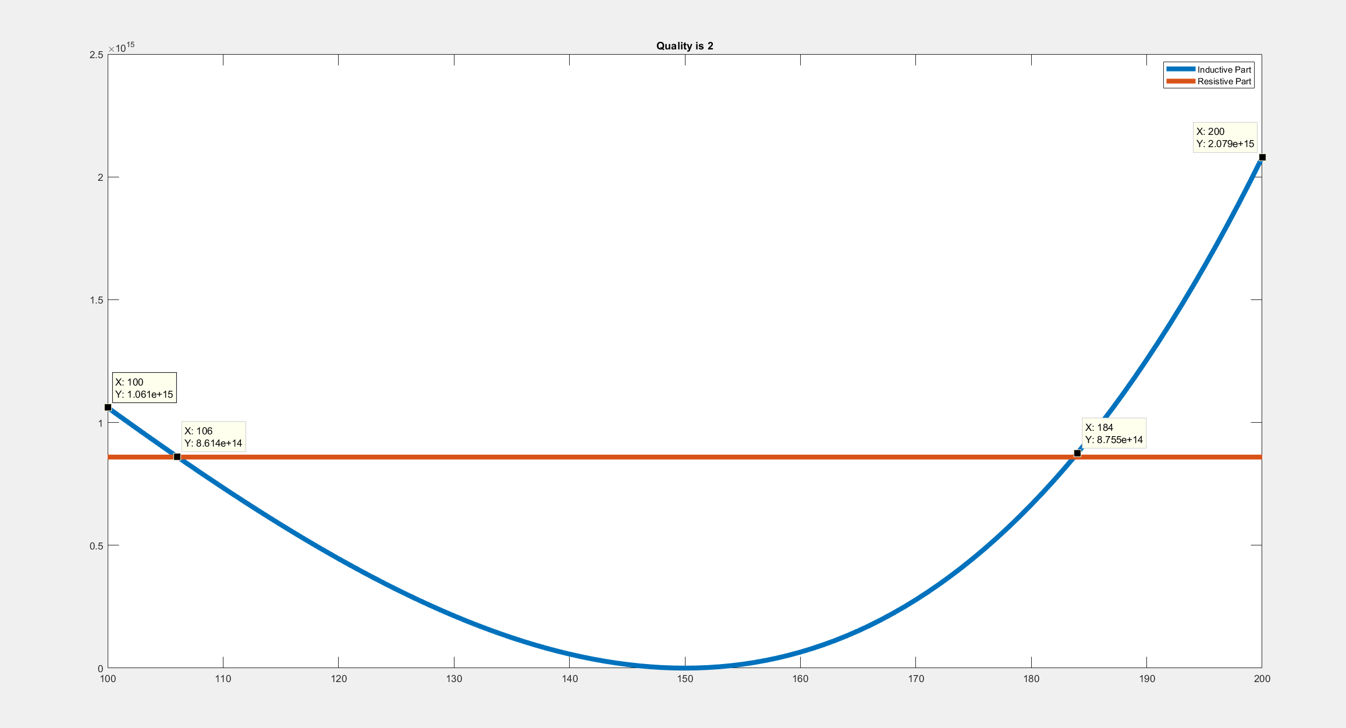
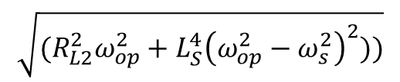
We can investiagate for different Quality factor.
$$\sqrt{(R_{L2}^{2}ω_{op}^{2}+L_{S}^{4}{\left(ω_{op}^{2}−ω_{s}^{2}\right)}^{2}))}$$

Slide 16
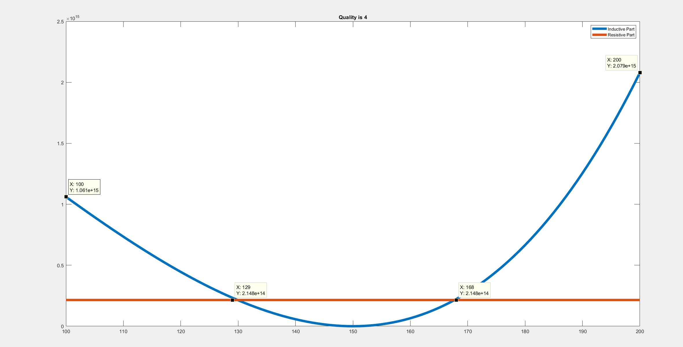

Slide 17
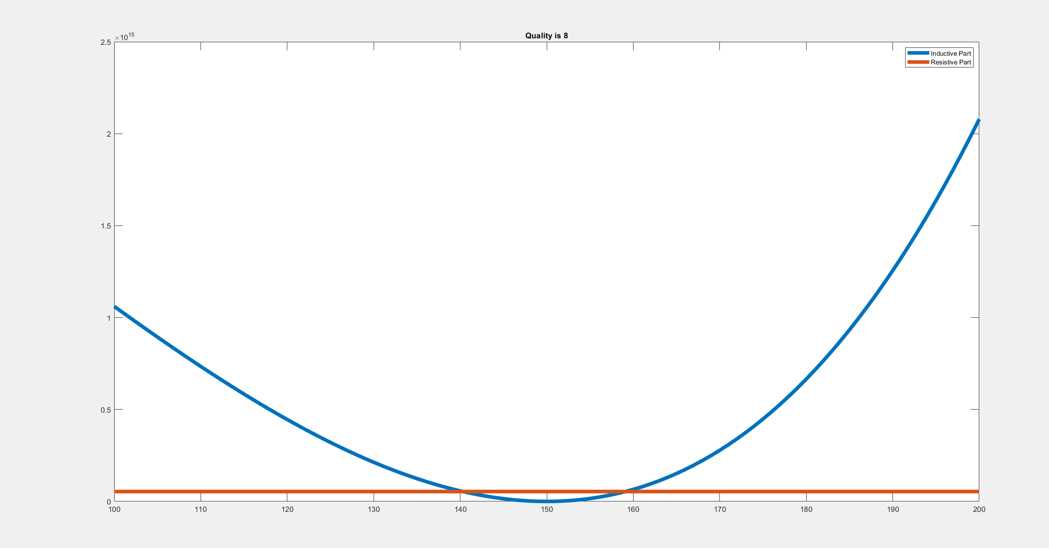

Slide 18
Increasing operation frequency while keeping constant reasonant tank of primary and secondaries causes the current balancing.However, it makes primary currrent lags and the output power decrease.
Keeping constant operation frequency while decreasing frequency of secondary resonant tank led current balancing which is limited to the square of the ratio of mutual coupling. it makes primary currrent lead and the output power increase.
Decreasing resonant frequency of the secondary sides and cross-coupling increases the current balancing.

Slide 19
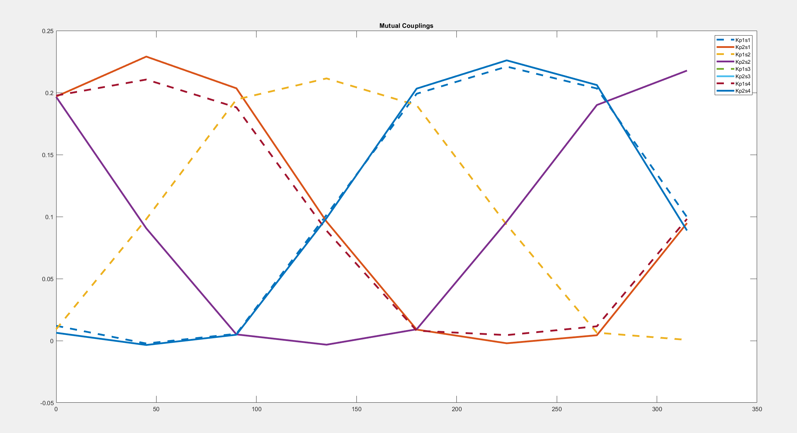
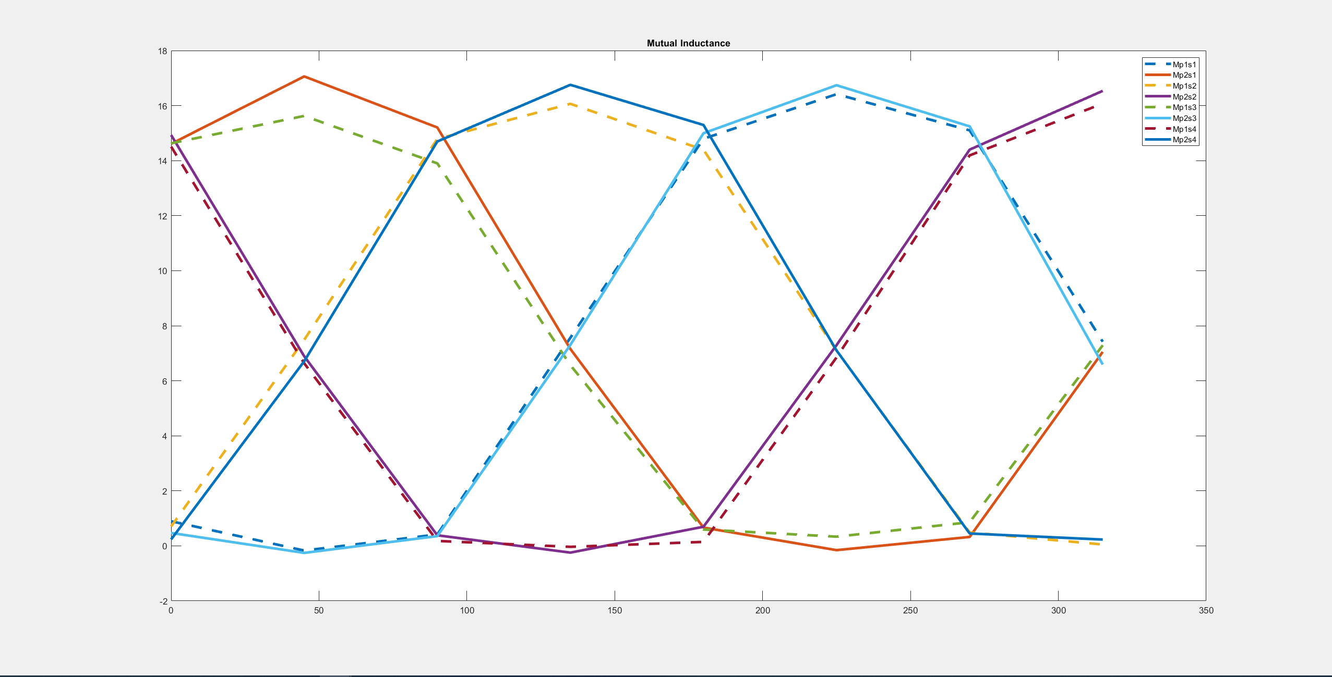
TESTING REAL INDUCTANCE VALUES

Slide 20
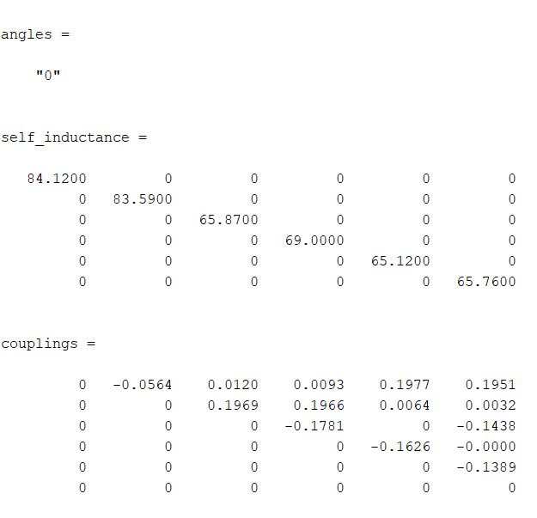
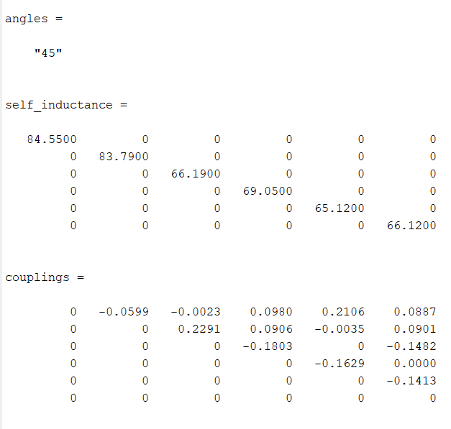

Slide 21
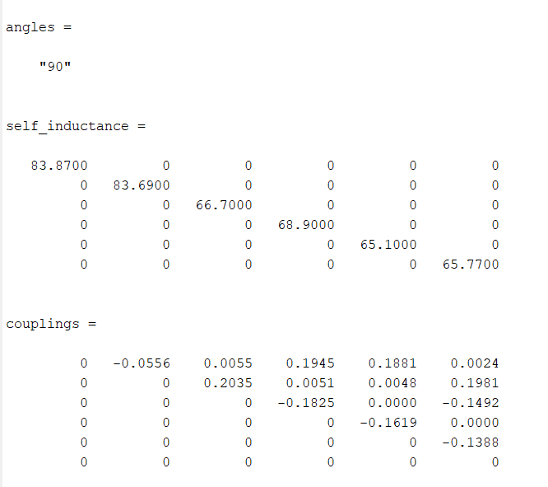
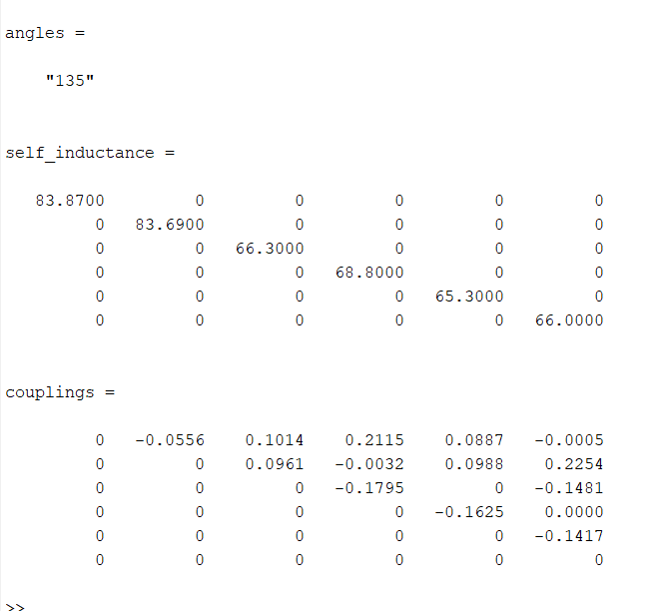

Slide 22
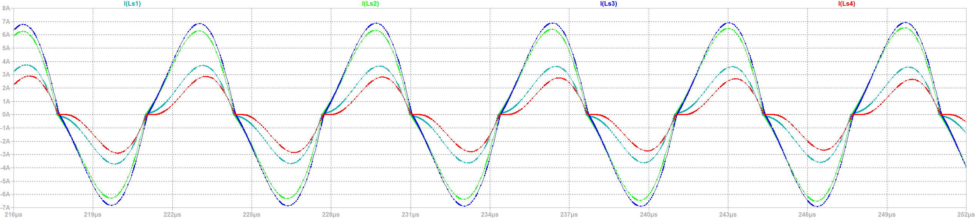
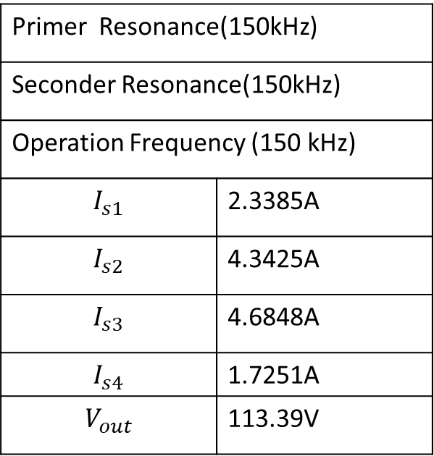
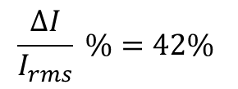


Primer Resonance(150kHz)
Seconder Resonance(150kHz)
Operation Frequency (150 kHz)
$$I_{s1}$$ | 2.3385A
$$I_{s2}$$ | 4.3425A
$$I_{s3}$$ | 4.6848A
$$I_{s4}$$ | 1.7251A
$$V_{out}$$ | 113.39V
$$I_{rms}=7 .01 A$$
$$ΔI =0.72 A$$
$$\frac{ΔI}{I_{rms}} \%=42\%$$

Slide 23
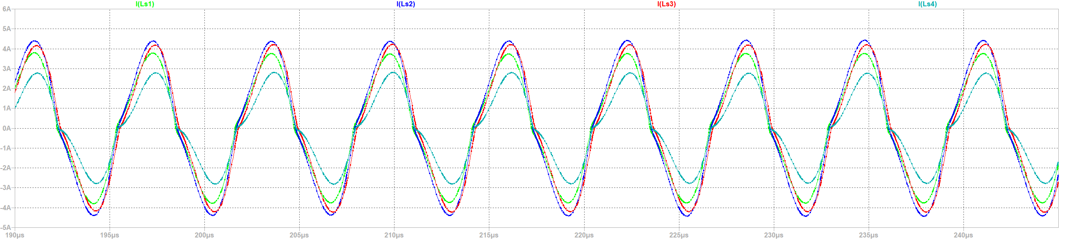
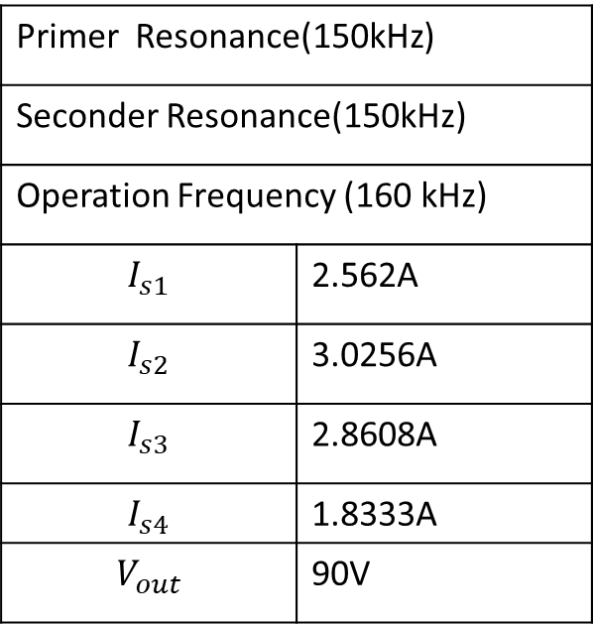
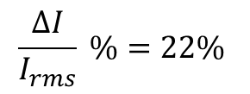


Primer Resonance(150kHz)
Seconder Resonance(150kHz)
Operation Frequency (160 kHz)
$$I_{s1}$$ | 2.562A
$$I_{s2}$$ | 3.0256A
$$I_{s3}$$ | 2.8608A
$$I_{s4}$$ | 1.8333A
$$V_{out}$$ | 90V
$$I_{rms}=5.216 A$$
$$ΔI =1.192 A$$
$$\frac{ΔI}{I_{rms}} \%=22\%$$

Slide 24




Primer Resonance(150kHz)
Seconder Resonance(131kHz)
Operation Frequency (155 kHz)
$$I_{s1}$$ | 3.2025A
$$I_{s2}$$ | 3.2516A
$$I_{s3}$$ | 2.9696A
$$I_{s4}$$ | 2.5344A
$$V_{out}$$ | 100V
$$I_{rms}=6 .01 A$$
$$ΔI =0.72 A$$
$$\frac{ΔI}{I_{rms}} \%=12\%$$

Slide 25





Primer Resonance(150kHz)
Seconder Resonance(131kHz)
Operation Frequency (150 kHz)
$$I_{s1}$$ | 2.80A
$$I_{s2}$$ | 2.94A
$$I_{s3}$$ | 3.0428A
$$I_{s4}$$ | 2.518A
$$V_{out}$$ | 98.4V
$$I_{rms}=5.66A$$
$$ΔI =0.52 A$$
$$\frac{ΔI}{I_{rms}} \%=9.22\%$$

