Slide 1
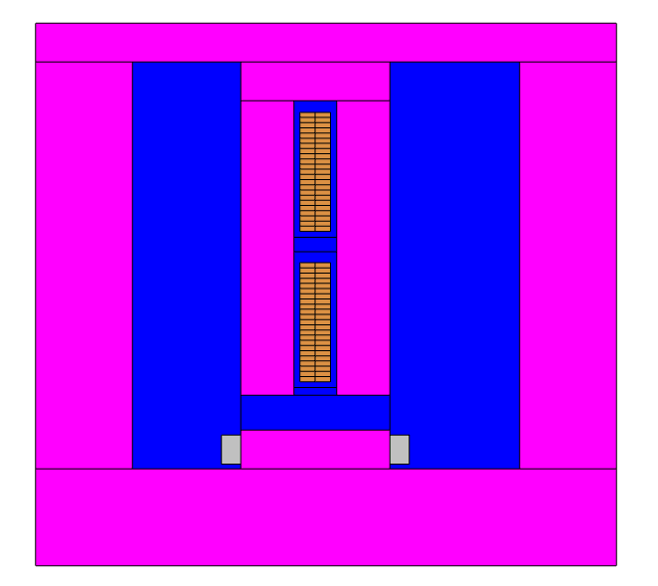
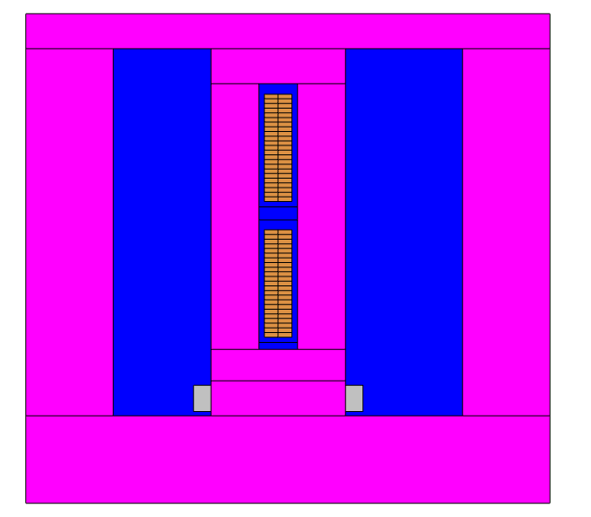
Infinitely permeable core
Copper strands
Bottom
Air
Excitation coil (Field)
We have two magnetic fields on the strands:
Radial Flux
Tangential Flux
Top

Slide 2
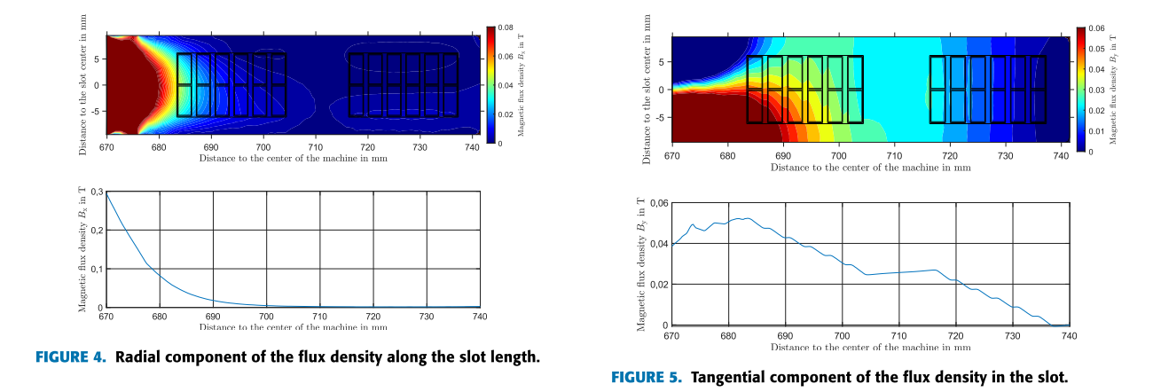
The Impact of the Radial and Tangential Flux Components
Starting
first
winding
Ending
first
winding
Starting
first
winding
Ending
first
winding
M. W. Meiswinkel, A. Ebrahimi, C. Wohlers and T. Neschitsch, "Transient Roebel Bar Force Calculation in Large Salient-Pole Synchronous Machines," in IEEE Access, vol. 9, pp. 2266-2273, 2021, doi: 10.1109/ACCESS.2020.3046789.

Slide 3
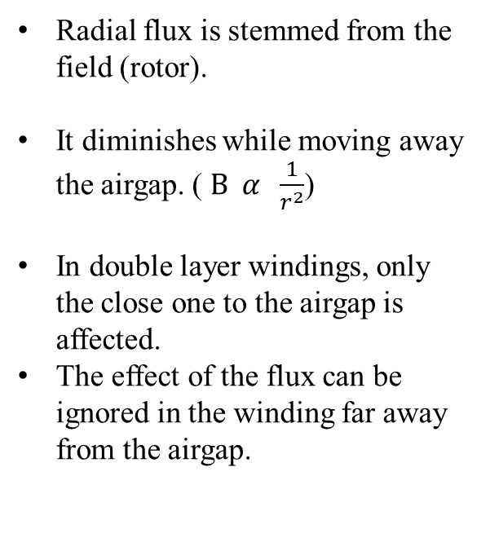
The Radial Flux Component
Radial flux is stemmed from the field (rotor).
It diminishes while moving away the airgap. ($B α \frac{1}{r^{2}}$)
In double layer windings, only the close one to the airgap is affected.
The effect of the flux can be ignored in the winding far away from the airgap.
Ending
first
winding
Starting
first
winding

Slide 4
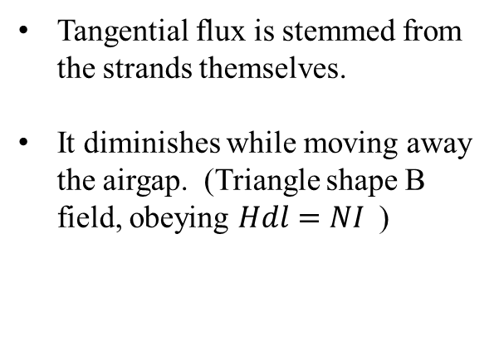
The Tangential Flux
Ending
second
winding
Starting
second
winding
Tangential flux is stemmed from the strands themselves.
It diminishes while moving away the airgap. (Triangle shape B field, obeying $Hdl=NI$)
Ending
first
winding
Starting
first
winding

Slide 5
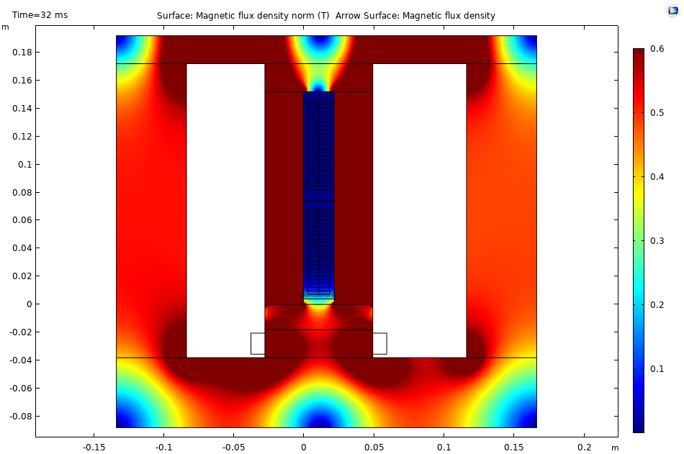
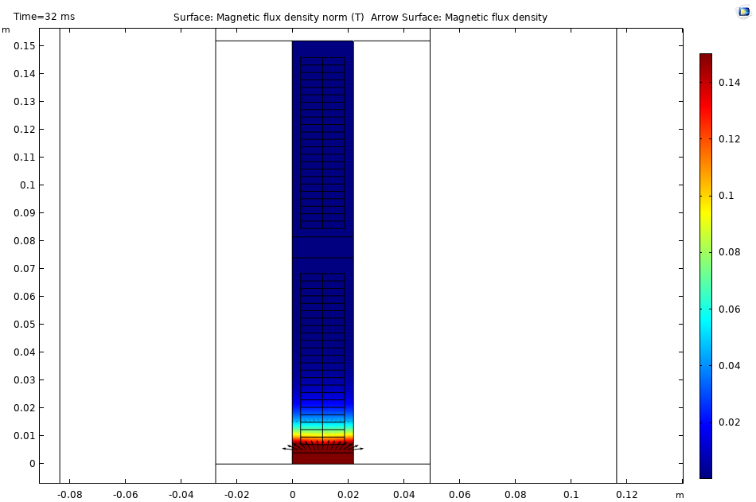
Radial Flux on the Strands

Slide 6
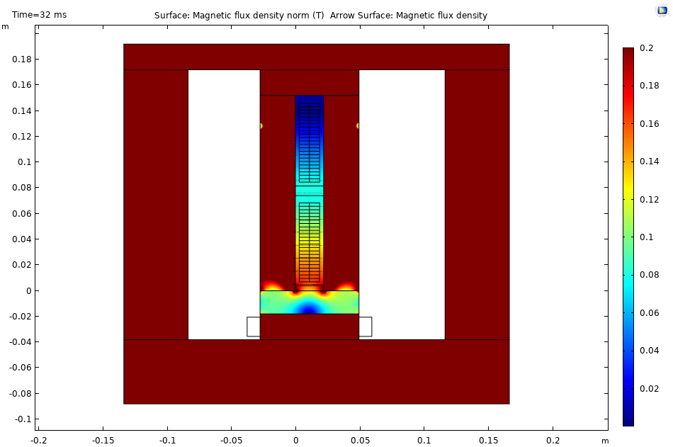
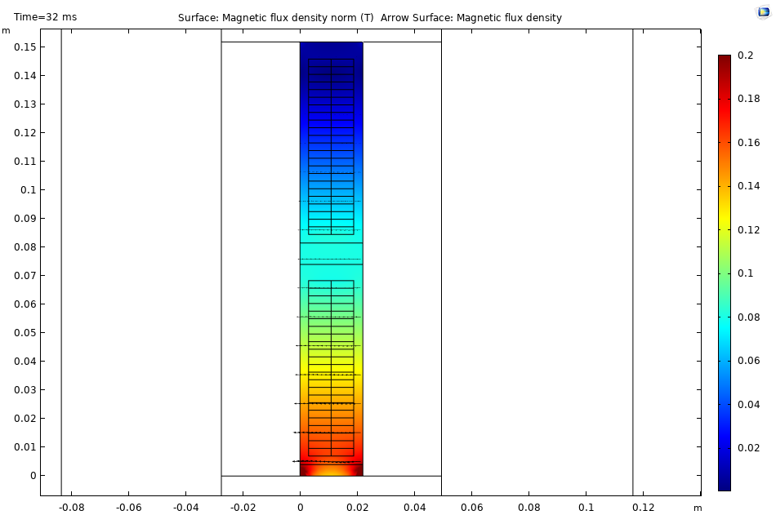
Tangential Flux on the Strands

Slide 7
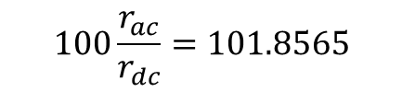
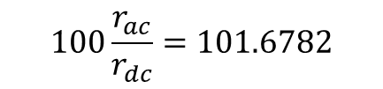
Circulating Currents (Tangential Flux)
$$100\frac{r_{ac}}{r_{dc}}=101.6782$$
$$100\frac{r_{ac}}{r_{dc}}=101.8565$$

Slide 8
Max 1.2 mH
Max 2.4 mH
Slot Number
Top
Bottom
Inductance matrices without roebel

Slide 9

Max 0.9mH
Max 2.1 mH
Slot Number
Top
Bottom
Inductance matrices with ${180}^{o}$ roebel

Slide 10

Inductance Matrices
Max 0.7 mH
Max 1.9 mH
Slot Number
Top
Bottom
Inductance matrices with ${360}^{o}$ roebel

Slide 11
Top
Bottom
Induced voltage from tangential fluxes without roebel

Slide 12
Top
Bottom
Induced voltage from tangential fluxes with ${180}^{o}$ roebel

Slide 13
Top
Bottom
Induced voltage from tangential fluxes with ${360}^{o}$ roebel

Slide 14
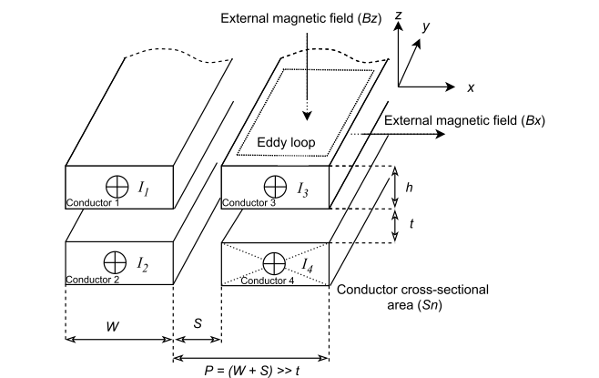
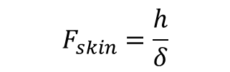
$$F_{skin}=\frac{h}{δ}$$

Slide 15
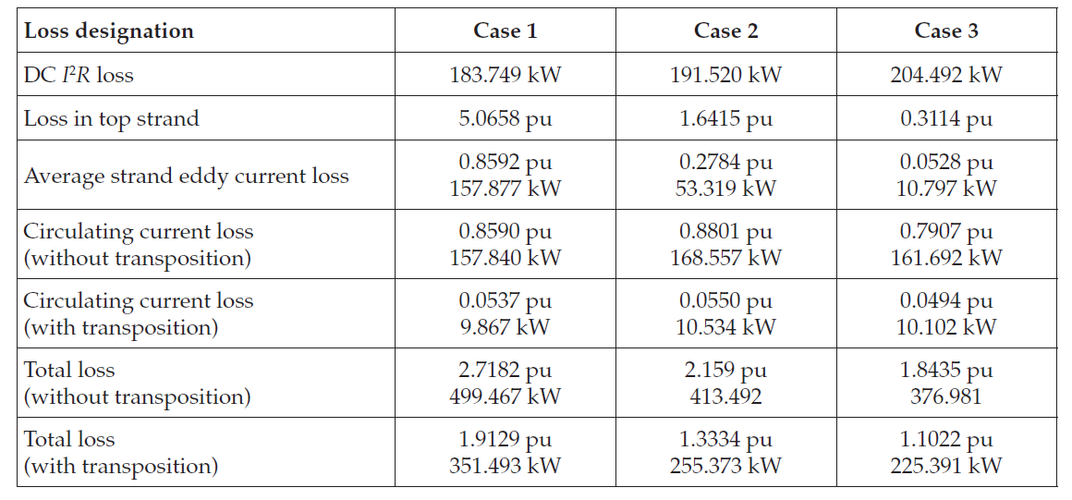

Slide 16
