Slide 1
Flying Capacitor Boost Converter

Slide 2
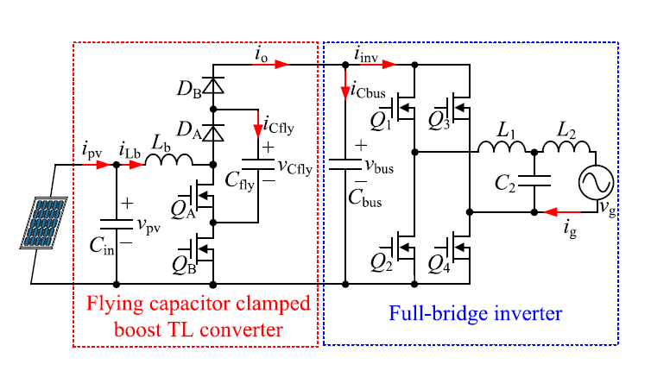
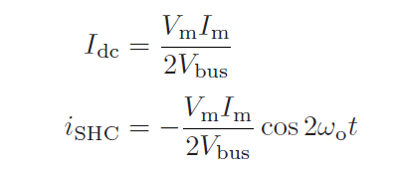

Pros
Smaller capacitance
Smaller inductance
Low frequency active filtering
$$i_{inv}=I_{dc}+i_{SCH}$$
Cons
Semiconductor voltage stress
Unbalance

Slide 3
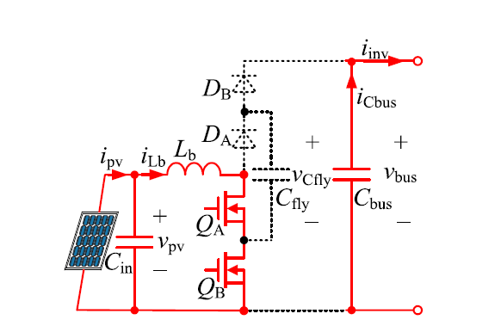
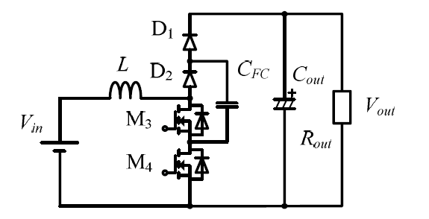
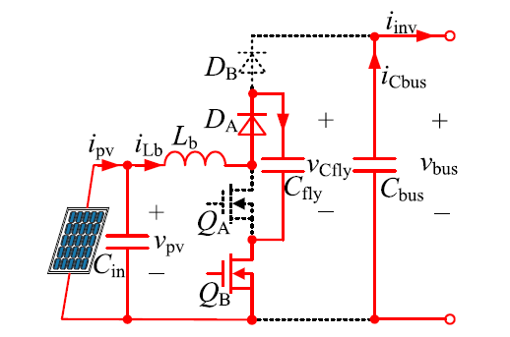
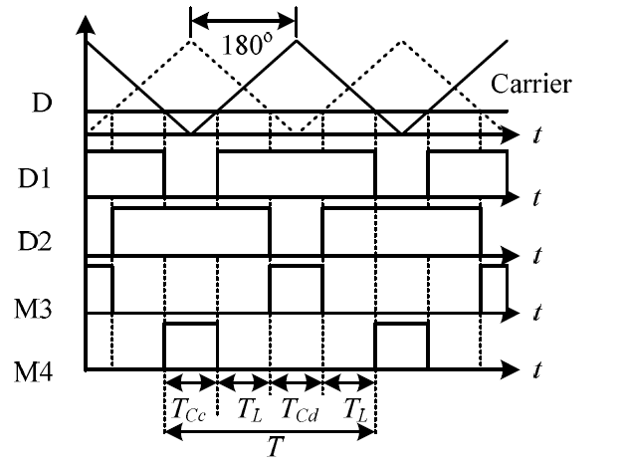
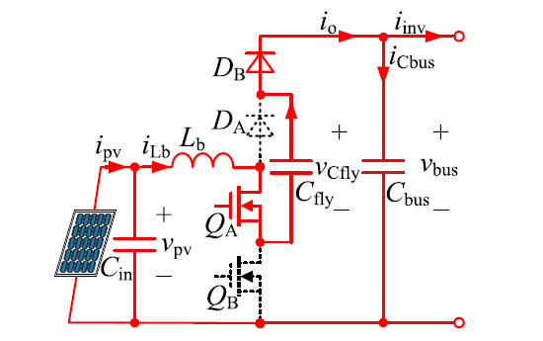
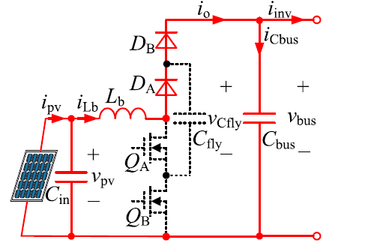
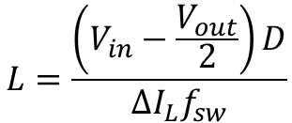

Inductor charging
Inductor charging
Flying capacitor charging
$$L=\frac{\left(V_{in}−\frac{V_{out}}{2}\right)D}{{ΔI_{L}f}_{sw}}$$
Inductor charging
Flying capacitor discharging
$900$➔ 300
Inductor discharging

Slide 4
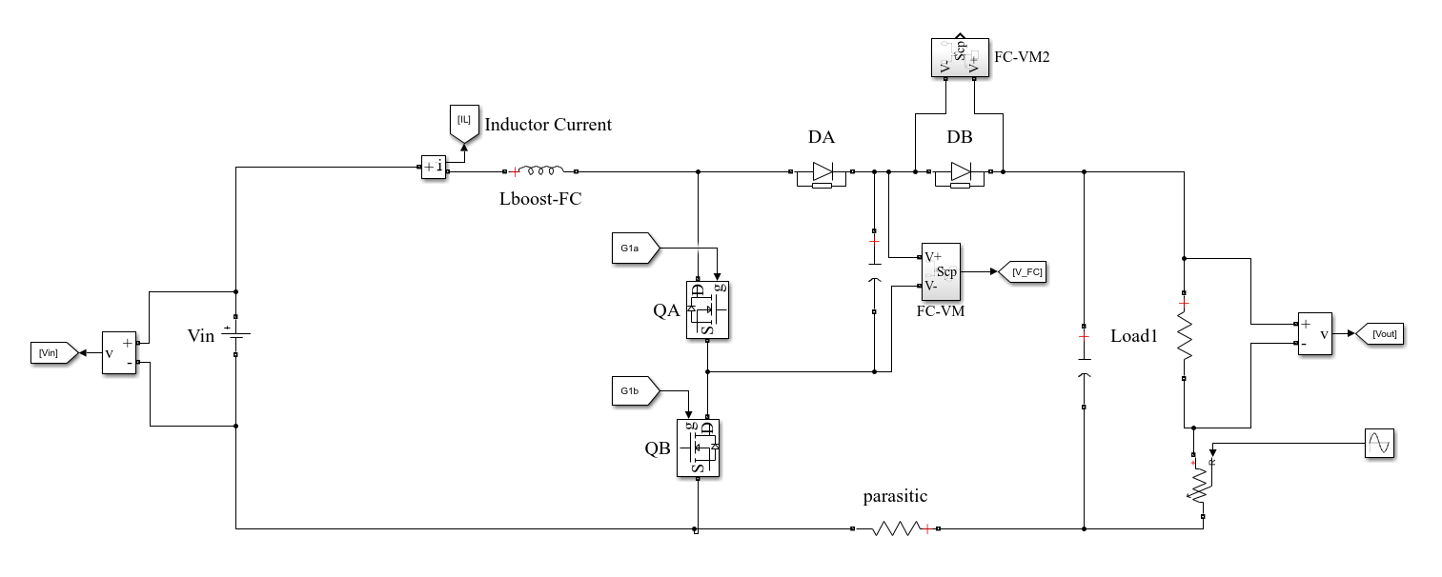
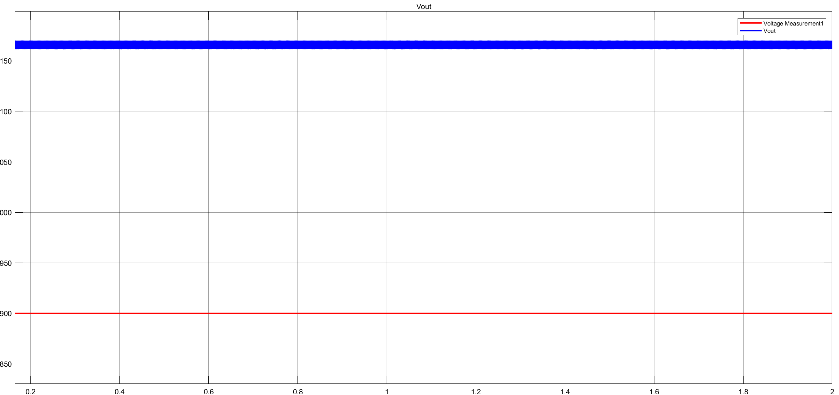
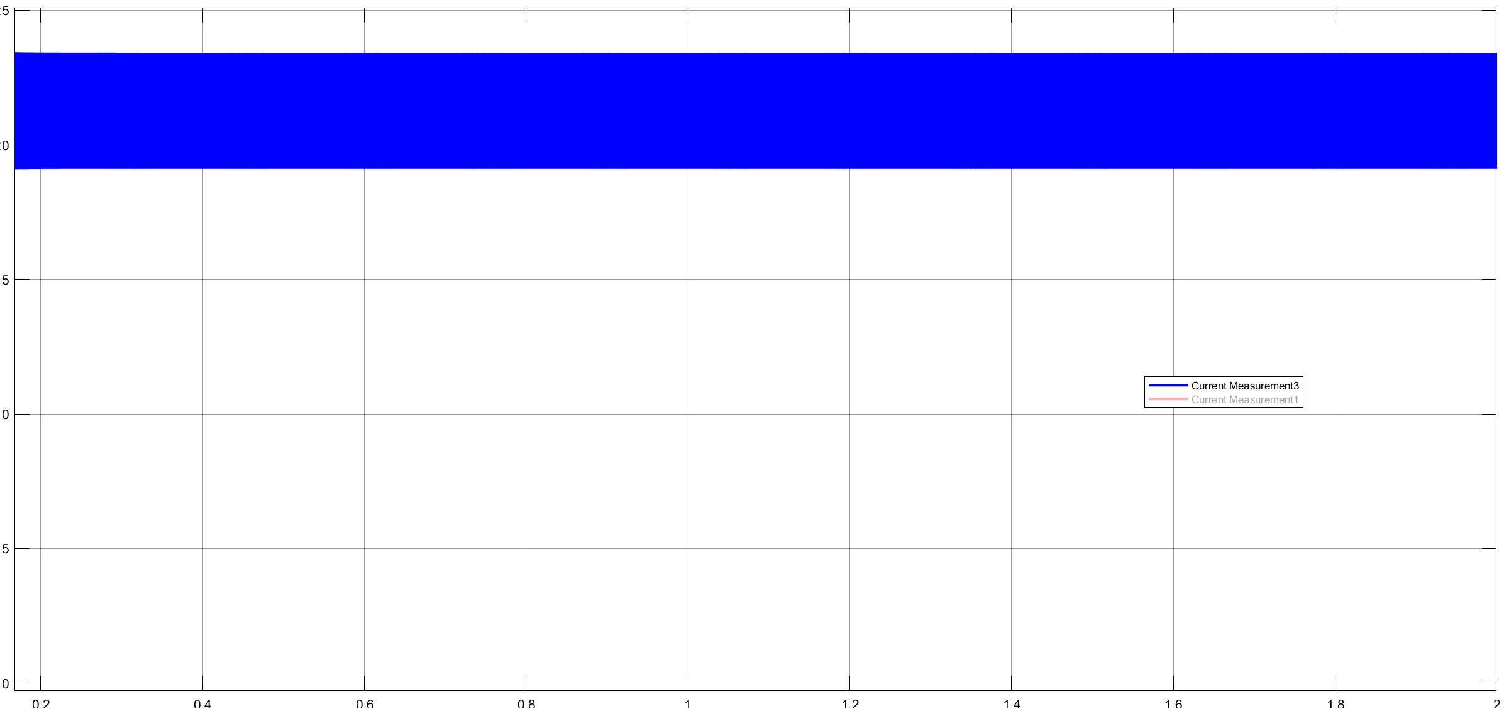
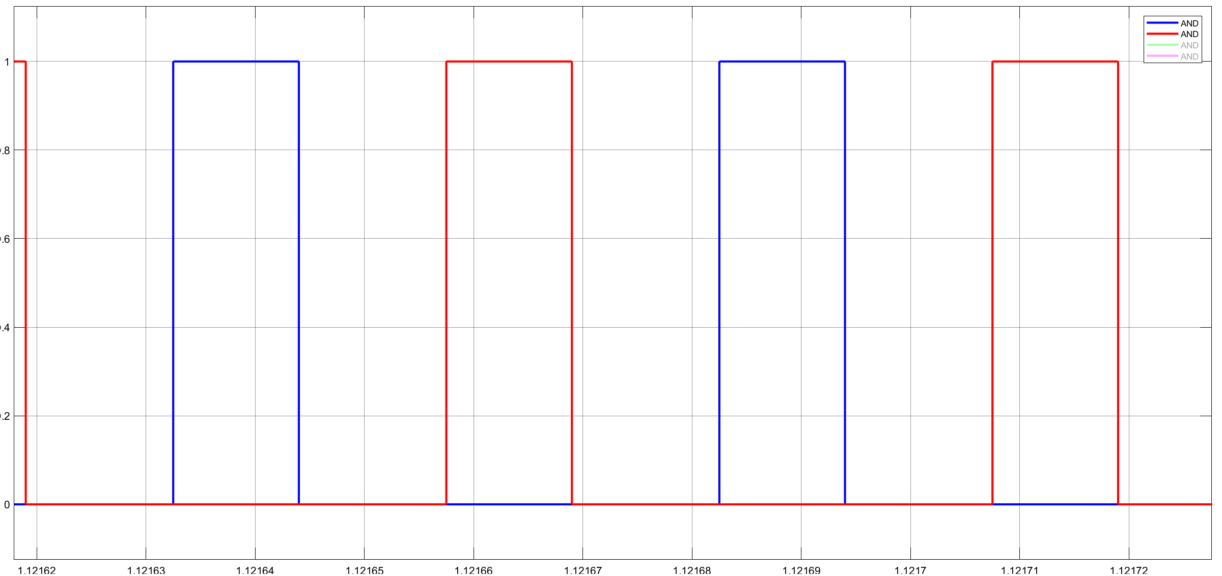
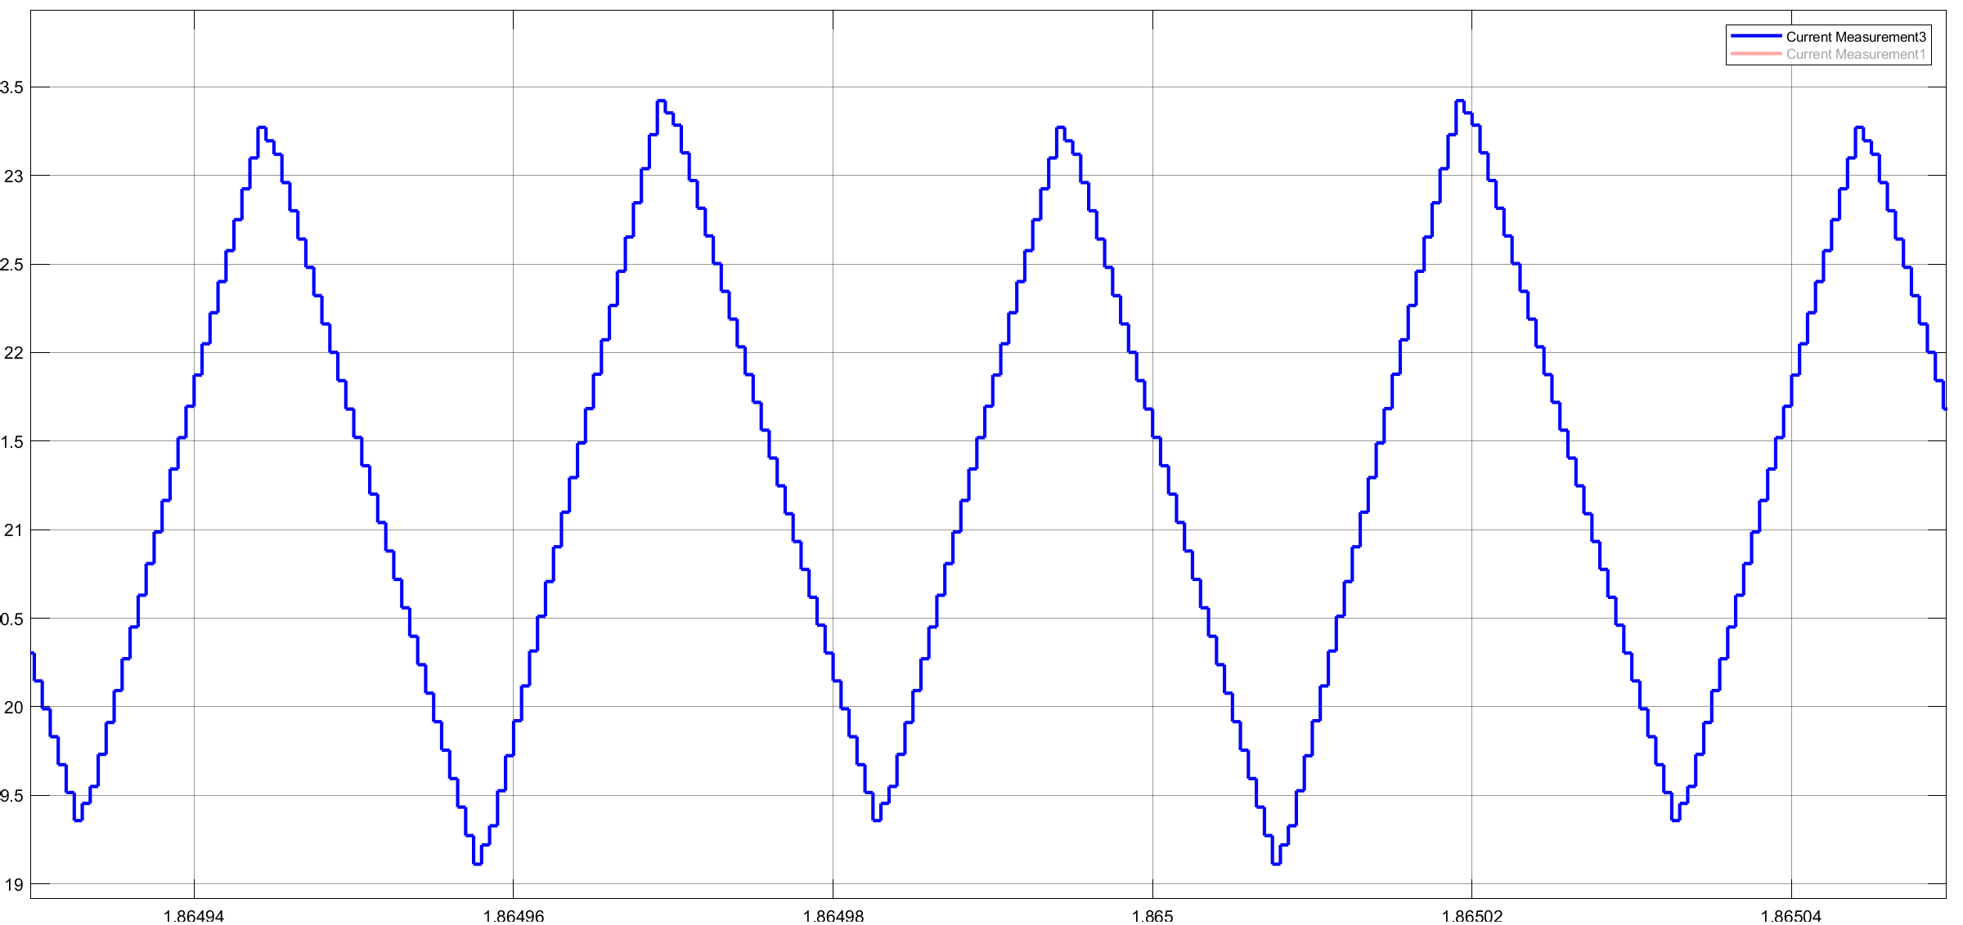
M3
M4

Slide 5
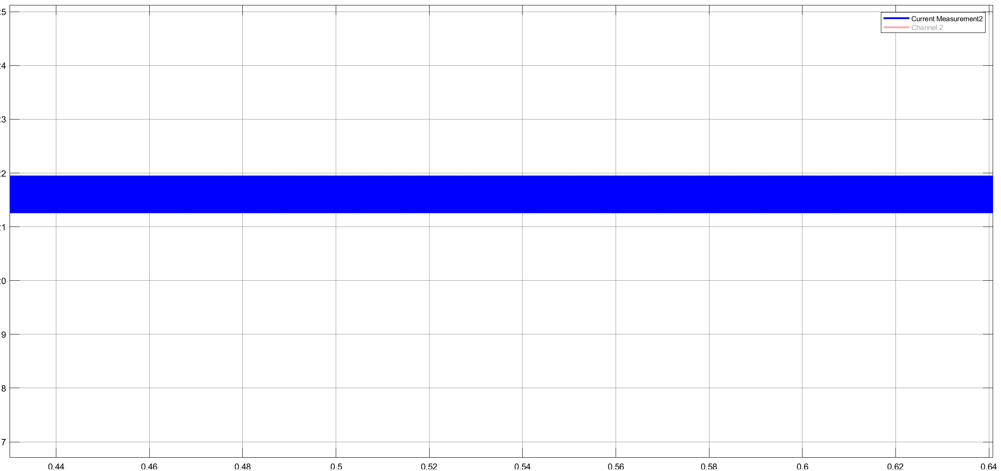
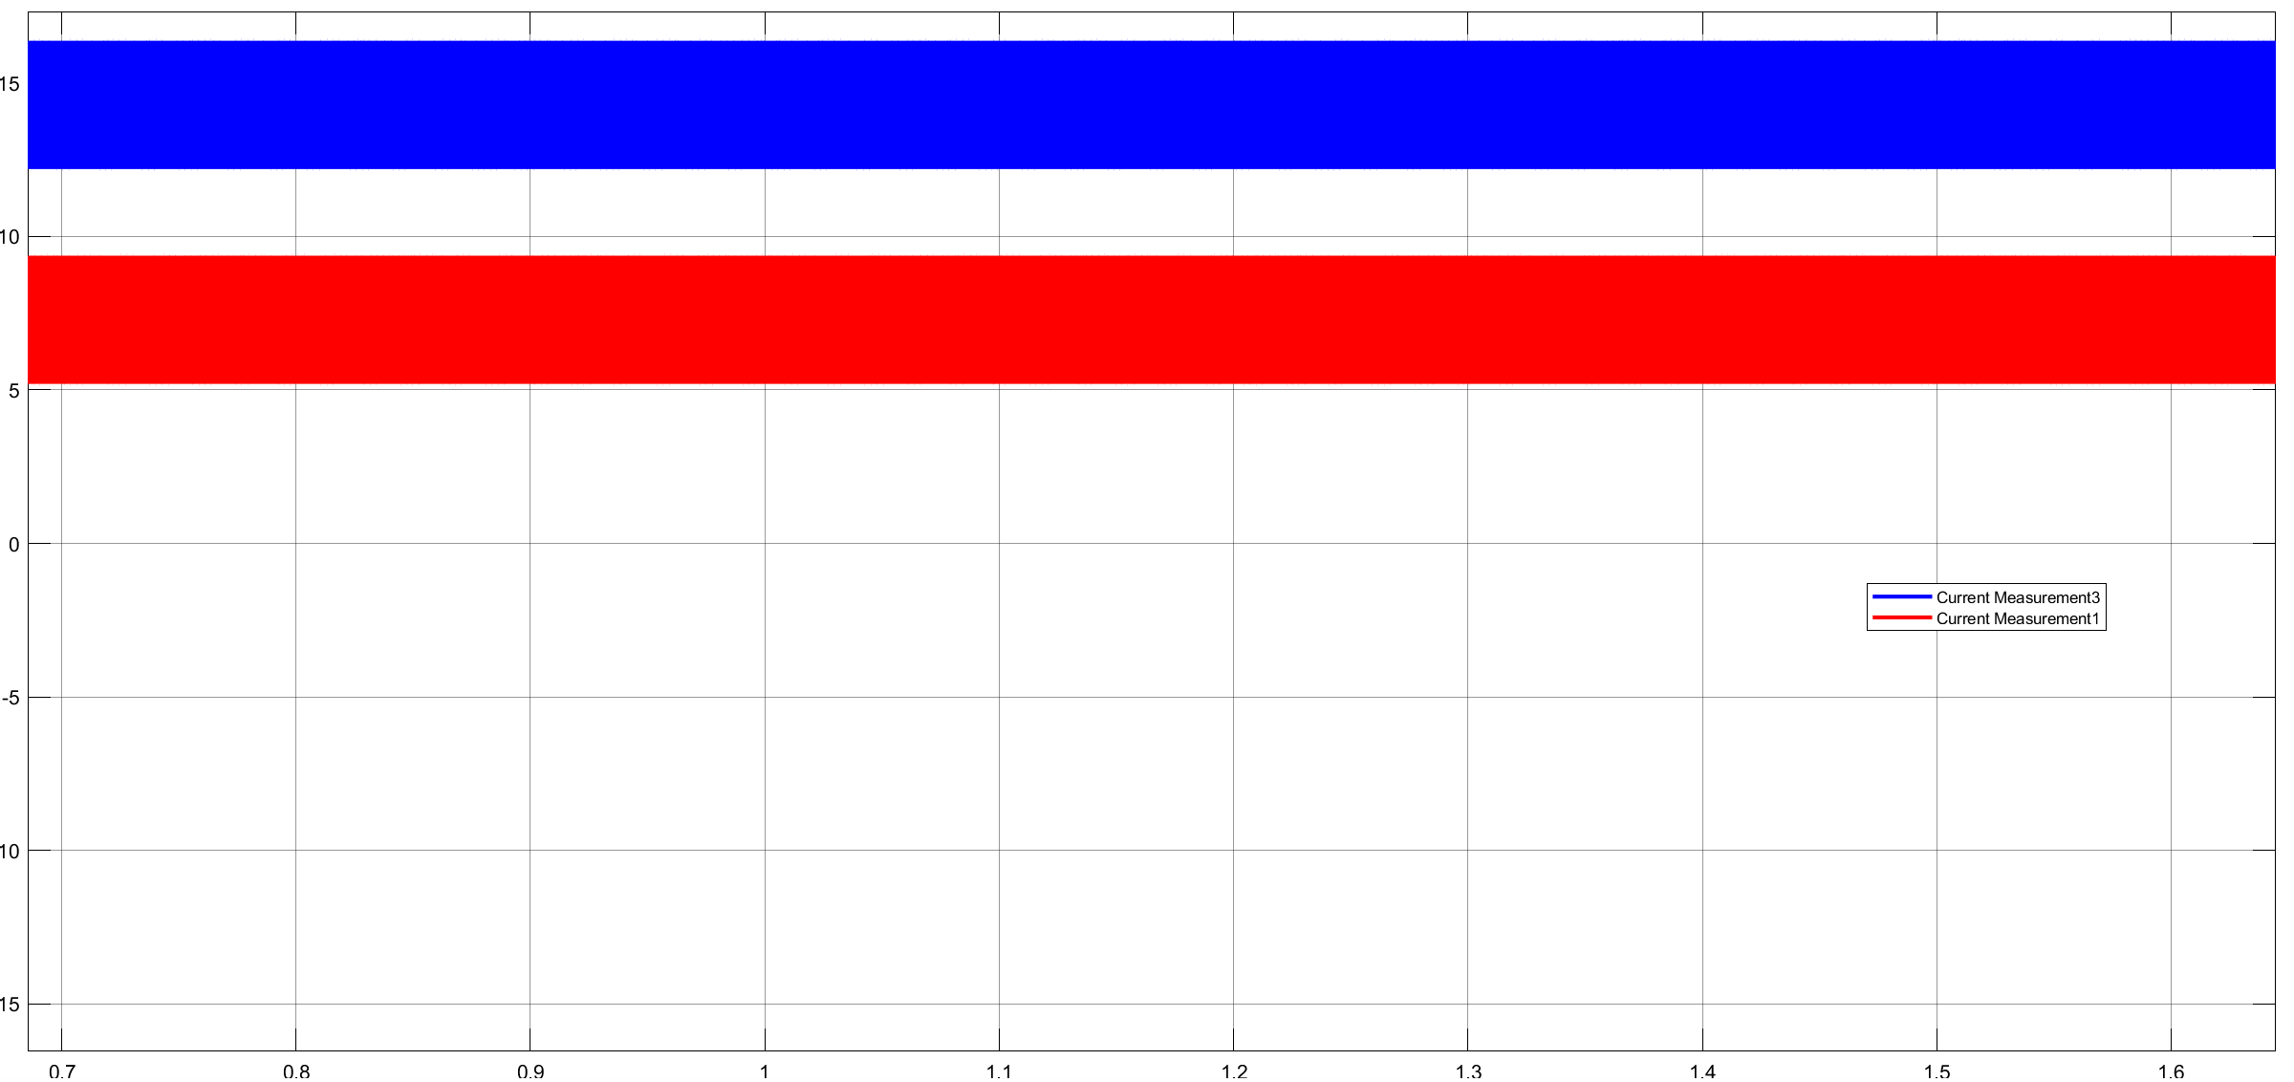
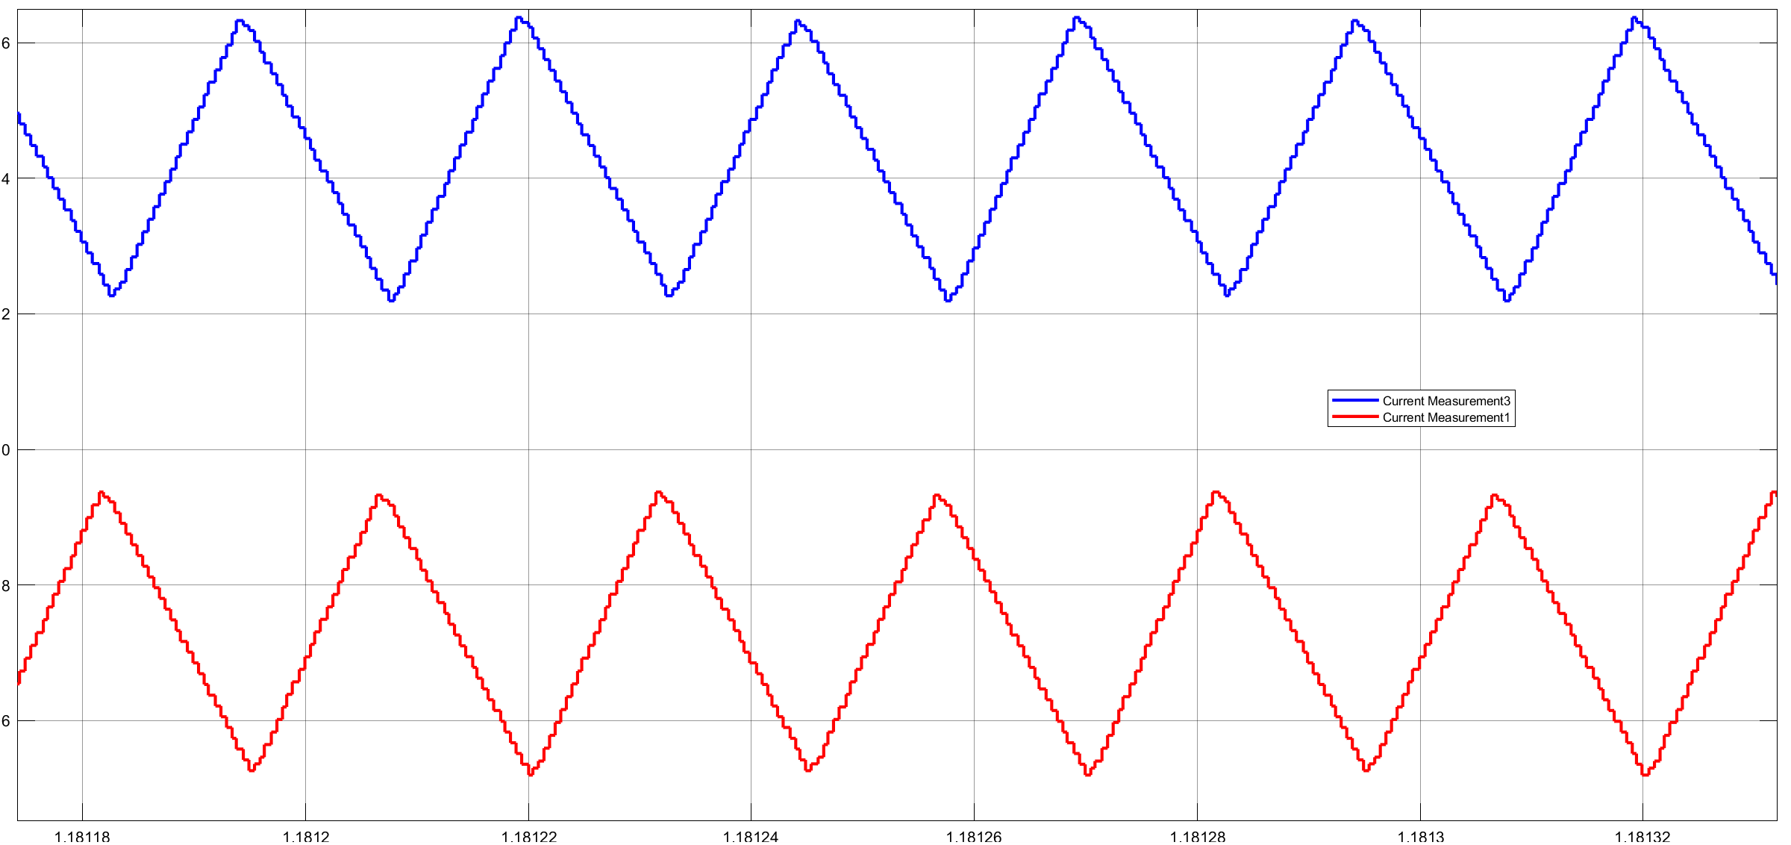
Input current
Module-1 current
Module-2 current
Interleaving

Slide 6
References ( Makaleler Mendeley’de DC-DC/ 3-Level-Boost/Flying capacitor BC 3-level dosyasında paylaşılmıştır.):
Second Harmonic Current Reduction for Flying Capacitor Clamped Boost Three-Level Converter in Photovoltaic Grid-Connected Inverter
Control Strategies and Power Decoupling Topologies to Mitigate 2!-Ripple in Single-Phase Inverters: A Review and Open Challenges
Development of DC to Single-Phase AC Voltage Source Inverter With Active Power Decoupling Based on Flying Capacitor DC/DC Converter
Parameters Design Evaluation in 3-level Flying Capacitor Boost Converter
Multiple Modulation Strategy of Flying Capacitor DC/DC Converter
Active Capacitor Voltage Balancing Control for Three-Level Flying Capacitor Boost Converter Based on Average-Behavior Circuit Model

