Slide 1
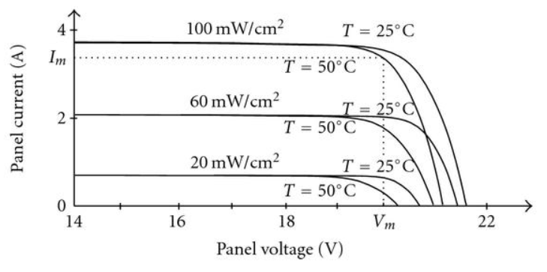
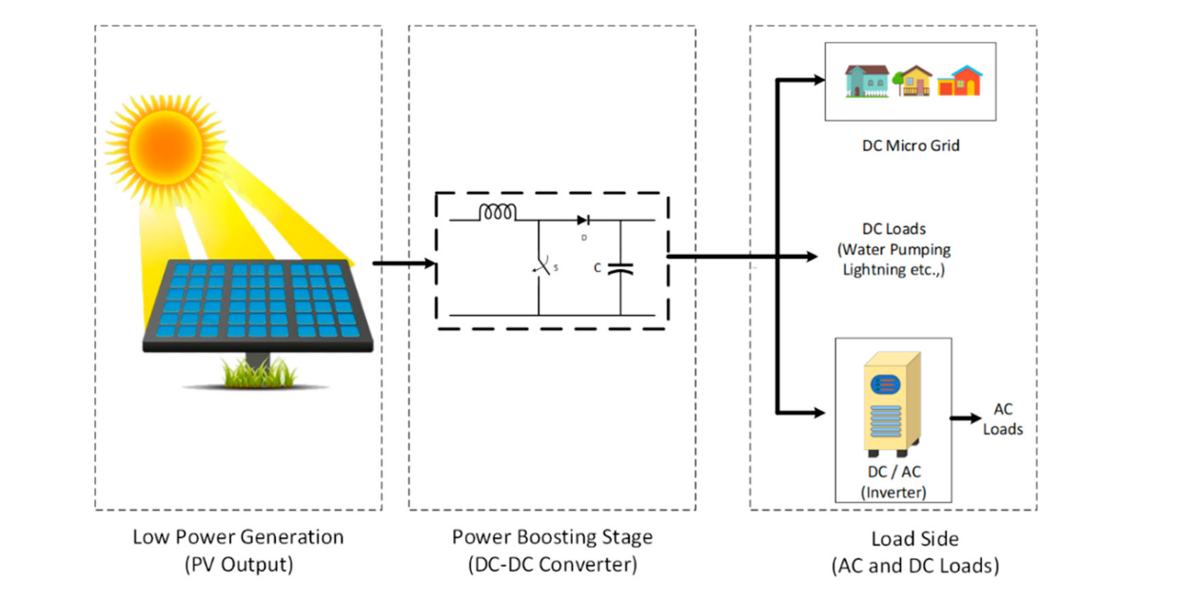
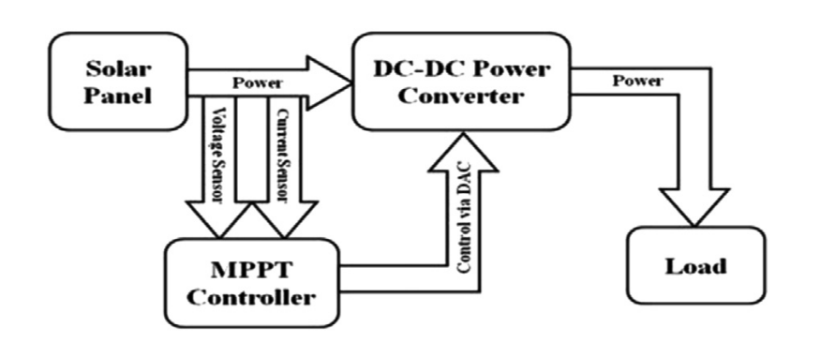

Slide 2
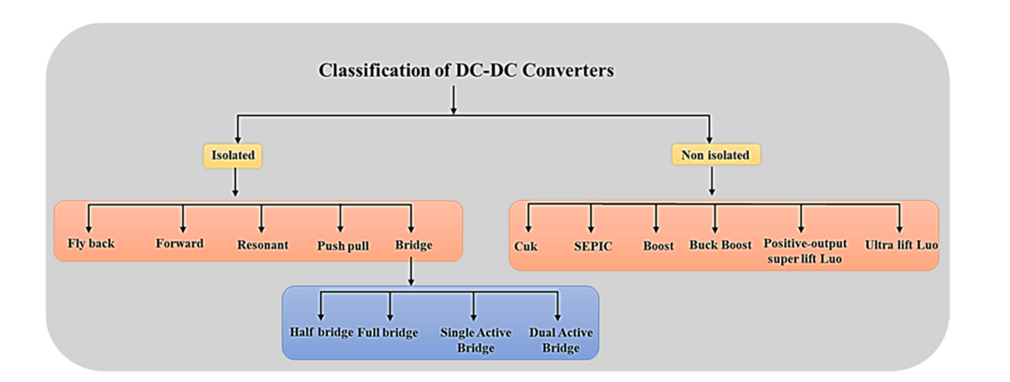
Isolated : lower EMI, transformer, higher cost, higher loss(if not resonant converter)
Non-isolated : Boost, buck boost, problem of common-mode voltage

Slide 3
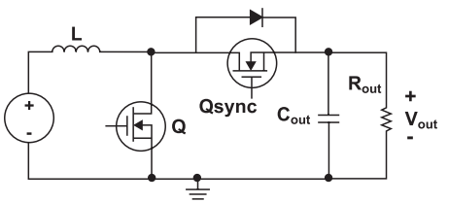
Synchronous boost
Si-based diode losses: Reverse Recovery, drop-voltage
MOSFET: Low Rdson, lower conduction losses

Slide 4
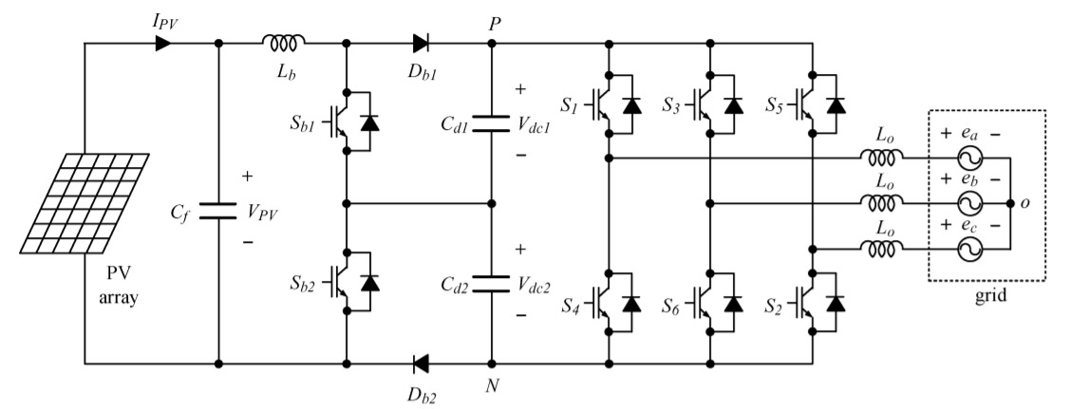
Three Level Boost
Switch voltage rating is halved.
Reduced switching loss and reverse recovery losses.
Voltage balancing control for capacitors

Slide 5
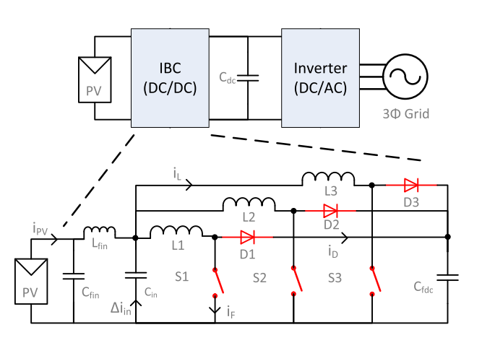
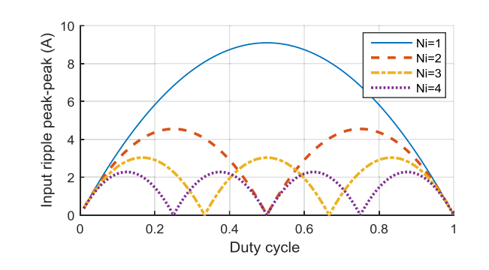
Interleaved boost
Switch and inductor currents 1/N
Total volume of the inductor 1/N
Effective frequency fsw*N
Input current ripple reduced by 1/N

Slide 6
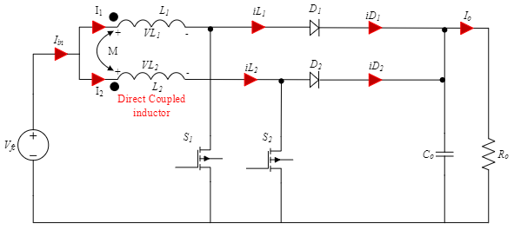
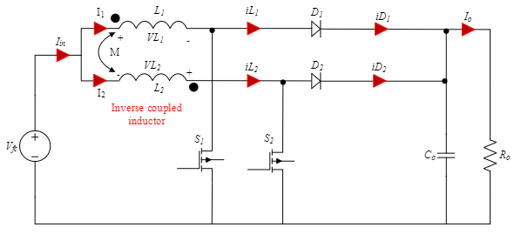
Interleaved Boost with Coupled Inductors

Slide 7
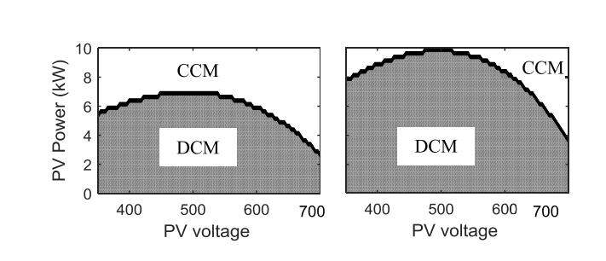
Losses
Soft-Switching
Material
Operation modes: DCM,CCM Resonant :ZVS,ZCS
Si vs SiC
Si-diode : Reverse recovery, drop-voltage
Si-Mosfet⇒ lower-frequency, low breakdown voltage and higher Rds-on
SiC: Higher frequency, low Rds-on, irradiance(?)

Slide 8
Articles | Topologies | Power ratings | Material | Features
[1] | IBC(coupled inductor) | 500W | Si | ZVS, high voltage gain
[2] | BC(with additional resonant level) | 10kW | 900V-SiC | ZVS,1500V-DC
[3] | IBC | 10kW | 1200V-SiC | 47kHz,Powdered iron core
[4] | BC vs BBC | 22kW | 1200V SiC | Efficiency
[5] | IBC(coupled inductor) | 1kW | Si | Magnetic losses and inductor size
[6] | IBC | - | - | (#module cost and reliability)
[7] | CRD-60DD12N | 60kW | SiC-1200V | 4x15kW IBC,850VDC

Slide 9
Articles | Topologies | Power ratings | Material | Features
[8] | IMMC Boost Converter | 1MW/ 500W | SiC 6.5kV | modular, power sharing issues
[9] | IBS (soft switching) | 1.2kW | IGBT | single switch, additional resonator

Slide 10
[1] M. Muhammad, M. Armstrong and M. A. Elgendy, "A Nonisolated Interleaved Boost Converter for High-Voltage Gain Applications," in IEEE Journal of Emerging and Selected Topics in Power Electronics, vol. 4, no. 2, pp. 352-362, June 2016, doi: 10.1109/JESTPE.2015.2488839.
[2] B. Stevanović, D. Serrano, M. Vasić, P. Alou, J. A. Oliver and J. A. Cobos, "Highly Efficient, Full ZVS, Hybrid, Multilevel DC/DC Topology for Two-Stage Grid-Connected 1500-V PV System With Employed 900-V SiC Devices," in IEEE Journal of Emerging and Selected Topics in Power Electronics, vol. 7, no. 2, pp. 811-832, June 2019, doi: 10.1109/JESTPE.2019.2893106.
[3] G. R. Chandra Mouli, J. H. Schijffelen, P. Bauer and M. Zeman, "Design and Comparison of a 10-kW Interleaved Boost Converter for PV Application Using Si and SiC Devices," in IEEE Journal of Emerging and Selected Topics in Power Electronics, vol. 5, no. 2, pp. 610-623, June 2017, doi: 10.1109/JESTPE.2016.2601165.
[4] B. Stevanović, E. Serban, M. Vasić, M. Ordonez, S. Cóbreces and P. Alou, "Energy Harvesting Comparison and Analysis in 1000V and 1500V Grid-Connected PV Systems," 2020 IEEE Energy Conversion Congress and Exposition (ECCE), 2020, pp. 116-123, doi: 10.1109/ECCE44975.2020.9236312.
[5] Nandakumar Selvaraju, Prabhuraj Shanmugham, Sakda Somkun,
Two-Phase Interleaved Boost Converter Using Coupled Inductor for Fuel Cell Applications,Energy Procedia,
Volume 138,2017,Pages 199-204,ISSN 1876-6102,https://doi.org/10.1016/j.egypro.2017.10.150.
(https://www.sciencedirect.com/science/article/pii/S1876610217350932)
[6] F. H. Aghdam and M. Abapour, "Reliability and Cost Analysis of Multistage Boost Converters Connected to PV Panels," in IEEE Journal of Photovoltaics, vol. 6, no. 4, pp. 981-989, July 2016, doi: 10.1109/JPHOTOV.2016.2566885.

Slide 11
[7]https://www.wolfspeed.com/downloads/dl/file/id/1545/product/424/crd_60dd12n_application_note.pdf
[8] F. M. Alhuwaishel, A. K. Allehyani, S. A. S. Al-Obaidi and P. N. Enjeti, "A Medium-Voltage DC-Collection Grid for Large-Scale PV Power Plants With Interleaved Modular Multilevel Converter," in IEEE Journal of Emerging and Selected Topics in Power Electronics, vol. 8, no. 4, pp. 3434-3443, Dec. 2020, doi: 10.1109/JESTPE.2019.2934736.
[9] D. Jung, Y. Ji, S. Park, Y. Jung and C. Won, "Interleaved Soft-Switching Boost Converter for Photovoltaic Power-Generation System," in IEEE Transactions on Power Electronics, vol. 26, no. 4, pp. 1137-1145, April 2011, doi: 10.1109/TPEL.2010.2090948.
[10] A. B. Ponniran and M. A. N. B. Kasiran, "Parameters design evaluation in 3-level flying capacitor boost converter," 2017 IEEE Symposium on Computer Applications & Industrial Electronics (ISCAIE), 2017, pp. 195-199, doi: 10.1109/ISCAIE.2017.8074976.

Slide 12
[11] S. Kan, X. Ruan, X. Huang and H. Dang, "Second Harmonic Current Reduction for Flying Capacitor Clamped Boost Three-Level Converter in Photovoltaic Grid-Connected Inverter," in IEEE Transactions on Power Electronics, vol. 36, no. 2, pp. 1669-1679, Feb. 2021, doi: 10.1109/TPEL.2020.3007806.
[12] C. Xia, X. Gu, T. Shi and Y. Yan, "Neutral-Point Potential Balancing of Three-Level Inverters in Direct-Driven Wind Energy Conversion System," in IEEE Transactions on Energy Conversion, vol. 26, no. 1, pp. 18-29, March 2011, doi: 10.1109/TEC.2010.2060487.

