Slide 1
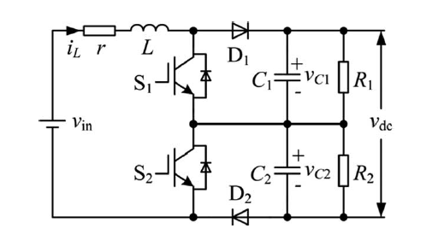
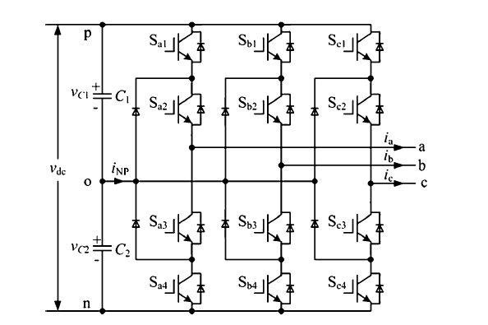
Problem Definition
3-level Boost Converter
3-Phase Inverter
A fluctuation of neutral-point potential
(due to an NPC type inverter)
The inverter is equivalent to variable resistive loads

Slide 2
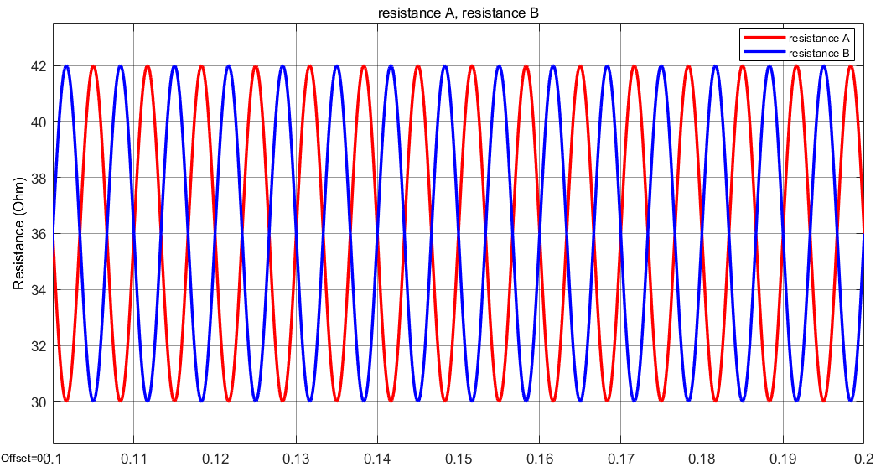
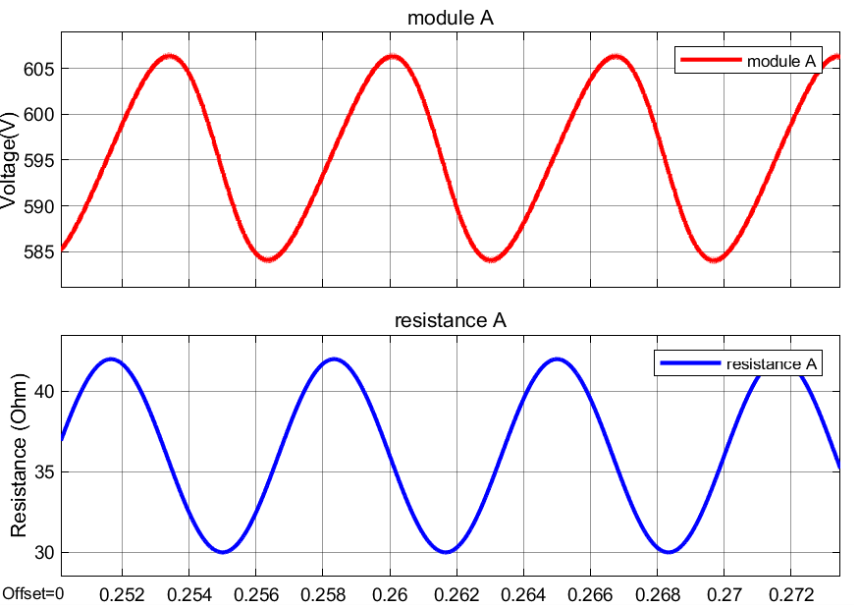
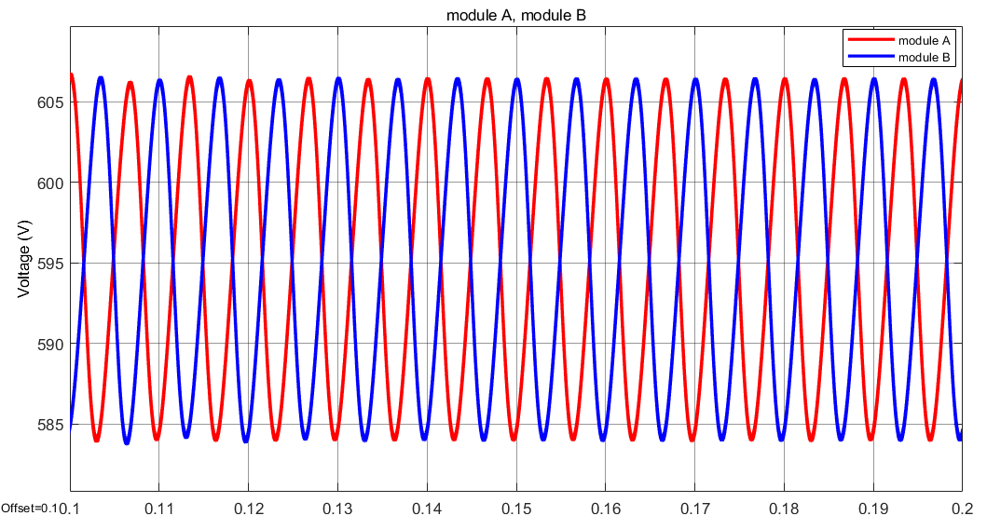
Vout = 1190 V

Slide 3
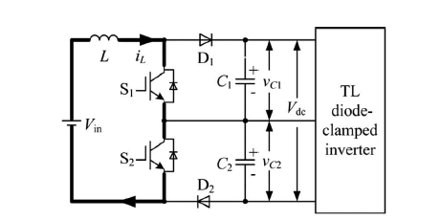
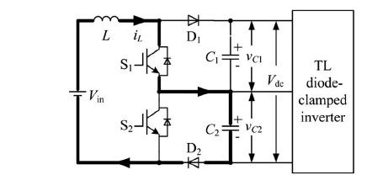
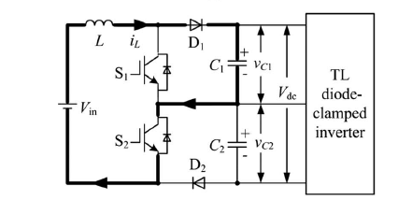
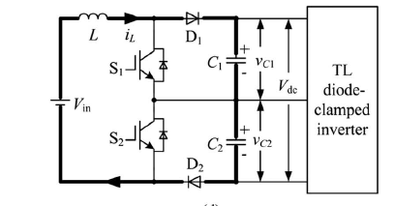
Operation modes
 | #1 | #2 | #3 | #4
S1 | on | on | off | off
D1 | off | off | on | on
S2 | on | off | on | off
D2 | off | on | off | on
#1
#2
Discharge
C1, C2
Charge C1
Discharge C2
#3
Discharge C1
Charge C2
Charge
C1,C2
#4

Slide 4
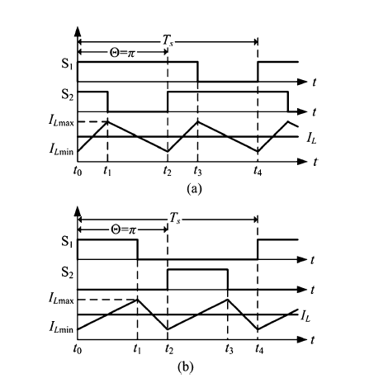
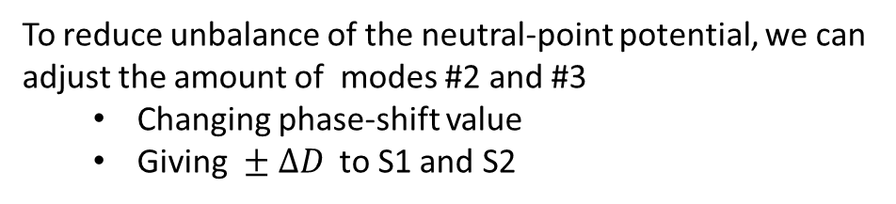

To reduce unbalance of the neutral-point potential, we can adjust the amount of modes #2 and #3
Changing phase-shift value
Giving $± ΔD$ to S1 and S2
For these two methods, the voltage gain ratio of the boost converter stay the same. ( $\frac{1}{1−D}$ )
a) D>0.5 b) D<0.5

Slide 5
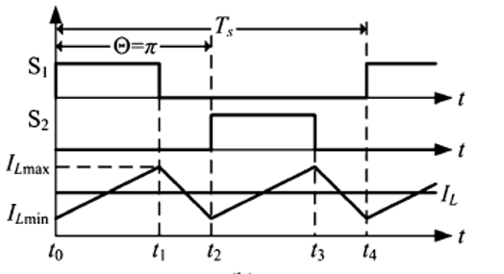
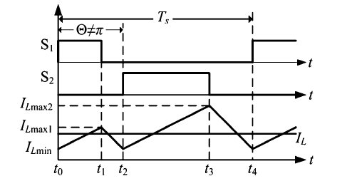

















Phase-Shift
Duty-Cycle Change
$$T_{s}$$
$$D+ΔD$$
$$D−ΔD$$
$$S_{1}$$
$$t$$
$$S_{2}$$
$$t$$
$$I_{Lmax2}$$
$$I_{Lmax1}$$
$$I_{L}$$
$$I_{Lmin}$$
$$t$$
$$t_{0}$$
$$t_{1}$$
$$t_{3}$$
$$t_{4}$$
$$t_{2}$$

Slide 6
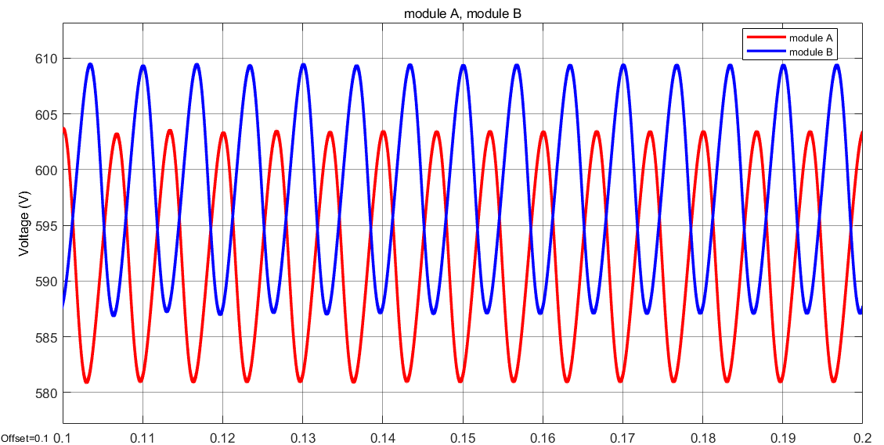
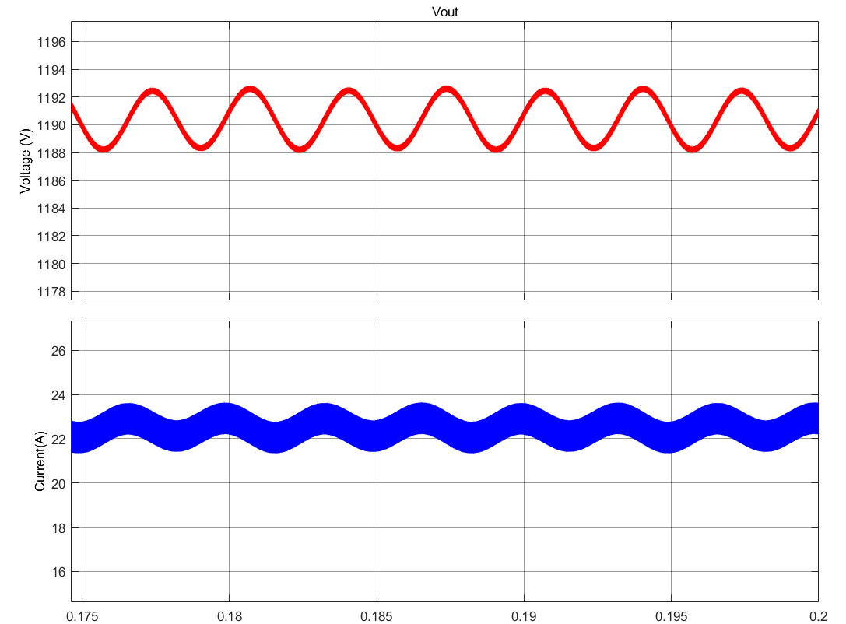
Equal D with unequal resistances

Slide 7
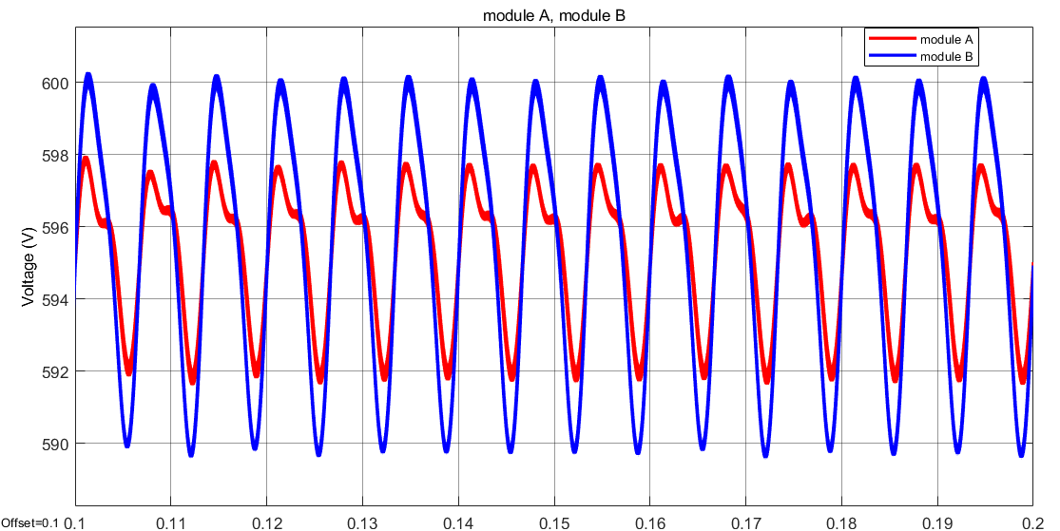
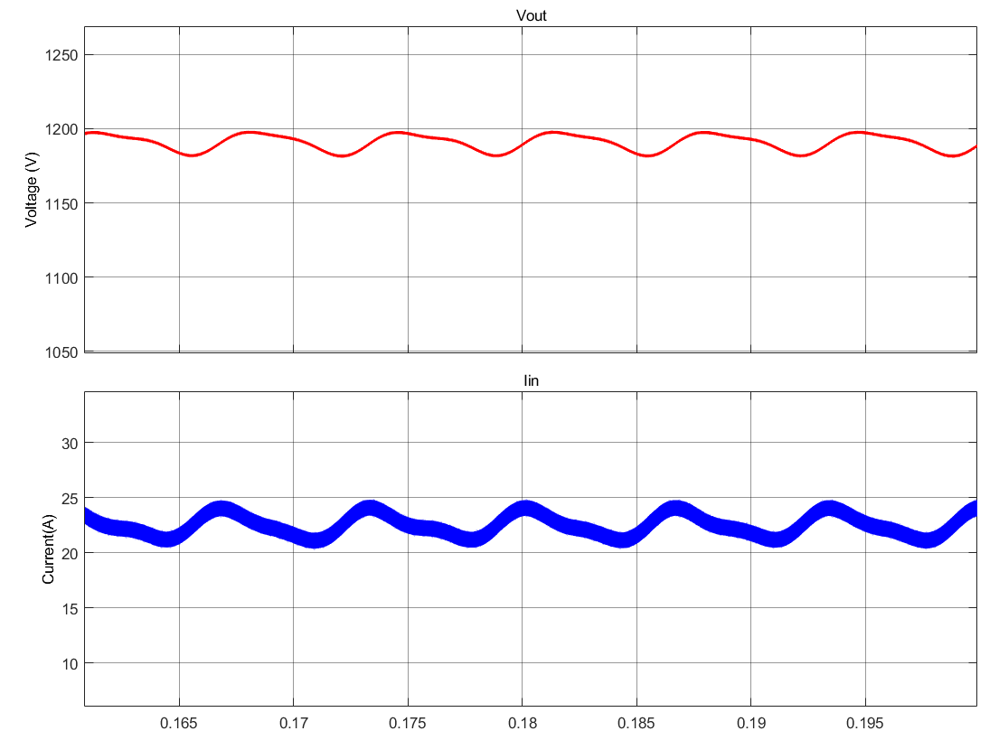

Added $±ΔD$ with unequal resistances
Low-frequency ripple of input current and output voltage increases.
Unbalance between the modules is decreased.

Slide 8
[1] Neutral-Point Potential Balancing of Three-Level Inverters in Direct-Driven Wind Energy Conversion System
[2] Pulse delay control for capacitor voltage balancing in a three-level boost neutral point clamped inverter

