Slide 1
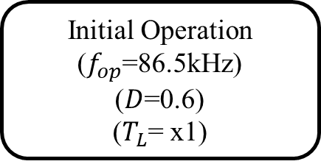
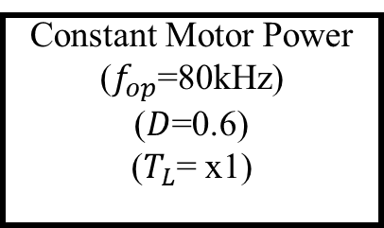
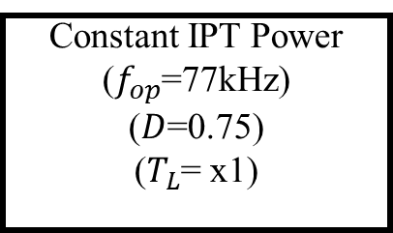
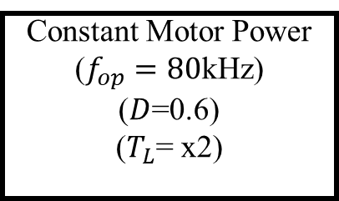
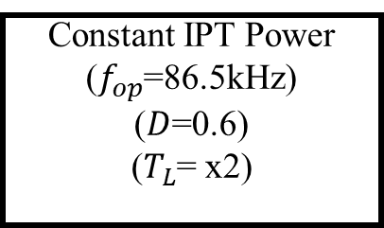
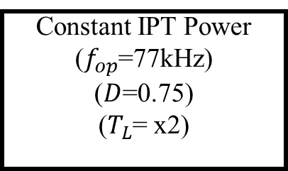
Initial Operation
($f_{op}$=86.5kHz)
($D$=0.6)
($T_{L}$= x1)
Motor
Speed
Control
Constant IPT Power
($f_{op}$=77kHz)
($D$=0.75)
($T_{L}$= x1)
A
B
IPT Power
Control
Motor Load
Changes
Constant Motor Power
($f_{op}$=80kHz)
($D$=0.6)
($T_{L}$= x1)
Constant IPT Power
($f_{op}$=77kHz)
($D$=0.75)
($T_{L}$= x2)
F
C
Motor Load
Changes
Motor
Speed
Control
Constant Motor Power
($f_{op}=80$kHz)
($D$=0.6)
($T_{L}$= x2)
Constant IPT Power
($f_{op}$=86.5kHz)
($D$=0.6)
($T_{L}$= x2)
E
D
IPT Power
Control

Slide 2
Experimental data will be expended.
Above 100 kHz (102.5 105)

Slide 3
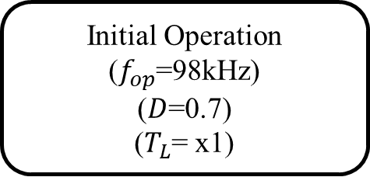
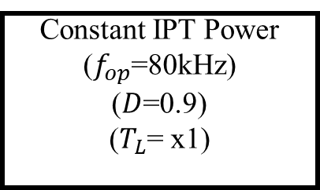
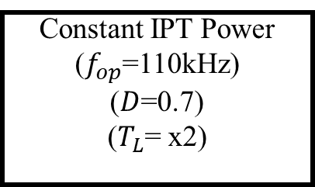
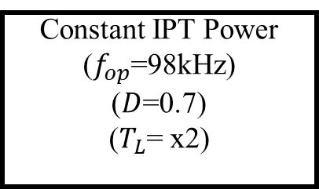
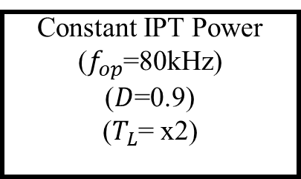
E
B
Constant IPT Power
($f_{op}$=110kHz)
($D$=0.7)
($T_{L}$= x2)
Motor
Speed
Control
Constant IPT Power
($f_{op}$=80kHz)
($D$=0.9)
($T_{L}$= x1)
A
Initial Operation
($f_{op}$=98kHz)
($D$=0.7)
($T_{L}$= x1)
IPT Power
Control
Motor Load
Changes
Constant IPT Power
($f_{op}$=98kHz)
($D$=0.7)
($T_{L}$= x2)
Constant IPT Power
($f_{op}$=80kHz)
($D$=0.9)
($T_{L}$= x2)
Motor Speed Control
D
C

Slide 4
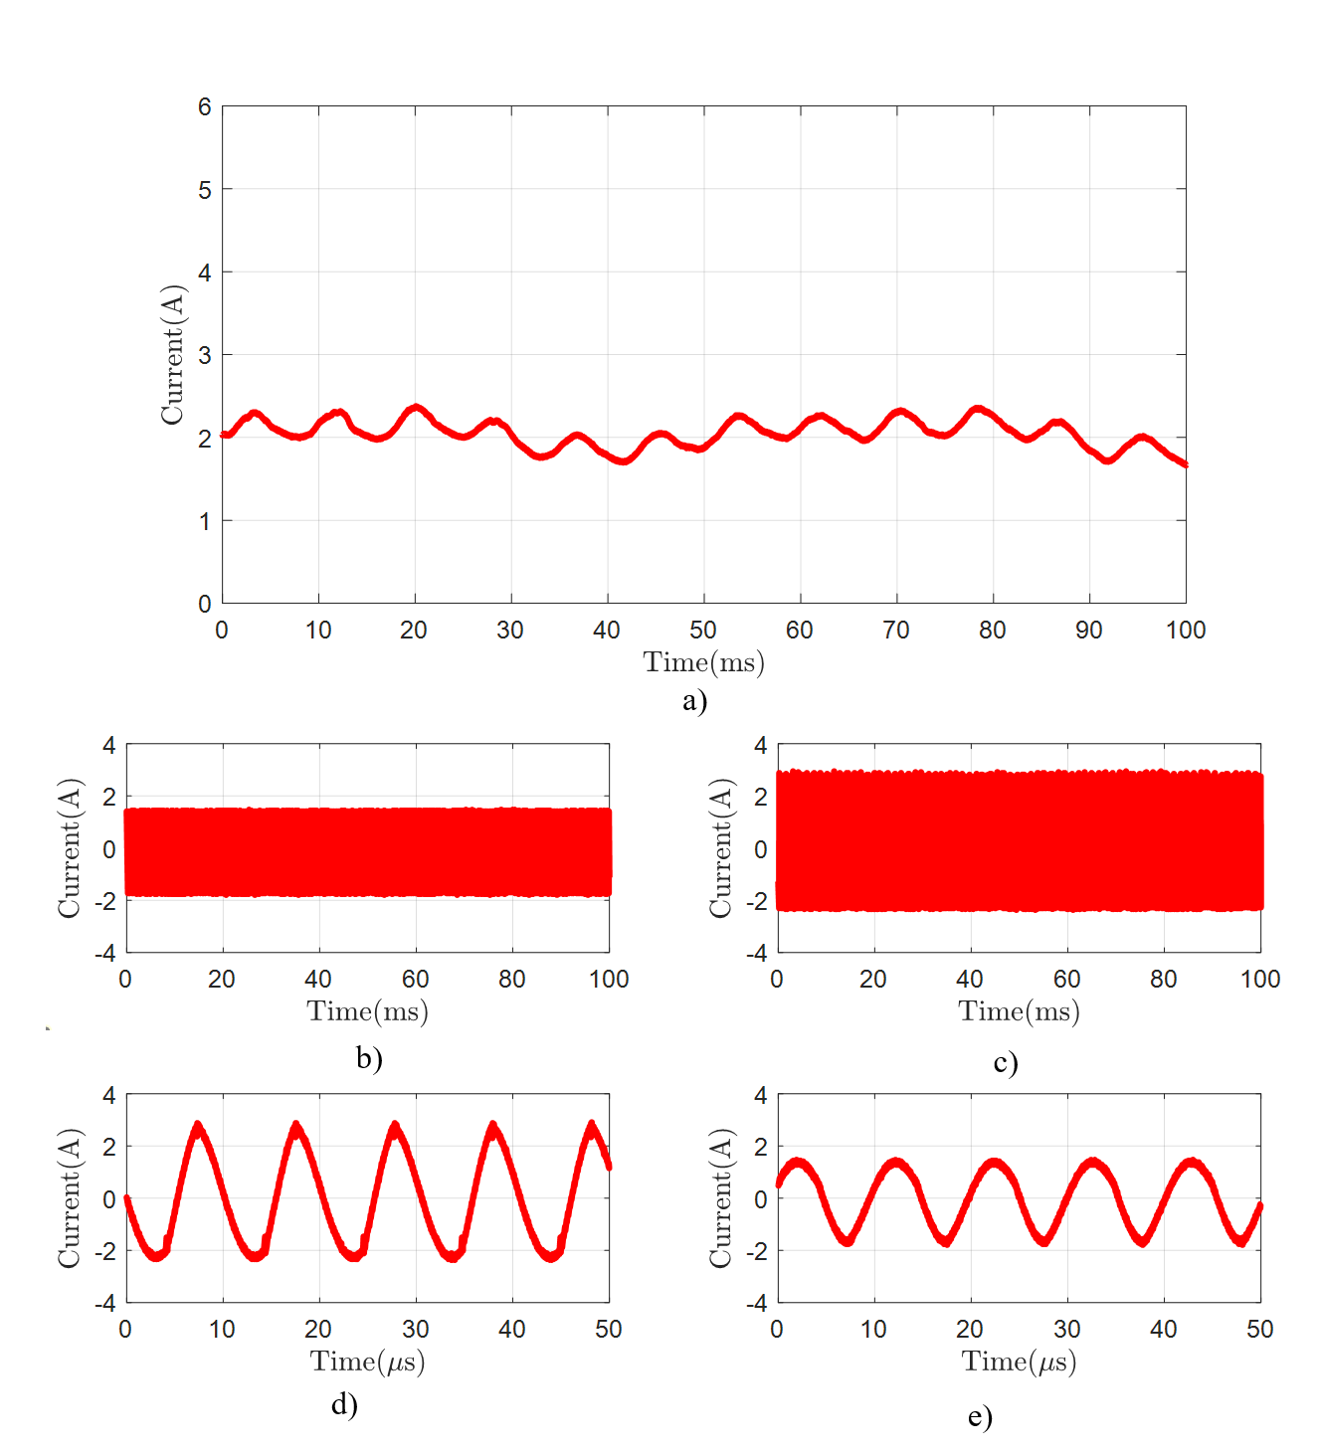
Frequency | 98kHz
Duty Cycle | 0.7
Tx-Current | 1.724A (rms)
Rx-Current | 1.066A (rms)
Motor-Current | 2.05 A (mean)
Motor-Speed | 243 rpm

Slide 5
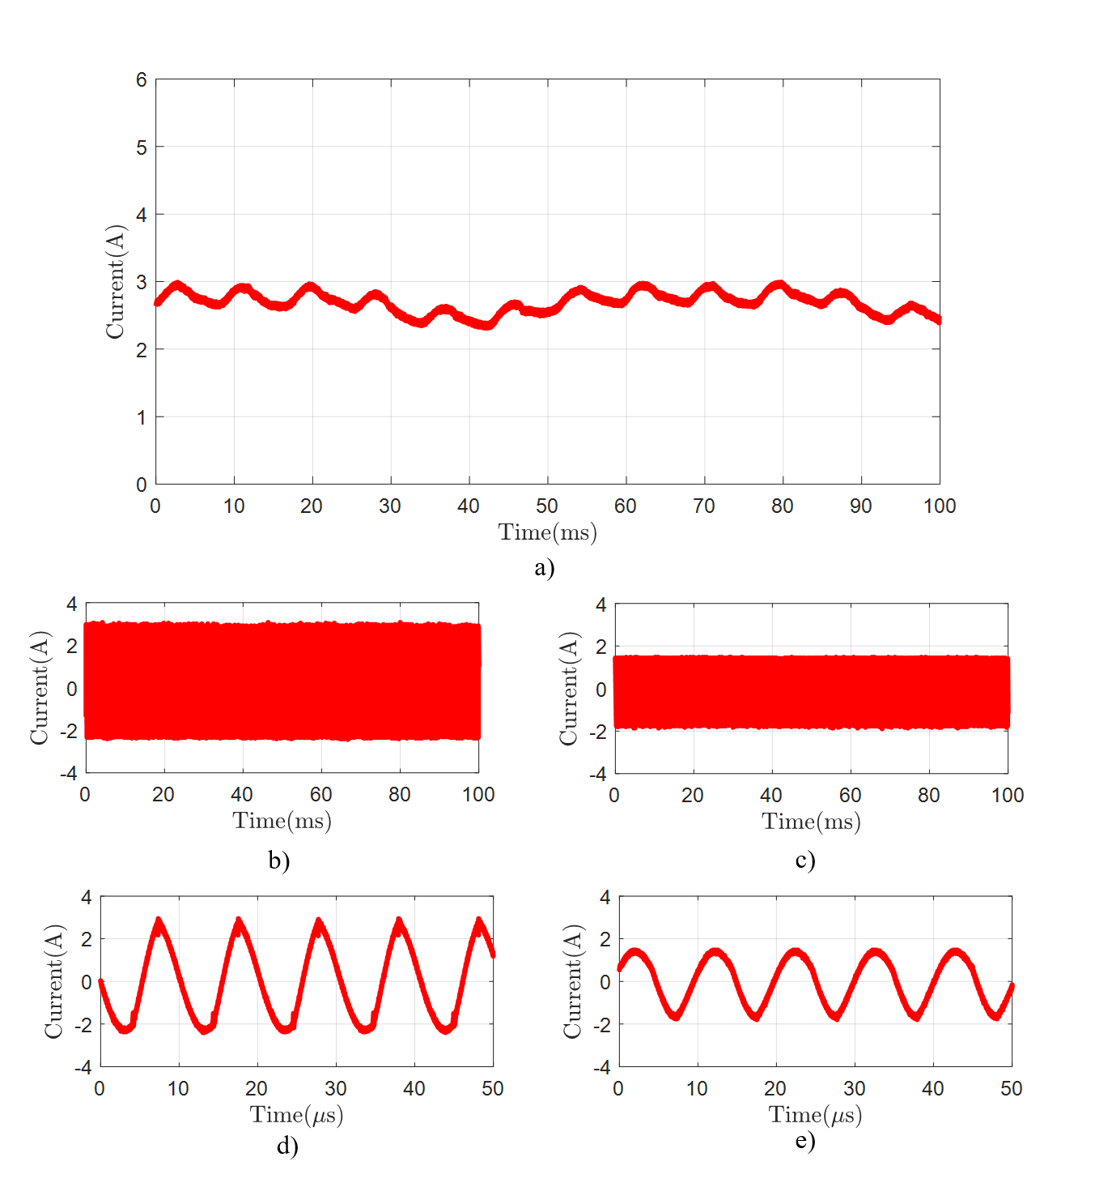
Frequency | 98kHz
Duty Cycle | 0.7
Tx-Current | 1.724A (rms)
Rx-Current | 1.08A (rms)
Motor-Current | 2.7 A (mean)
Motor-Speed | 250 rpm

Slide 6
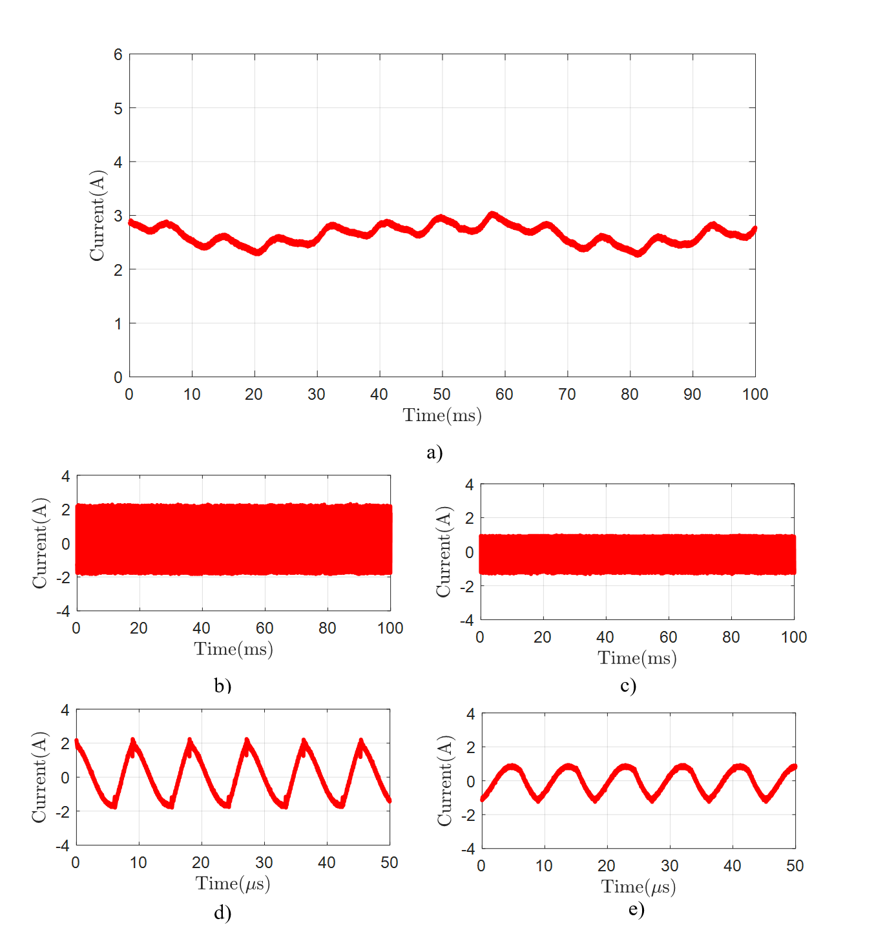
Frequency | 110kHz
Duty Cycle | 0.7
Tx-Current | 1.211A (rms)
Rx-Current | 0.67A (rms)
Motor-Current | 2.64 A (mean)
Motor-Speed | 242 rpm

Slide 7
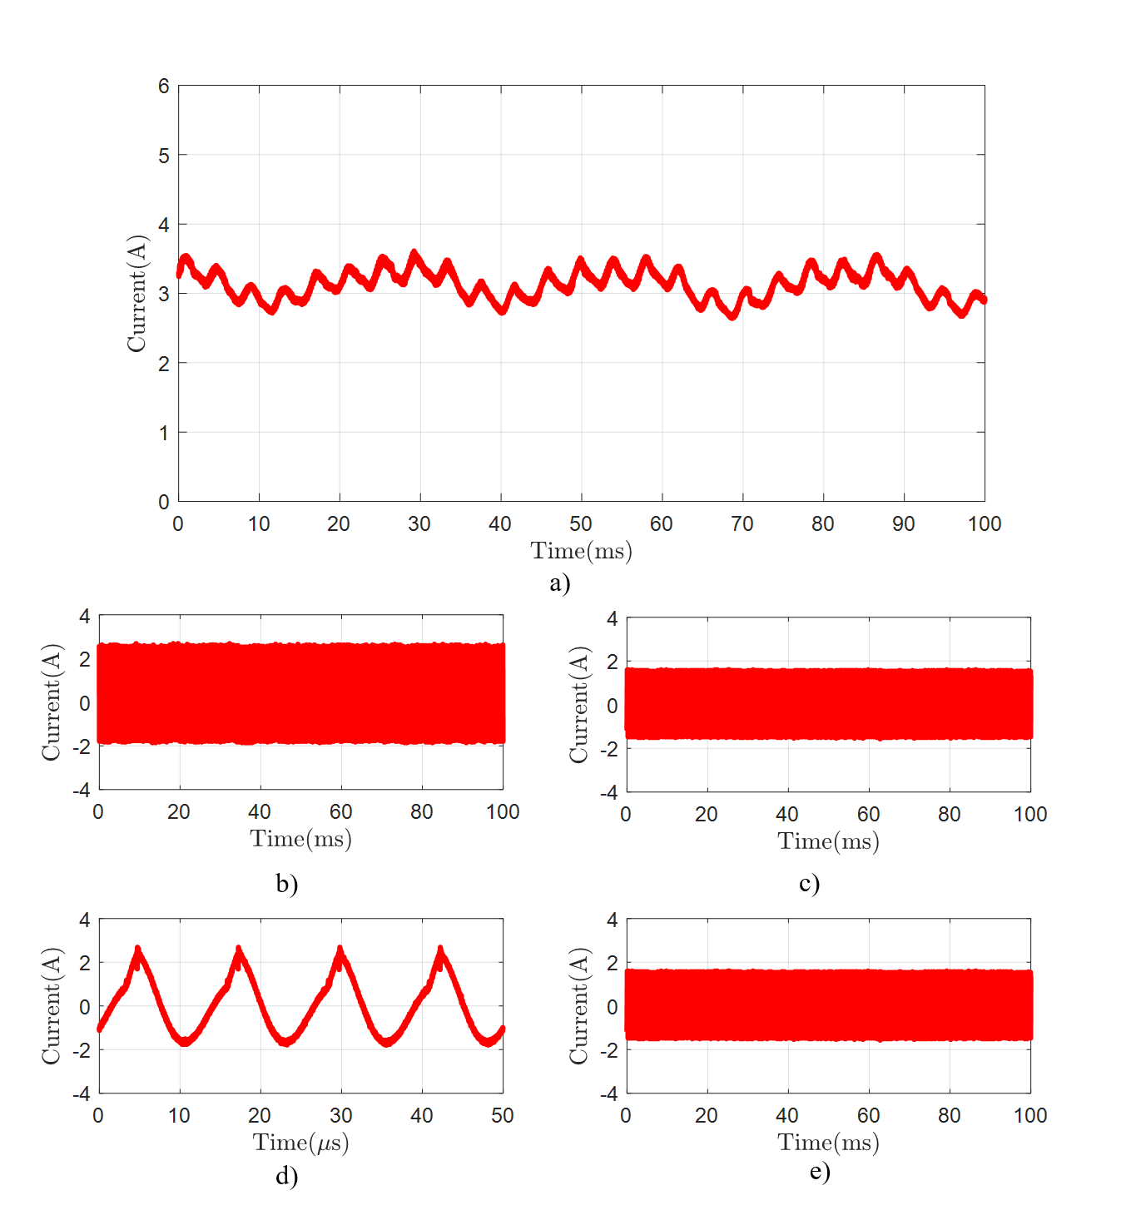
Frequency | 80kHz
Duty Cycle | 0.9
Tx-Current | 1.28A (rms)
Rx-Current | 1.037A (rms)
Motor-Current | 3.12 A (mean)
Motor-Speed | 501 rpm

Slide 8
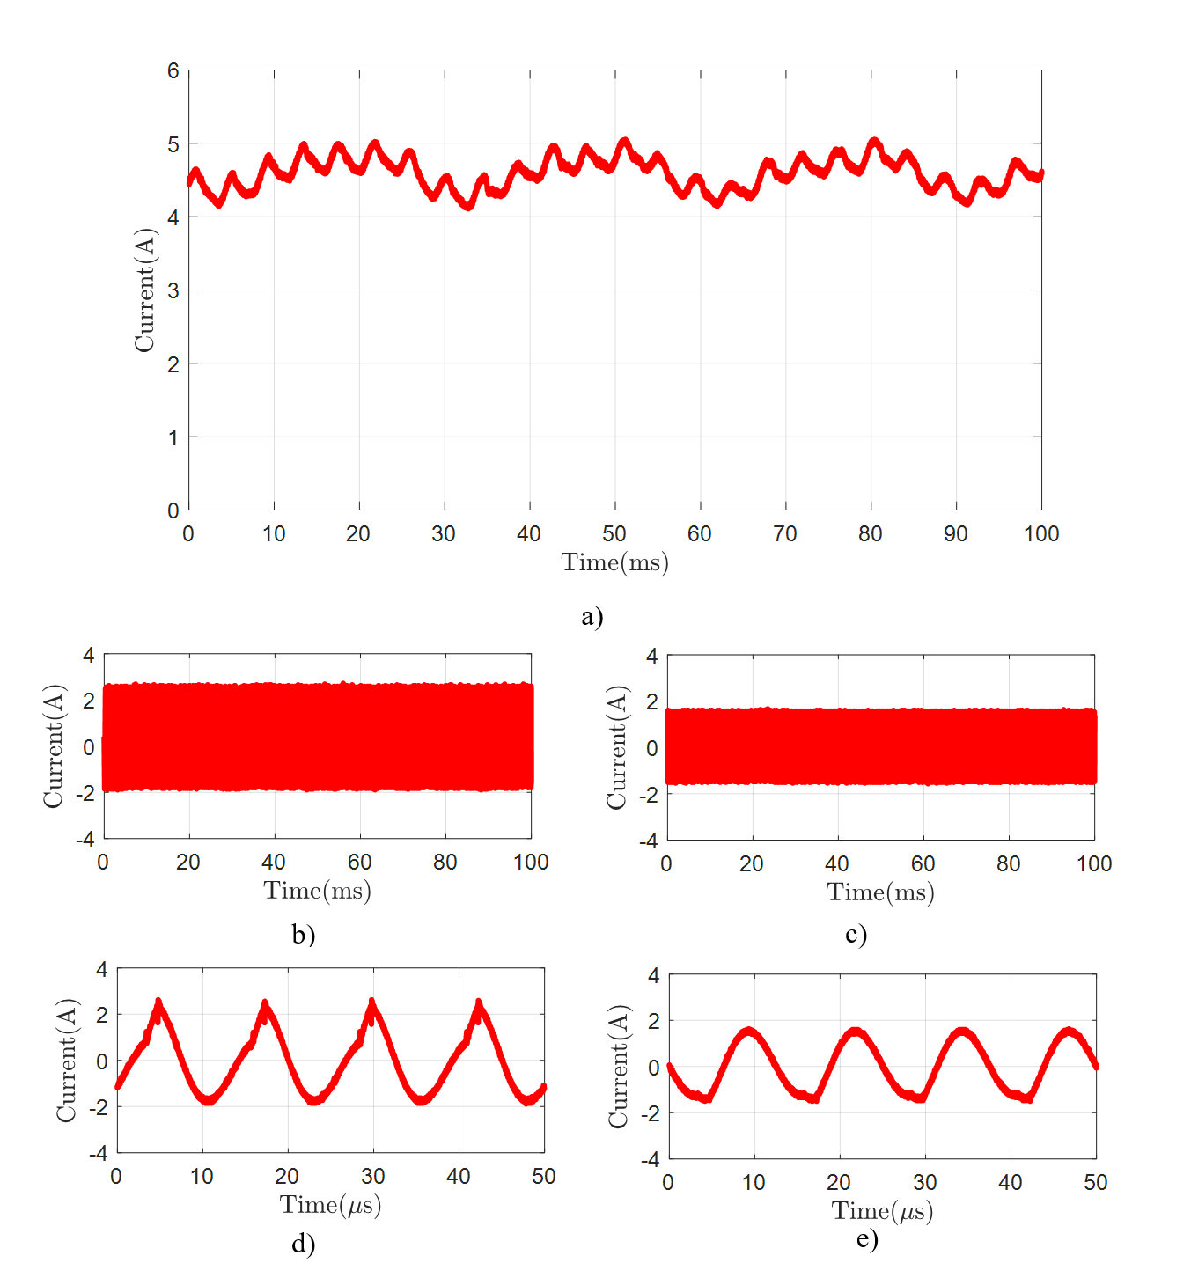
Frequency | 80kHz
Duty Cycle | 0.9
Tx-Current | 1.31A (rms)
Rx-Current | 1.044A (rms)
Motor-Current | 4.58 A (mean)
Motor-Speed | 480 rpm

Slide 9
 | Case A | Case B | Case C | Case D | Case E
Frequency | 98kHz | 80kHz | 80kHz | 98kHz | 110kHz
Duty Cycle | 0.7 | 0.9 | 0.9 | 0.7 | 0.7
Tx-Current | 1.724A (rms) | 1.28A (rms) | 1.31A (rms) | 1.724A (rms) | 1.211A (rms)
Rx-Current | 1.066A (rms) | 1.037A (rms) | 1.044A (rms) | 1.08A (rms) | 0.67A (rms)
Motor-Current | 2.05 A (mean) | 3.12 A (mean) | 4.58 A (mean) | 2.7 A (mean) | 2.64 A (mean)
Motor-Speed | 243 rpm | 501 rpm | 480 rpm | 250 rpm | 242 rpm

Slide 10
Motor and IPT Power veririz

Slide 11
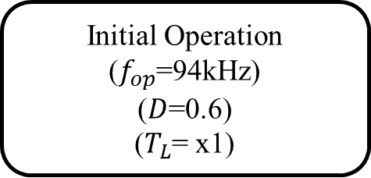
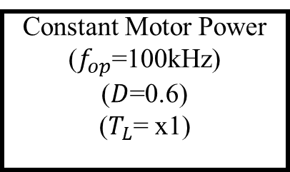
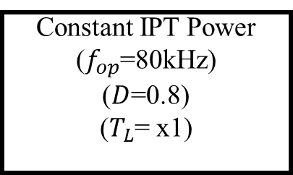
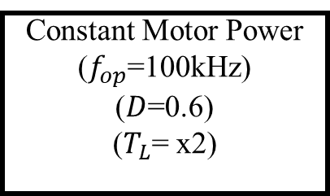
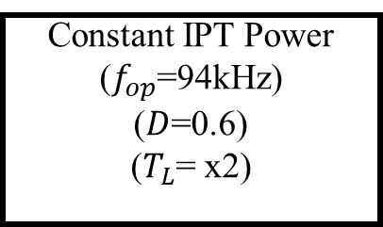
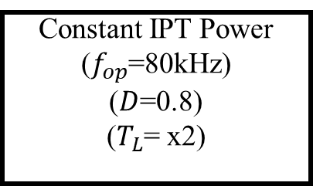
E
A
B
Constant Motor Power
($f_{op}$=100kHz)
($D$=0.6)
($T_{L}$= x1)
Initial Operation
($f_{op}$=94kHz)
($D$=0.6)
($T_{L}$= x1)
Constant IPT Power
($f_{op}$=80kHz)
($D$=0.8)
($T_{L}$= x1)
IPT Power
Control
Motor
Speed
Control
Motor Load
Changes
Motor Load
Changes
Constant Motor Power
($f_{op}$=100kHz)
($D$=0.6)
($T_{L}$= x2)
Constant IPT Power
($f_{op}$=94kHz)
($D$=0.6)
($T_{L}$= x2)
Constant IPT Power
($f_{op}$=80kHz)
($D$=0.8)
($T_{L}$= x2)
IPT Power
Control
Motor
Speed
Control
E
D
C

Slide 12
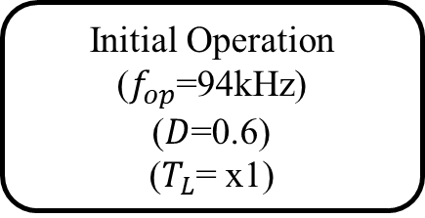
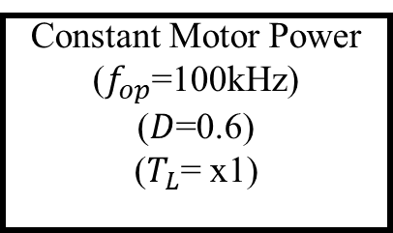
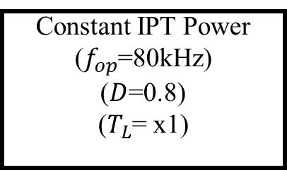
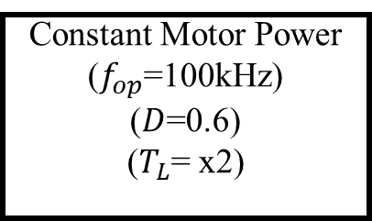
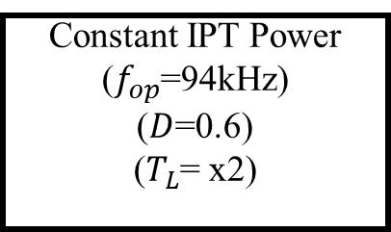
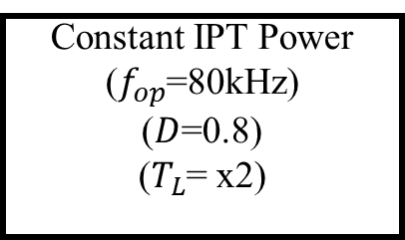
Initial Operation
($f_{op}$=94kHz)
($D$=0.6)
($T_{L}$= x1)
Motor
Speed
Control
Constant IPT Power
($f_{op}$=80kHz)
($D$=0.8)
($T_{L}$= x1)
A
B
IPT Power
Control
Motor Load
Changes
Constant Motor Power
($f_{op}$=100kHz)
($D$=0.6)
($T_{L}$= x1)
Constant IPT Power
($f_{op}$=80kHz)
($D$=0.8)
($T_{L}$= x2)
F
C
Motor Load
Changes
Motor
Speed
Control
Constant Motor Power
($f_{op}$=100kHz)
($D$=0.6)
($T_{L}$= x2)
Constant IPT Power
($f_{op}$=94kHz)
($D$=0.6)
($T_{L}$= x2)
E
D
IPT Power
Control

