Slide 1
Experimental data will be expended.
Above 100 kHz (102.5 105)

Slide 2
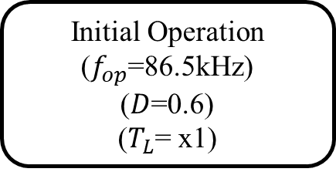
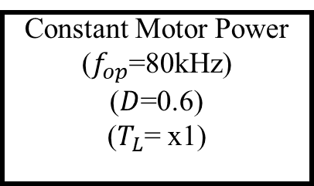
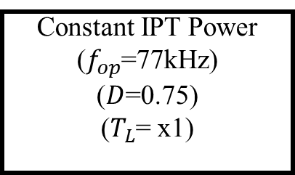
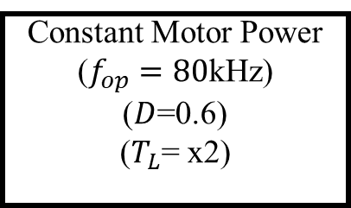
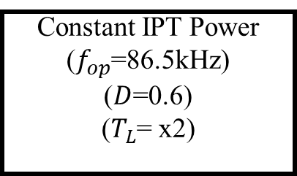
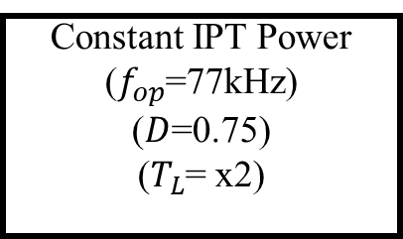
Initial Operation
($f_{op}$=86.5kHz)
($D$=0.6)
($T_{L}$= x1)
Motor
Speed
Control
Constant IPT Power
($f_{op}$=77kHz)
($D$=0.75)
($T_{L}$= x1)
A
B
IPT Power
Control
Motor Load
Changes
Constant Motor Power
($f_{op}$=80kHz)
($D$=0.6)
($T_{L}$= x1)
Constant IPT Power
($f_{op}$=77kHz)
($D$=0.75)
($T_{L}$= x2)
F
C
Motor Load
Changes
Motor
Speed
Control
Constant Motor Power
($f_{op}=80$kHz)
($D$=0.6)
($T_{L}$= x2)
Constant IPT Power
($f_{op}$=86.5kHz)
($D$=0.6)
($T_{L}$= x2)
E
D
IPT Power
Control

Slide 4
D=0.6
F=80
L1
Zoom
Zoom

Slide 5
D=0.6
F=86
L1
Zoom
Zoom

Slide 6
D=0.6
F=86
L1
caseA
Zoom
Zoom

Slide 7
D=0.75
F=77
L1
Case B
Zoom
Zoom

Slide 8
D=0.75
F=77
L2
CaseC
Zoom
Zoom

Slide 9
D=0.6
F=86
L2
Case D
Zoom
Zoom

Slide 10
D=0.6
F=80
L2
Case E
Zoom
Zoom

Slide 11
D=0.6
F=80
L1
Case F
Zoom
Zoom

