Slide 1
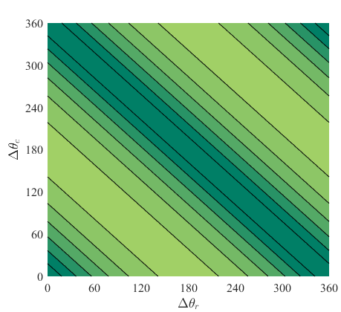
(a)
(b)

Slide 2
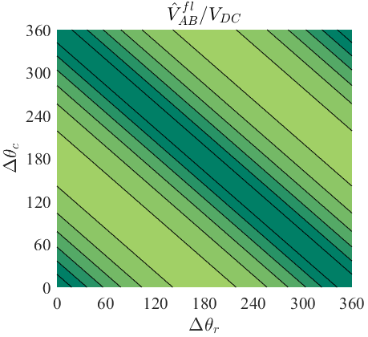
(a)
(b)

Slide 3
(a)
(b)

Slide 4
(a)
(b)

