Slide 1
In a Nutshell: Wireless Power Transfer Systems
Enes Ayaz
^{10/04/2023}

Slide 2
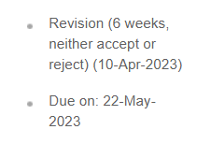
Previously on the 30-min Presentation
Future Works:
1- Synchronous motor journal : Written, but some experimental results are needed. ✓
2- Preparing Wide/narrow bandgap wireless power transfer journal draft : ✓
Literature Review (almost made) ✓
Analytic modelling : ✓
SPWM is ready ✓
SPWM with additional harmonic is standing ✗
Experimental setup: ✗
Find Of-the-shelf inductance for the story ✓
Power is about 30W to 5W
6.78 MHz with 80kHz-200kHz or 900kHz-1000kHz with 80kHz-200KHz
3-Preparing Balancing journal draft ( we can focus TPEL special section about high power and misalingment)
Discussions to get into focus
High power, series/parallel connection
Cost and feasibility
Notes:
The WPT system is connected between phase-A and phase B.
By carrier phase shift to phase B, we achieve this contour of the magnitude of the switching frequency.
We can observe that we can have a constant gain for any modulation.
The constant gain is between 0.25 and 0.45 over a DC-link voltage.
The control diagram is shown.
We adjust the carrier phase shift according to modulation to control the WPT power.

Slide 3
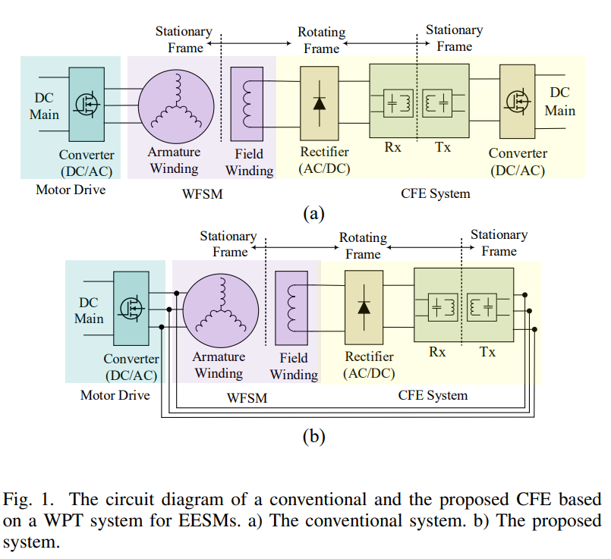
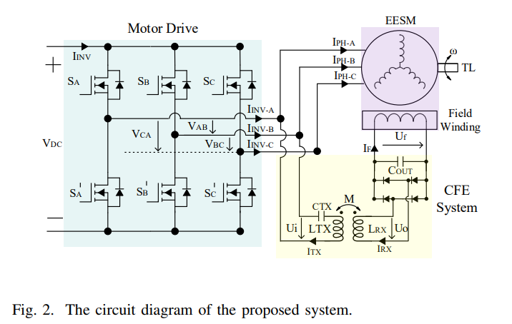
Contactless Field Excitation System of Electrically Excited Synchronous Motors

Slide 4
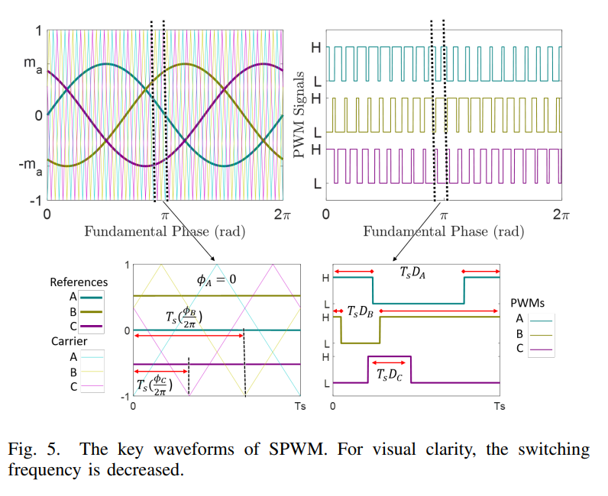
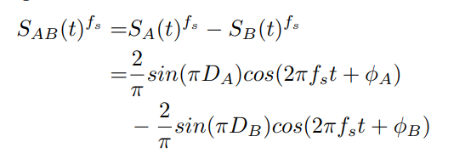
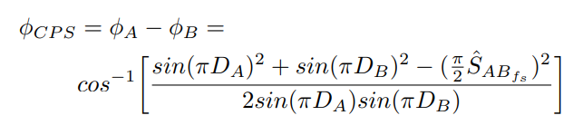
Contactless Field Excitation System of Electrically Excited Synchronous Motors

Slide 5
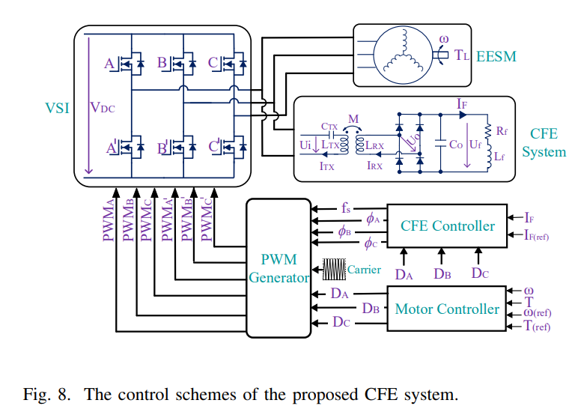
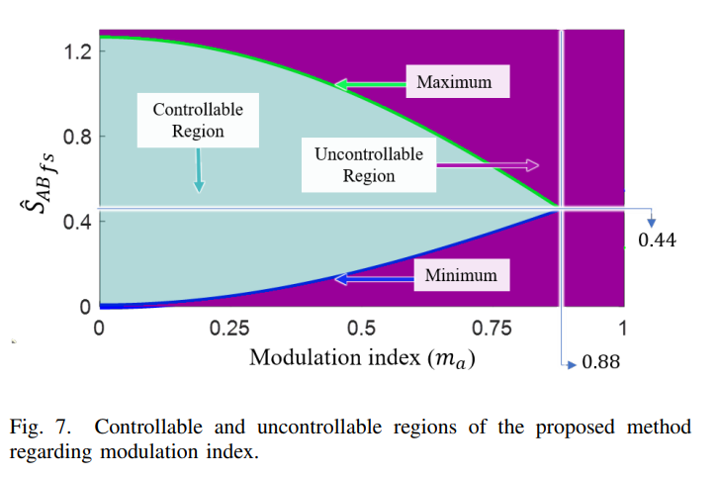
Contactless Field Excitation System of Electrically Excited Synchronous Motors

Slide 6
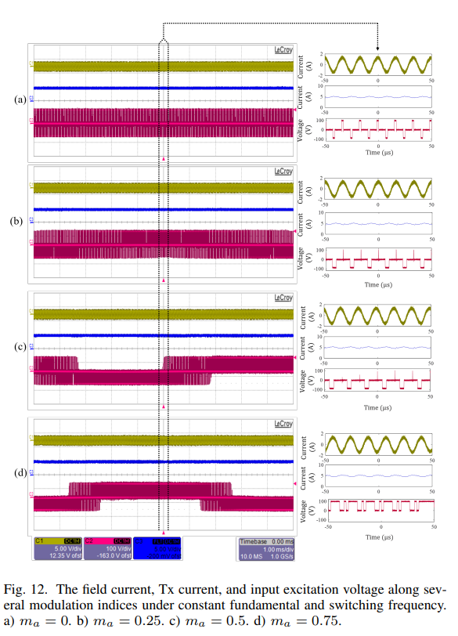
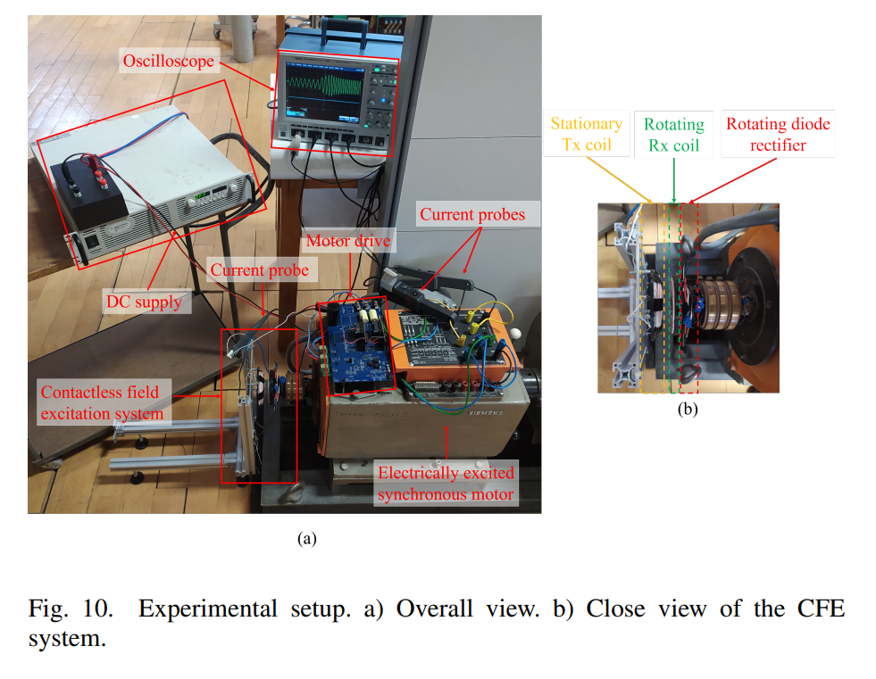
Contactless Field Excitation System of Electrically Excited Synchronous Motors

Slide 7
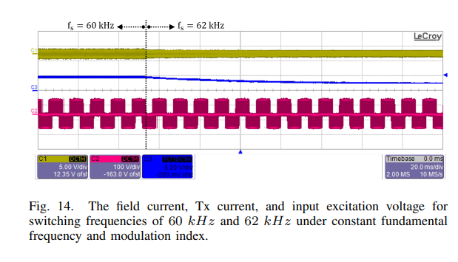
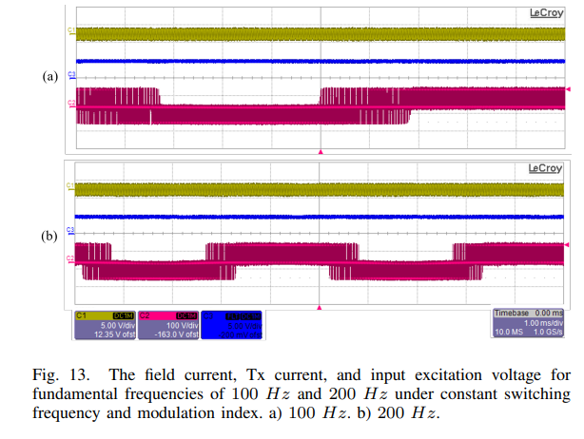
Contactless Field Excitation System of Electrically Excited Synchronous Motors

Slide 8
Narrowband and Wideband Dual-mode Wireless Power Transfer System
Motivations:
To Increase power
To reduce switching components
To increase DC-link utilization rate
To provide operation for more than one standards
Some Topologies:
Multi-converter and multi-resonant
Single-converter and multi-resonant
Single-converter and multi-load
Standards:
Wireless Power Consortium (WPC)
Power Matters Alliance (PMA)
Alliance for Wireless Power (A4WP)
100 - 205/300 kHz for magnetic resonant and induction technology for mobile devices; WPT systems for consumer devices, power transfer typically < 200 W; plan to be used worldwide
6765 - 6795 kHz for magnetic resonant technology for mobile devices; WPT systems for consumer devices, power transfer typically < 30 W; plan to be used.
300 - 500 kHz: WPT systems for consumer devices, power transfer typically < 5 W; plan to be used for smaller devices.
900 - 1 000 kHz: WPT systems for consumer devices, power transfer typically < 5 W; plan to be used for smaller devices.
Notes:
The WPT system is connected between phase-A and phase B.
By carrier phase shift to phase B, we achieve this contour of the magnitude of the switching frequency.
We can observe that we can have a constant gain for any modulation.
The constant gain is between 0.25 and 0.45 over a DC-link voltage.
The control diagram is shown.
We adjust the carrier phase shift according to modulation to control the WPT power.

Slide 9
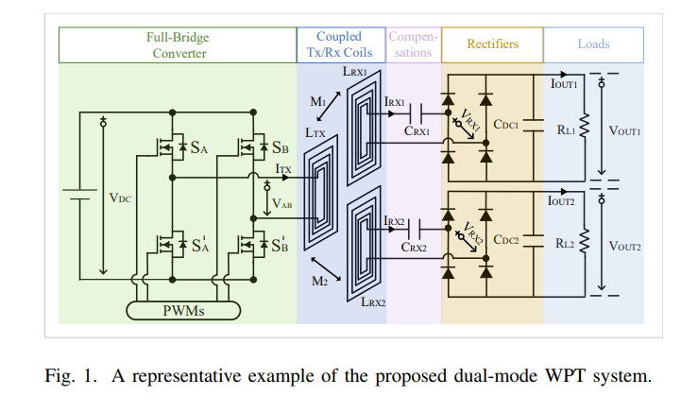
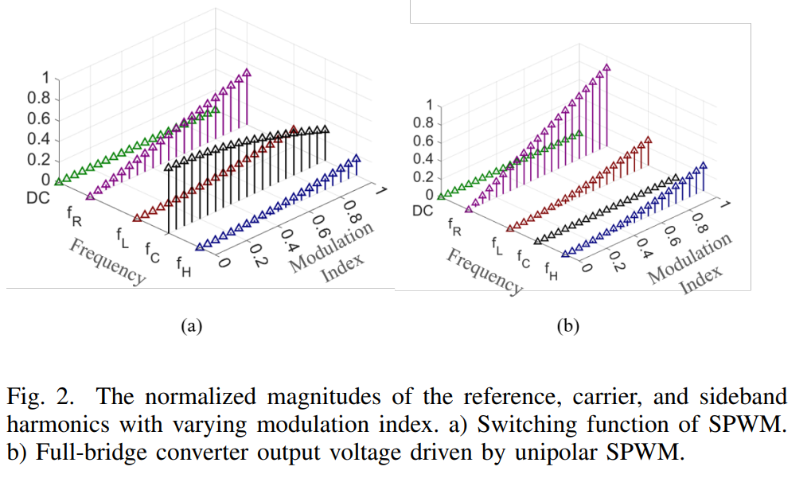
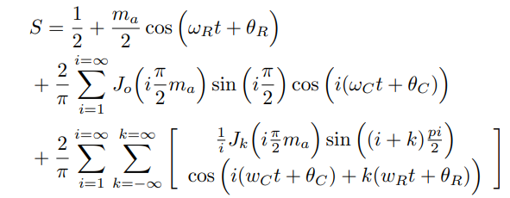
Narrowband and Wideband Dual-mode Wireless Power Transfer System

Slide 10
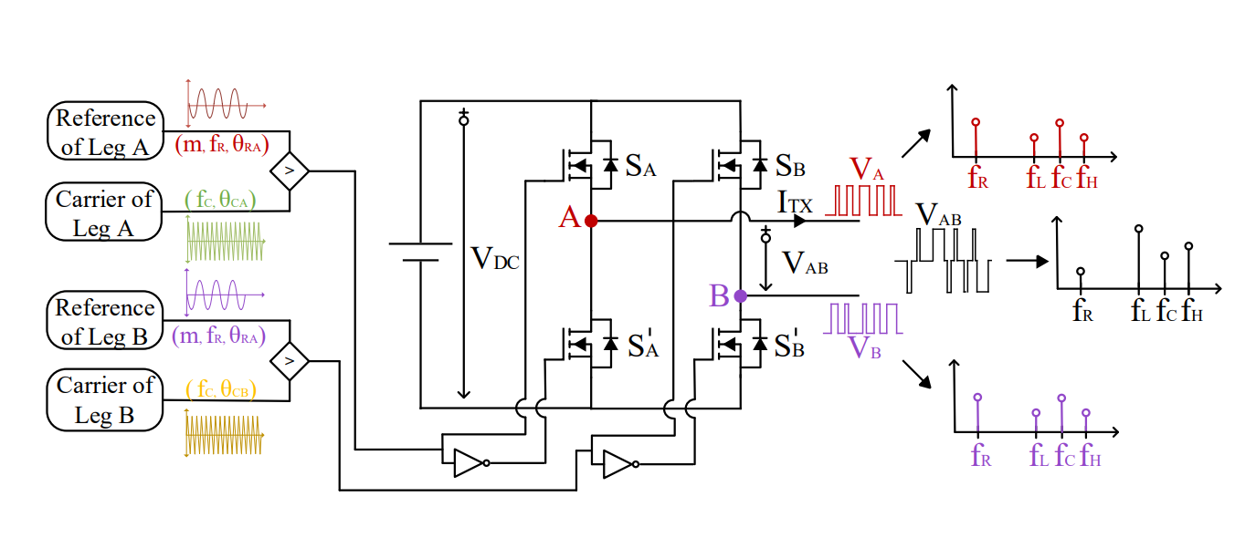
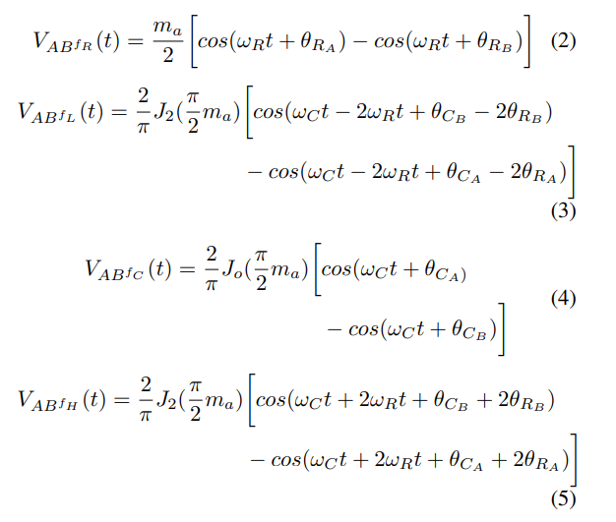
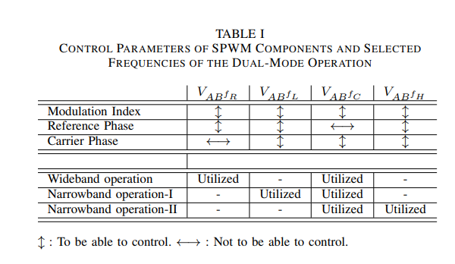
Narrowband and Wideband Dual-mode Wireless Power Transfer System

Slide 11
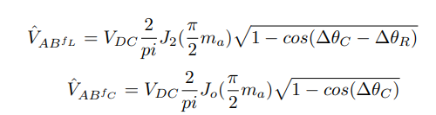
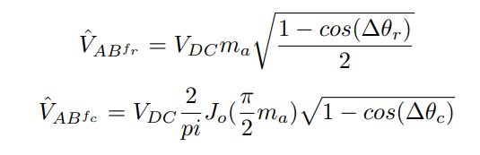
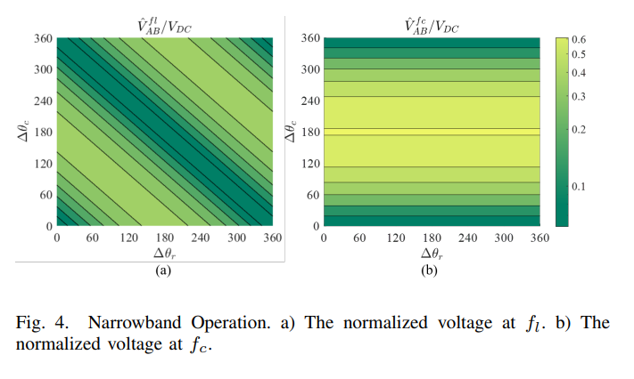
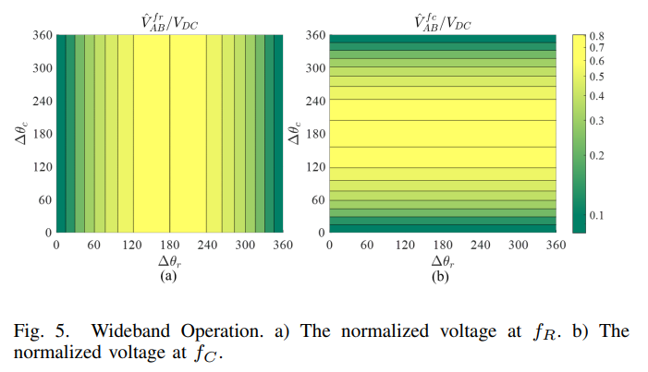
Narrowband and Wideband Dual-mode Wireless Power Transfer System

Slide 12
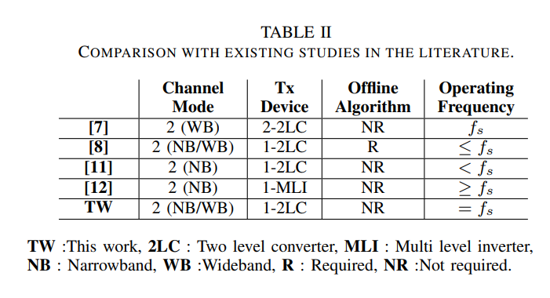
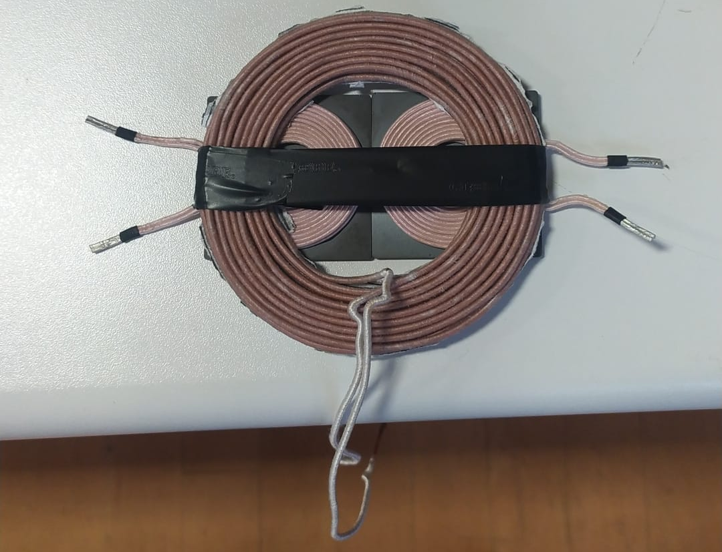
Narrowband and Wideband Dual-mode Wireless Power Transfer System

Slide 13
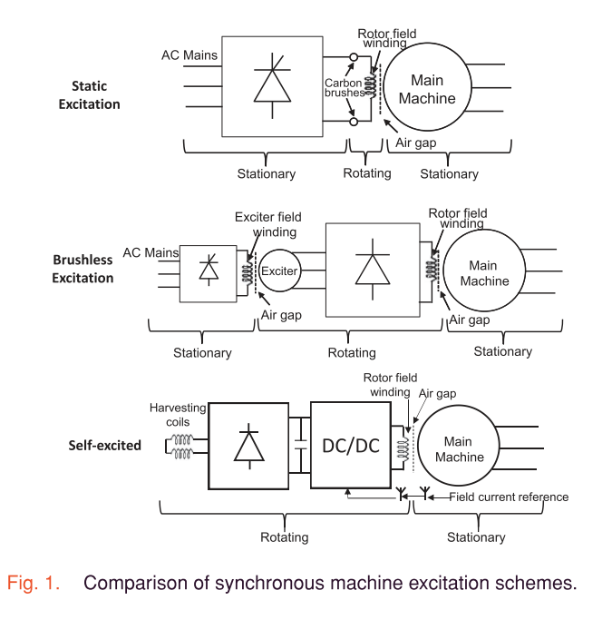
Pending researches
Self-Excited Synchronous Machine Using Airgap Harmonics:
Proposed System

Slide 14
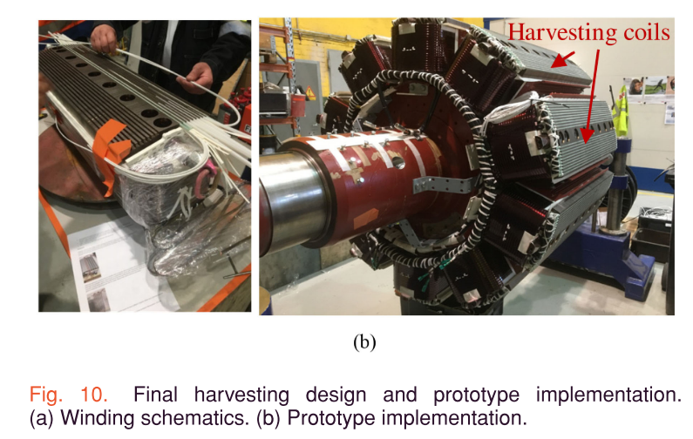
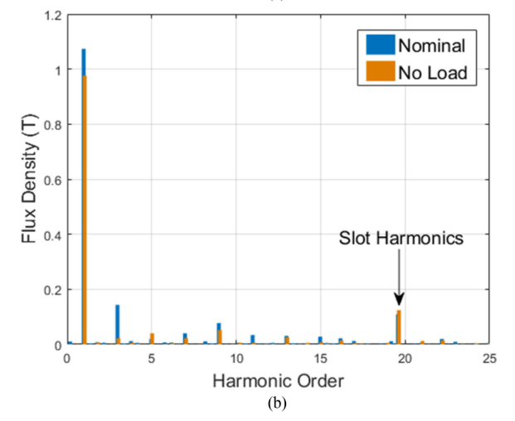
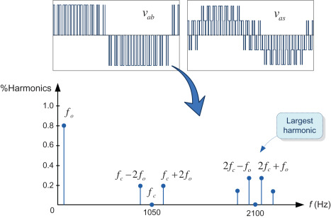

Slide 15
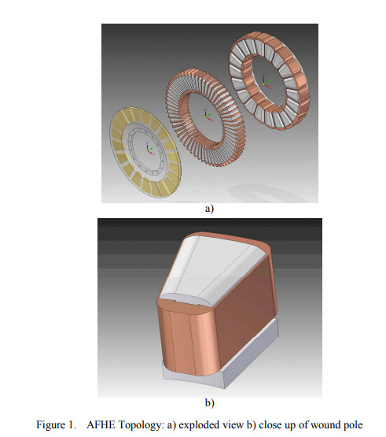

Slide 16
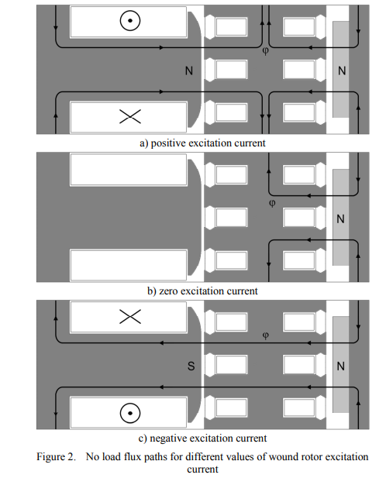
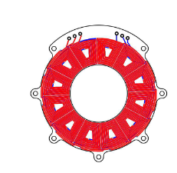
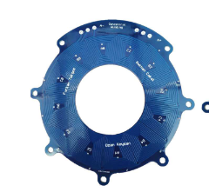
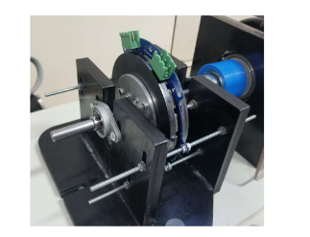
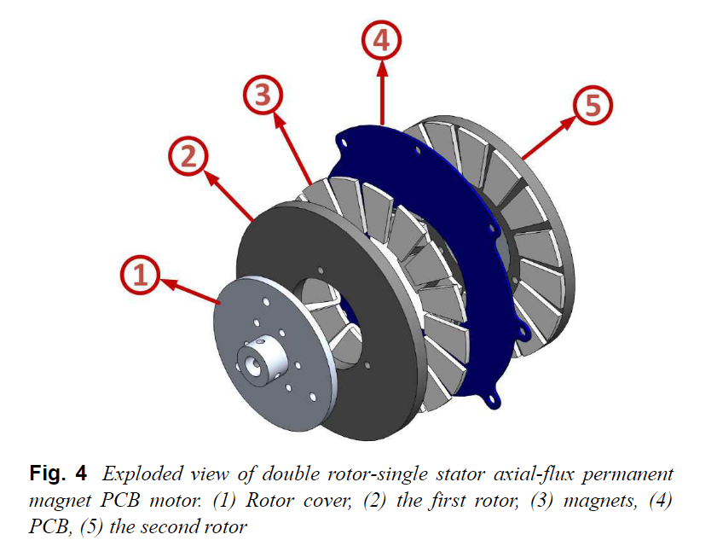

Slide 17
Pending researches
Multi frequency modulation method
Multi frequency output with f1,f2,f3 and their higher order harmonics
Requires multi-level converter
Multi frequency output with complex frequencies stemmed from the multiplication
Requires two-level converter

Slide 18


Time domain multiplication
Frequency domain convolution
Also it can be formulated considering duty cycle

Slide 19
 | 0 | f1 | f2 | 2f1 | 2f2 | 3f1 | 3f2 | 4f1 | 4f2
PWM1 | A0 | A1 | - | A2 | - | A3 | - | A4 | -
PWM2 | B0 | - | B1 | - | B2 | - | B3 | - | B4
PWMres = PWM1 x PWM2
 | 0 | f2-f1 | f1 | f2+f1 | f2 | 2f1-f2 | 2f1 | 2f2-f1 | 2f2 | 2f1+f2 | 3f1 | 3f1-f2 | 2f2+f1
PWMres | A0x B0 | A1/2 X B1/2 | A1 X B0 | A1/2 X B1/2 | A0 X B2 | A2/2 X B1/2 | A2/2 X B0 | A2/2 X B1/2 | A0 X B2 | A2/2 X B1/2 | A3/2 X B0 | A3/2 X B1/2 | A1/2 X B2/2

Slide 20
For example, we want to utilize frequencies of 50 kHz, 120 kHz, and 180 kHz with magnitudes of Fa, Fb, Fc.
Assume that unknown pulses with frequencies of f1 , f2, and f3.
Select which resultant frequencies , from convolution, is selected as the desired frequencies of 50kHz, 100kHz, and 200kHz.
f1=50 kHz
f2+f1=120 kHz
f3+f1=180 kHz
f1=50kHz
f2=70kHz
f3=130 kHz
Fa=A1
Fb=A1/2+B1/2
Fc=A1/2+ C1/2

Slide 21

Future Works
1- Wide/narrow bandgap wireless power transfer : Written, but experimental results are needed.
2- Preparing a concept design of contactless field excitation for axial flux- PCB stator synchronous motor
3-

Slide 22
Thanks!
For more about me : https://enesayaz.github.io/

