Slide 1
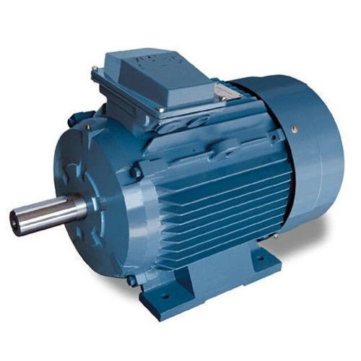
Drive
Electrical
Source
Power
Converter
Load
Controller
Sensor

Slide 2
Motor Drive
DC
Source
Converter
(DC/DC) (DC/AC)
Load
Controller
Measurement Unit

Slide 3
+
-
DC
ωref
Speed Controller
Current Controller
D
DC/DC
Converter
Load
+
+
-
-
IA
ω
+-

Slide 4
Voltage
Source
ωref
Speed Controller
Current Controller
D
DC/DC
Converter
Load
+
+
-
-
IA
ω

Slide 5
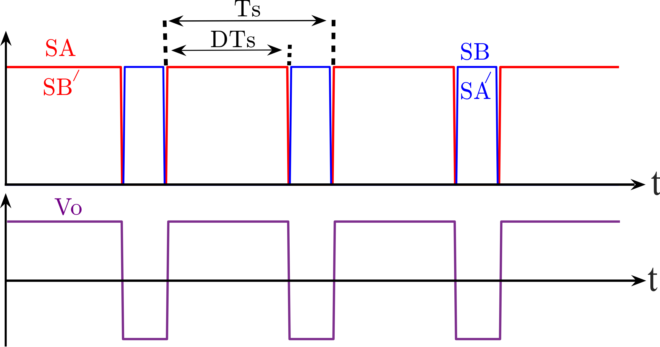

Slide 6
Idref
+
-
DC
ωeref
Speed Controller
Iqref
Current Controller
Modulator
DC/AC
Converter
Load
+
+
-
-
Iq
Ia
abc/dq
Ib
Id
Ic
d/dt
p
ωe
θe
θm

Slide 7
Idref
+
-
Voltage
Source
ωeref
Speed Controller
Iqref
Current Controller
Modulator
DC/AC
Converter
Load
+
+
-
-
Iq
Ia
abc/dq
Ib
Id
Ic
d/dt
p
ωe
θe
θm

Slide 8
P
T
Constant P
Constant T
[rad/sec]
ωbase
ωmax

Slide 9
T
P
T
Constant P
Constant T
[rad/sec]
ωs

Slide 10
T
P
T
Constant P
Constant T
[rad/sec]
Increasing ωs

Slide 11
[kW]
[kHz]

Slide 12
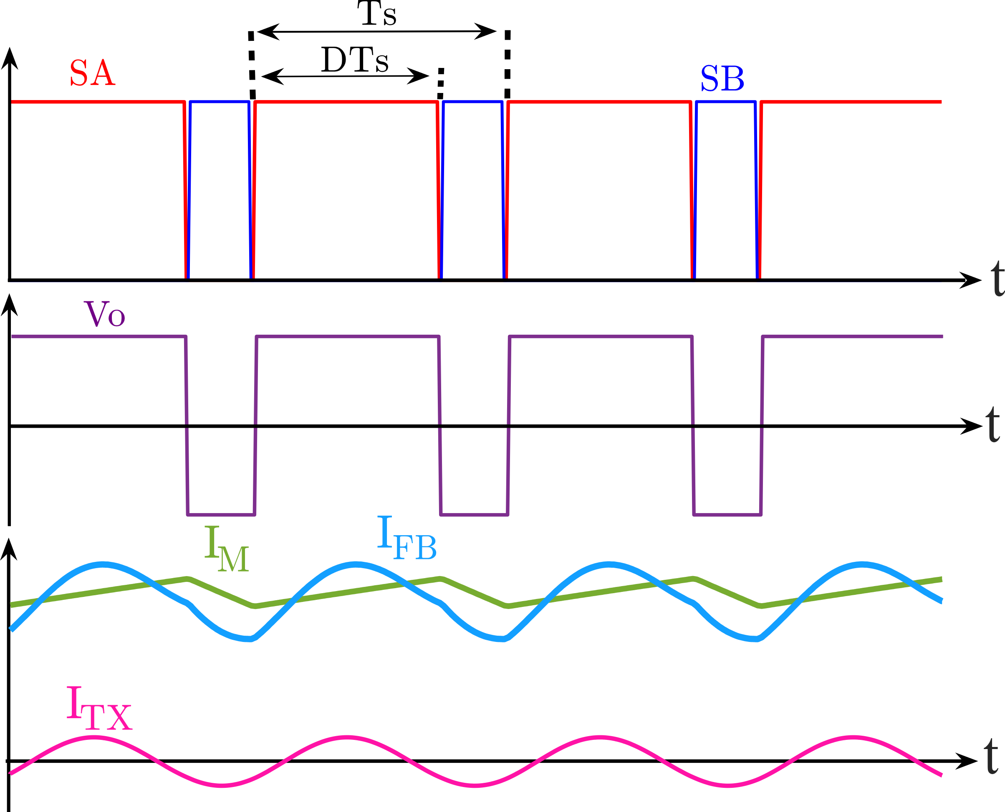
Switching
States
Output Voltage
Currents

