Slide 1
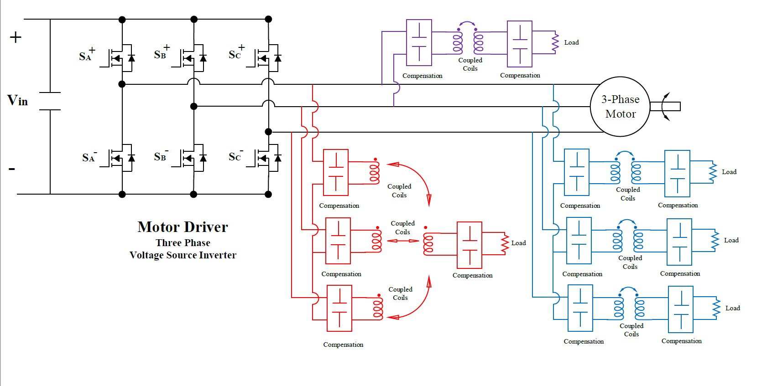

Slide 2
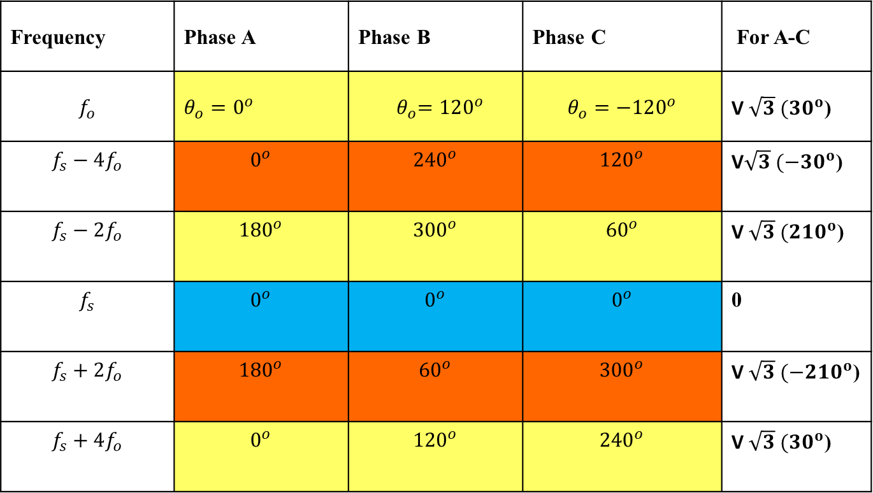
Frequency | Phase A | Phase B | Phase C | For A-C
$$f_{o}$$ | $θ_{o}=0^{o}$ | $${ θ}_{o}=120^{o}$$ | $$θ_{o}=−120^{o}$$ | V$\sqrt{3} (30^{o}$)
$$f_{s}−4f_{o}$$ | $$0^{o}$$ | $${240}^{o}$$ | $${120}^{o}$$ | V$\sqrt{3} (−30^{o}$)
$$f_{s}−2f_{o}$$ | $${180}^{o}$$ | $${300}^{o}$$ | $${60}^{o}$$ | V$\sqrt{3} (210^{o}$)
$$f_{s}$$ | $$0^{o}$$ | $$0^{o}$$ | $$0^{o}$$ | 0
$$f_{s}+2f_{o}$$ | $${180}^{o}$$ | $${60}^{o}$$ | $${300}^{o}$$ | V$\sqrt{3} (−210^{o}$)
$$f_{s}+4f_{o}$$ | $$0^{o}$$ | $${120}^{o}$$ | $${240}^{o}$$ | V$\sqrt{3} (30^{o}$)

Slide 3
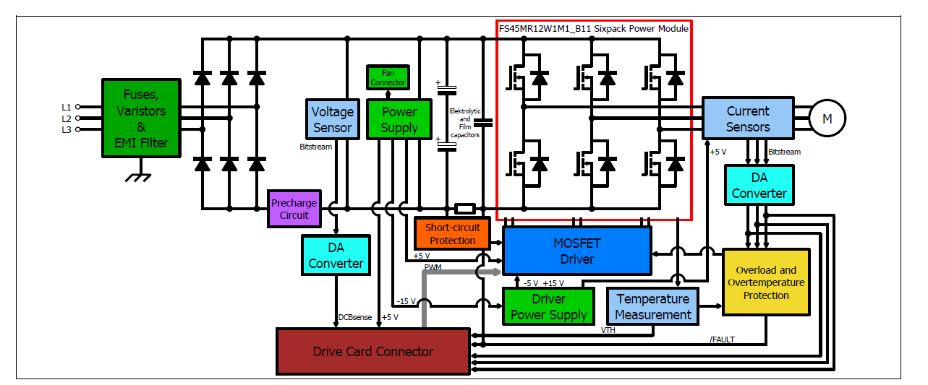
WPT

Slide 4
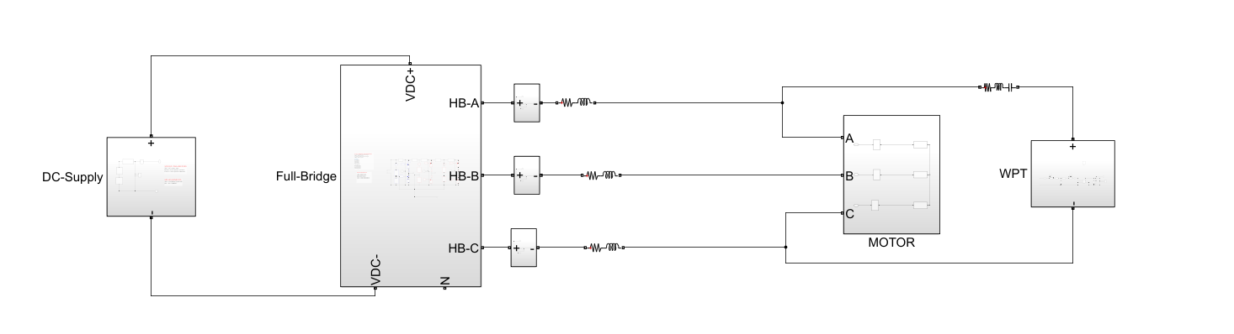
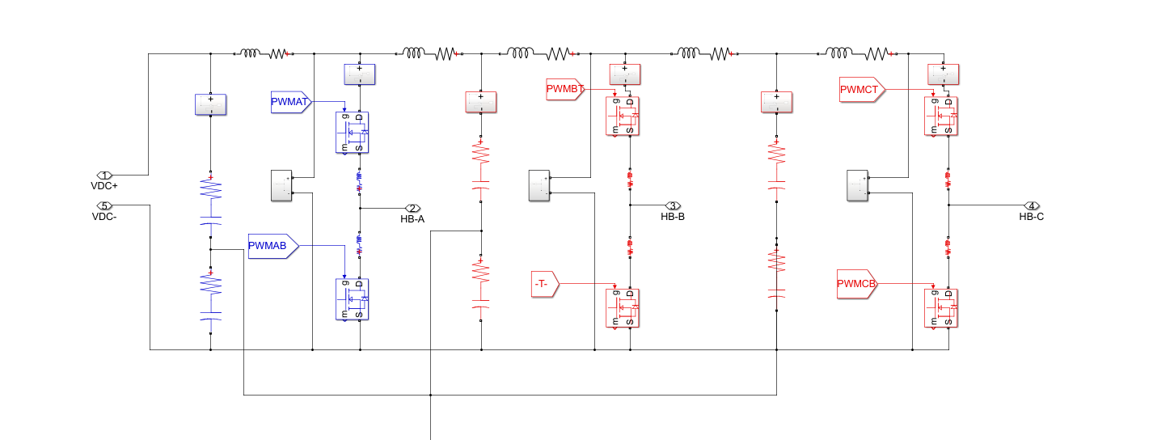
Converter currents
Problems
Uneven current distribution
Uneven DC link capacitor ripple distribution

Slide 5
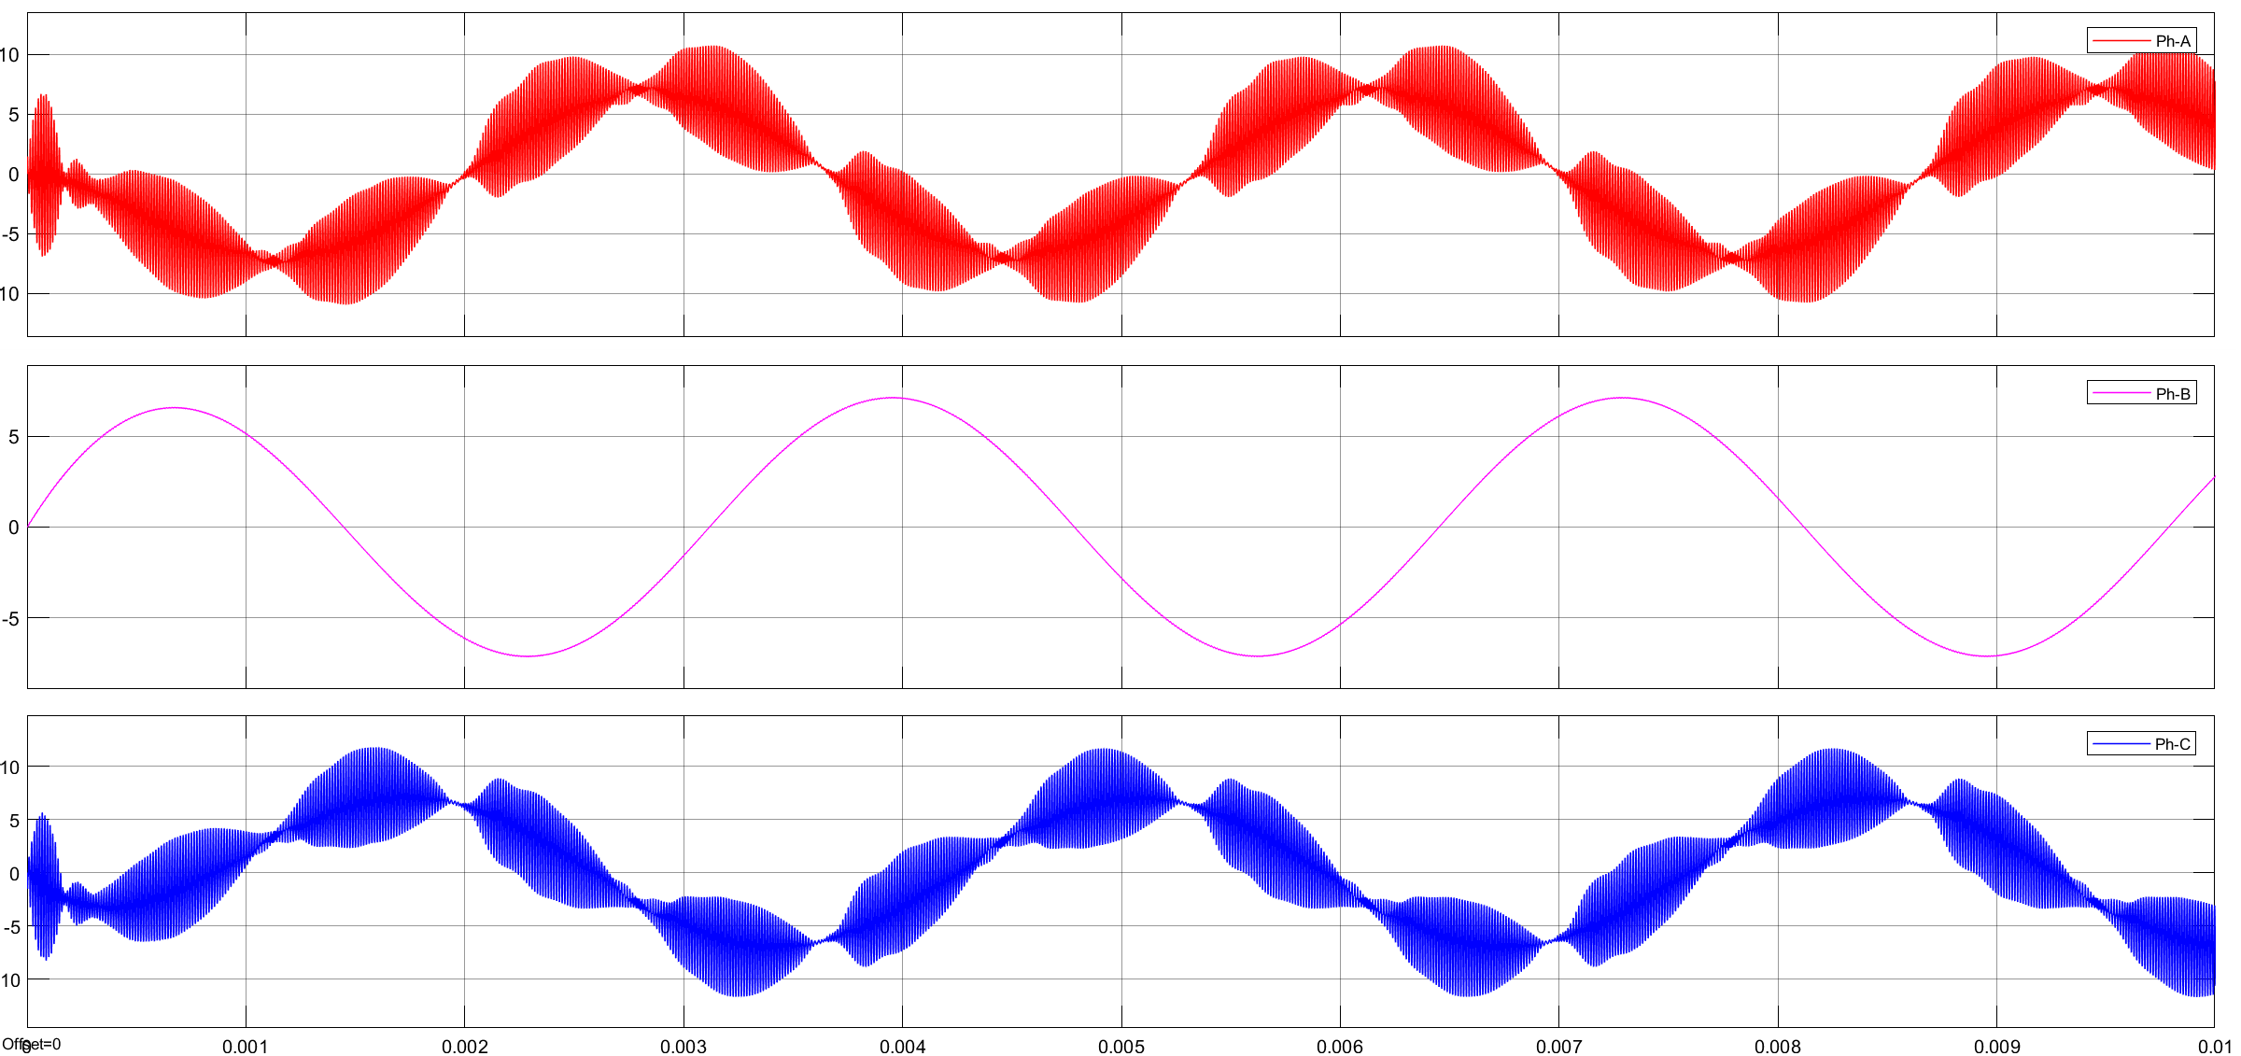

Slide 6
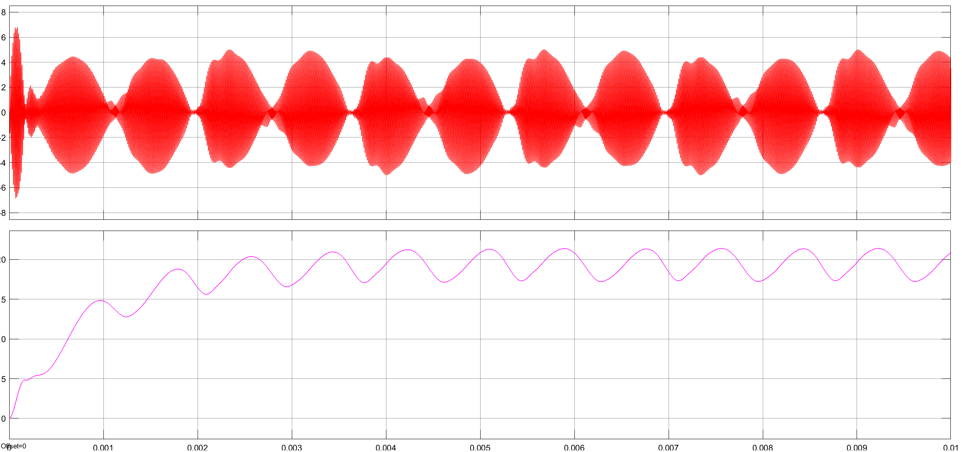

Slide 7
80kHz

Slide 8
Side-band
10 kHz sampling
harmonic

Slide 9
Fundemental
Side Band
Bu dq frame de sorun çıkarmaz
- hatta Tx akımı da daha switching frequeny de bir dq ya sokulabilir

Slide 10
Bu motor controlünü kötü etkilemez mi?
Double fundamental ???

