Slide 1
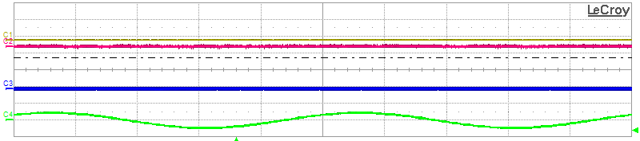
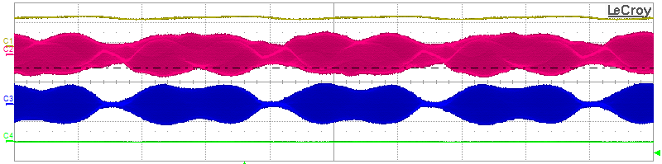
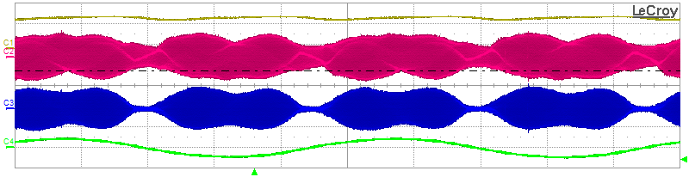
IM = 1.58A
(a)
VOUT = 14.75 V
ITX = 1.13 A
IRX = 2.48 A
(b)
VOUT = 15 V
ITX =1.16 A
IRX =2.52 A
IM = 1.57 A
C1 = 10V/div
C2 =2A/div
C3=5A/div
C4 = 5A/div
T=10ms/div
(c)

Slide 2
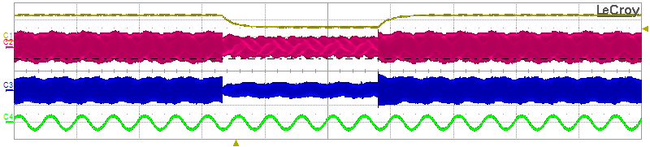
t1
t2
C1 = 10V/div
C2 =2A/div
C3=5A/div
C4 = 5A/div
T=200ms/div

Slide 3
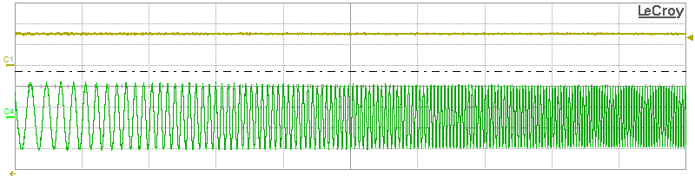
VOUT = 15.08 V
Iph = 0.53 A
C1 = 10V/div
C4 = 0.5A/div
T=500ms/div

