Slide 1
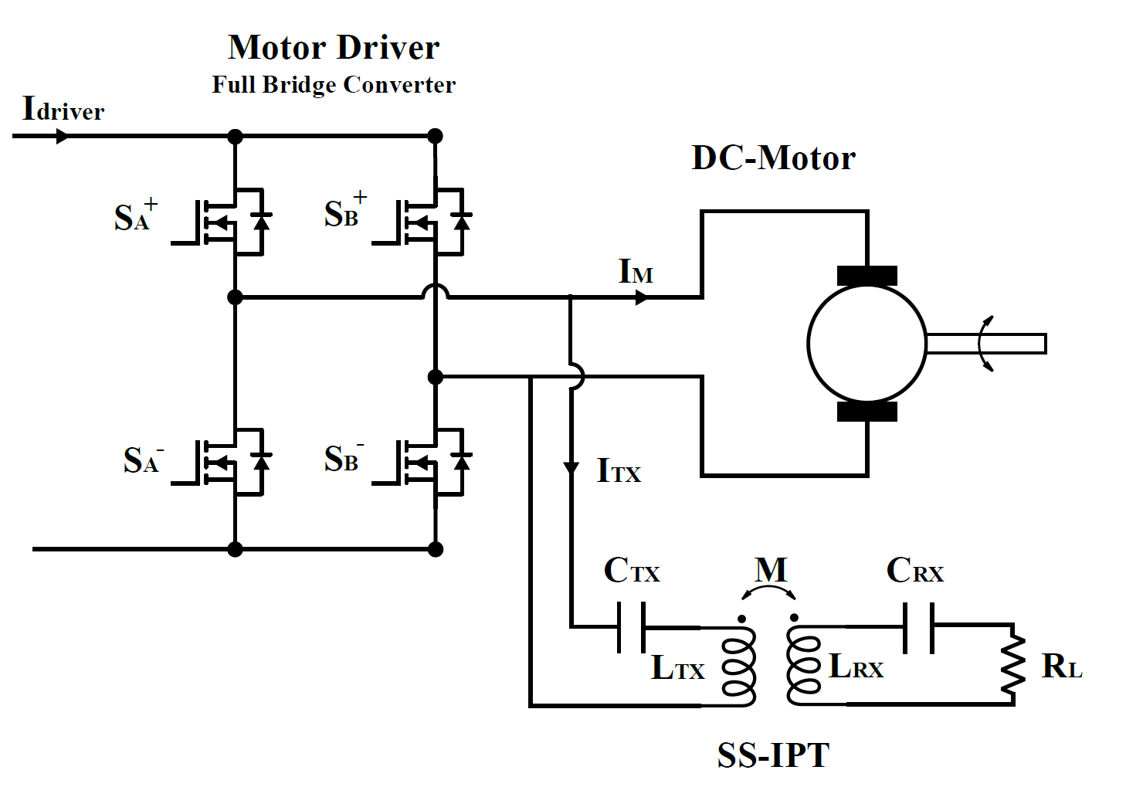
Tests
Only SS-IPT Tests
Frequency Control
Duty Cycle Control
Only motor Tests
Duty Cycle Control
Frequency ripple control
IPT and Motor Tests
Isohips line

Slide 2
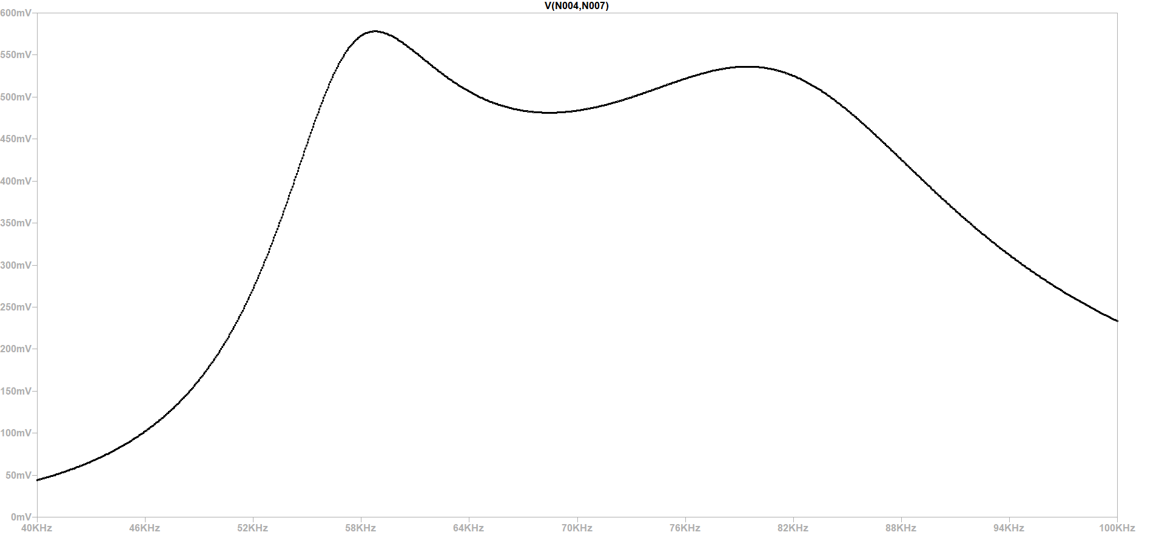
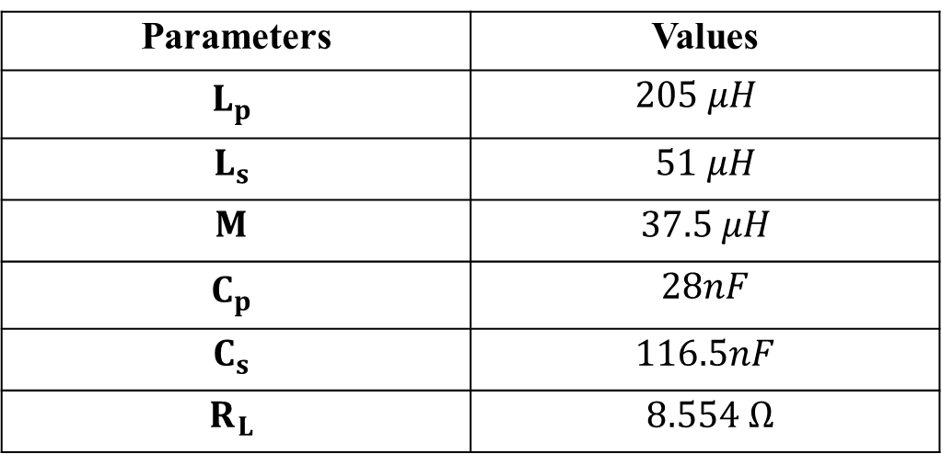
Parameters | Values
$$L_{p}$$ | $$205 μH$$
$$L_{s}$$ | $51 μH$
$$M$$ | $37.5 μH$
$$C_{p}$$ | $28nF$
$$C_{s}$$ | $116.5nF$
$$R_{L}$$ | $8.554 Ω$
Frequency
Duty

Slide 3
IPT-Tests
Duty
Frequency

Slide 4
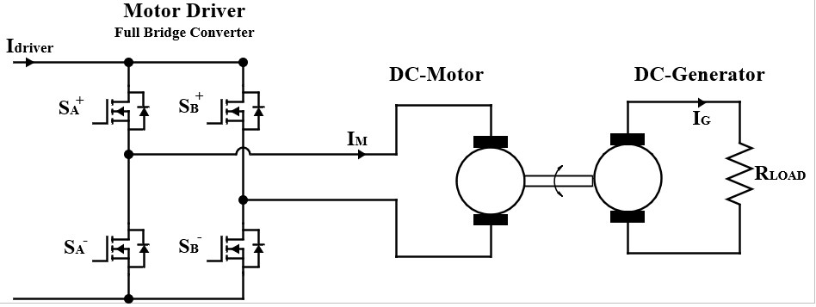
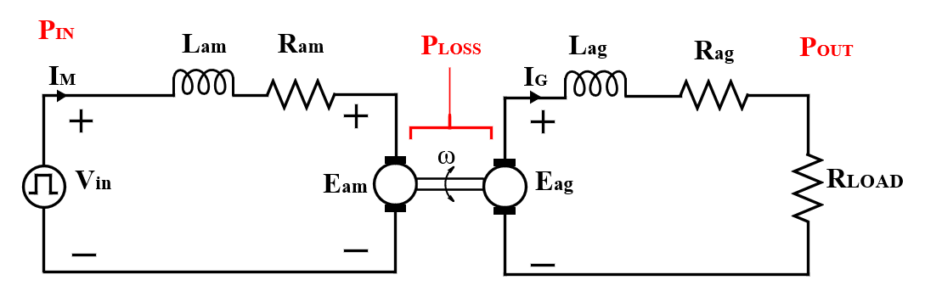

Slide 5
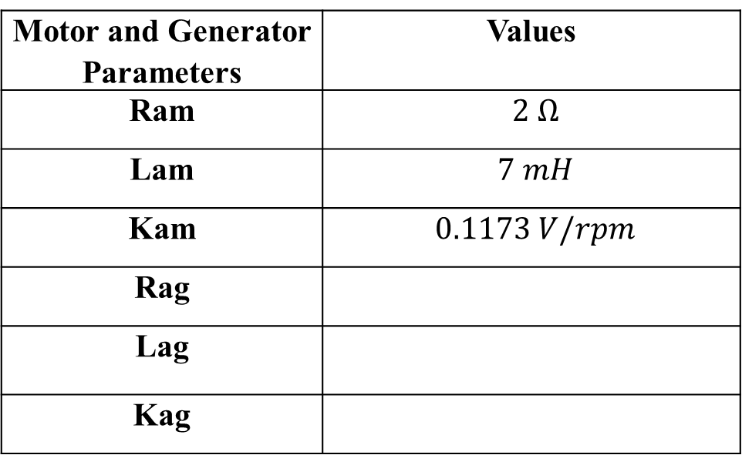
Motor and Generator Parameters | Values
Ram | $2 Ω$
Lam | $7 mH$
Kam | $0.1173 V/rpm$
Rag
Lag
Kag
No Interpole

Slide 6
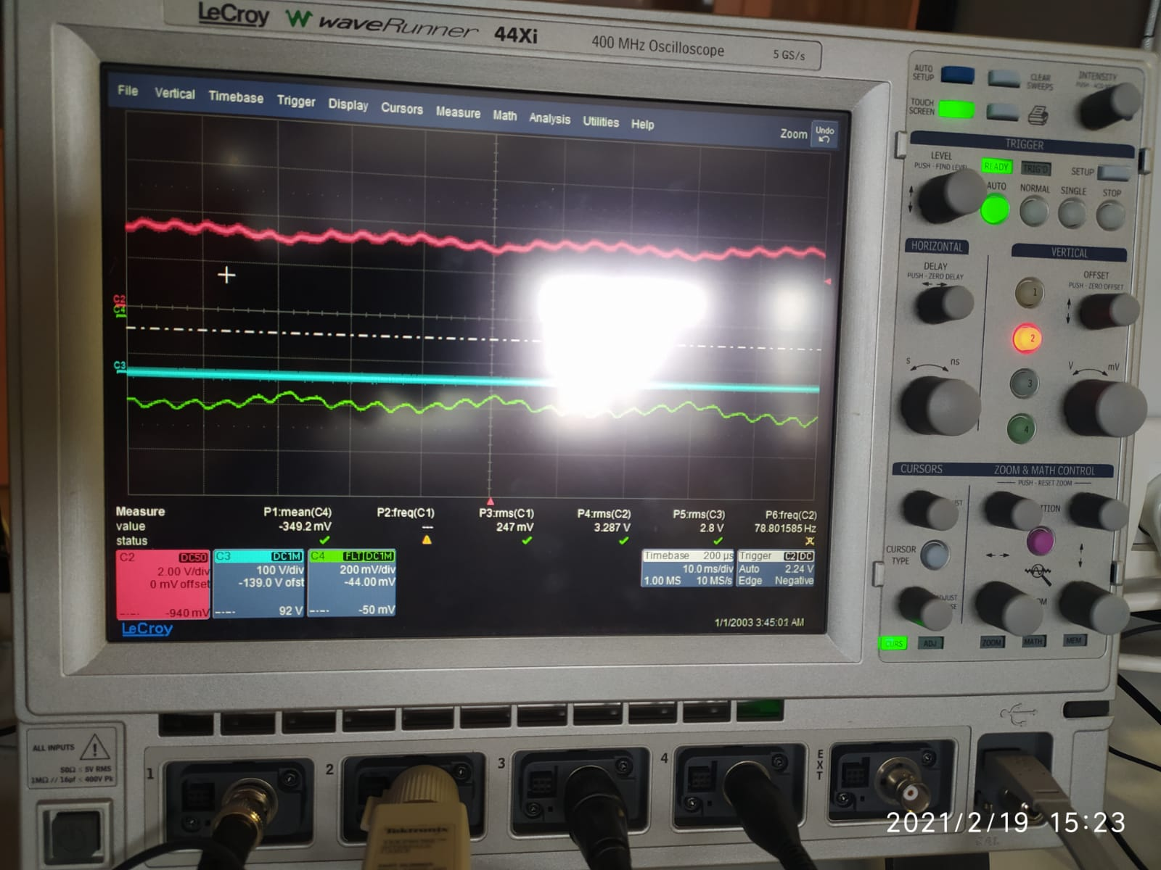
Agilent, No driver
Commutator number 80-90
Brush ?
375 rpm ➔ 180 Hz
503 rpm ➔ 250 Hz

Slide 7
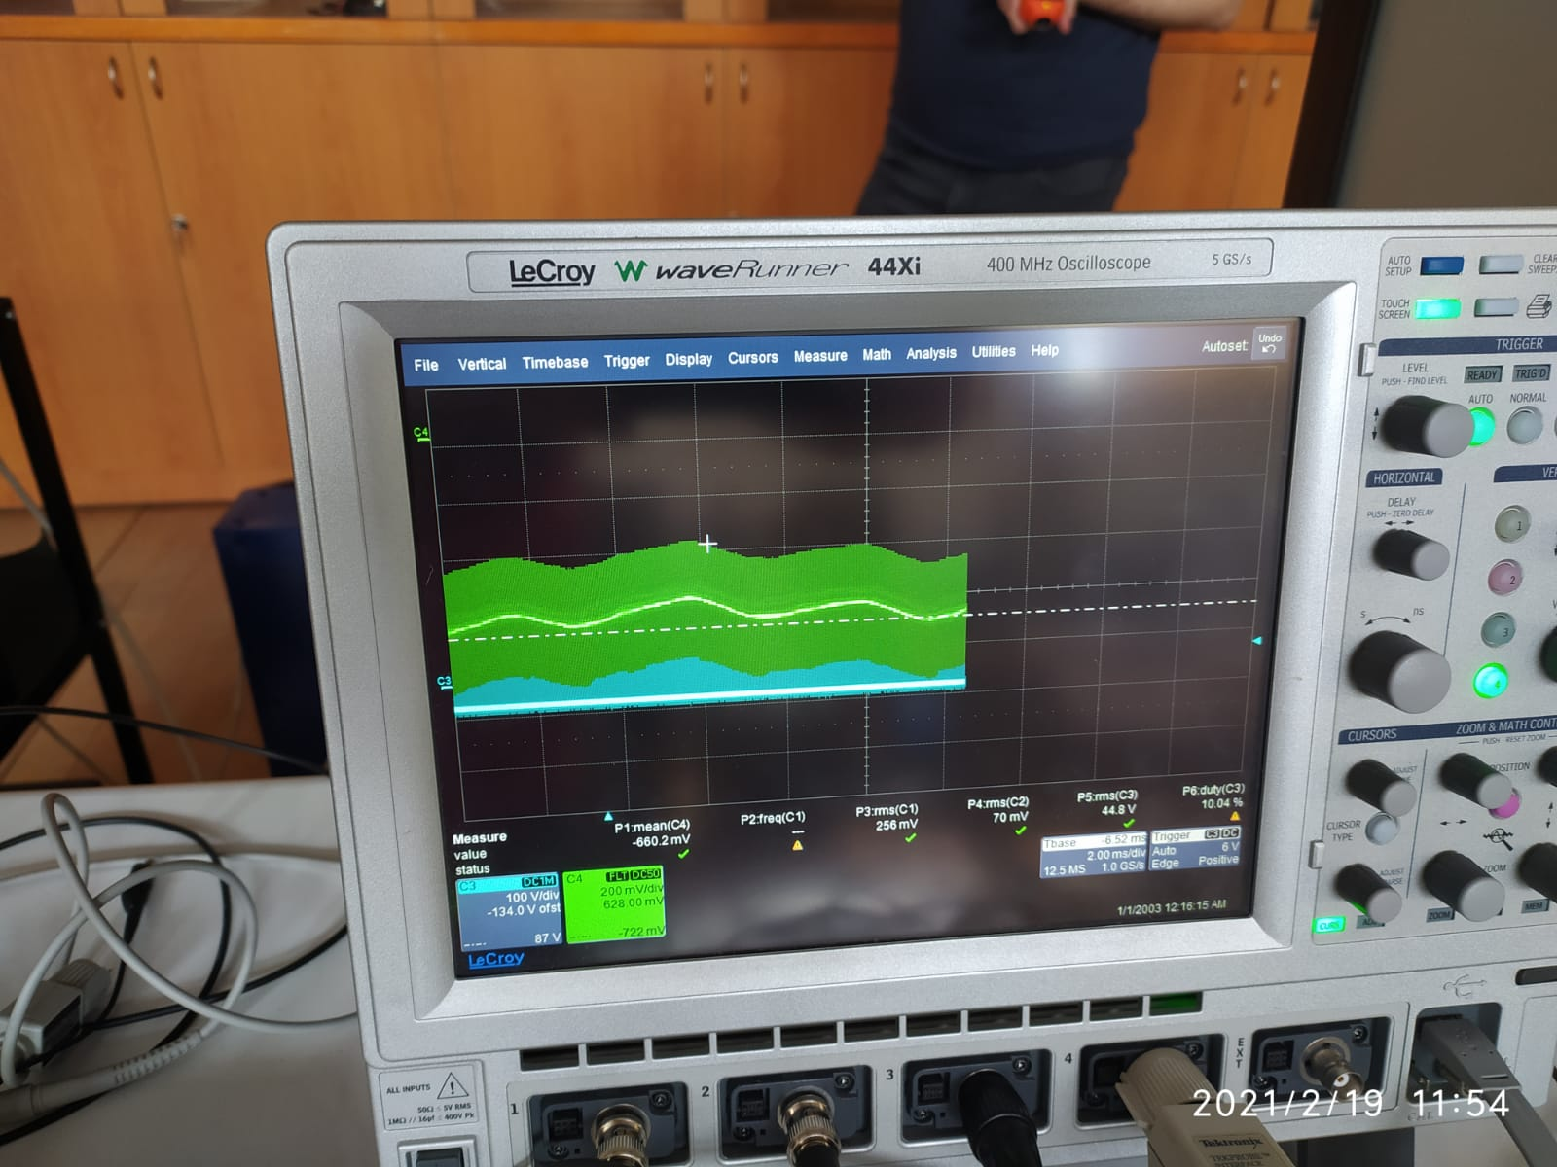
Low frequency are still present.
Also, we observe switching harmonics ?? Why

