Slide 1
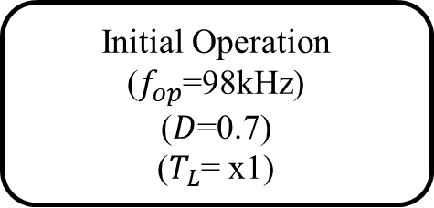
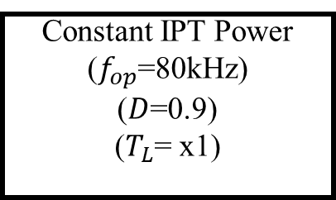
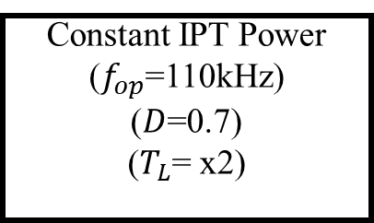
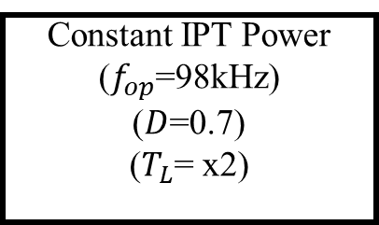
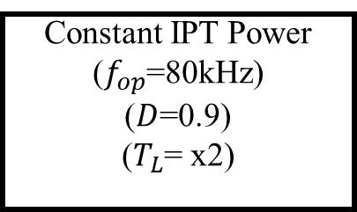
Constant IPT Power
($f_{op}$=110kHz)
($D$=0.7)
($T_{L}$= x2)
Constant IPT Power
($f_{op}$=80kHz)
($D$=0.9)
($T_{L}$= x1)
Motor Speed Control
Initial Operation
($f_{op}$=98kHz)
($D$=0.7)
($T_{L}$= x1)
Motor Load Changes
IPT Power Control
Constant IPT Power
($f_{op}$=98kHz)
($D$=0.7)
($T_{L}$= x2)
Constant IPT Power
($f_{op}$=80kHz)
($D$=0.9)
($T_{L}$= x2)
Motor Speed Control

Slide 2
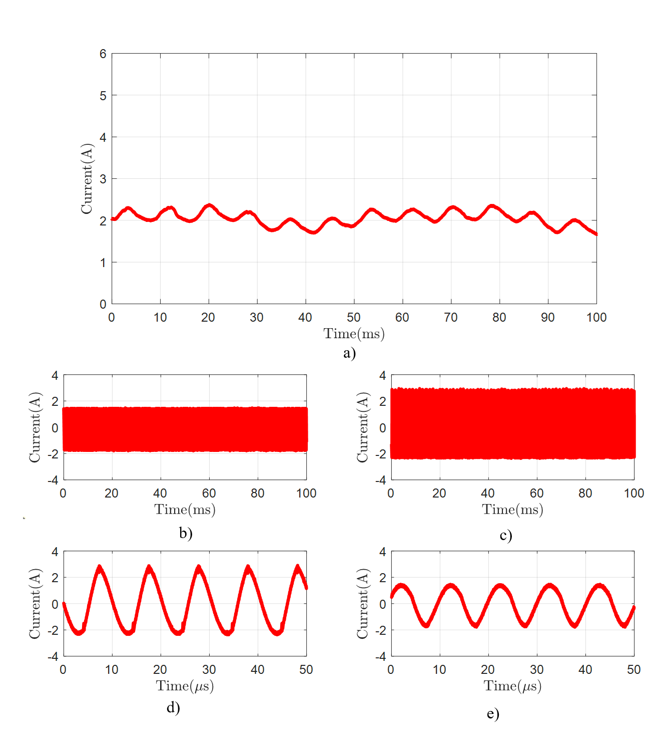
Frequency | 98kHz
Duty Cycle | 0.7
Tx-Current | 1.724A (rms)
Rx-Current | 1.066A (rms)
Motor-Current | 2.05 A (mean)
Motor-Speed | 243 rpm

Slide 3
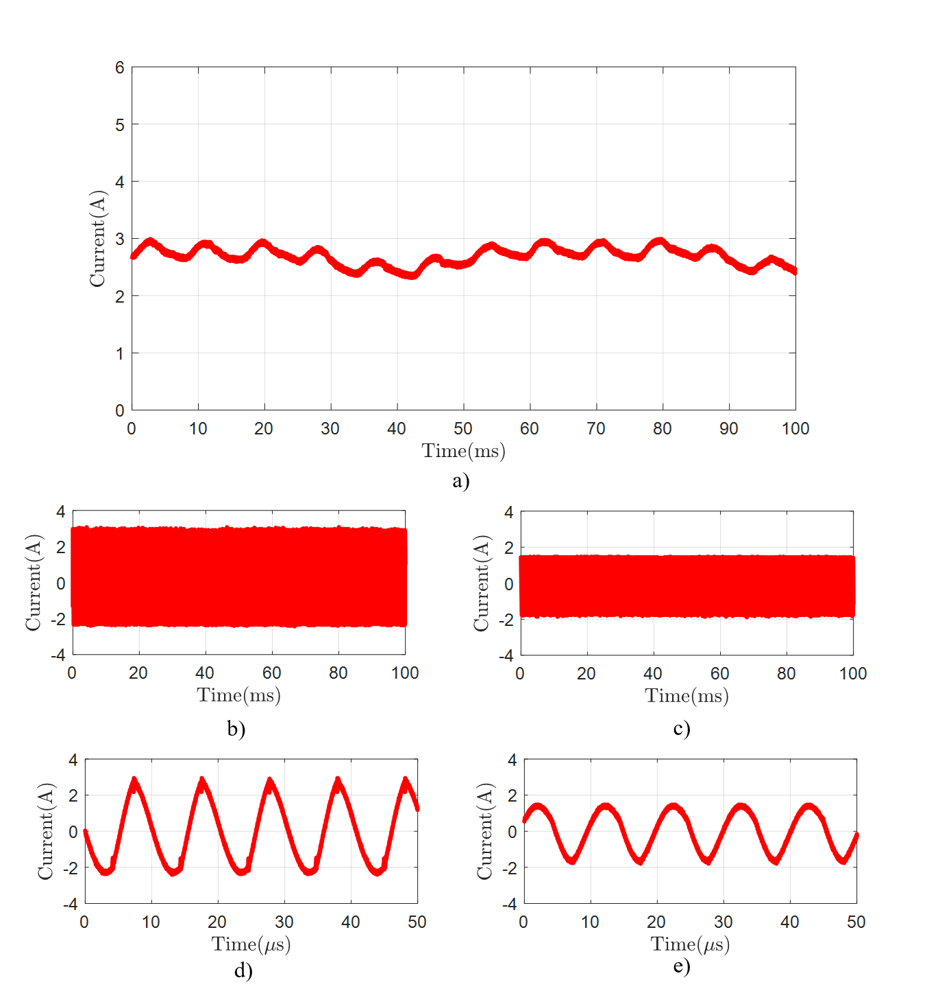
Frequency | 98kHz
Duty Cycle | 0.7
Tx-Current | 1.724A (rms)
Rx-Current | 1.08A (rms)
Motor-Current | 2.7 A (mean)
Motor-Speed | 250 rpm

Slide 4
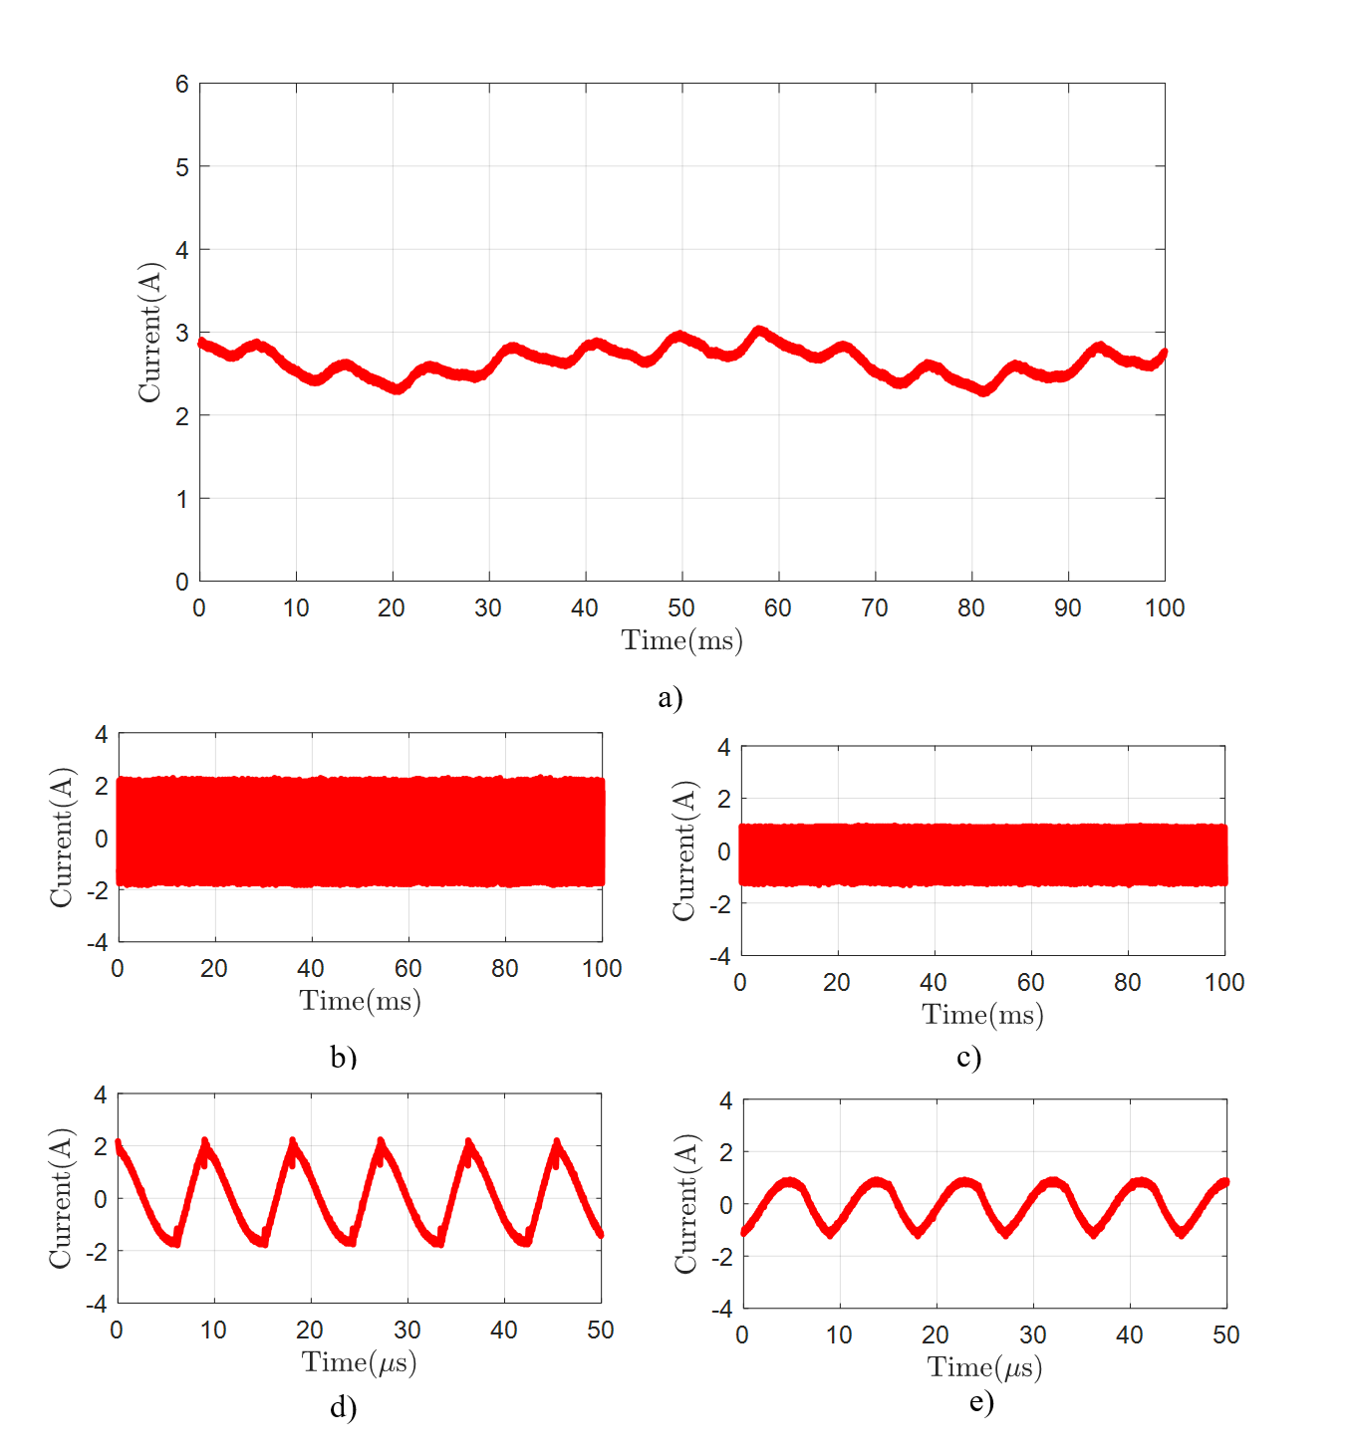
Frequency | 110kHz
Duty Cycle | 0.7
Tx-Current | 1.211A (rms)
Rx-Current | 0.67A (rms)
Motor-Current | 2.64 A (mean)
Motor-Speed | 242 rpm

Slide 5
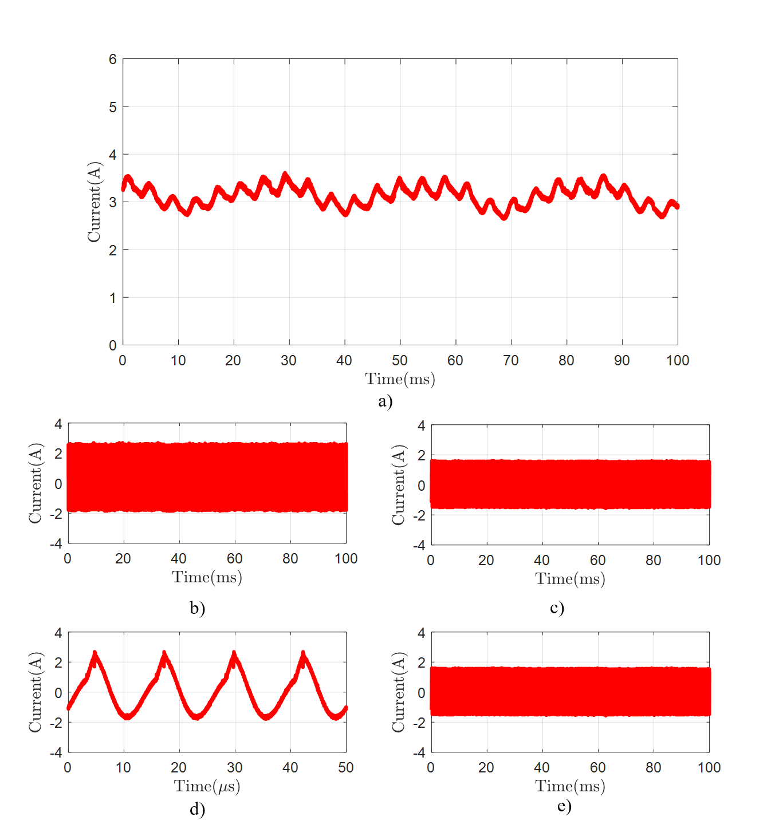
Frequency | 80kHz
Duty Cycle | 0.9
Tx-Current | 1.28A (rms)
Rx-Current | 1.037A (rms)
Motor-Current | 3.12 A (mean)
Motor-Speed | 501 rpm

Slide 6
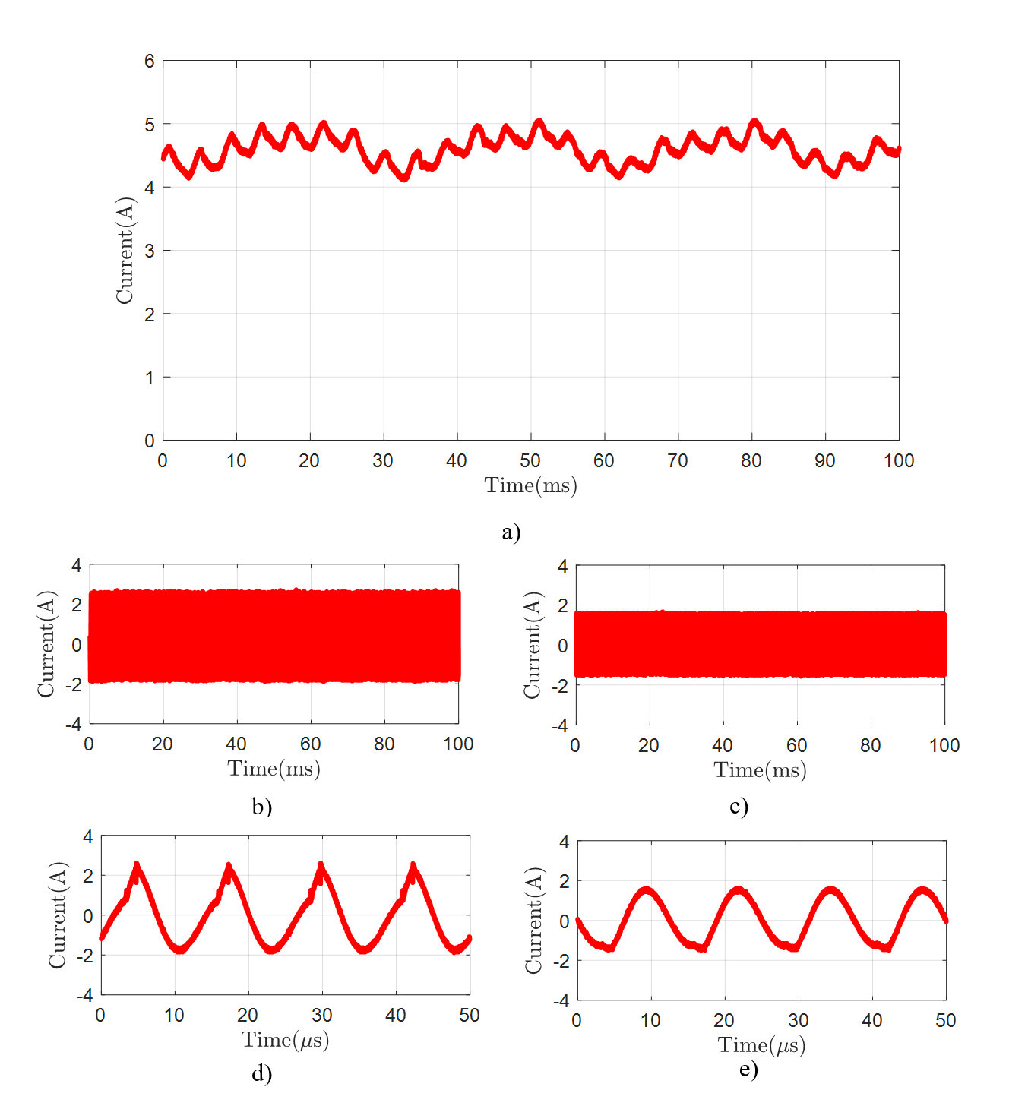
Frequency | 80kHz
Duty Cycle | 0.9
Tx-Current | 1.31A (rms)
Rx-Current | 1.044A (rms)
Motor-Current | 4.58 A (mean)
Motor-Speed | 480 rpm

