Slide 1
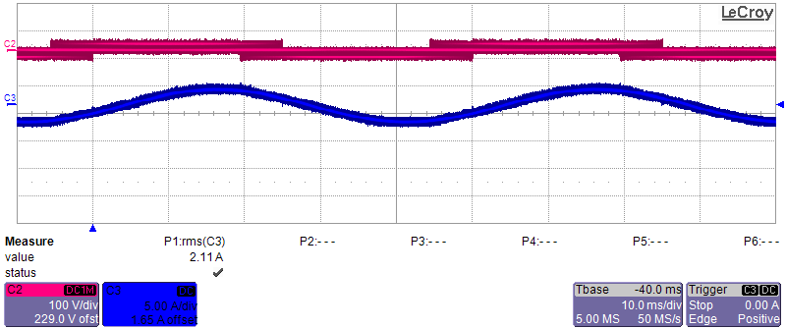
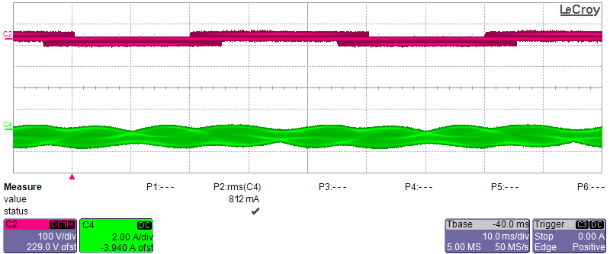
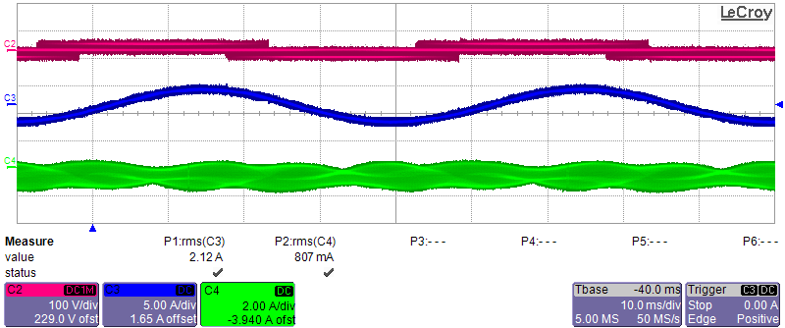

Slide 2
 | Only WPT operation | Only motor operation | Simultaneous operation
Vin (V) | 50 | 50 | 50
Fundamental Frequency (Hz) | 20 | 20 | 20
Switching Frequency (kHz) | 80 | 80 | 80
Modulation Index (ma) | 0.8 | 0.8 | 0.8
Motor Current (mArms) | 812 | - | 807
Tx Current (Arms) | - | 2.11 | 2.12

Slide 3
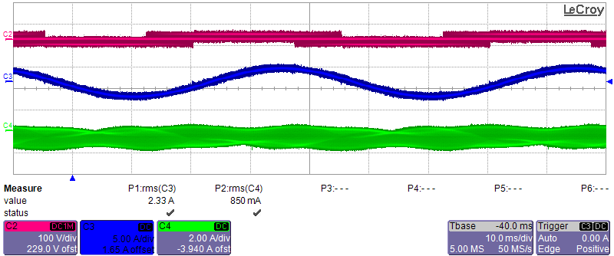
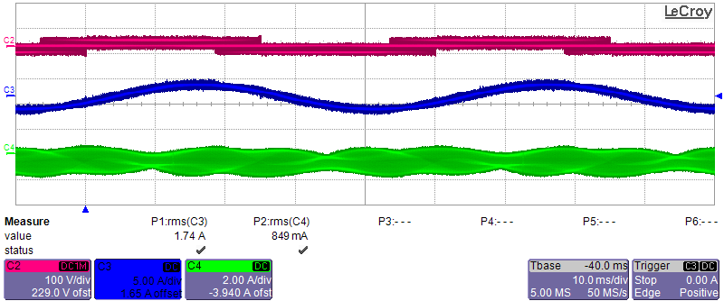
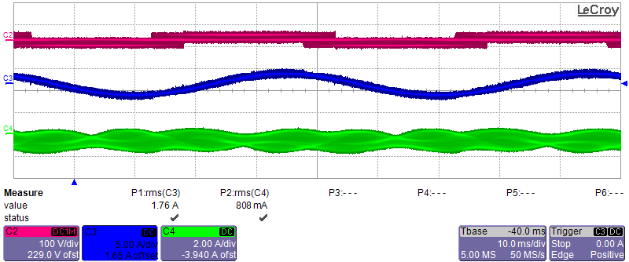
Motor current increases while Tx current is unchanging
Tx current decreases while
Motor current is unchanging

