Slide 1
Zero Sequences
Negative Sequence
Positive Sequence

Slide 2
Negative Sequences
Positive Sequence
Zero

Slide 3
Positive Sequences
Zero Sequences
Negative Sequences

Slide 4
60
180
60
-60
-60

Slide 6
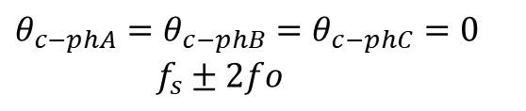
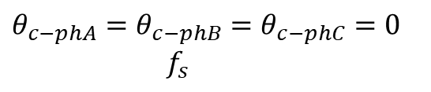
$θ_{c−phA}=θ_{c−phB}=θ_{c−phC}=0$ $f_{s}$
$θ_{c−phA}=θ_{c−phB}=θ_{c−phC}=0$ $f_{s}±2fo$
PhA-PhB-PhC

Slide 7
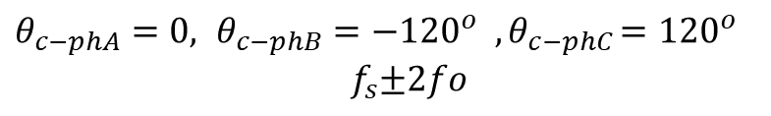
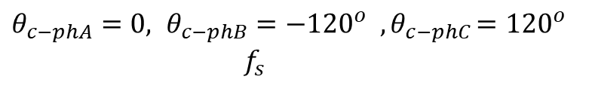


$θ_{c−phA}=0, θ_{c−phB}={−120}^{o} {, θ}_{c−phC}={120}^{o}$ ${ f}_{s}$
$θ_{c−phA}=0, θ_{c−phB}={−120}^{o} {, θ}_{c−phC}={120}^{o}$ ${ f}_{s}±2fo$
$$V_{AB}$$
$$V_{AB}$$

Slide 8

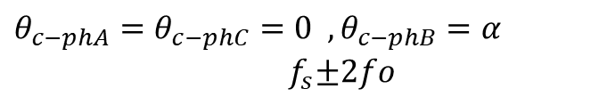

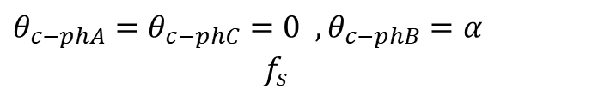




$θ_{c−phA}=θ_{c−phC}=0 ,θ_{c−phB}=α$ ${ f}_{s}$
$θ_{c−phA}=θ_{c−phC}=0 ,θ_{c−phB}=α$ ${ f}_{s}±2fo$
PhA-PhB-PhC
$$V_{AB}$$
$α$
$$V_{AB}$$
$$V_{AB}$$
$α$
$α$

Slide 9
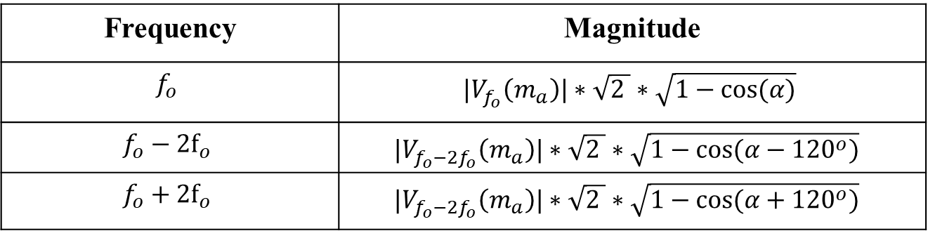
Frequency | Magnitude
$$f_{o}$$ | ${|V}_{f_{o}}\left(m_{a}\right)|∗\sqrt{2 }∗\sqrt{1−cos⁡(α)}$
$$f_{o}−2f_{o}$$ | $${|V}_{f_{o}−2f_{o}}\left(m_{a}\right)|∗\sqrt{2 }∗\sqrt{1−cos⁡(α−{120}^{o})}$$
$$f_{o}+2f_{o}$$ | $${|V}_{f_{o}−2f_{o}}\left(m_{a}\right)|∗\sqrt{2 }∗\sqrt{1−cos⁡(α+{120}^{o})}$$

Slide 10
Vdc=100V | fsw=80kHz | fm=500 Hz | ölçümler VAB (line-to-line)
carrier phase yok

Slide 11
Vdc=100V | fsw=80kHz | fm=500 Hz | ölçümler VAB (line-to-line)
carrier 120 shifted

Slide 12
Analytic Results vs Simulation Results
Also, m=0.8 and m=0.5 are validated experimentally.

Slide 16
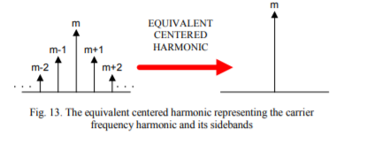
max | 46.2
min | 39.23
diff | 6.97
average | 42.65091
deviation % | 16.34197
Analysis and Characterization of DC Bus Ripple Current of Two-Level Inverters Using The Equivalent Centered Harmonic Approach

