Slide 1
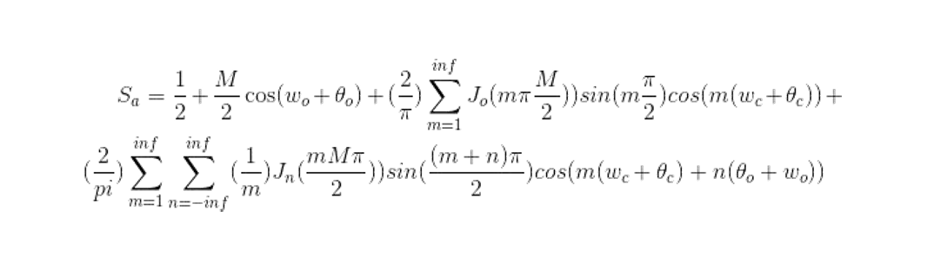
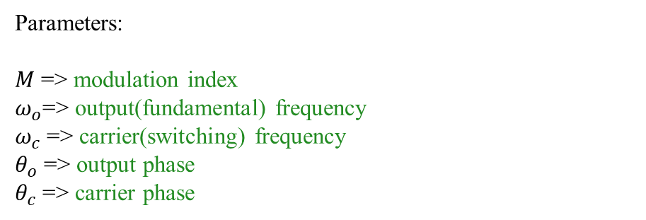


Bessel function ( $0$ order)
Fundamental
Component
Switching
Harmonics
Parameters:
$M$ => modulation index
$ω_{o}$=> output(fundamental) frequency
$ω_{c}$=> carrier(switching) frequency
$θ_{o}$ => output phase
$θ_{c}$ => carrier phase
Side Band harmonics
Bessel function ( $n^{th}$ order)
Deductions
Fundamental component is independent from carrier(switching) frequency and phase
There is no even harmonics of the switching and the sign of the odd harmonics is alternated.
The switching harmonics are independent from fundamental frequency and phase.
The side band harmonics are affected by all fundamental and carrier frequency and phases.

Slide 2
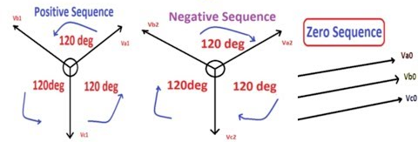
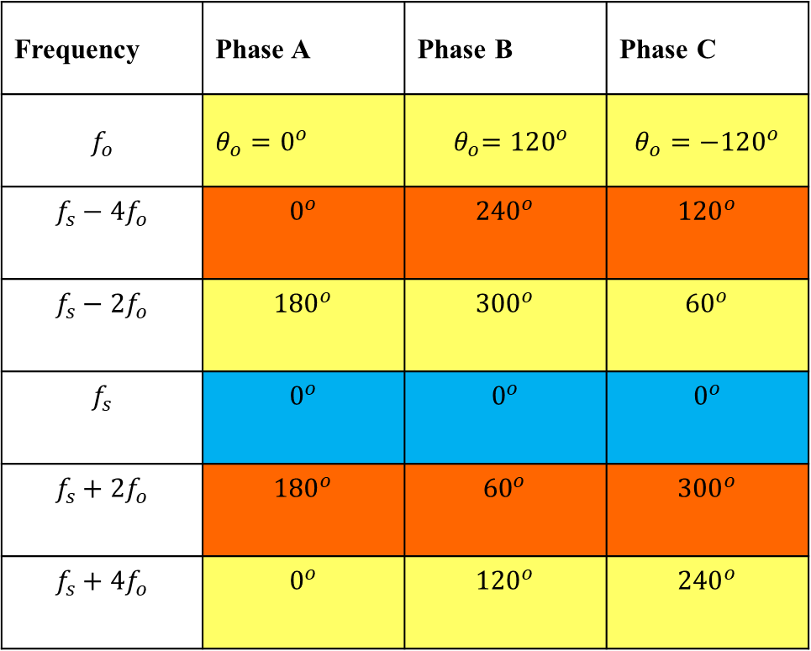
Sequences of the Switching Harmonics and Side Bands
Frequency | Phase A | Phase B | Phase C
$$f_{o}$$ | $θ_{o}=0^{o}$ | $${ θ}_{o}=120^{o}$$ | $$θ_{o}=−120^{o}$$
$$f_{s}−4f_{o}$$ | $$0^{o}$$ | $${240}^{o}$$ | $${120}^{o}$$
$$f_{s}−2f_{o}$$ | $${180}^{o}$$ | $${300}^{o}$$ | $${60}^{o}$$
$$f_{s}$$ | $$0^{o}$$ | $$0^{o}$$ | $$0^{o}$$
$$f_{s}+2f_{o}$$ | $${180}^{o}$$ | $${60}^{o}$$ | $${300}^{o}$$
$$f_{s}+4f_{o}$$ | $$0^{o}$$ | $${120}^{o}$$ | $${240}^{o}$$
If the fundamental is positive sequences

Slide 3
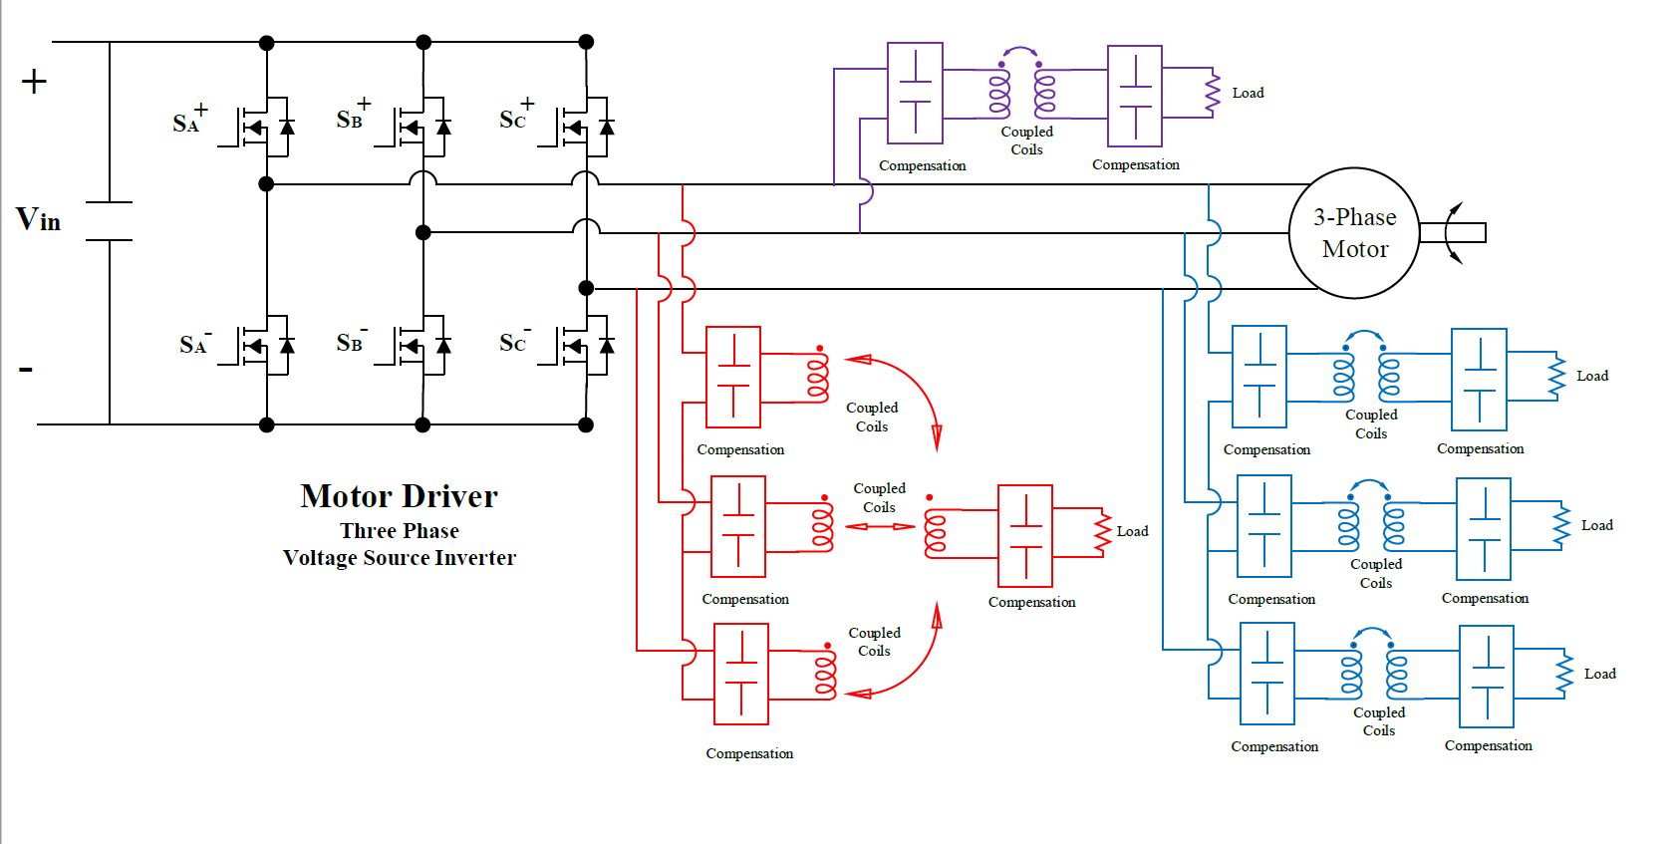
Single Leg having higher switching frequency
Removed side-bands (positive, negative sequences)
Having side-bands

Slide 4
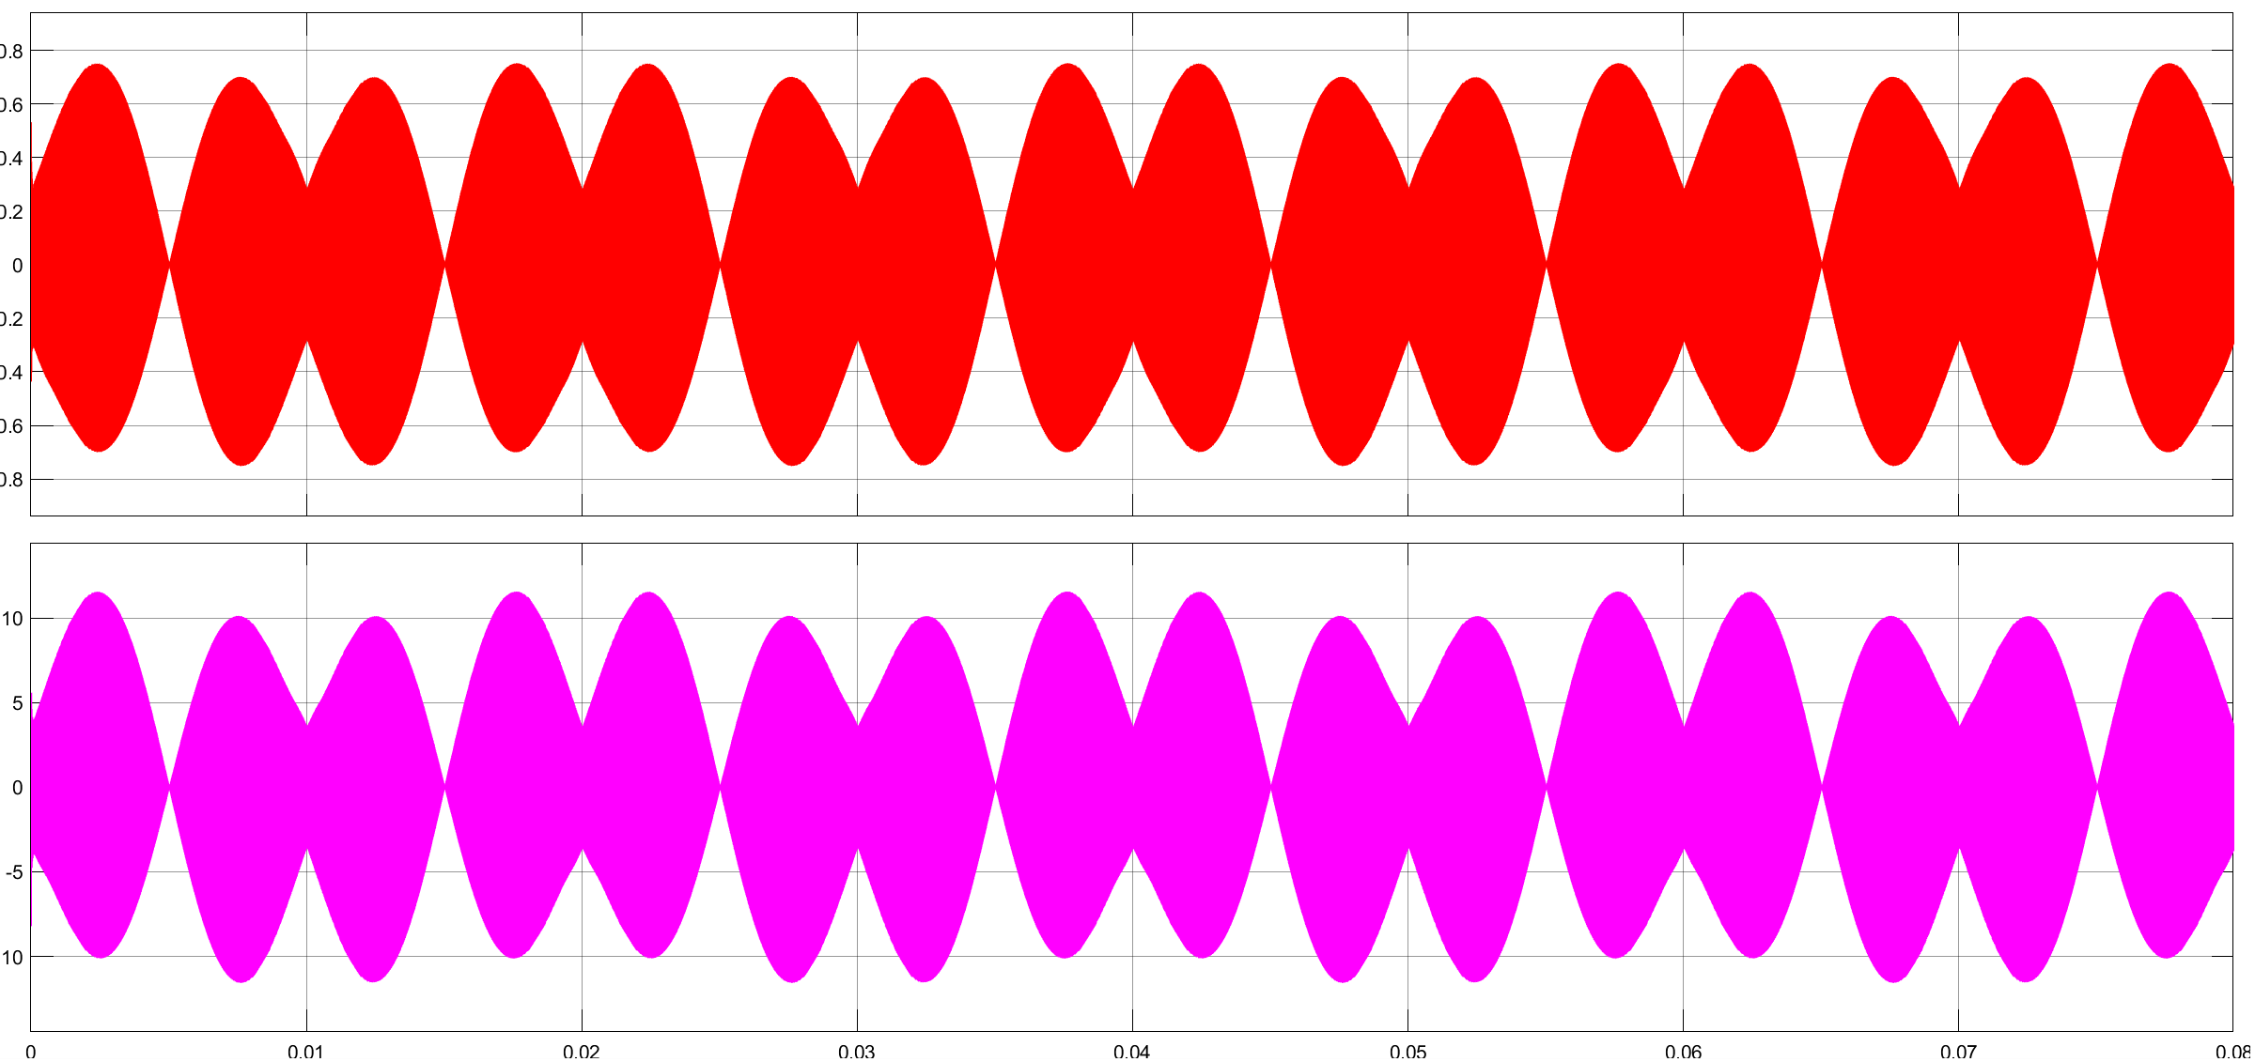
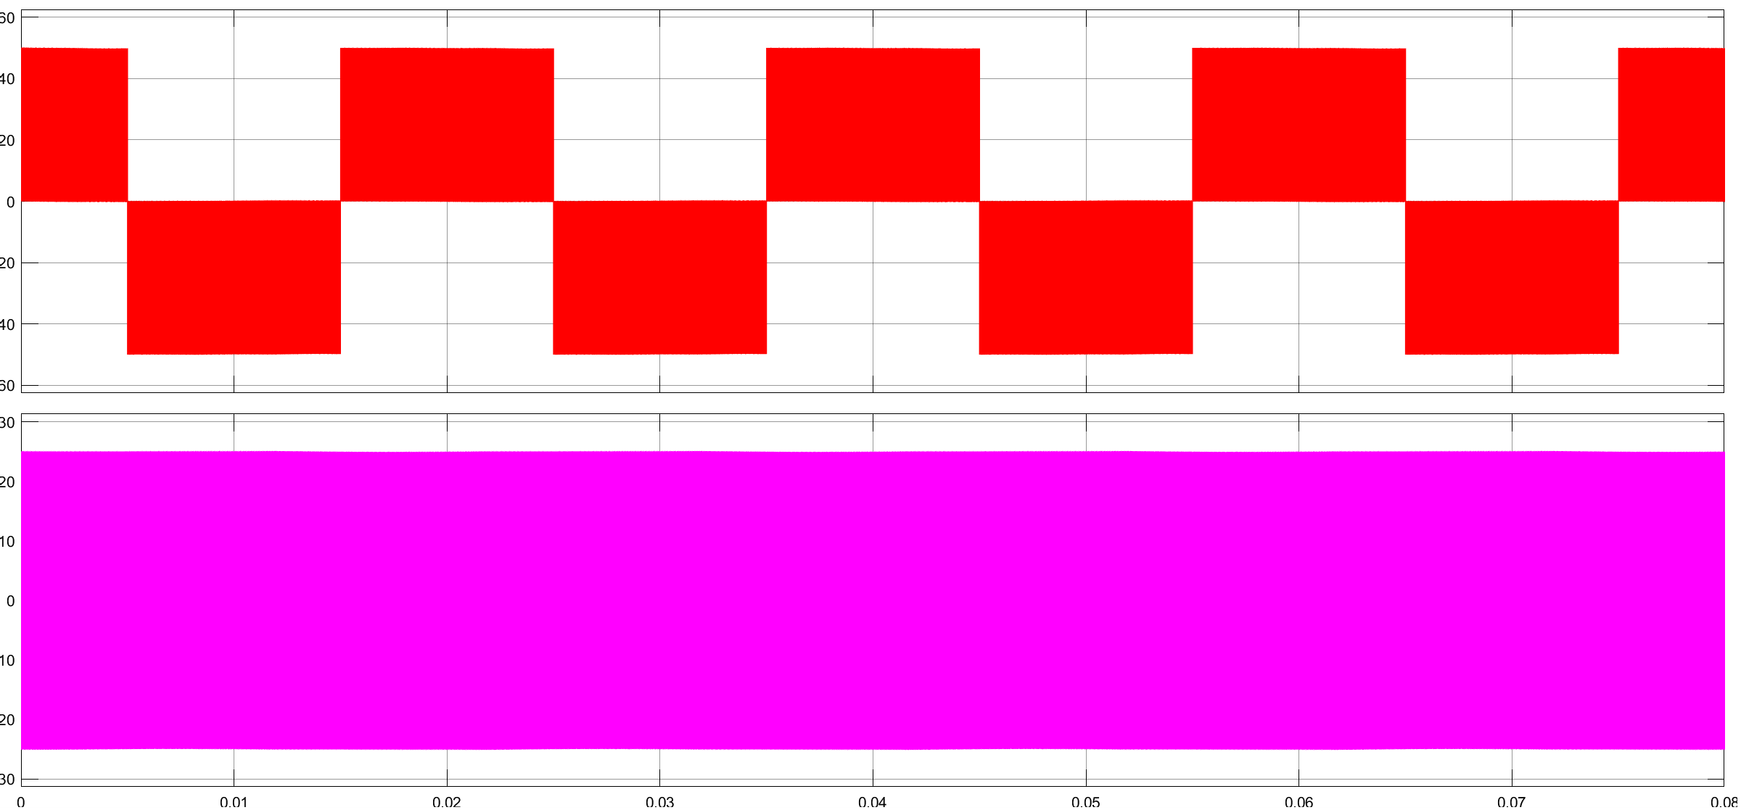

Slide 5
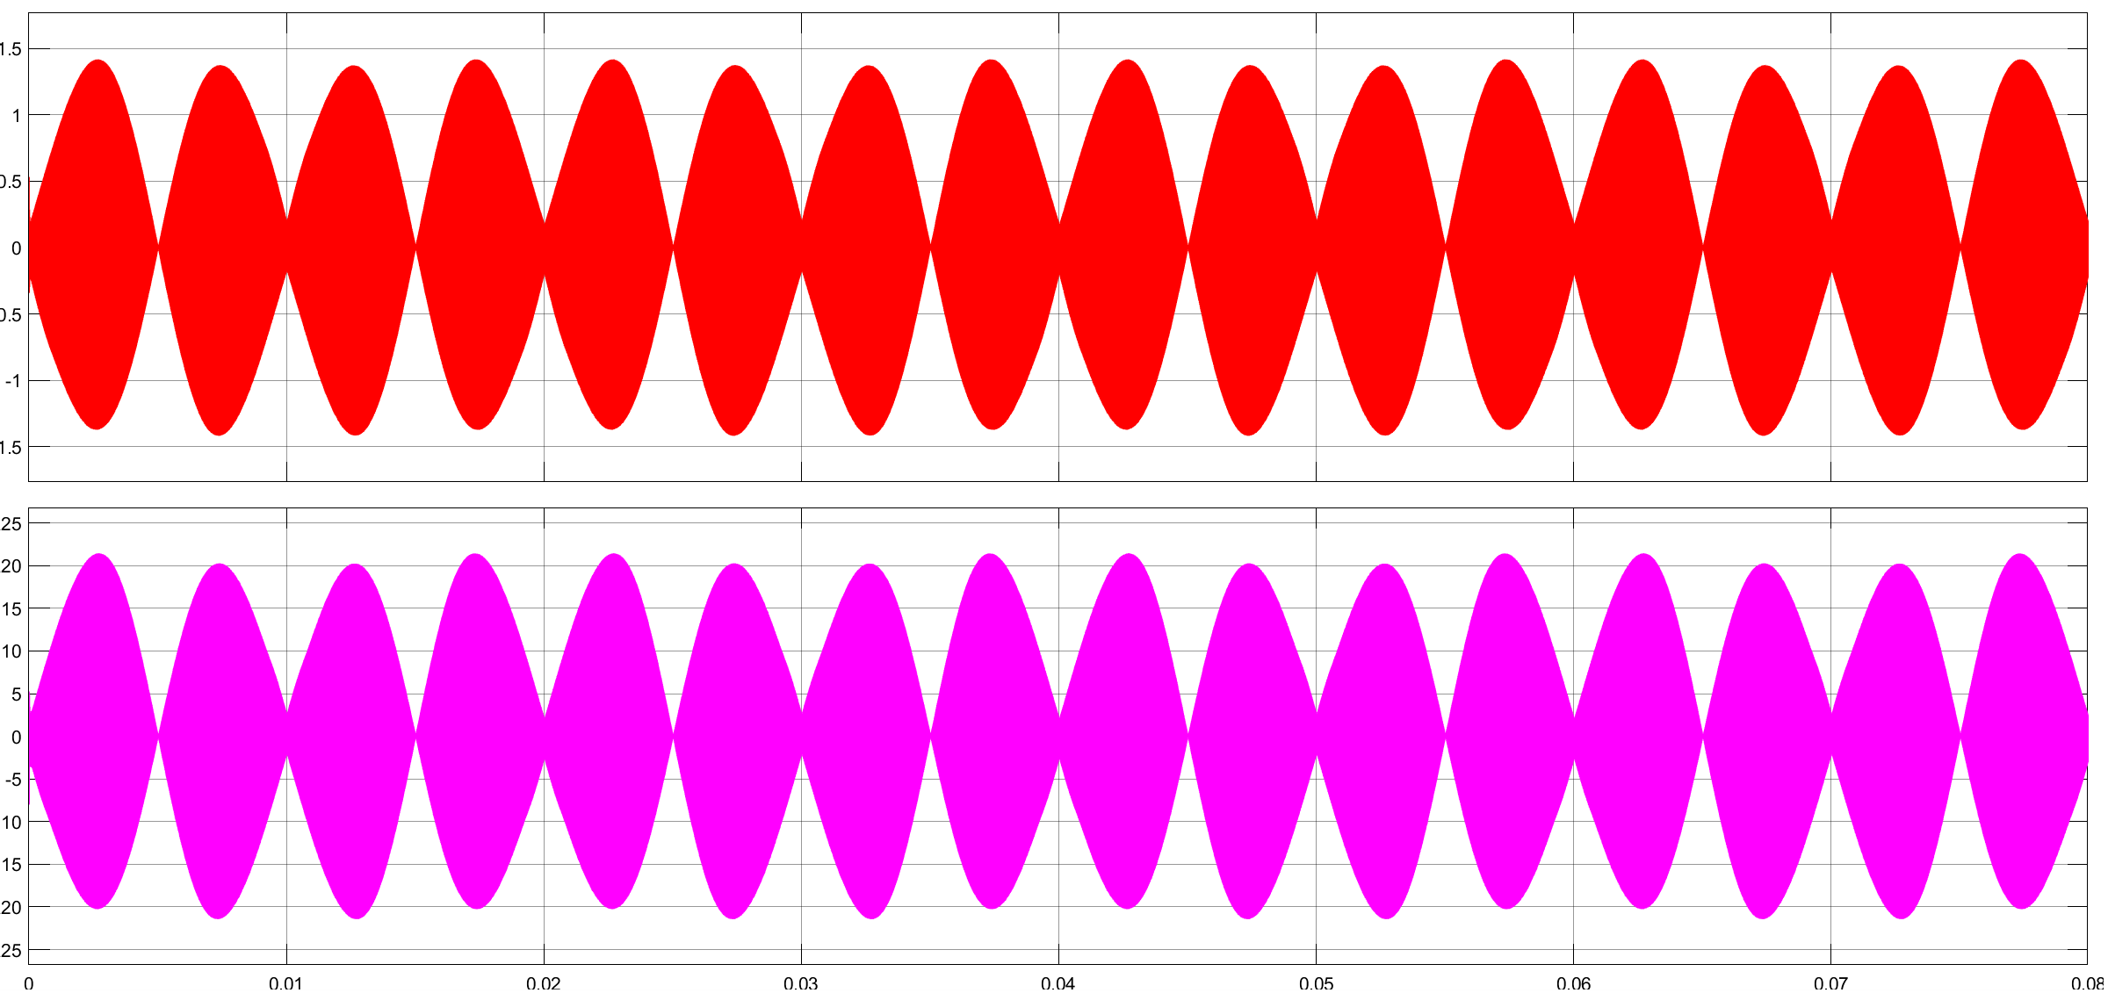

Slide 6
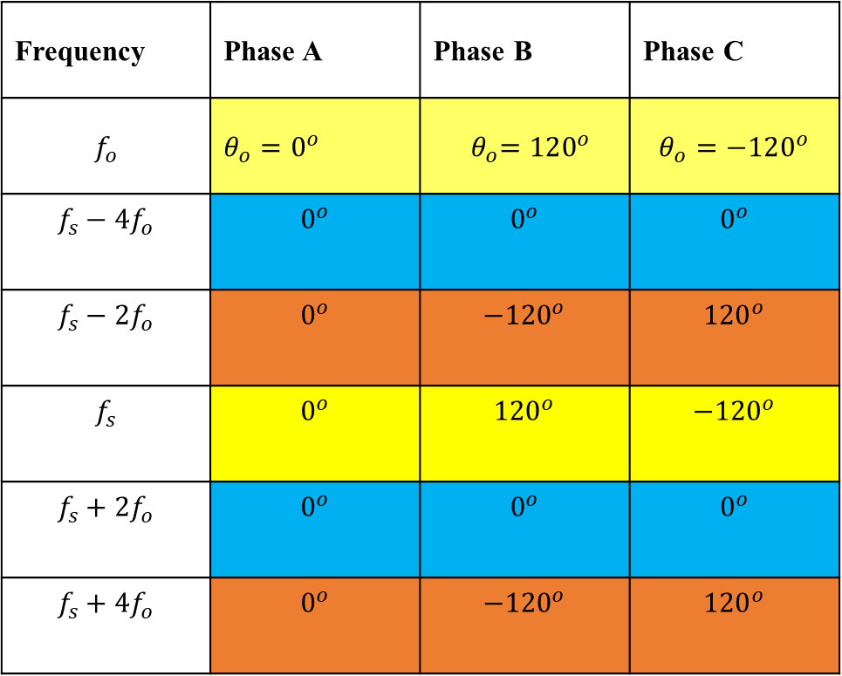
Sequences of the Switching Harmonics and Side Bands
Frequency | Phase A | Phase B | Phase C
$$f_{o}$$ | $θ_{o}=0^{o}$ | $${ θ}_{o}=120^{o}$$ | $$θ_{o}=−120^{o}$$
$$f_{s}−4f_{o}$$ | $$0^{o}$$ | $$0^{o}$$ | $$0^{o}$$
$$f_{s}−2f_{o}$$ | $$0^{o}$$ | $${−120}^{o}$$ | $${120}^{o}$$
$$f_{s}$$ | $$0^{o}$$ | $${120}^{o}$$ | $${−120}^{o}$$
$$f_{s}+2f_{o}$$ | $$0^{o}$$ | $$0^{o}$$ | $$0^{o}$$
$$f_{s}+4f_{o}$$ | $$0^{o}$$ | $${−120}^{o}$$ | $${120}^{o}$$
If the fundamental is positive sequences

Slide 7
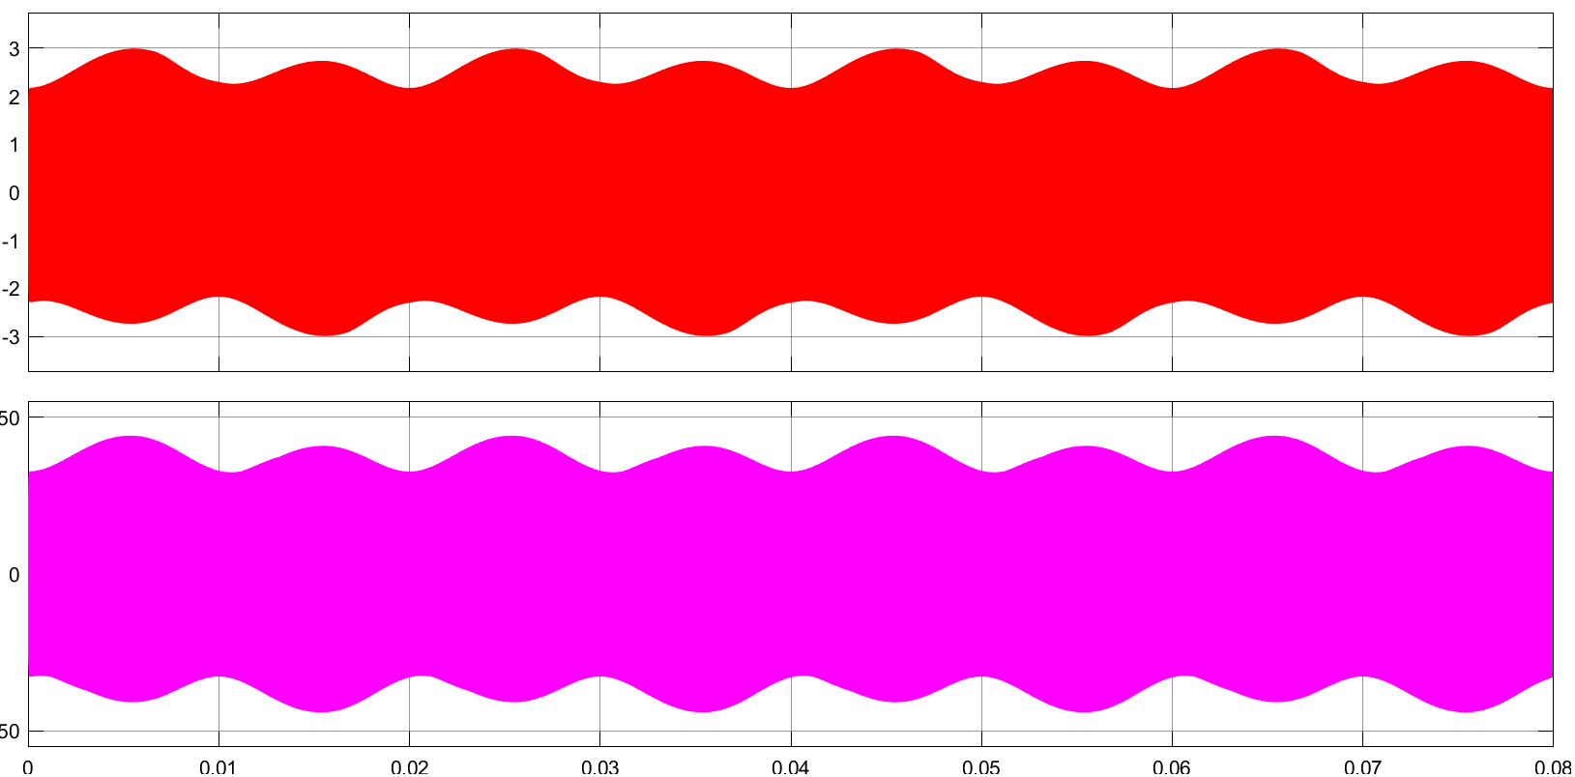
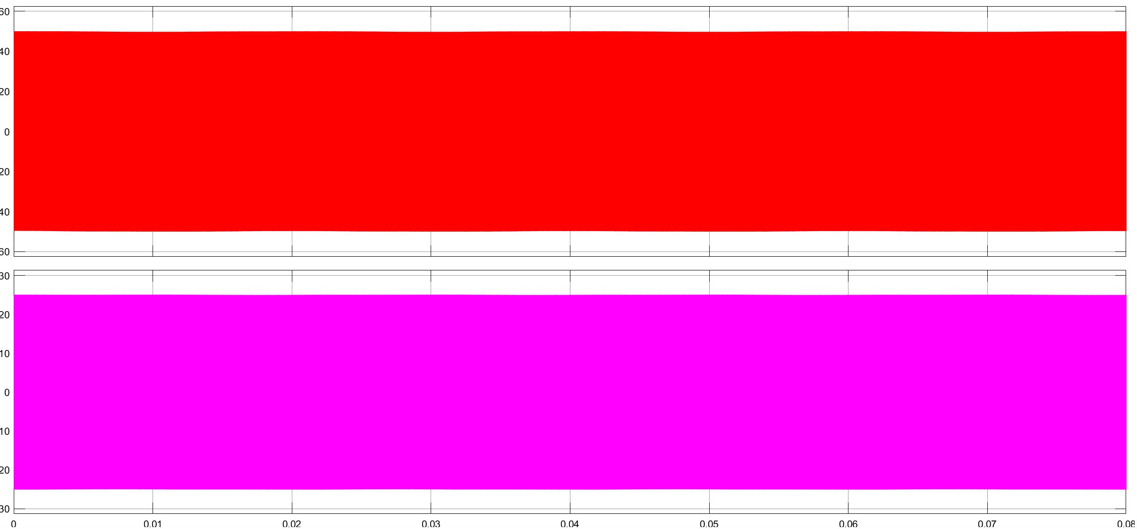

Slide 8
