Slide 1
Literature
Simultaneous
power transfer
Selective
Power Transfer
Slip-Ring Applications
Single-Stage
Power Transfers
Simultaneous Wireless Information and Power Transfer (SWIPT): Recent Advances and Future Challenges (2018)
Integrated Resonant Structure for Simultaneous Wireless Power Transfer and Data Telemetry(2012)
A Generalized Methodology to Generate, Amplify and Compensate Multi-Frequency Power for a Single-Inverter-Based MF-MR-S-WPT System(2020)
A Simultaneous Wireless Power and Data Transmission Method for Multi-Output WPT Systems: Analysis, Design, and Experimental Verification (2020)
Single-Inductor Multiple-Output (SIMO) Buck Hybrid Converter for Simultaneous Wireless and Wired Power Transfer(2020)
Cross Interference Minimization and Simultaneous Wireless Power Transfer to Multiple Frequency Loads Using Frequency Bifurcation Approach(2019)
Selective Omnidirectional Magnetic Resonant Coupling Wireless Power Transfer With Multiple-Receiver System(2018)
Design and Analysis of Wireless Switched Reluctance Motor Drives(2019)
Frequency Splitting-Based Wireless Power Transfer and Simultaneous Propulsion Generation to Multiple Micro-Robots(2018)
Comparative Analysis of Frequency-Selective Wireless Power Transfer for Multiple-Rx Systems(2020)
A Frequency-Selective EMI Reduction Method for Tightly Coupled Wireless Power Transfer Systems Using Resonant Frequency Control of a Shielding Coil in Smartphone Application(2020)
Selective Wireless Power Transfer for Smart Power Distribution in a Miniature-Sized Multiple-Receiver System(2016)
A Multifrequency Superposition Methodology to Achieve High Efficiency and Targeted Power Distribution for a Multiload MCRWPT System(2018)
Cross Interference Minimization and Simultaneous Wireless Power Transfer to Multiple Frequency Loads Using Frequency Bifurcation Approach
A Primary-Side Control Method of Wireless Power Transfer for Motor Electric Excitation(2019)
Wireless DC Motor Drives with Selectability and Controllability(2017)
An Airborne Radar Power Supply With Contactless Transfer of Energy—Part I: Rotating Transformer (2007)
Aerodynamic Fluid Bearings for Translational and Rotating Capacitors in Noncontact Capacitive Power Transfer Systems(2014)
Synchronous Generator Brushless Field Excitation and Voltage Regulation via Capacitive Coupling Through Journal Bearings(2017)
Operation of an Electrical Excited Synchronous Machine by Contactless Energy Transfer to the Rotor(2018)
A Rotation-Lightweight Wireless Power Transfer System for Solar Wing Driving(2019)
Wireless Power Transfer for Smart Industrial and Home Applications(2019)
A High-Efficiency GaN-Based Single-Stage 6.78 MHz Transmitter for Wireless Power Transfer Applications(2019)
Cooperative Integration of RF Energy Harvesting and Dedicated WPT for Wireless Sensor Networks(2019)
A Three-Phase Single-Stage AC–DC Wireless-Power-Transfer Converter With Power Factor Correction and Bus Voltage Control(2020)
Individually Regulated Multiple-Output WPT System With a Single PWM and Single Transformer (2020)
Look at Mendeley : PowerLab/Enes/WPT-Motor

Slide 2
Impedance Modelling
%% Analytical model with motor
|--------------|---rp----Cp----Lp'(Lp-M)---|---Ls'(Ls-M)--Cs-|
| | | |
| --Lmotor-- | |
--|V_in|-- | --Lm-- --RLoad--
| | | |
| --Rmotor-- | |
|--------------|---------------------------|-------rs--------|
% Parameters
rp=0.3; % ohm
rs= 0.3; % ohm
Lp=205e-6;
Ls=51e-6;
M=41e-6;
RL=8.44;
Cs=115e-9;
Cp=28.5e-9;
Lp_p=Lp-M;
Ls_p=Ls-M;
Rmotor=2;
Lmotor=1e-3;

Slide 3
This point parallel resonance ???
What if we add parasitic line impedances???
Motor
Operation
WPT
Operation
Bu frekansda çalıştırıp bakıcam, unuttum ☺
Bir şey olmadı bu frekansta aklım çok karışık ☹

Slide 4
Motor
Operation
WPT
Operation

Slide 5
Motor Current

Slide 6
WPT OUTPUT VOLTAGE
WPT INPUT CURRENT

Slide 7
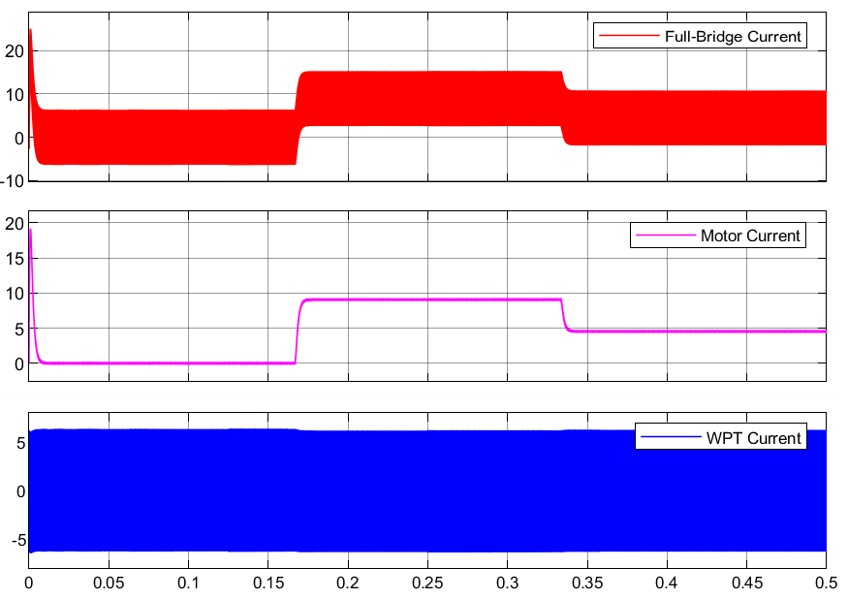
Transients
Motor load torque changes
WPT does not effected from change on motor load.
Constant Duty Cycle(0.8)
Constant Frequency (80kHz)
Motor Current changes

Slide 8
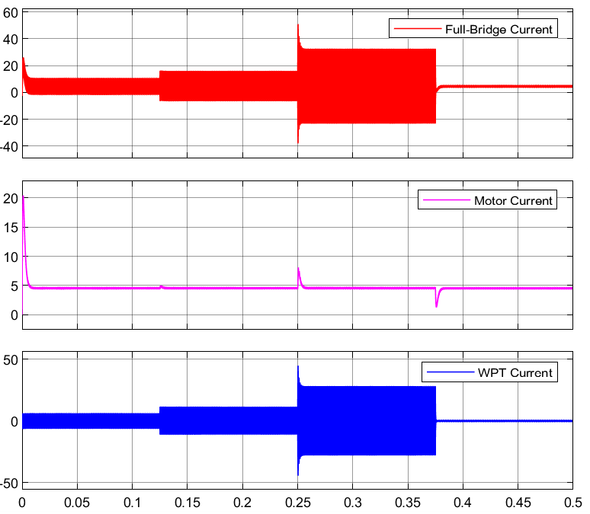
Transients
Motor effected from change on WPT load.
4.5 A
Constant Duty Cycle(0.8)
Constant Frequency (80kHz)
5 A
8 A
1 A
Half-Resistance
Short
Open

Slide 9
Impedance Modelling
Behaves like short if short
Behaves like short if open

Slide 10
Duty Cycle-Frequency
Constant Duty Cycle
Constant Frequency
Minimum frequency 80 khZ : Gain 0.52
Maximum frequency 110kHz: Gain 0.16
Minimum duty 0.5: Gain 1.27
Maximum duty 0.9: Gain 0.3935
DC gain ➔ 0.6 (maximum)
AC gain ➔ 0.20 (constant)

Slide 11
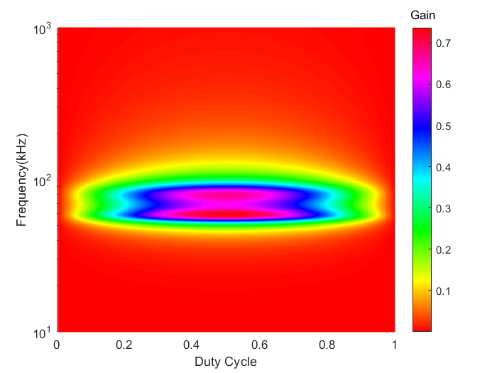

Slide 12
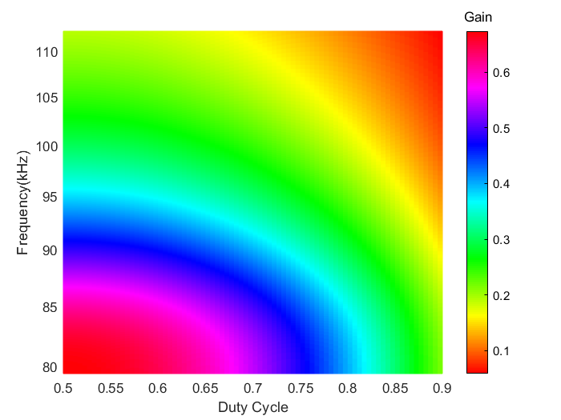

Slide 13
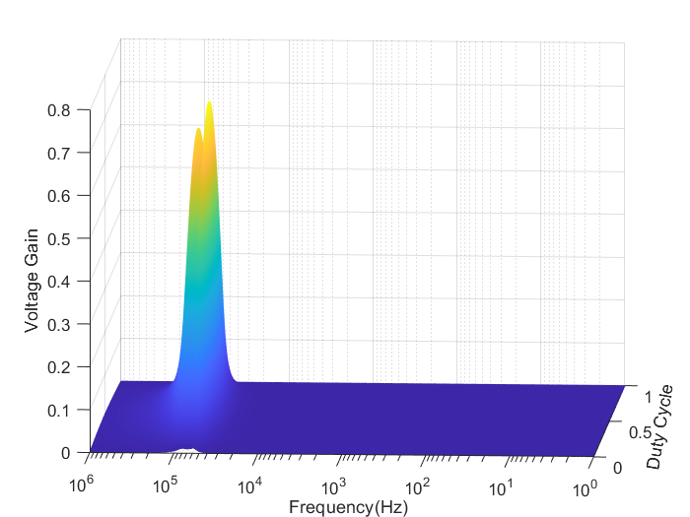
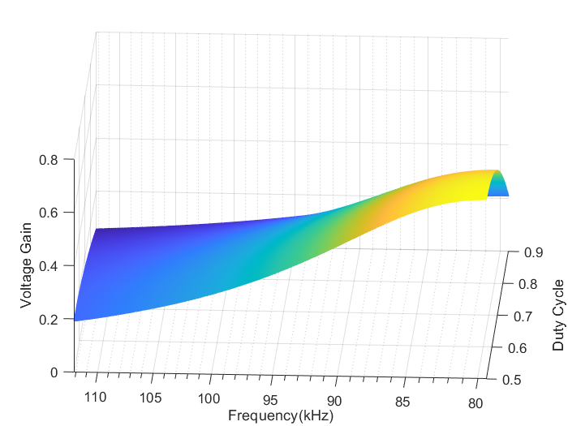

Slide 14
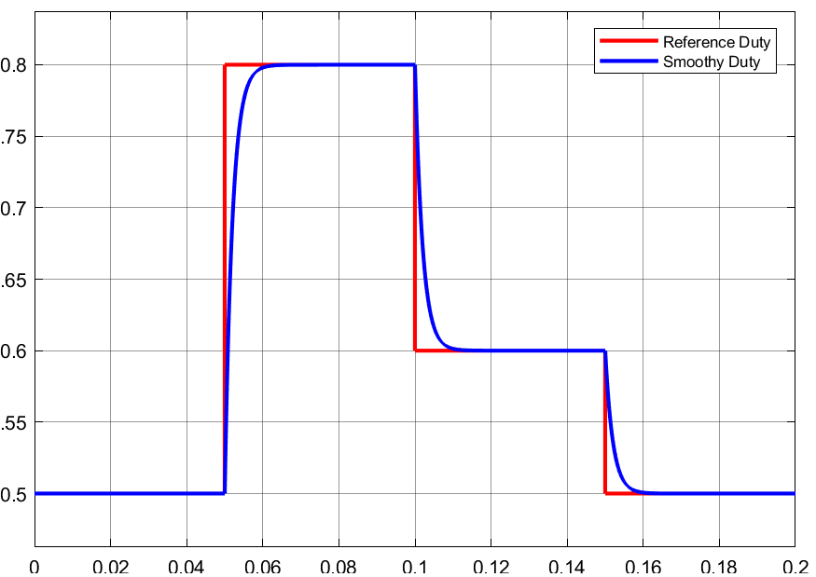
Variable Duty Cycle
At 80kHz

